Slide 1
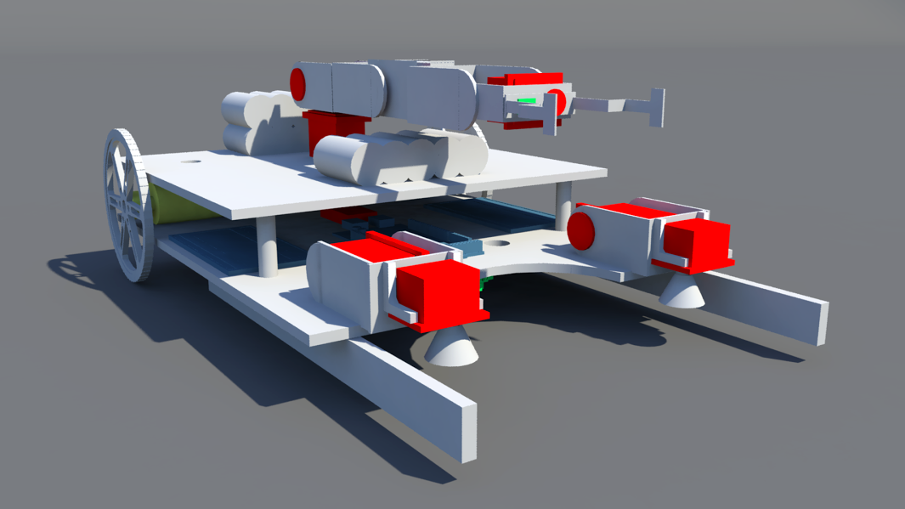
MILESTONE 3: DESIGN REVIEW
SOUTHEASTCON TEAM 1B
Senior Design Team:
Ivan Vargas Lorenzo Smith
Chelsea Ogle Evan Marshall
Louis Cooper
Coordinator: Dr. Michael Frank
Advisors: Dr. Bruce Harvey
Reviewers: Dr. Victor DeBrunner
Notes:
Chelsea Ogle
Evan Marshall
Ivan Vargas
Lorenzo Smith
Louis Cooper

Slide 2
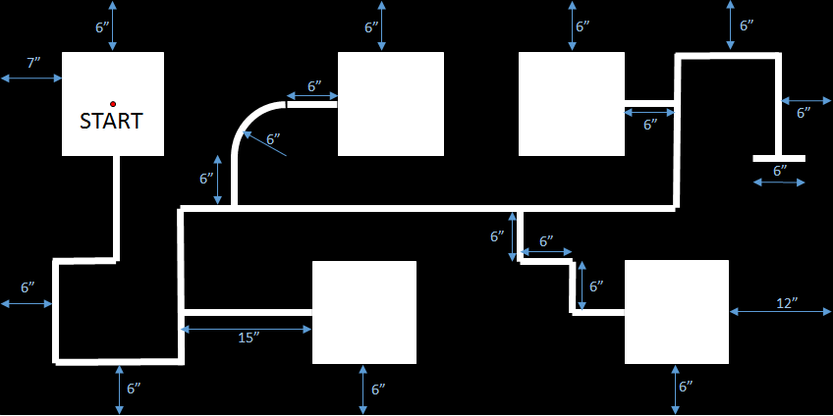
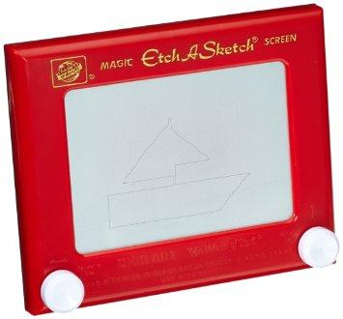
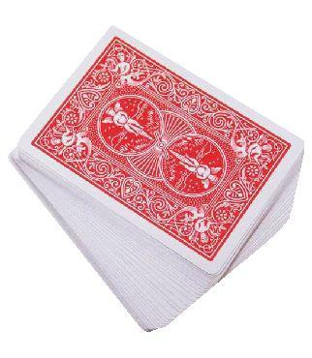
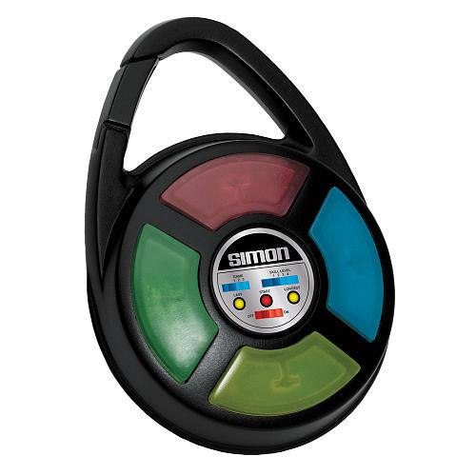
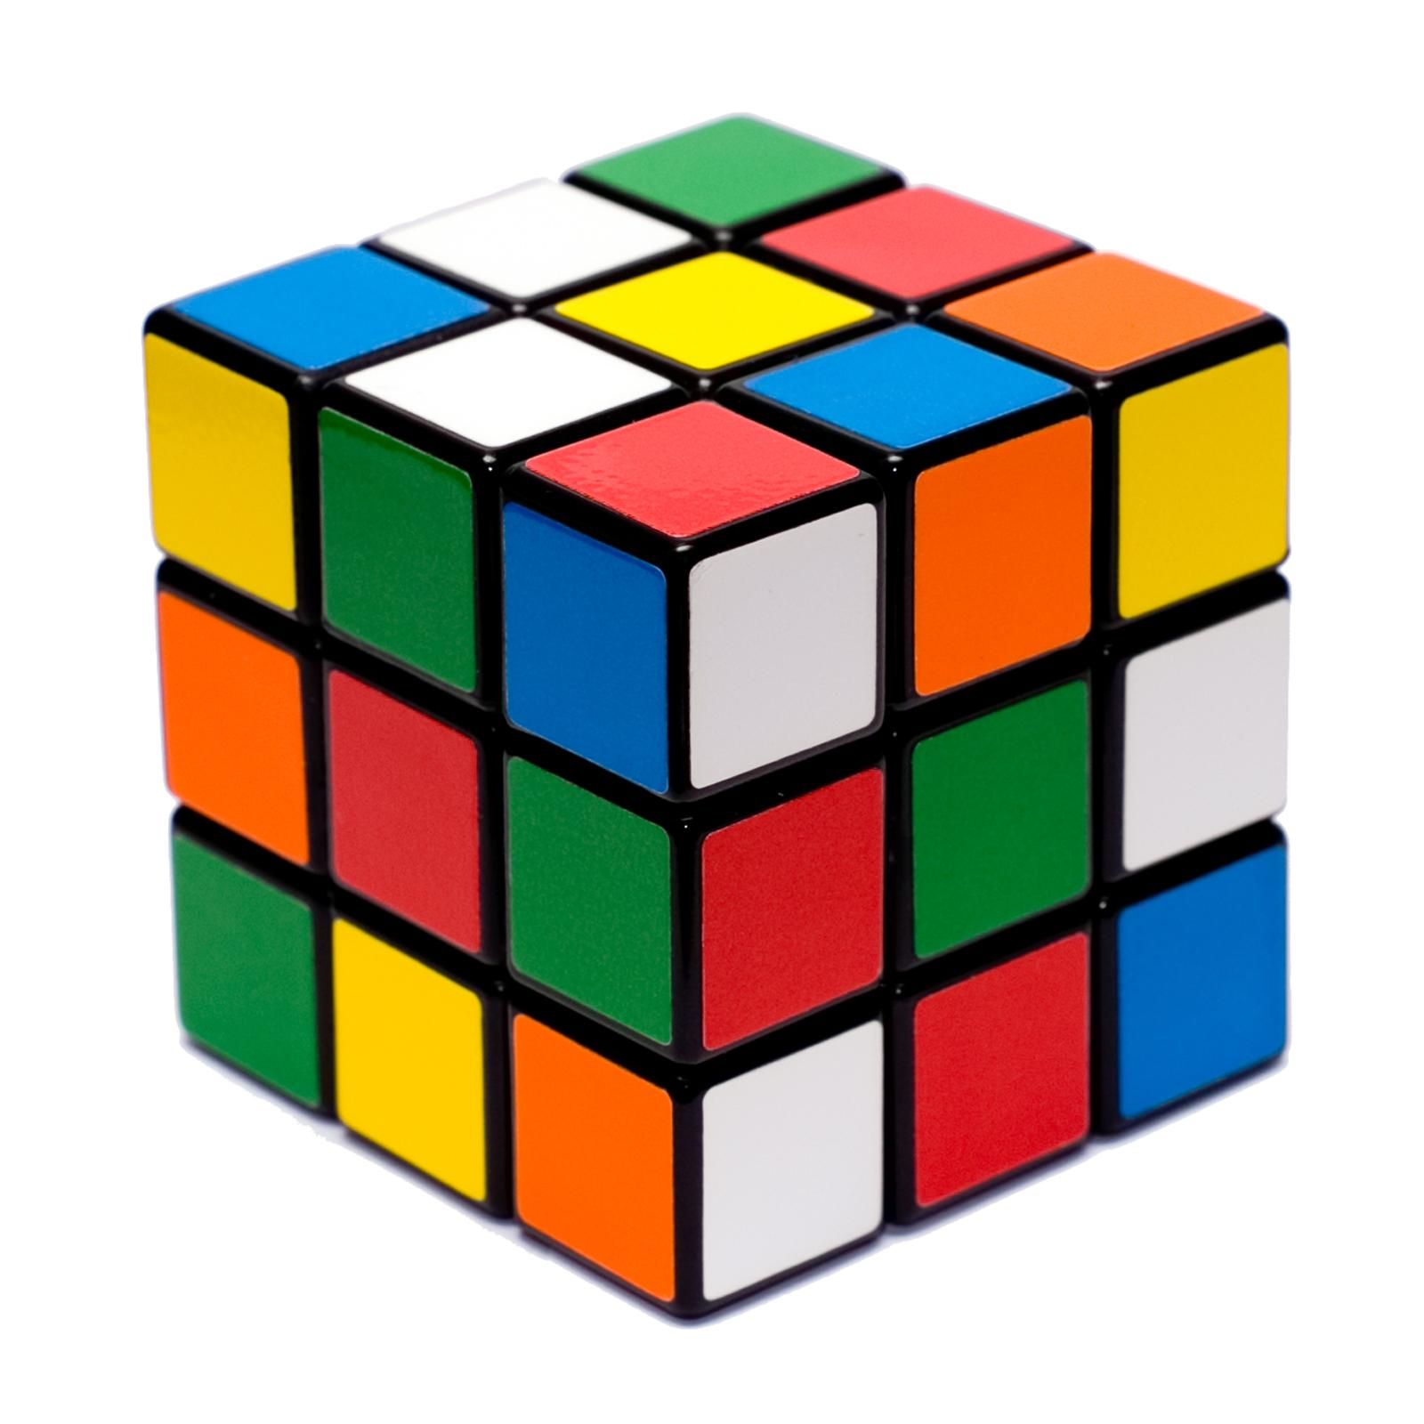
Test course
PRESENTER: IVAN VARGAS

Slide 3
OVERVIEW
MCU
Power
Drive System
Sensors
Chassis
Arms/Grippers
Budget
Schedule
Deliverables
PRESENTER: IVAN

Slide 4
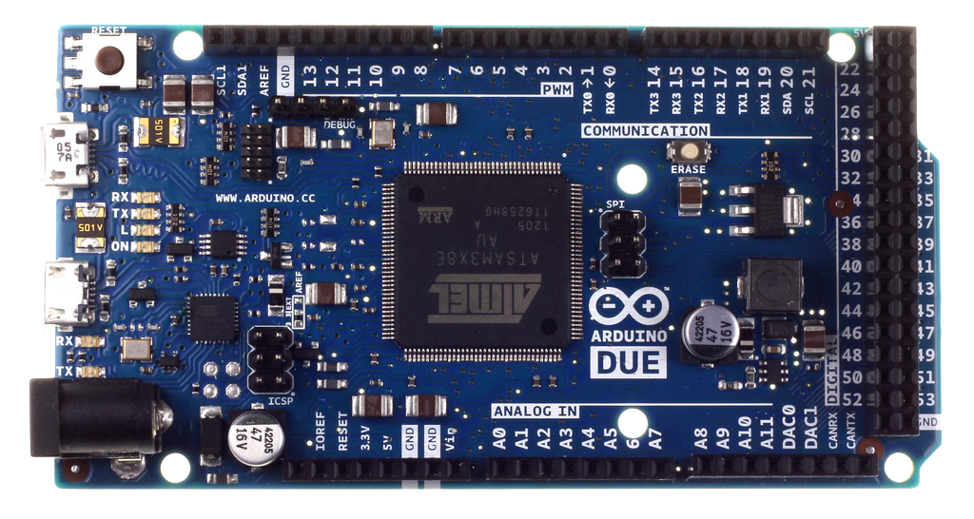
Arduino Due
Cost | $40
Operating Voltage | 3.3 V
Microcontroller | AT91SAM3X8E
Input Voltage | 7-12V recommended
Digital I/O Pins | 54 with 12 being PWM
Analog Input Pins | 12
Analog Output Pins | 2
Flash Memory | 512 KB
Clock Speed | 84 MHz
PRESENTER: IVAN

Slide 5
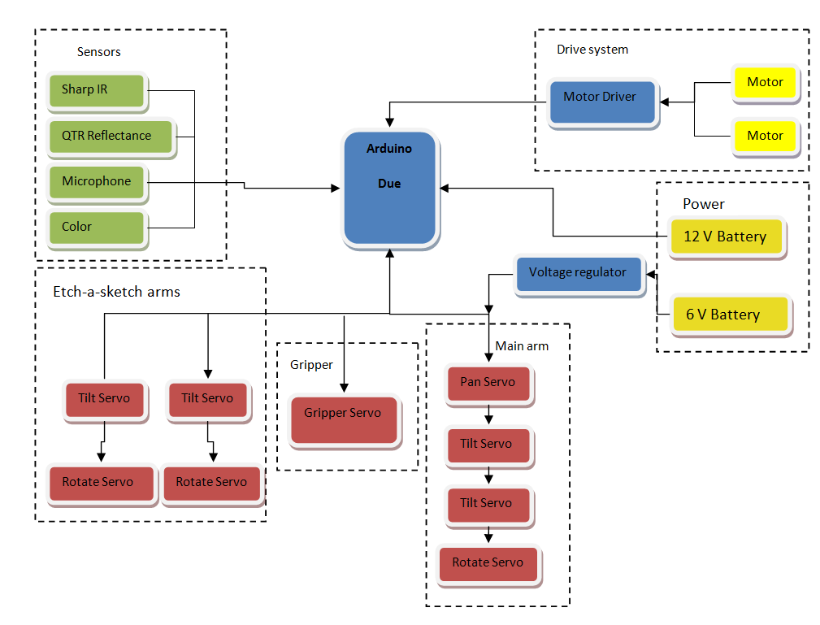
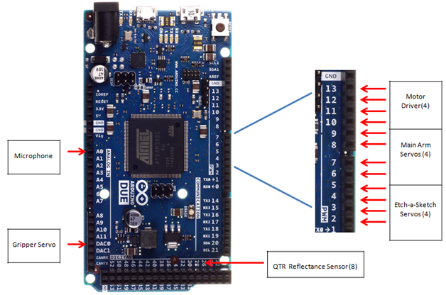
Top level overview
PRESENTER: IVAN

Slide 6
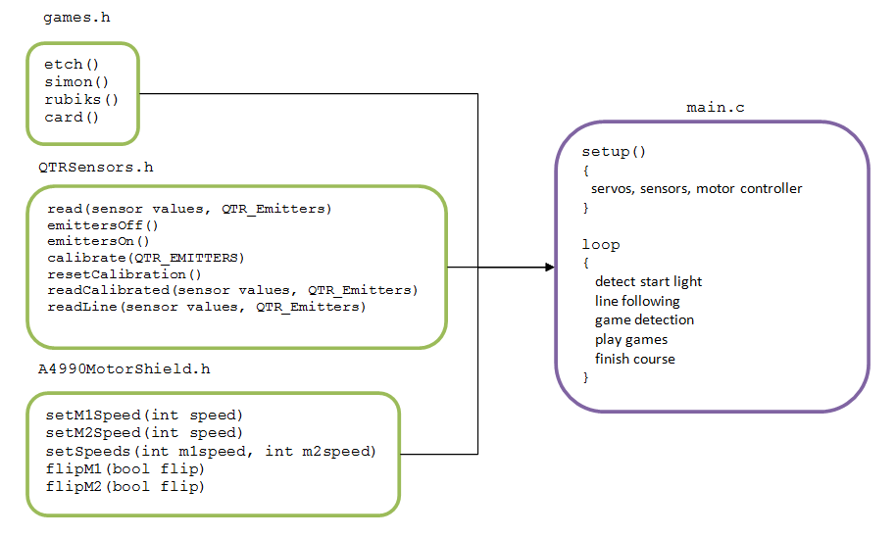
Code Overview
PRESENTER: IVAN

Slide 7
MCU Risk Assessment
Board Overload:Too much current to the board
Loose connections: Solderless board, devices not receiving data, volts
Poor coding practices: improper syntax
Static discharge shocking the board: improper testing procedures
PRESENTER: IVAN

Slide 8
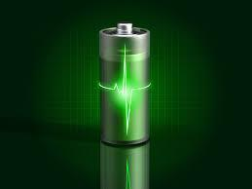
POWER SUPPLY
Batteries
  12 & 6 Volt NiMH
  Arduino will be an additional power source
  One spare for each will be needed
  One charger each
Connection
  Two Solderless breadboards: neat configuration of wires providing power.
  Wires
  Male/Female connectors
PRESENTER: LORENZO SMITH
Notes:
More detail systeme analysis will be done with Dr. Pedro Moss, as well as verified by Dr. Jim P. Zheng.
Power Consumptions
Circuit
Any elements needed

Slide 9
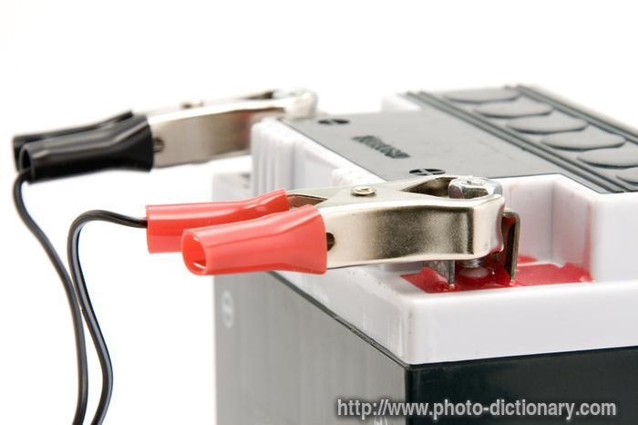
POWER SUPPLY
12 Volt NiMH
  10 AA 2200 mAh Batteries in series (2x5)
  Supplies Voltage for:
    (2) Drive Motors
    (1) Arduino Due
6 Volt NiMH
  5 AA 2200 mAh Batteries in series
  Supplies Voltage for:
    All Servos
Arduino Due
  Each pin is configured to send out 5V or 3.3V
  Supplies Voltage for:
    All Sensors
PRESENTER: LORENZO

Slide 10
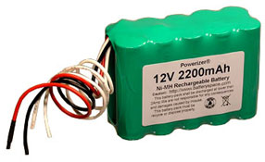
POWER SUPPLY
12 Volt NiMH Battery
Analysis
  26.4 Wh, 26.4 W
  1 CC
  2200 mAh
Voltage Peak
  14.7 V
Charging Rate
  0.5-2.2 A (2.5hrs @ 0.9 A)
Discharging Rate
  2 Amp
Dimensions
  51 mm x 29 mm x 72 mm (H x W x L)
Weight
  10 oz (283 grams)
Red - Positive, Black - Negative
PRESENTER: LORENZO

Slide 11
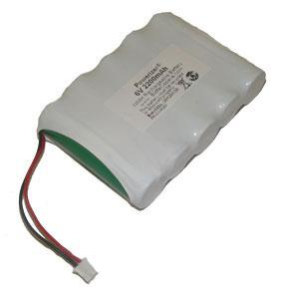
POWER SUPPLY
6 Volt NiMH Battery
Analysis
    9.6 Wh, 9.6 W
    1 CC
    2200 mAh
Voltage Peak
    7.1 Volts
Charging Rate
    0.5-2.2 A (2.5hrs @ 0.9 A)
Discharging Rate
    2 Amp
Dimensions
    51 mm x 15 mm x 72 mm (H x W x L)
Weight
    4.8 oz (140 grams)
Red - Positive, Black - Negative
PRESENTER: LORENZO

Slide 12
Power Risk Assessment
Possible Risk
  Battery Lifespan decrease over time due to testing and experimenting
  Battery Output current too low due to the overload of devices
  Battery Peak Voltage blows devices being supplied with power
  Battery Disconnection during the competition
  High Stall Current may drain the battery before being used
  Battery Corrosion low probability
PRESENTER: LORENZO

Slide 13
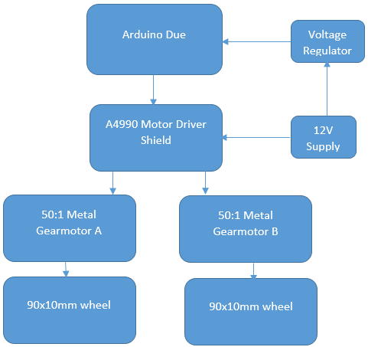
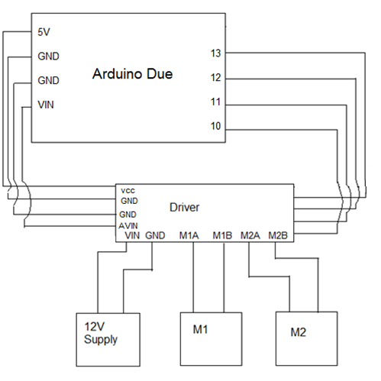
DRIVE SYSTEM - TOP LEVEL & PIN CONNECTIONS
PRESENTER: CHELSEA OGLE

Slide 14
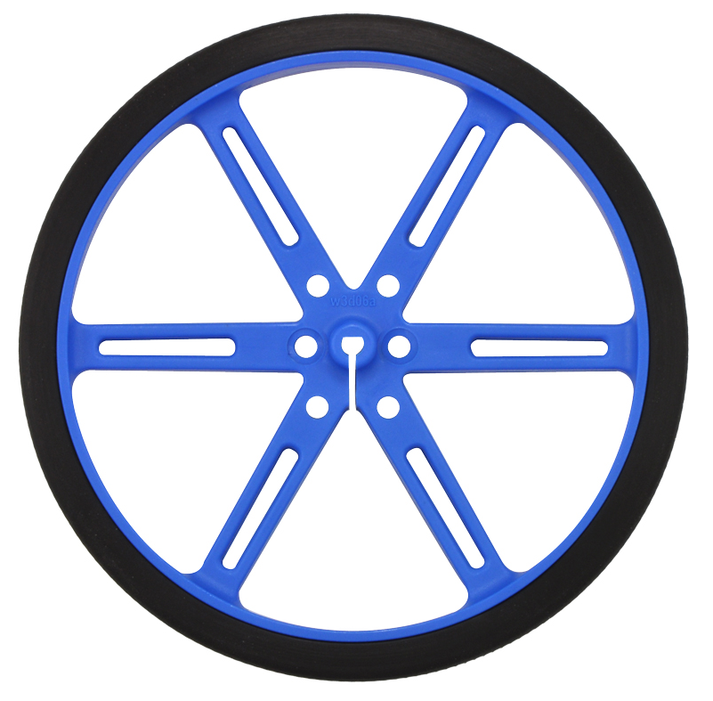
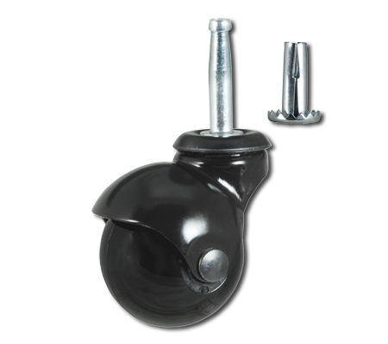
DRIVE SYSTEM - WHEELS
Two Pololu 90x10mm wheels with tires, one 2’’ stem-and-socket ball caster wheel
PRESENTER: CHELSEA

Slide 15
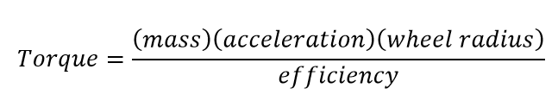
DRIVE SYSTEM - MOTOR CALCULATIONS
Estimating the torque needed as follows:
With mass estimated at 7 kg, acceleration 0.1524 m/s^2 (half max velocity of 1 ft/s), wheel radius 0.045 m
Most DC brushed motors have efficiency of 68%, efficiency used will be 58% to account for potential frictional forces
Yields necessary torque of 8.27 kg-cm for 7 kg mass estimate
PRESENTER: CHELSEA

Slide 16
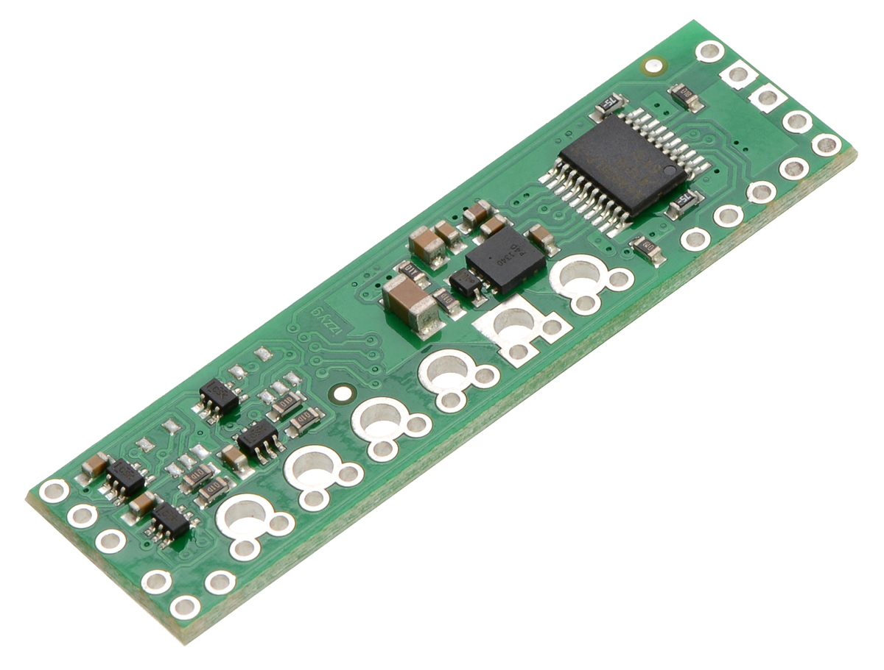
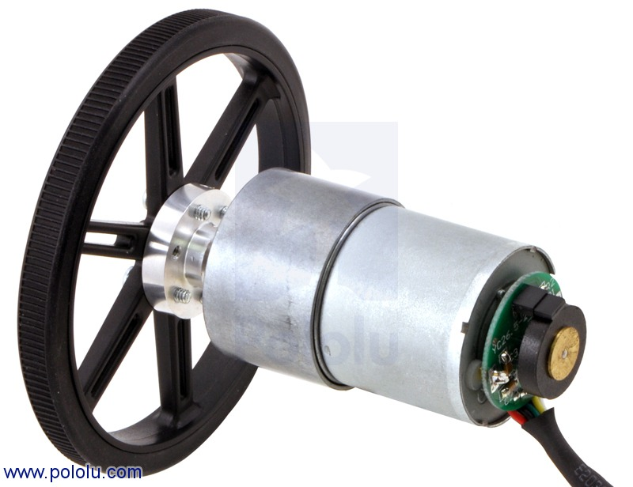
DRIVE SYSTEM - MOTOR & MOTOR DRIVER
Chose two 12V DC brushed metal gearmotors with 64 CPR encoder
  12 kg-cm of torque
  200 RPM
  300 mA free-run
Pololu A4990 Dual Motor Driver Shield for Arduino
  Current/Voltage Rating sufficient
    6-32 V, 0.9 mA max
  Libraries/Support exist
  Cost efficient
PRESENTER: CHELSEA

Slide 17
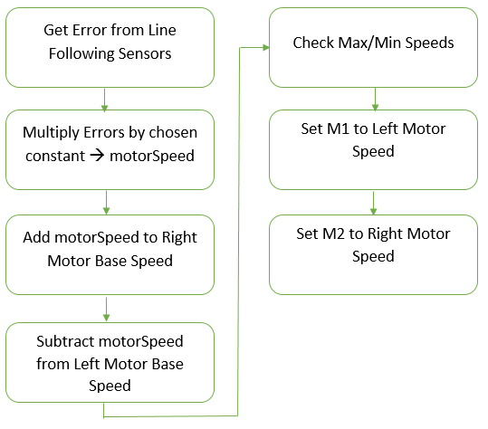
DRIVE SYSTEM - PSEUDOCODE
PRESENTER: CHELSEA

Slide 18
DRIVE SYSTEM - RISKS
Current overdraw: Motor may draw too much current affecting the power consumption
Traction failure: In the event of braking and accelerating the friction is not strong enough.
Caster Wheel failure: Caster wheel is not strong enough to support the robot’s weight will affect the robot’s turns and line following points
PRESENTER: CHELSEA

Slide 19
SENSORS
Start LED detection
Line Following
Object Detection
Microphone (Simon)
PRESENTER: EVAN MARSHALL

Slide 20

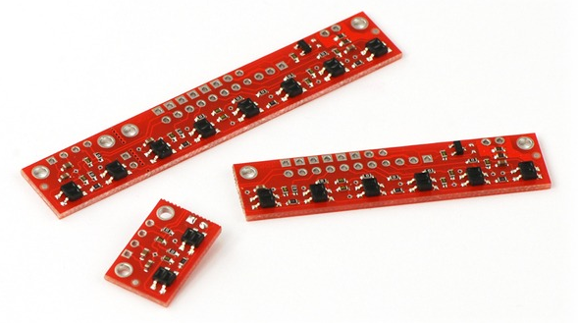

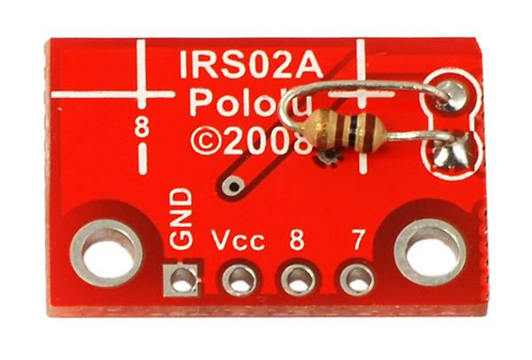
Starting and Navigation
Starting (Red LED detection)
PololuQTR-8RC small module
8 IR/LED Phototransistor pairs
Will detect change in light
Will also help with line following
PRESENTER: EVAN

Slide 21
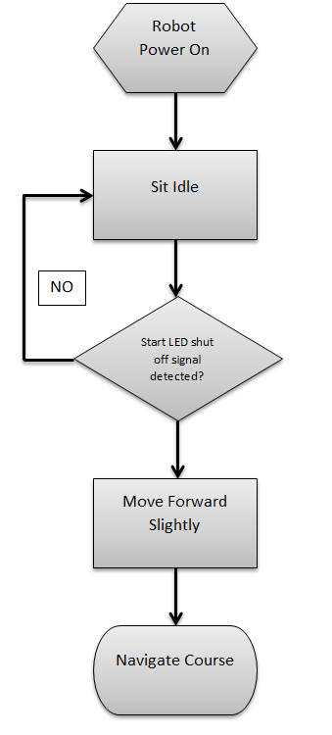
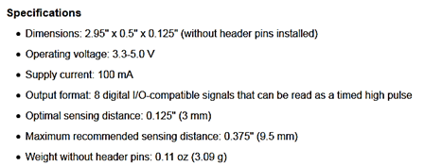
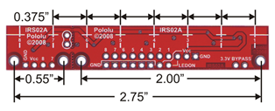
Starting Course
PRESENTER: EVAN

Slide 22
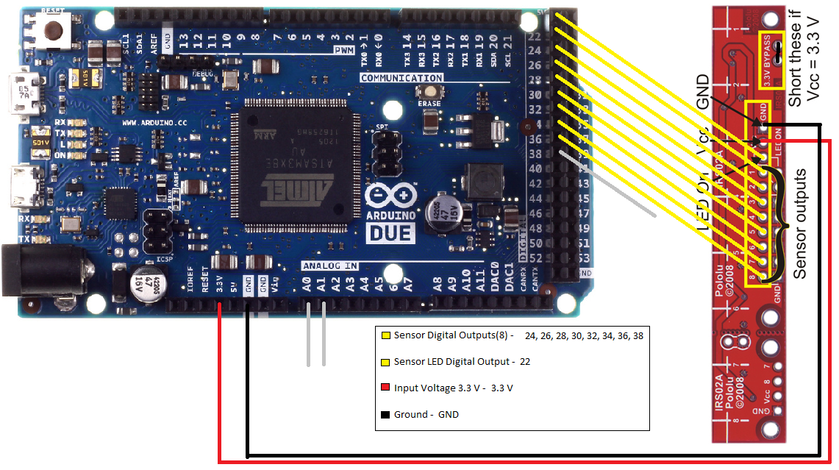

Starting and Navigation Pin Connections
PRESENTER: EVAN

Slide 23
Navigation Risk
Improper Calibration: Sensors does not center the line
Failure to start: Start LED signal is not recognized
Missing a turn: Playing the wrong game
Failure to finish: Lost following the track looping continuously, Lose points
PRESENTER: EVAN

Slide 24
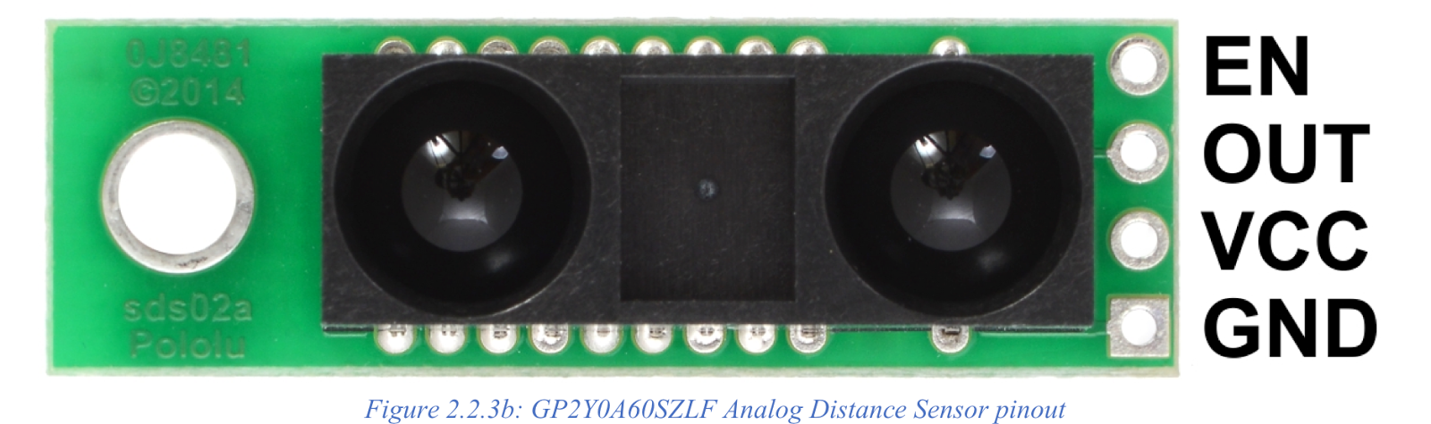
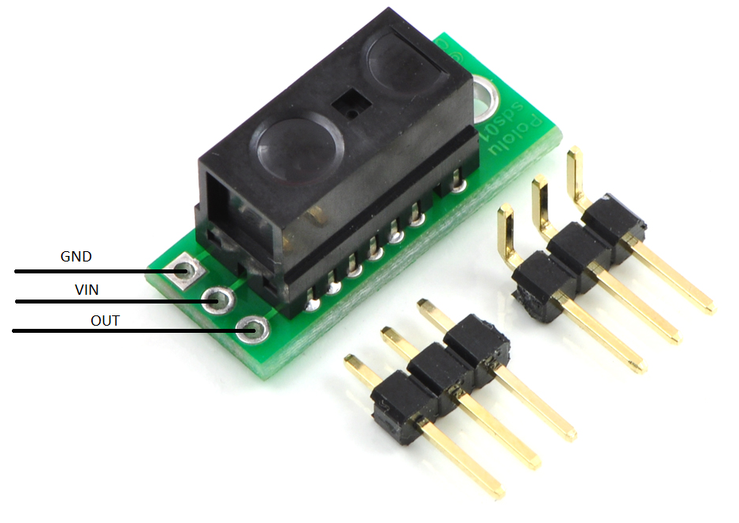
Object Detection
2 IR Optical Range Sensors
Sharp GP2Y0A60SZLF Analog Distance Sensor 3V (4” – 60”)
Sharp GP2Y0D815Z0F Digital Distance Sensor (0.2” – 6”)
PRESENTER: EVAN

Slide 25
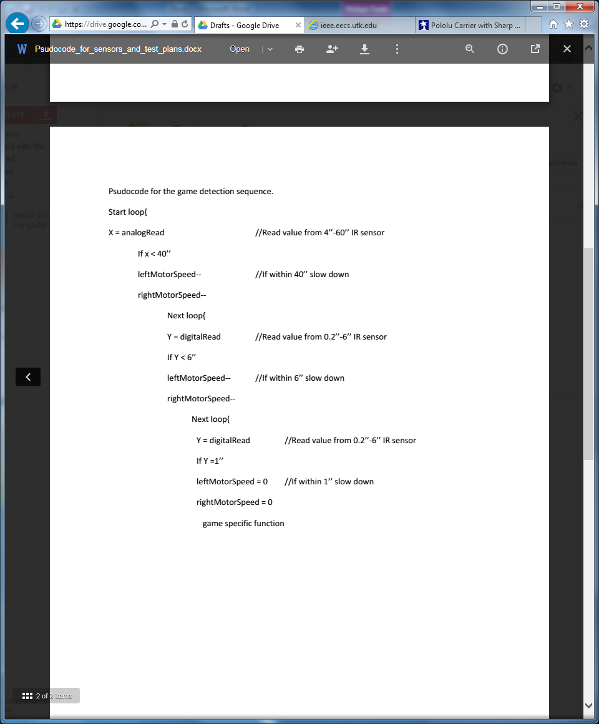
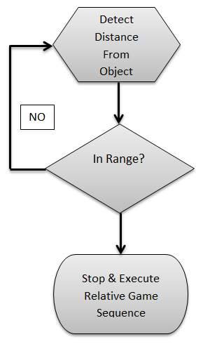
Object Detection Sequence
PRESENTER: EVAN

Slide 26
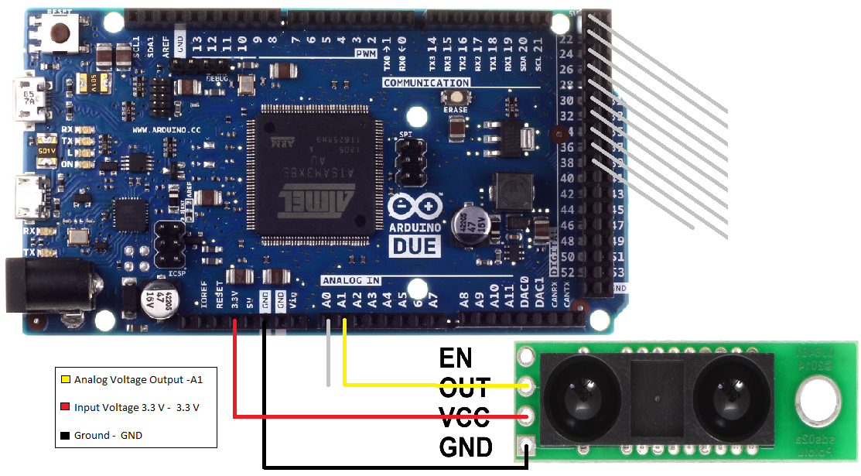
Analog: Pin Connections & Risk
Inaccurate Reading
  Missed Reading (running into a game)
PRESENTER: EVAN

Slide 27
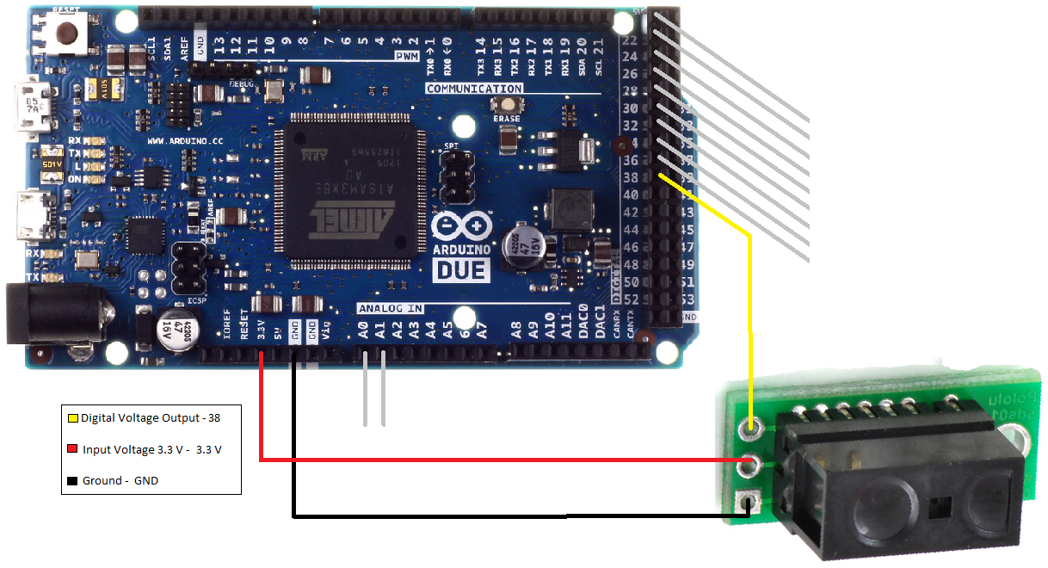
Digital: Pin Connections & Risk
Inaccurate Reading
  Missed Reading (running into a game)
PRESENTER: EVAN

Slide 28

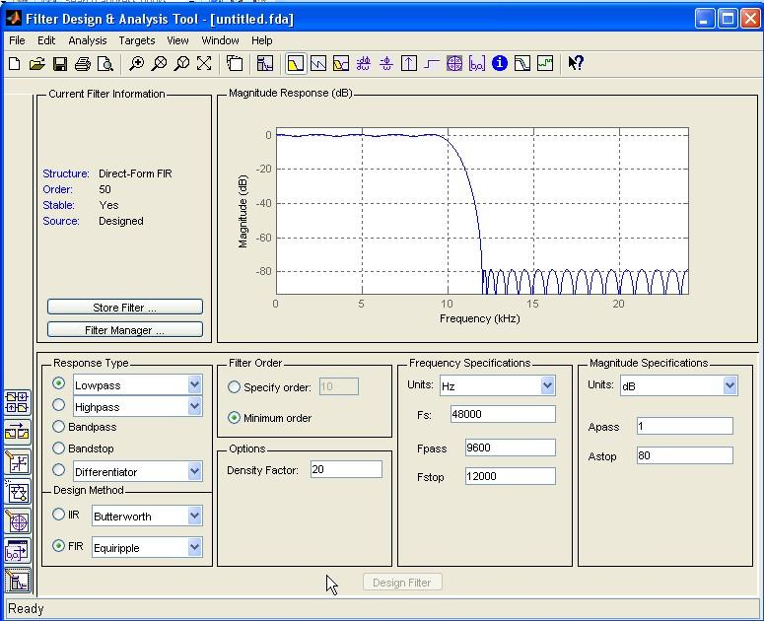
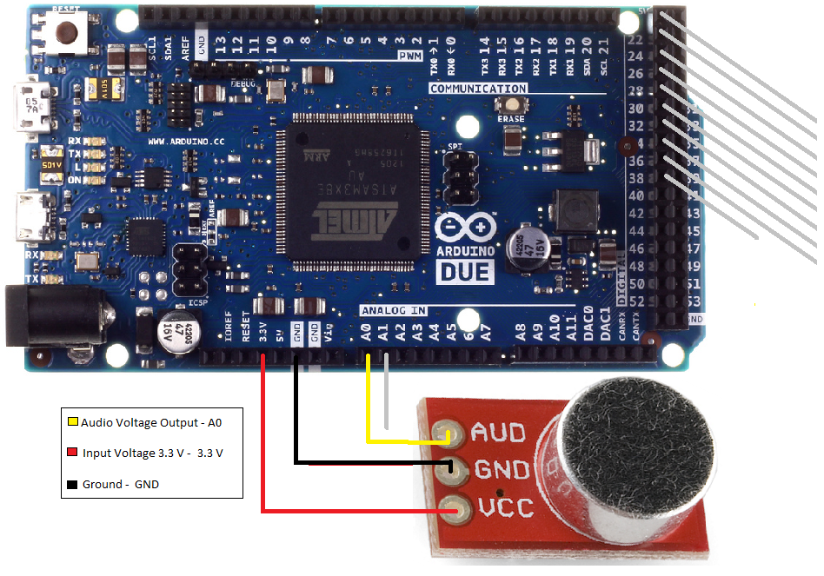
Microphone For Simon
Sparkfun Electret Microphone Breakout
Utilize MATLAB FIR filter to determine frequency ranges
PRESENTER: EVAN

Slide 29
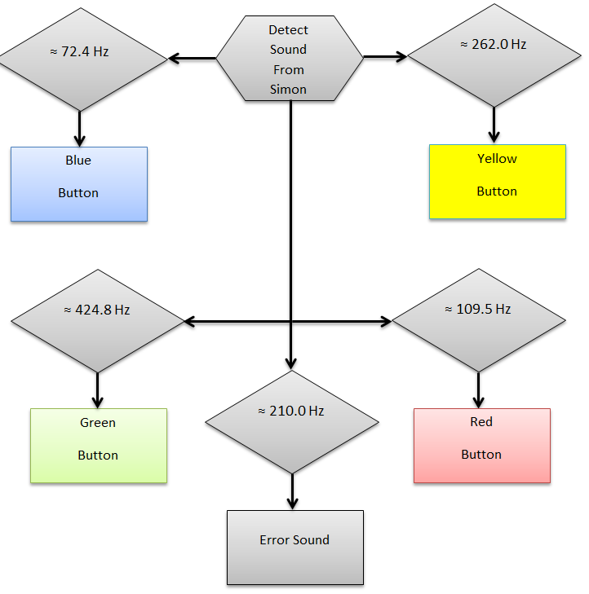
Microphone Sequence
Risk
Wrong Frequency
Background Noise: crowd is too loud
PRESENTER: EVAN

Slide 30
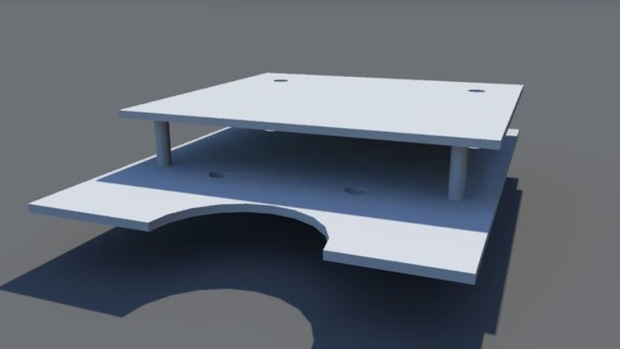
CHASSIS
2 layers of HDPE (High-density polyethylene)
Lightweight and Sturdy for speed
Low center of gravity
PRESENTER: EVAN

Slide 31
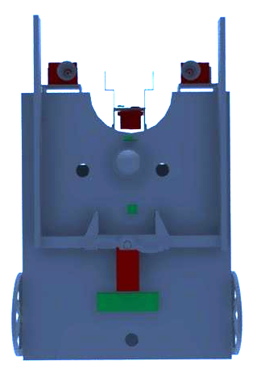
1st Layer Bottom
IR Distance Sensors
Castor Wheel
Start LED/Line Follower Small Module
Gripper w/Servo
Main Line Follower Module
PRESENTER: EVAN

Slide 32
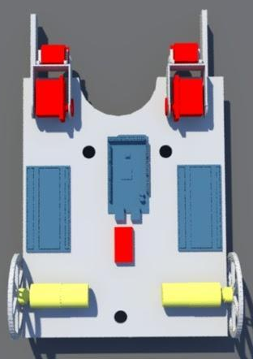
1st Layer Top
Etch-a-Sketch Arms w/Servos (x2)
MCU (Arduino Due)
Breadboards (x2)
Gripper Servo Extended Through
Driver Motors w/Wheels (x2)
12 V
6 V
PRESENTER: EVAN

Slide 33
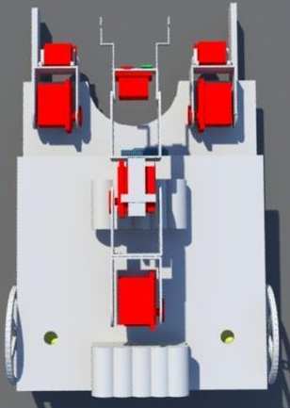
2nd Layer
Microphone for Simon
Rotate Servo
Tilt Servo (Wrist)
6 V Battery
Pan & Tilt Servos (Elbow)
12 V Battery
PRESENTER: EVAN

Slide 34
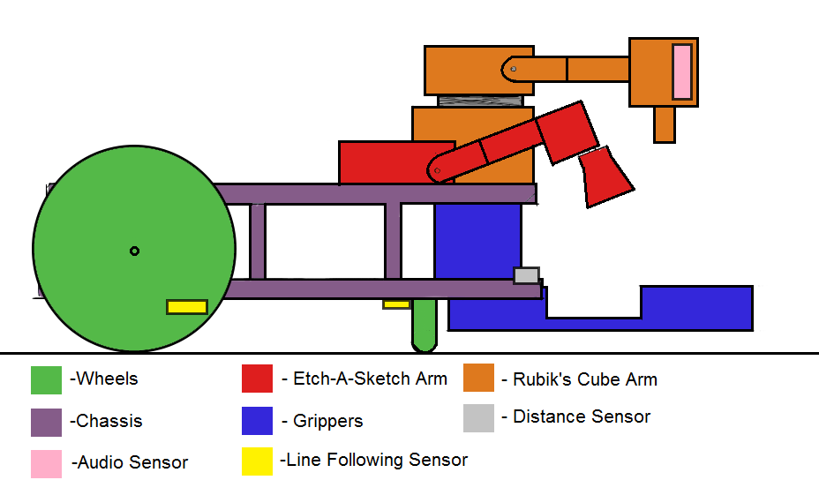
CHASSIS (From Proposal)
PRESENTER: EVAN

Slide 35
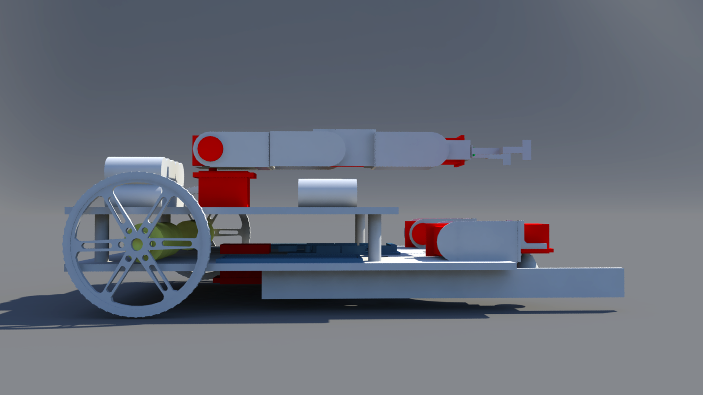
CHASSIS (Updated)
PRESENTER: EVAN

Slide 36
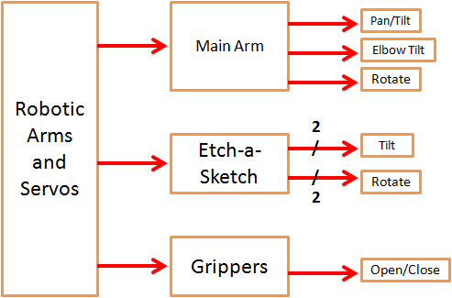
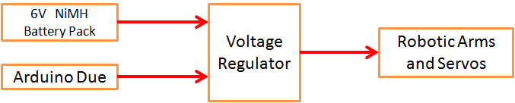
ARMS/GRIPPERS
PRESENTER: LOUIS COOPER

Slide 37
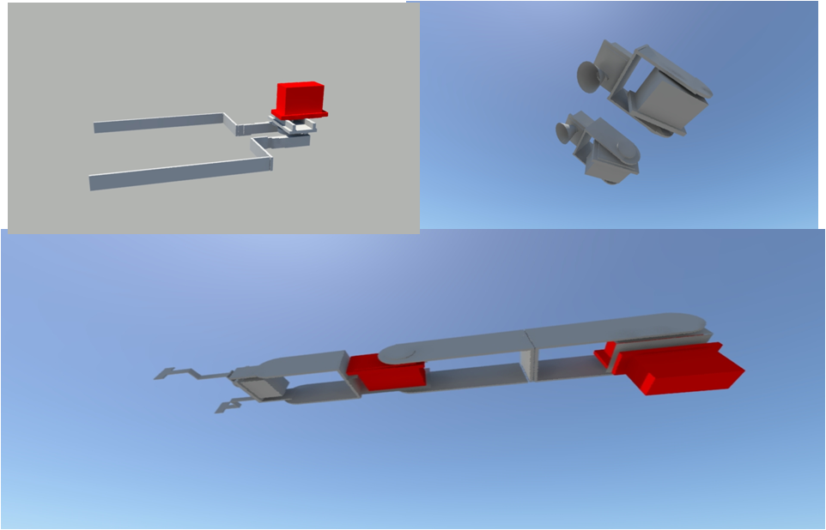
ARMS/GRIPPERS
Top Left: Grippers
Top Right:
Etch-a-Sketch Arms
Bottom:
Main Arm
PRESENTER: LOUIS
Notes:
Emphasize that you was the overall designer of the arms/grippers but we as a group will collaberately build and code the arm/grippers.

Slide 38
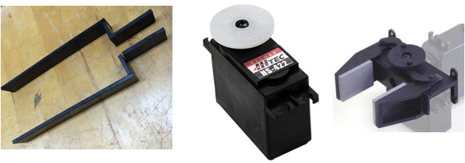
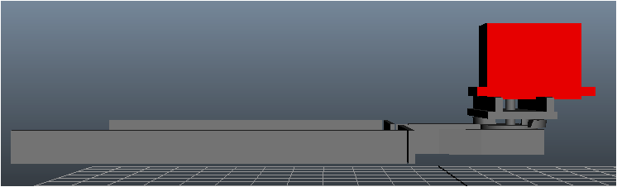
ARMS/GRIPPERS – Grippers
Total Weight = 50 g
Closed = 2.5”
Open = 3.8”
Custom end-piece made from High Density Polyethylene
2”
PRESENTER: LOUIS
8.5”

Slide 39
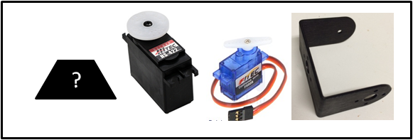
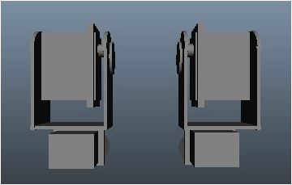

ARMS/GRIPPERS – Etch-A-Sketch Arms
Total Weight = 133 g
End-piece Torque = 21 oz-in (1.5 kg-cm)
1.75”
2.4”
PRESENTER: LOUIS

Slide 40
ARMS/GRIPPERS – Etch-A-Sketch Arms
Servo Name | Location | Direction | Servo Rotation | PWM Duty Cycle
FS90R | EaS Arm End | CCW | CCW | < 1.5ms
HS-422 | EaS Arm Base | Tilt Up | - - | - -
HS-422 | Grippers | Open | - - | - -
FS90R | EaS Arm End | CW | CW | > 1.5ms
HS-422 | EaS Arm Base | Tilt Down | - - | - -
HS-422 | Grippers | Close | - - | - -
The arms will be able to tilt and rotate using servos and brackets
PRESENTER: LOUIS

Slide 41



ARMS/GRIPPERS – MAIN ARM
Total Weight = 254 g
End-piece Torque = 46.8 oz-in (3.37 kg-cm)
2.8”
Adhesive
9.5”
PRESENTER: LOUIS
2.3”

Slide 42
ARMS/GRIPPERS - Main Arm
The arm will be able to pan, tilt, extend, contract and rotate using servos and brackets.
Servo Name | Location | Direction | Servo Rotation | PWM Duty Cycle
HS-422 | Main Arm Base | Pan Left | CCW | < 1.5 ms
HS-422 | Main Arm Base | Tilt Up | - - | - -
HS-422 | Main Arm Elbow | Extend | - - | - -
HSR-1425CR | Main Arm End | CCW | - - | - -
HS-422 | Main Arm Base | Pan Right | CW | > 1.5 ms
HS-422 | Main Arm Base | Tilt Down | - - | - -
HS-422 | Main Arm Elbow | Contract | - - | - -
HSR-1425CR | Main Arm End | CW | - - | - -
PRESENTER: LOUIS

Slide 43
ARMS/GRIPPERS - Risks
Incorrect positioning of servo splines could cause the arms to miss toys
End-pieces may not function properly
Could place too much weight on the caster wheel
Too much resistance could cause the internal gears to break
PRESENTER: LOUIS

Slide 44
SCHEDULE
Subtask | Start | End
LED Activation | Oct. 27 | Dec. 15
2. Drive System | Oct. 27 | Nov. 17
3. Line Following | Nov. 16 | Dec. 8
4. Proximity Sensor & Microphone | Nov. 17 | Dec. 8
Grippers | Nov. 3 | Dec. 1
Simon | Dec. 8 | Jan. 19
7. Etch-a-Sketch | Jan. 5 | Mar. 23
8. Rubik's Cube | Dec. 8 | Mar. 2
9. Playing Card | Jan. 12 | Mar. 2
PRESENTER: LOUIS

Slide 45

BUDGET
PRESENTER: LOUIS

Slide 46
DELIVERABLES
Fully autonomous robot that meets all needs and requirements of 2015 SoutheastCon Hardware Competition
  Hardware
  Software
All Milestone Reports and Presentations
Documentation of meetings, design, budget, important subsystem information
PRESENTER: CHELSEA

Slide 47

Servo/Arms Demonstration
PRESENTER: CHELSEA

Slide 48

Line Following Demonstration
PRESENTER: CHELSEA

