Slide 1
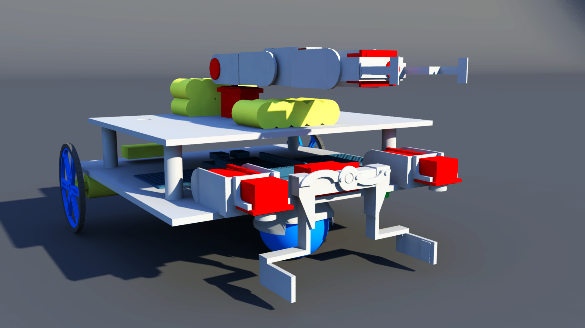
MILESTONE 4: DESIGN REVIEW
SOUTHEASTCON TEAM 1B
Senior Design Team:
Ivan Vargas Lorenzo Smith
Chelsea Ogle Evan Marshall
Louis Cooper
Coordinator: Dr. Michael Frank
Advisors: Dr. Bruce Harvey
Reviewers: Dr. Victor DeBrunner
Notes:
Chelsea Ogle
Evan Marshall
Ivan Vargas
Lorenzo Smith
Louis Cooper

Slide 2
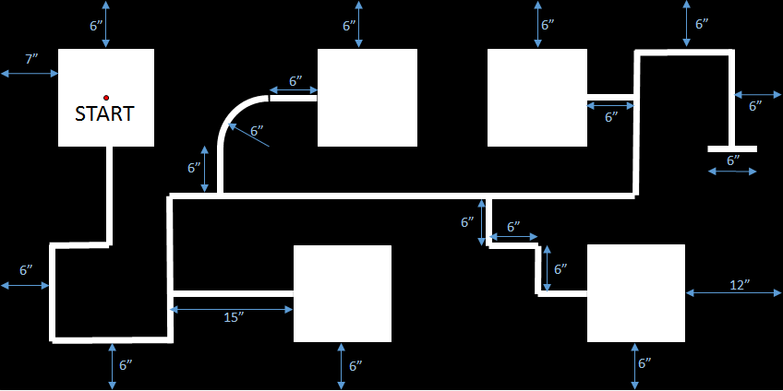
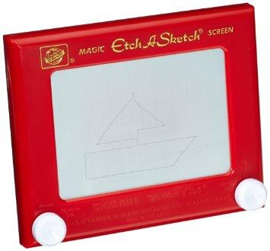

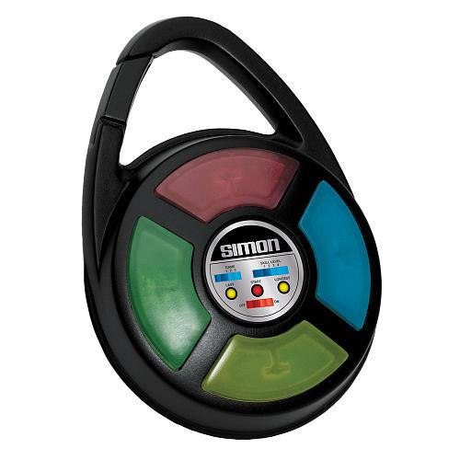
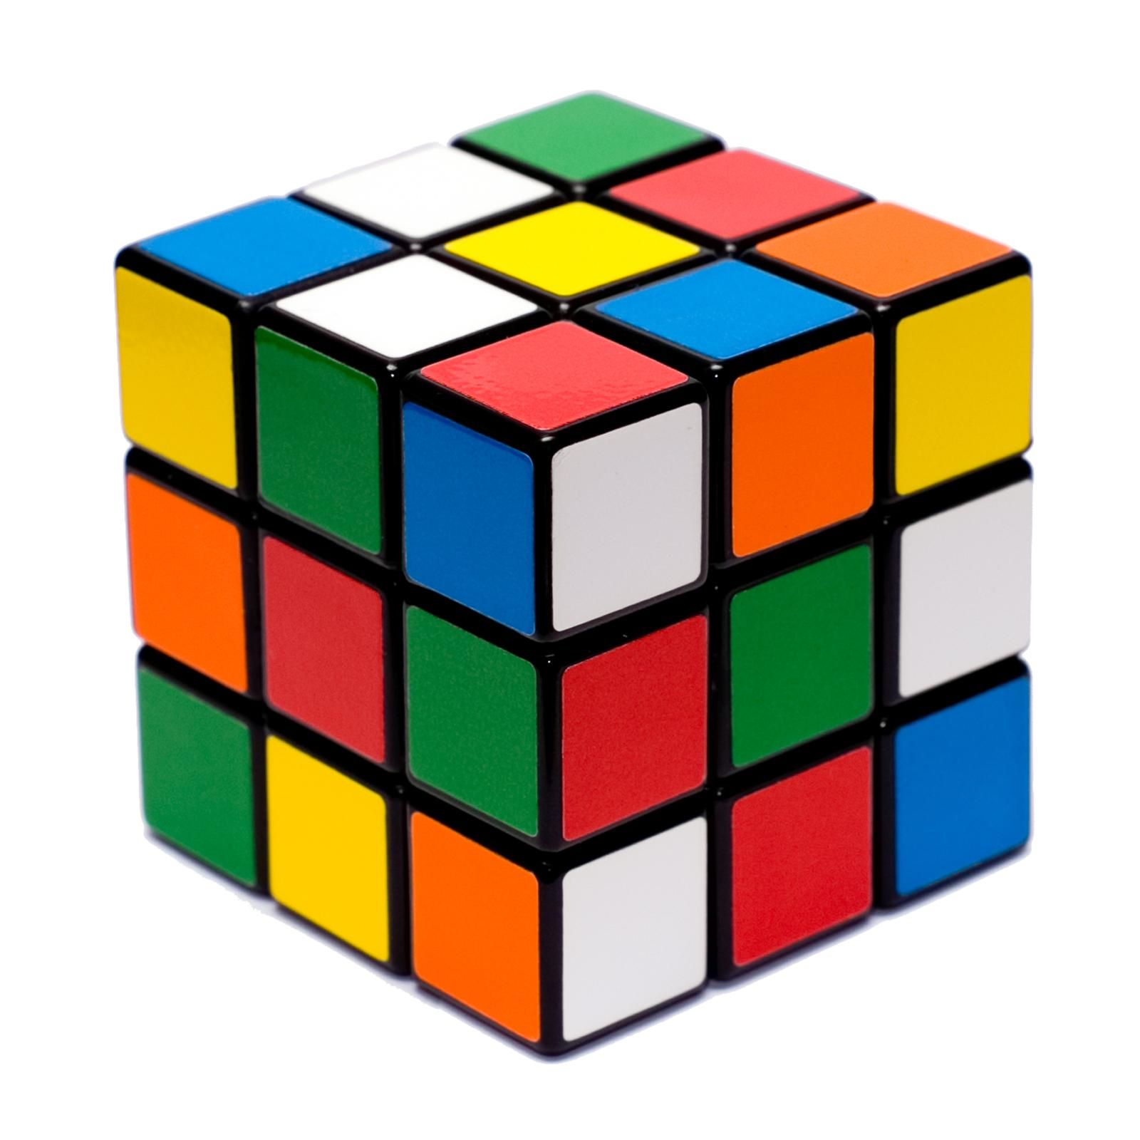
Test course
PRESENTER: IVAN VARGAS

Slide 3
OVERVIEW
MCU
Power
Drive System
Sensors
Chassis
Arms/Grippers
Schedule
Budget
Testing Plans
Deliverables
PRESENTER: IVAN

Slide 4
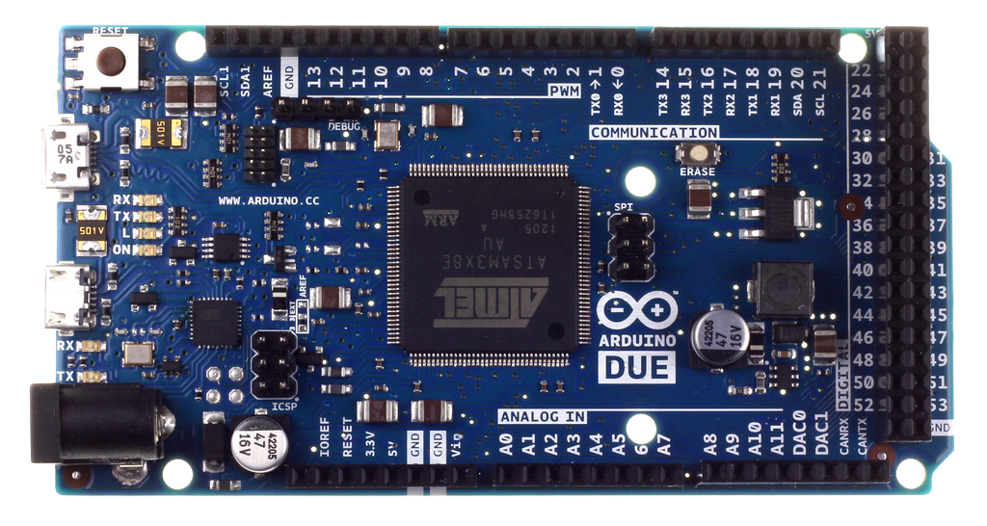
Arduino Due
Cost | $40
Operating Voltage | 3.3 V
Microcontroller | AT91SAM3X8E
Input Voltage | 7-12V recommended
Digital I/O Pins | 54 with 12 being PWM
Analog Input Pins | 12
Analog Output Pins | 2
Flash Memory | 512 KB
Clock Speed | 84 MHz
PRESENTER: IVAN

Slide 5
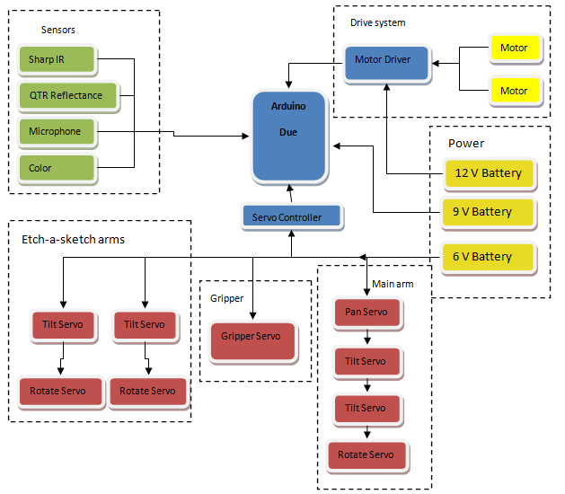
Top level block overview
PRESENTER: IVAN
Notes:
New Pics needed

Slide 6
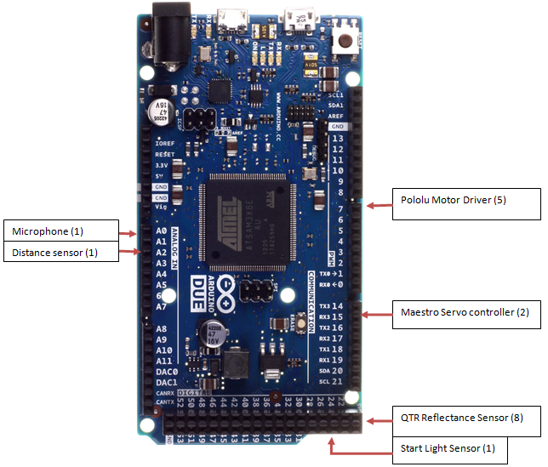
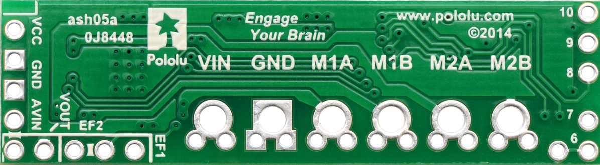
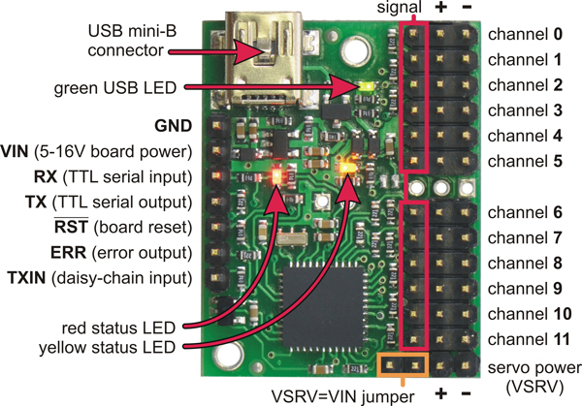
Top Level Pin connections
PRESENTER: IVAN

Slide 7
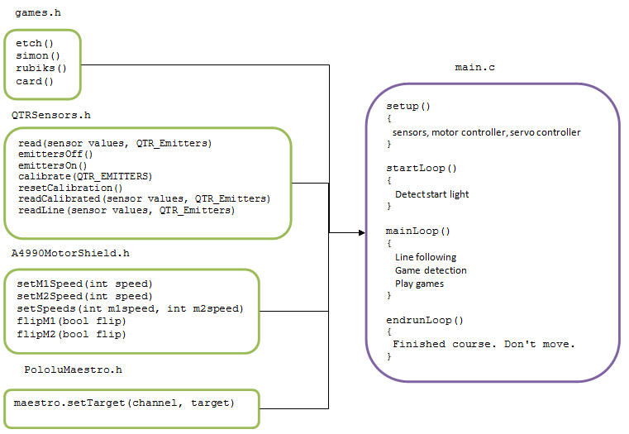
Code Overview
PRESENTER: IVAN

Slide 8
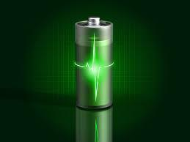
POWER SUPPLY
Batteries
  12 & 6 Volt NiMH
  Added 9V
  Arduino will be an additional power source
  One spare for each will be needed
  One charger each
Connection
  Two Solderless breadboards: neat configuration of wires providing power.
  Wires
  Male/Female connectors
PRESENTER: LORENZO SMITH

Slide 9
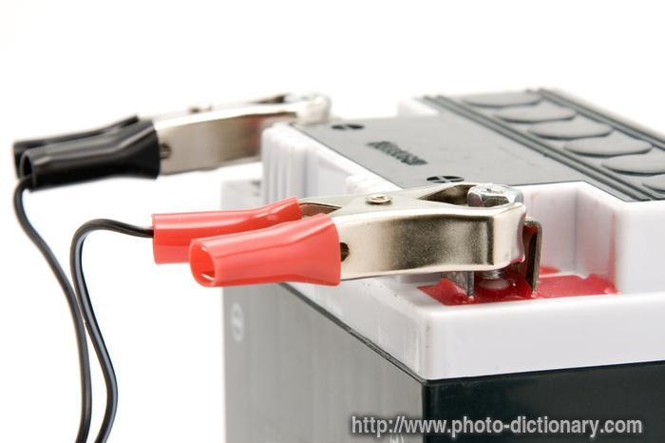
POWER SUPPLY
12 Volt NiMH
  10 AA 2200 mAh Batteries in series (2x5)
  Supplies Voltage for:
    (2) Drive Motors
6 Volt NiMH
  5 AA 2200 mAh Batteries in series
  Supplies Voltage for:
    All Servos
  Mini Maestro Servo Controller
  Supplies Voltage for:
    All Sensors
PRESENTER: LORENZO

Slide 10
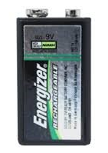
POWER SUPPLY
9 Volt Energizer Rechargeable Battery
  14200 mAh
  Supplies Voltage for:
    Arduino Due
  Charge Cycles 1500
  Charge retention 12 months
  Usage time 360 minutes
PRESENTER: LORENZO

Slide 11
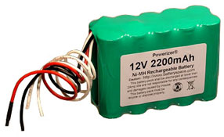
POWER SUPPLY
12 Volt NiMH Battery
Analysis
  26.4 Wh, 26.4 W
  1 CC
  2200 mAh
Voltage Peak
  14.7 V
Charging Rate
  0.5-2.2 A (2.5hrs @ 0.9 A)
Discharging Rate
  2 Amp
Dimensions
  51 mm x 29 mm x 72 mm (H x W x L)
Weight
  10 oz (283 grams)
Red - Positive, Black - Negative
PRESENTER: LORENZO

Slide 12
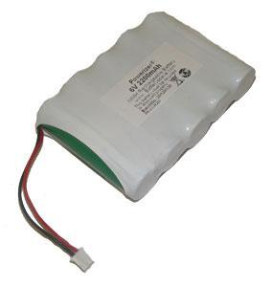
POWER SUPPLY
6 Volt NiMH Battery
Analysis
    9.6 Wh, 9.6 W
    1 CC
    2200 mAh
Voltage Peak
    7.1 Volts
Charging Rate
    0.5-2.2 A (2.5hrs @ 0.9 A)
Discharging Rate
    2 Amp
Dimensions
    51 mm x 15 mm x 72 mm (H x W x L)
Weight
    4.8 oz (140 grams)
Red - Positive, Black - Negative
PRESENTER: LORENZO

Slide 13
Power Risk Assessment
Possible Risk
  Battery Lifespan decreases over time due to testing and experimenting
  Battery Output current too low due to the overload of devices
  Battery Peak Voltage blows devices being supplied with power
  Battery Disconnection during the competition
  High Stall Current may drain the battery before being used
  Battery Corrosion low probability
PRESENTER: LORENZO

Slide 14
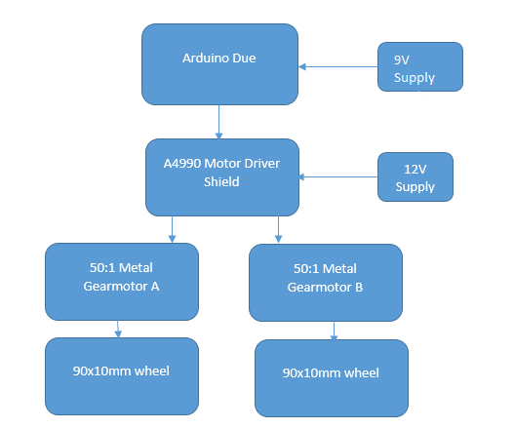
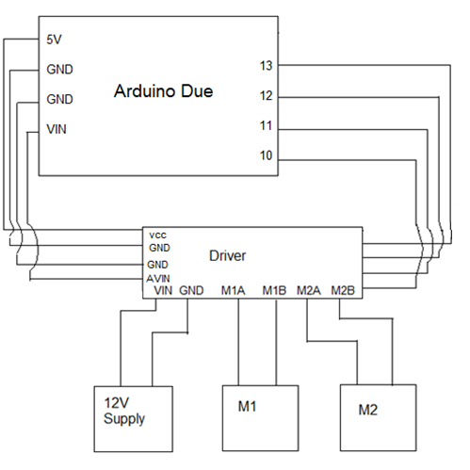
DRIVE SYSTEM - TOP LEVEL & PIN CONNECTIONS
PRESENTER: CHELSEA OGLE

Slide 15
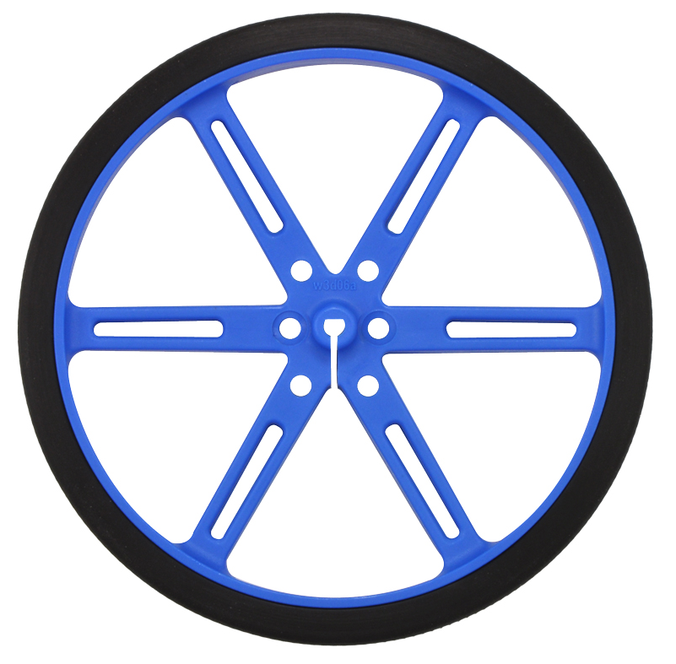
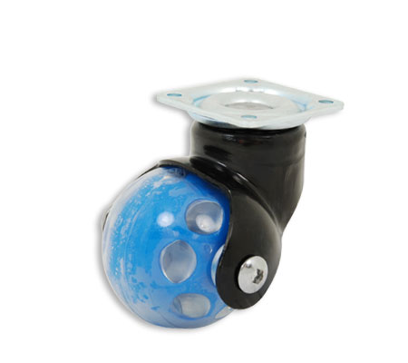
DRIVE SYSTEM - WHEELS
Two Pololu 90x10mm wheels with tires, one 2’’ ball caster wheel with swivel plate
PRESENTER: CHELSEA

Slide 16
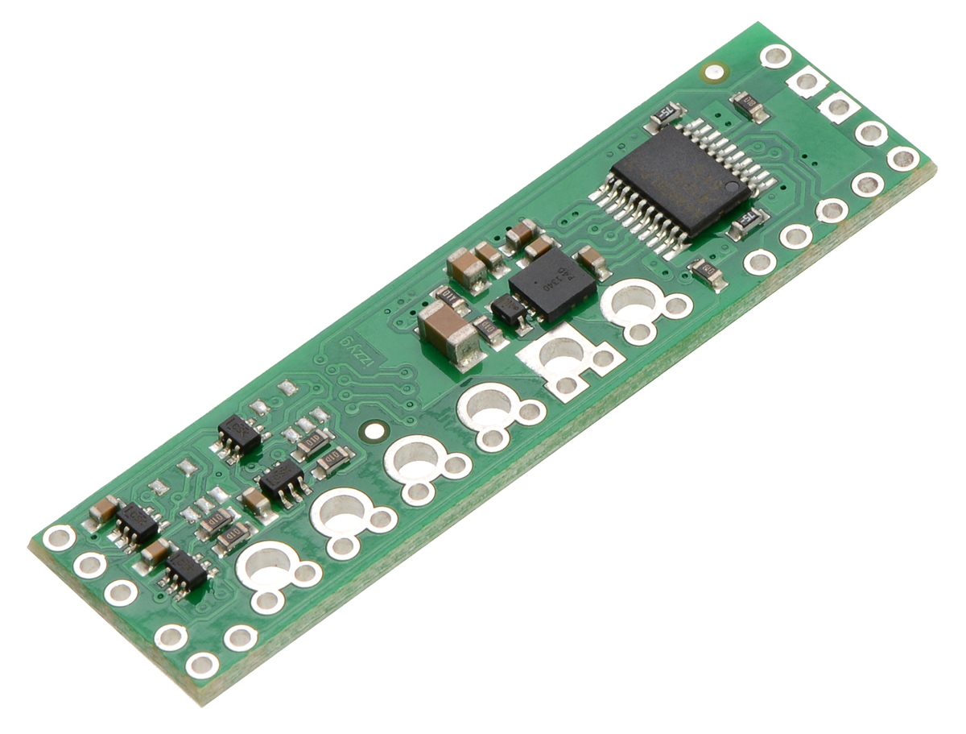
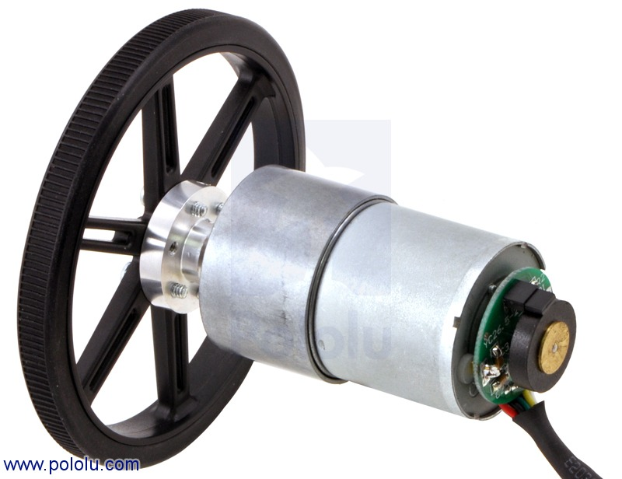
DRIVE SYSTEM - MOTOR & MOTOR DRIVER
Chose two 12V DC brushed metal gearmotors with 64 CPR encoder
  12 kg-cm of torque
  200 RPM
  300 mA free-run
Pololu A4990 Dual Motor Driver Shield for Arduino
  Current/Voltage Rating sufficient
    6-32 V, 0.9 mA max
  Protects against over- and under-voltage, reverse voltage, shorts and over temperature
PRESENTER: CHELSEA

Slide 17
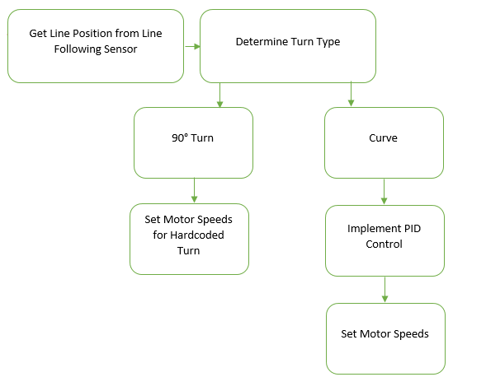
DRIVE SYSTEM - PSEUDOCODE
PRESENTER: CHELSEA

Slide 18
DRIVE SYSTEM - RISKS
Current overdraw: Motor may draw too much current affecting the power consumption
Traction failure: In the event of braking and accelerating the friction is not strong enough.
Caster Wheel failure: Caster wheel could affect the robot’s turns and line following points
PRESENTER: CHELSEA

Slide 19
SENSORS
Start LED detection
Line Following
Object Detection
Microphone (Simon)
PRESENTER: CHELSEA

Slide 20

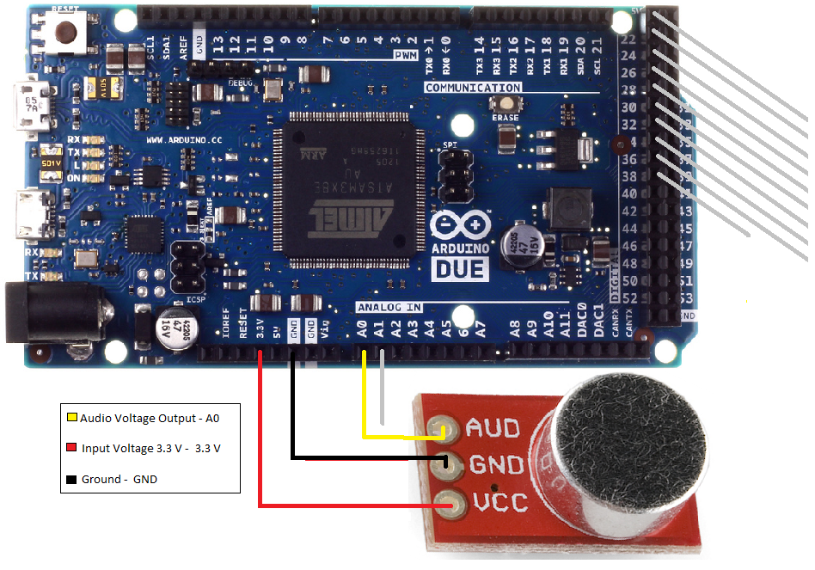

Microphone For Simon
Adafruit Electret Microphone Breakout
Initial plan to use FFT or FHT to determine frequency
Considering detecting waveform period (successful results)
Risks
Wrong Frequency detected
Background Noise: crowd is too loud
PRESENTER: CHELSEA

Slide 21
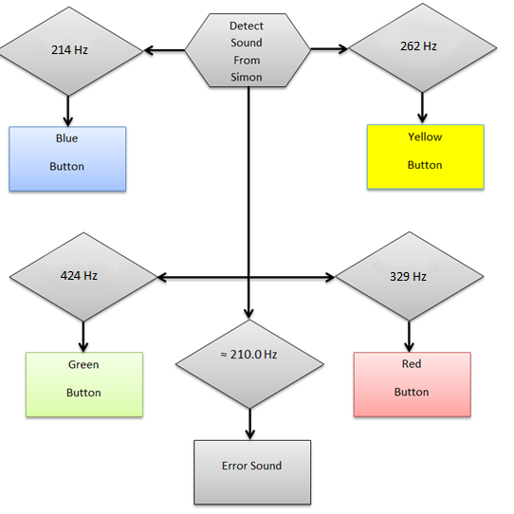
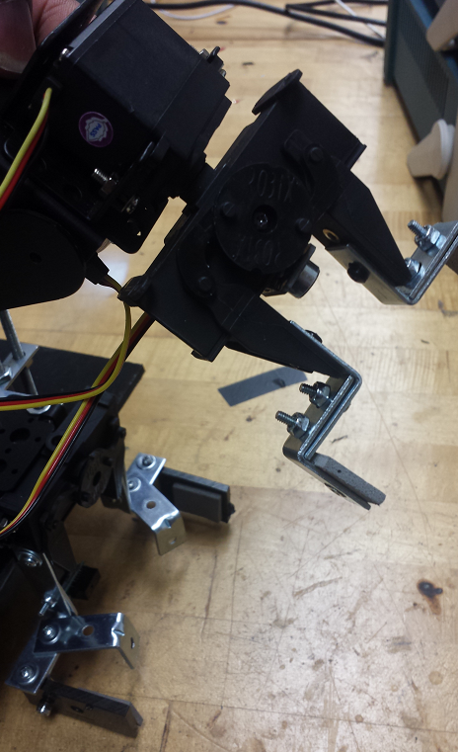
Microphone Sequence
and Location

Slide 22
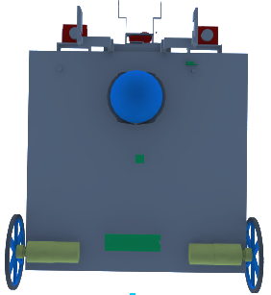
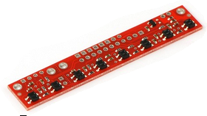
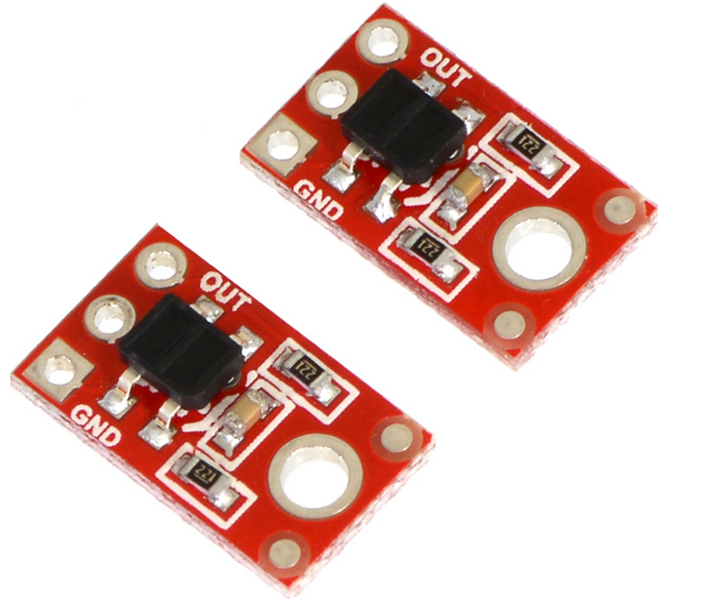
Starting and Navigation
Starting (Red LED detection)
PololuQTR-1RC small module
PololuQTR-8RC large module
8 + 1 IR/LED Phototransistor pairs
Will detect change in light
Will also help with line following
PRESENTER: EVAN

Slide 23
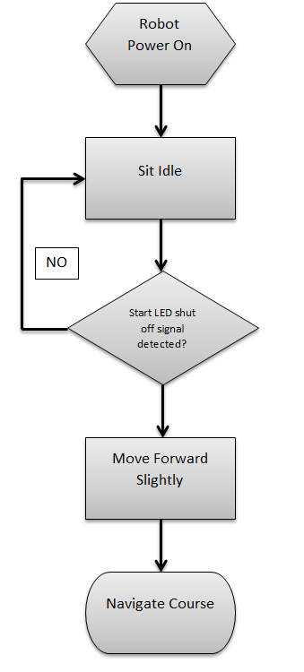


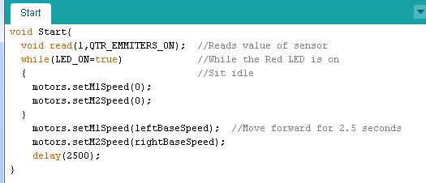
Starting Course
PRESENTER: EVAN

Slide 24
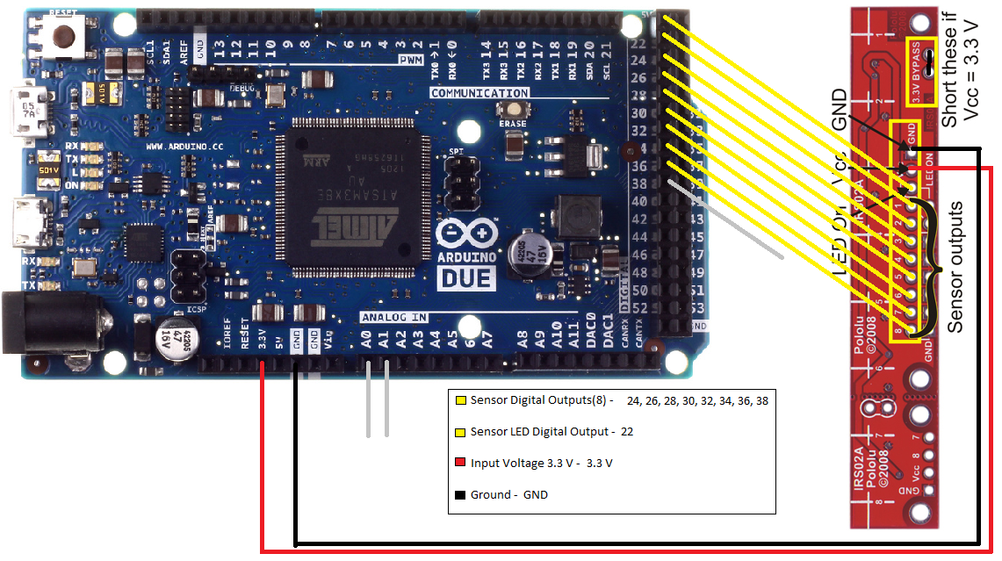

Starting and Navigation Pin Connections
PRESENTER: EVAN

Slide 25
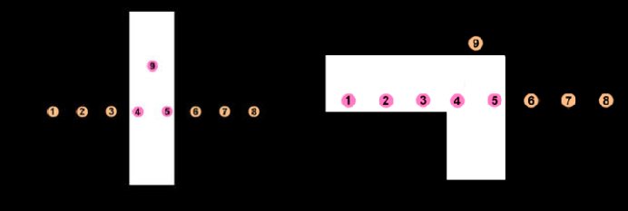
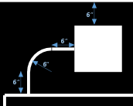
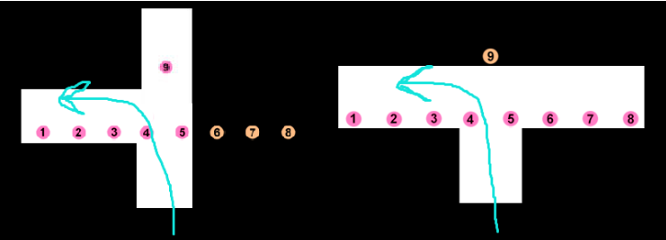
Navigating the Course
PRESENTER: EVAN

Slide 26
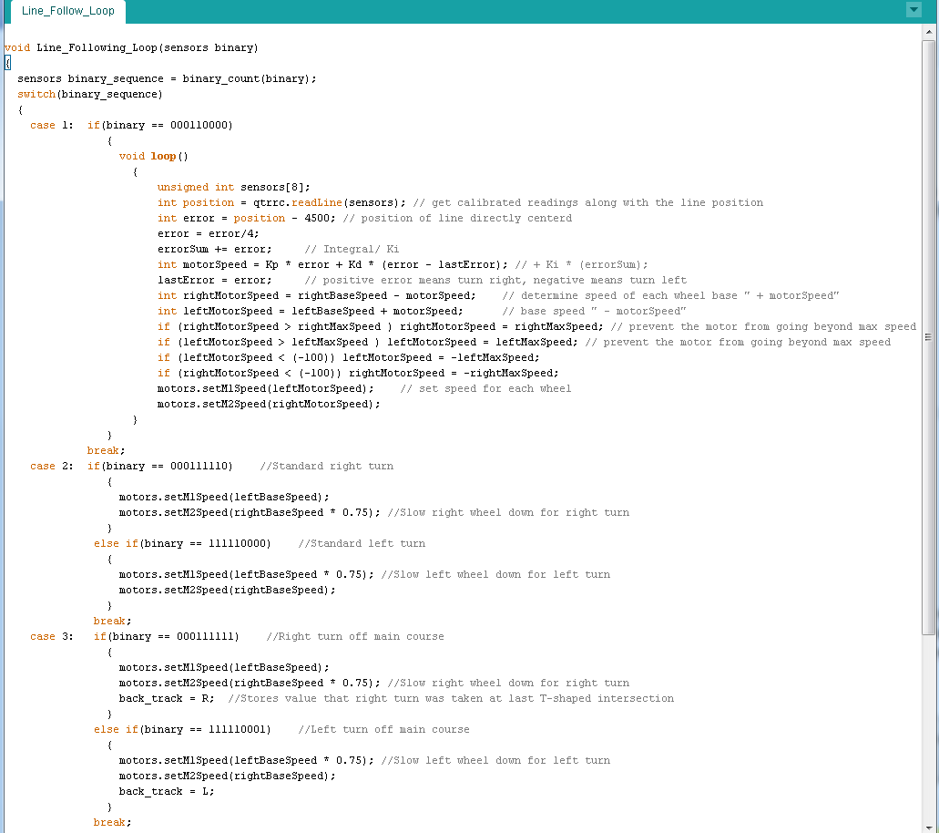
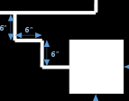
Navigating
the Course
PRESENTER: EVAN

Slide 27
Navigation Risk
Improper Calibration: Sensors does not center the line
Failure to start: Start LED signal is not recognized
Missing a turn (Lower Risk) : Playing the wrong game
Failure to finish (Lower Risk) : Lost following the track looping continuously, Lose points
PRESENTER: EVAN

Slide 28
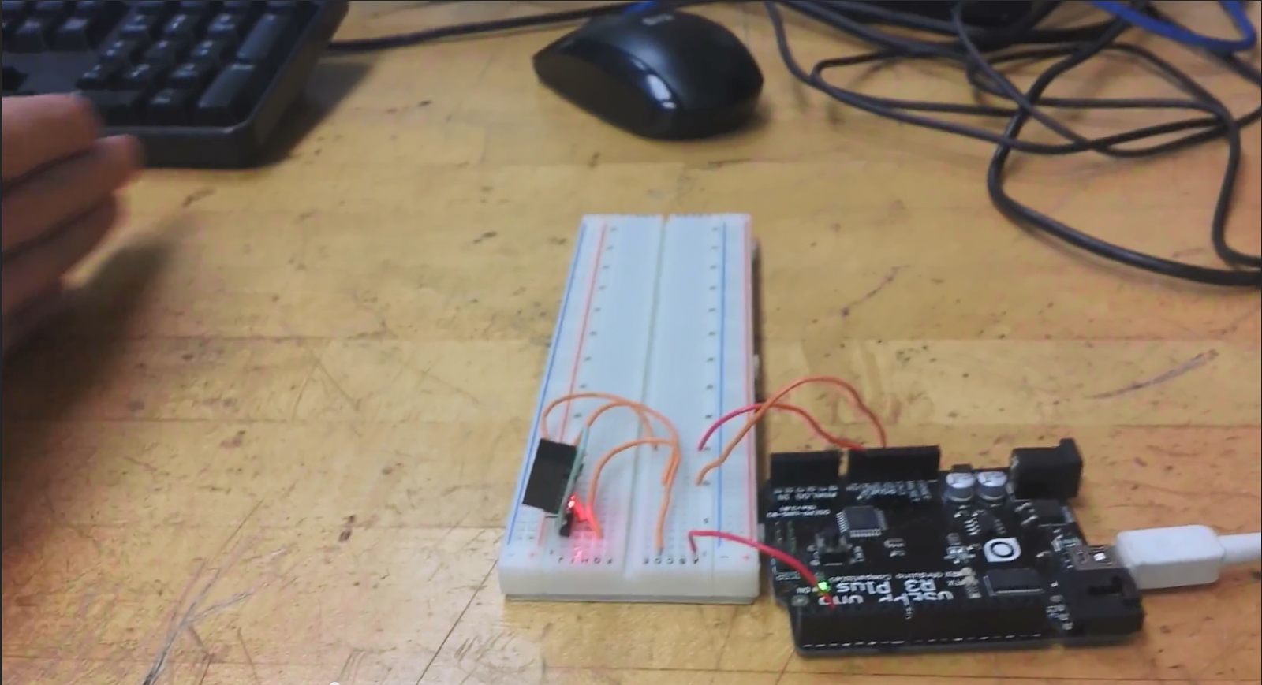
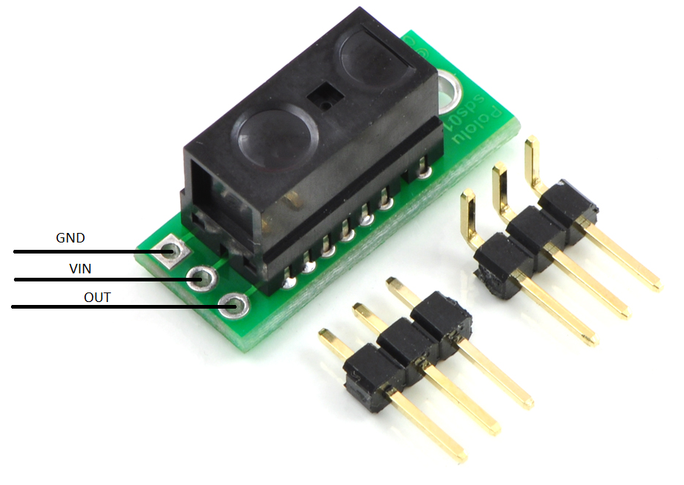
Object Detection
2 IR Optical Range Sensors
Sharp GP2Y0D815Z0F Digital Distance Sensor (0.2” – 6”)
(Optional)Sharp GP2Y0A60SZLF Analog Distance Sensor 3V (4” – 60”)
PRESENTER: EVAN

Slide 29
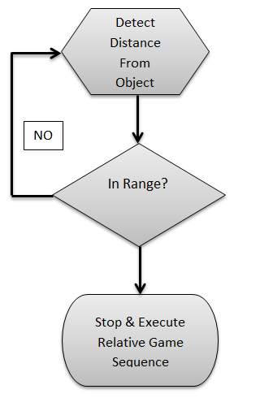
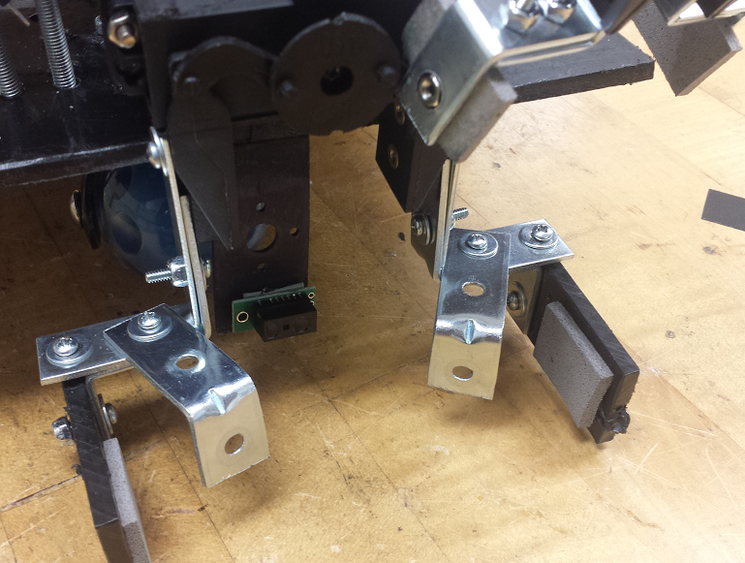
Object Detection Sequence, Location, and Risk
Inaccurate Reading
  Missed Reading (running into a game)
PRESENTER: EVAN

Slide 30
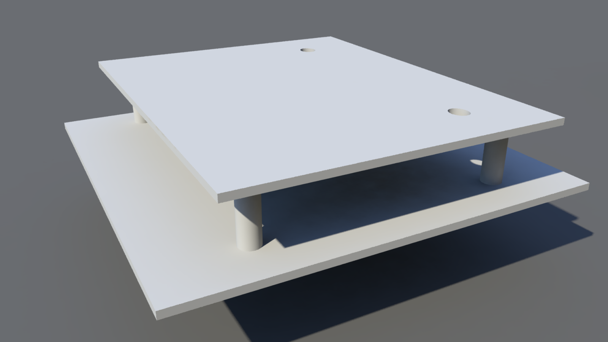
CHASSIS
2 layers of HDPE (High-density polyethylene)
Lightweight and Sturdy for speed
Low center of gravity
PRESENTER: EVAN

Slide 31
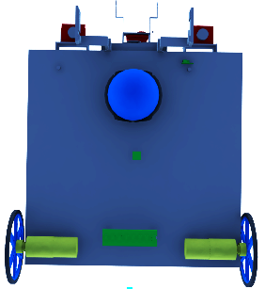
1st Layer Bottom
Gripper w/Servo
IR Distance Sensor
Castor Wheel
Start LED/Line Follower Small Module
Main Line Follower Module
PRESENTER: EVAN

Slide 32
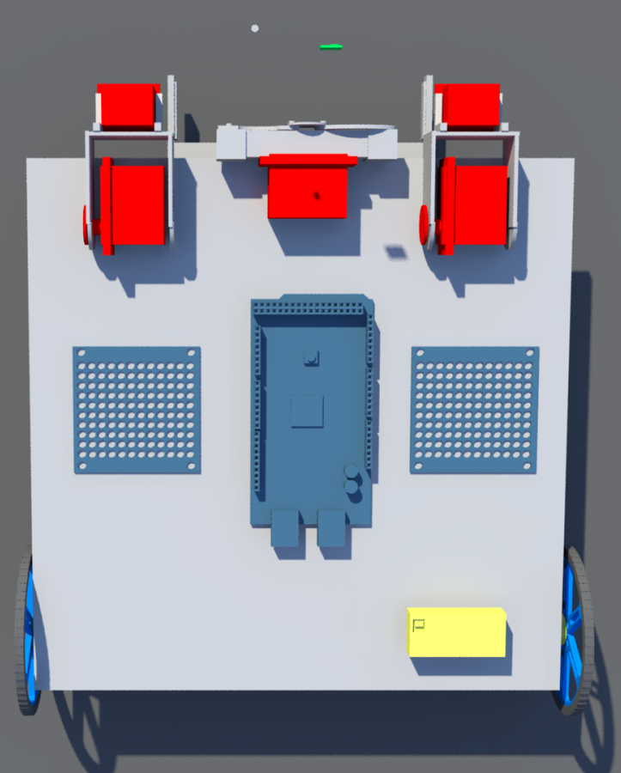
1st Layer Top
Etch-a-Sketch Arms w/Servos (x2)
Gripper Servo
MCU (Arduino Due)
Breadboards (x2)
Driver Motors w/Wheels (x2)
9V Battery
12 V
6 V
PRESENTER: EVAN

Slide 33
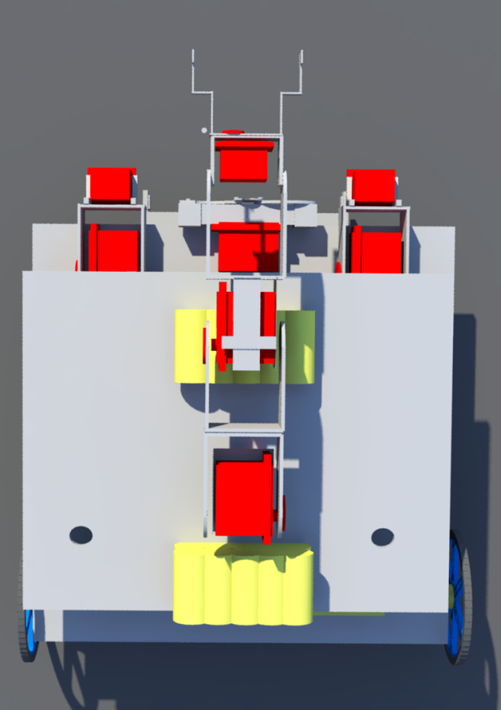
2nd Layer
Microphone for Simon
Rotate Servo
Tilt Servo (Wrist)
6 V Battery
Pan & Tilt Servos (Elbow)
12 V Battery
PRESENTER: EVAN

Slide 34
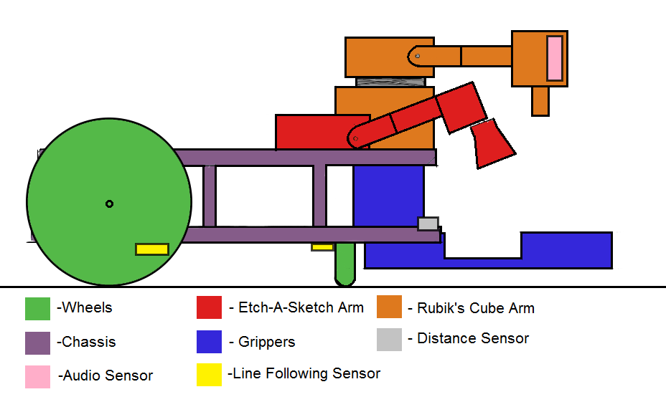
CHASSIS (Milestone 2)
PRESENTER: EVAN

Slide 35
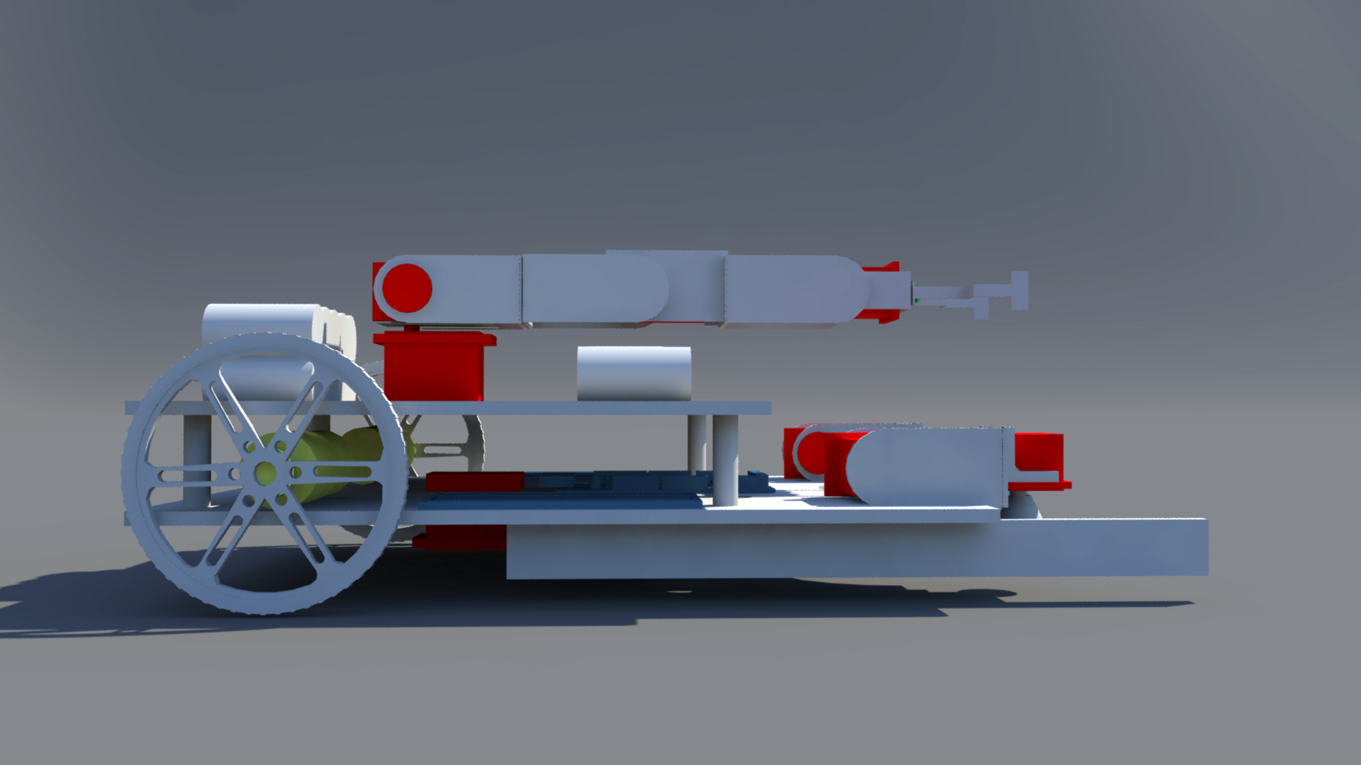
CHASSIS (Milestone 3)
PRESENTER: EVAN

Slide 36
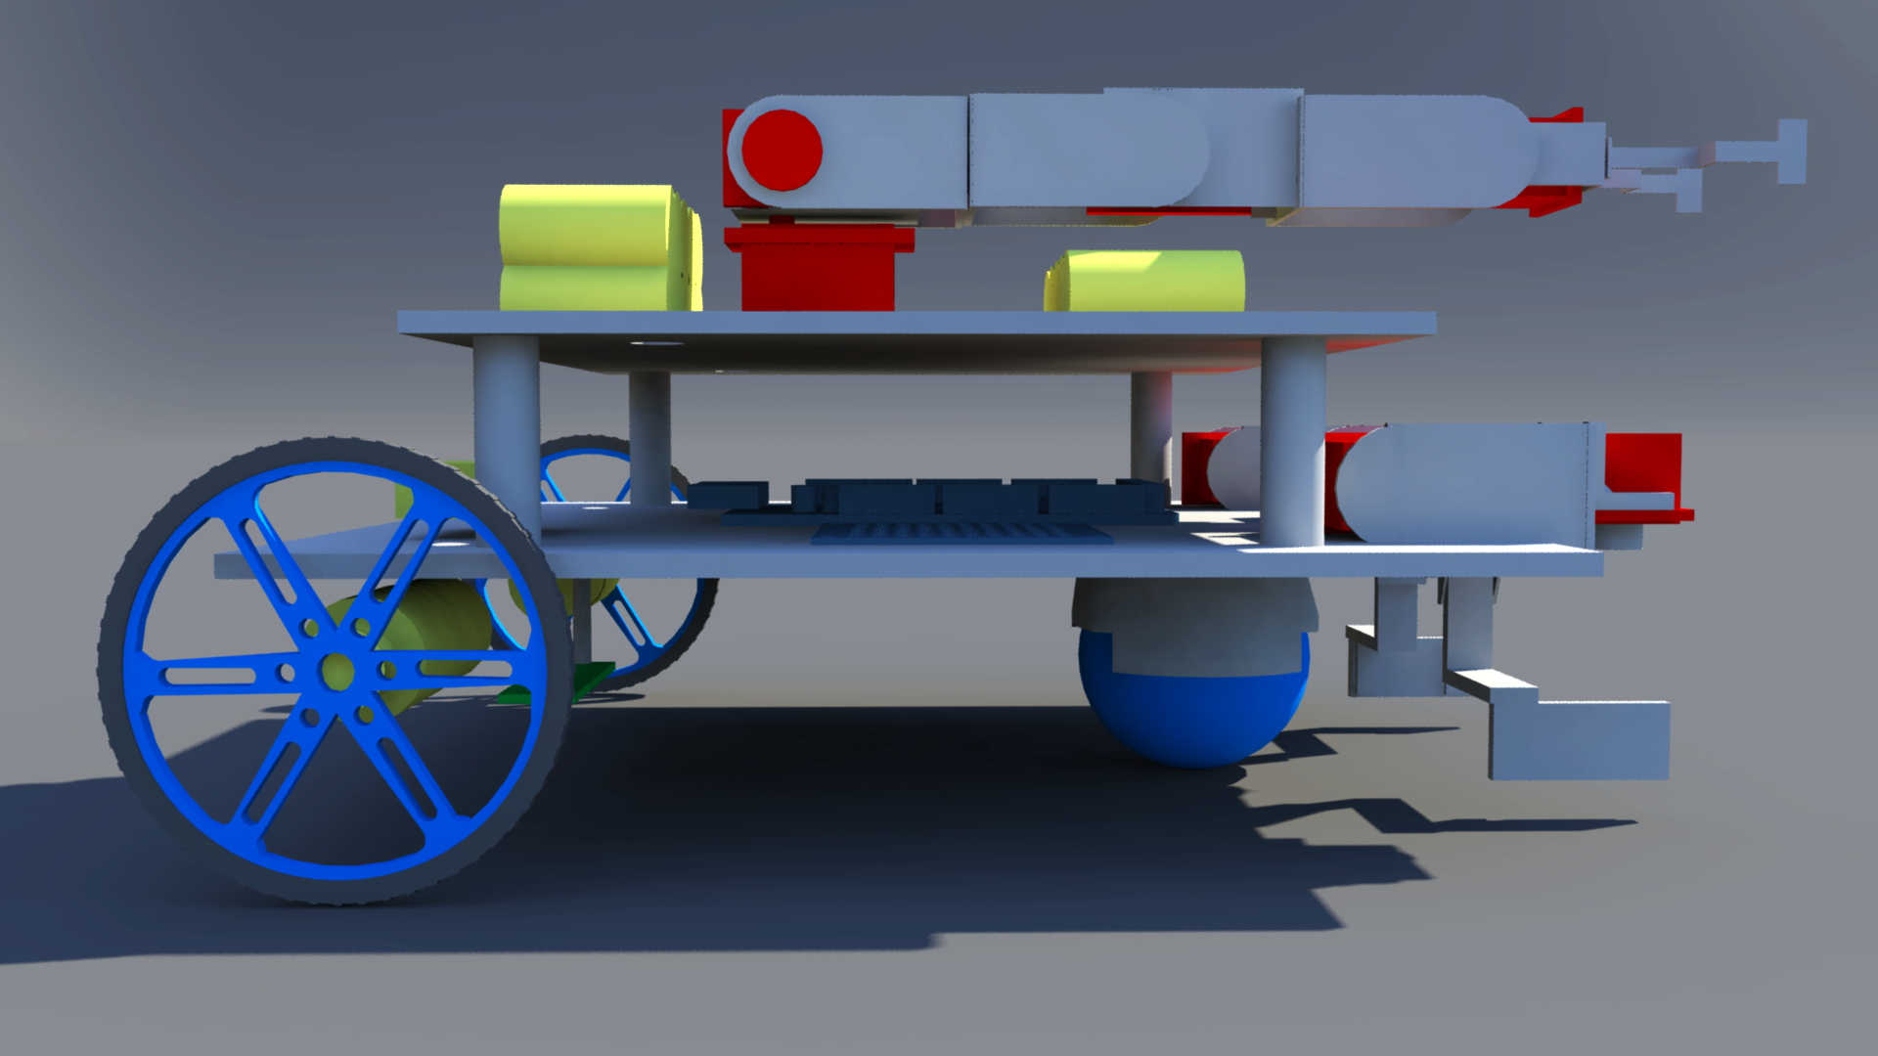
CHASSIS (Updated - Milestone 4)
PRESENTER: EVAN

Slide 37
ARMS/GRIPPERS
PRESENTER: LOUIS COOPER

Slide 38
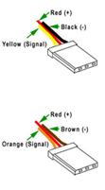
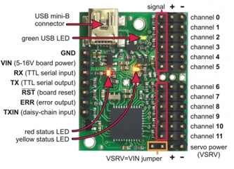

ARMS/GRIPPERS
PRESENTER: LOUIS COOPER

Slide 39

ARMS/GRIPPERS
PRESENTER: LOUIS COOPER

Slide 40



ARMS/GRIPPERS
PRESENTER: LOUIS

Slide 41



ARMS/GRIPPERS
PRESENTER: LOUIS

Slide 42



ARMS/GRIPPERS
PRESENTER: LOUIS

Slide 43
ARMS/GRIPPERS - Risks
Missed or incorrect servo positions
Servo electronics malfunction
Insufficient power circuit
Stalled servo gearbox
PRESENTER: LOUIS

Slide 44
ARMS/GRIPPERS - Risks
End-pieces may not function properly
Too much weight on the caster wheel
Too much stress on wires
PRESENTER: LOUIS

Slide 45
SCHEDULE
Subtask | Start | End
LED Activation | Jan. 11 | Feb. 25
2. Drive System | Jan. 11 | Jan. 17
3. Line Following | Jan. 18 | Mar. 2
Proximity Sensor & Microphone | Jan. 18 | Feb. 25
Grippers | Jan. 11 | Feb. 18
Simon | Jan. 18 | Feb. 18
Etch-a-Sketch | Jan. 28 | Feb. 25
Rubik's Cube | Feb. 11 | Mar. 2
Playing Card | Feb. 11 | Mar. 2
PRESENTER: LORENZO

Slide 46

BUDGET
PRESENTER: LOUIS

Slide 47
Testing Plans
Drive System
  Motors/Driver
  Chassis
Sensors
  Line Following
  Object Detection
  Microphone
  Start LED
Arms/Grippers
  Servos
  Chassis Gripper
  Main Arm
  EaS Gripper

Slide 48

Example Testing Plan

Slide 49
DELIVERABLES
Fully autonomous robot that meets all needs and requirements of 2015 SoutheastCon Hardware Competition
  Hardware
  Software
All Milestone Reports and Presentations
Documentation of meetings, design, budget, important subsystem information
PRESENTER: CHELSEA

Slide 50

Servo/Arms Demonstration
PRESENTER: CHELSEA

Slide 51
Thank You
SOUTHEASTCON TEAM 1B
Notes:
Chelsea Ogle
Evan Marshall
Ivan Vargas
Lorenzo Smith
Louis Cooper

Slide 52

DRIVE SYSTEM - MOTOR CALCULATIONS
Estimating the torque needed as follows:
With mass estimated at 7 kg, acceleration 0.1524 m/s^2 (half max velocity of 1 ft/s), wheel radius 0.045 m
Most DC brushed motors have efficiency of 68%, efficiency used will be 58% to account for potential frictional forces
Yields necessary torque of 8.27 kg-cm for 7 kg mass estimate
PRESENTER: CHELSEA

Slide 53

Line Following Demonstration
PRESENTER: CHELSEA

