Slide 1
Needs Analysis & Requirements Specification
Southeast Con 1B “Success” Senior Design Team
Louis Cooper
Evan Marshall
Chelsea Ogle
Lorenzo Smith
Ivan Vargas

Slide 2
Table of Contents
Introduction(Positions, Technical Specialty)
Project Overview
Code of Conduct
Competition ( Rules and Objective)
Methodical Specification
Testing Plan
Schedule and budget
Risk Assessment

Slide 3
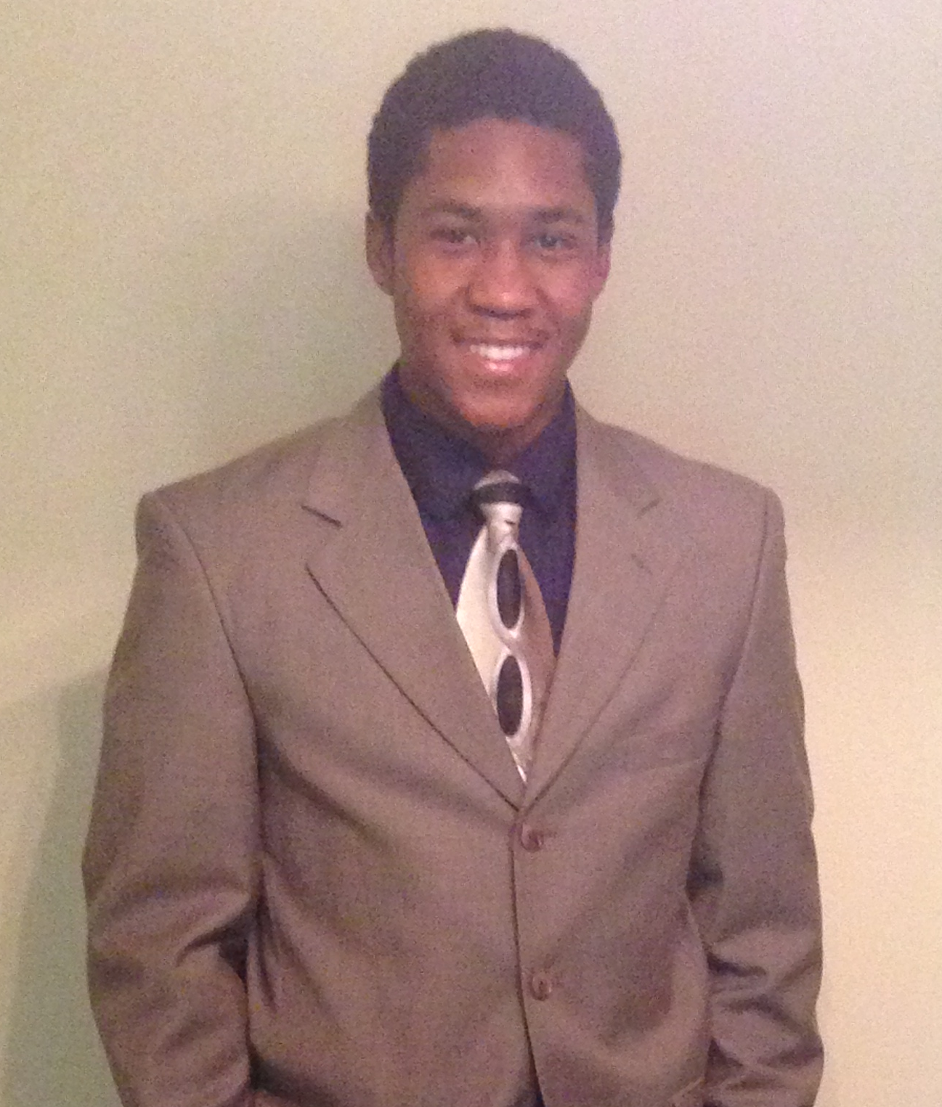
Lorenzo Smith
5th Year Electrical Engineering Student
Project Manager
Technical Specialty: Robot Mechanics and Design

Slide 4
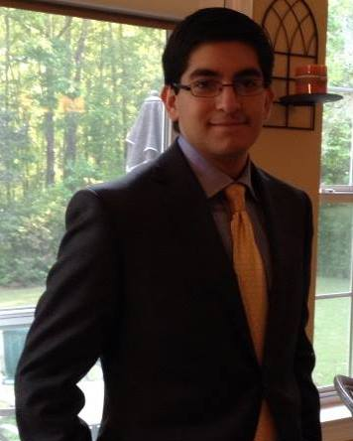
Ivan Vargas
4th Year Electrical Engineering Students
Equipment Technician
Technical Specialty: Microcontroller Programming

Slide 5

Chelsea Ogle
4th year Electrical Engineering Student
Secretary
Technical Specialty: Power and Designs

Slide 6

Evan Marshall
4th Year Computer Engineering Student
Assistant Equipment Technician
Technical Specialty: Microcontroller Programming

Slide 7

Louis Cooper
4th year Electrical Engineering Student
Treasurer
Technical Specialty: Communication, Power, and Motors

Slide 8

Project Overview
To exit the College of Engineering with a Bachelor’s Degree within their technical field
Compete in Technical, Professional and Student Conference, hardware competition
In which the senior design team will build a autonomous robot fit to win the competition
The competing robot is required to navigate a plywood course completing four task under a time limit
Write reports, conduct meetings, build, test and troubleshoot the project.
Notes:
Students are giving a senior design project to complete to exit the College of Engineering with a Bachelor’s Degree within their technical field.
Students will enter an annual Technical, Professional and Student Conference, hardware competition held by IEEE as a team.
In which the senior design team will build a autonomous robot fit to win the competition.
The competition consist of a competing robot is required to navigate a plywood course completing 4 task under a time limit.
Students will write reports, conduct meetings, build, test and troubleshoot the project.

Slide 9
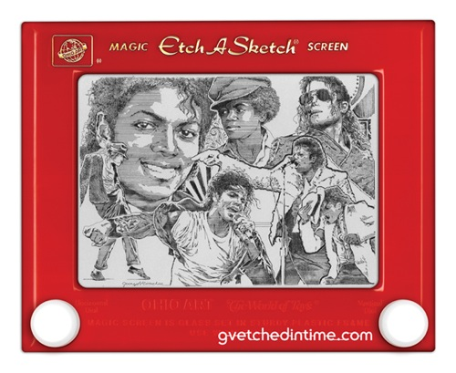



Project Games

Slide 10
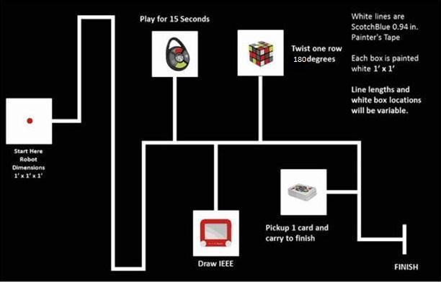
Course

Slide 11
Code of Conduct
Communication: Groupme, email, & phone
Decision Making: Discussion of ideas, vote, advisor assistance.
Conflict Resolution: Discussion, Project Manager or Advisor Intervention
Meetings: Weekly Group meetings, bi-weekly advisor meetings, monthly
Deliverables: Autonomous robot, meet budget requirement, project reports.
Team Dynamics: Common manners, communicate, preparation, participation, innovative, optimistic.
Notes:
All communication over email must be copied to all group members. Members will be informed of
meetings via phone or email at least 24 hours ahead of time, and all group members should be present
at meetings unless previous engagements have been discussed with group. Members will reply
within 24 hours to phone and emails. First line of communication will be GroupMe and second line of
communication will be email.

Slide 12
Competition
Playing surface: 5/8” x 4’ x 8’ Sanded Pine Plywood, black with 0.94” white course line
Vehicle cannot be larger than 1’ x 1’ x 1’, all parts must remain attached
1 minute to place vehicle and align toys, vehicle must start at red LED turning off
Must drive on white line (5 pts)
Play Simon Says Carabiner for 15 seconds (15 pts)
Draw IEEE on Pocket Etch-A-Sketch (20 pts)
Twist top layer of Rubik’s cube 180 degrees (5 pts)
Pick up one card and carry to finish (5 pts)
Complete course in five minutes or less, three rounds
Notes:
Chelsea

Slide 13
Methodical Specification
Functional Requirements
Robot must move, turn 90 degrees
Must have operational/battery life to last three five-minute rounds
Robot must follow white line of course, go to each toy, cross finish line in 5 minutes
Must have microcontroller units capable of performing desired tasks Must start with LED turning off
Must be able to find/grip all of the toys in place
Must have an apparatus to grip the knobs of Etch-a-Sketch and top of the Rubik’s cube (~2.5 inches wide, close)
Notes:
Chelsea

Slide 14
Methodical continued…
Must be able to press the buttons on Simon
Must distinguish colors
Must recognize Simon’s pattern (audio)
Must have an apparatus capable of rotating Rubik's cube and Etch-A-Sketch knobs
Must be able to write “IEEE” with specified knob-turning pattern
Must be able to pick up card
Non Functional Requirements
Modular design/assembly
Easy replace/implanted power source
Easy to maintain and service

Slide 15
Testing Plan
Capabilities Test
  Movement/Navigation
    Successful movements in the four cardinal directions
    Smooth transitions
    Navigate only on white line till finish
  Software
    Must interface between different sensors, motors, and other hardware
  Operating Life/Power
    Observe heat dissipation
    Last well beyond run time
  LED Response
    Start after LED light is detected off
  On/Off
    Power robot on and off
  Distance/Holding
    Detect correct distance from games
    Position holders correctly
  Arm
    Rotational, vertical, and horizontal movement
    Open and close wide enough
  Sound Response
    Microphone to trigger proper motion/action of arm
Notes:
Evan

Slide 16
Testing Plan continued…
Requirement/Game specific test
  Simon Carabiner
    Start game and react to sound frequency
    Speed to correctly play for 15 seconds
  Rubik’s Cube
    Placement of arm and 180° rotation
  Pocket Etch-a-sketch
    Arms clamp onto knobs
    Sequential coding to rotate arms for desired “sketch”
  Playing Card Test
    Panel and adhesive
    Separation of one card; gently
    Hold long enough till finish
Constraints Test
  Size
    Frequent measurements to maintain 1’x1’x1’ design
  Deadline
    Weekly deadlines and goals
  Budget
    Rough estimates made early. Detailed ones prior to purchase
    Time budget, splitting parts of design for efficiency

Slide 17
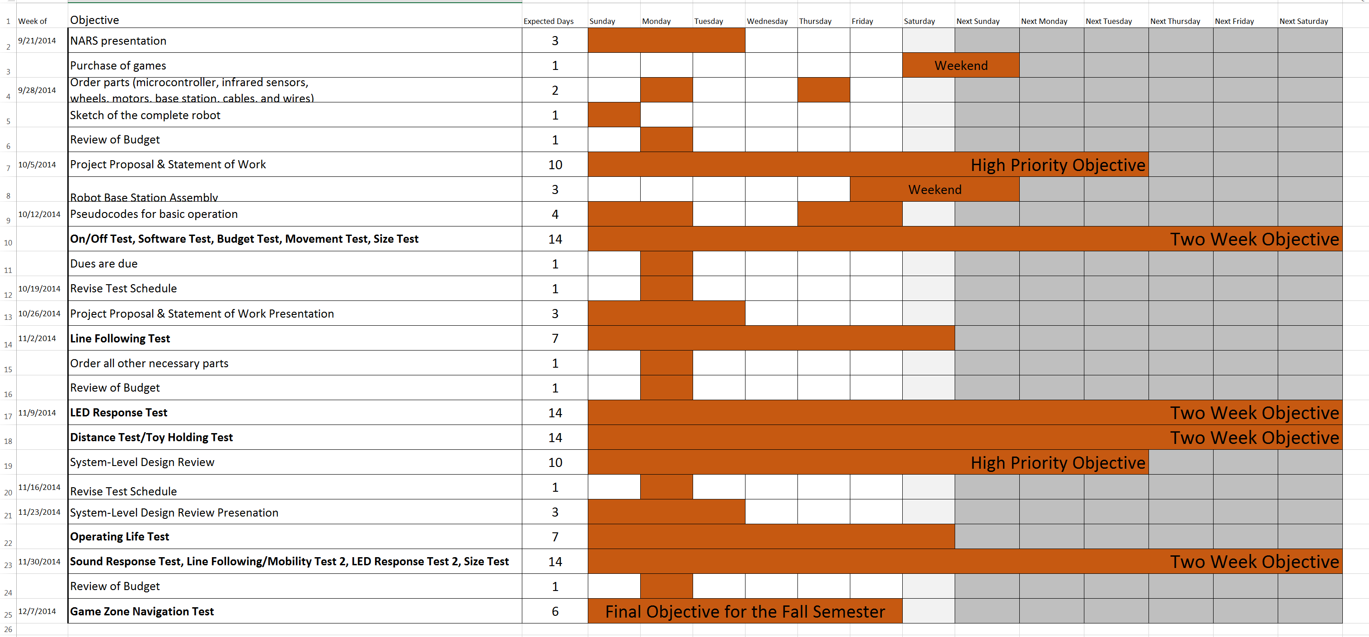
Fall Schedule
Notes:
Louis

Slide 18
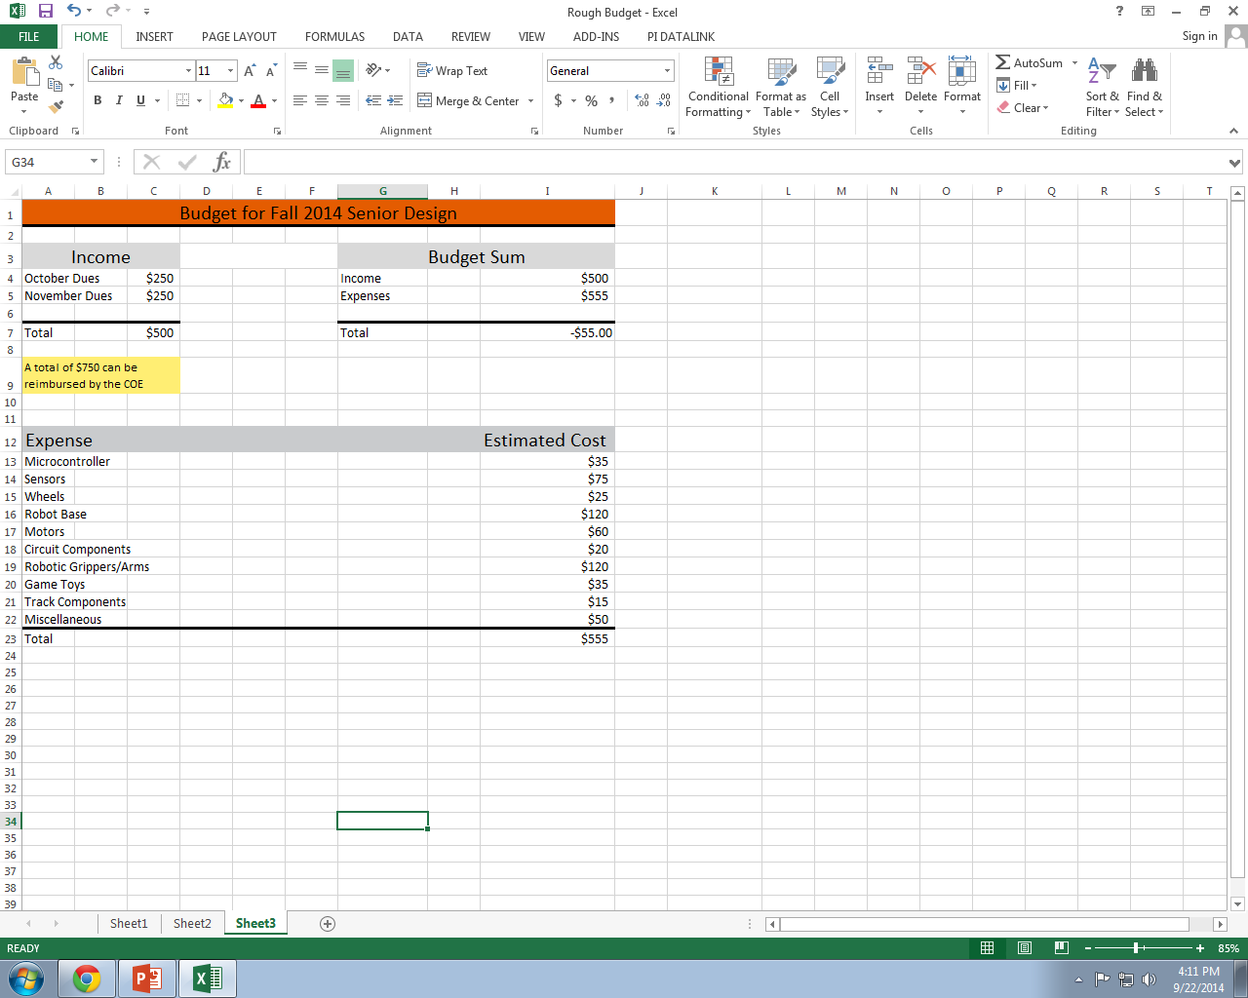
Expected Budget

Slide 19
Risk Assessment
Safety Risk- Electric shock, bodily injury
Financial Risk- Waste of money
Academic Risk- Failing Course

