Slide 1



MILESTONE 2: THE PROPOSAL
SOUTHEASTCON TEAM 1B
Notes:
Chelsea Ogle
Evan Marshall
Ivan Vargas
Lorenzo Smith
Louis Cooper

Slide 2
OVERVIEW
Conceptualization and Design of Major Subsystems
  Microcontroller
  Drive System
  Chassis
  Sensors
  Power Supply
  Gripper/Arm Mechanisms
Risk Assesment
Schedule
Statement of Work
Budget
Deliverables
PRESENTER: LORENZO

Slide 3
LORENZO SMITH - TASK MANAGER/ POWER TECH
Managerial Skills/Qualifications
  Head Resident Assistant- Schedule creator, Community building, Communication, Task management
EEE 3300 Electronics
EEL 3216 Fundamentals of Power
EEL 4351 Solid States
PRESENTER: LORENZO

Slide 4
IVAN VARGAS - MICROCONTROLLER PROGRAMMER
Responsible for code framework
Co-lead with Evan on line-following
Assist with other programming related tasks
Relevant coursework:
  EEL 4746 - Microprocessors
  EEL 4710 - Field Programmable Logic Devices
PRESENTER: IVAN

Slide 5
CHELSEA OGLE -DRIVE SYSTEM
Electrical Engineering Student
Relevant Coursework
  EEE3300 – Electronics
  EGM3512 – Engineering Mechanics
  EEL3216 – Fundamentals of Power Systems
  EEE4351 – Solid State Electronic Devices (In Progress)
PRESENTER: CHELSEA

Slide 6

LOUIS COOPER – ROBOTICS ENGINEER
Electrical Engineering Student
Experience
  First LEGO League Robotics Competition
  DC Electronics for TAMU Trap
Relevant Coursework
  EGM 3512 Engineering Mechanics
  EEL 3216 Fundamentals of Power Systems
  EEE 3300 Electronics
PRESENTER: LOUIS

Slide 7

EVAN MARSHALL - PROGRAMMER AND SENSOR LEAD
Computer Engineering Student
Languages
  C, C++, Assembly Programming Language
Coursework
  COP 3530 Data Structures
  EEL 4710 Introduction to FPLD’s
  EEL 4713 Computer Architecture and Organization
  EEL 4746 Microprocessor Based System Design
PRESENTER: EVAN

Slide 8
MICROCONTROLLER OPTIONS
Micro | Clock speed | Operating voltage | Memory | Pins | Price
Arduino Due | 84 MHz | 3.3 | 512 KB | 68 | $38
Arduino Mega | 16 MHz | 5 | 256 KB | 70 | $50
BeagleBone | 720 MHz | 5 | SD slot | 92 | $89
TI MSP430 Launchpad | 16 MHz | 5 | 16 KB | 14 | $10
STM32 Value Line Discovery | 24 MHz | 3.3 | 128 KB | 64 | $10
PRESENTER: IVAN
Notes:
12 PWM for Due 15 for Mega.TI doesn’t have enough features. Beaglebone way too expensive/complicated. Mega too slow. DUE favorite option. Fast, plenty of memory and ports. Also has a bunch of tutorials available. Talk about placement on chassis.

Slide 9
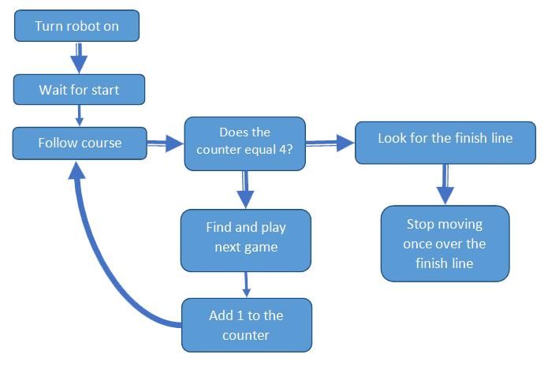
TOP LEVEL
Counter value | Game being played
0 | Simon
1 | Etch-a-Sketch
2 | Rubik’s Cube
3 | Playing card
4 | No game - go to finish
PRESENTER: IVAN
Notes:
Change top level to actual shapes when moving over to powerpoint.

Slide 10
DRIVE SYSTEM TOP LEVEL
MCU/motor controllers
DC Motors
Powered Wheels
Power Supply
 | Forward | Backwards | Left | Right | Sharper Left | Sharper Right
Left Wheel | Forwards On | Backwards On | Off | Forwards On | Backwards On | Forwards On
Right Wheel | Forwards On | Backwards On | Forwards On | Off | Forwards On | Backwards On
PRESENTER: CHELSEA

Slide 11
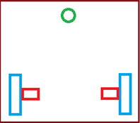
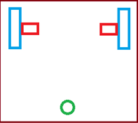
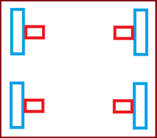
DRIVE SYSTEM - WHEEL CONFIGURATION
 | A | B | C
Pros | less expensive than C, room for arm components | less expensive than C, dragging caster behind | more stable (but 2 casters could just be used), precise
Cons | less stability in front but could add additional caster | less room for arm components in front | additional monetary and power costs
front
PRESENTER: CHELSEA

Slide 12
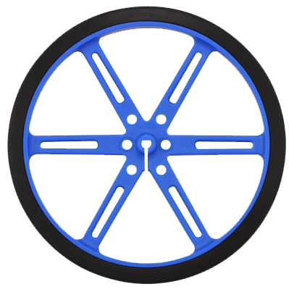
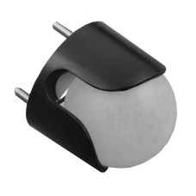
DRIVE SYSTEM - WHEELS CONT.
Two Pololu 90x10mm wheels with tires, one (or two), 1’ caster wheel(s)
PRESENTER: CHELSEA

Slide 13
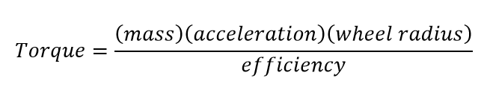
DRIVE SYSTEM - MOTOR CALCULATIONS
Estimating the torque needed as follows:
With mass estimated at 3 kg, acceleration 0.1524 m/s^2, wheel radius, 0.09 m
Most DC brushed motors have efficiency of 68%, efficiency used will be 58% to account for potential frictional forces
Yields necessary torque of 0.0355 kg-m for 3 kg mass estimate
To be safe: estimated mass @ 5 kg necessary torque = 0.118 kg-m
PRESENTER: CHELSEA

Slide 14
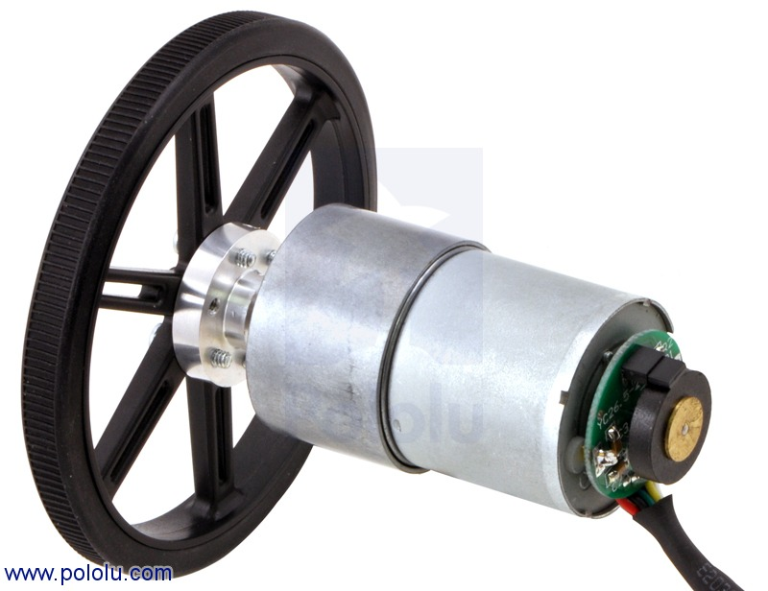
DRIVE SYSTEM - MOTOR SELECTION
Chose 12V DC brushed metal gearmotor with an encoder (over brushless for price, simplicity), each option has 64 CPR encoder
Wheel chosen to go with motor: 90x10mm, shown attached
 | Motor A | Motor B
Gear Ratio | 50:1 | 30:1
Stall Torque (@12V, kg-m) | 0.12 | 0.08
RPM | 200 | 350
Price (USD) | 39.95 | 39.95
PRESENTER: CHELSEA

Slide 15
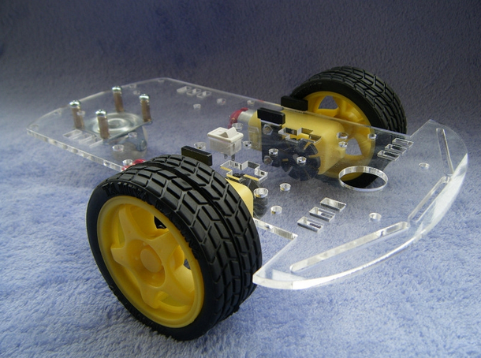
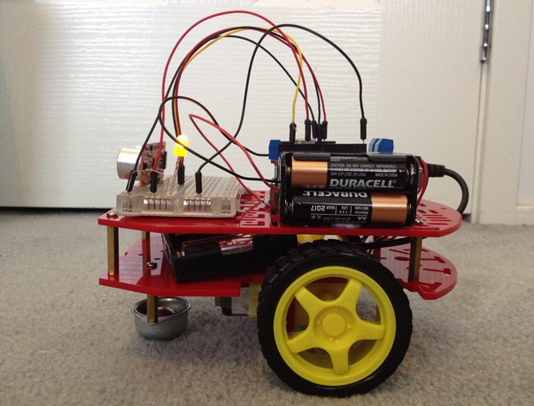
CHASSIS
Plastic or Laser-cut Acrylic
Lightweight and Sturdy
Emphasize speed later on
PRESENTER: EVAN

Slide 16
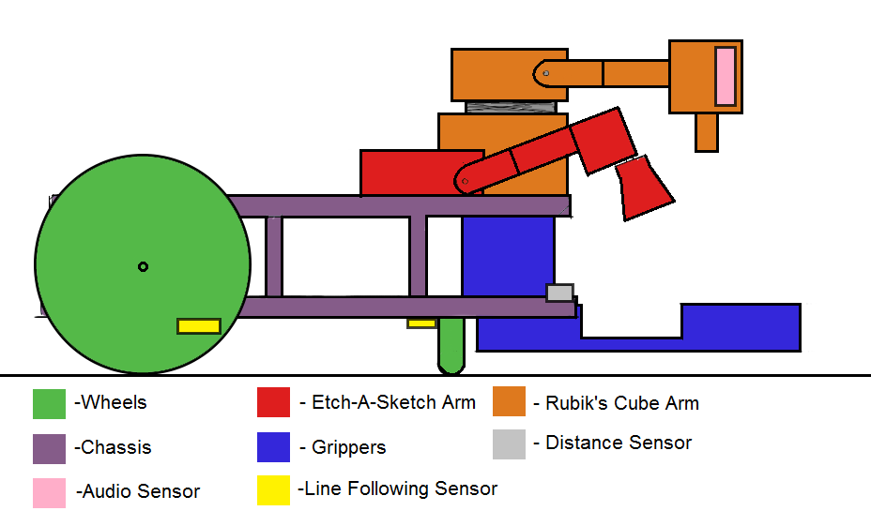
CHASSIS
PRESENTER: EVAN

Slide 17
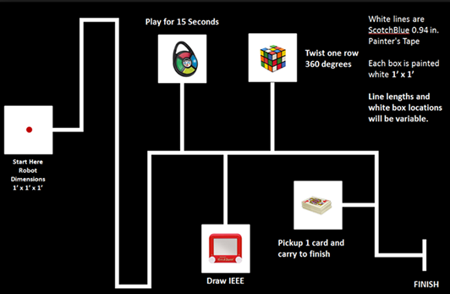
SENSORS
Starting (Red LED detection)
Course Navigation / Line Following
Object Detection
Microphone (Simon)
PRESENTER: EVAN

Slide 18


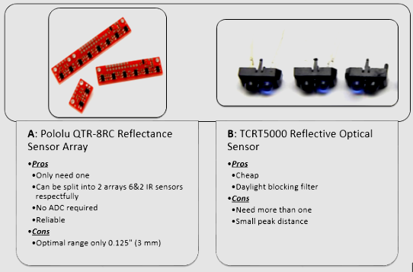
Starting and Navigation
PRESENTER: EVAN

Slide 19
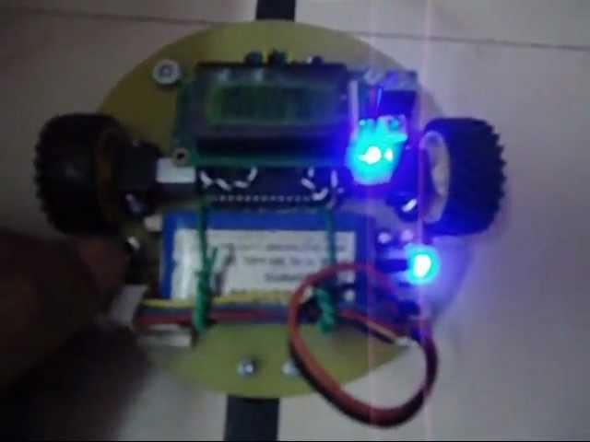
Option A - Pololu QTR-8RC Sensor Array
PRESENTER: EVAN
0:30

Slide 20
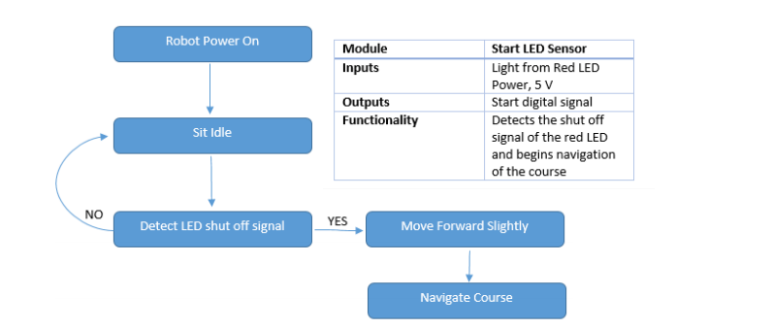
Starting and Navigation
PRESENTER: EVAN

Slide 21

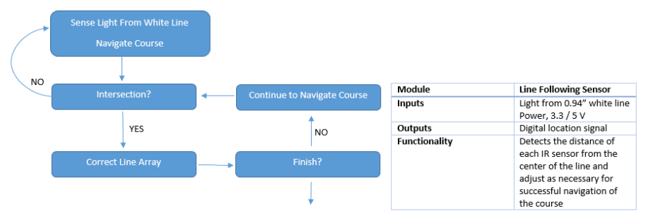
Starting and Navigation
PRESENTER:
EVAN

Slide 22

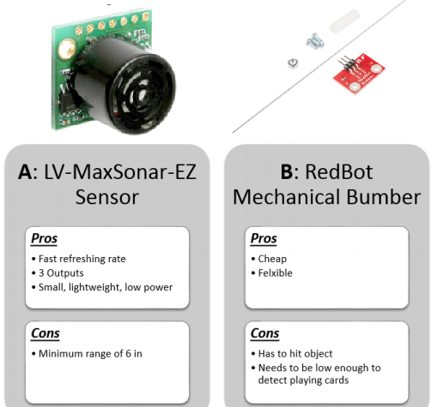
Object Detection
Others
  IR Distance
  Camera
PRESENTER: EVAN

Slide 23
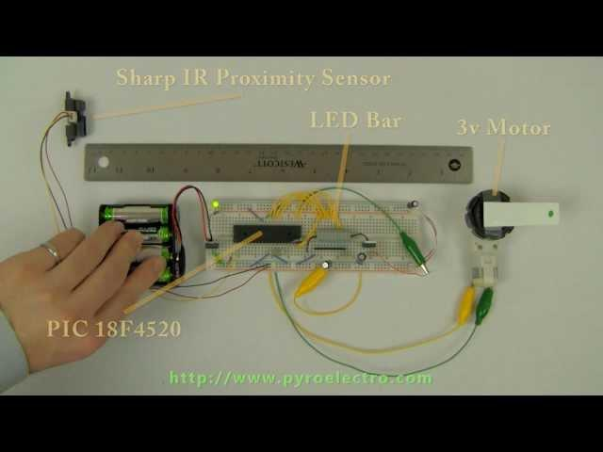
Option A - Distance Sensor
PRESENTER: EVAN
0:30

Slide 24
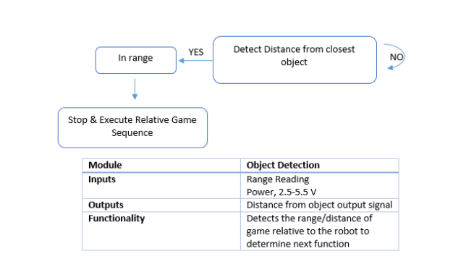
Object Detection
PRESENTER: EVAN

Slide 25

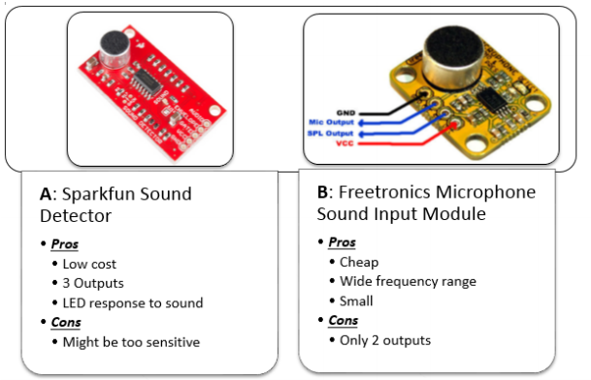
Microphone For Simon
PRESENTER:
EVAN

Slide 26
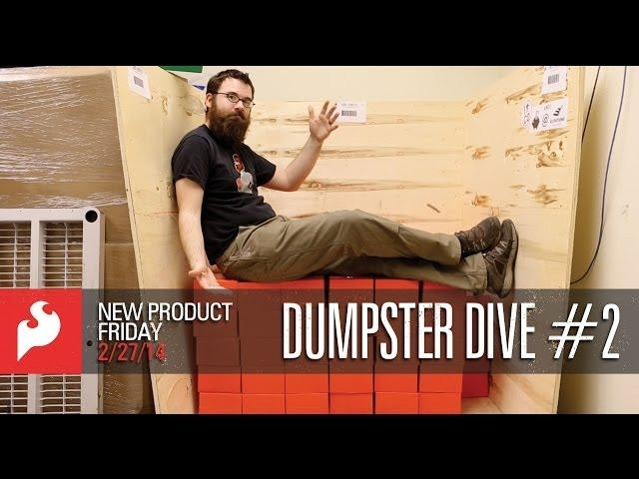
Microphone For Simon
PRESENTER:
EVAN
5:20

Slide 27
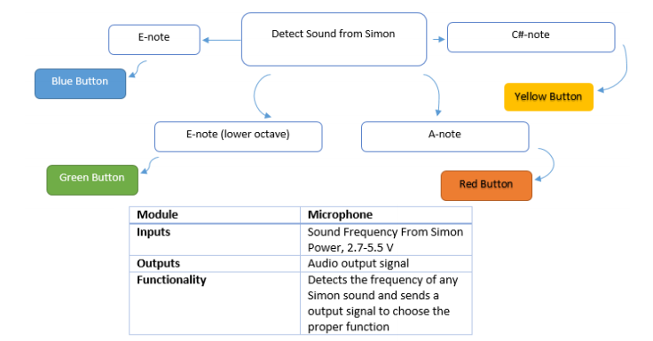
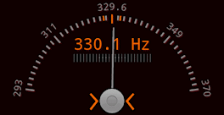
Microphone For Simon
PRESENTER: EVAN

Slide 28
BATTERY
 | Alkaline | Fuel Cell | Lead Acid | Lithium | NiCad | NiMH
Price | Cheap | Expensive | Cheap | Most Expensive | Cheap | Cheap
Power Capacities | Low Power | High Power | Low power | High Power | High Power | High Power
Weight | Heavy | Heavy | Light | Very Light | Light | Light
Replace Expense | Expensive | Expensive | Cheap | Expensive | Cheap | Cheap
Ability to supply large amount of current in small time periods | Bad | Good | Average | Average | Great | Great
Rechargeable | Yes | Yes | Yes | Yes | Yes | Yes
PRESENTER: LORENZO

Slide 29
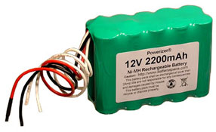
POWER SUPPLY
Batteries
  12 Volt NiMH and 6 Volt NiMH
  Arduino will be acting as a third power source
  One spare for each will be needed
  One charger each
Connection
  Two Solderless breadboards: neat configuration of wires providing power.
  Wires
  Male/Female connectors
PRESENTER: LORENZO
Notes:
More detail systeme analysis will be done with Dr. Pedro Moss, as well as verified by Dr. Jim P. Zheng.
Power Consumptions
Circuit
Any elements needed

Slide 30
BATTERY COMPARISON
12 Volts | Price | Current Output (mAh) | Weight
Battery 1 | $54.95 | 5000 | 283 grams
Battery 2 | $29.95 | 2200 | 997 grams
6 Volts
Battery 1 | $15.15 | 2200 | 142 grams
Battery 2 | $9.95 | 900 | 63 grams
PRESENTER: LORENZO
Notes:
12 Volts Battery 2, 6 Volts Battery 1

Slide 31
ARMS/GRIPPERS
Servos create all of the movements
Custom end pieces need to be manufactured
Sequential programming will position joints and end pieces
PRESENTER: LOUIS

Slide 32
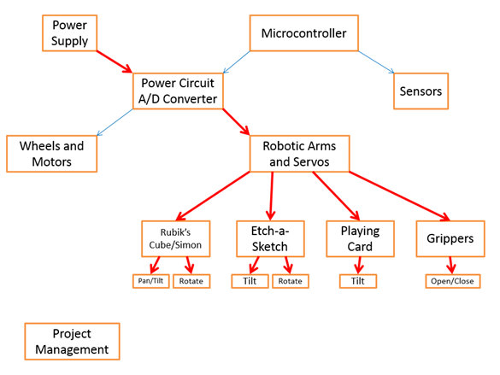
ARMS/GRIPPERS
PRESENTER: LOUIS

Slide 33
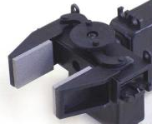
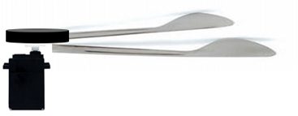
ARMS/GRIPPERS
Curved Brackets
Rotating Plate
Servo
Curved Brackets
Gripping Tongs
Servo
Rotating Plate
PRESENTER: LOUIS

Slide 34
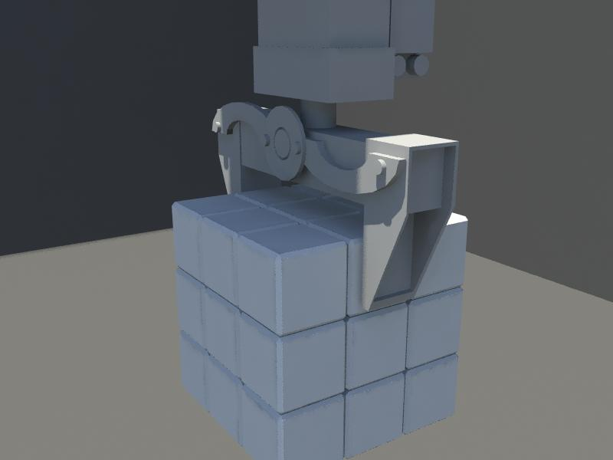
ARMS/GRIPPERS – Rubik’s Cube Option A
The arm will be able to pan, tilt, and rotate using servos and brackets.
Tong shaped end-piece
The alternative approach would be to purchase the (LGK)
PRESENTER: LOUIS

Slide 35
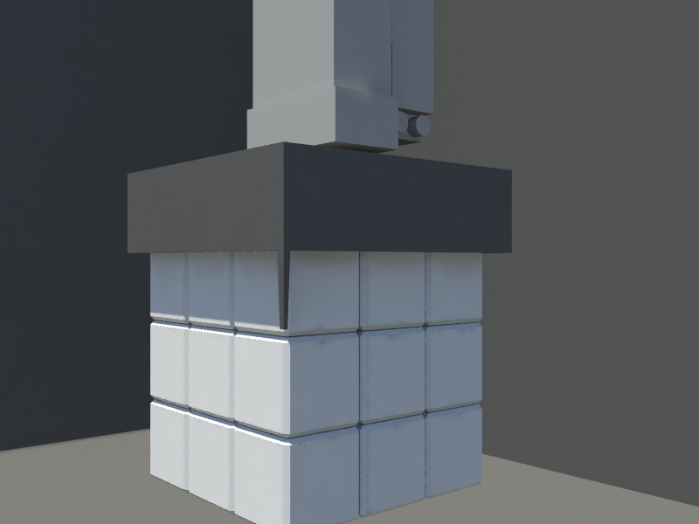
ARMS/GRIPPERS – Rubik’s Cube Option B
Box to twist the top layer of the Rubik’s cube
One edge will be slightly larger to play Simon
Arm mechanics would not change
PRESENTER: LOUIS

Slide 36
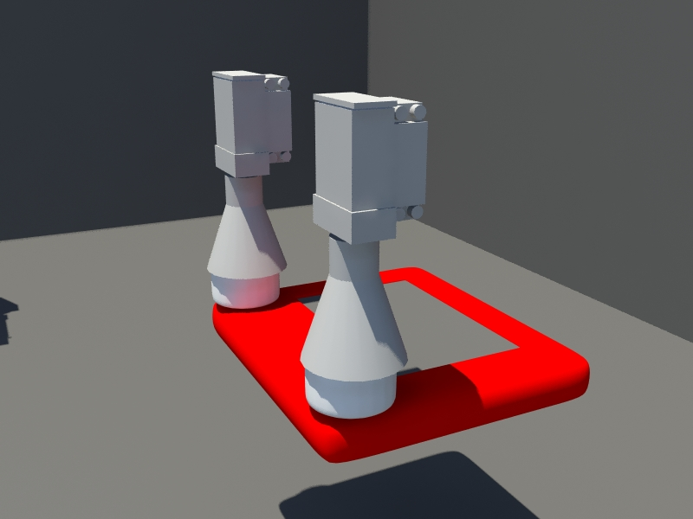
ARMS/GRIPPERS – Etch-A-Sketch Option A
Standard servos will be used for the pan and tilt motion
Special micro servo will be used to create the continuous rotation of the knobs
A subroutine will be used to draw the letters and complete the challenge
PRESENTER: LOUIS

Slide 37
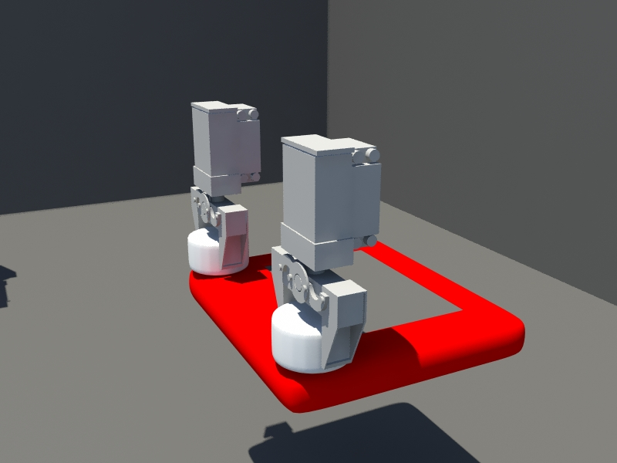
ARMS/GRIPPERS –Etch-A-Sketch Option B
Purchase two (LGNK) kits
Order two continuous rotation motors
More time and work to program the servos
PRESENTER: LOUIS

Slide 38
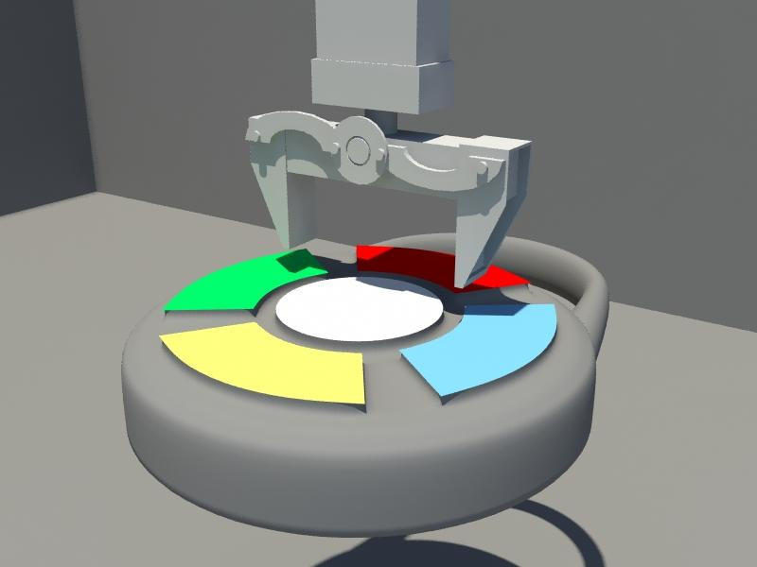
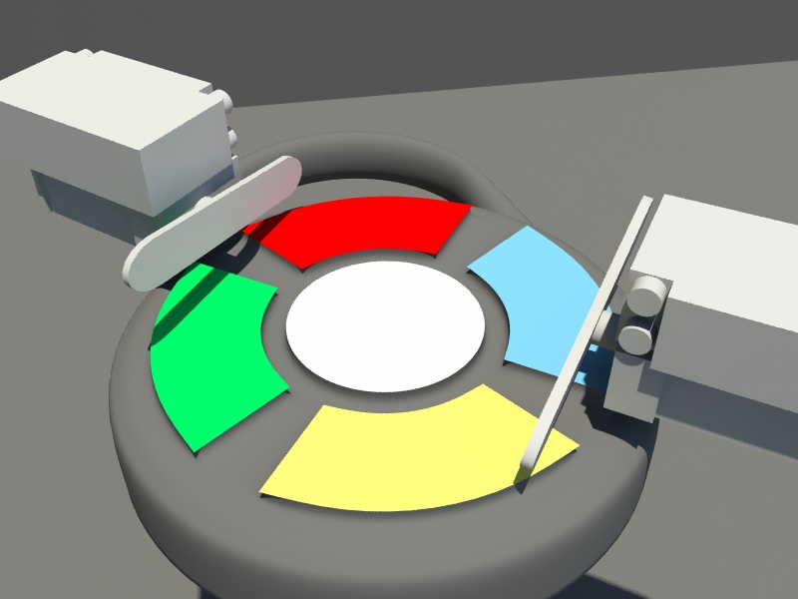
ARMS/GRIPPERS – Simon
Option A
Simon’s buttons will be pushed by the ends of the pair of tongs
The buttons are fairly sensitive, positioning is vital
The microphone and mechanical arm will cooperate
Option B
2 servos and 2 long servo arms
Simple movements
A
B
PRESENTER: LOUIS

Slide 39
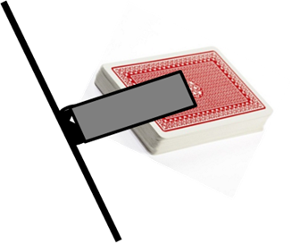
ARMS/GRIPPERS – Playing Card
Option A
Suction cup on the inner brackets of the Rubik’s Cube arm
Option B will also be pursued to ensure a working solution
Option B
Larger suction cup will be attached to the metal surface
Act as a drawbridge
Option B
PRESENTER: LOUIS

Slide 40
RISK ASSESSMENT
Financial
Scheduling Failure
Structural Failure
Software Failure
Line Following System Failure
Gripper/Arm Mechanisms Failure
Audio Sensor Failure
Power System Failure
PRESENTER: CHELSEA

Slide 41
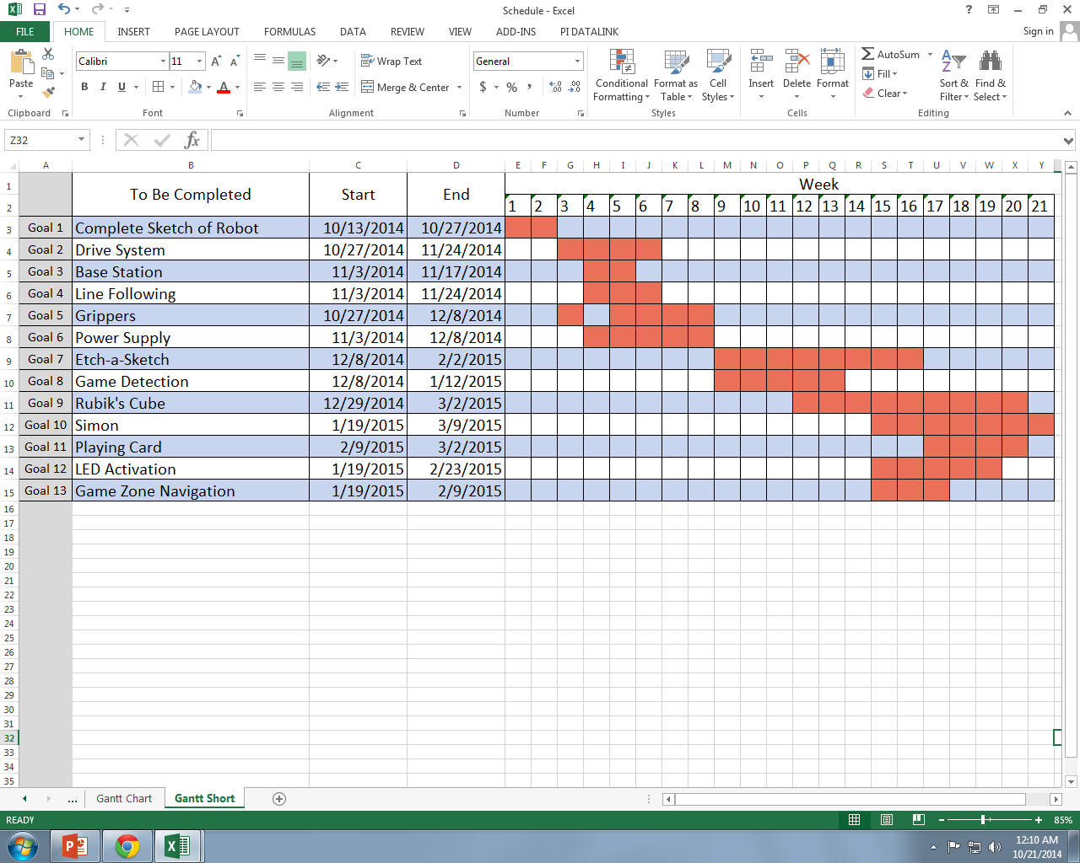
SCHEDULE
PRESENTER: LOUIS

Slide 42
SOW (Statement of Work):
Task 1 Robot Sketch Design
Subtask | People Responsible | Objectives
1.1 Proposed Design | Team | Length, width, and height measurements for robot chassis and extensions
1.2 Dimensional Analysis | Evan Chelsea | Determine the size and weight
1.3 Sketch | Evan Chelsea Ivan | Pencil Sketch Photoshop CS6 (2D) Maya 2014 (3D)
PRESENTER: LORENZO

Slide 43
SOW (Statement of Work):
Task 2 - Drive System
Subtask | People Responsible | Objectives
2.1 Complete Mechanical and Power Analysis | Lorenzo Chelsea | Determine the power needed
2.2 Assemble Parts | Lorenzo Chelsea Evan | ●Test movement of drive train and wheels ●Identify and remove any obstruction
2.3 Complete Hardware Design | Chelsea Lorenzo | Control drive train and wheels using Arduino and temporary power supply
PRESENTER: CHELSEA

Slide 44
SOW (Statement of Work):
Task 3 - Chassis Design
Subtask | People Responsible | Objectives
3.1 Complete Chassis Design | Evan Chelsea | Detailed Schematic of Robot Chassis
3.2 CPU casing and breadboard | Lorenzo Evan | ●Circuit Schematic for microcontroller I/O's ●Detailed Schematic for casing
3.3 Integrate remaining components to chassis | Chelsea Lorenzo Louis | Tighten and secure the electronics for the robot on to the chassis
PRESENTER: CHELSEA

Slide 45
SOW (Statement of Work):
Task 4 - Arms/Grippers
Subtask | People Responsible | Objectives
4.1 Dimensional Analysis | Louis
4.2 Control Servos w/ Arduino | Louis Ivan | Pulse Width Modulation for analog or digital servos
4.3 Manufacture Custom Components | Louis Lorenzo Ivan | Machine the custom end pieces for the proposed design
4.4 Assemble Mechanical Arm | Louis | Build and test for successful operation
4.5 System Integration | Team | Attach to chassis
PRESENTER: LOUIS

Slide 46
SOW (Statement of Work): Task 5 - Sensors
Subtask | People Responsible | Objectives
5.1 Complete Hardware Design | Evan | Arduino interfaces with sensors
5.2 Basic operation of sensors | Evan, Ivan | Subroutines and basic coding for sensors
5.3 Mount Sensors on Chassis and Arms | Evan, Lorenzo | Test for optimal positioning
5.4 Optimize Performance | Evan | Test distance Test sensitivity to color difference Test for pitch and accuracy
5.5 System Integration | Team | Complete Autonomous Robot
PRESENTER: IVAN

Slide 47
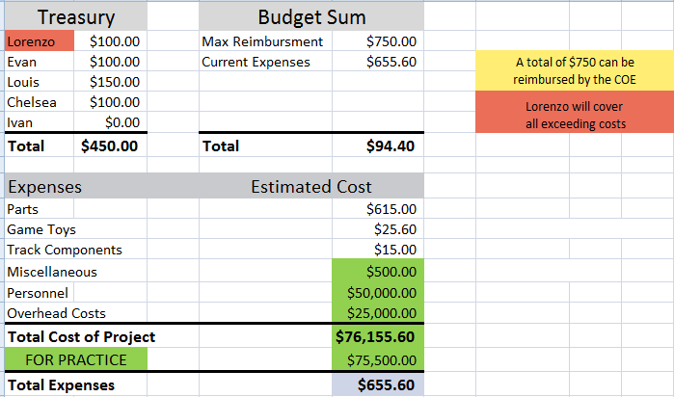
BUDGET ESTIMATE
PRESENTER: LOUIS

Slide 48
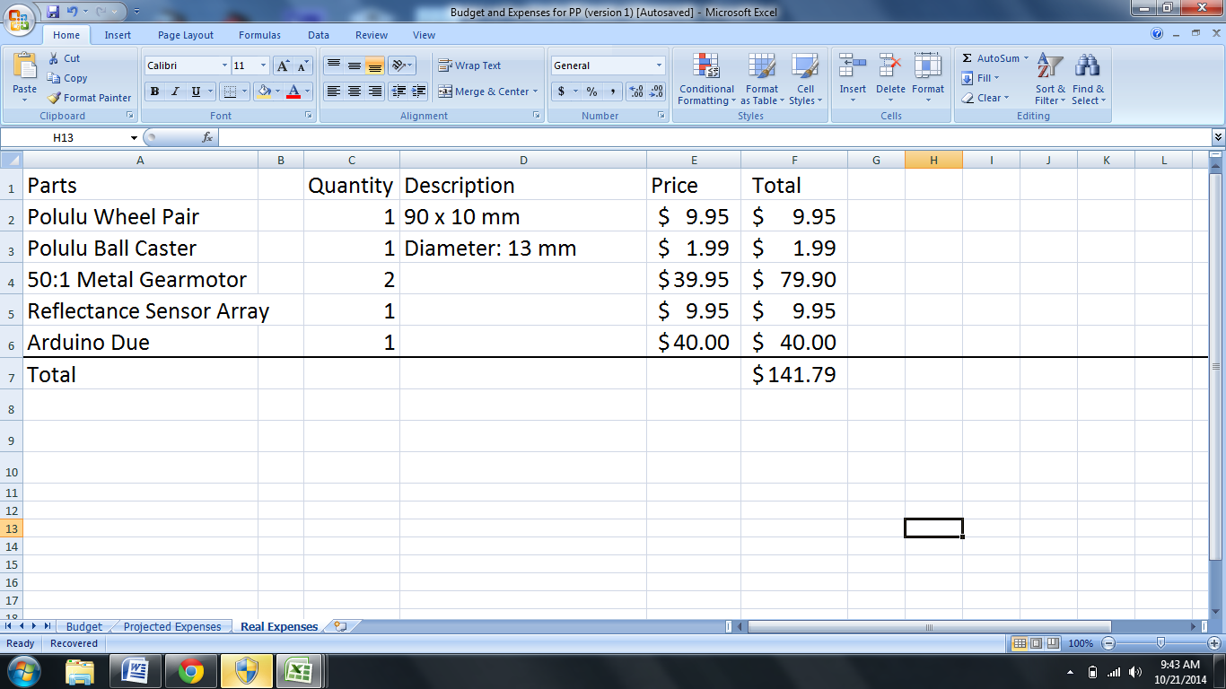
BUDGET ESTIMATE
PRESENTER: LOUIS

Slide 49
DELIVERABLES
Fully autonomous robot that meets all needs and requirements of 2015 SoutheastCon Hardware Competition
  Hardware
  Software
All Milestone Reports and Presentations
Documentation of meetings, design, budget, important subsystem information
PRESENTER: CHELSEA

