Slide 1
Team #12: Energy Management
Project Proposal

Slide 2
Contributors
Advisors
Team Members
Mr. Jim Stephens
Dr. Faruque
Dr. Li
Dr. McGinnis
Dr. Frank
Patrick Dawson
Dallas Prekins
Matt Streich
David Gonsoulin

Slide 3
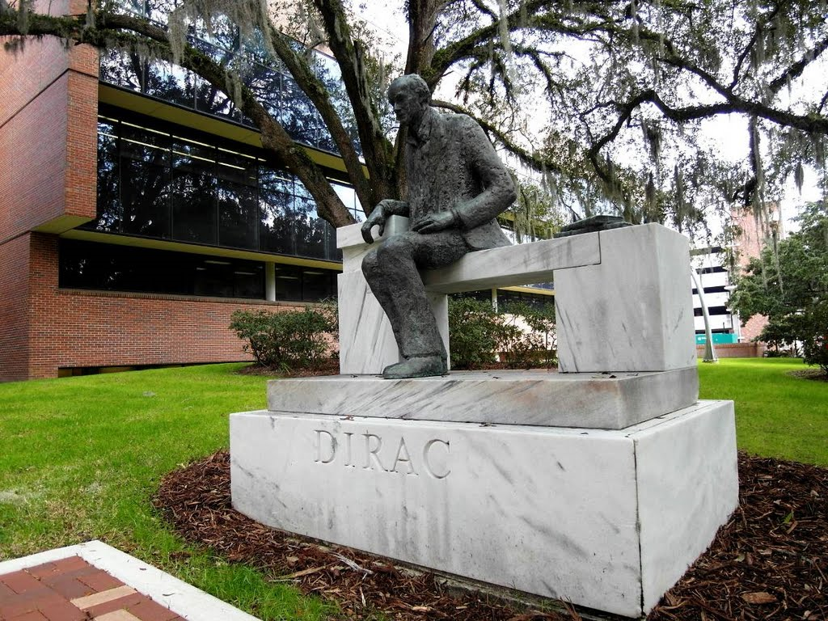
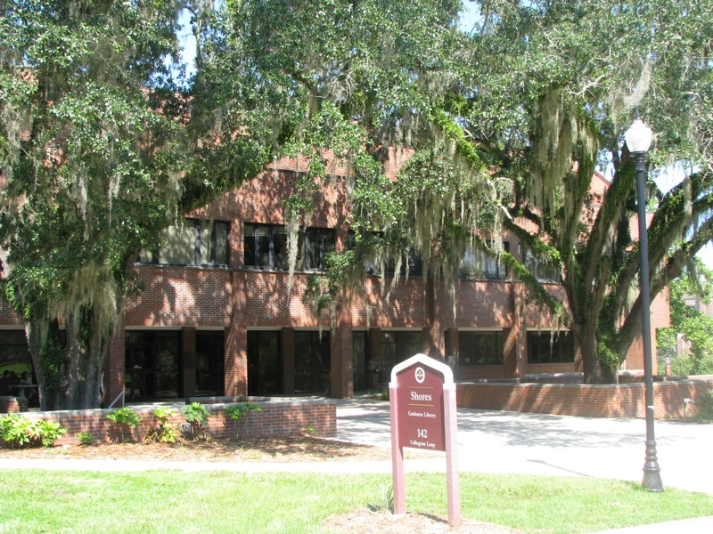
Problem Statement
Design and Implement a cost effective Demand Side Management system
  Reduce Energy Costs
Two Buildings:
      Dirac
      Shores

Slide 4
Intended…
Uses
Users
Reduce costs attributed to energy usage
Monitor different data points
  Temperature
  CO2
  Power Usage
Installed by qualified Company/Individuals
Implemented and Maintained by people with knowledge of FSU Siemens System

Slide 5
Assumptions and Limitations
Assumptions
Limitations
Tariff rate structure will not change
Data received by sensors are correct
Building Environment must be maintained
University receives 7.5% discount for not producing own electricity
  Solar may not be plausible
Critical Loads

Slide 6
End Product
System designed to adapt to a given set of inputs and mitigates the peak demand on a daily basis to reduce costs while maintaining all critical loads.

Slide 7
Concept Generation

Slide 8
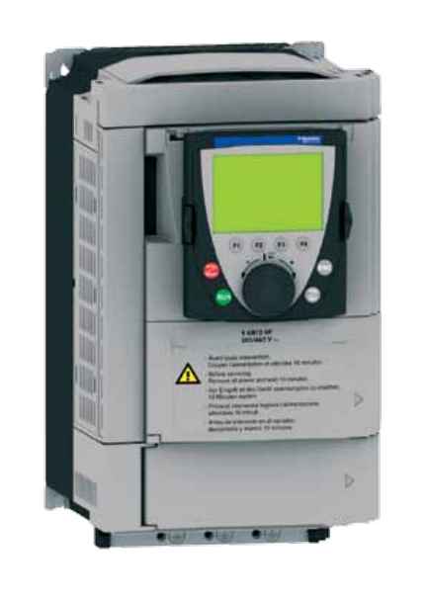
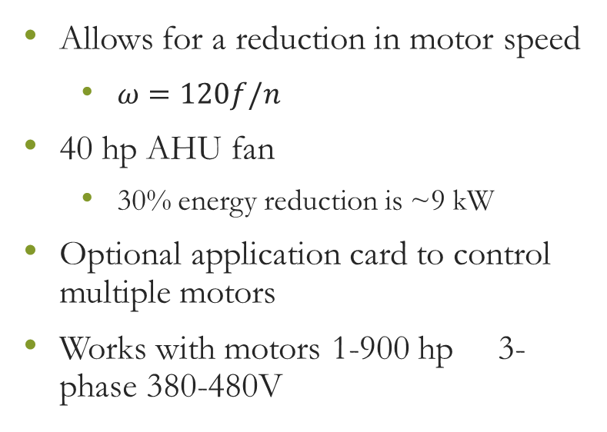
Variable Frequency Drives
Allows for a reduction in motor speed
  $ω=120f/n$
40 hp AHU fan
  30% energy reduction is ~9 kW
Optional application card to control multiple motors
Works with motors 1-900 hp 3-phase 380-480V
Taco-HVAC Advantage 61

Slide 9
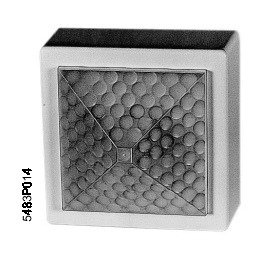
Motion Sensors
Used to determine building occupancy
Can control lighting and HVAC equipment
Can be used in areas where occupants would be seated
Varying delay times depending on level of activity
Siemens QPA82.2

Slide 10
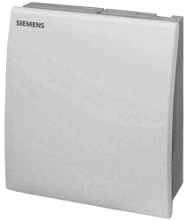
Wall Mounted CO2 Sensors
Detects CO2 ranging from 0 to over 2000 ppm
Gives estimate of number of people in detection area
Provides an air quality analysis
  Gives range for acceptable supply fan reduction
Siemens QPA2000

Slide 11
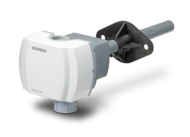
Duct Mounted CO2 Sensors
Same sensing range as wall mounted sensors
Less required since mounted in return ducts
Slightly more expensive per unit
Can be used in areas where occupancy is evenly distributed
Siemens QPM2100

Slide 12
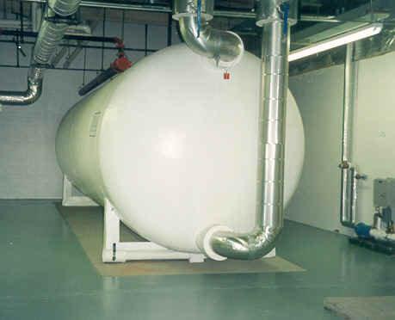
Thermal Storage
Used to store excess chilled water during off-peak hours
Offset demand on AHU’s during peak times
Size can be varied depending on flow rate and duration needed
  30 gpm for 2 hours would need a 3600 gallon tank
Presents a space concern

Slide 13
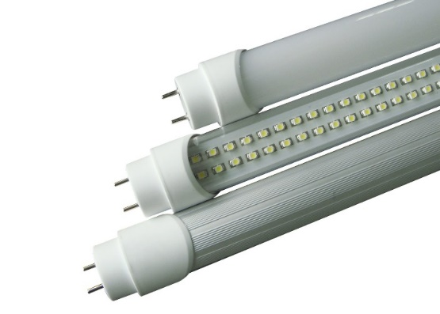
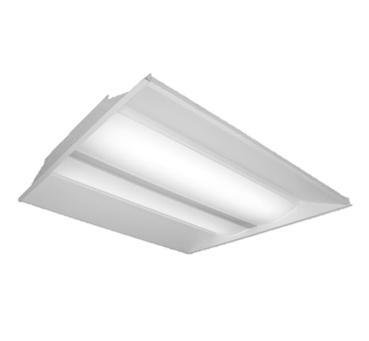
Lighting Renovation
18 W T8 LED bulb comparable to current 25 W bulbs
250 W LED exterior light comparable to 400 W HID or HPS
Can be completed as existing lights go out
Already being implemented in buildings throughout campus

Slide 14
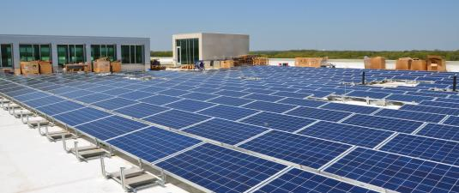
Photovoltaics
Alternative to thermal storage
  Roof area available
Peak production occurs same time as peak consumption
Would need ~50 kW array to offset peak
  Costs $100,000+
Currently too expensive – may be viable later

Slide 15
Proposed Design

Slide 16
Variable Frequency Drives

Slide 17
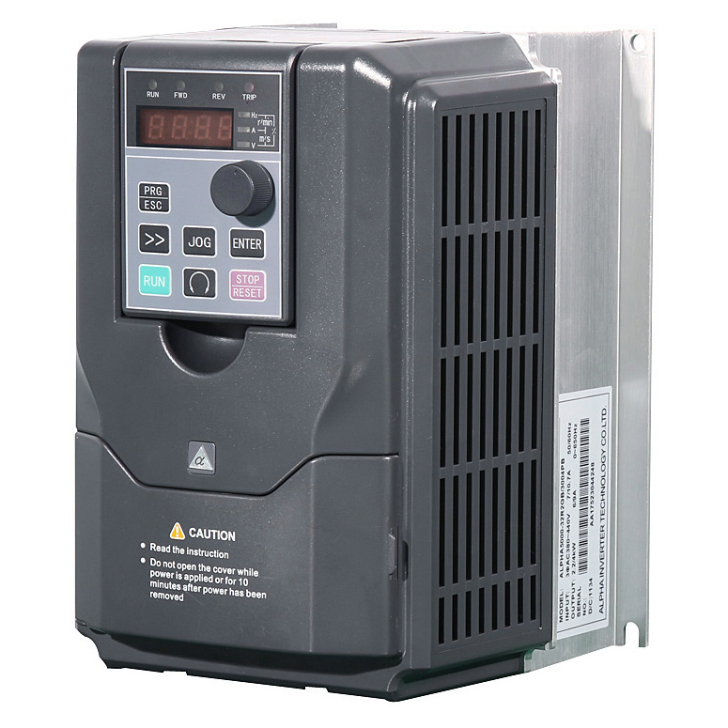
Overall Design and Methodology
Allows reduction of speed for motors when full power is not needed

Slide 18
Outcomes and Contingency Plan
Allow precise control of the motors in the buildings
Reduce energy consumption throughout the day
Enable peak clipping in response to rising demand
Proven to work in other buildings on campus.
Any failure will require a certified technician

Slide 19
Load Scheduling

Slide 20


Overall Design and Methodology
Peak Clipping, load shifting, and conservation will contribute to the Load Scheduling aspect
Implemented through use of sensors and other relevant data
  CO2 Sensors
  Campus wide demand data
  Building demand data
  Temperature sensors

Slide 21
Outcomes and Contingency Plan
Used to help reduce energy usage during peak demand
More accurately measured air quality metric data to better monitor room climate and adjust the ventilation accordingly
Provide approximation of building occupancy
Proven to work in other buildings on campus.
Any failure will require a certified technician to diagnose and fix

Slide 22
Thermal Storage

Slide 23

Overall Design and Methodology
Supply cold water during peak demand times
Reduces energy costs during peak times associated with supplying cold water to the building

Slide 24
Outcomes and Contingency Plan
Consistently reduce the peak demand daily by reducing the areas of energy consumption that deals with producing and pumping cold water.
Provide enough storage to supply the building(s) with cold water during the peak
Use the current water cooling system at main campus to supply the thermal storage system
Proven to work in other buildings on campus.
Any failure in system will require a certified technician to diagnose and fix

Slide 25
Lighting Renovation

Slide 26
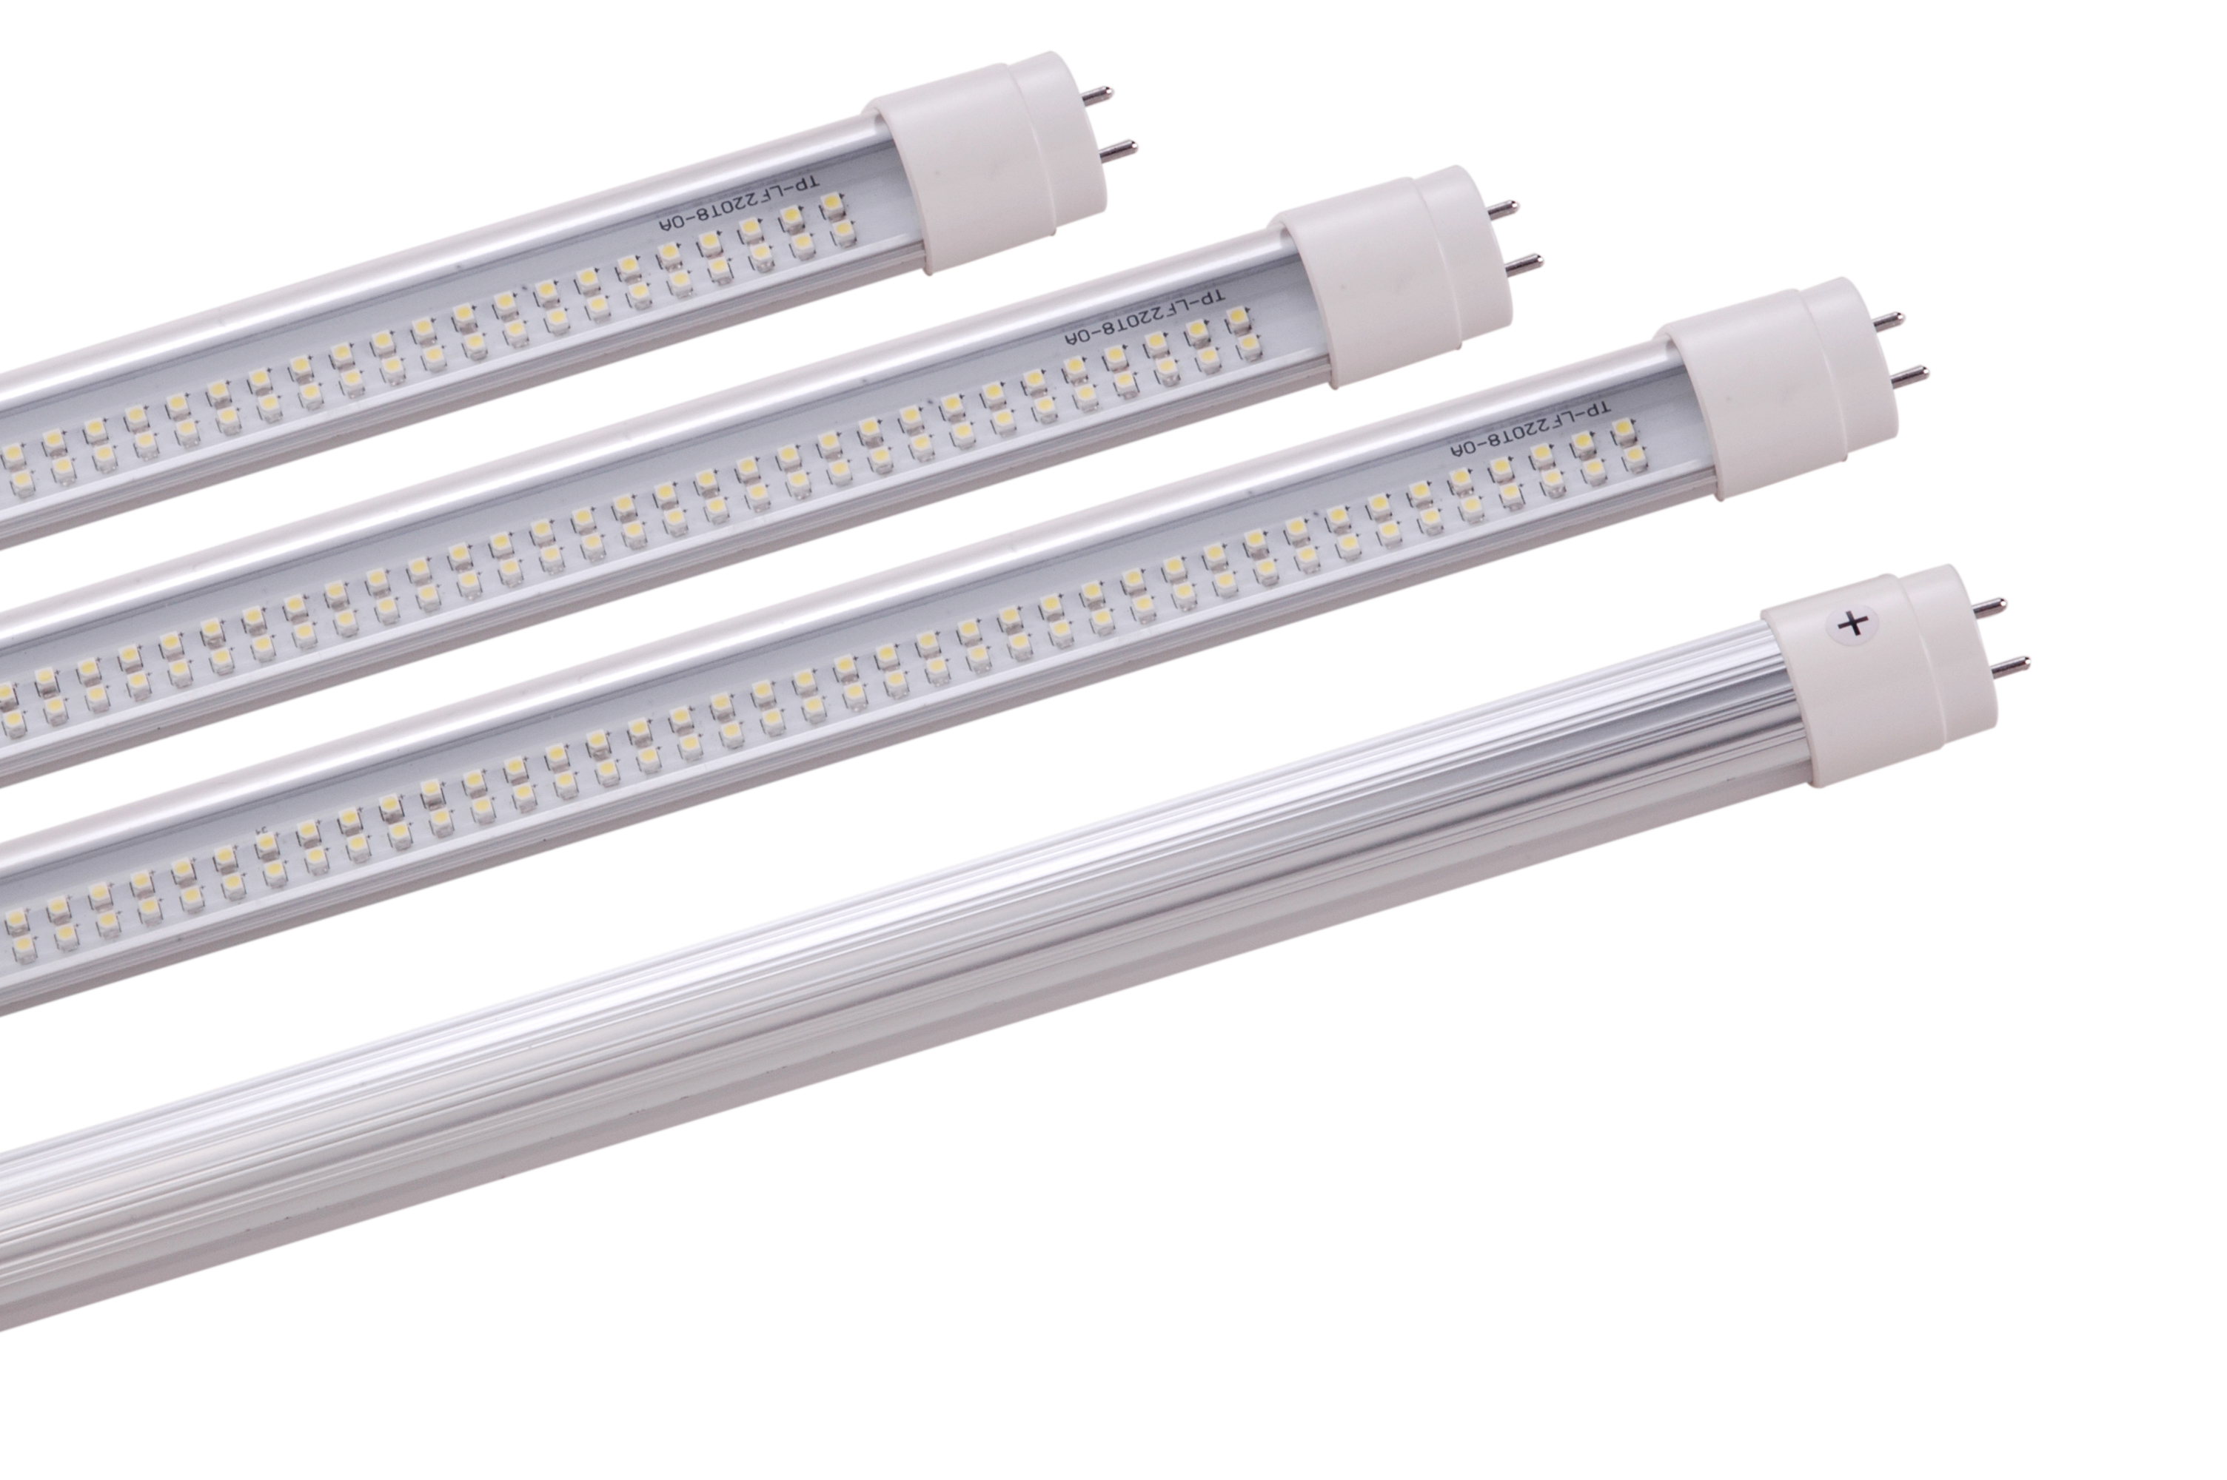
Overall Design and Methodology
Replace fluorescent lighting with more energy efficient LED lighting
Few Options:
  Direct Replacement of current fluorescent bulb
  New ballasts along with new LED tube

Slide 27
Outcomes and Contingency Plan
Reduce the total energy usage by the university and in turn reduce the peak demand
Possibly dim an appropriate amount to reduce energy consumption while maintaining proper lighting requirement
If not cost effective, purchase and installation can be postponed

Slide 28
Statement of Work (SOW)

Slide 29

Contents
Project Management
Research
Design
Implementation
Analysis
Documentation

Slide 30

Project Management
Patrick Dawson: Project Management and Business Analysis
Matthew Streich: Coding and implementation of design blocks with controls engineer
Dallas Perkins: Construction standards and implementation lead
David Gonsoulin: Main researcher and simulator

Slide 31
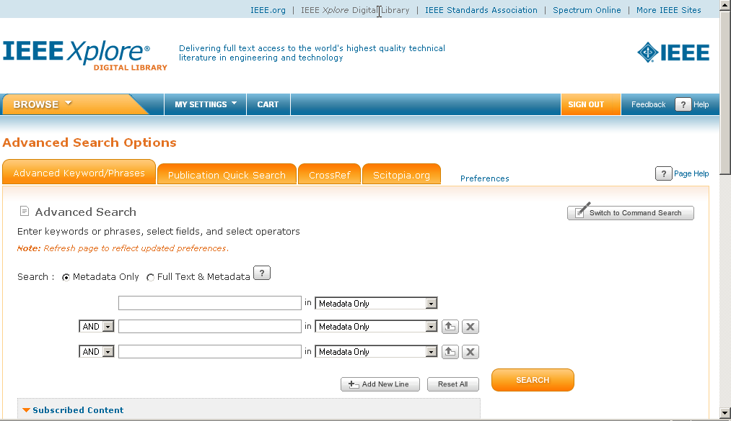
Research
Research Specific Technologies
  IEEE Xplore
  Manufacturer’s Website
Rate Tariffs
  Published rates must be analyzed for most efficient spending

Slide 32
Design
Variable Frequency Drives
  Reduce power consumption by lowering speed of drives when not needed
  Monitor results through adding data points on Siemens system
Load Scheduling
  Identify possible loads to shift and implications caused by rate tariffs
Thermals Storage
  Finically responsible and efficient storage of energy

Slide 33

Design
Lighting Renovation
  Replacement of old bulbs with new LED bulbs when decommissioned
  Dimming switches controlled by Siemens system
Ventilation Control
  CO2 sensors help show necessary ventilation concerns
  Cooling building during off peak hours to mitigate warm up in afternoon

Slide 34

Implementation
Simulation Using MATLAB
  Students create design parameters in MATLAB for review of efficiency
Review Simulation with advisors
Physical Implementation
  Monitor progress to ensure correct hardware installation
Integration with Siemens system
  Verify that installed hardware accurately interacts with Siemens system

Slide 35

Analysis
Economic Impact to University
  Use captured data and compare with historical data from Siemens system
Future Savings
  Forecast the future savings by analysis of rate tariffs
Environmental Impacts
  Compare energy saved to energy consumed in past years
Efficiency of System

Slide 36

Documentation
Course Reports
  Create detailed reports that are necessary for analysis of design
  Present information and design
FEEDER Competition
  More details to come

Slide 37
Risk Assessment, Schedule, Budget, Deliverables
Matthew Streich

Slide 38

Risk Assessment
2 Types
  Physical
    Includes damage to both people and existing expensive equipment
  Administrative
    Includes risks associated with bad management
Can be mitigated through proper safety and planning

Slide 39

Physical Risks
Installation Risk
  Use a licenced electrician for installation
Equipment Risk
  Get design approved by PE, simulate design
Software Failure
  Create test cases for software, prove algorithms created are invariant
Quality of Life (QOL) risks
  Monitor buildings, allow manual override/safeguards against defective sensors

Slide 40
Administrative Risks
Completion Risks
  Use extensive scheduling
  Meet regularly with group/advisors to monitor progress
Cost risks
  Always slightly overestimate the true cost, underestimate savings for a cushion
  Price shop to get best deals

Slide 41

Project Responsibilities
Team Member Key
Member | Key
Patrick Dawson | A
Dallas Perkins | B
Matthew Streich | C
David Gonsoulin | D
Task | Subtask | Title | Team Member(s) | Due Date | Skills and Knowledge
1 |  | Project Management | A | 4/15/2015 | Leadership, Planning, Communication
2 |  | Research | Mainly D A,B,C to a lesser extent | 11/29/2014 | Reading Comprehension, EE background, search engine use

Slide 42
Project Responsibilities (cont.)
3 |  | Design | A,B,C,D | 1/19/2015 | Simulation Software, Critical Thinking, Power Systems, Programming
 | 1 | Variable Frequency Drives(VFD) | B,C | 11/27/2014 | Power Systems, Software
 | 1.1 | Interface VFD with Siemens system | C | 11/5/2014 | Software
 | 1.2 | Monitoring Software | C | 11/9/2014 | Software
 | 2 | Load Scheduling | B | 11/15/2014 | Power Systems
 | 2.1 | Identifying Loads to be shifted | B | 10/31/2014 | Observation
 | 2.2 | Shift Loads | B | 11/15/2014 | Power Systems
 | 3 | Thermal Storage | D | 12/4/2014 | Power Systems, Thermodynamics, Spatial Analysis
 | 3.1 | Analysis of possible locations of tanks | D | 11/11/2014 | Spatial Analysis
 | 3.2 | Scheduling of Storage | D | 12/4/2014 | Thermodynamics, Power Systems
 | 4 | Lighting Renovation | A,B,C | 1/1/2014 | Spatial Analysis, Budgeting, Wiring, Software
 | 4.1 | Updating Lighting | A | 12/20/2014 | Budgeting, Wiring
 | 4.2 | Adding Lighting Motion Sensors | B | 12/1/2014 | Spatial Analysis, Wiring
 | 4.3 | Lighting Control | C | 1/11/2014 | Software, Wiring
 | 5 | Photovoltaics | B,C,D | 1/19/2014 | Software, Power Systems, Energy Storage, Renewable Energy Planning, Budgeting
 | 5.1 | Scouting Possible PV locations | D | 10/31/2014 | Renewable Energy Planning
 | 5.2 | Analysis of Economic Impacts | D | 12/15/2014 | Budgeting
 | 5.3 | Monitoring Software | B,C | 1/19/2014 | Software, Power Systems
 | 6 | Ventilation Control | A,C | 12/31/2014 | Software, Power Systems, Wiring
 | 6.1 | Installing CO2 sensors | A | 12/2/2014 | Power Systems, Wiring
 | 6.2 | Cooling of Buildings during Off-Peak Hours | A,C | 12/25/2014 | Software
 | 6.2.1 | Monitoring Software | A,C | 12/31/2014 | Software

Slide 43
Project Responsibilities (cont.)
4 |  | Implementation | A,B,C,D | 4/1/2015 | Programming, Wiring, Simulation Software(SIMULINK), Power Systems
 | 1 | Simulation | D | 1/31/2015 | SIMULINK
 | 2 | Review of Simulation | B,C,D | 2/5/2015 | Power Systems
 | 3 | Physical Implementation | A | 4/1/2015 | Wiring, Power Systems
5 |  | Integration into Siemens System | B,C,D | 3/17/2015 | Electrician skills, Software Interfaces
 | 1 | Hardware Connections | School-contracted electrician | 3/1/2015 | Electrician skills
 | 2 | Interface Hardware into Siemens System | B,C | 3/5/2015 | Software Interfaces
 | 3 | Add extra controls software | C,D | 3/17/2015 | Software
6 |  | Analysis | A,B,D | 4/1/2015 | Data mining, Budgeting, Environmental Science
 | 1 | Economic Impact to University | A | 1/15/2015 | Budgeting
 | 2 | Future Savings | B | 1/17/2015 | Budgeting
 | 3 | Analyzing Environmental Impact | D | 1/1/2015 | Environmental Science
 | 4 | Measure Efficiency of Installed System | A,B,D | 4/1/2015 | Data Mining
7 |  | Documentation | A,B,C,D | 4/5/2015 | EE background, Programming(for psuedocode), Technical Writing
 | 1 | Course Reports |  | 4/5/2015 | Technical Writing, EE Background, Programming

Slide 44

Schedule
 | ACTIVITY | START | DURATION | START | DURATION | COMPLETE
1 | Project Management | 1 | 35 | 1 |  | 25%
2 | Research | 1 | 12 | 1 |  | 50%
3 | Design | 10 | 11 | 9 |  | 10%
3.1 | Design Variable Freuqency Drives | 10 | 4 | 9 |  | 10%
3.1.1 | Interface VFD with Siemens System | 10 | 2 |  |  | 0%
3.1.2 | Monitoring Software | 12 | 2 |  |  | 0%
3.2 | Load Scheduling | 10 | 3 |  |  | 0%
3.2.1 | Identifying Loads to be Scheduled | 10 | 1 | 9 |  | 5%
3.2.2 | Shifting Loads | 11 | 2 |  |  | 0%
3.3 | Thermal Storage | 10 | 5 |  |  | 0%
3.3.1 | Analysis of Possible Tank Locations | 10 | 2 |  |  | 0%
3.3.2 | Scheduling of Storage | 12 | 3 |  |  | 0%
3.4 | Lighting Renovation | 14 | 6 |  |  | 0%
3.4.1 | Updating Lighting | 14 | 3 |  |  | 0%
3.4.2 | Add Lighting Motion Sensors | 15 | 2 |  |  | 0%
3.4.3 | Lighting Control | 17 | 3 |  |  | 0%
3.5 | Photovoltaics | 12 | 8 |  |  | 0%

Slide 45
Schedule (cont.)
3.5.1 | Scouting Possible PV Locations | 12 | 1 |  |  | 0%
3.5.2 | Analysis of Economic Impacts | 12 | 5 |  |  | 0%
3.5.3 | Monitoring Software | 14 | 6 |  |  | 0%
3.6 | Ventilation Control | 13 | 5 |  |  | 0%
3.6.1 | Plan Where to Install CO2 Sensors | 13 | 3 |  |  | 0%
3.6.2 | Off-Peak Hours Building Cooling | 14 | 2 |  |  | 0%
3.6.3 | Monitoring Software | 13 | 5 |  |  | 0%
4 | Implementation | 20 | 11 |  |  | 0%
4.1 | Simulation | 20 | 3 |  |  | 0%
4.2 | Review of Simulation | 23 | 2 |  |  | 0%
4.3 | Physical Implementation | 25 | 6 |  |  | 0%
5 | Integration into Siemens System | 23 | 8 |  |  | 0%
5.1 | Hardware Connections | 25 | 6 |  |  | 0%
5.2 | 3.1.1 Interface VFD with Siemens System | 27 | 2 |  |  | 0%
5.3 | 3.1.2 Monitoring Software | 29 | 3 |  |  | 0%
6 | Analysis | 13 | 19 |  |  | 0%
6.1 | Economic Impact to the University | 13 | 8 |  |  | 0%
6.2 | Future Savings | 15 | 5 |  |  | 0%
6.3 | Analyzing Environmental Impact | 31 | 1 |  |  | 0%
6.4 | Measure Efficiency of Installed System | 22 | 28 |  |  | 0%
7 | Documentation | 1 | 31 | 1 |  | 10%

Slide 46
Schedule
 |  |  | Plan |  |  | Actual |  |  | % Complete (beyond plan)
 |  |  | % Complete |  |  | Actual (beyond plan) |  |  |  |  |  |  |  | #NAME?
Aug |  | Sept |  |  |  |  | Oct |  |  |  | Nov |  | Dec |  |  |  |  |  | Jan |  |  |  | Feb |  |  |  |  | MARCH |  |  | April
Weeks
1 | 2 | 3 | 4 | 5 | 6 | 7 | 8 | 9 | 10 | 11 | 12 | 13 | 14 | 15 | 16 | 17 | 18 | 19 | 20 | 21 | 22 | 23 | 24 | 25 | 26 | 27 | 28 | 29 | 30 | 32 | 33 | 34 | 35 | 36
1 | Project Management
2 | Research
3 | Design
3.1 | Design Variable Freuqency Drives
3.1.1 | Interface VFD with Siemens System
3.1.2 | Monitoring Software
3.2 | Load Scheduling
3.2.1 | Identifying Loads to be Scheduled
3.2.2 | Shifting Loads
3.3 | Thermal Storage
3.3.1 | Analysis of Possible Tank Locations
3.3.2 | Scheduling of Storage
3.4 | Lighting Renovation
3.4.1 | Updating Lighting
3.4.2 | Add Lighting Motion Sensors
3.4.3 | Lighting Control
3.5 | Photovoltaics
3.5.1 | Scouting Possible PV Locations
3.5.2 | Analysis of Economic Impacts
3.5.3 | Monitoring Software

Slide 47
Schedule
3.6 | Ventilation Control
3.6.1 | Plan Where to Install CO2 Sensors
3.6.2 | Off-Peak Hours Building Cooling
3.6.3 | Monitoring Software
4 | Implementation
4.1 | Simulation
4.2 | Review of Simulation
4.3 | Physical Implementation
5 | Integration into Siemens System
5.1 | Hardware Connections
5.2 | 3.1.1 Interface VFD with Siemens System
5.3 | 3.1.2 Monitoring Software
6 | Analysis
6.1 | Economic Impact to the University
6.2 | Future Savings
6.3 | Analyzing Environmental Impact
6.4 | Measure Efficiency of Installed System
7 | Documentation

Slide 48

Budget Estimate
Personnel | Cost/unit | Total Units | Total Cost
Matthew Streich | $30/hr. | 360 | $10,800
Patrick Dawson | $30/hr. | 360 | $10,800
David Gonsoulin | $30/hr. | 360 | $10,800
Dallas Perkins | $30/hr. | 360 | $10,800
Electrician | $60/hr. | 50 | $3,000
Subtotal A. |  |  | $46,200
Fringe Benefits
 | $46,200 | .29 | $13,398
Subtotal B. |  |  | $59,598
Minor Expenses
LED Lights | $5.00 | 4,000 | $20,000
Subtotal C. |  |  | $79,598

Slide 49
Budget Estimate (cont.)
Overhead costs
 | 9,598 | .45 | $35,819.10
Subtotal D. |  |  | $115,417
Equipment
40 Hp Variable Speed Drive | $5,500 | 2 | $11,000
120 Gallon Water Electricity Storage Tank | $1,600 | 1 | $1600
Siemens Duct-Mounted Sensor | $600 | 10 | $6,000
Motion Sensor | $50 | 200 | $4,000
1 kW Solar Panels | $1,000 | 400 | $400,000
Total Project Cost |  |  | $538,017
Total Projected Cost: $532,017

Slide 50

Deliverables
Report
  Includes all Milestones, figures, drawings
Design
  Includes all documentation and simulation results
Software
  Includes proofs for algorithms and comments, psuedocode, and UML description

Slide 51
References
[1] "Google Shopping." Google Shopping. N.p., n.d. Web. 17 Oct. 2014.
[2] "Download Center V3 Mobile // Version: 3.0.108. 76." Siemens Download Center Mobile. N.p., n.d. Web. 17 Oct. 2014.
[3]"QPA2000." - Building Technologies. N.p., n.d. Web. 17 Oct. 2014.
[4]"QPM2100." - Building Technologies. N.p., n.d. Web. 17 Oct. 2014.
[5]"Taco-Hvac: Advantage 61 Variable Speed AC Drive." Taco-Hvac: Advantage 61 Variable Speed AC Drive. N.p., n.d. Web. 17 Oct. 2014.

