Slide 1
Team #12: Energy Management
System-Level Design Review

Slide 2
Contributors
Advisors
Team Members
Mr. Jim Stephens
Dr. Faruque
Dr. Li
Dr. McGinnis
Dr. Frank
Patrick Dawson
Dallas Perkins
Matt Streich
David Gonsoulin

Slide 3
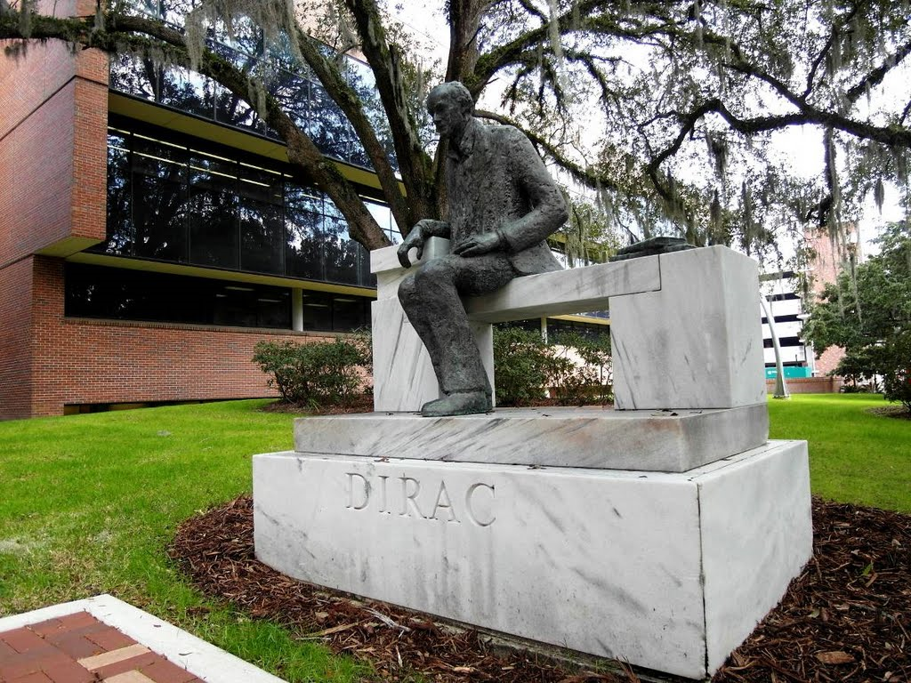
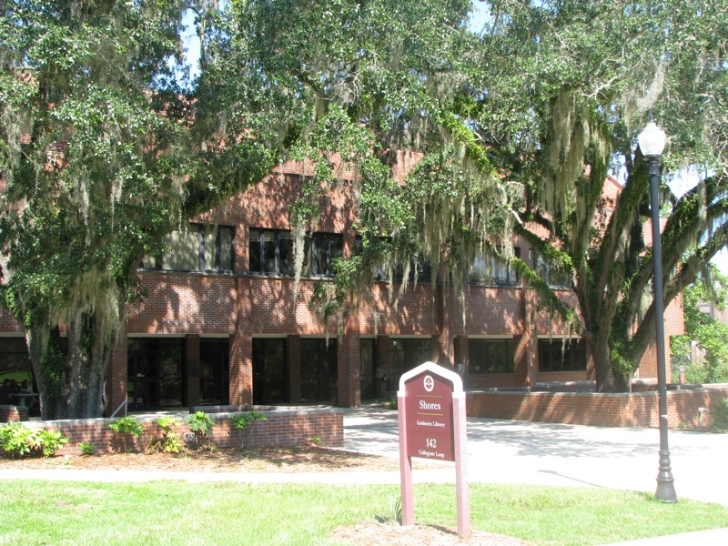
Problem Statement
Design and Implement a cost effective Demand Side Management system
  Reduce Energy Costs
Two Buildings:
      Dirac
      Shores

Slide 4
Intended…
Uses
Users
Reduce costs attributed to energy usage
Monitor different data points
  Temperature
  CO2
  Power Usage
Installed by qualified Company/Individuals
Implemented and Maintained by people with knowledge of FSU Siemens System

Slide 5
Assumptions and Limitations
Assumptions
Limitations
Tariff rate structure will not change
Data received by sensors are correct
Building Environment must be maintained
University receives 7.5% discount for not producing own electricity
  Solar not plausible
Critical Loads

Slide 6
End Product
System designed to adapt to a given set of inputs and mitigates the peak demand on a daily basis to reduce costs while maintaining all critical loads.

Slide 7
System Design

Slide 8
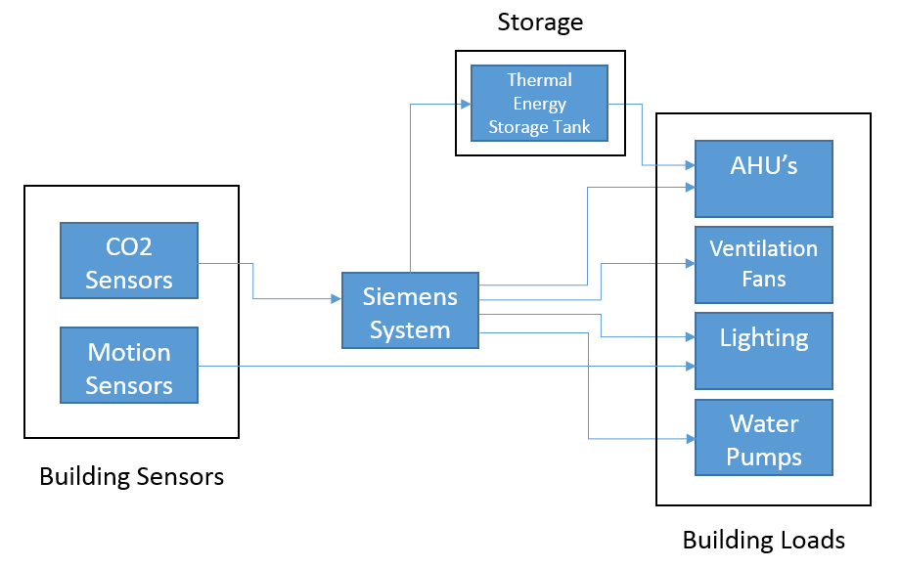
Block Diagram

Slide 9
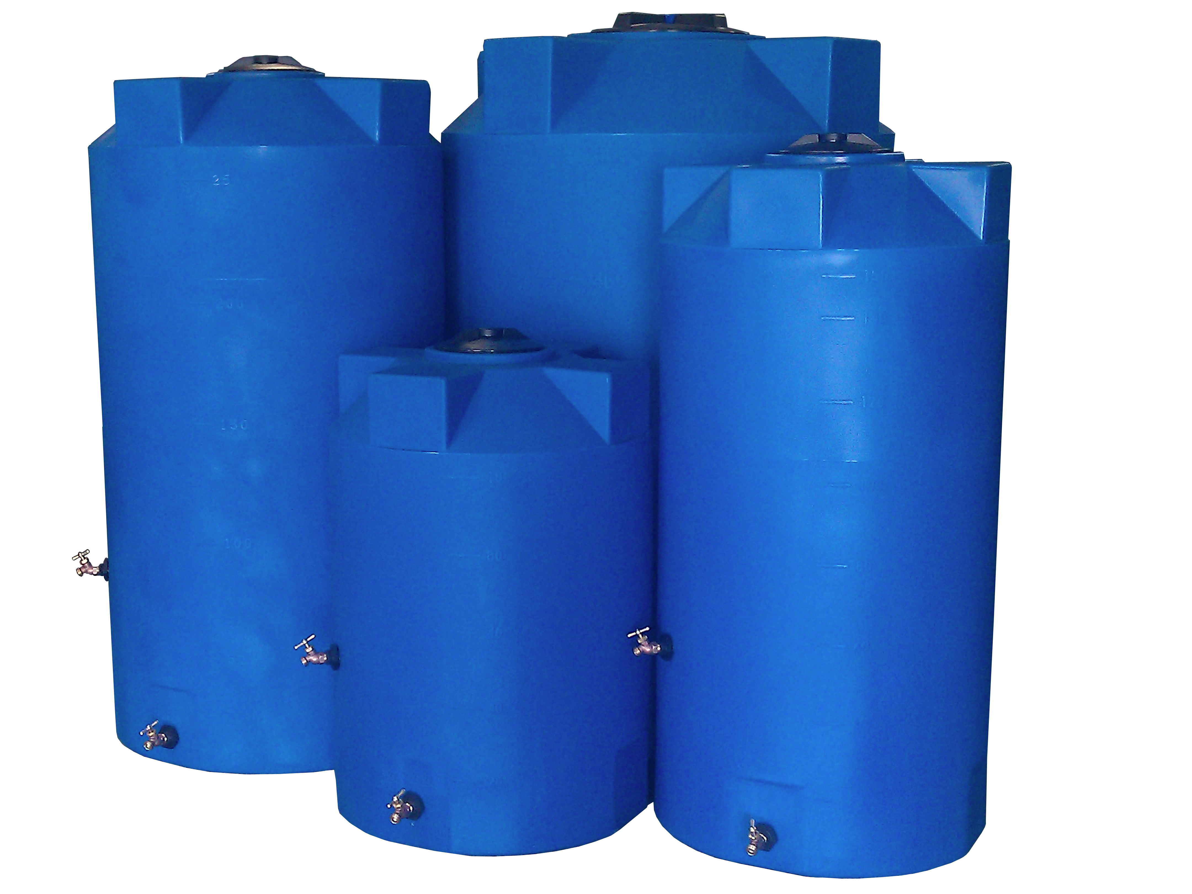
Major Components
Sensors will be responsible for collecting the necessary motion or air quality data to determine the building occupancy
  Motion sensors in hallways and sparsely populated areas to reduce lighting
Storage Tank will act as an “energy storage” device by storing water during non-peak times
  HVAC system will then pull water from the storage tank to maintain the QOL in the building

Slide 10
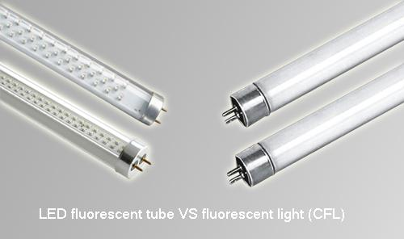
Major Components
Motor Control
  Ventilation motors and water pumps will be upgraded to allow for more precise control of the motors
Lighting system will be slowly upgraded to LED technology
  Will also integrate the motion sensors and dimming capabilities to lower lighting when not needed

Slide 11
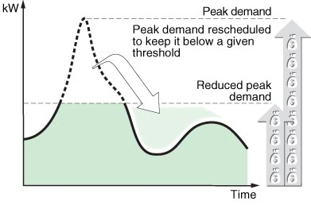
Subsystem Requirements
Variable Frequency Drives
  Interface with Siemens system
  Monitoring output
Load Scheduling
  Analysis of peak and low times of load
  Software must be implemented to track and communicate to schedule loads

Slide 12
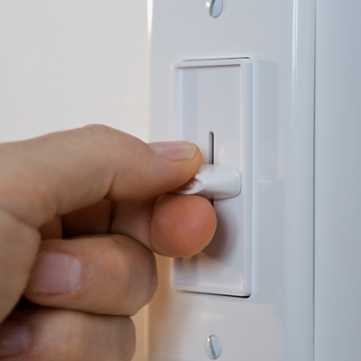
Subsystem Requirements
Thermal Storage
  Scheduling of filling and releasing of cold water for optimal cost advantages
  Monitor water temperature, water level, and flow rate of storage tank
Lighting Renovation
  Motion sensors will be added or optimized to decrease lighting needs throughout the building
  Controlled through dimming switches or through turning off the lighting when areas of a building have sparse occupancy or is not in use

Slide 13
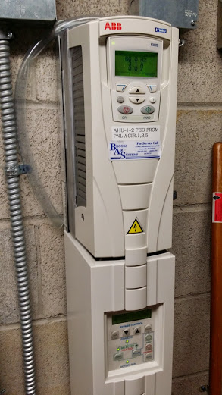
Subsystem Requirements
Ventilation control
  CO2 sensors will provide data to determine the amount of airflow needed
  Variable speed drives will adjust airflow based on CO2 sensors installed
  Track and monitor the data that will be produced from the Siemens system pertaining to ventilation and atmospheric conditions in the building

Slide 14
Performance Assessment
Analyze the amount of power that a specific component will save over the course of each average month
Calculate new costs based off of new peak and total power estimate
Subtract new costs from old costs to determine power saved over an average month.
Estimate how long system will take to pay off itself – if time is ~7 years, then the technique is viable.

Slide 15

Design Process
Need to come up with a Load Scheduling plan
  Must find a way to accurately predict when the daily peak will occur
    This can be done by analyzing old data or even detecting when a peak is approaching on a daily basis
  All lighting, Quality of Life, and critical loads must be maintained
    Need to find the minimum standards for the lighting and quality of life

Slide 16
Design of Major Components/Subsystems

Slide 17
Sensors

Slide 18
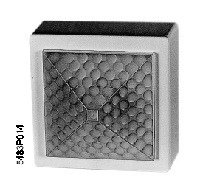
Motion Sensors
Used to determine building occupancy
Can control lighting and HVAC equipment
Can be used in areas where occupants would be seated, such as downstairs Dirac
Varying delay times depending on level of activity
Siemens QPA82.2

Slide 19
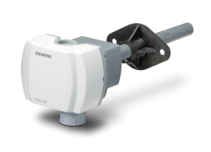
Duct Mounted CO2 Sensors
Same sensing range as wall mounted sensors
Less required since mounted in return ducts
Slightly more expensive per unit
Can be used in areas where occupancy is evenly distributed
Siemens QPM2100

Slide 20
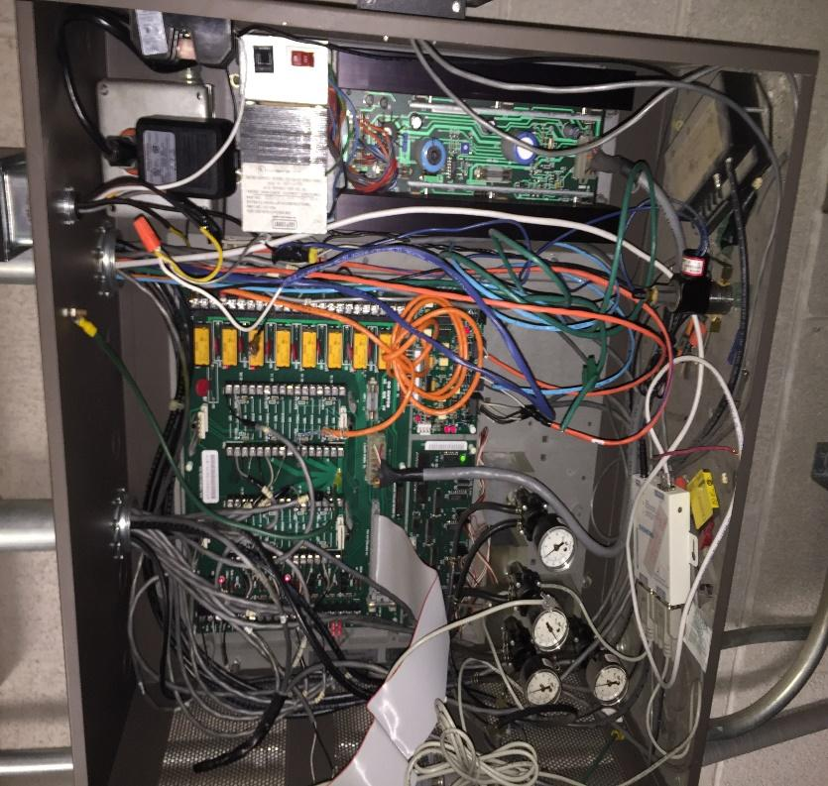
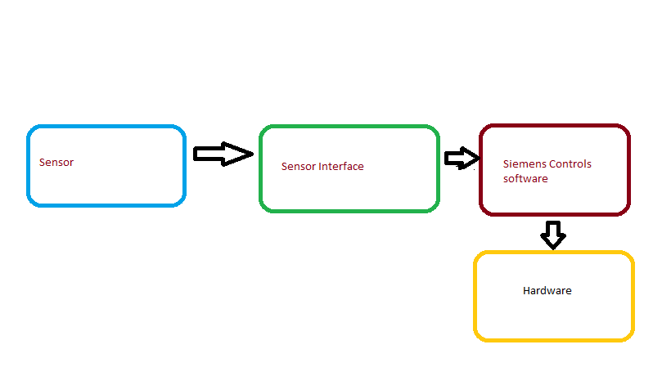
Sensor Interfaces
General design should be consistent between all types of sensors
Must interface with current Siemens system
Will connect through existing siemens ports

Slide 21
Other Major System Components

Slide 22
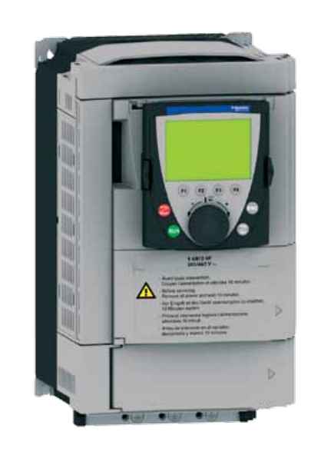
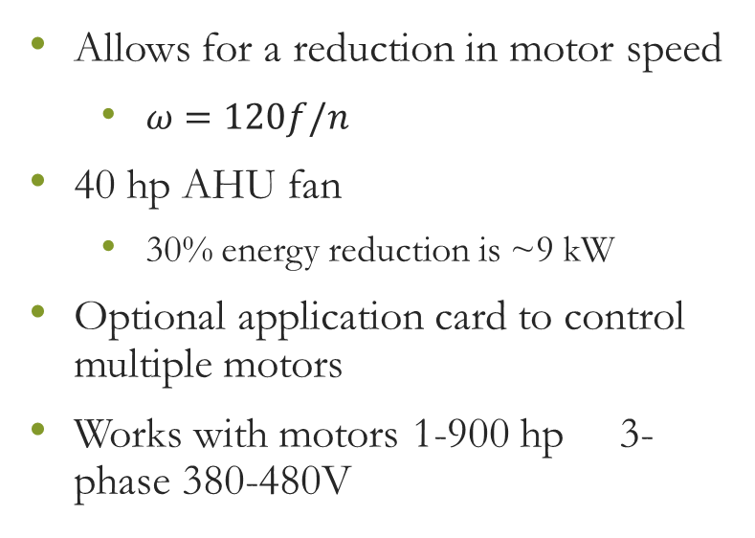
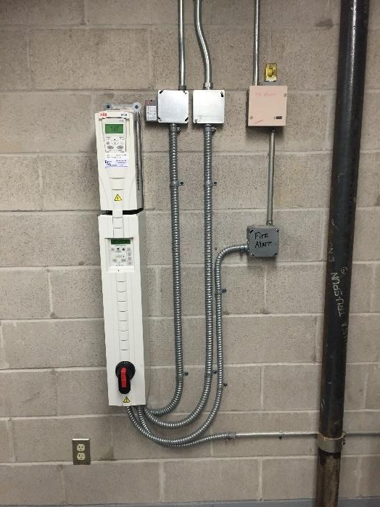
Variable Frequency Drives
Taco-HVAC Advantage 61

Slide 23
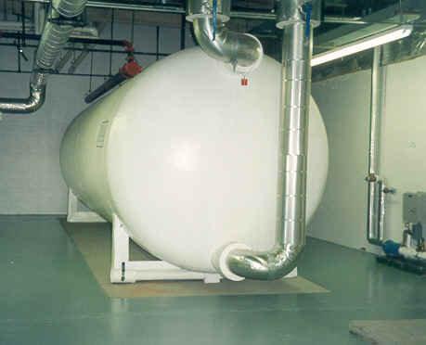
Storage Tank
Used to store excess chilled water during off-peak hours
Offset demand on AHU’s during peak times
Size can be varied depending on flow rate and duration needed
  30 gpm for 2 hours would need a 3600 gallon tank
Presents a space concern
  ~5000 gallon tank has been recommended

Slide 24
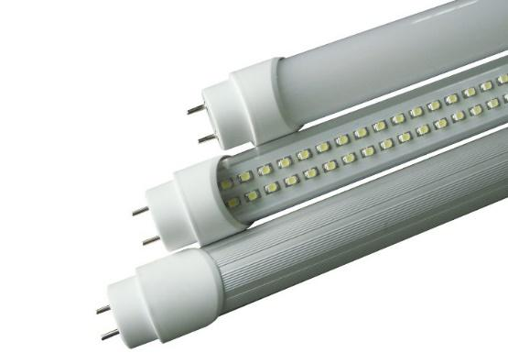
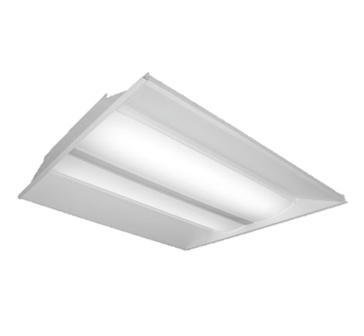
Lighting Renovation
18 W T8 LED bulb comparable to current 25 W bulbs
250 W LED exterior light comparable to 400 W HID or HPS
Can be completed as existing lights go out – full replacement of 2,500 bulbs in Shores and 4,750 bulbs in Dirac would be costly
Already being implemented in buildings throughout campus

Slide 25
Building Layouts

Slide 26
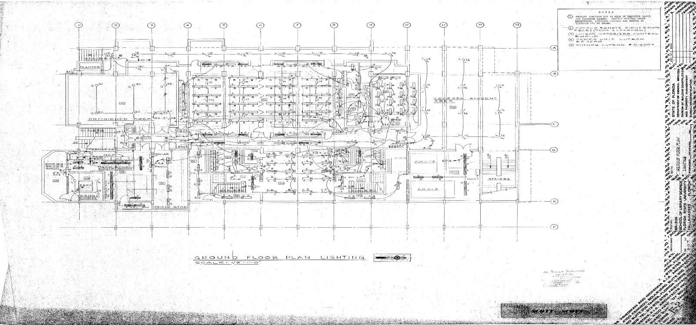
Dirac Lighting Plan

Slide 27
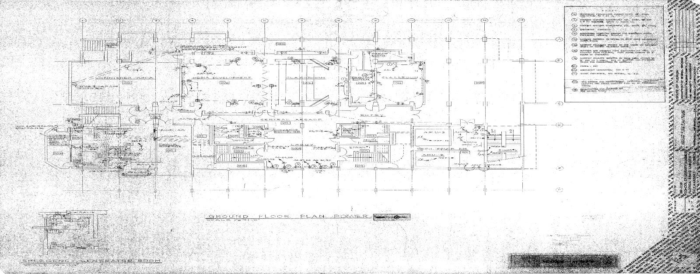
Diric Power Layout

Slide 28
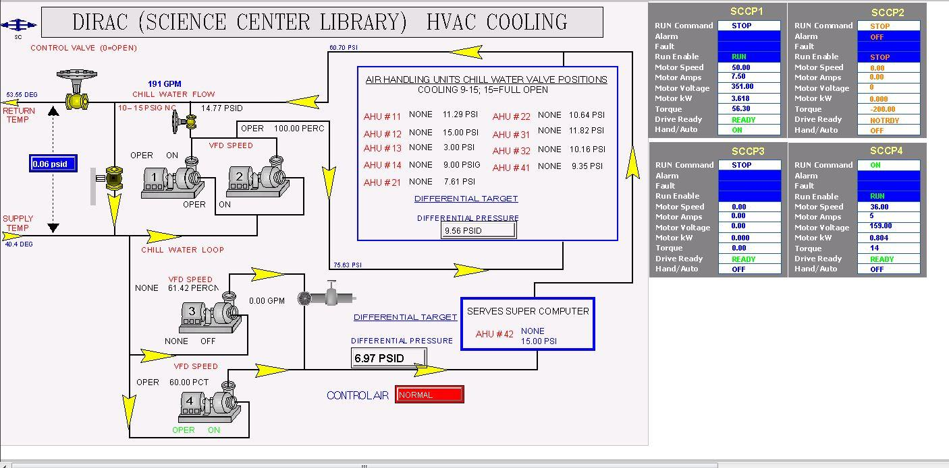
HVAC System Layout

Slide 29
Schedule

Slide 30

Schedule
 | Project 12:
 | Demand-Side Management
 |  | PLAN | PLAN | ACTUAL | ACTUAL | PERCENT
 | ACTIVITY | START | DURATION | START | DURATION | COMPLETE
1 | Project Management | 1 | 35 | 1 | 35 | 45%
2 | Research | 1 | 15 | 1 | 15 | 60%
3 | Design | 10 | 11 | 9 | 9 | 25%
3.1 | Design Variable Freuqency Drives | 10 | 4 | 9 | 9 | 90%
3.1.1 | Interface VFD with Siemens System | 10 | 2 | 11 |  | 10%
3.1.2 | Monitoring Software | 12 | 2 |  |  | 0%
3.2 | Load Scheduling | 10 | 3 |  |  | 0%
3.2.1 | Identifying Loads to be Scheduled | 10 | 1 |  |  | 5%
3.2.2 | Shifting Loads | 11 | 2 |  |  | 15%
3.3 | Thermal Storage | 10 | 5 | 10 | 5 | 15%
3.3.1 | Analysis of Possible Tank Locations | 10 | 2 |  |  | 0%
3.3.2 | Scheduling of Storage | 12 | 3 | 12 |  | 5%
3.4 | Lighting Renovation | 14 | 6 | 10 | 6 | 10%
3.4.1 | Updating Lighting | 14 | 3 | 10 | 3 | 30%
3.4.2 | Add Lighting Motion Sensors | 15 | 2 |  |  | 0%
3.4.3 | Lighting Control | 17 | 3 |  |  | 0%

Slide 31
Schedule (cont.)
3.5 | Ventilation Control | 13 | 5 |  |  | 0%
3.5.1 | Plan Where to Install CO2 Sensors | 13 | 3 |  |  | 0%
3.5.2 | Off-Peak Hours Building Cooling | 14 | 2 |  |  | 0%
3.5.3 | Monitoring Software | 13 | 5 |  |  | 0%
4 | Implementation | 20 | 11 |  |  | 0%
4.1 | Simulation | 20 | 3 |  |  | 0%
4.2 | Review of Simulation | 23 | 2 |  |  | 0%
4.3 | Physical Implementation | 25 | 6 |  |  | 0%
5 | Integration into Siemens System | 23 | 8 |  |  | 0%
5.1 | Hardware Connections | 25 | 6 |  |  | 0%
5.2 | 3.1.1 Interface VFD with Siemens System | 27 | 2 |  |  | 0%
5.3 | 3.1.2 Monitoring Software | 29 | 3 |  |  | 0%
6 | Analysis | 13 | 19 |  |  | 0%
6.1 | Economic Impact to the University | 13 | 8 |  |  | 0%
6.2 | Future Savings | 15 | 5 |  |  | 0%
6.3 | Analyzing Environmental Impact | 31 | 1 |  |  | 0%
6.4 | Measure Efficiency of Installed System | 22 | 28 |  |  | 0%
7 | Documentation | 1 | 31 | 1 | 31 | 25%

Slide 32
Schedule
Fall 2014 |  |  | Plan |  |  | Actual |  |  | % Complete (beyond plan)
 |  |  | % Complete |  |  | Actual (beyond plan) |  |  |  |  |  |  |  | #NAME?
Aug |  | Sept |  |  |  |  | Oct |  |  |  | Nov |  | Dec |  |  |  |  |  | Jan |  |  |  | Feb |  |  |  |  | MARCH |  |  | April
Weeks
1 | 2 | 3 | 4 | 5 | 6 | 7 | 8 | 9 | 10 | 11 | 12 | 13 | 14 | 15 | 16 | 17 | 18 | 19 | 20 | 21 | 22 | 23 | 24 | 25 | 26 | 27 | 28 | 29 | 30 | 32 | 33 | 34 | 35
1 | Project Management
2 | Research
3 | Design
3.1 | Design Variable Freuqency Drives
3.1.1 | Interface VFD with Siemens System
3.1.2 | Monitoring Software
3.2 | Load Scheduling
3.2.1 | Identifying Loads to be Scheduled
3.2.2 | Shifting Loads
3.3 | Thermal Storage
3.3.1 | Analysis of Possible Tank Locations
3.3.2 | Scheduling of Storage
3.4 | Lighting Renovation
3.4.1 | Updating Lighting
3.4.2 | Add Lighting Motion Sensors
3.4.3 | Lighting Control

Slide 33
Schedule
3.5 | Ventilation Control
3.5.1 | Plan Where to Install CO2 Sensors
3.5.2 | Off-Peak Hours Building Cooling
3.5.3 | Monitoring Software
4 | Implementation
4.1 | Simulation
4.2 | Review of Simulation
4.3 | Physical Implementation
5 | Integration into Siemens System
5.1 | Hardware Connections
5.2 | 3.1.1 Interface VFD with Siemens System
5.3 | 3.1.2 Monitoring Software
6 | Analysis
6.1 | Economic Impact to the University
6.2 | Future Savings
6.3 | Analyzing Environmental Impact
6.4 | Measure Efficiency of Installed System
7 | Documentation

Slide 34
Budget

Slide 35
Rough Budget ROI
Item Description | Manufacturer | Per Unit Construction Cost | Quantity | Total Cost | p.u. kW Reduction | Total kW Reduction | Demand Charge Reduction | Kwh Savings per year | Total Savings | Simple Payback (Years)
Variable Frequency Drive (40 hp) | Taco-HVAC | $15,000 | 2 | $30,000 | 4.47 | 8.94 | $49.75 | $3,549 | $4,146.01 | 7.24
Variable Frequency Drive (7 ½ hp) | Taco-HVAC | $10,000 | 2 | $20,000 | 0.839 | 1.68 | $9.34 | $2,841 | $2,953.06 | 6.77
T8 LED Replacements - Shores | Phillips | $20 | 2,460 | $49,200 | 0.007 | 17.22 | $191.66 | $4,726.55 | $7,026.45 | 7.00
T8 LED Replacements - Dirac | Phillips | $20 | 4,742 | $94,840 | 0.007 | 33.19 | $369.45 | $9,111.09 | $13,544.48 | 7.00
5000 gallon thermal storage tank |  | $50,000 | 1 | $50,000 | 57.8 | 57.80 | $643.31 | $1,265.82 | $8,985.59 | 5.56
Duct CO2 Sensors | Siemens | $729.00 | 11 | $8,019
Total |  |  |  | $252,059 |  | 118.83 | $1,263.51 | $21,493.45 | $36,655.59 | 6.88

Slide 36

Budget Estimate
Personnel | Cost/unit | Total Units | Total Cost
Matthew Streich | $30/hr | 360 | $ 10,800
Patrick Dawson | $30/hr | 360 | $ 10,800
David Gonsoulin | $30/hr | 360 | $ 10,800
Dallas Perkins | $30/hr | 360 | $ 10,800
Electrician | $60/hr | 50 | $ 3,000
Subtotal A |  |  | $ 46,200
Fringe Benefits
 | $ 46,200 | 0.29 | $ 13,398
Subtotal B |  |  | $ 59,598
Overhead Costs
 | $ 59,598 | 0.45 | $ 26,819
Subtotal C |  |  | $ 86,417

Slide 37
Budget Estimate Cont.
Equipment | Cost/unit | Total Units | Total Cost
40 Hp Variable Speed Drive | $ 15,000 | 2 | $ 30,000
7.5 Hp Variable Speed Drive | $ 10,000 | 2 | $ 20,000
5000 Gallon Thermal Storage Tank | $ 50,000 | 1 | $ 50,000
LED Replacement Tube | $ 20 | 7,202 | $ 144,040
Duct-Mounted CO2 Sensor | $ 729 | 11 | $ 8,019
Motion Sensor | $ 50 | 200 | $ 10,000
Total Project Cost |  |  | $ 348,476

Slide 38
Risk Assessment

Slide 39

Technical Risks
Installation risk
  Handling of high voltages, dangerous equipment
  Leaks or other efficiency losses throughout system
Load/equipment damage
  Disconnecting power to certain areas could disrupt loads
Software error
  Need to ensure all programs function for all possible ranges of parameters
Quality of Life risks

Slide 40

Scheduling Risks
Completion risks
  Requires proper scheduling and communication with advisors
Installation time
  Time required to contract out work
  Allow for extra time in design schedule
Equipment malfunction/failure
  Delay for replacement

Slide 41

Budget Risks
Equipment cost
  Inaccurate pricing information
  Go through FSU for best available price
Installation cost
  Competitive bidding
  Use of in-house employees

Slide 42
Conclusion

Slide 43
Conclusion
Most major choices have already been decided
Software components are next focus
  Used for controlling load scheduling
Thermal storage tank space availability needs analysis
Motion Sensor locations need to be determined
Hopeful for implementation in spring semester
  Quantitative savings analysis

