Slide 1
Team #12: Energy Management
Detailed Design Review and Test Plan

Slide 2
System Design
Presented By David Gonsoulin

Slide 3
Block Diagram

Slide 4
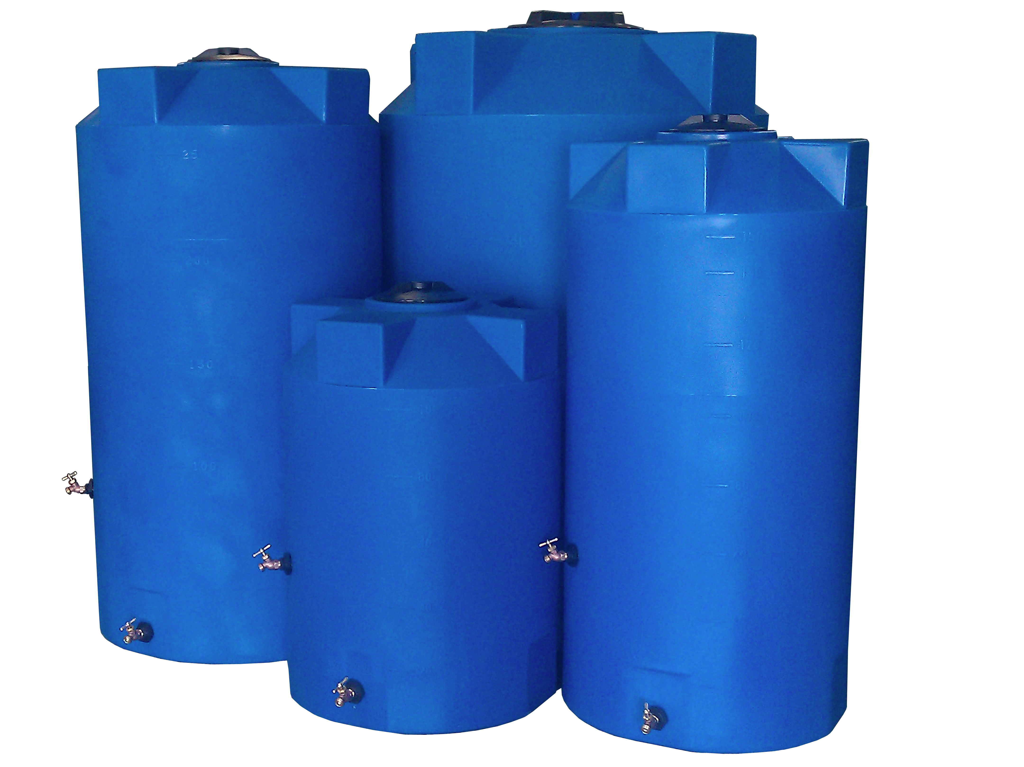
Major Components
Sensors will be responsible for collecting the necessary motion and air quality data to determine the building occupancy
  Motion sensors in hallways and sparsely populated areas to reduce lighting
  Photo Sensors will be installed on second floor along the windows to determine amount of light inside the building
  CO2 Sensors
Storage Tank will act as an “energy storage” device by storing water during non-peak times
  HVAC system will then pull water from the storage tank to maintain the QOL in the building
  May be part of a future project; not viable in current time frame of project

Slide 5
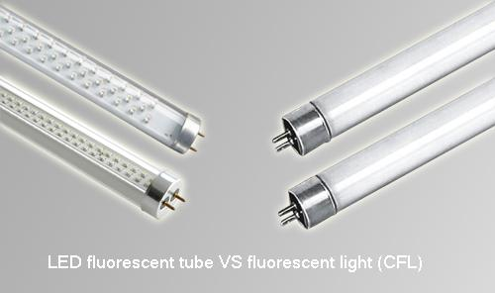
Major Components
Motor Control
  Ventilation motors and water pumps will be controlled to allow for more energy savings
Lighting system will be slowly upgraded to LED technology
  Will also integrate the motion sensors and dimming capabilities to lower lighting when not needed
  This aspect is still being discussed with Utility Department

Slide 6
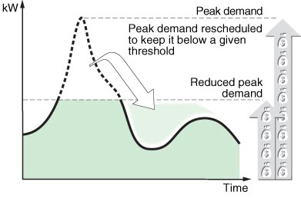
Subsystem Requirements
Variable Frequency Drives
  Interface with Siemens system
  Monitor output
Load Scheduling
  Use of peak and trough times of energy usage
  Software must be implemented to track usage, respond to the real-time data, and communicate to the loads

Slide 7

Subsystem Requirements
Lighting Renovation
  Motion sensors will be added and/or optimized to decrease lighting needs throughout the building
  Controlled through turning off the lighting when areas of a building are not in use

Slide 8
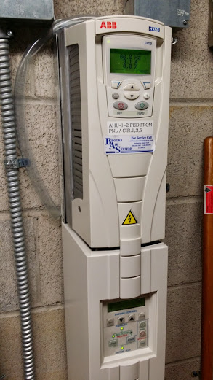
Subsystem Requirements
Ventilation control
  CO2 sensors will provide data to determine the amount of airflow needed
  Motion sensors will also provide occupancy data
  Variable speed drives and electronic dampers will adjust airflow to different areas of building based on data from CO2 and motion sensors installed

Slide 9
Performance Assessment
Analyze the amount of power that a specific component will save over the course of each average month
Calculate new costs based off of new peak and total power estimate
Subtract new costs from old costs to determine power saved over an average month.
Estimate how long system will take to pay off itself – if time is ~7 years, then the technique is viable.

Slide 10

Design Process
Things to consider:
Need to come up with a Load Scheduling plan
  Many aspects are implemented in various buildings throughout campus
    Use these buildings as a template
  This can be done by analyzing old data or even detecting when a peak is approaching on a daily basis
  All lighting, Quality of Life, and critical loads must be maintained

Slide 11
Design Process Cont…
LED Lighting
  Still possible to implement a replacement plan?
    Ballasts need replacing?
Thermal Storage Tank
  Do costs outweigh benefits?
  Need to talk to current controls engineer about current system installed in AME building

Slide 12
Design Of Major Components
Presented By Patrick Dawson

Slide 13
PLC-MULTIPOINT CELESTIAL AMBIENT LIGHT SENSORS
Self Contained MK7-B Series
Variable output voltage based upon the amount of ambient light detected in the specified area
Analog signal to transmit the amount of light currently present in a location
Factory calibrated
Output signal of 0-5, 1-5, 0-10, 1-10 VDC

Slide 14
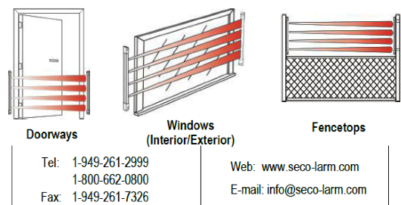
Enforcer Curtain Barrier Sensor
Best utilized when installed in doorways, windows, or fences
Detects motion passing through a specific barrier
Triggers when any one or two adjacent beams have been broken
The range for indoor use is 50 [ft] and is available in five different sizes

Slide 15
WattStopper’s WT Ultrasonic Ceiling Sensors
32 KHz frequencies in a variety of models to control lighting
Omni-directional technology
Designed to filter out moving air noise
Range up to 2200 ft²
Time delay can span from 15 seconds to 30 minutes
Zoning abilities

Slide 16
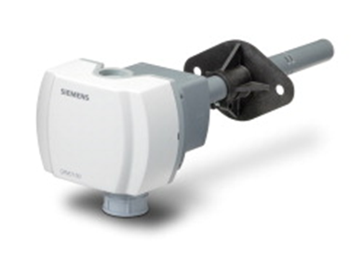
Duct Mounted CO2 Sensors - Siemens QPM2100
Analyze CO₂ and volatile organic compound concentrations, relative humidity, and temperature
Measures the CO2/VOC concentrations and outputs it as a 0 to 10 Vdc or 0 to 5 Vdc linear proportional signal
Changes capacitance relative to the humidity levels
Changes electrical resistance as a function of the temperature

Slide 17
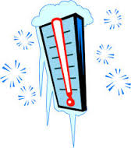

Temperature Control Software
IF time = off_peak_hours
Temp_low_point=68 //Set low point to 68 for winters
Temp_high_point=72 //Set high point to 72 for summers
END IF
IF SEASON = Summer
If time > PREVIOUS_DAYS_PEAK-4 and time < previous_days_peak-2
Temp_high_point=Temp_low_point=68 //Lower temperatures to anticipate peak energy usage
END IF
END IF

Slide 18

Lighting Software
IF person detected in a zone=yes
For 15 minutes
Lights in that zone=on
END For
END IF
//We will do a test study in the library to see if this is adequate for determining lighting levels for people
IF light Levels by windows – lumens created by lights > Lumens required in library by state of Florida
Turn Off lights in window zone
END IF

Slide 19

Variable Speed Drive Software
IF CO2 Level > 1000 ppm Then //Level mandated by state
Then Variable Speed Drive = turn faster
Else If CO2 Level < 600 and Temperature=Set Point Then
Variable Speed Drive = operate slower
End If

Slide 20
Test Plan
Presented By Dallas Perkins

Slide 21
Component Testing
Large number of sensors installed by Siemens
Initially assumed to be accurate
  Observe trends in collected data to validate
May become necessary to test individual sensors
  Verify correct detection/communication
  Verify range of detection
Test reporting sheets in Appendix C of report

Slide 22
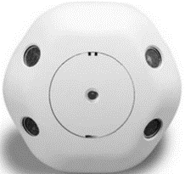
Ceiling Occupancy Sensors
Determine if sensor is correctly detecting motion
  Observe digital output
Test range of sensor to determine area of detection
Test integration to Siemens system

Slide 23
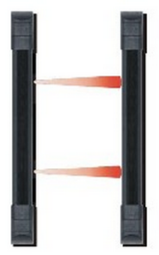
Curtain Motion Sensors
Determine if sensor is correctly detecting motion
  Only registers motion when beam is broken
Ensure distance between transmitter and receiver is within operating range (50’)
Test integration to Siemens system

Slide 24
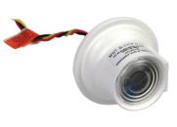
Photo Sensors
Determine if sensor is correctly collecting ambient light data
  Analog output should vary according to light intensity (0 – 5/10V)
  5-750 footcandles
  Establish base point for minimum light level
Test integration to Siemens system

Slide 25
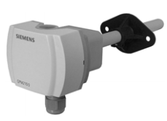
CO₂ Sensors
Determine if sensor is correctly collecting CO₂ data
  Analog output should vary according to the CO₂ concentration present (0 – 10V)
  Range from 0 – 2000 ppm
  Establish output for maximum CO₂ concentration
Test integration to Siemens system

Slide 26
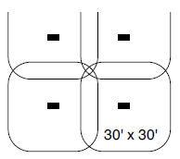
System Integration
Ensure that all sensors are correctly relaying information
Detect and remedy any “dead zones” in coverage
  Some overlap of zones
Future testing could become necessary when control is introduced
Sensor coverage for open areas

Slide 27

Summary of Test Plan Status
Installation of sensors still in progress
Initial assumption is that they all function properly
Testing will become necessary if data seems abnormal

Slide 28
Risk Assessment
Presented By Matthew Streich

Slide 29

Technical Risks
Installation risk
  Handling of high voltages, dangerous equipment
  Leaks or other efficiency losses throughout system
Load/equipment damage
  Disconnecting power to certain areas could disrupt loads
Software error
  Need to ensure all programs function for all possible ranges of parameters
Quality of Life risks

Slide 30

Scheduling Risks
Completion risks
  Requires proper scheduling and communication with advisors
Installation time
  Time required to contract out work
  Allow for extra time in design schedule
Equipment malfunction/failure
  Delay for replacement

Slide 31

Budget Risks
Risks have by-in-large been eliminated
  Focusing on Dirac removes cost of VFD’s
  Siemens Contracts signed on some work orders,
  installation prices have been finalized

Slide 32
Schedule

Slide 33
Schedule
 |  | PLAN | PLAN | ACTUAL | ACTUAL | PERCENT
 | ACTIVITY | START | DURATION | START | DURATION | COMPLETE
1 | Project Management | 1 | 35 | 1 | 35 | 65%
2 | Research | 1 | 15 | 1 | 15 | 100%
3 | Design | 10 | 11 | 9 | 9 | 75%
3.1 | Design Variable Freuqency Drives | 10 | 4 | 9 | 9 | 100%
3.1.1 | Interface VFD with Siemens System | 10 | 2 | 11 | 2 | 100%
3.1.2 | Monitoring Software | 12 | 2 | 12 | 2 | 50%
3.2 | Load Scheduling | 10 | 3 | 10 | 3 | 40%
3.2.1 | Identifying Loads to be Scheduled | 10 | 1 | 10 | 1 | 100%
3.2.2 | Shifting Loads | 11 | 2 |  |  | 50%
3.4 | Lighting Renovation | 14 | 6 | 10 | 6 | 60%
3.4.1 | Updating Lighting | 14 | 3 | 10 | 3 | 60%
3.4.2 | Add Lighting Motion Sensors | 15 | 2 | 15 | 2 | 85%
3.4.3 | Lighting Control | 17 | 3 | 17 | 3 | 50%
3.5 | Ventilation Control | 13 | 5 | 13 | 5 | 80%
3.5.1 | Plan Where to Install CO2 Sensors | 13 | 3 | 13 | 3 | 100%
3.5.2 | Off-Peak Hours Building Cooling | 14 | 2 | 14 | 2 | 45%
3.5.3 | Monitoring Software | 13 | 5 | 13 | 5 | 40%

Slide 34
Schedule (cont.)
 |  | PLAN | PLAN | ACTUAL | ACTUAL | PERCENT
 | ACTIVITY | START | DURATION | START | DURATION | COMPLETE
4 | Implementation | 20 | 11 | 20 | 11 | 15%
4.1 | Simulation | 20 | 3 | 20 | 3 | 65%
4.2 | Review of Simulation | 23 | 2 | 23 | 2 | 85%
4.3 | Physical Implementation | 25 | 6 | 25 | 6 | 20%
5 | Integration into Siemens System | 23 | 8 | 23 | 8 | 85%
5.1 | Hardware Connections | 25 | 6 | 25 | 6 | 15%
6 | Analysis | 13 | 19 | 13 | 19 | 75%
6.1 | Economic Impact to the University | 13 | 8 | 13 | 8 | 100%
6.2 | Future Savings | 15 | 5 | 15 | 5 | 95%
6.3 | Analyzing Environmental Impact | 31 | 1 | 31 | 1 | 100%
6.4 | Measure Efficiency of Installed System | 22 | 28 | 22 | 27 | 0%
7 | Documentation | 1 | 31 | 1 | 31 | 50%

Slide 35
Schedule
1 | Project Management
2 | Research
3 | Design
3.1 | Design Variable Freuqency Drives
3.1.1 | Interface VFD with Siemens System
3.1.2 | Monitoring Software
3.2 | Load Scheduling
3.2.1 | Identifying Loads to be Scheduled
3.2.2 | Shifting Loads
3.4 | Lighting Renovation
3.4.1 | Updating Lighting
3.4.2 | Add Lighting Motion Sensors
3.4.3 | Lighting Control
3.5 | Ventilation Control
3.5.1 | Plan Where to Install CO2 Sensors
3.5.2 | Off-Peak Hours Building Cooling
3.5.3 | Monitoring Software

Slide 36
Schedule(cont)
4 | Implementation
4.1 | Simulation
4.2 | Review of Simulation
4.3 | Physical Implementation
5 | Integration into Siemens System
5.1 | Hardware Connections
6 | Analysis
6.1 | Economic Impact to the University
6.2 | Future Savings
6.3 | Analyzing Environmental Impact
6.4 | Measure Efficiency of Installed System
7 | Documentation

Slide 37
Budget

Slide 38

Rough Budget ROI
Focus now on Dirac – ROI goes up significantly
  Variable speed drives already installed but not tuned – tuning with CO2 sensors provides massive benefits
  This reduction removes budget risks
  As installation plans become finalized, estimates turn into concrete numbers, further reducing risks as estimates prove close to actual costs
Light Sensor Savings an estimate – sensors being installed into Dirac
  Population study

Slide 39
Budget Estimate
Item Description | Per Unit Construction Cost | Quantity | Total Cost | p.u. kW Reduction | Total kW Reduction | Demand Charge Reduction | Kwh Savings per year | Total Savings | Simple Payback (Years)
Variable Frequency Drive (40 hp) |  |  |  | 4.47 | 8.94 | $49.75 | $3,549 | $4,146 | N/A
Variable Frequency Drive (7 ½ hp) |  |  |  | 0.839 | 1.68 | $9.34 | $2,841 | $2,954 | N/A
T8 LED Replacements | $20 | 4,742 | $94,840 | 0.007 | 33.19 | $370 | $9,111 | $13,545 | 7.00
Duct CO2 Sensors | $729 | 11 | $8,019
WT Ultrasonic Room Sensors | $80 | 40 | $3,200
E-9611-2B25 Beam Sensors | $50.00 | 6 | $300
MK7-B-CCF analog photon sensors | $219 | 2 | $438
Sensor cost w/ Installation |  |  | $79,000 | N/A | 29.2 | $325 | $8,016 | $11,917 | 6.63
Total |  |  | $183,840 |  | 73.01 | $1,264 | $23,517 | 32,560 | 5.65

Slide 40
Conclusion

Slide 41
Conclusion
Testing plan has been completed
Component installation has began
Budget risks have been eliminated with cost finalization
Moving forward –
  Writing monitoring software for installed components
  Perform population study to get a better estimate of energy savings
  Continue to monitor component installation, begin analyzing impact

