Slide 1
Team #12: Energy Management
Detailed Design Review and Test Plan

Slide 2
Contributors
Advisors
Team Members
Mr. Jim Stephens
Dr. Faruque
Dr. Li
Dr. McGinnis
Dr. Frank
Patrick Dawson
Dallas Perkins
Matt Streich
David Gonsoulin

Slide 3
System Design
Presented By David Gonsoulin

Slide 4
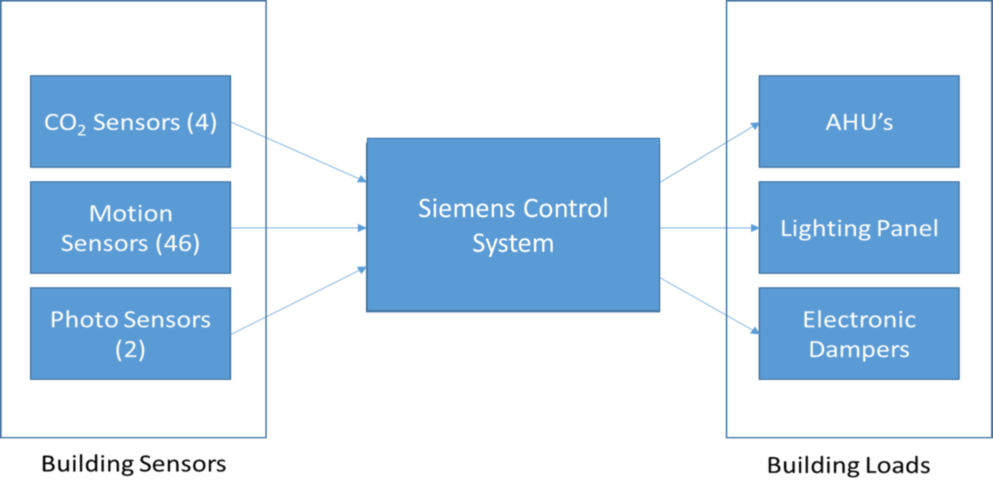
Block Diagram

Slide 5
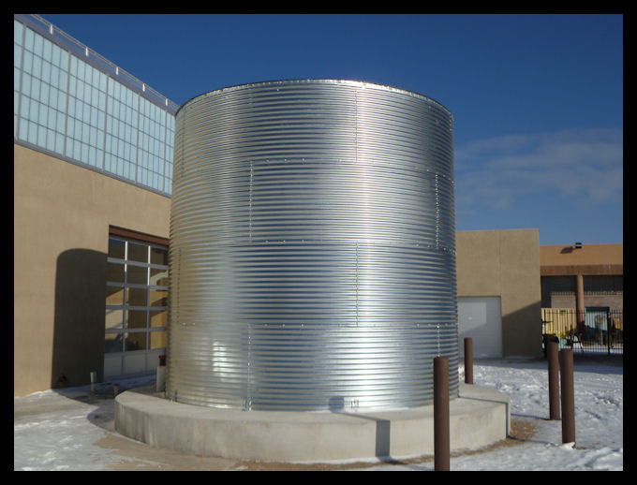
Major Components
Sensors are responsible for collecting the necessary motion and air quality data to determine the building occupancy
  Motion sensors in hallways and sparsely populated areas to reduce lighting
  Photo Sensors will be installed on second floor along the windows to determine amount of light inside the building
  CO2 Sensors
Storage Tank will act as an “energy storage” device by storing water during non-peak times
  HVAC system will then pull water from the storage tank to maintain the QOL in the building
  May be part of a future project; NOT viable in current time frame of project

Slide 6
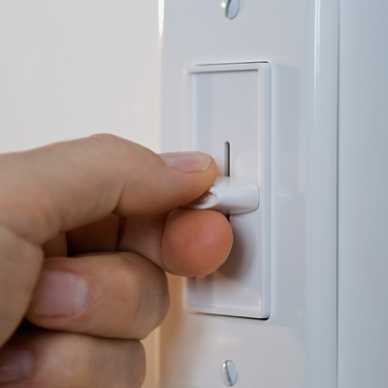
Major Components
Lighting Renovation
  Motion sensors have been added to decrease lighting needs throughout the building
  Controlled through turning off the lighting when areas of a building are not in use or if enough ambient light is detected in well lit areas
  Used existing layout of lighting panel on main floor to decrease cost of installation

Slide 7
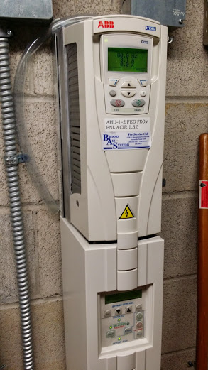
Major Components
Team has suggested for LED technology additions with replacement of failing bulbs
  Replacement at end of life will allow for additional savings rather than immediate replacement
Motor Control
  Ventilation motors and water pumps will be controlled to allow for more energy savings

Slide 8
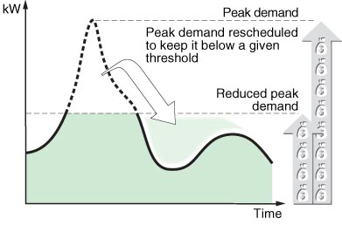
Major Components
Load Scheduling
  Possibly allow swing in building temperature during peak demand
  Need energy storage system to effectively mitigate peak demand for Dirac
    Solar Panels w/ batteries
    Thermal Storage

Slide 9
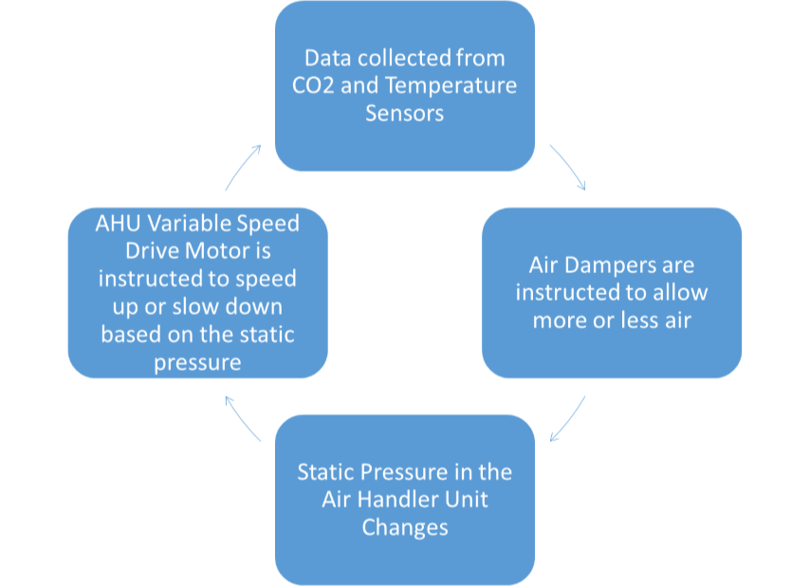
Major Components
Ventilation control
  CO2 sensors static pressure sensors, and temperature sensors will provide data to determine the amount of airflow needed

Slide 10
Design Performance Assessment
Analyze the amount of power that a specific component will use over a certain length of time for the current equipment/software and the newly implemented equipment and software
Determine savings from implemented equipment/software

Slide 11
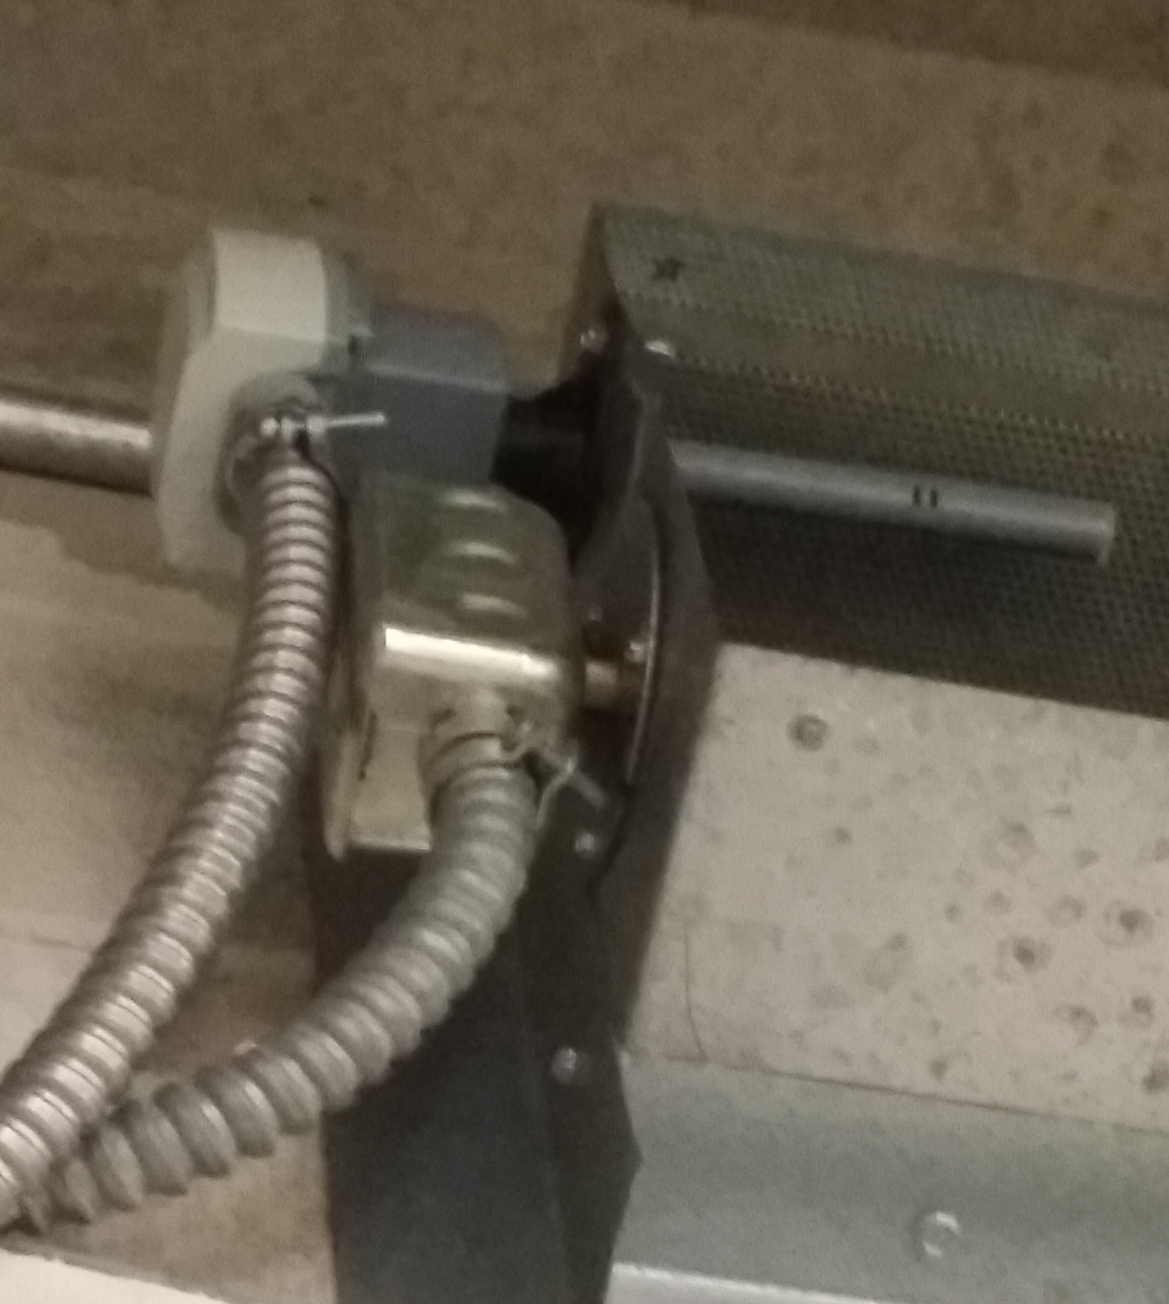
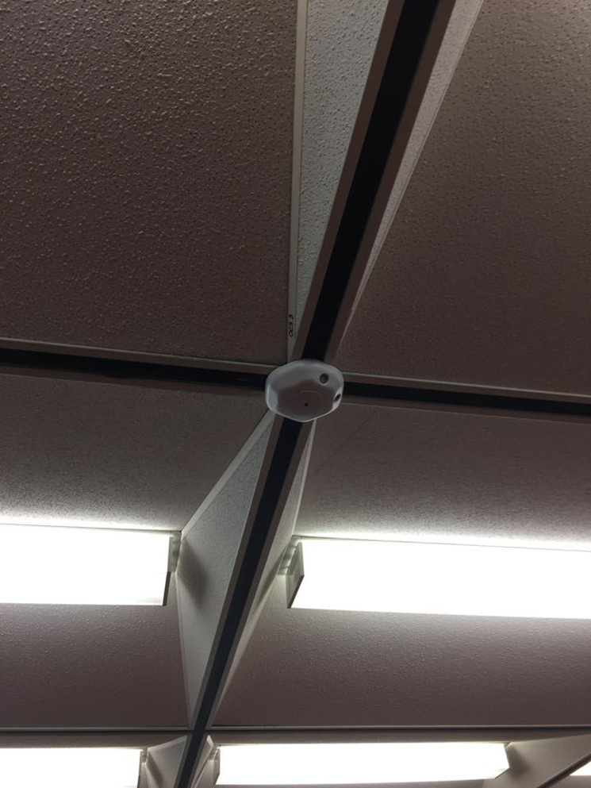
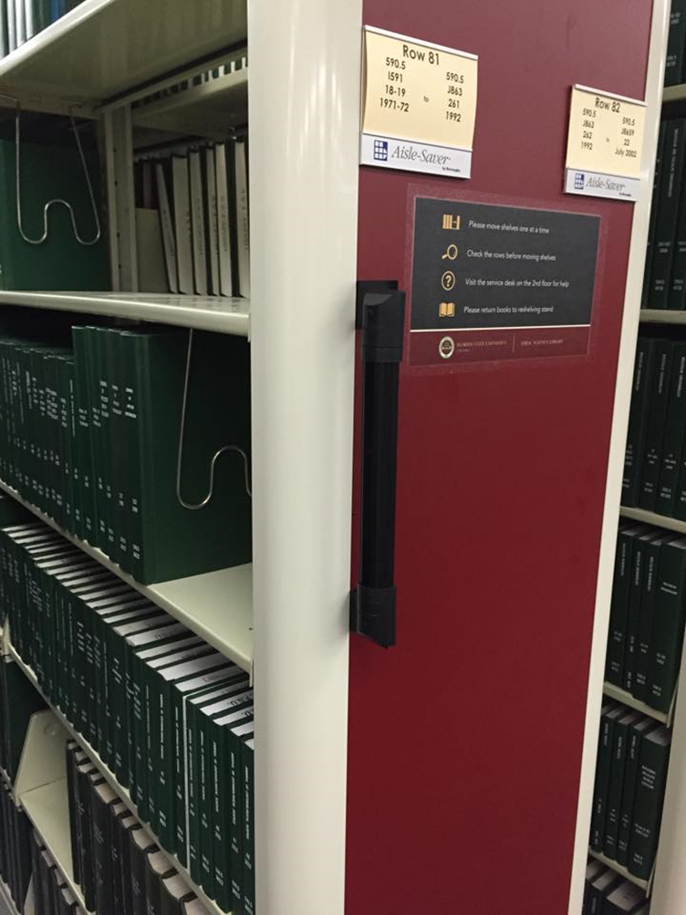
Installation Performance Assessment
Ensure installed sensors are functioning properly
Ensure data is being collected correctly

Slide 12

Design Process
Decided on what modifications in the building are the most viable and cost-effective:
  Motion Sensors in sparsely populated areas
  Photo Sensors by windows
  Duct-mounted CO2 sensors
  Slowly install LED lights able to connect to working ballasts as old lights die out
Schedule/cost constraints did not allow the following to be considered
  Water Tank Storage
  Solar

Slide 13
Individual Contribution
Provided ideas for areas of cost savings
Assisted in researching system components for design choices
Provided technical assistance in the analysis of floor plans
Assisted in zoning sensors
Aided in analyzing sensor data to determine occupancy trends

Slide 14
Design Of Major Components
Presented By Patrick Dawson

Slide 15
PLC-MULTIPOINT CELESTIAL AMBIENT LIGHT SENSORS
Self Contained MK7-B Series
Variable output voltage based upon the amount of ambient light detected in the specified area
Analog signal to transmit the amount of light currently present in a location
Factory calibrated
Output signal of 0-5, 1-5, 0-10, 1-10 VDC

Slide 16
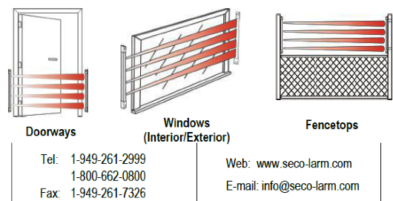
Enforcer Curtain Barrier Sensor
Best utilized when installed in doorways, windows, or fences
Detects motion passing through a specific barrier
Triggers when any one or two adjacent beams have been broken
The range for indoor use is 50 [ft] and is available in five different sizes

Slide 17
WattStopper’s WT Ultrasonic Ceiling Sensors
32 KHz frequencies in a variety of models to control lighting
Omni-directional technology
Designed to filter out moving air noise
Range up to 2200 ft²
Time delay can span from 15 seconds to 30 minutes
Zoning abilities

Slide 18
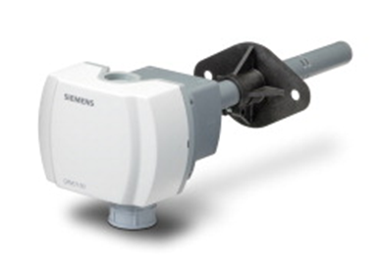
Duct Mounted CO2 Sensors - Siemens QPM2100
Analyze CO₂ and volatile organic compound concentrations, relative humidity, and temperature
Measures the CO2/VOC concentrations and outputs it as a 0 to 10 Vdc or 0 to 5 Vdc linear proportional signal
Changes capacitance relative to the humidity levels
Changes electrical resistance as a function of the temperature

Slide 19


Temperature Control Software
10 C IF THE PEAK LOAD LIMIT IS HIT THEN LET DRIFT ELSE IF SYSTEM IN NIGHT MODE THEN LET DRIFT ELSE HOLD CONSTANT
20 IF (DIRAC.GE.@PDL) THEN DIRAC.TEMPSETPOINT.LOW = 66 ELSE IF ((MONTH.GE.5.AND.MONTH.LE.4).OR.(DIRAC.NGTMODE)) THEN DIRAC.TEMPSETPOINT.LOW = 68 ELSE DIRAC.TEMPSETPOINT.LOW=70
30 C SET HIGH POINT SAME AS LOW POINT
40 IF (DIRAC.GE.@PDL) THEN DIRAC.TEMPSETPOINT.HIGH = 74 ELSE IF ((MONTH.GE.5.AND.MONTH.LE.4).OR.(DIRAC.NGTMODE)) THEN DIRAC.TEMPSETPOINT.HIGH = 72 ELSE DIRAC.TEMPSETPOINT.HIGH = 70

Slide 20

Lighting Software
10 C CODE TO CONTROL THE LIGHTING SENSOR FOR ONE ZONE, CALLED Z1
20 IF(DIRAC.PHOTONSENSOR1.GE.(500+@LIGHTINGLEVELATNIGHT) THEN OFF(DIRAC.LIGHTING.Z1) ELSE IF(DIRAC.MOTIONSENSORS.Z1.EQ.OCC) THEN ON(DIRAC.LIGHTING.Z1) ELSE OFF(DIRAC.LIGHTING.Z1)

Slide 21

Variable Speed Drive Software
10 C CODE TO CONTROL THE ELECTRONIC DAMPER USING INTEGRAL GAIN ALGORITHM
20 IF(DIRAC.GE.@PDL) THEN LOOP(0,"DIRAC.AHU1CO2SENSOR","DIRAC.AHU1DAMPER",1500,1000,200,0,2,50,0,100,0)
ELSE LOOP(0,"DIRAC.AHU1CO2SENSOR","DIRAC.AHU1DAMPER",1000,1000,200,0,2,50,0,100,0)

Slide 22

MATLAB Simulation
tsched=input('Is the Library Open? 1=YES , 0=NO '); %Time Schedule
if tsched==1
urs11=input('First floor occupied? 1=YES , 0=NO '); %Ultrasonic sensor floor 1
urs21=input('Second floor occupied? 1=YES , 0=NO '); %Ultrasonic sensor floor 2
tsched=input('Are we 5% below the daily peak? 1=YES , 0=NO ');
else
urs11=0;
urs21=0;
end
if urs11 ==1
bs11=input('Stack occupied? 1=YES , 0=NO ');
%Beam Sensor
else
bs11=0;
end
if urs21==1
ps1=input('What is the ambient lighting level? ');
else
ps1=0;
end
ts11=input('What is the current Temp? '); %Temperature Sensor
co21=input('What is the current CO2 Level? '); %CO2 Sensor

Slide 23
Individual Contributions
Organize basic concept of project
Organize meetings with FSU Utilities
Create software simulation in MATLAB
Research hardware
Participate in cost analysis

Slide 24
Occupancy Study Data
Presented by Dallas Perkins

Slide 25
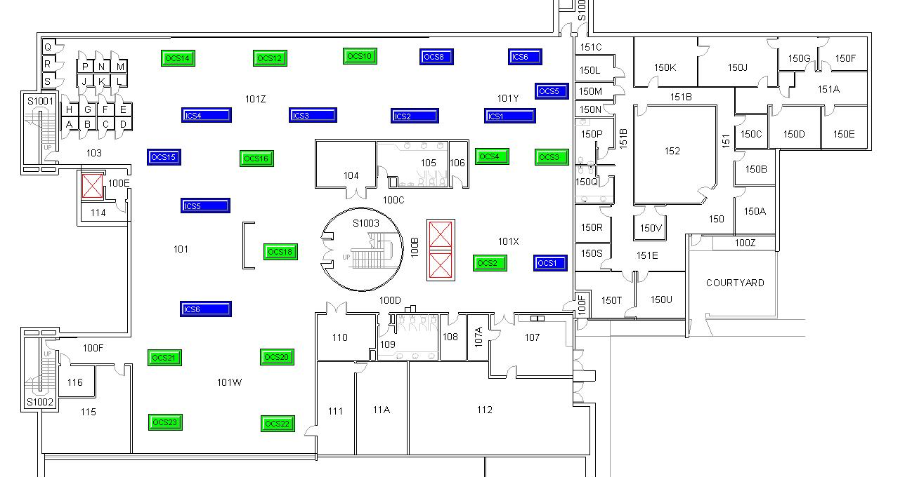
1st Floor Sensor Layout

Slide 26
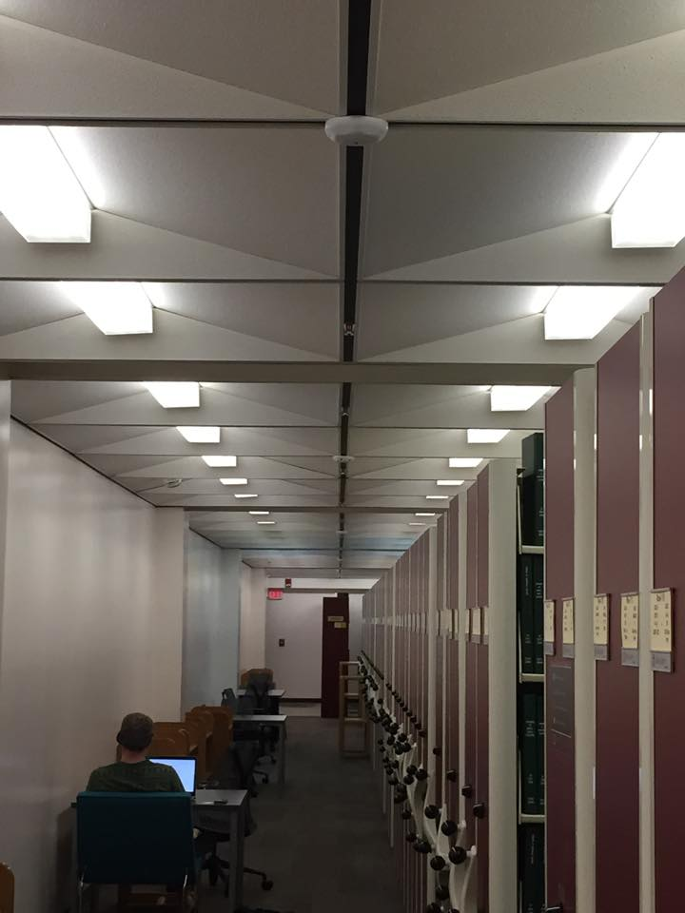


Slide 27
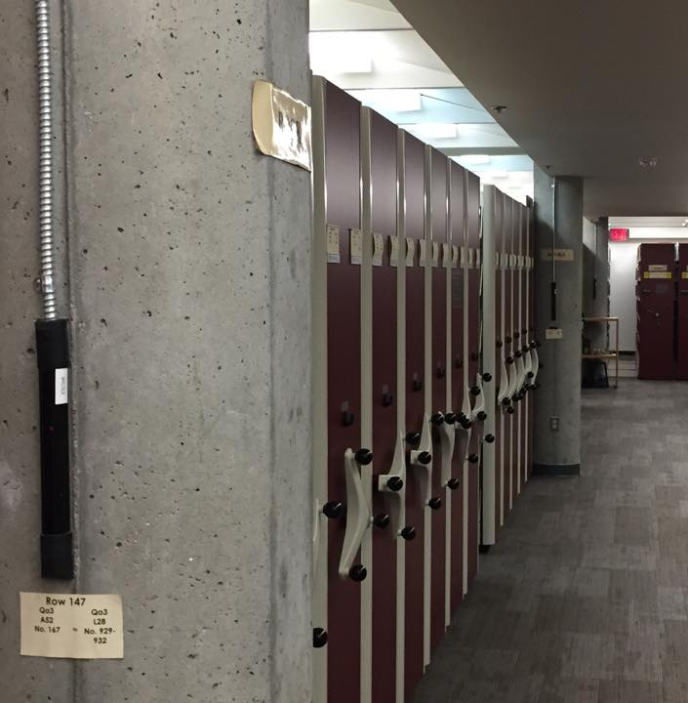
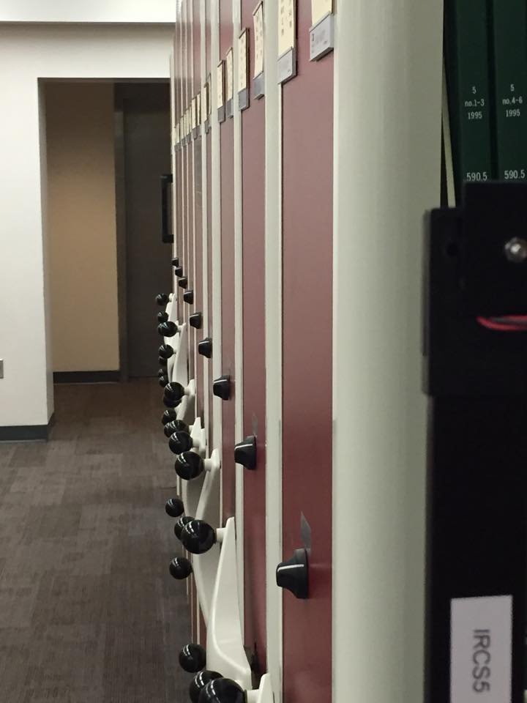

Slide 28
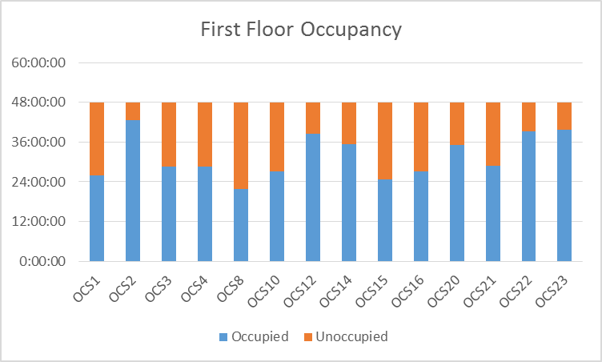
1st Floor Data
Curtain sensors not included
  No delay was set when providing data
  Some stack zones included hallway areas
Data covers 12:01 AM 4/9/15 – 11:59 PM 4/10/15
  (Thursday and Friday)

Slide 29
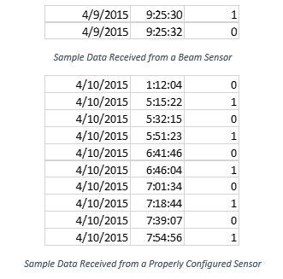
Sample Sensor Data
Beam sensors registered as unoccupied immediately after beam was restored
Ceiling mount sensors incorporated proper delay
  Does not register unoccupied within 15 min of detecting motion
CO₂ collected at set intervals, return ppm concentration

Slide 30
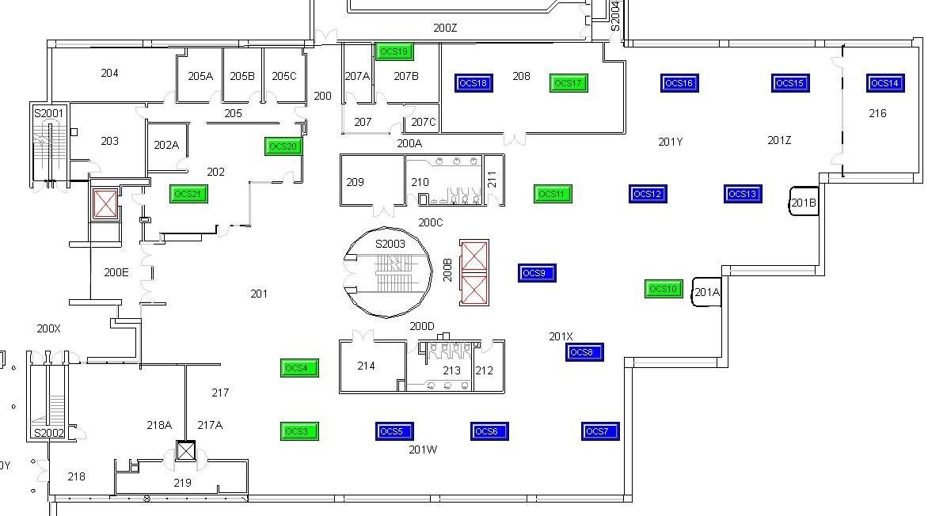
2nd Floor Sensor Layout

Slide 31
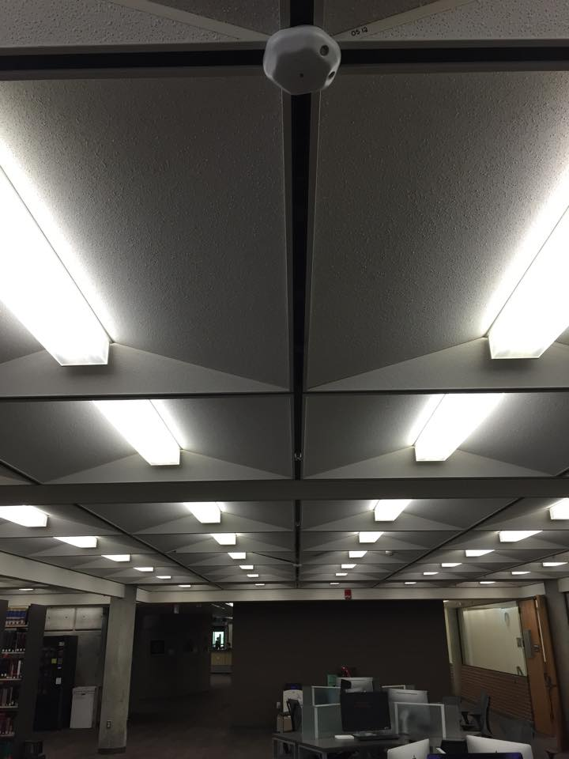
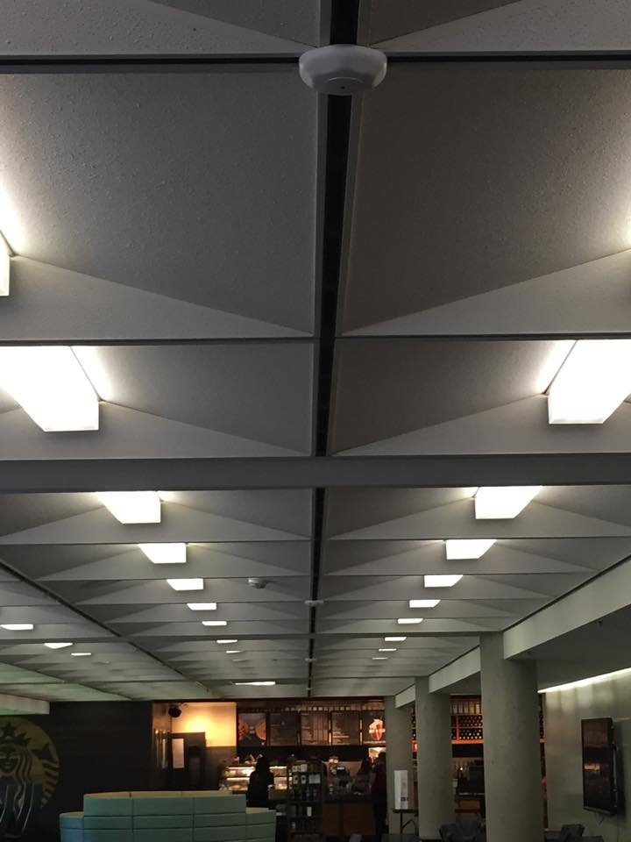

Slide 32
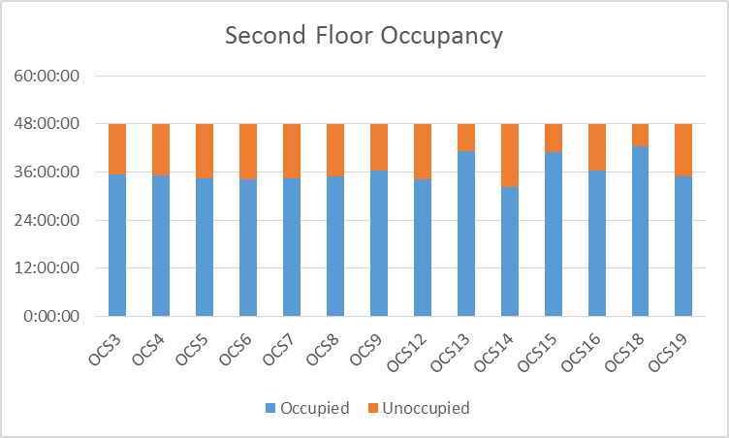
2nd Floor Data
Clearly higher occupancies than 1st floor
  Similar/Lower levels expected for 3rd floor
Ambient lighting sensors still require installation
Same time span as 1st floor study

Slide 33
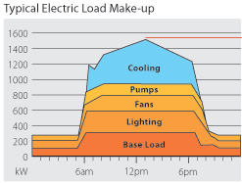
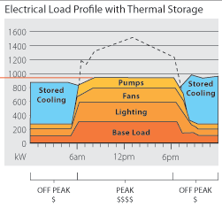
Data Summary
On average weekday 1st and 2nd floor are occupied ~70% of the time
270 kWh savings available for zones studied per two day period
  Adding in stack zone data would raise savings to ~600 kWh
Savings estimate of approximately $5,500 per year
  Low estimate – does not account for weekend/break trends
Provides extra incentive for thermal storage or other peak-shifting option
  Most savings from lighting control come from off-peak hours
  Lower “valleys” allow for more thermal energy to be stored
    Higher total displacement of peak possible

Slide 34
Individual Contribution
Researched system components for design choices
Performed cost/benefit analysis and return on investment estimate
Provided technical assistance in the analysis of floor plans
Assisted in zoning sensors
Analyzed sensor data to determine occupancy trends
  Used to update savings values

Slide 35
Schedule
Presented by Matthew Streich

Slide 36
Schedule
 |  | PLAN | PLAN | ACTUAL | ACTUAL | PERCENT
 | ACTIVITY | START | DURATION | START | DURATION | COMPLETE
1 | Project Management | 1 | 35 | 1 | 35 | 100%
2 | Research | 1 | 15 | 1 | 15 | 100%
3 | Design | 10 | 11 | 9 | 9 | 100%
3.1 | Design Variable Freuqency Drives | 10 | 4 | 9 | 9 | 100%
3.1.1 | Interface VFD with Siemens System | 10 | 2 | 11 | 2 | 100%
3.1.2 | Monitoring Software | 12 | 2 | 12 | 2 | 100%
3.2 | Load Scheduling | 10 | 3 | 10 | 3 | 100%
3.2.1 | Identifying Loads to be Scheduled | 10 | 1 | 10 | 1 | 100%
3.2.2 | Shifting Loads | 11 | 2 |  |  | 100%
3.3 | Thermal Storage | 10 | 5 | 10 | 0 | 0%
3.3.1 | Analysis of Possible Tank Locations | 10 | 2 | 10 | 0 | 0%
3.3.2 | Scheduling of Storage | 12 | 3 | 12 | 0 | 0%
3.4 | Lighting Renovation | 14 | 6 | 10 | 6 | 100%
3.4.1 | Updating Lighting | 14 | 3 | 10 | 3 | 100%
3.4.2 | Add Lighting Motion Sensors | 15 | 2 | 15 | 2 | 100%
3.4.3 | Lighting Control | 17 | 3 | 17 | 3 | 100%
3.5 | Ventilation Control | 13 | 5 | 13 | 5 | 100%
3.5.1 | Plan Where to Install CO2 Sensors | 13 | 3 | 13 | 3 | 100%
3.5.2 | Off-Peak Hours Building Cooling | 14 | 2 | 14 | 2 | 100%
3.5.3 | Monitoring Software | 13 | 5 | 13 | 5 | 100%

Slide 37
Schedule (cont.)
 |  | PLAN | PLAN | ACTUAL | ACTUAL | PERCENT
 | ACTIVITY | START | DURATION | START | DURATION | COMPLETE
4 | Implementation | 20 | 11 | 20 | 11 | 100%
4.1 | Simulation | 20 | 3 | 20 | 3 | 100%
4.2 | Review of Simulation | 23 | 2 | 23 | 2 | 100%
4.3 | Physical Implementation | 25 | 6 | 20 | 6 | 90%
5 | Integration into Siemens System | 23 | 8 | 23 | 8 | 100%
5.1 | Hardware Connections | 25 | 6 | 25 | 6 | 100%
5.2 | 3.1.1 Interface VFD with Siemens System | 27 | 2 | 27 | 2 | 100%
5.3 | 3.1.2 Monitoring Software | 29 | 3 | 29 | 3 | 100%
6 | Analysis | 13 | 19 | 13 | 19 | 100%
6.1 | Economic Impact to the University | 13 | 8 | 13 | 8 | 100%
6.2 | Future Savings | 15 | 5 | 15 | 5 | 100%
6.3 | Analyzing Environmental Impact | 31 | 1 | 31 | 1 | 100%
6.4 | Measure Efficiency of Installed System | 22 | 28 | 25 | 28 | 85%
7 | Documentation | 1 | 31 | 1 | 31 | 100%

Slide 38
Schedule
1 | Project Management
2 | Research
3 | Design
3.1 | Design Variable Freuqency Drives
3.1.1 | Interface VFD with Siemens System
3.1.2 | Monitoring Software
3.2 | Load Scheduling
3.2.1 | Identifying Loads to be Scheduled
3.2.2 | Shifting Loads
3.4 | Lighting Renovation
3.4.1 | Updating Lighting
3.4.2 | Add Lighting Motion Sensors
3.4.3 | Lighting Control
3.5 | Ventilation Control
3.5.1 | Plan Where to Install CO2 Sensors
3.5.2 | Off-Peak Hours Building Cooling
3.5.3 | Monitoring Software

Slide 39
Schedule(cont)
4 | Implementation
4.1 | Simulation
4.2 | Review of Simulation
4.3 | Physical Implementation
5 | Integration into Siemens System
5.1 | Hardware Connections
6 | Analysis
6.1 | Economic Impact to the University
6.2 | Future Savings
6.3 | Analyzing Environmental Impact
6.4 | Measure Efficiency of Installed System
7 | Documentation

Slide 40
Schedule Summary
Initial projections fairly accurate, but a couple discrepancies
Had to cancel plans for Water Tank storage, economically feasible but time of installation/approval of space for >1000G tank kept from being installed
Analysis of installed sensors started late, installation time longer than expected
    Tying into this, photon sensors still not installed in Dirac, we have contacted Siemens about this

Slide 41
Project Task Completion

Slide 42
Matthew Streich
Wrote PPCL code
Tested PPCL code on Siemens TEC 1000
Created and updated group website
Wrote meeting minutes
Assisted with schedule/budget creation

Slide 43
Budget

Slide 44
Budget Estimate
Item Description | Per Unit Construction Cost | Quantity | Total Cost | p.u. kW Reduction | Total kW Reduction | Demand Charge Reduction | Kwh Savings per year | Total Savings | Simple Payback (Years)
Variable Frequency Drive (40 hp) |  |  |  | 4.47 | 8.94 | $49.75 | $3,549 | $4,146 | N/A
Variable Frequency Drive (7 ½ hp) |  |  |  | 0.839 | 1.68 | $9.34 | $2,841 | $2,954 | N/A
T8 LED Replacements | $20 | 4,742 | $94,840 | 0.007 | 33.19 | $370 | $9,111 | $13,545 | 7.00
Duct CO2 Sensors | $729 | 11 | $8,019
WT Ultrasonic Room Sensors | $80 | 40 | $3,200
E-9611-2B25 Beam Sensors | $50.00 | 6 | $300
MK7-B-CCF analog photon sensors | $219 | 2 | $438
Sensor cost w/ Installation |  |  | $79,000 | N/A | 29.2 | $325 | $8,016 | $11,917 | 6.63
Total |  |  | $183,840 |  | 73.01 | $1,264 | $23,517 | 32,560 | 5.65

Slide 45

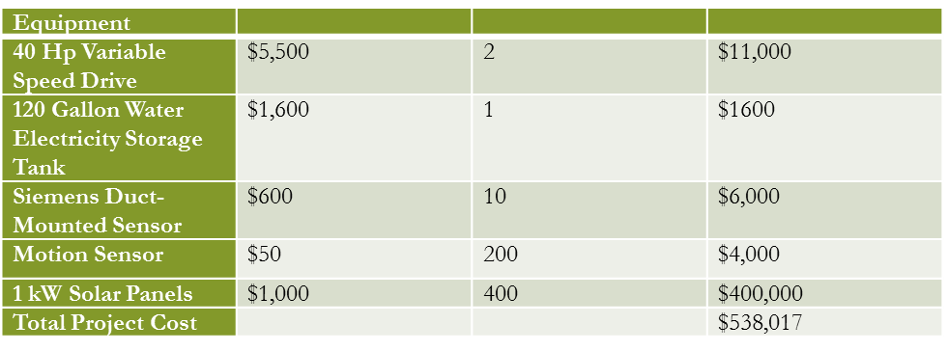
Initial Budget Estimate

Slide 46

Budget Summary
Overhead costs and Solar panels greatly inflated initial budgete
However, sensor/sensor installation costs were greatly underestimated, hiring electricians much more than $45/hr for 30 hours.
Overall met budget goals, payoff in <6 years
  Actual numbers may vary, however great enough buffer to maintain estimates at minimum

Slide 47
Conclusion

Slide 48
Conclusion
Demand-Side Management provided a relatively simple way to save a lot of energy/money for university
Component installation mostly completed
Data from sensors shows expected cost savings
Waiting for follow-up with Siemens regarding photon sensor installation

Slide 49
Thank You
A big thank you goes out to Mr. Jim Stephens and Dr. Faruque for assisting the team in the design.
The team learned a lot about the process of incorporating energy saving techniques into building designs
Notes:
There is no class really for this. Having this project helped the team discover the possibilities present for reducing energy consumption using various methods.

Slide 50
Questions???

