Slide 1
T506: Material Handling Robot
Team: Taylor Harvey, Diandra Reyes, Peter Watson, Alexander Wozny

Slide 2




ME Senior Design Team 506
DIANDRA REYES
Additive Manufacturing Engineer
ALEXANDER WOZNY
Systems Engineer
TAYLOR HARVEY
Mechanical Design Engineer
PETER WATSON
Materials Engineer
Taylor Harvey
Notes:
Each member present themselves on this slide

Slide 3


Senior Design ECE Team
WALTER CALDWELL
Project Manager
TIFFANY MILLER
Hardware Engineer
SEBASTIAN MURIEL
System Engineer
ALEX JEN
Software Engineer
TONY ZHENG
Financial Advisor
Taylor Harvey

Slide 4




Sponsors
Project Sponsor
Dr. Jerris Hooker
Project Advisor
Dr. Camilo Ordóñez
Dr. Shayne McConomy
FAMU – FSU College of Engineering
Taylor Harvey
Notes:
Project Sponsor (Dr. Jerris Hooker) - Design Professor.
Project Advisor Camil Ordonez -
Dr. Shayne McConomy – Our teacher that offers guidance foe the project

Slide 5


Objective
The objective of this project is to create a partially autonomous material handling robot that works in a dark warehouse with conditions unfavorable to human workers.

Slide 6
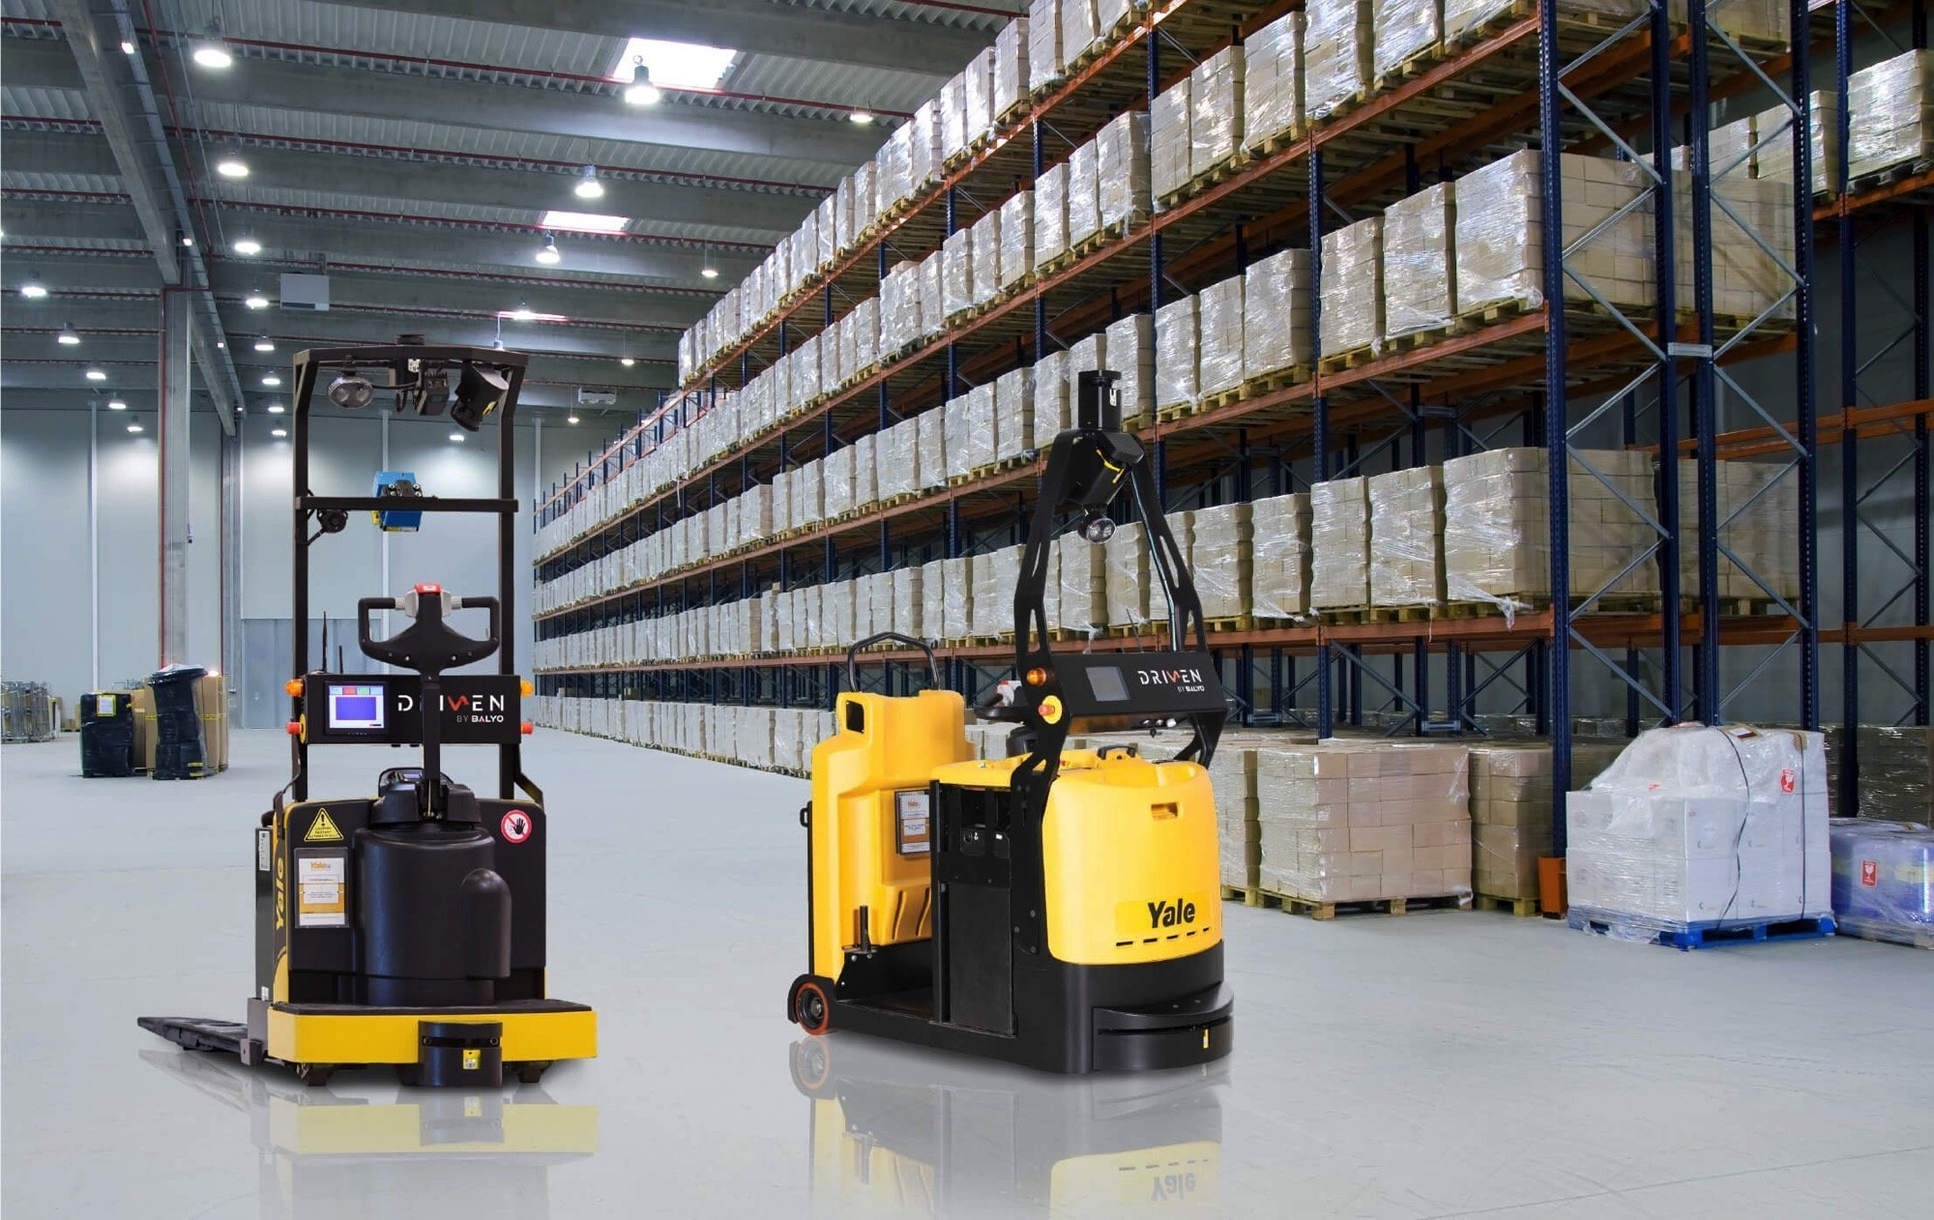
Motivation
Semi-autonomous warehouse where robots do most of the labor
Reduce costs and increase profits
  No lights or AC needed
  Robots can work 24 hours a day
  Less staff needed to manage the warehouse

Slide 7









Goals
Partial autonomy
Operate in a Dark Environment
Lift Up to 25 lbs
Track Inventory
Rechargeable
Maneuver w/o Collision
Obstacle Avoidance
Notes:
Robot movement is partially autonomous, and partially under human control
Operate in a dark environment
Safely lift and move up to a 50lb load
Track inventory
Avoid obstacles- Robot must be able to maneuver itself around the warehouse without collision

Slide 8





Assumptions
Maintenance will be provided by a third party
Traverses flat surfaces
The warehouse will not be altered.
A power supply is accessible.
The product is working indoors.
Notes:
Though maintenance is not included, users could access components of the robots for maintenance.
Will not provide regular services or maintenance for the robot. This is outside of the scope of our project.
Robot will only traverse over flat surfaces and no rugged terrain
The Mechanical engineering side of the group will be responsible for the package manipulation, whereas the Electrical engineering group will focus on navigation and movement of the robot

Slide 9

Critical Targets and Metrics
Change in Heading Angle: 360° rotation
Applies Even Torque
Maintain Heading Angle
Locate Inventory
Connect Wirelessly
Scans Inventory
Notes:
The robot will be able to turn around in both directions. This is important in case it senses and obstacle in front of it as well as for overall maneuverability as well.

Slide 10

Critical Targets and Metrics
Change in Heading Angle
Applies Even Torque: less than 1% error
Maintain Heading Angle
Locate Inventory
Connect Wirelessly
Scans Inventory
Notes:
The robot should be able to apply even torque to the wheels, which is important for controlling the robot. This leads into "maintaining the heading angle"...

Slide 11
Critical Targets and Metrics
Change in Heading Angle
Applies Even Torque
Maintain Heading Angle: 0°
Locate Inventory
Connect Wirelessly
Scans Inventory
Notes:
The robot will maintain a heading angle of 0 degrees relative to its desired path. This means the robot will not be swerving around and will follow its path smoothly.

Slide 12
Critical Targets and Metrics
Change in Heading Angle
Applies Even Torque
Maintain Heading Angle: 0°
Locate Inventory
Connect Wirelessly
Scans Inventory
Notes:
The robot will maintain a heading angle of 0 degrees relative to its desired path. This means the robot will not be swerving around and will follow its path smoothly.

Slide 13
Critical Targets and Metrics
Change in Heading Angle
Applies Even Torque
Maintain Heading Angle: 0°
Locate Inventory
Connect Wirelessly
Scans Inventory
Notes:
The robot will maintain a heading angle of 0 degrees relative to its desired path. This means the robot will not be swerving around and will follow its path smoothly.

Slide 14


Critical Targets and Metrics
Change in Heading Angle
Applies Even Torque
Maintain Heading Angle
Locate Inventory: 1 (Boolean)
Connect Wirelessly
Scans Inventory
Notes:
The robot will also be able to locate inventory and know where it is in the warehouse. This is important in the case the robot needs to retrieve a package or it needs to deliver a package to a location in the warehouse.

Slide 15


Critical Targets and Metrics
Change in Heading Angle
Applies Even Torque
Maintain Heading Angle
Locate Inventory
Connect Wirelessly: 1 (Boolean)
Scans Inventory
Notes:
Additionally, the robot needs to be able to connect wirelessly. It wouldn't be able to move around the whole warehouse otherwise.

Slide 16

Critical Targets and Metrics
Change in Heading Angle
Applies Even Torque
Maintain Heading Angle
Locate Inventory
Connect Wirelessly
Scans Inventory: 1 (Boolean)
Notes:
The robot also needs to be able to scan inventory so that it can identify it and be able to do what was described in locating the inventory

Slide 17

Final Concept
Notes:
The final concept that we ended up choosing was the "Omnidirectional Forklift".

Slide 18
Forks for Package
Manipulation
Notes:
For package manipulation, the robot has forks with a lifting mechanism to lift the package on a pallet.

Slide 19
Infared with Black Line for Path Following
Notes:
Since the robot is an AGV, it will follow a black line path to navigate around the warehouse, using an infrared sensor to detect the path.

Slide 20
Ultrasonic Object Detection
Notes:
The robot will use an ultrasonic sensor for detection of obstacles, which will be useful in the dark.

Slide 21
QR Codes For Scanning
Notes:
The robot will use QR codes to scan the packages and help localize itself. This is because QR codes hold a good amount of information. Additionally, they can be scanned at different angles, allowing for more flexibility. Holds 7000 numbers—or 4000 alphanumeric characters. Doesn't require an expensive scanner.

Slide 22
Omni-Directional Wheels for movement
Notes:
With the omni-direction wheels however, if the robot ends up too far to the left or right, it is able to just move sideways. It doesn’t have to spend time backing up. It is able to line itself up easier. Note that a forklift setup is used in this example.

Slide 23


What Has Been Ordered

Slide 24

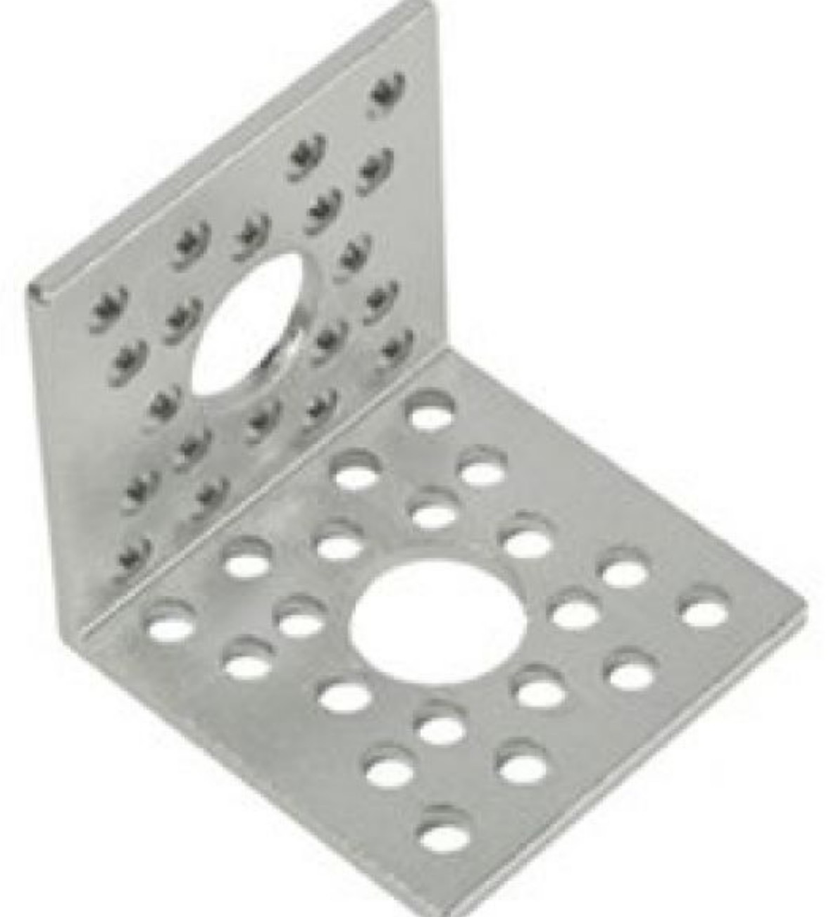
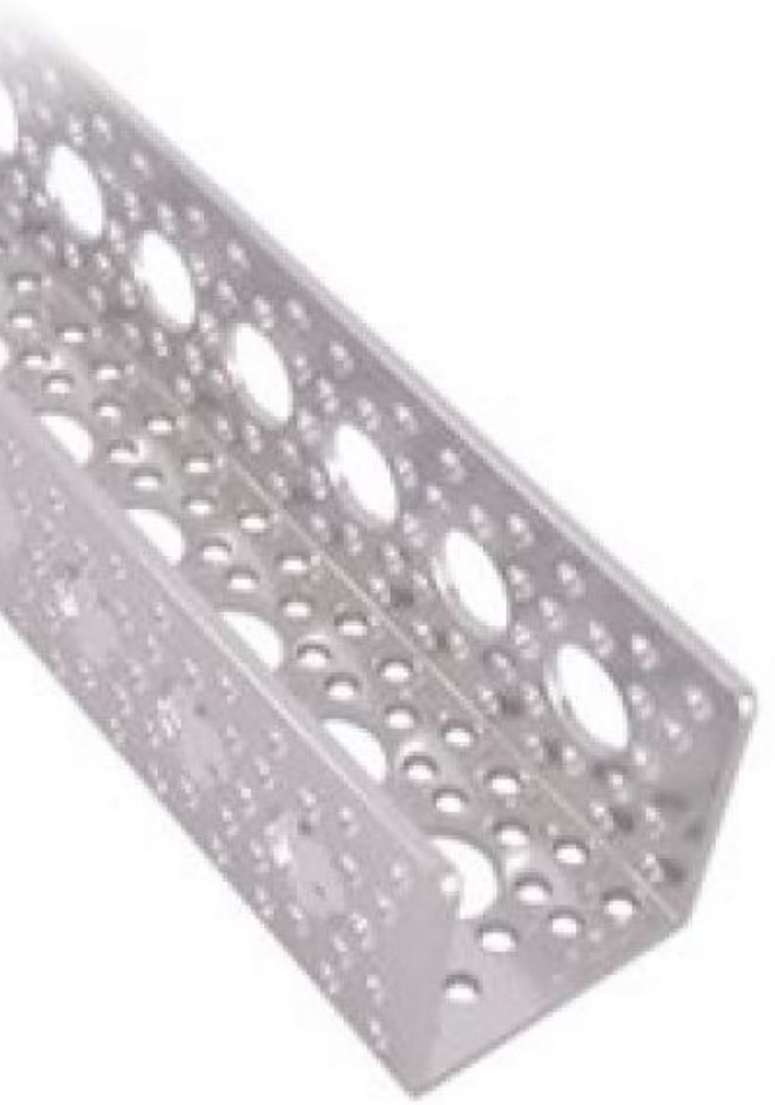
Base
2ft x 2ft x ¾'' Plywood
Aluminum Channel 15"
90° Angle Aluminium Channel Bracket
Taylor Harvey

Slide 25
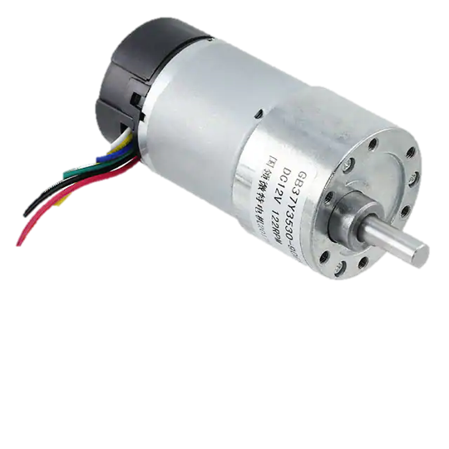
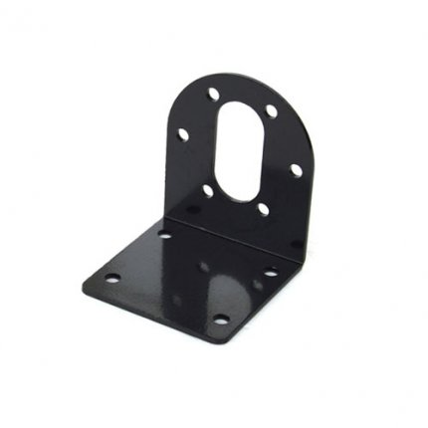
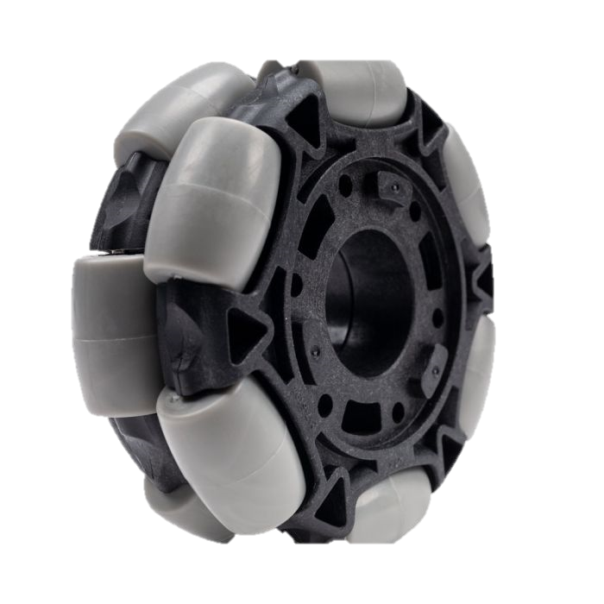
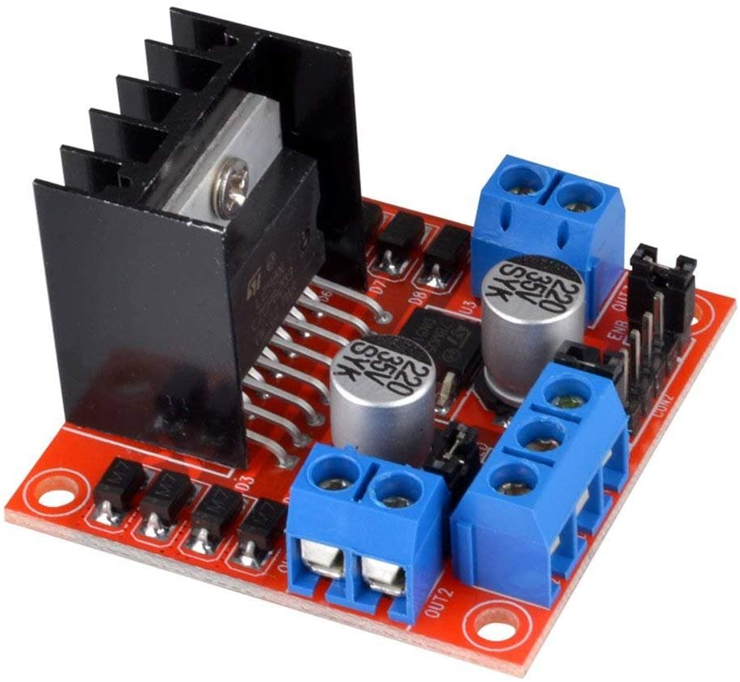
Mobility
Omni Directional Wheels
12v motors
Motor drivers
Motor Mounting Bracket
Taylor Harvey

Slide 26
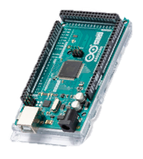

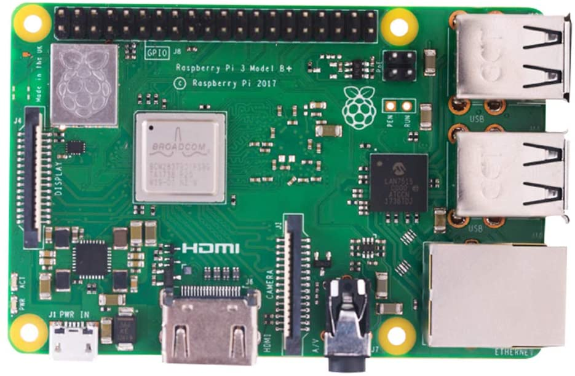
Controller + Memory
Raspberry Pi 3 Model B+ Board
32GB Micro SD
Arduino DUO
Taylor Harvey

Slide 27
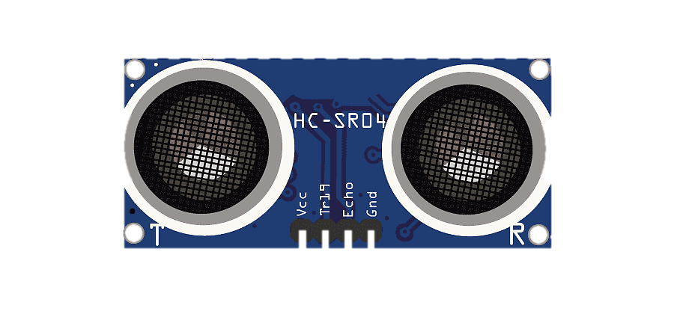
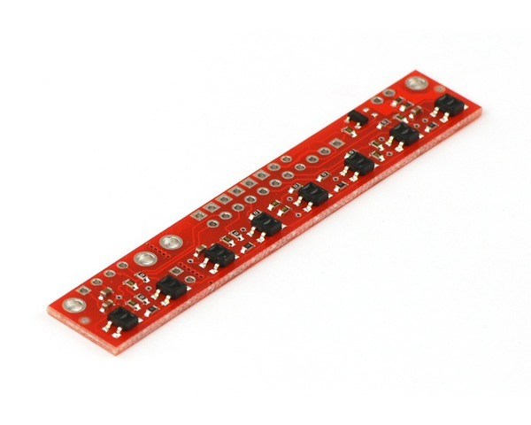
Obstacle Detection + Line Following
Ultrasonic Sensor
Reflectance Sensor
Taylor Harvey
Notes:
Ultrasonic sensor for obstacle detection
Infrared reflectance sensor for the line path following

Slide 28
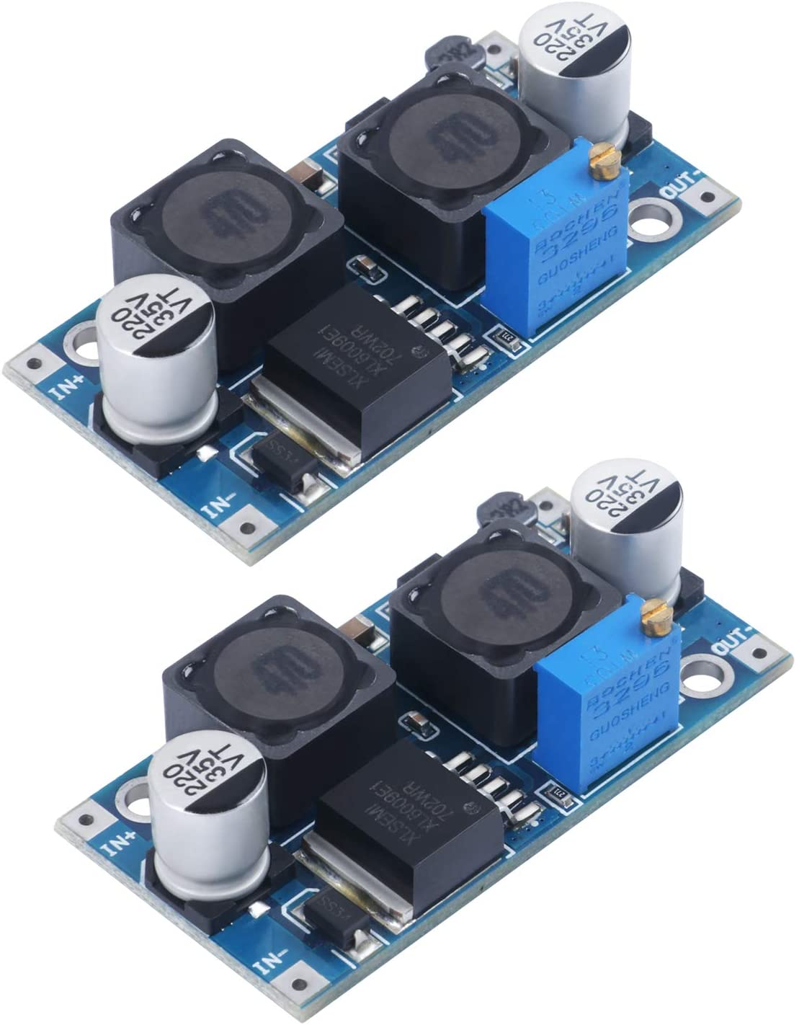
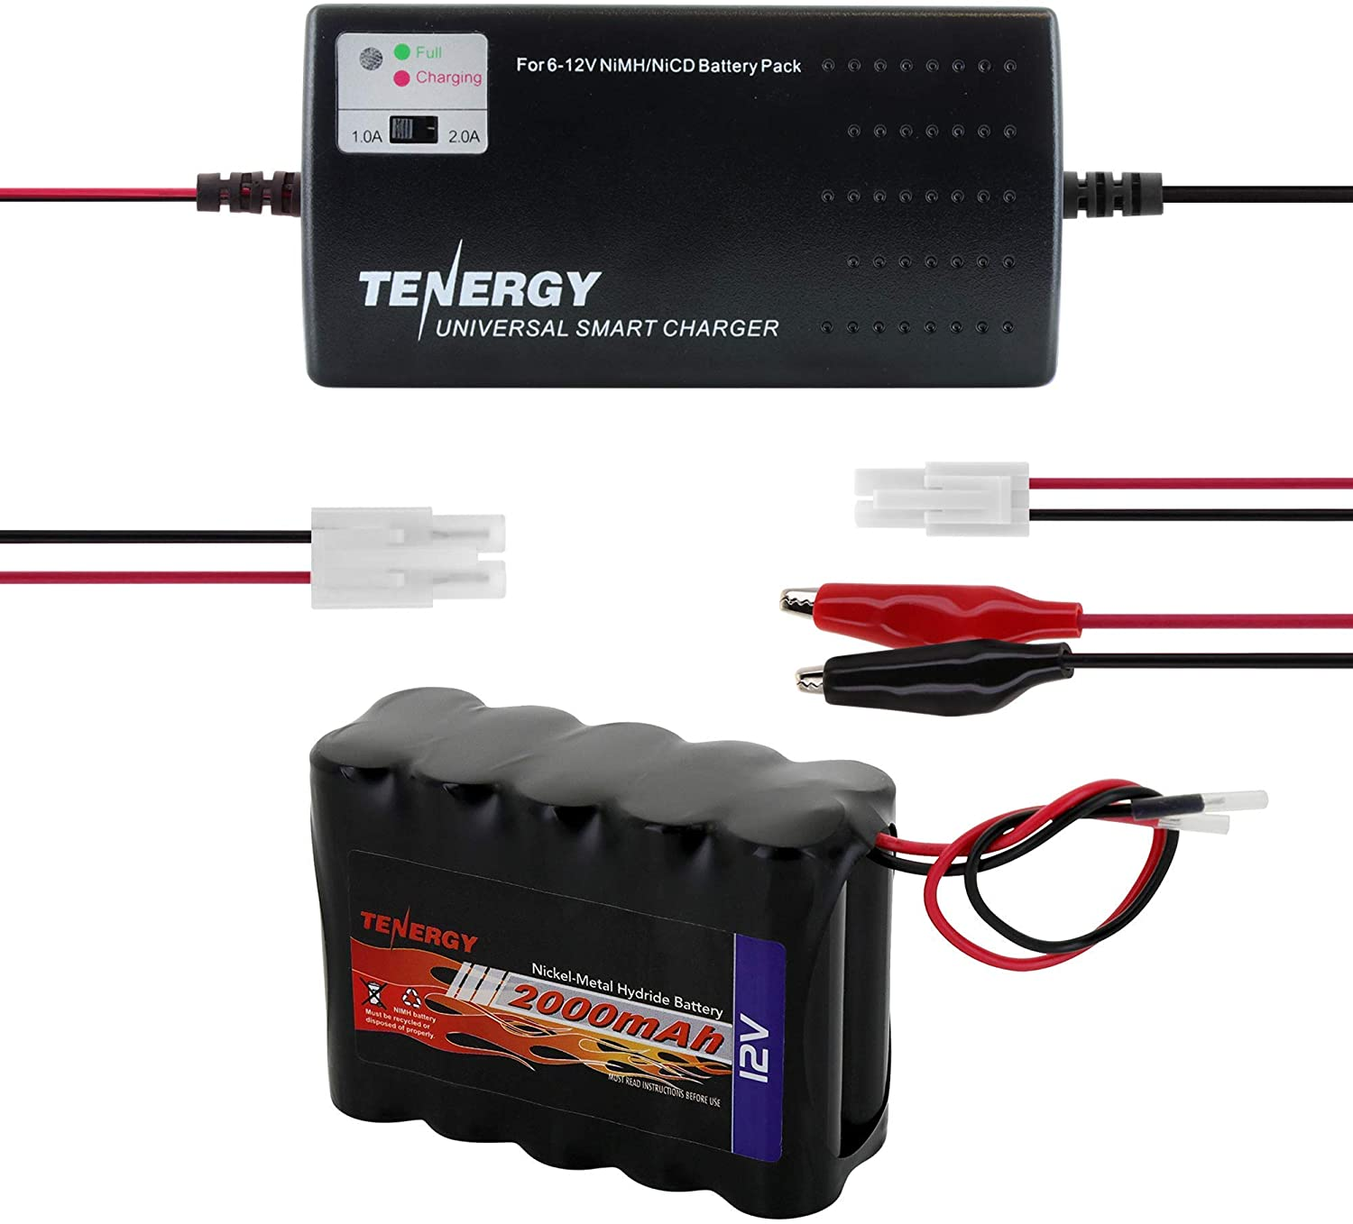
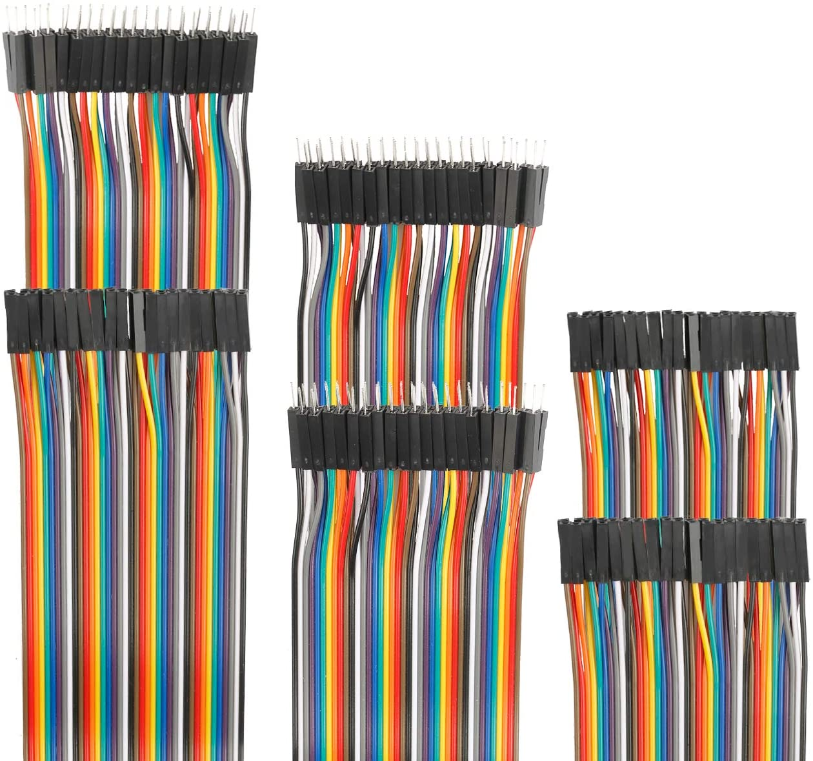
Power
DC-DC Buck Boost Converter
Battery and Charger
Wires
Taylor Harvey

Slide 29
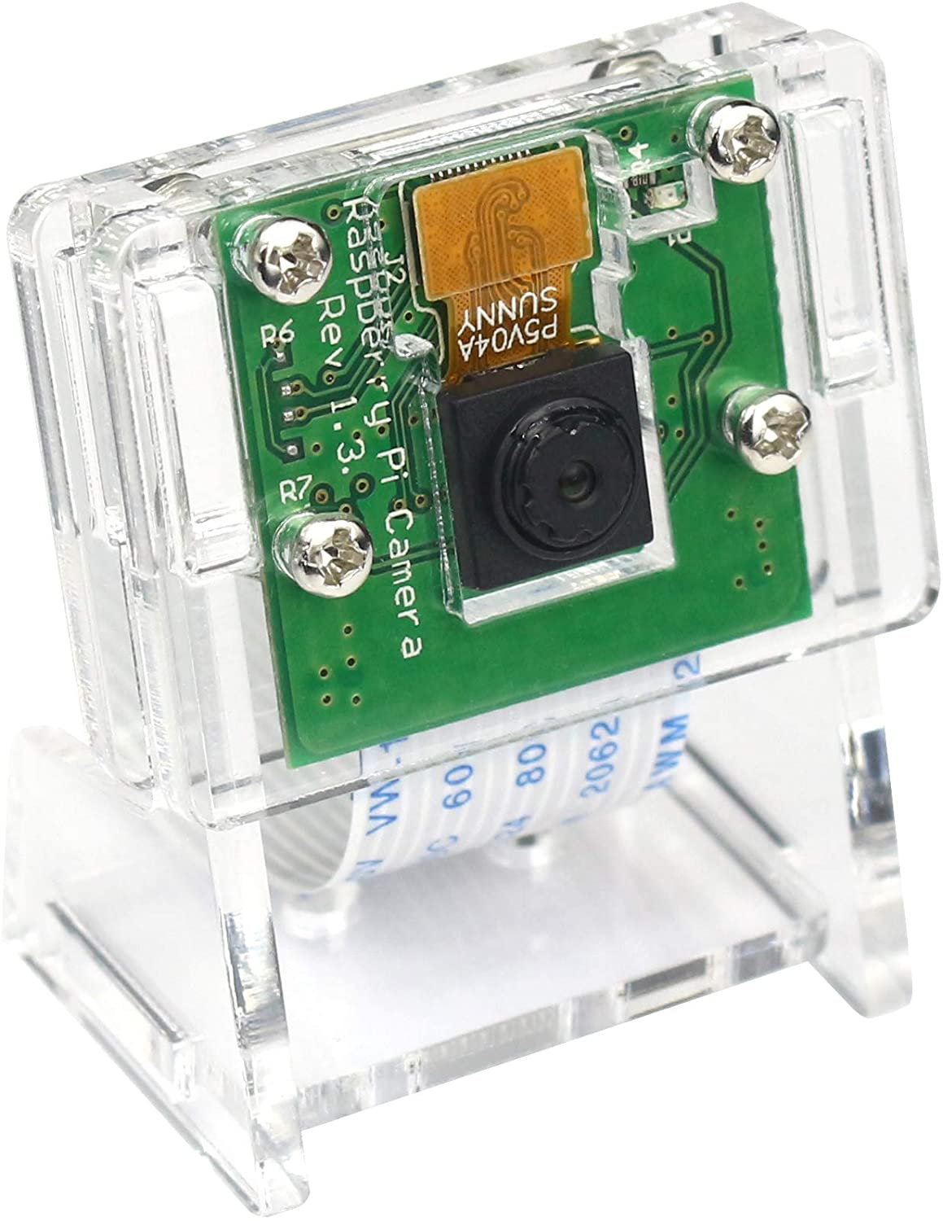
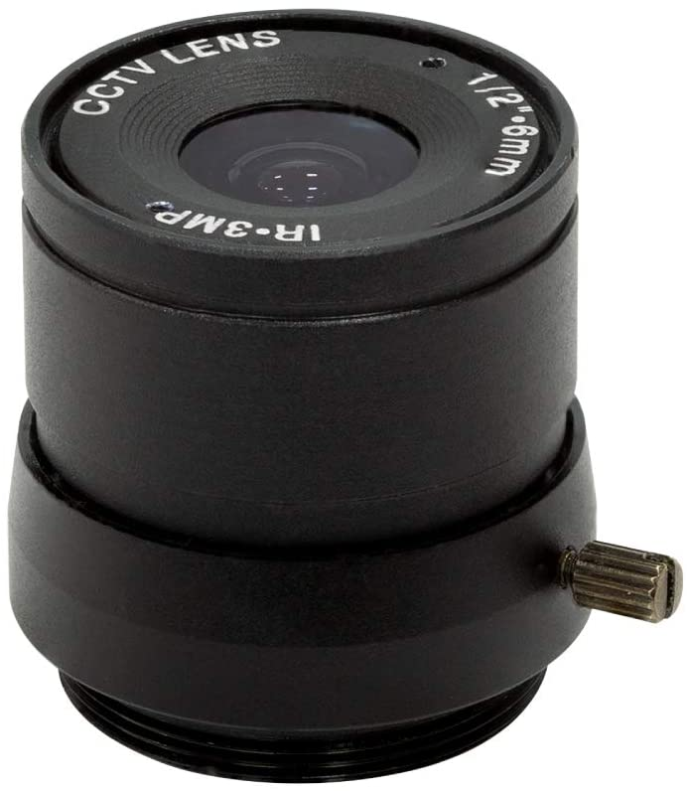
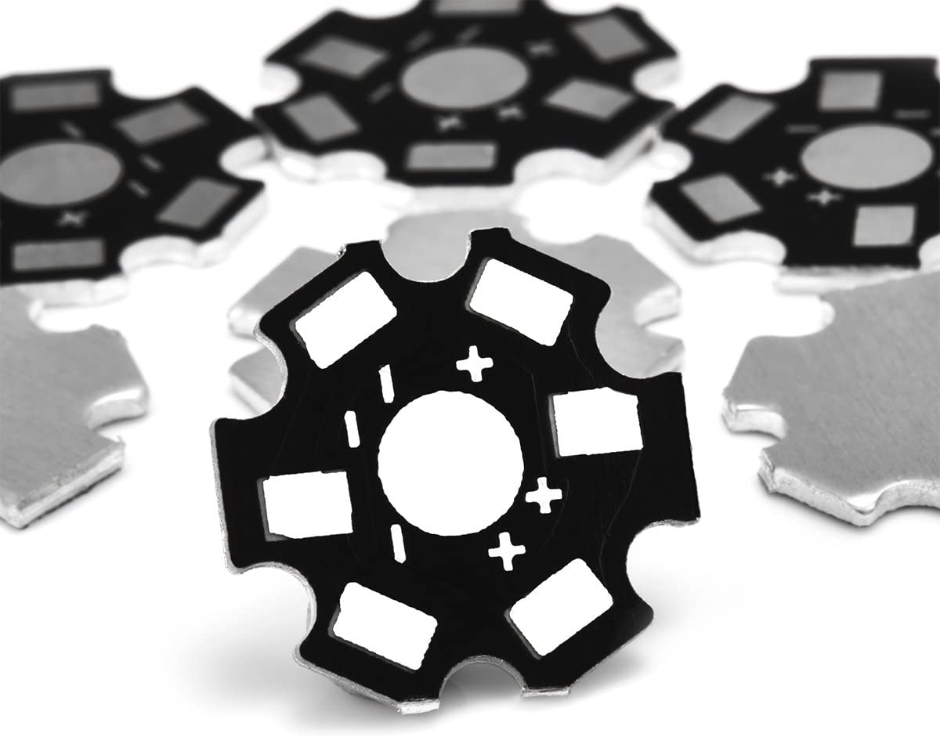
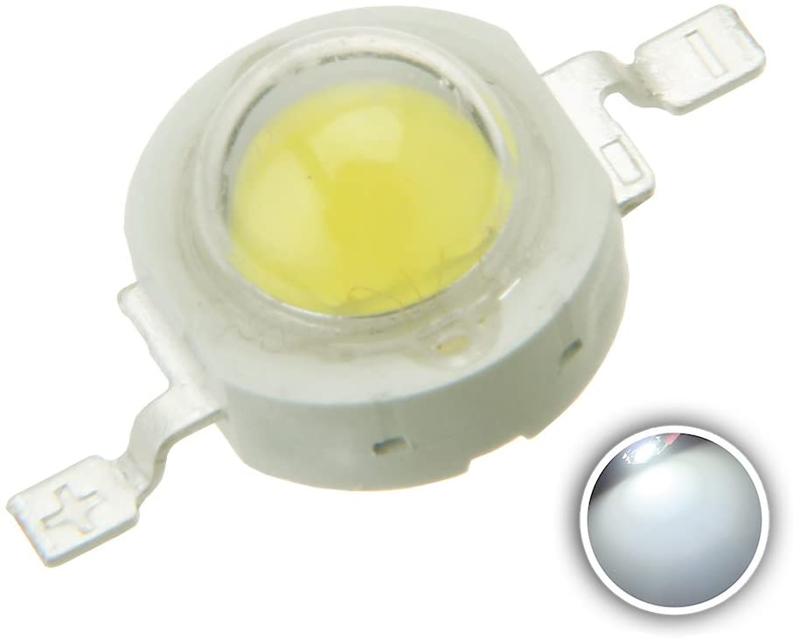
Scanning
LED Heat Sink
1080P Video Camera
Wide Angle Lens
Higher Powered LED
Taylor Harvey
Notes:
The Pi camera with the wide angle lens is for seeing and scanning the QR code, and the higher powered LED is so that the QR code can be seen in the dark. We also want to note that most of our parts have been ordered, but they are having difficulty shipping for some reason.

Slide 30
What We Did So Far This Semester
Staff meeting with Dr. McConomy
Meeting with Dr. Harvey
Preliminary lifting mechanism
Taylor Harvey

Slide 31




Future Work
CAD and fabricate the base, lifting mechanism, and pallet
Test stability of chassis and begin mounting components
Begin programming lifting mechanism
Test and improve lifting mechanism
Taylor Harvey

Slide 32
Concerns: Tipping
Notes:
A potential problem that we will have to account for is tipping. If the robot is too unbalanced it could tip, which would be harmful to the robot and the package. It is also a safety concern for when we are assembling and testing our robot. . We need to apply a counter weight that is able to balance out the robot when it is lifting a package so that it does not tip. We also have to make sure we do not disregard how the counterweight affects the robot when it has no load so the counterweight does not make the robot difficult to control or cause a problem such as the

Slide 33
Concerns: Tipping
Notes:
A potential problem that we will have to account for is tipping. If the robot is too unbalanced it could tip, which would be harmful to the robot and the package. It is also a safety concern for when we are assembling and testing our robot. . We need to apply a counter weight that is able to balance out the robot when it is lifting a package so that it does not tip. We also have to make sure we do not disregard how the counterweight affects the robot when it has no load so the counterweight does not make the robot difficult to control or cause a problem such as the

Slide 34

Concerns: Tipping
Notes:
A potential problem that we will have to account for is tipping. If the robot is too unbalanced it could tip, which would be harmful to the robot and the package. It is also a safety concern for when we are assembling and testing our robot. . We need to apply a counter weight that is able to balance out the robot when it is lifting a package so that it does not tip. We also have to make sure we do not disregard how the counterweight affects the robot when it has no load so the counterweight does not make the robot difficult to control or cause a problem such as the

Slide 35
Concerns: Tipping
Notes:
This causes an uneven distribution of weight, which could potentially make it more difficult in controlling the omnidirectional wheels.

Slide 36
Concerns: Weight Distribution
Notes:
Uneven weight distribution might pose a challenge when using omni-directional wheels. Because it might cause there to be less friction between certain wheels and the ground, causing it to be more difficult to control the robot. It is thus important that the robot is balanced and there is an even weight distribution so the robot can move more smoothly.

Slide 37
Concerns: Weight Distribution
Notes:
Uneven weight distribution might pose a challenge when using omni-directional wheels. Because it might cause there to be less friction between certain wheels and the ground, causing it to be more difficult to control the robot. It is thus important that the robot is balanced and there is an even weight distribution so the robot can move more smoothly.

Slide 38
Concerns: Weight Distribution
Notes:
Uneven weight distribution might pose a challenge when using omni-directional wheels. Because it might cause there to be less friction between certain wheels and the ground, causing it to be more difficult to control the robot. It is thus important that the robot is balanced and there is an even weight distribution so the robot can move more smoothly.

Slide 39




Taylor Harvey
Diandra Reyes
Phone: 321-201-8727
Email: tah16c@my.fsu.edu
Phone: 786-333-9946
Email: dreyesb97@gmail.com
Alexander Wozny
Peter Watson
Phone: 727-600-6472
Email: phw17@my.fsu.edu
Phone: 480-599-9937
Email: alexanderwozny24@gmail.com
Notes:
Any questions?

Slide 43



Notes:
Locomotion:
Locomotion is a main function and involves physically moving the robot since it needs to traverse around the warehouse effectively. One of the assumptions that made this is easier is that the warehouse ground is relatively flat and smooth, which is generally what a warehouse floor is like anyways. For successful locomotion, the robot would need to be able to move and keep the chassis stable. To move, the robot would need to be able to translate and rotate, which involves the robot moving backwards and forwards, as well as turning, and thus torque and control over the amount and direction of torque needs to be produced. We also included chassis stability because if it were unstable, it would not be able to move properly and would most likely fail in the future.

Slide 44







“Vacuuminator”
“Omni Forklift
Scan Inventory
Magnetic Tape
Omni-Directional
Vacuum End-Defector
Obstacle Detection
QR Code
Line Path
Forks
RFID
Lidar
Ultrasonic
Path Following
Drive Train
Control Package
Notes:
Omni-directional Wheels
lithium polymer battery
Magnetic tape for navigation
Vacuum end effector for manipulation
RFID
Lidar

Slide 45

Autonomous Robots
at work
Notes:
The robot will be able to support a load of 50 pounds

Slide 46


Slide 47


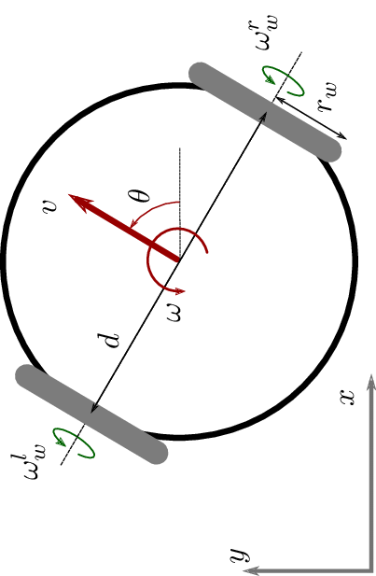
“”
“Differential Forklift”
Differential
steering
RFID
Magnetic tape
Ultrasonic
Infrared
Fork

Slide 48


Path Finding
Notes:
MAYBE ADD HEATED WIRE AS WELL

Slide 49


Slide 50
Lift Force
Notes:
Claw

Slide 51
Appendix

Slide 52
Needs Table
What is the purpose of this robot? | The robot must be able to retrieve and deliver things in a warehouse setting. -Customer | Robot is autonomous in nature and capable of data-processing.
What are the surroundings and environment the robot will be operating in? | It will be used in a warehouse setting. The robot should be able to operate in conditions that are unfavorable to humans (i.e. hot temperatures that could make workers pass out or get heat strokes). -Customer/Dr. McConomy | The robot is able to navigate around a warehouse.
 |  | The robot is able to sense and navigate around obstacles.
 |  | The robot can perform tasks in the dark.
 |  | Also, will perform in temperature conditions undesirable to humans.

Slide 53
Needs Table (continued)
What kind of items should the robot be able to handle? (Approximate weight) | Following OSHA regulations, a person should not be able to carry more than 50 lbs. If the robot were to malfunction a worker must aid it. Thus, the robot should carry a max load of 50 lbs. -OSHA | The robot can carry packages up to 50 lbs.
 |  | The robot will follow OSHA regulations.
 |  | When the robot malfunctions, it sends out an error alert for servicing.
What kind of retrieval methods should the robot achieve? | The robot should be able to pick things in a vertical and horizontal motion. Also, items shouldn’t be damaged when being set down. -Customer | Robot will have multiple degrees of freedom for movement.
 |  | Robot includes grasp force and manipulation control to prevent damaging items.

Slide 54
Needs Table (continued)
Would you want to have a handling input device? | “The robot can be operated under supervisory control. ​” -Customer | The user will operate and control the robot if desired.
What forms of power supply are accessible to you? What kind of power source do you prefer? | The robot has to have some way to recharge its battery fully so it can be active all hours of the working day. -Customer | Robot can operate over a 9-hour period before it has to recharge.
 |  | Robot navigates to an area where it can receive charging before the battery runs out.
Do you need the robot to track inventory as it delivers items? | Yes, it must be able to interface with our supply chain system | The robot will include modules to process machine readable codes and deliver information.

Slide 55
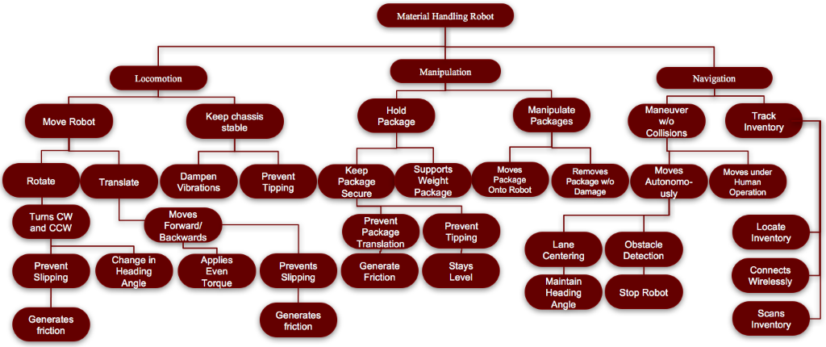
Functional Decomposition
Notes:
3 primary systems:
Locomotion – has to do with physically moving the robot
Manipulation – has to do with moving and manipulating the packages
Navigation – has to do with moving around and navigating around the warehouse
- Inventory Tracking

Slide 56
Material Robot
Locomotion
Move Robot
Keep Chassis Stable
Manipulation
Manipulate Package
Navigation
Hold Package
Track Inventory
Manuever Without Collision

Slide 57
Locomotion
Move Robot
Keep Chassis Stable
Translate
Dampen Vibration
Prevent Tipping
Rotate
Moves Forward and Backward
Turns CW and CCW
Applies even torque
Prevents slipping
Change heading angle
Prevents slipping

Slide 58
Manipulation
Manipulates Package
Moves Package onto Robot
Removes Package from Robot
Holds Package
Keeps Package Secure
Prevent Package Translation
Prevent Package Tipping
Support Package Weight

Slide 59
Navigation
Maneuver without Collision
Moves autonomously
Moves under Human Operation
Track Inventory
Connects to Network
Locates Inventory
Scans Inventory
Lane Centering
Obstacle Detection

Slide 60
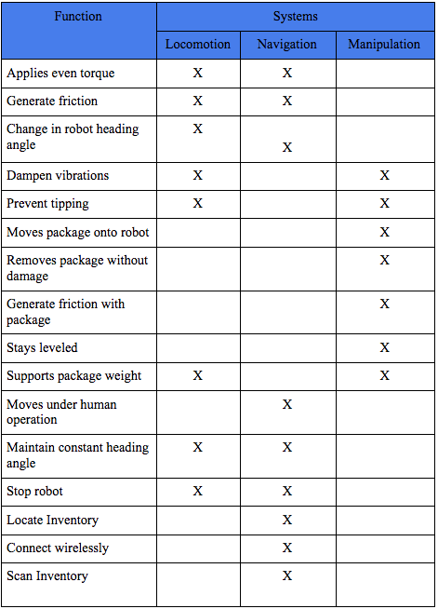

Slide 61
Targets and Metrics
Attribute | Target | Unit of Measure | Metric | Description
Generates Friction (wheels) | 17.1 N | Newtons | Force | The wheels must have enough friction to prevent slip
Change in Heading Angle | 360º | Degrees | Angle | Robot turns in a full circle.
Applies Even Torque | <1% | Percent | Error | Robot applies even torque on both sides of the wheels to move straight.
Control velocity | 2.25 m/s | Meters per second | Velocity | Minimum traveling speed through the warehouse.
Generates friction (box) | ≤ 22.68 N | Newtons | Force | The box must be prevented from sliding.
Generates friction (manipulator) | ≤ 22.68 N | Newtons | Force | The manipulator must have enough friction to prevent box from slipping
Stays level | 0º | Degrees | Angle | Robot maintains an even horizontal alignment.
Moves Package onto Robot | 224 N | Newton | Force | Robot lifts package inventory.

Slide 62
Targets and Metrics (cont.)
Attribute | Target | Unit of Measure | Metric | Description
Moves Package onto Robot | 224 N | Newton | Force | Robot lifts package inventory.
Removes Package w/o Damage | 0 | Packages | Amount | Only a certain percent of packages show signs of damage.
Maintain Heading Angle (Relative to Path) | 0º | Degrees | Direction | Robot accurately follows a path.
Stop Robot | 0 m/s | Meters per second | Velocity | Robot stays in the stopping position.
Accelerate Robot | < 1 m/s² | Meters per second squared | Acceleration | Robot must not accelerate (positively and negatively) so fast that the package falls off.
Moves Under Human Operation | 1 | N/A | Boolean | Robot responds to human input
Locate Inventory | 1 | N/A | Boolean | Robot knows where inventory belongs and takes/retrieves inventory to the correct location.
Connect Wirelessly | 1 | N/A | Boolean | Robot can successfully connect to inventory database and be controlled wirelessly.

Slide 63
Targets and Metrics (cont.)
Attribute | Target | Unit of Measure | Metric | Description
Moves Package onto Robot | 224 N | Newton | Force | Robot lifts package inventory.
Connect Wirelessly | 1 | N/A | Boolean | Robot can successfully c
Scans Inventory | 1 | N/A | Boolean | Robot is able to scan a label and identify inventory.
Senses Obstacles | 2.5 m | Meters | Distance | Robot detects obstacle in its path.
Sends Error Message | 1 | N/A | Boolean | If the robot detects an obstacle it will send an error message to the appropriate personnel.

Slide 64
Morphological Chart
 | Option 1 | Option 2 | Option 3 | Option 4 | Option 5 | Option 6 | Option 7
Drive Train | Differential Steering | Omni-Directional (Universal) | Ackerman (Rear wheel drive) | Ackerman (Front wheel drive) | Track Rails | Magnetic Track
Power | Lithium Ion | Lead Acid | Lithium Polymer | Alkaline | Nickel Cadmium
Path Following | Magnetic tape | Line path | Track “rails” | GPS | Heated line | Pavement Markers | Induction Wire
Obstacle Detection | Lidar | Thermal | Visual Inertial | Infrared | Ultrasonic | Distance sensor | Push sensor with bumper
Controls package | Forks | Vacuum end effector | Single Clamp/claw | Magnet end effector | Hook | Two Clamps/Claw
Scans Inventory | QR Code | RFID Tag | Barcode Scanner | April Tag | Color coded

Slide 65
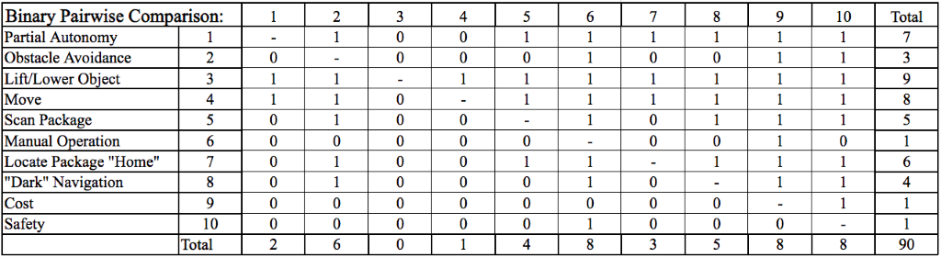
Binary Pairwise Comparison

Slide 66
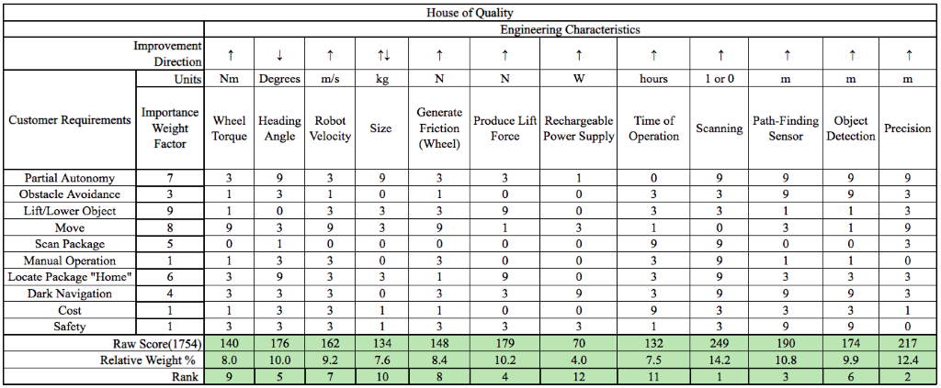
House of Quality

Slide 67
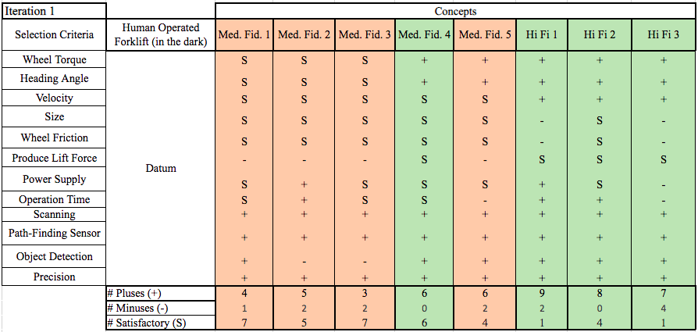
Pugh Chart Iteration 1

Slide 68
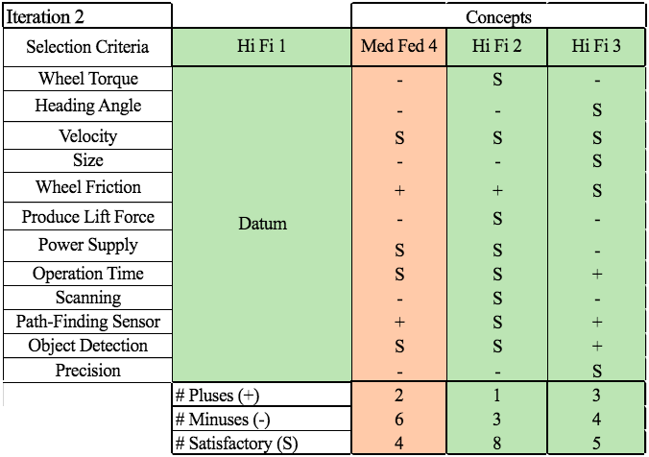
Pugh Chart Iteration 2

Slide 69
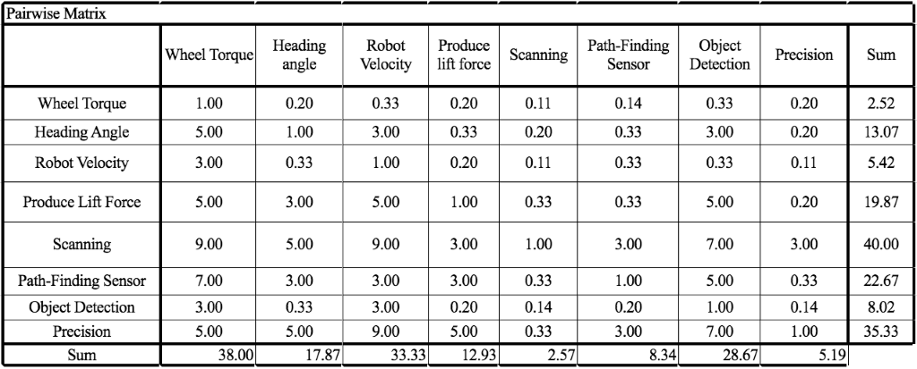
Pairwise Matrix

Slide 70
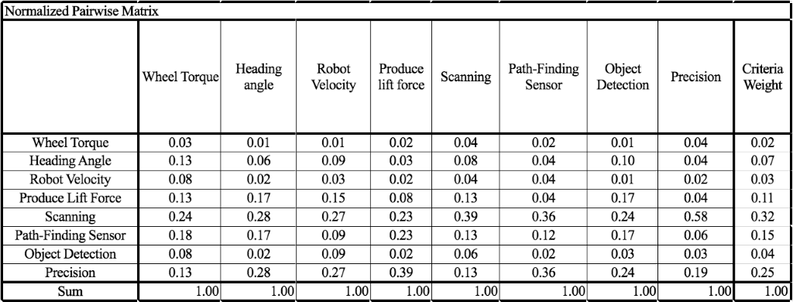
Normalized Pairwise Matrix

Slide 71
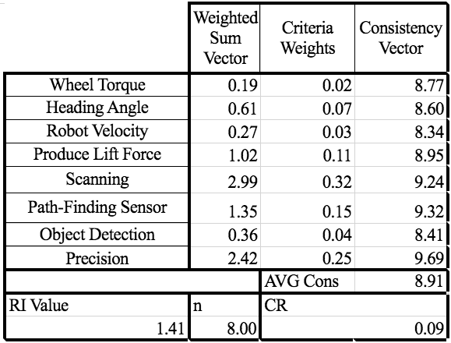
Consistency Check Engineering Characteristics

Slide 72
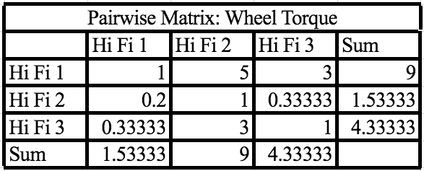
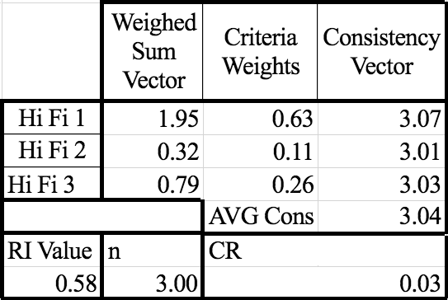
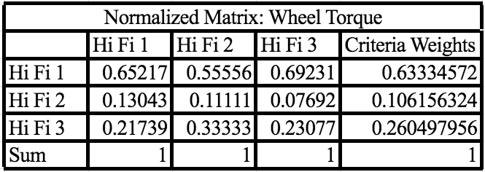
Wheel Torque Matrices

Slide 73
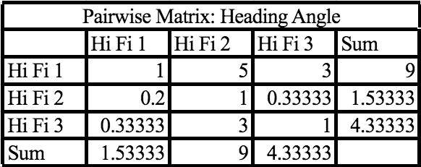
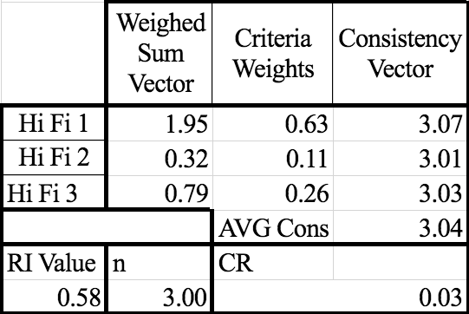
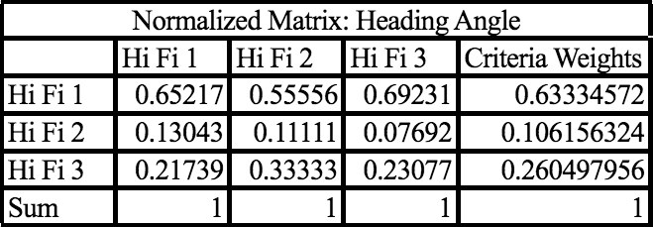
Heading Angle Matrices

Slide 74
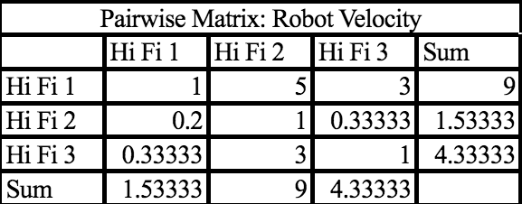
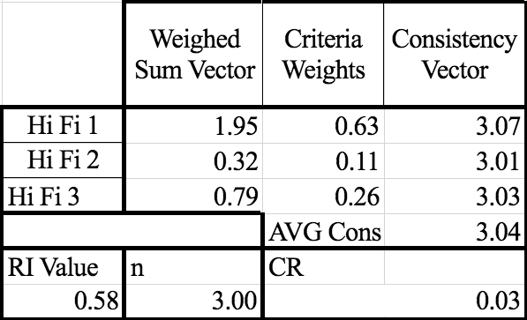
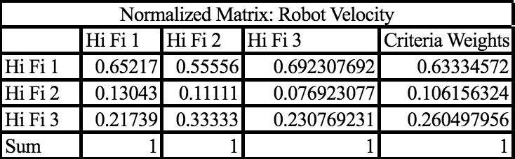
Robot Velocity Matrices

Slide 75
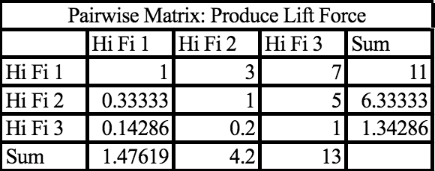
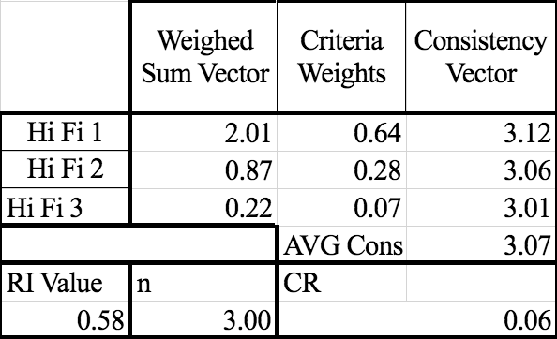
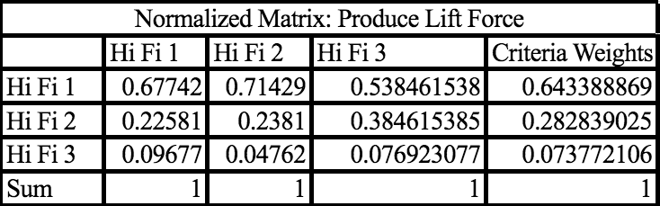
Lift Force Matrices

Slide 76
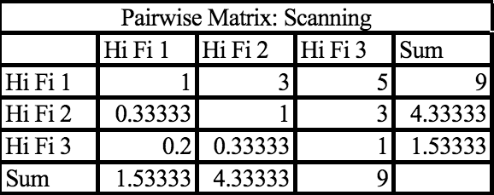
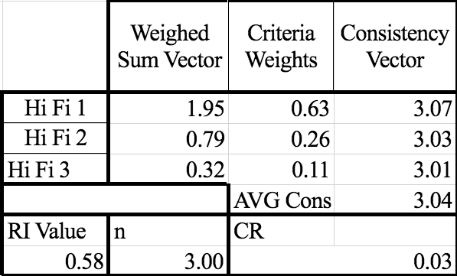
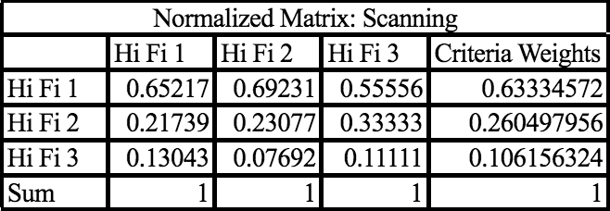
Scanning Matrices

Slide 77
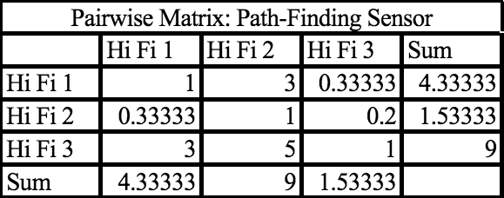
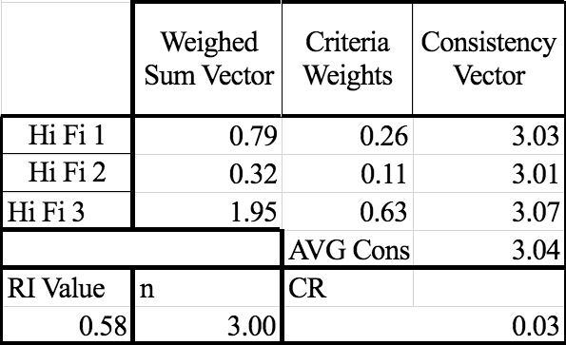
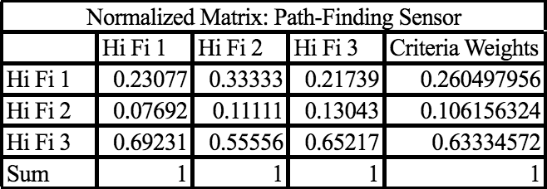
Path Finding Matrices

Slide 78
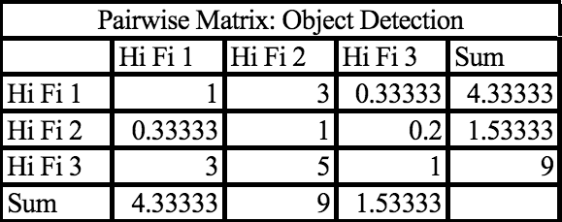
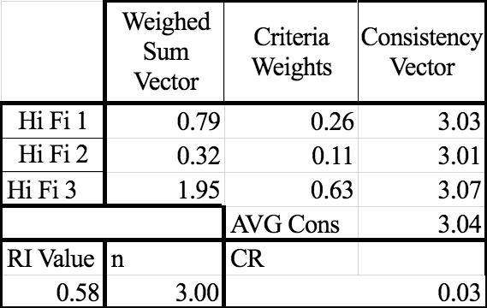
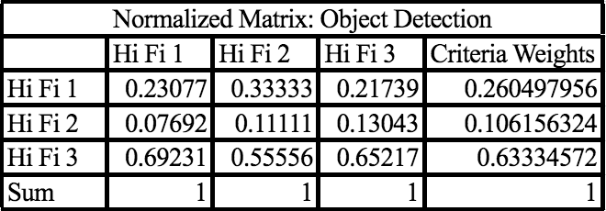
Object Detection

Slide 79
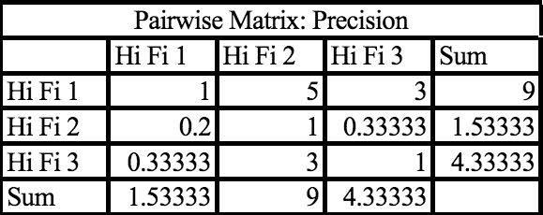


Precision

Slide 80


Final Selection

Slide 81

Spring Plan ME Team

Slide 82

Spring Plan EE Team

