Slide 1
T506: Material Handling Robot
Team: Taylor Harvey, Diandra Reyes, Peter Watson, Alexander Wozny

Slide 2




ME Senior Design Team 506
DIANDRA REYES
Mechatronics Engineer
ALEXANDER WOZNY
Systems Engineer
TAYLOR HARVEY
Mechanical Design Engineer
PETER WATSON
Materials Engineer
Diandra Reyes
Notes:
Each member present themselves on this slide

Slide 3


Senior Design ECE Team
WALTER CALDWELL
Project Manager
TIFFANY MILLER
Hardware Engineer
SEBASTIAN MURIEL
System Engineer
ALEX JEN
Software Engineer
TONY ZHENG
Financial Advisor
Diandra Reyes

Slide 4




Sponsors
Project Sponsor
Dr. Jerris Hooker
Project Advisor
Dr. Camilo Ordóñez
Dr. Shayne McConomy
FAMU – FSU College of Engineering
Diandra Reyes
Notes:
We'd like to thank our sponsors:
Project Sponsor (Dr. Jerris Hooker) - Design Professor.
Project Advisor Camil Ordonez -
Dr. Shayne McConomy – Our teacher that offers guidance for the project

Slide 5


Objective
The objective of this project is to create a partially autonomous material handling robot that works in a dark warehouse with conditions unfavorable to human workers.
Notes:
State objective

Slide 6
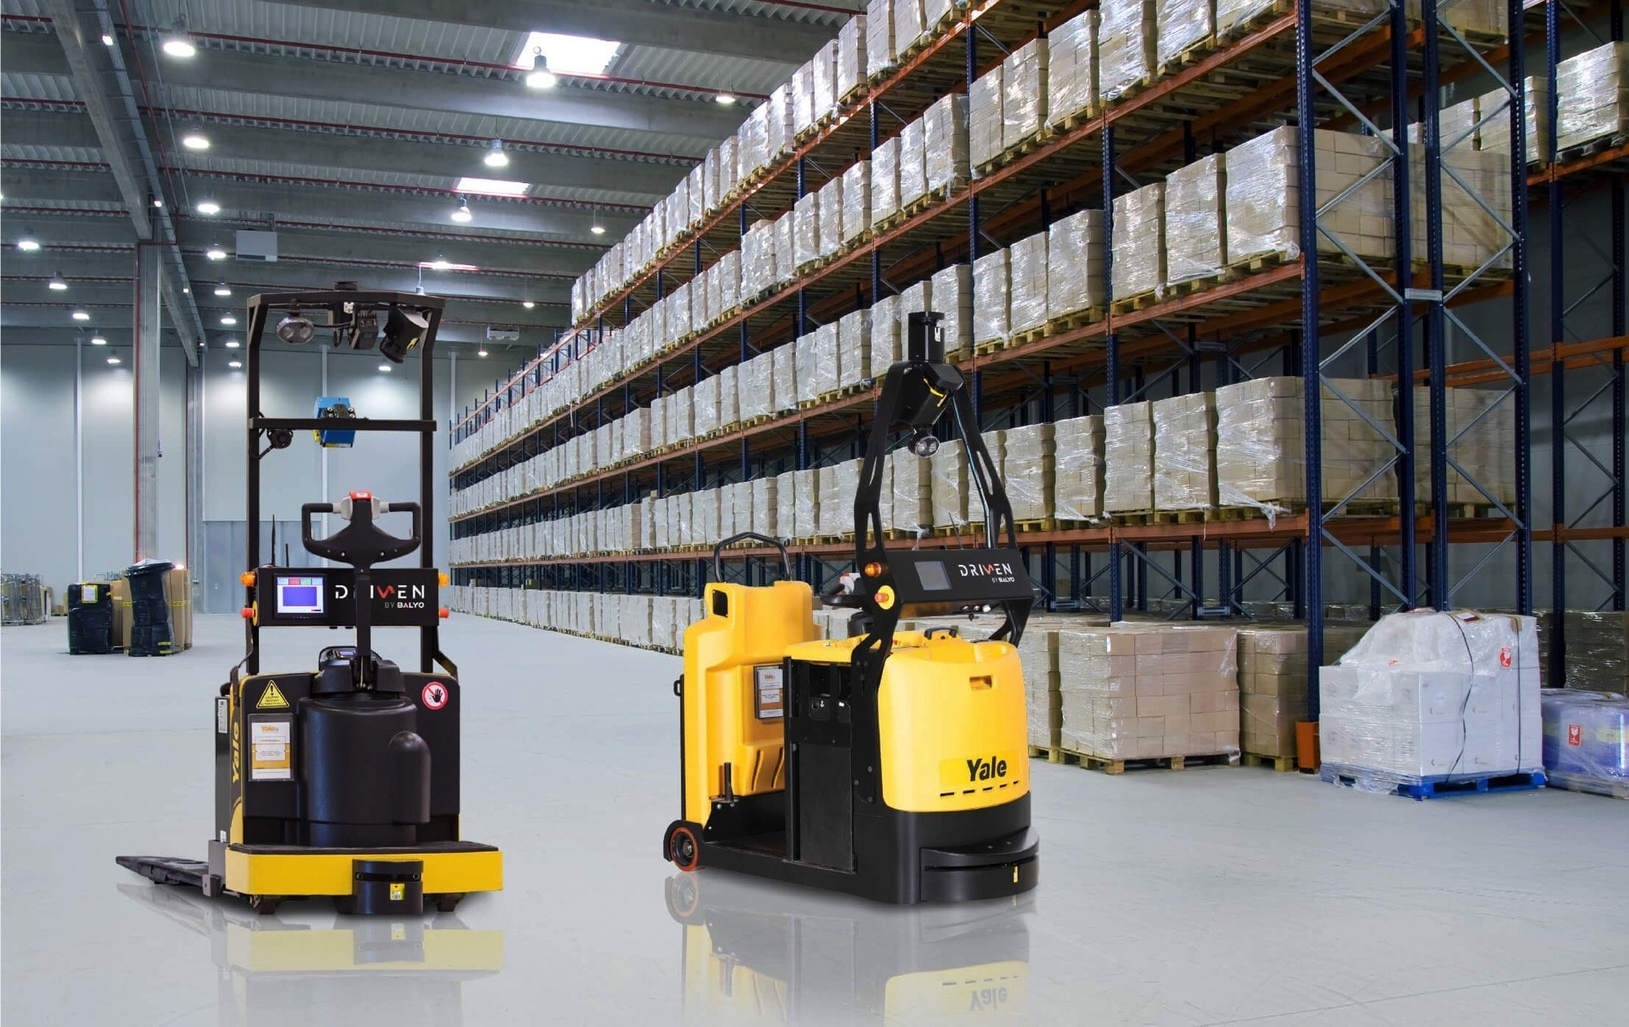
Motivation
Semi-autonomous warehouse where robots do most of the labor
Reduce costs and increase profits
  No lights or AC needed
  Robots can work 24 hours a day
  Less staff needed to manage the warehouse

Slide 7
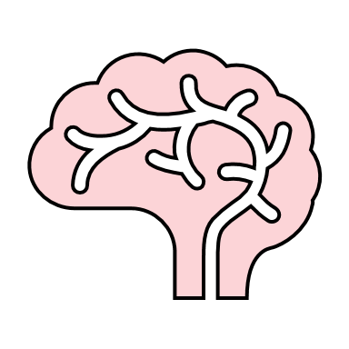








Goals
Partial Autonomy
Operate in a Dark Environment
Lift Up to 25 lbs
Track Inventory
Rechargeable
Maneuver w/o Collision
Obstacle Avoidance
Notes:
Robot movement is partially autonomous
Operate in a dark environment
The robot that we will be building is expected to safely lift and move up to a 25 lb load
Track inventory, which involves being able to know a package's location in the warehouse and the path to get there
Avoid obstacles- Robot must be able to maneuver itself around the warehouse without collision

Slide 8





Assumptions
Maintenance will be provided by a third party
Traverses' flat surfaces
The warehouse will not be altered.
A power supply is accessible.
The product is working indoors.
Notes:
Though maintenance is not included, users could access components of the robots for maintenance.
Will not provide regular services or maintenance for the robot. This is outside of the scope of our project.
Robot will only traverse over flat surfaces and no rugged terrain
The warehouse will not be altered by humans making mistakes and moving stuff around. Additionally, since the robot will not be fully autonomous the shelves won't be constantly being moved around so the warehouse

Slide 9


Autonomous Robots
at work
Notes:
Final concept selected

Slide 10
Autonomous Robots
at work
Notes:
Final concept selected

Slide 11

Autonomous Robots
at work

Slide 12
Autonomous Robots
at work

Slide 13
What We’ve Done So Far Since VDR4
Started the assembly of the chassis
Incorporated new motor for the lifting mechanism and 3D printed motor mount.
The EE team is working on the inventory database and coding the navigation for the system

Slide 14

Notes:
QR codes will be placed around the warehouse. At each line intersection, the robot will scan a QR code, which helps it to localize itself. Lines will also break off from the main line towards the package locations on the shelves. This will help the robot line itself up with the package to pick it up or place it down on a shelf.

Slide 15
Notes:
QR codes will be placed around the warehouse. At each line intersection, the robot will scan a QR code, which helps it to localize itself. Lines will also break off from the main line towards the package locations on the shelves. This will help the robot line itself up with the package to pick it up or place it down on a shelf.

Slide 16
Notes:
QR codes will be placed around the warehouse. At each line intersection, the robot will scan a QR code, which helps it to localize itself. Lines will also break off from the main line towards the package locations on the shelves. This will help the robot line itself up with the package to pick it up or place it down on a shelf.

Slide 17

Notes:
For navigation, the robot needs to be able to find the shortest path to get to the goal. To make navigation easier, the warehouse can be mapped as a grid, with each intersection representing a point on the grid with an x and y coordinate. For example….

Slide 18
Notes:
For navigation, the robot needs to be able to find the shortest path to get to the goal. This is important so that it does not waste time traveling all the warehouse taking a long path.

Slide 19
(1,4)
(0,1)
Notes:
For example, let’s say the robot is at point (0,1) on this grid, and it wants to travel to a goal location at (1,4).

Slide 20
Notes:
Based on its current location, the robot would check the nodes, or intersections, closest to it.

Slide 21
Notes:
Once it knows the closest nodes in its immediate vicinity, the distance from these closest nodes to the goal location is calculated.

Slide 22
Notes:
The robot then decides to move to the node in its immediate vicinity that is closest to the goal location.

Slide 23
Notes:
The robot then continues to do the same process. Once it knows it has reached the node it chose to travel to, it looks for the closest nodes in its immediate vicinity and finds the distance from each node to the goal.

Slide 24
Notes:
Then, of these nodes, it selects the one closest to the goal location

Slide 25
Notes:
The robot does this until it finally reaches the goal location

Slide 26
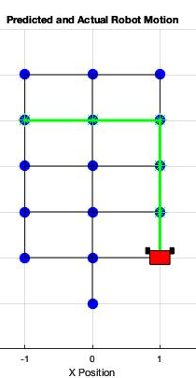
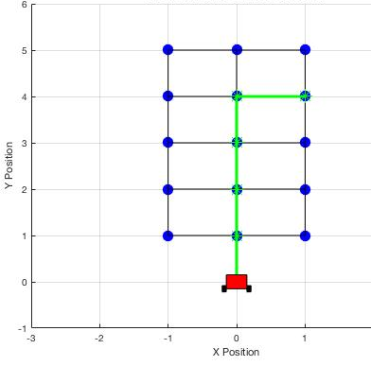
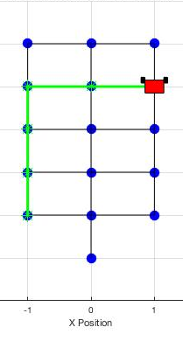
MATLAB Path Finding Simulation
Notes:
Here is a simulation of the robot choosing a path from one location to another. It finds the shortest path. However, it still has a few bugs as it does not always take the best path based on the robots orientation. For example, in the third plot to the right, it would make more sense for the robot go straight and then head to the left, making only 1 turn. Instead, though, it makes 2 turns by heading to the left first and then turning again to go downwards.

Slide 27
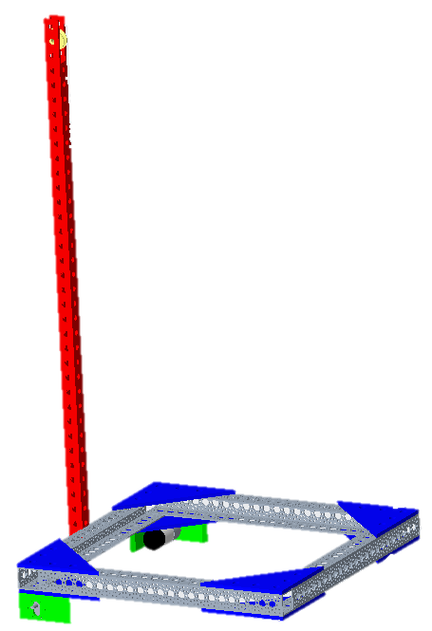
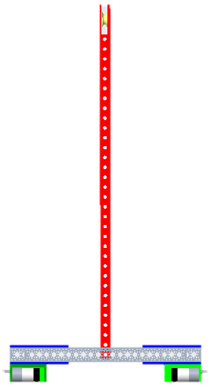
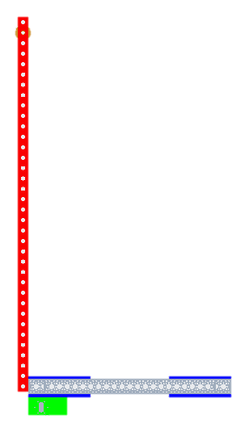
Chassis Assembly
Chassis Frame
Custom Brackets
Nuts and Bolts
Mast
Motor Mounts
General View
Front View
Side View
Peter Watson
Notes:
Nuts and bolts to secure channel: M12-1.75
Bolts

Slide 28

Chassis Assembly
Chassis Frame
Custom Brackets
Nuts and Bolts
Mast
Motor Mounts
Composed of 4 channels channels 18” long
Material: 6061 T6 Aluminum
Compatible Hub Patterns: 0.770'' and 1.50''
Peter Watson
Notes:
Aluminum 6061 T6 has good strength-to-weight ratio which is why it is known to be used in structural applications.
- hub patterns refer to the arrangement of the holes
we utilized 1.5'' pattern for all added components that we manufactured ourselves.
Composed of 4 channels 18” long
Material: 6061 T6 Aluminum
Compatible Hub Patterns: 0.770'' and 1.50''

Slide 29

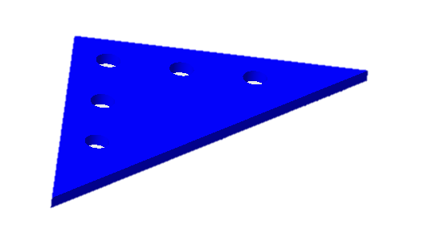

Chassis Assembly
Chassis Frame
Custom Brackets
Nuts and Bolts
Mast
Motor Mounts
Material: Aluminum 6061 T6
0.25-inch-thick sheets used to waterjet 8 triangular brackets
1.5'' Hub pattern utilized
Peter Watson
Notes:
Aluminum 6061 T6 has good strength-to-weight ratio which is why it is known to be used in structural applications.
Material: Aluminum 6061 T6
0.25-inch-thick sheets used to waterjet 8 triangular brackets
1.5'' Hub pattern utilized

Slide 30

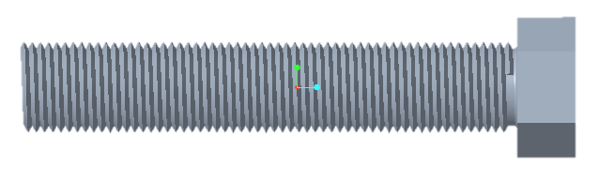

Chassis Assembly
Chassis Frame
Custom Brackets
Nuts and Bolts
Mast
Motor Mounts
M12 – 1.75 mm x 3-inch hex bolts and nuts
Material: Stainless Steel
Total quantity: 16 bolts and nuts
Peter Watson
Notes:
Make sure to mention the brackets in the back are fully secured (all 5 holes bolted) for the sake of securing the motor mounts.
M12 – 1.75 mm x 3-inch hex bolts and nuts
Material: Stainless Steel
Total quantity: 16 bolts and nuts

Slide 31
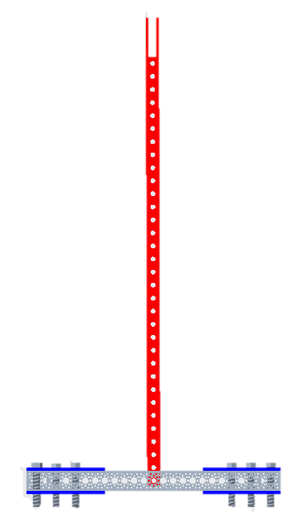

Chassis Assembly
Chassis Frame
Custom Brackets
Nuts and Bolts
Mast
Motor Mounts
1-inch x 1-inch x 3 feet hollow square tube
Material: Galvanized Steel
Machined for pulley incorporation
Secured using 3/16 - 18 hex bolts and nuts
Peter Watson
Notes:
Explain the cut: for pulley
REMEMBER TO MENTION: the nuts and bolts for the mast aren't in metric is because they were found in our local resource center the Senior Design Lab. All other nuts and bolts used in the chassis were ordered by team 506.
1-inch x 1-inch x 3 feet channel
Material: Galvanized Steel
At the top of channel, a 0.6-inch x 3-inch slot was cut to make room for the pulley wheel used in lift system.
Secured using 3/16 - 18 hex bolts and nuts

Slide 32
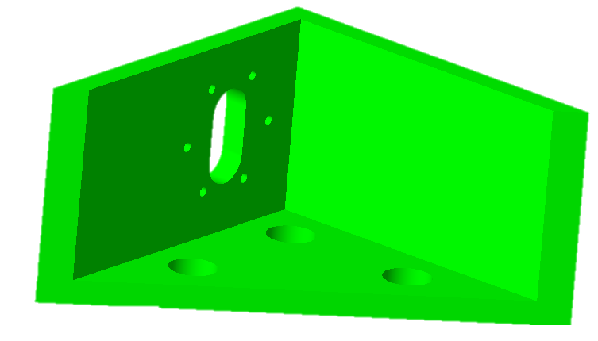
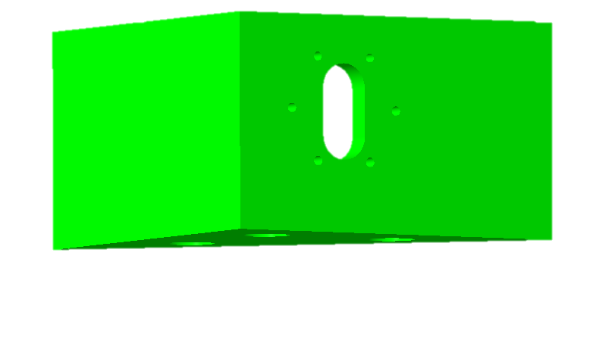
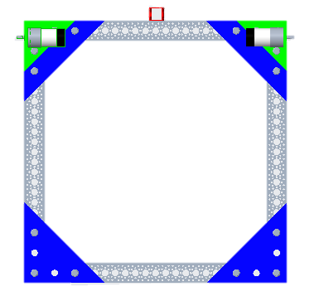
Chassis Assembly
Chassis Frame
Custom Brackets
Nuts and Bolts
Mast
Motor Mounts
3D printed motor mounts
Material: PLA
Secured using M12-1.75mm x 3-inch hex bolts and nuts
Motors secured to mounts using M3 – 0.5 mm x 20 mm bolts
Peter Watson
Notes:
Aluminum 6061 T6 has good strength-to-weight ratio which is why it is known to be used in structural applications.
3D printed motor mounts using 1.5'' hub patterns to connect to channel
Material: PLA
Secured using M12-1.75mm x 3-inch hex bolts and nuts
Motors will be secured to mounts using M3 – 0.5 mm x 20 mm bolts

Slide 33
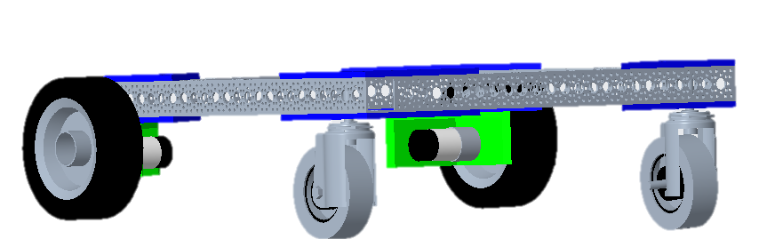
Drive Train
Differential Drive
Rear wheels will dictate speed and direction.
Materials
2 DC Gear motors with encoders
2 6-inch diameter tires
Validation
Due to delayed deliveries of materials caused by external forces both the ME and ECE teams decided to pursue this specific form of drive train
2 caster wheels
Peter Watson

Slide 34


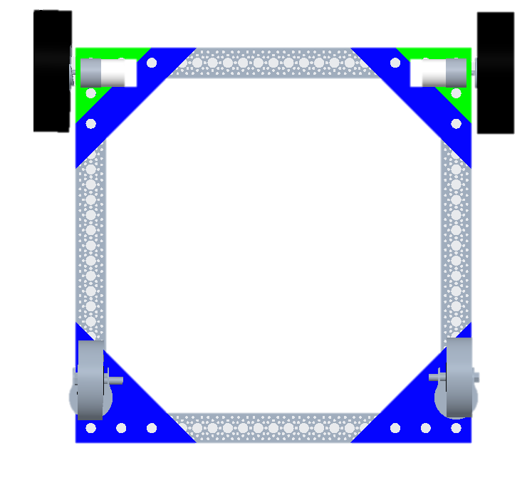
Drive Train
1000 rpm
1006 rpm
1010 rpm
1009 rpm
1004 rpm
1001 rpm
1008 rpm
1007 rpm
1005 rpm
1002 rpm
1000 rpm
1003 rpm
The motors have built in Hall quadrature encoders with a resolution of 5756 counts per revolution
The encoder can give us the position and speed of the motor so that we can better control the robots heading.
Peter Watson
Notes:
- motors come with encoders and will be programs using the Encoder library within the Arduino compiler which counts pulses from quadrature encoded signals, which are commonly available from the motor and other position sensors.

Slide 35
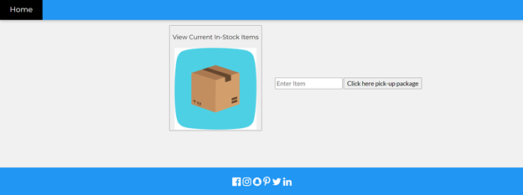
User Interface
View Current In-Stock Items
Enter item
Click here pick-up package
Peter Watson
Notes:
Now to walk the audience through our interface

Slide 36
User Interface
View Current In-Stock Items
Box 1
Click here pick-up package
Peter Watson
Notes:
Let's say you want to pick up and deliver "box 1" to a certain location

Slide 37

User Interface
You’re package is being delivered!
Peter Watson
Notes:
The interface notifies you when the process begins

Slide 38
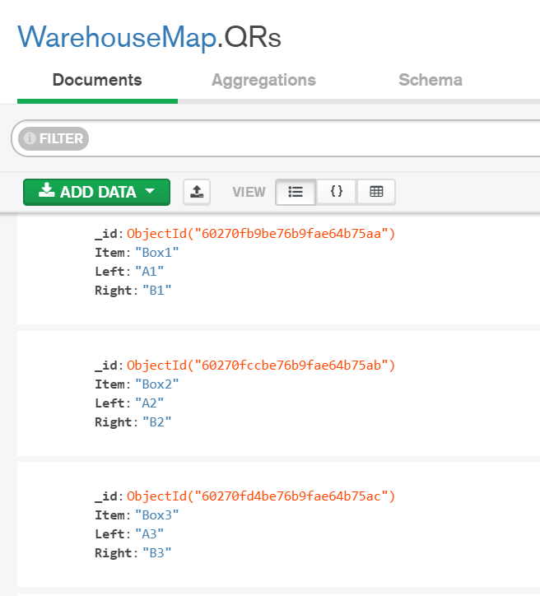
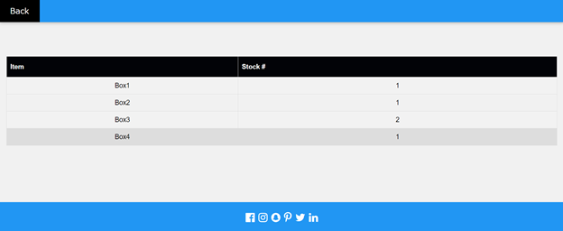
User Interface
Peter Watson
Notes:
Meanwhile, in the backend, the warehouse is mapped using QR codes. Each code delivers instructions to the robot regarding the package it is handling as well as the direction it must go. The robot would "read" these codes using a Camera that will be connected to the PI so there is a steady flow of information throughout the process.
- User doesn't

Slide 39
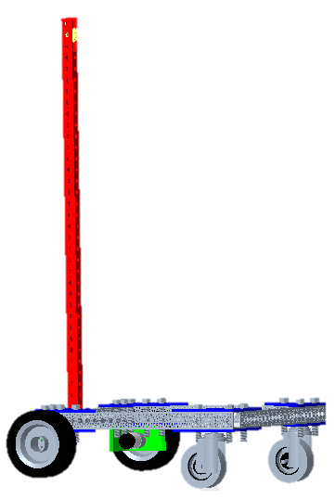
Communication Process
Web browser
User provides desired package
Node JS is used to deliver python scripts to PI
Raspberry Pi
Python scripts call the Arduino using I/O or input/output
Arduino
Compiled from C to control motor encoders resulting in desired navigation.
Personal web server set up onto it
Pi Camera captures information from QR codes
Peter Watson
Notes:
- node js is an open source, cross platform backend runtime that delivers scripted code outside the web browser
-I/O is just a form of communication that occurs between a processing unit and
Look at texts from a. jen
Explica el proceso del usuario usando la pagina y la pagina controlando la sistema
Fotos!
Menciona lo diferente idiomas que usaron pero no da tanto detalle que nosotros somos ingieneros mecanicos no de computadora.

Slide 40
Future Work
Attach the lifting mechanism to the chassis
Program and test lifting mechanism
Test and attach appropriate counterweight to chassis to avoid tipping
Peter Watson

Slide 41
Future Work
Attach wheels to motors
Line following
Creation of the fork carriage and the sliding mechanism
Peter Watson
Notes:
(hey peter add that we have to design and manufacture the whats it called....shaft)

Slide 42



Taylor Harvey
Diandra Reyes
Phone: 321-201-8727
Email: tah16c@my.fsu.edu
Phone: 786-333-9946
Email: dreyesb97@gmail.com
Alexander Wozny
Peter Watson
Phone: 727-600-6472
Email: phw17@my.fsu.edu
Phone: 480-599-9937
Email: alexanderwozny24@gmail.com
Notes:
Any questions?

Slide 46



Notes:
Locomotion:
Locomotion is a main function and involves physically moving the robot since it needs to traverse around the warehouse effectively. One of the assumptions that made this is easier is that the warehouse ground is relatively flat and smooth, which is generally what a warehouse floor is like anyways. For successful locomotion, the robot would need to be able to move and keep the chassis stable. To move, the robot would need to be able to translate and rotate, which involves the robot moving backwards and forwards, as well as turning, and thus torque and control over the amount and direction of torque needs to be produced. We also included chassis stability because if it were unstable, it would not be able to move properly and would most likely fail in the future.

Slide 47







“Vacuuminator”
“Omni Forklift
Scan Inventory
Magnetic Tape
Omni-Directional
Vacuum End-Defector
Obstacle Detection
QR Code
Line Path
Forks
RFID
Lidar
Ultrasonic
Path Following
Drive Train
Control Package
Notes:
Omni-directional Wheels
lithium polymer battery
Magnetic tape for navigation
Vacuum end effector for manipulation
RFID
Lidar

Slide 48
Autonomous Robots
at work
Notes:
The robot will be able to support a load of 50 pounds

Slide 49



Slide 50


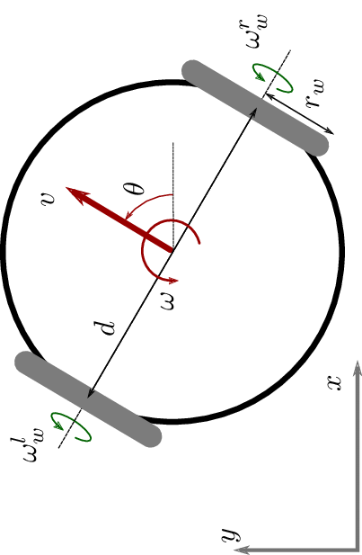
“”
“Differential Forklift”
Differential
steering
RFID
Magnetic tape
Ultrasonic
Infrared
Fork

Slide 51


Path Finding
Notes:
MAYBE ADD HEATED WIRE AS WELL

Slide 52


Slide 53
Lift Force
Notes:
Claw

Slide 54
Appendix

Slide 55
Needs Table
What is the purpose of this robot? | The robot must be able to retrieve and deliver things in a warehouse setting. -Customer | Robot is autonomous in nature and capable of data-processing.
What are the surroundings and environment the robot will be operating in? | It will be used in a warehouse setting. The robot should be able to operate in conditions that are unfavorable to humans (i.e. hot temperatures that could make workers pass out or get heat strokes). -Customer/Dr. McConomy | The robot is able to navigate around a warehouse.
 |  | The robot is able to sense and navigate around obstacles.
 |  | The robot can perform tasks in the dark.
 |  | Also, will perform in temperature conditions undesirable to humans.

Slide 56
Needs Table (continued)
What kind of items should the robot be able to handle? (Approximate weight) | Following OSHA regulations, a person should not be able to carry more than 50 lbs. If the robot were to malfunction a worker must aid it. Thus, the robot should carry a max load of 50 lbs. -OSHA | The robot can carry packages up to 50 lbs.
 |  | The robot will follow OSHA regulations.
 |  | When the robot malfunctions, it sends out an error alert for servicing.
What kind of retrieval methods should the robot achieve? | The robot should be able to pick things in a vertical and horizontal motion. Also, items shouldn’t be damaged when being set down. -Customer | Robot will have multiple degrees of freedom for movement.
 |  | Robot includes grasp force and manipulation control to prevent damaging items.

Slide 57
Needs Table (continued)
Would you want to have a handling input device? | “The robot can be operated under supervisory control. ​” -Customer | The user will operate and control the robot if desired.
What forms of power supply are accessible to you? What kind of power source do you prefer? | The robot has to have some way to recharge its battery fully so it can be active all hours of the working day. -Customer | Robot can operate over a 9-hour period before it has to recharge.
 |  | Robot navigates to an area where it can receive charging before the battery runs out.
Do you need the robot to track inventory as it delivers items? | Yes, it must be able to interface with our supply chain system | The robot will include modules to process machine readable codes and deliver information.

Slide 58
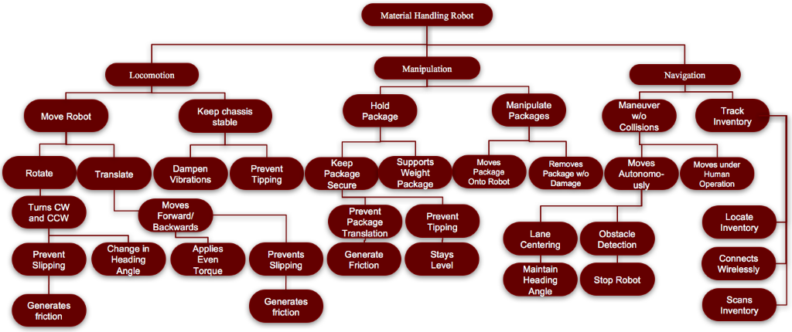
Functional Decomposition
Notes:
3 primary systems:
Locomotion – has to do with physically moving the robot
Manipulation – has to do with moving and manipulating the packages
Navigation – has to do with moving around and navigating around the warehouse
- Inventory Tracking

Slide 59
Material Robot
Locomotion
Move Robot
Keep Chassis Stable
Manipulation
Manipulate Package
Navigation
Hold Package
Track Inventory
Manuever Without Collision

Slide 60
Locomotion
Move Robot
Keep Chassis Stable
Translate
Dampen Vibration
Prevent Tipping
Rotate
Moves Forward and Backward
Turns CW and CCW
Applies even torque
Prevents slipping
Change heading angle
Prevents slipping

Slide 61
Manipulation
Manipulates Package
Moves Package onto Robot
Removes Package from Robot
Holds Package
Keeps Package Secure
Prevent Package Translation
Prevent Package Tipping
Support Package Weight

Slide 62
Navigation
Maneuver without Collision
Moves autonomously
Moves under Human Operation
Track Inventory
Connects to Network
Locates Inventory
Scans Inventory
Lane Centering
Obstacle Detection

Slide 63
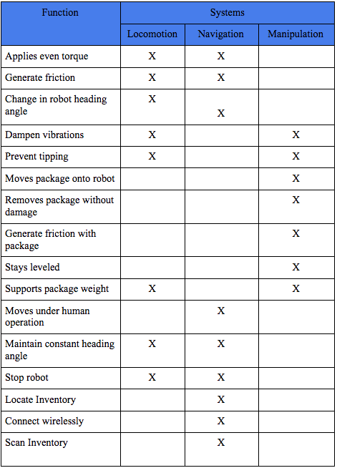

Slide 64
Targets and Metrics
Attribute | Target | Unit of Measure | Metric | Description
Generates Friction (wheels) | 17.1 N | Newtons | Force | The wheels must have enough friction to prevent slip
Change in Heading Angle | 360º | Degrees | Angle | Robot turns in a full circle.
Applies Even Torque | <1% | Percent | Error | Robot applies even torque on both sides of the wheels to move straight.
Control velocity | 2.25 m/s | Meters per second | Velocity | Minimum traveling speed through the warehouse.
Generates friction (box) | ≤ 22.68 N | Newtons | Force | The box must be prevented from sliding.
Generates friction (manipulator) | ≤ 22.68 N | Newtons | Force | The manipulator must have enough friction to prevent box from slipping
Stays level | 0º | Degrees | Angle | Robot maintains an even horizontal alignment.
Moves Package onto Robot | 224 N | Newton | Force | Robot lifts package inventory.

Slide 65
Targets and Metrics (cont.)
Attribute | Target | Unit of Measure | Metric | Description
Moves Package onto Robot | 224 N | Newton | Force | Robot lifts package inventory.
Removes Package w/o Damage | 0 | Packages | Amount | Only a certain percent of packages show signs of damage.
Maintain Heading Angle (Relative to Path) | 0º | Degrees | Direction | Robot accurately follows a path.
Stop Robot | 0 m/s | Meters per second | Velocity | Robot stays in the stopping position.
Accelerate Robot | < 1 m/s² | Meters per second squared | Acceleration | Robot must not accelerate (positively and negatively) so fast that the package falls off.
Moves Under Human Operation | 1 | N/A | Boolean | Robot responds to human input
Locate Inventory | 1 | N/A | Boolean | Robot knows where inventory belongs and takes/retrieves inventory to the correct location.
Connect Wirelessly | 1 | N/A | Boolean | Robot can successfully connect to inventory database and be controlled wirelessly.

Slide 66
Targets and Metrics (cont.)
Attribute | Target | Unit of Measure | Metric | Description
Moves Package onto Robot | 224 N | Newton | Force | Robot lifts package inventory.
Connect Wirelessly | 1 | N/A | Boolean | Robot can successfully c
Scans Inventory | 1 | N/A | Boolean | Robot is able to scan a label and identify inventory.
Senses Obstacles | 2.5 m | Meters | Distance | Robot detects obstacle in its path.
Sends Error Message | 1 | N/A | Boolean | If the robot detects an obstacle it will send an error message to the appropriate personnel.

Slide 67
Morphological Chart
 | Option 1 | Option 2 | Option 3 | Option 4 | Option 5 | Option 6 | Option 7
Drive Train | Differential Steering | Omni-Directional (Universal) | Ackerman (Rear wheel drive) | Ackerman (Front wheel drive) | Track Rails | Magnetic Track
Power | Lithium Ion | Lead Acid | Lithium Polymer | Alkaline | Nickel Cadmium
Path Following | Magnetic tape | Line path | Track “rails” | GPS | Heated line | Pavement Markers | Induction Wire
Obstacle Detection | Lidar | Thermal | Visual Inertial | Infrared | Ultrasonic | Distance sensor | Push sensor with bumper
Controls package | Forks | Vacuum end effector | Single Clamp/claw | Magnet end effector | Hook | Two Clamps/Claw
Scans Inventory | QR Code | RFID Tag | Barcode Scanner | April Tag | Color coded

Slide 68
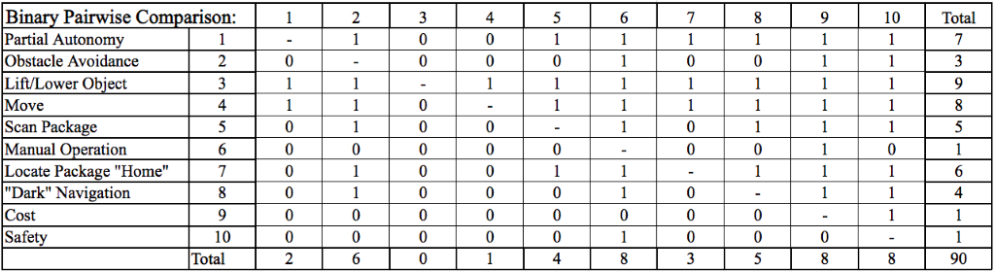
Binary Pairwise Comparison

Slide 69
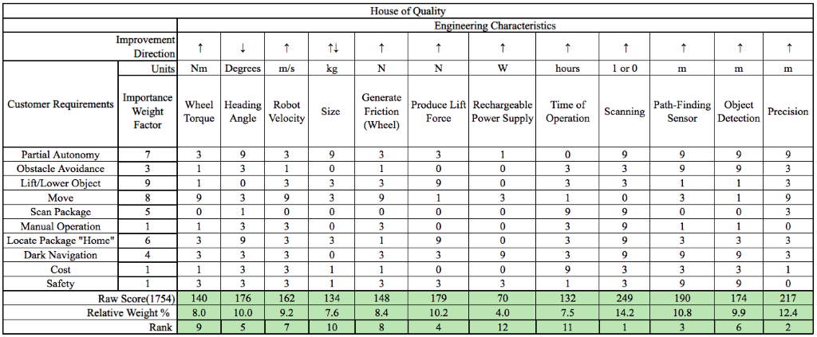
House of Quality

Slide 70
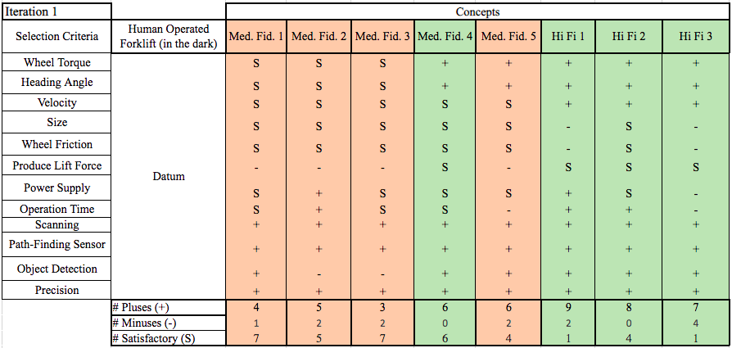
Pugh Chart Iteration 1

Slide 71
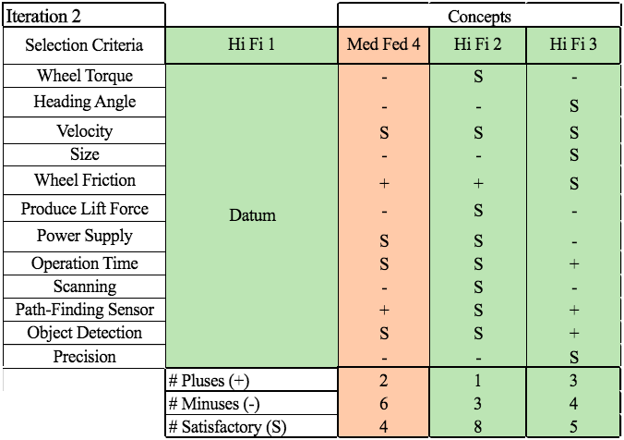
Pugh Chart Iteration 2

Slide 72
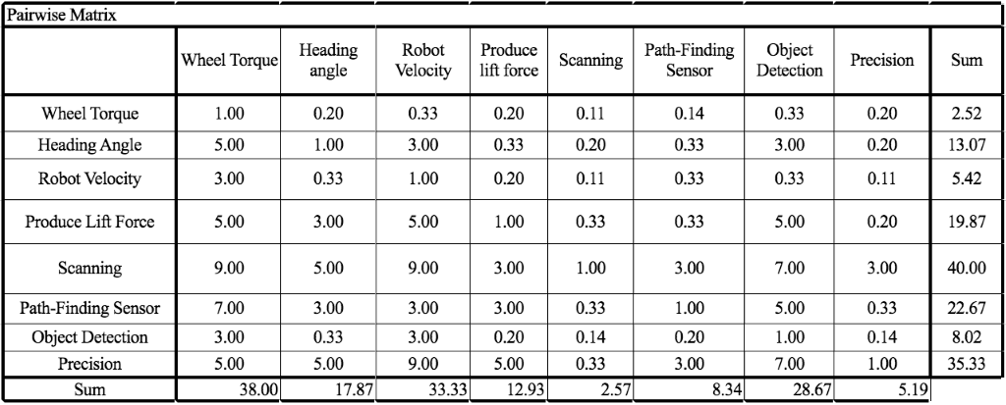
Pairwise Matrix

Slide 73
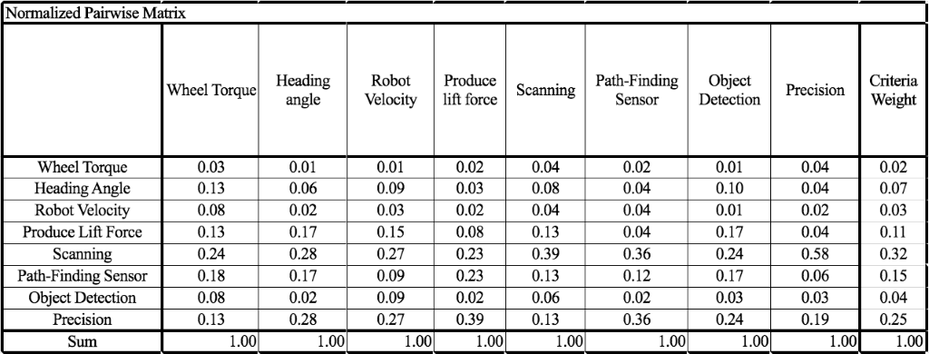
Normalized Pairwise Matrix

Slide 74
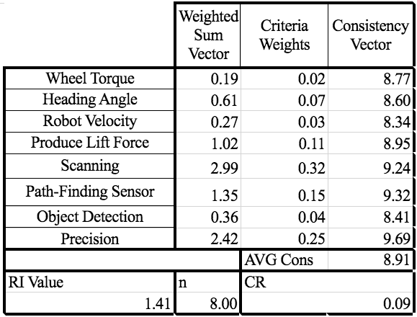
Consistency Check Engineering Characteristics

Slide 75
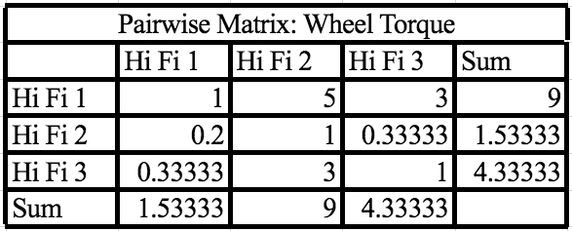
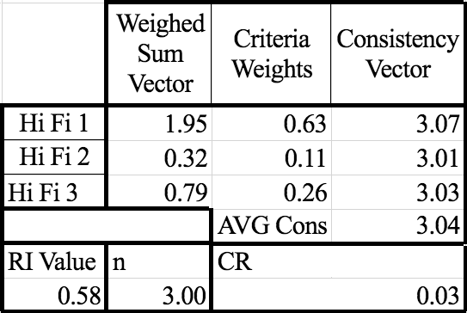
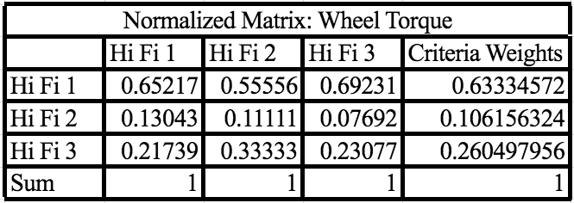
Wheel Torque Matrices

Slide 76
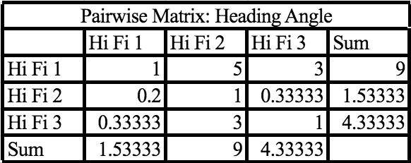
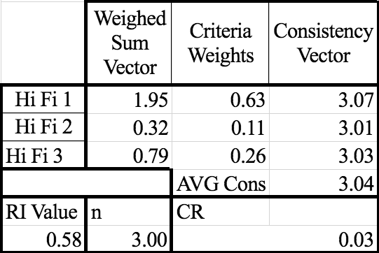
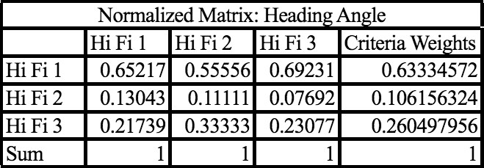
Heading Angle Matrices

Slide 77
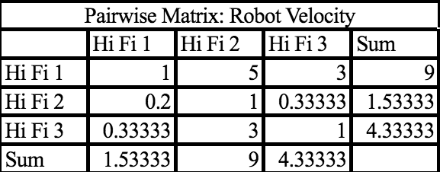
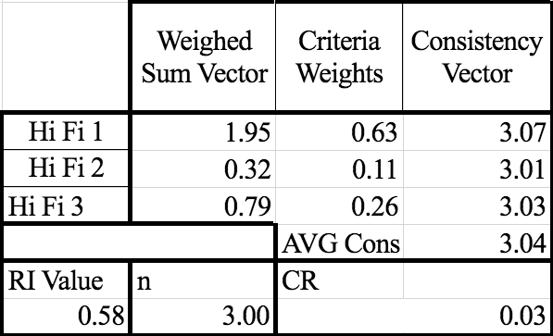
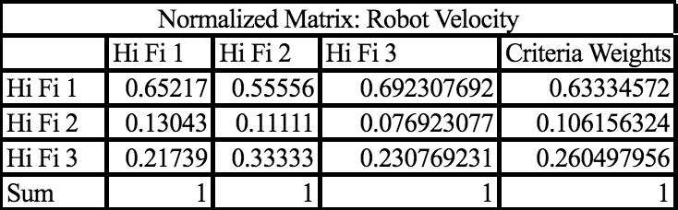
Robot Velocity Matrices

Slide 78
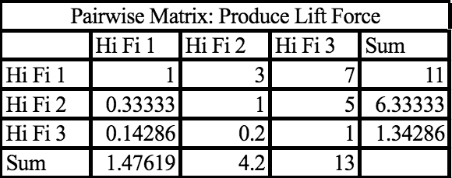
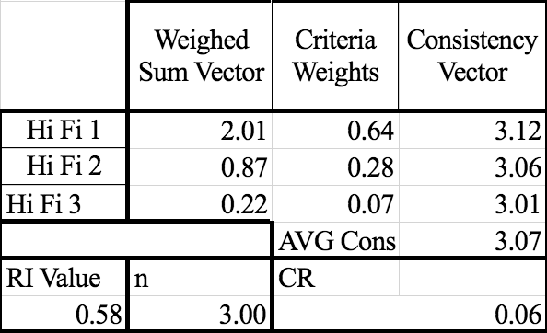
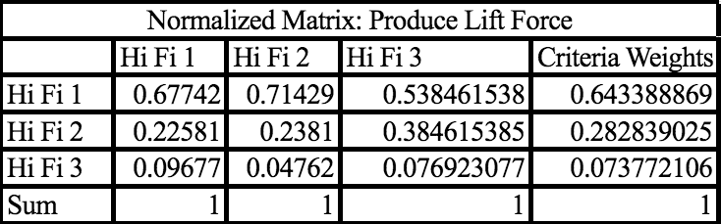
Lift Force Matrices

Slide 79
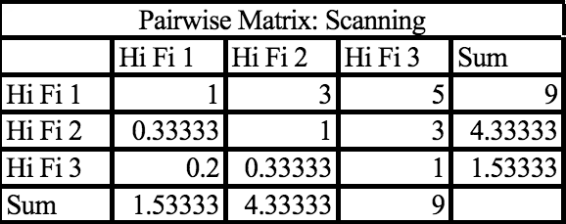
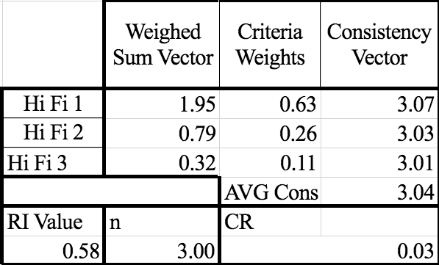
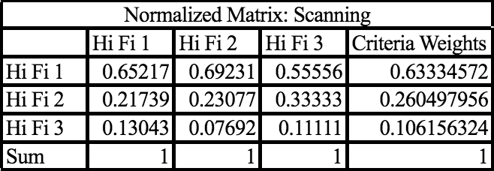
Scanning Matrices

Slide 80
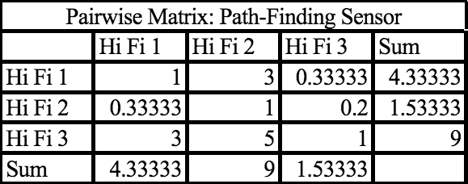
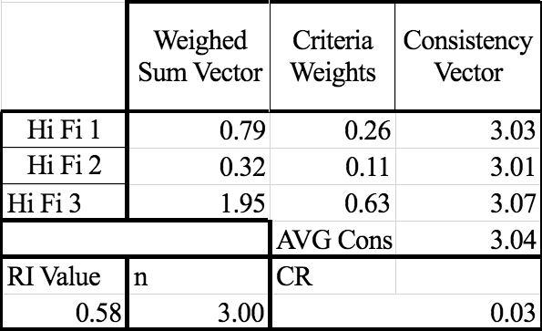
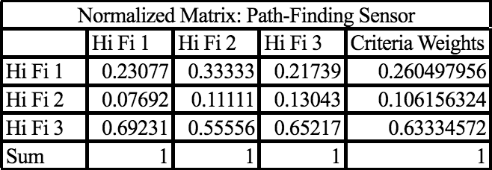
Path Finding Matrices

Slide 81
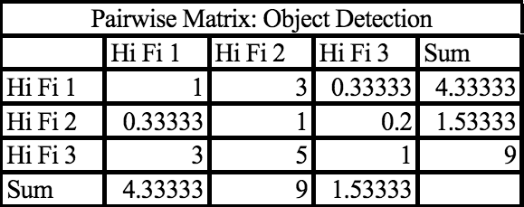
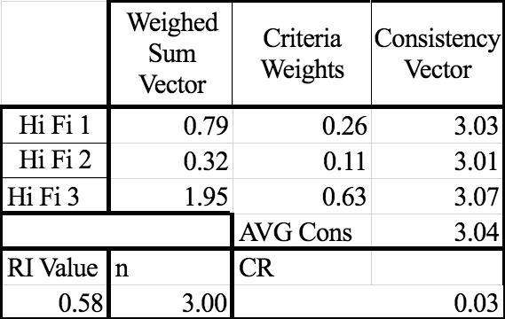

Object Detection

Slide 82



Precision

Slide 83


Final Selection

Slide 84

Spring Plan ME Team

Slide 85

Spring Plan EE Team

