Slide 1
T311- Material Handler Robot
EEL4911C
16-Oct-20

Slide 2
Team Introductions
ECE/EE Team
Walter Caldwell - Project Manager
Alex Jen - Lead Software Engineer
Tiffany Miller - Lead Hardware Engineer
Sebastian Muriel - System Engineer
Tony Zheng - Financial Advisor
ME Team
Diandre Reyes
Peter Watson
Nick Norwood
Alex Wozny
Taylor Harvey

Slide 3
Sponsor

Slide 4
Objective & Market
The objective of this project is to create an autonomous material handling robot that is able to work in a dark warehouse in conditions unfavorable to human workers. This project will decrease the cost of operations by decreasing the need for manpower or around the clock utility usage hence optimizing profits for the sponsor.
Primary markets would be warehouses that aim to reduce expenses from human workers and increase productivity (i.e. labor, A/C, heating, lighting of warehouses, and human injury costs). Secondary markets include a hardware store, such as distribution centers. This can also include physical stores that can use robotics for inventory and stocking purposes. Another possible secondary market could include places like libraries, where the inventory is constantly being reshuffled, requiring constant organization.
Notes:
Sebastian Muriel

Slide 5
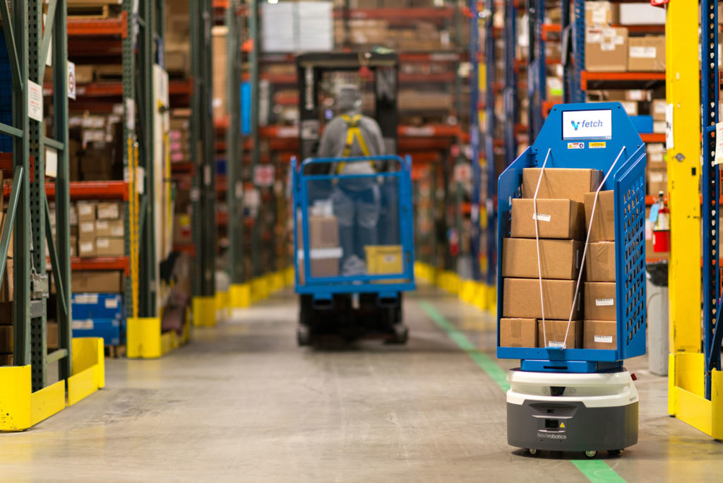
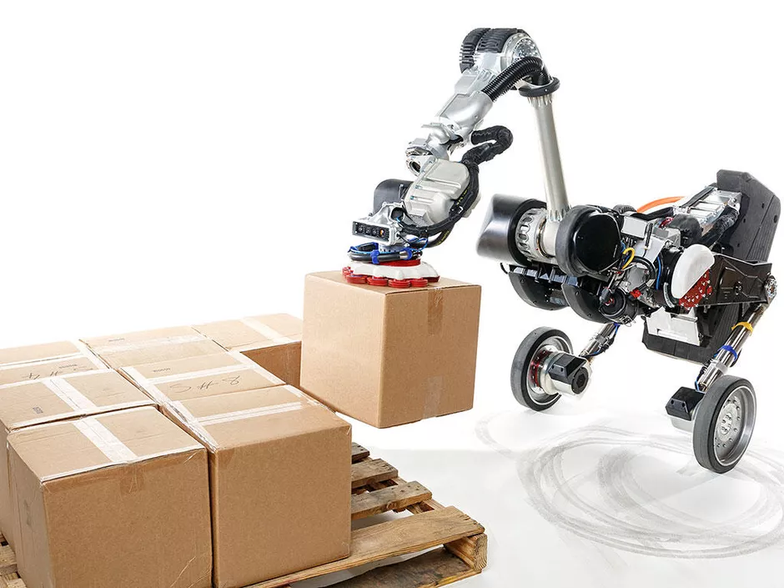
Project Background

Slide 6

Key Goals
Pick up Boxes/Packages up to 25 lbs
Autonomous Movement and charging
Obstacle Avoidance
Inventory tracking
Navigate warehouse
Handle hard to reach packages
Error Alerts for servicing
Creating a scaled down version of the robot
Notes:
Walter Caldwell

Slide 7
Customer Needs
The robot must be able to retrieve and deliver things in a warehouse setting. -Customer
It will be used in a warehouse setting. The robot should be able to operate in conditions that are unfavorable to humans (i.e. hot temperatures that could make workers pass out or get heat strokes). -Customer/Dr. McConomy
Following OSHA regulations a person should not be able to carry more than 50 lbs. If the robot were to malfunction a worker must aid it. Thus, the robot should carry a max load of 50 lbs. -OSHA
The robot should be able to pick things in a vertical and horizontal motion. Also, items shouldn’t be damaged when being set down. -Customer
“The robot can be operated under supervisory control.​” -Customer
The robot has to have some way to recharge its battery fully so it can be active all hours of the working day. -Customer
The robot must be able to interface with our supply chain system
Notes:
Walter Caldwell

Slide 8
Functional Decomposition
Notes:
Alex Jen

Slide 9
No | Function | Systems
 |  | Locomotion | Navigation | Manipulation | Inventory Tracking | Maintenance
1 | Traverse warehouse in three directional axes | X | X
1-1 | Avoids obstacles | X | X
1-1-1 | Decides how to move if there’s an obstacle |  | X
1-1-2 | Sensing of obstacles in the path |  | X
1-2 | Compute Pathing Algorithm |  | X
2-1 | Scans Inventory |  |  |  | X
2-1-1 | Interfaces with customer supply chain system |  |  |  | X
2-1-2 | Add item to database |  |  |  | X
2-1-3 | Remove item from database |  |  |  | X
2-2 | Manage Inventory |  |  |  | X
2-2-1 | Load location attribute |  |  |  | X
2-2-2 | Load type attribute |  |  |  | X
2-2-3 | Load identification attribute |  |  |  | X
2-2-4 | Load weight attribute |  |  |  | X
3-1 | Lift objects | X |  | X
Cross-Reference Chart
Took the interpreted needs and developed basic functions
Categorized by numbers
5 main systems
Many subsystems
Notes:
Alexandar Jen

Slide 10
Robot
Locomotion
Inventory Tracking
Manipulation
Navigation
Maintenance
Move Robot
Keep chassis stable
Lift Objects
Store Objects
Drop Objects
Traverse Warehouse in three axes
Power Motor
Spin Wheels
Scans Inventory
Manage Inventory
Avoids Obstacles
Compute Pathing Algorithm
Interface with supply chain system
Add item to database
Remove Item from Database
Decides Alternate Path
Senses Obstacles
Load Weight Attribute
Load Identification Attribute
Load Type Attribute
Load Location Attribute
Controlling manually from Admin
Recharge Autonomously
Servicing Requests
Understands when low battery
Return to charging area on low battery
Sends out Error Calls
Receive Error Calls
Receive Error when item not in database
Receive error when movement is prohibited
Receive error when item cannot be found
Notes:
Tiffany

Slide 11
Five Most Important Points from this Presentation
Autonomous Delivery Warehouse Retrieving/Storing Robot.
Robot is able to navigate and obtain items in the warehouse.
Robot is able to interface with supply chain systems.
Robot is able to work in unfavorable conditions to humans.
Collaborating with an mechanical engineering team for design and creation.
Notes:
Tony Zheng

Slide 12
References
https://www.jobs-ups.com/job/barre/package-delivery-driver/1187/560416
https://www.osha.gov/SLTC/etools/electricalcontractors/materials/heavy.html#:~:text=Limit%20weight%20you%20lift%20to,the%20load%20(Figure%204).
https://spectrum.ieee.org/robotics/robotics-software/three-engineers-hundreds-of-robots-one-warehouse
https://ieeexplore.ieee.org/abstract/document/8576899
https://ieeexplore.ieee.org/abstract/document/8956454
Notes:
Not this slide will advance on default after 2 seconds. If you would like to change this then go to the transition tab and under timing change the advance slide settings.

Slide 13

Questions
Notes:
Tony Zheng

Slide 14
Backup Sildes
Supporting Slides to the content above.

Slide 15
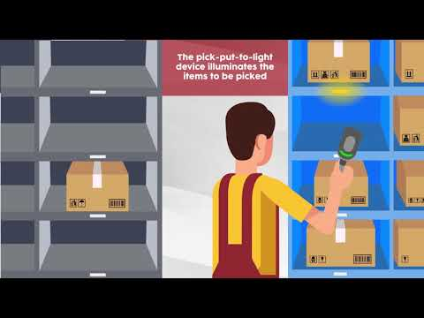

Slide 16
Standard Shapes
Summary Box
Text box 1
Outlined Text Box

Slide 17


Approved Logos

Slide 18
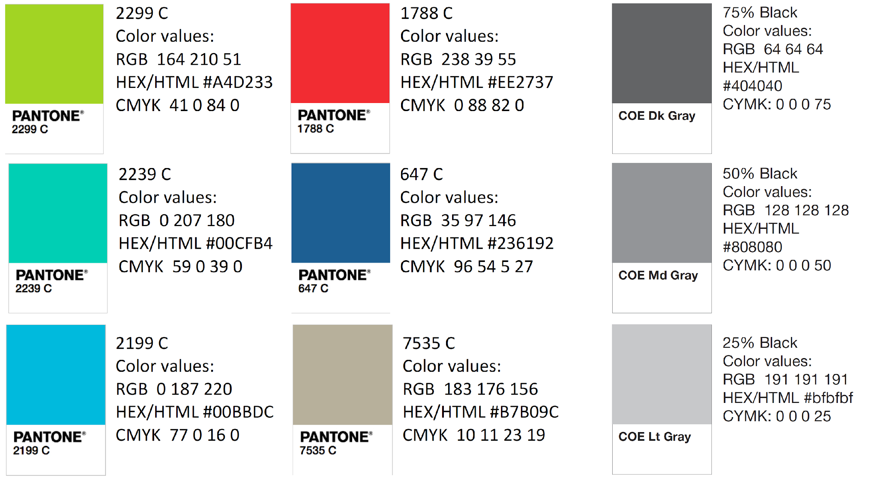
Color Palette

Slide 19
APA Tables
Category 1 | Category 2 | Category 3 | Category 4 | Category 5
Item 1
Item 2
Item 3
Item 4
 | Category 2 |  |  | Category 3
Category 1 | subcategory 1 | subcategory 2 |  | subcategory 1 | subcategory 2
Item 1
Item 2
Item 3
Item 4

