Slide 1
TEAM 12:
Low-Cost, Portable, Off-Grid Biodiesel Production Plant
Team Members:
James Black
Sam Dresser
Joey Kilmer
Matt Mills
Eglin AFB Sponsor:
John Deep
Faculty Advisor:
Dr. Dave Cartes

Slide 2
Motivations
Finite supply of fossil fuels
Need for alternative energy sources
Society should shift towards sustainable energy
Pollution levels
Green house and environmentally unsafe gas emissions
Provides a use for waste biological matter
TEAM 12: Low-Cost, Portable, Off-Grid
Biodiesel Production Plant
3/27/2008 Slide 2

Slide 3
Project Specifications
Low Cost ($1500 budget)
Portable (manufacturing plant should fit on trailer)
Off-grid (AKA self-sustaining)
Small design with ability to be scaled up
We will manufacture a 10-30 gallon working model
Keep safety in mind!
TEAM 12: Low-Cost, Portable, Off-Grid
Biodiesel Production Plant
3/27/2008 Slide 3

Slide 4
The Biodiesel Process
Catalyst Preparation
Transesterification Reaction
Product Separation
Glycerin Methanol Recovery
Biodiesel Washing
TEAM 12: Low-Cost, Portable, Off-Grid
Biodiesel Production Plant
3/27/2008 Slide 4

Slide 5
Design Elements
Mixing
Hoppers
Power
Heating Elements
Methanol Recovery
Washing
TEAM 12: Low-Cost, Portable, Off-Grid
Biodiesel Production Plant
3/27/2008 Slide 5

Slide 6
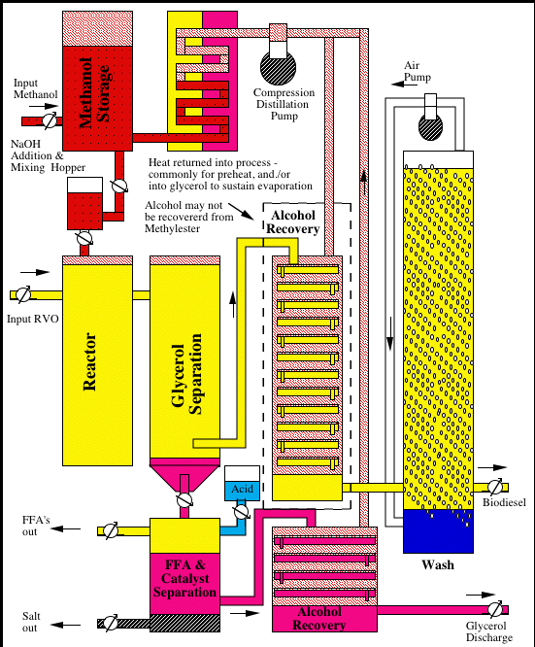
Conceptual
Design
TEAM 12: Low-Cost, Portable, Off-Grid
Biodiesel Production Plant
3/27/2008 Slide 6

Slide 7
Original Budget (based on Conceptual Design)
Part Description Quantity Per Unit Price Total Price
30 Gallon Storage Tank 2 $87.15 $174.30 Finned Strip Heating Element 6 $50.46 $302.76 Wash Tank 1 $103.93 $103.93 Meth oxide Tank 1 $67.18 $67.18 Bronze Circulating Pump 1 $143.03 $143.03 Vacuum Gauge 1 $17.07 $17.07 Vacuum Pump 1 $53.41 $53.41 Oil Filter 1 $1.26 $1.26 Check Valve 1 $13.80 $13.80 Chemical Storage Tank 3 $22.95 $68.85 Ball Valve 5 $7.96 $39.80 Temperature Gauge 1 $100.00 $100.00 Total Price $1085.38
TEAM 12: Low-Cost, Portable, Off-Grid
Biodiesel Production Plant
3/27/2008 Slide 7

Slide 8
Comparison of Design w/ Actual Plant
TEAM 12: Low-Cost, Portable, Off-Grid
Biodiesel Production Plant
3/27/2008 Slide 8

Slide 9
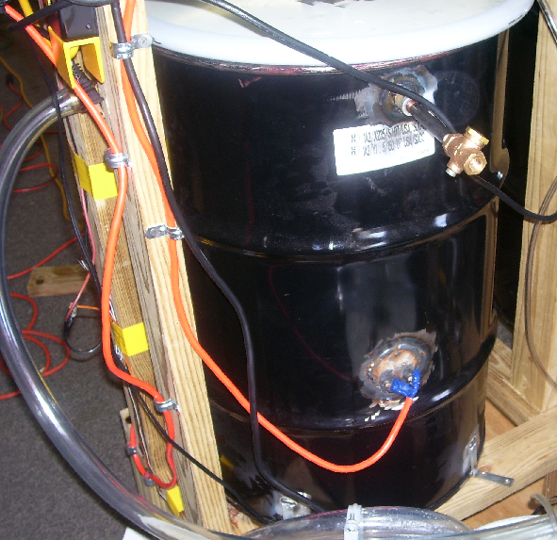
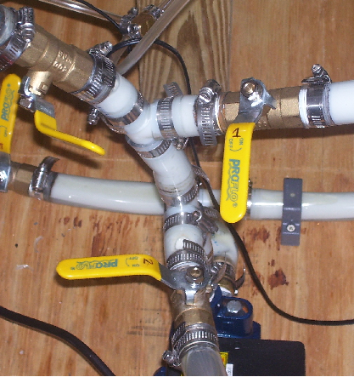
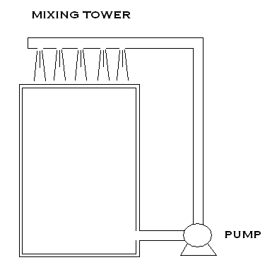
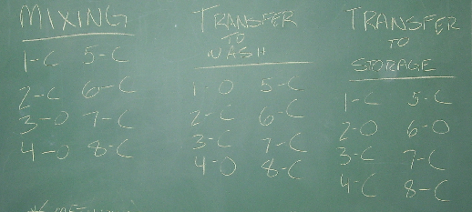
Mixing
Design:
Use pump to transfer mixture reaction
Construction:
Same as design, except pump outlet is in barrel instead of on top due to methanol recovery
One pump (due to budget)
TEAM 12: Low-Cost, Portable, Off-Grid
Biodiesel Production Plant
3/27/2008 Slide 9

Slide 10
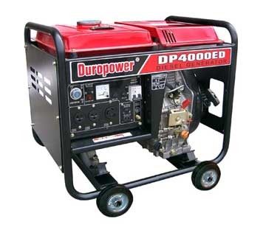
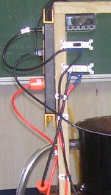
Power
Design:
Biodiesel generator to power pump, mixer, and heating elements
Construction:
120V AC Power (due to budget constraints)
TEAM 12: Low-Cost, Portable, Off-Grid
Biodiesel Production Plant
3/27/2008 Slide 10

Slide 11
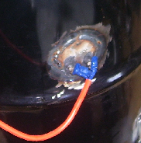
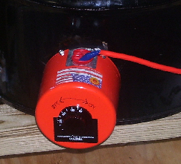
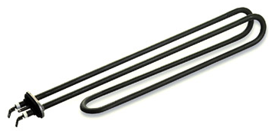
Heating Elements
Design:
Use two heating elements with adjustable temperature controls
Construction:
One temperature controlled and one without
TEAM 12: Low-Cost, Portable, Off-Grid
Biodiesel Production Plant
3/27/2008 Slide 11

Slide 12
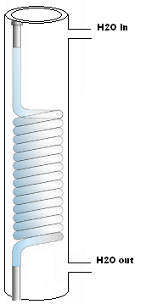
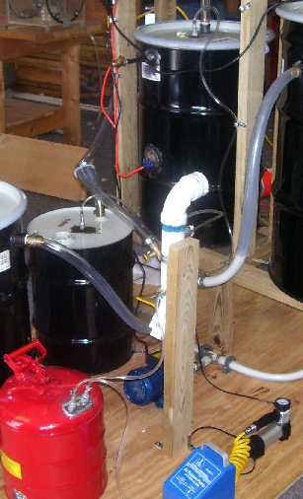
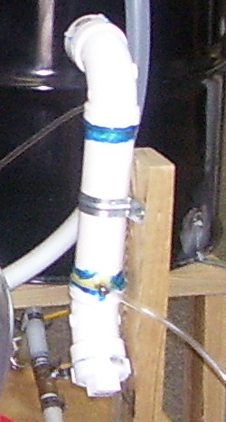
Methanol Recovery
Design:
Heat glycerin to 68˚C to vaporize methanol
Vacuum extract methanol from both the glycerin tank and reactor
Construction:
Same as design
TEAM 12: Low-Cost, Portable, Off-Grid
Biodiesel Production Plant
3/27/2008 Slide 12

Slide 13
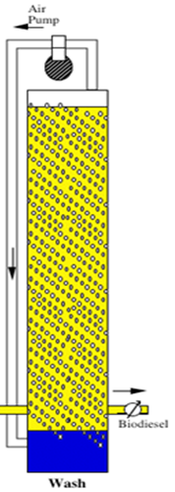
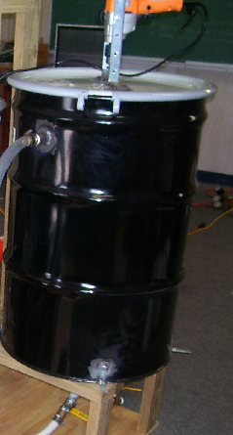
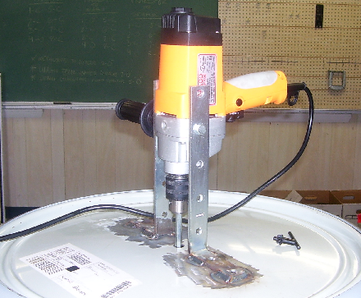
Washing
Design:
Bubble Wash with air pump
Construction:
Paddle and drill wash
TEAM 12: Low-Cost, Portable, Off-Grid
Biodiesel Production Plant
3/27/2008 Slide 13

Slide 14
Final Spending Report
Part Description | Quantity | Vendor | SKU # | Per Unit Price | Part Total Price
30 Gallon Steel Drum | 2 | McMaster Carr | 4115T61 | $87.15 | $174.30
55 Gallon Steel Drum | 1 | McMaster Carr | 4115T46 | $103.93 | $103.93
10 Gallon Steel Drum | 1 | McMaster Carr | 4115T12 | $67.18 | $67.18
10 Gallon Steel Drum Closed Head | 1 | McMaster Carr | 4115T64 | $55.09 | $55.09
12x12 Polyester Filter | 1 | McMaster Carr | 6376T11 | $1.43 | $1.43
Screw-Plug Immersion Heater | 1 | McMaster Carr | 3656K322 | $192.14 | $192.14
Purchase Order |  | Capital Cash & Carry |  | $213.00 | $213.00
1" Clear Water Pump | 1 | Harbor Freight | 1479-7VGA | $28.99 | $28.99
Compressor | 1 | Harbor Freight | 96068-1VGA | $25.67 | $25.67
Vacuum Pump | 1 | Harbor Freight | 92475-3VGA | $8.49 | $8.49
Clear Tubing | 25 | McMaster Carr | 5231K265 | $1.46 | $36.50
Weld on Tank Fitting | 1 | McMaster Carr | 12555K86 | $6.80 | $6.80
Brass Hose Fitting | 5 | McMaster Carr | 5346K69 | $11.81 | $59.05
Nylon Tube Fitting | 1 | McMaster Carr | 5372K627 | $14.18 | $14.18
Couplings | 6 | Ferguson |  | $1.91 | $11.46
3/4" Ball Valve | 8 | Ferguson | PF200F | $5.34 | $42.74
Heat Blanket | 1 | McMaster Carr | 3545K42 | $102.91 | $102.91
3/4" Galvanized Steel Nipple | 16 | Ferguson | GNFCL | $0.77 | $12.34
Methanol | 20 | FSU Chem Dept |  | $2.84 | $56.80
Sodium Hydoxide | 3 | FSU Chem Dept |  | $9.58 | $28.74
Lid | 1 | McMaster Carr |  | $34.99 | $34.99
Miscellaneous | 1 |  |  | $300.00 | $300.00
Total Cost of Parts Ordered |  |  |  |  | $1,576.73
Remaining Balance |  |  |  |  | -$76.73
TEAM 12: Low-Cost, Portable, Off-Grid
Biodiesel Production Plant
3/27/2008 Slide 14

Slide 15
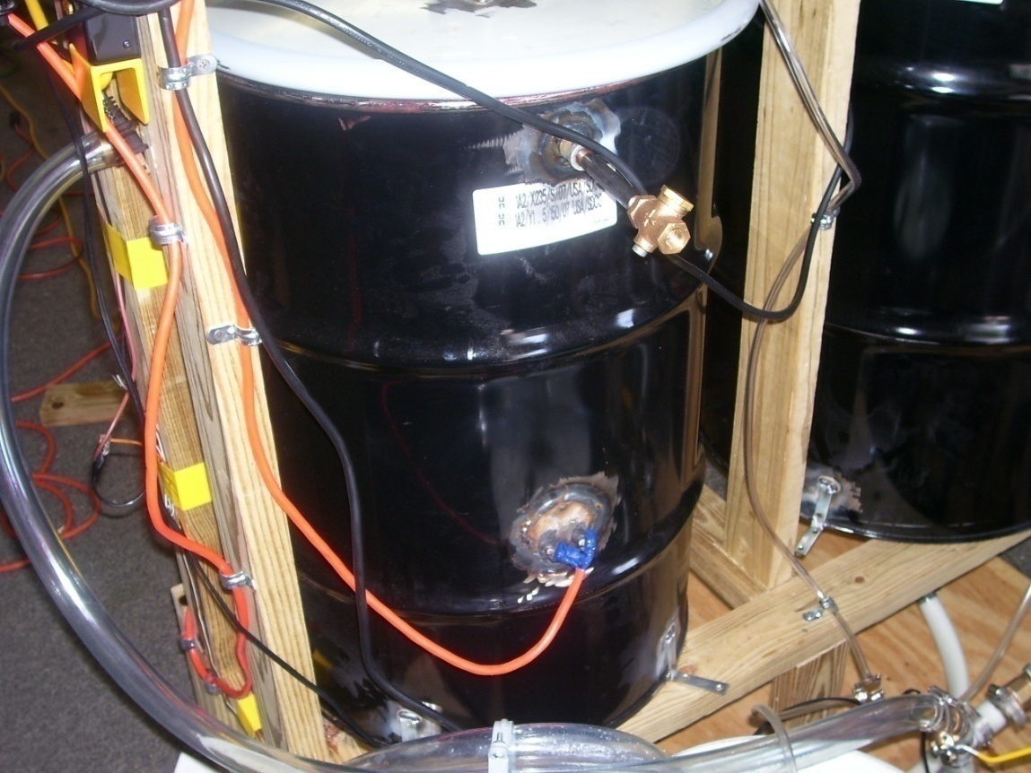
Chemical Mixing / Reactor Stage
Virgin feedstock mixes with methoxide
Two heating elements control temperature
Pump mixing
TEAM 12: Low-Cost, Portable, Off-Grid
Biodiesel Production Plant
3/27/2008 Slide 15

Slide 16
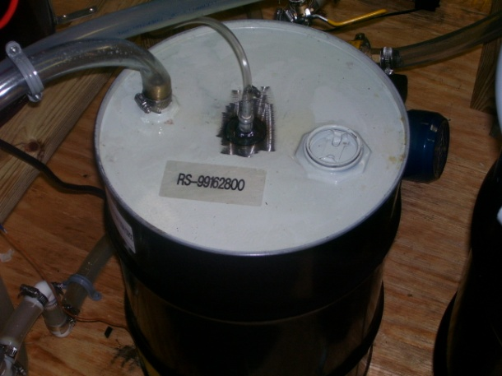
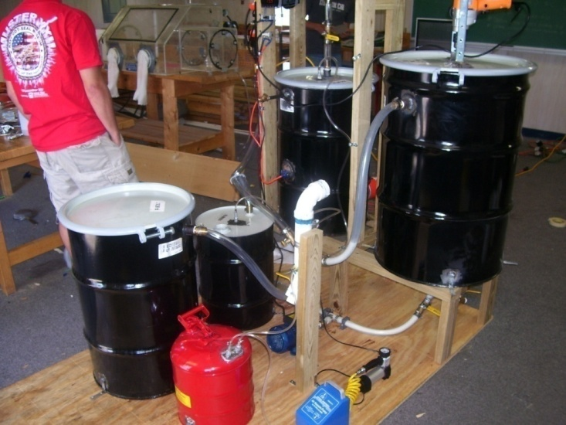
Glycerine Separation
Glycerine settles in bottom of reactor
Then drained off and transferred to glycerine tank
Heated to recover methanol
TEAM 12: Low-Cost, Portable, Off-Grid
Biodiesel Production Plant
3/27/2008 Slide 16

Slide 17
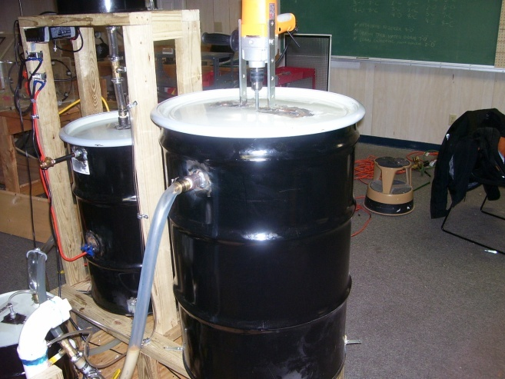
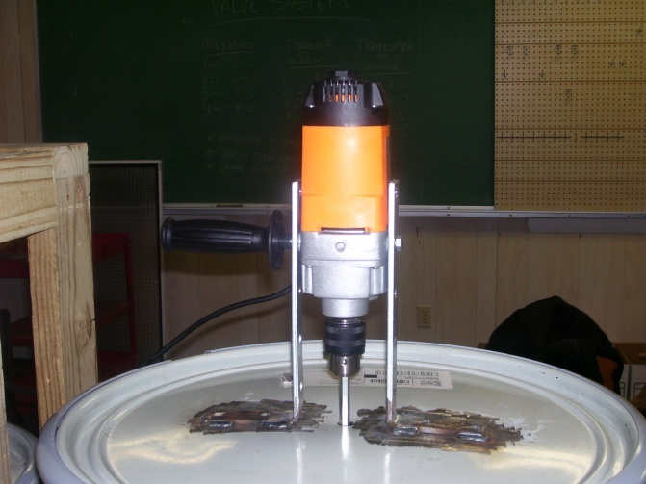
Washing Stage
Top layer of fluid (biodiesel) is transferred to wash tank
Water is added
Variable speed drill rotates paddle
Paddle mixes fluid to remove impurities
TEAM 12: Low-Cost, Portable, Off-Grid
Biodiesel Production Plant
3/27/2008 Slide 17

Slide 18
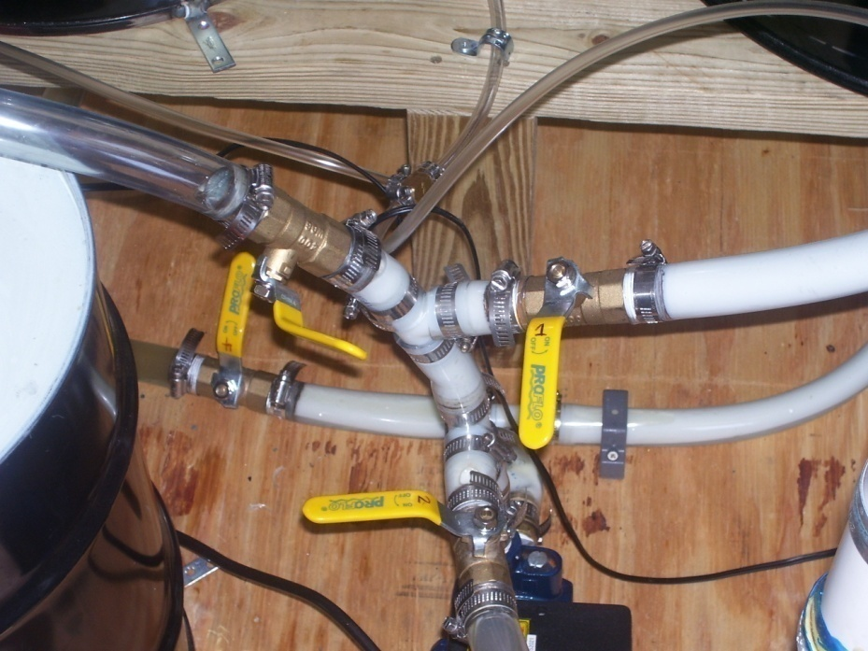
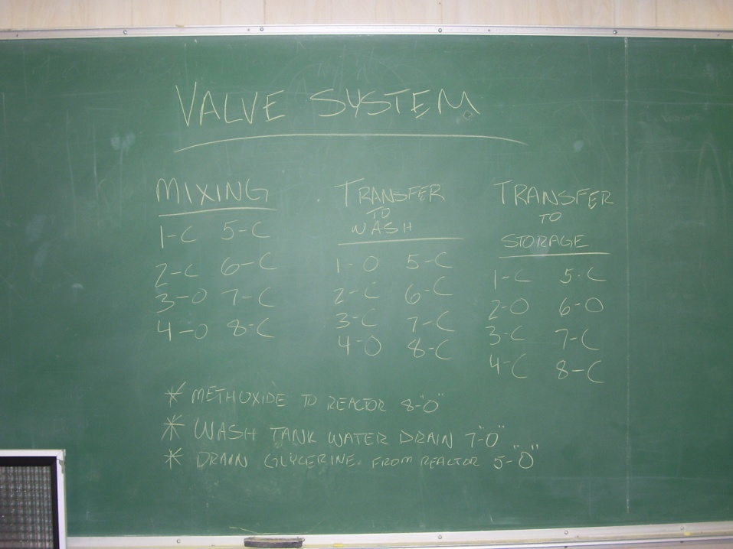
Transfer System
Single pump is used to transfer fluid
Set of valves are used to direct flow to required location
Illustration shows which valves should be open or closed for desired operation
TEAM 12: Low-Cost, Portable, Off-Grid
Biodiesel Production Plant
3/27/2008 Slide 18

Slide 19
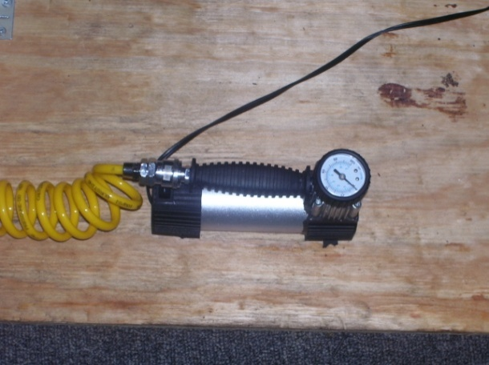
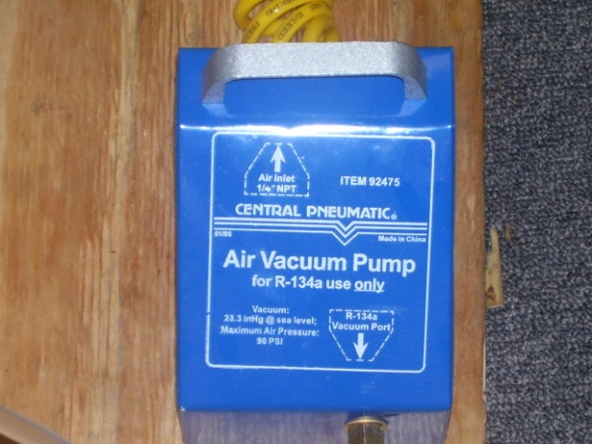
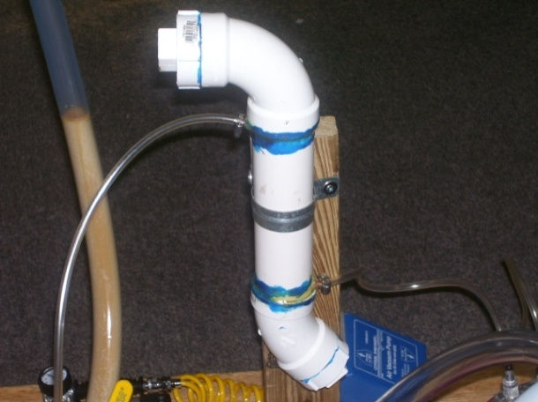
Methanol Recovery
Methanol is recovered during reaction and from glycerine tank
Vacuum pumps sucks vapors out of reactor/glycerine tank
Vapor is run through condenser
Condensed vapor is collected in methanol recovery tank
TEAM 12: Low-Cost, Portable, Off-Grid
Biodiesel Production Plant
3/27/2008 Slide 19

Slide 20
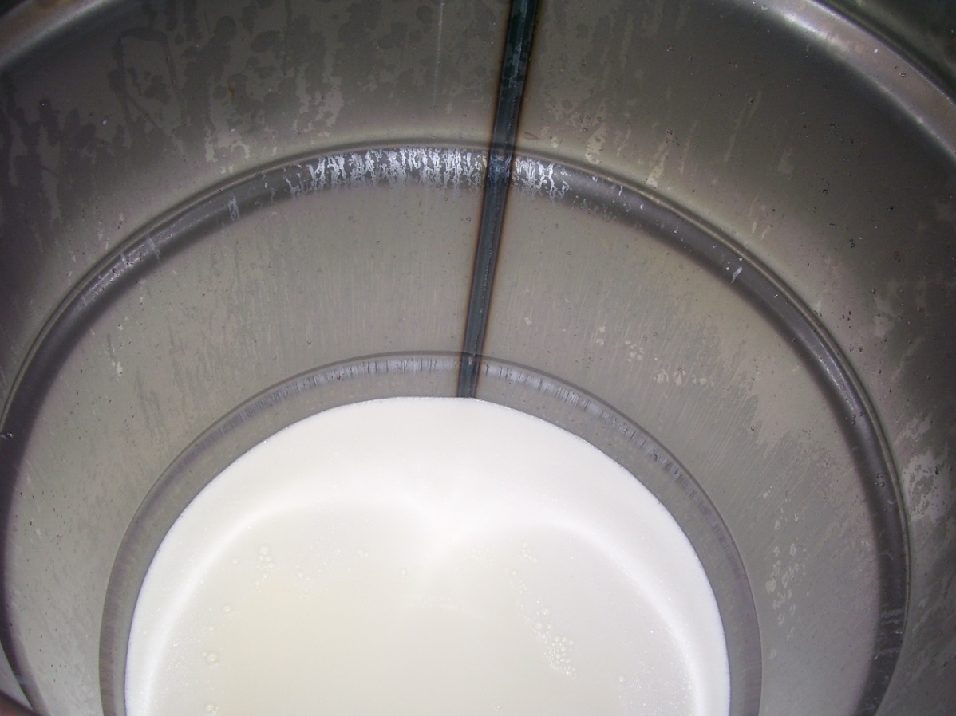
What Went Wrong
Incomplete reactions
Problems with methanol/lye mixture
Difficulty minimizing chemicals’ exposure to air
TEAM 12: Low-Cost, Portable, Off-Grid
Biodiesel Production Plant
3/27/2008 Slide 20

Slide 21
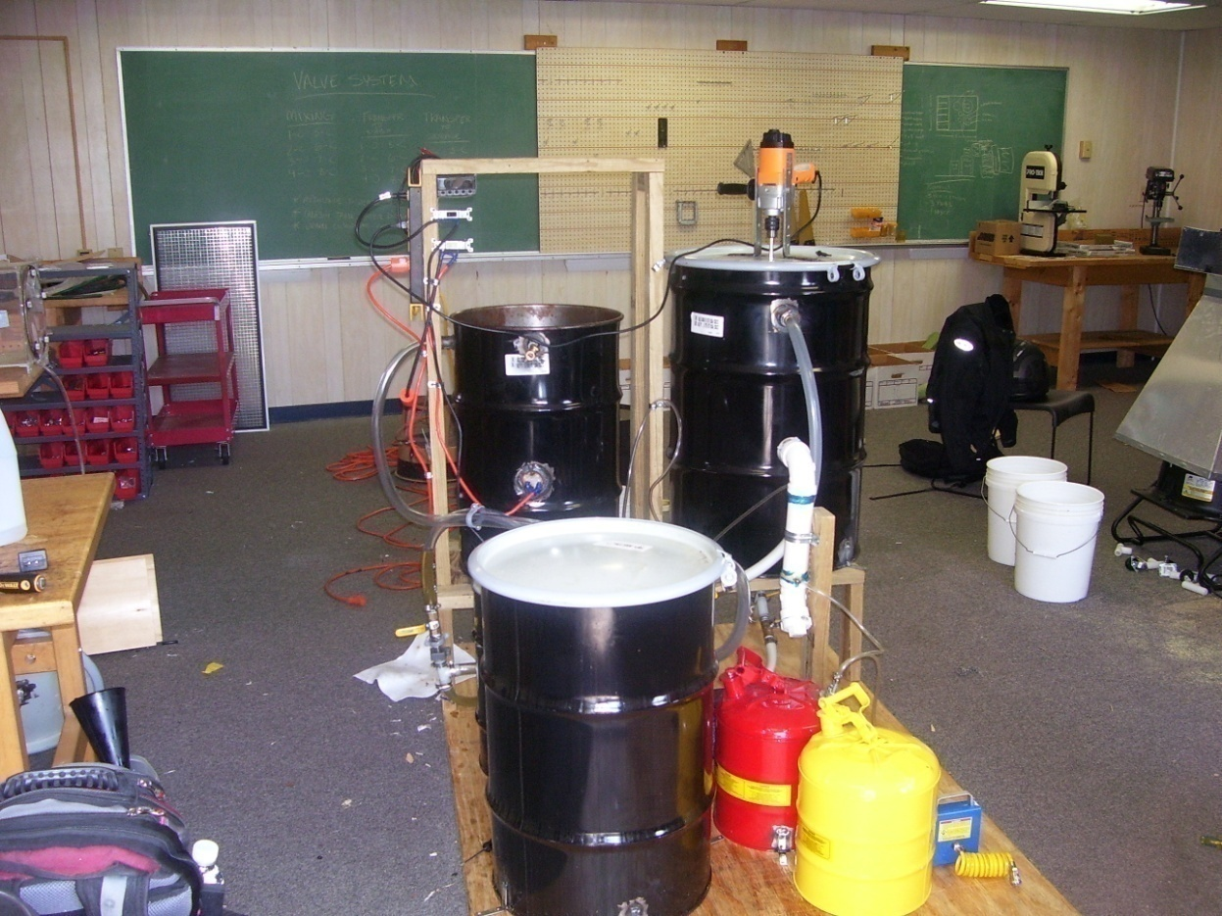
What We Would Do Differently
Use an airtight system of hoppers to mix the chemicals
Budget constraints limited our options
Minimize design time
Spend majority of time testing and redesigning
TEAM 12: Low-Cost, Portable, Off-Grid
Biodiesel Production Plant
3/27/2008 Slide 21

Slide 22
Conclusion
Completed one successful reaction
Not uncommon to have bad reactions
System design was a success, Chemical reaction not dependable
In retrospect, less designing, more testing
TEAM 12: Low-Cost, Portable, Off-Grid
Biodiesel Production Plant
3/27/2008 Slide 22

