Slide 1
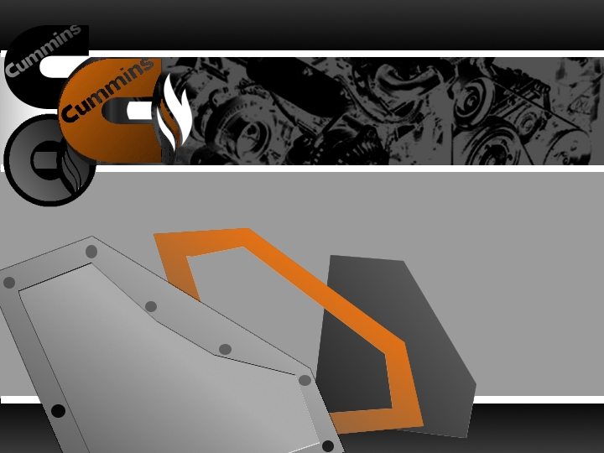
Cummins Active Noise Control
Final Project Design
GROUP MEMBERS
Chris Schultz
Joshua Hogue
Marshall Goerg
Michael Priebe
Quennan Davis
FACULTY ADVISOR
William Oates
CUMMINS REPRESENTATIVE
Richard Varo

Slide 2

Outline
Project Description
Project Design
Design Analysis
Project Testing
Data and Results
Project Conclusion

Slide 3
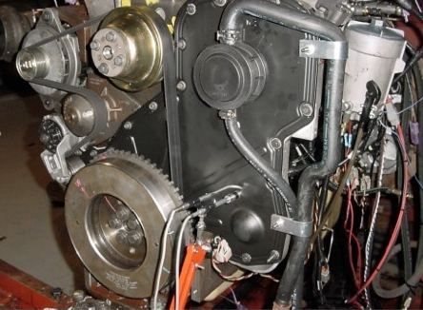
Project Description
Problem Statement:
  Propagation of vibrations in valve or gear covers in mid-sized diesel engines result in radiated noise
  Use active and passive materials to reduce noise
Constraints:
  Size and space limitations of engine
  Broadband frequency control
  Overall durability and robustness
Gear Cover Mounted on Engine
3

Slide 4
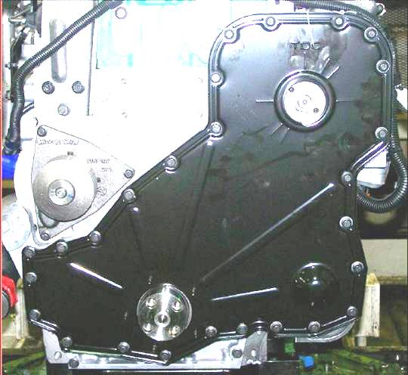
Project Aim
Project Specs:
  Thin, cost-efficient, and lightweight vibration control devise utilizing both active and passive materials
  Device should complement existing engine components
    Cannot exceed 15mm from top of cover
    Cannot surpass the existing perimeter of cover
  Develop working model
    Comparison of design vs. existing cover and dual-layer cover
Gear Housing
Gear Cover
4
Notes:
The working model is going to be used next semester to compare our model to the single and dual layer covers

Slide 5
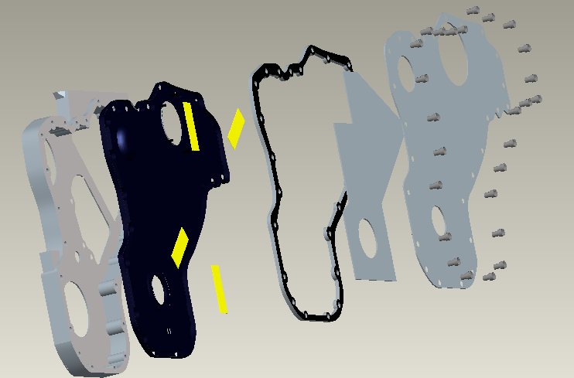
Design Concept
Optimal Design Concept:
  Use piezoelectric patch actuators to actively effect stiffness of gear cover
  Use sound “barrier” to block noise emissions from outside environment
  Passive Foam to prevent reflected noise
  Compliant seal to prevent transmission of vibrations from cover to barrier
  Downside: Unrealistic due to finances and complicated structure/size
Gear Cover
Compliant Seal
Sound Barrier
Gear Housing
PZT Strips
Passive Foam
Pro-E illustration of design
5
Notes:
Quickly go thru each part, don’t forget each component will be mentioned more in detail later
The illustration will have each part labeled so briefly explain each component while pointing to the illsustration
Use the last bullet to flow into the next slide which talks bout the need of the scaled model

Slide 6
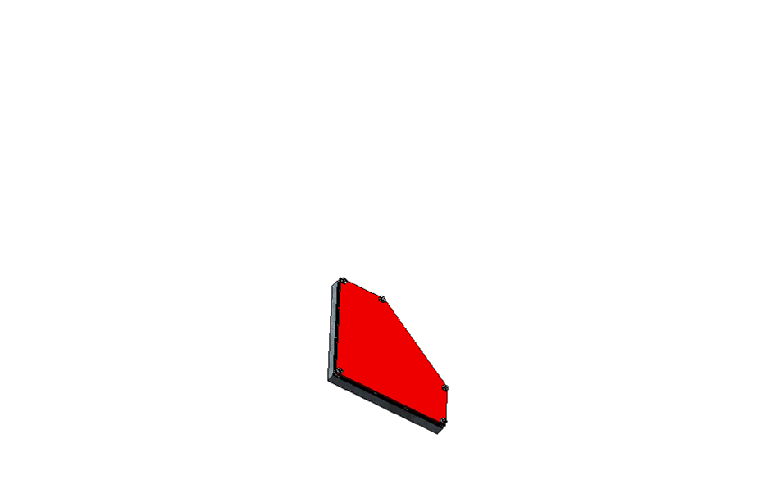
Design Solution
Scale model design
  Utilizes same components:
Barrier Panel: Encloses Components and Reduces Harmonics
SSP Foam: Sound Absorbing Foam
Vibra Block: Reduce Contact Vibrations
MFC Actuators: Active Control
Gear Cover: Main Design Component
Gear Housing: Attachment to Shaker Equipment
6

Slide 7
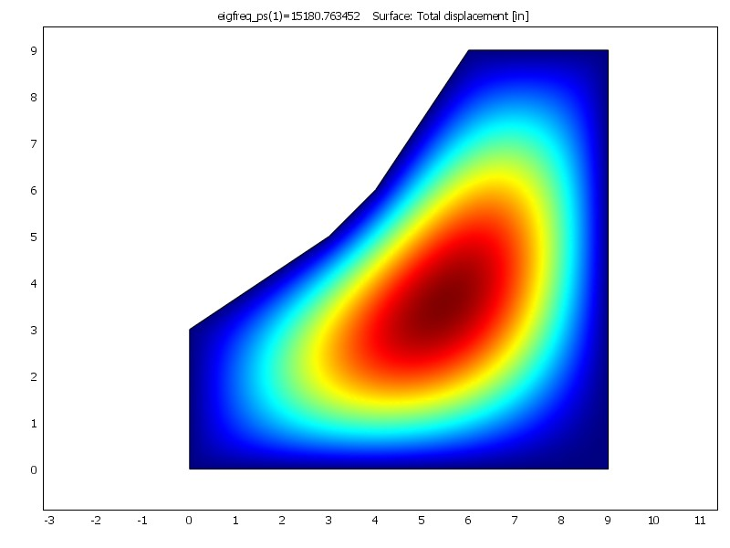
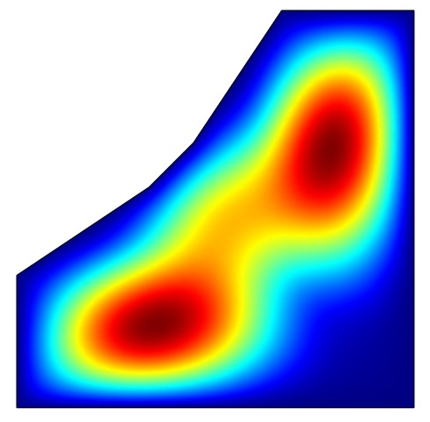
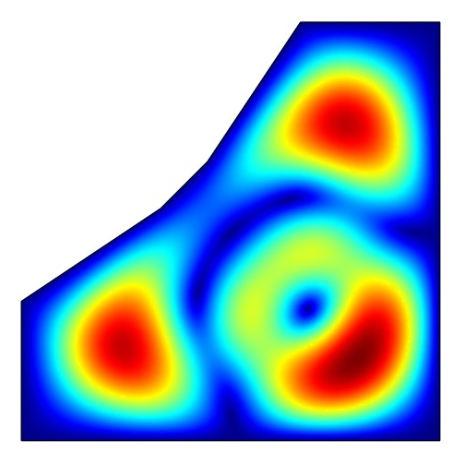
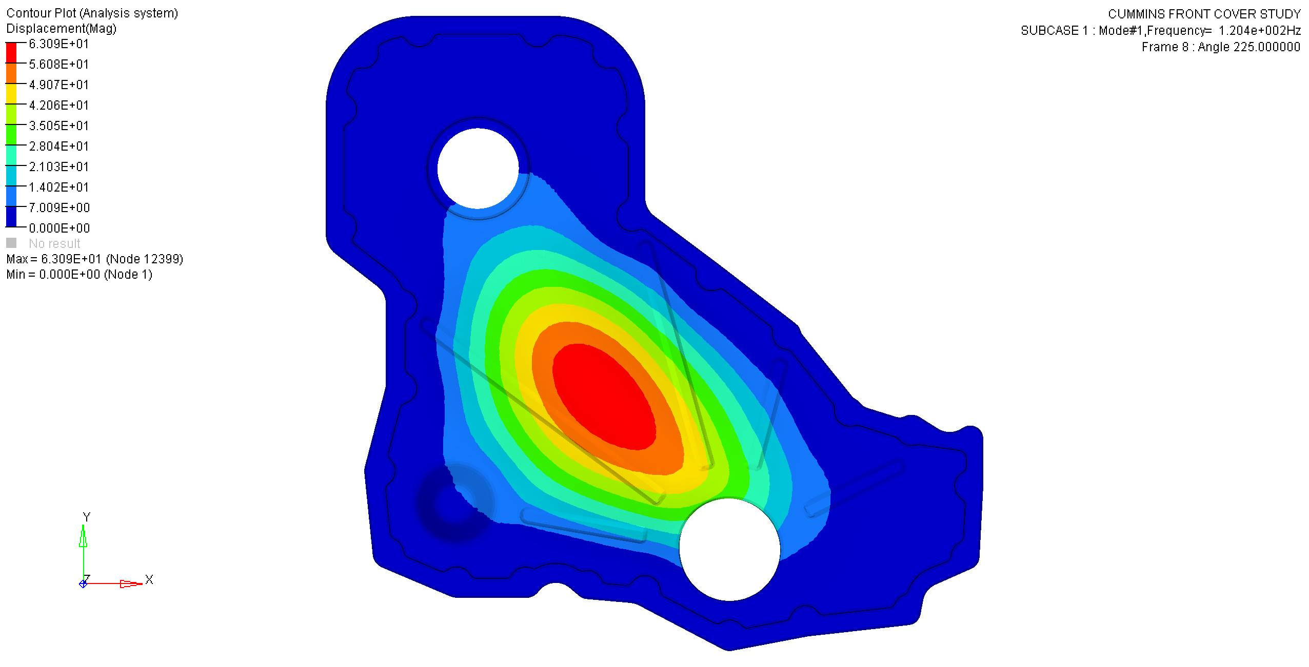
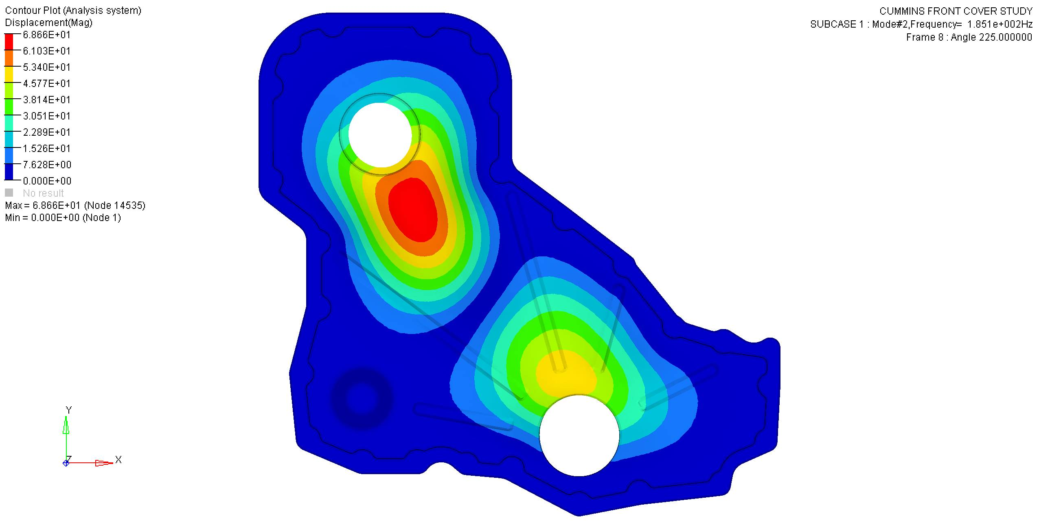
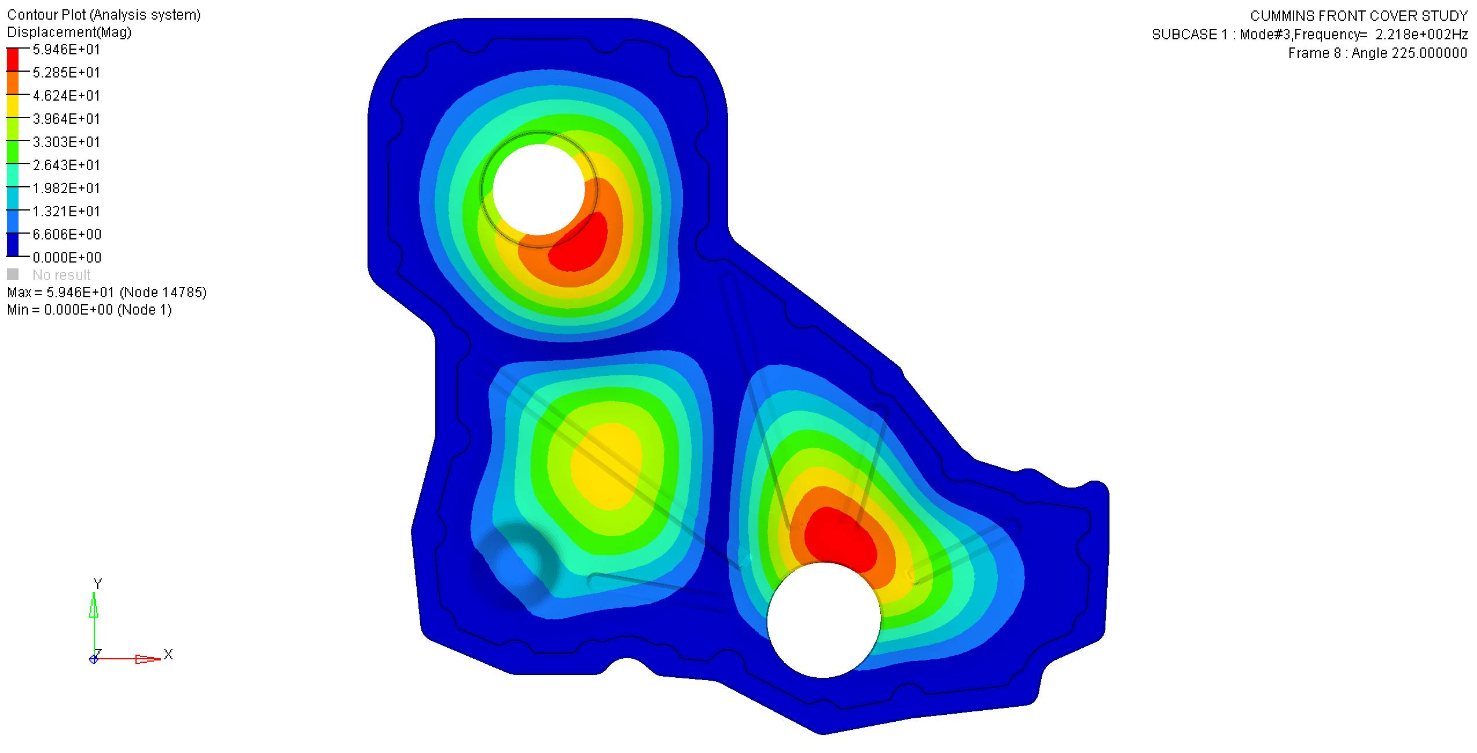
Design Analysis
Is the “scaled model” an accurate substitution?
  Finite element modal analysis computed
COMSOL FEA of First 3 Modes
7
Notes:
Josh starts here

Slide 8
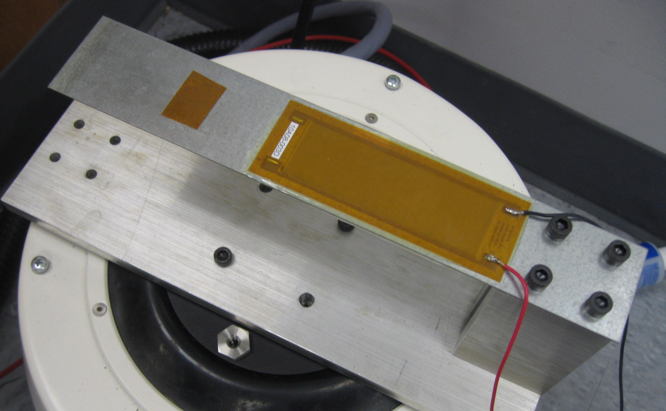
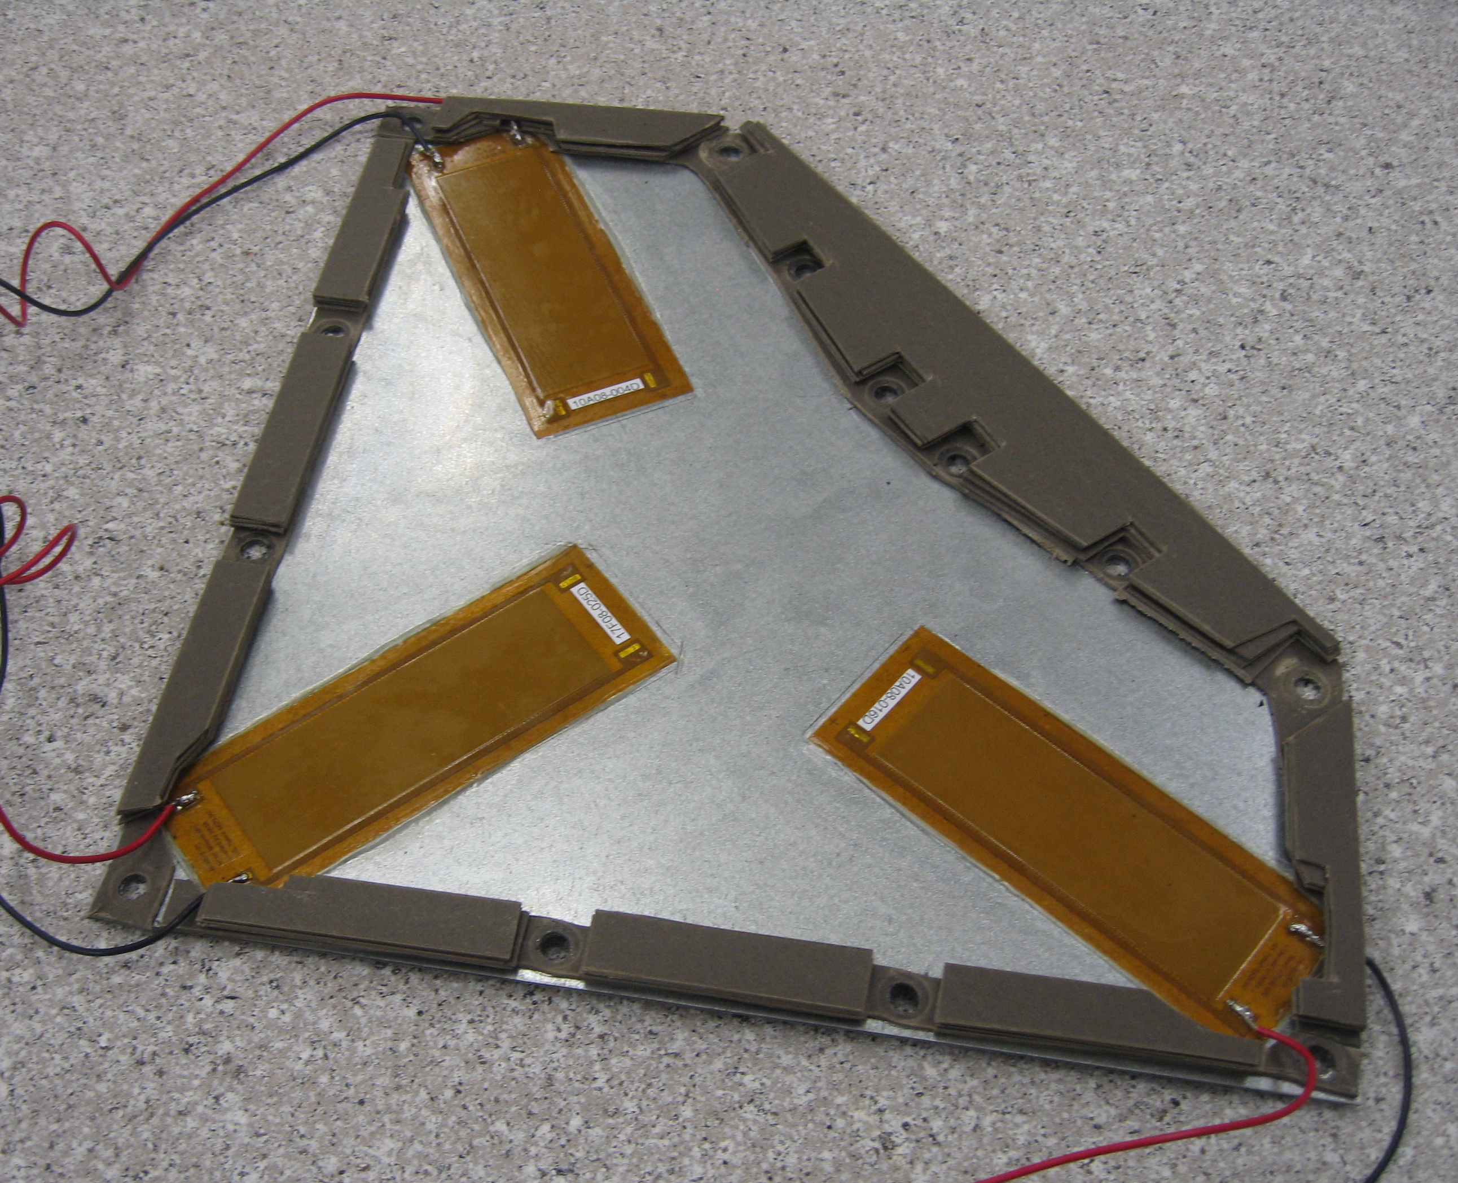
Design Analysis: MFC Actuators
Macro Fiber Composite (MFC)
  Consists of small piezo ceramic rods sandwiched in polyimide
Experimentally proven to reduce vibrations
  Oriented in the direction of vibration propagation
Cantilever Beam with MFC
Center of First Node
FEA of Scale Model Cover
Scale Model Cover with MFCs
8

Slide 9
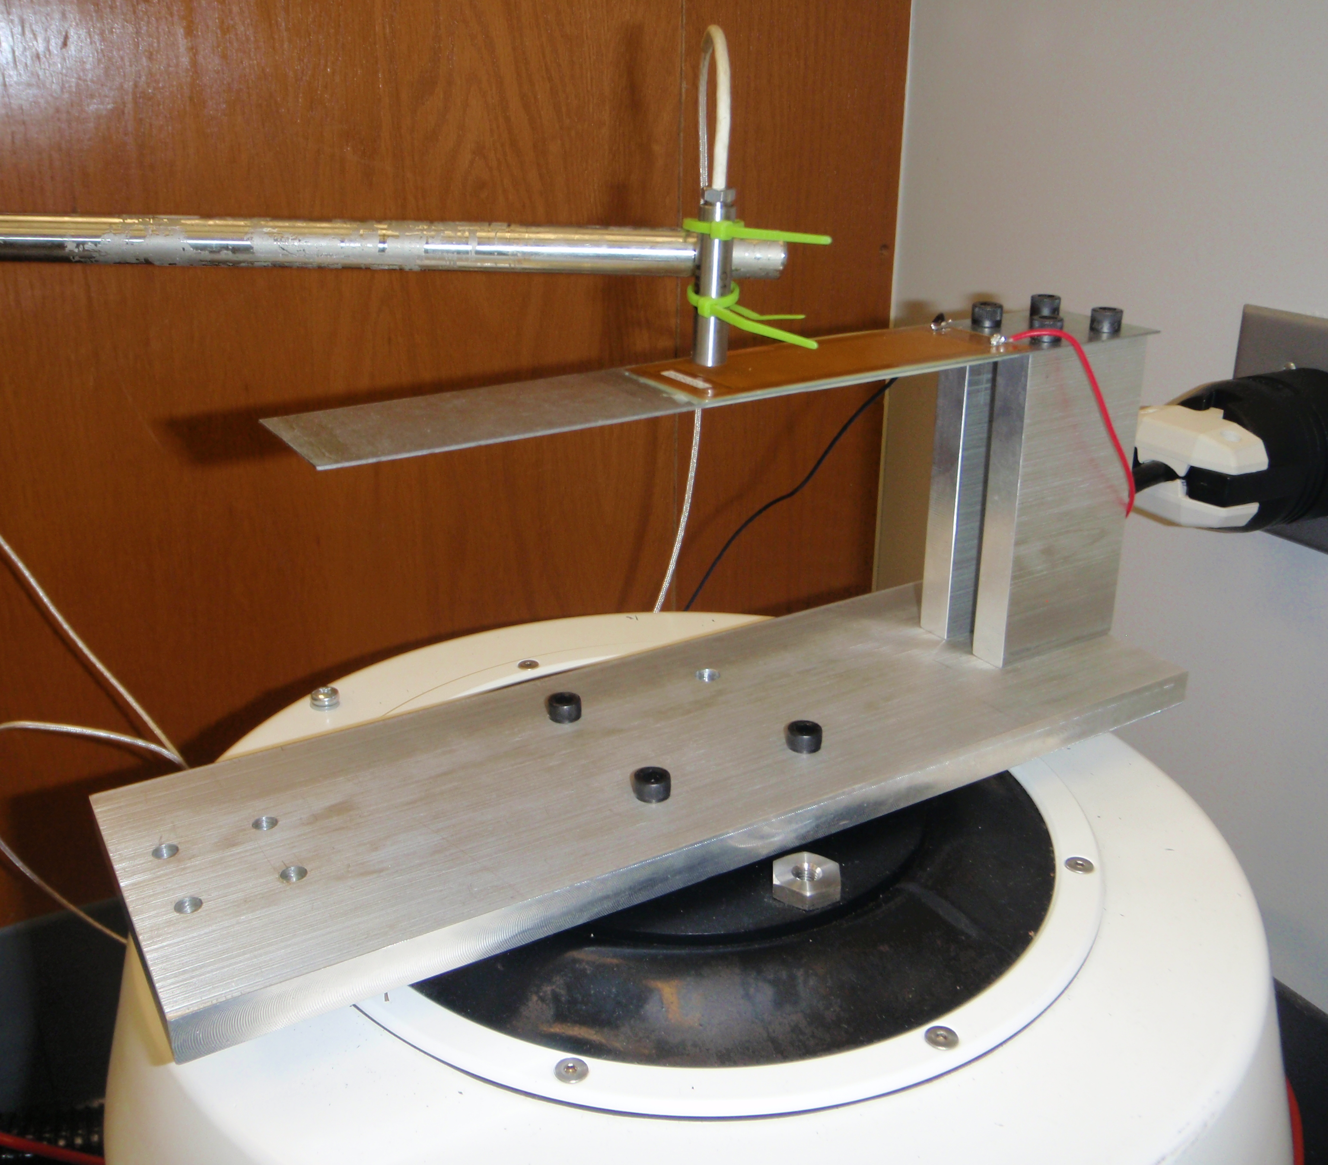
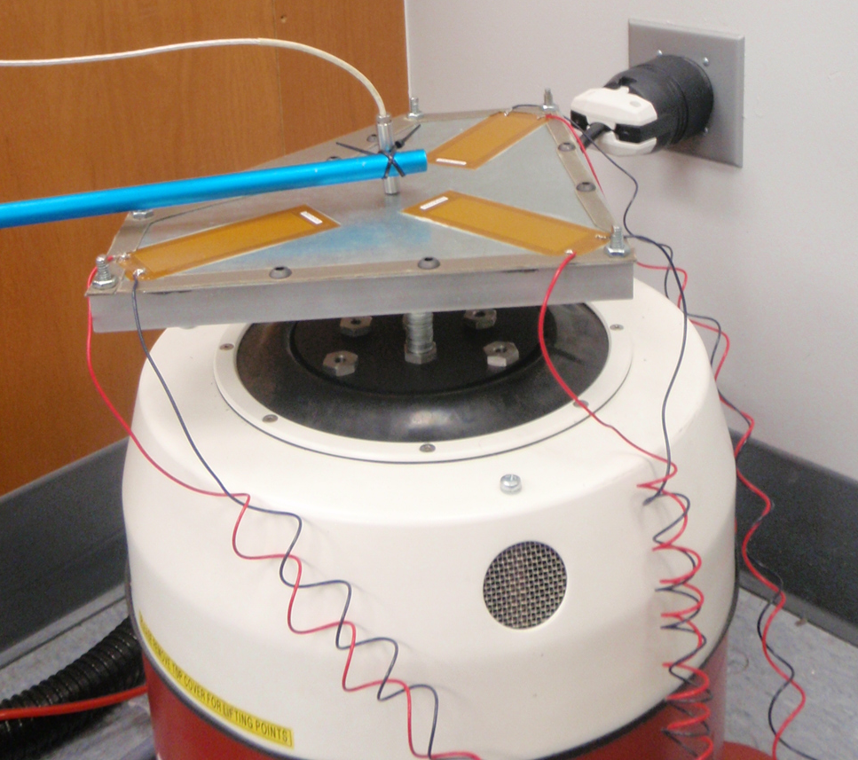
Project Testing: Active
Cantilever beam characterization:
  Used to test MFCs and implement control codes
Capacitor Probe
MFC
Cantilever Beam Apparatus
Shaker table:
  Provide steady state input vibrations for cantilever beam
  Frequency sweeps to test scale model cover with control
Scale Model Cover on Shaker
9

Slide 10
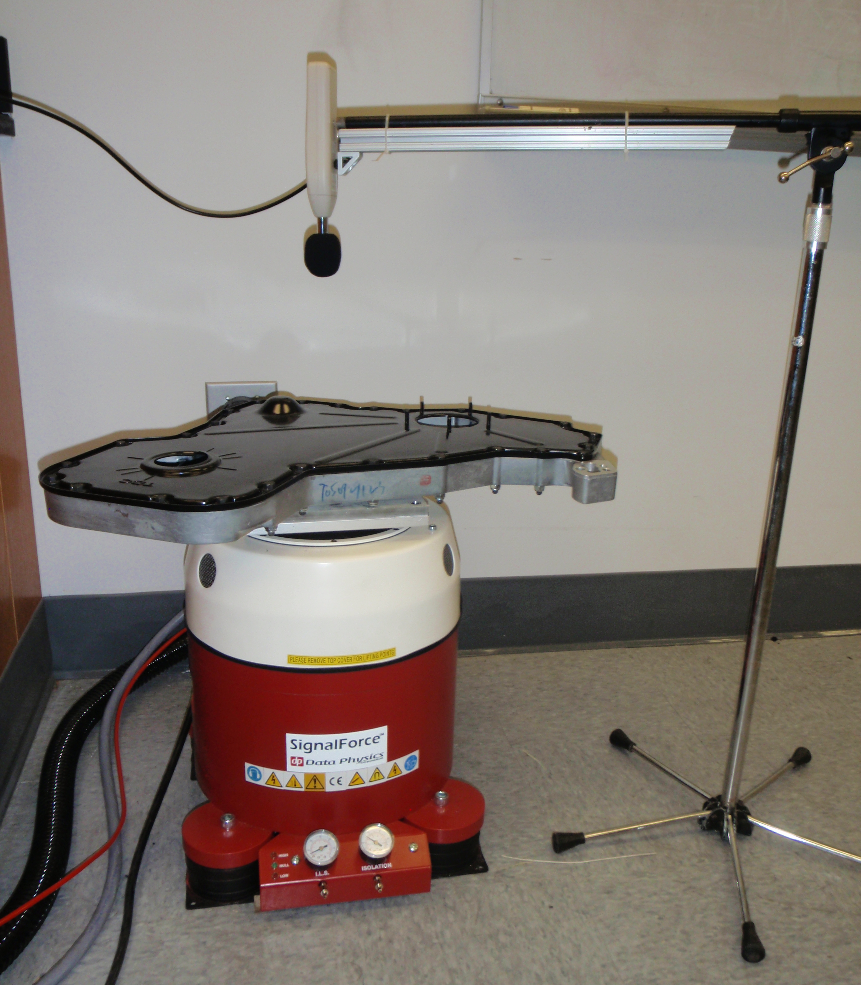
Project Testing: Passive
Experimental Setup:
  Shaker table induces vibrations at 2.5 g’s
  Sound level meter positioned above
  Signal Star software and DAQ system records data
Data recorded:
  Via voltage signal
  Scaled to appropriate dB value
  Plotted vs. engine’s frequency range
  Frequency sweeps vs. frequency dwells
Sound Meter
Gear Housing and Cover
Shaker
Shaker Equipment Setup

Slide 11
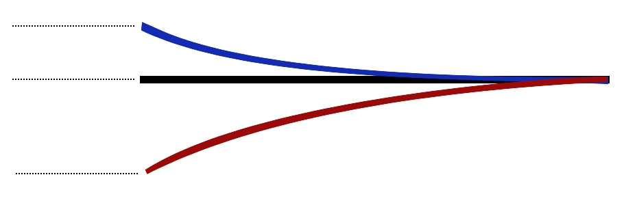

Design Testing: MFC Actuators
- 500 V
Contraction
2000 V Range
+1500 V
Expansion
MFC Actuator
0 - 500 V
Bias Voltage
500 – 1000 V
Constraints:
  Amplifier operation range is 0 to +1000V
  Amplifier cannot drive MFC negatively (one direction deflection)
  Having 3 MFCs in parallel splits amplitude and thus frequency response
Solution:
  Bias the voltage to 500V (preload material for maximum attenuation)
11

Slide 12
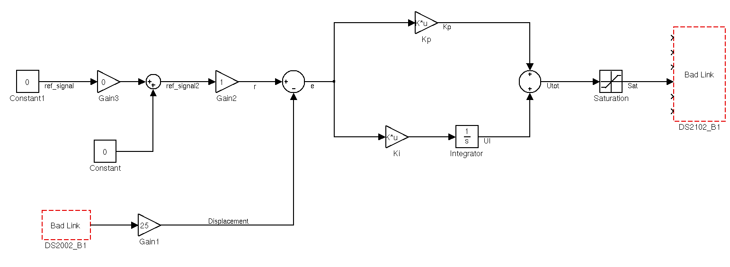
Design Testing: Active Control
Control Setup:
  Lead-lag filter/integral control scheme
  Filter targets resonance frequency
  Incorporates displacement feedback from capacitor probe
DAQ
DAQ
Capacitor Probe
Capacitor Probe
PI Control Schematic
Lead Lag / Integral Control Schematic
12
Notes:
Mention that Oates used a cantilever model to predict certain gains, etc. ….

Slide 13
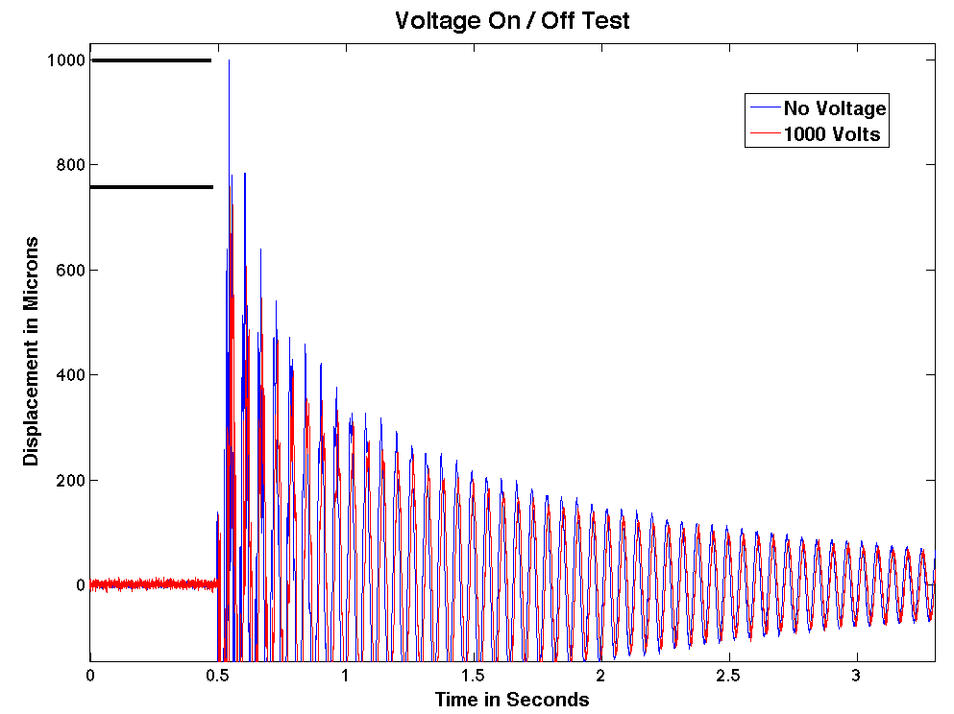
Project Results: Active
Characterization:
  Confirms dynamic properties
  Proves stiffness variance dependant on voltage
Controller gains:
  Estimated using dynamic properties combined with phase and gain Bode plots
> 200 μm initial difference
50 to 65% increase in damping
13

Slide 14
Project Results: Active
Controller success:
  PI Controller went unstable due to steady state error
  Lead lag filter reduced error
At 0.1g and resonance, 10x reduction in displacement
At 2.5g and resonance, 1.6mm displacement vs. 35mm displacement
Shaker Ramping Up
No Control
Steady State Disturbance
Shaker Ramping Up
Steady State Disturbance
No Control
Steady State Oscillation due to Bias
14

Slide 15
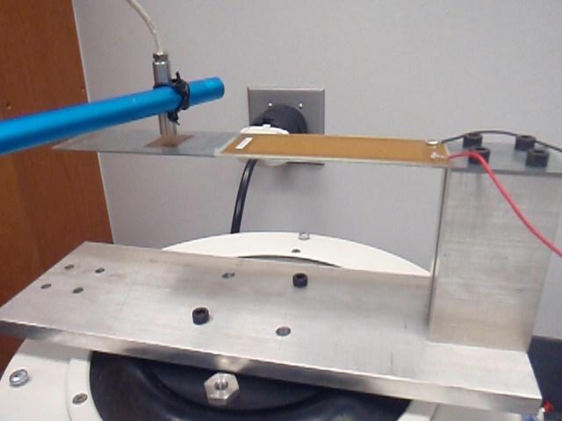
Project Results: Active
15

Slide 16
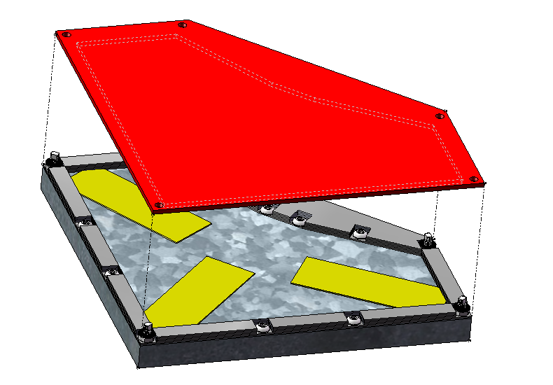
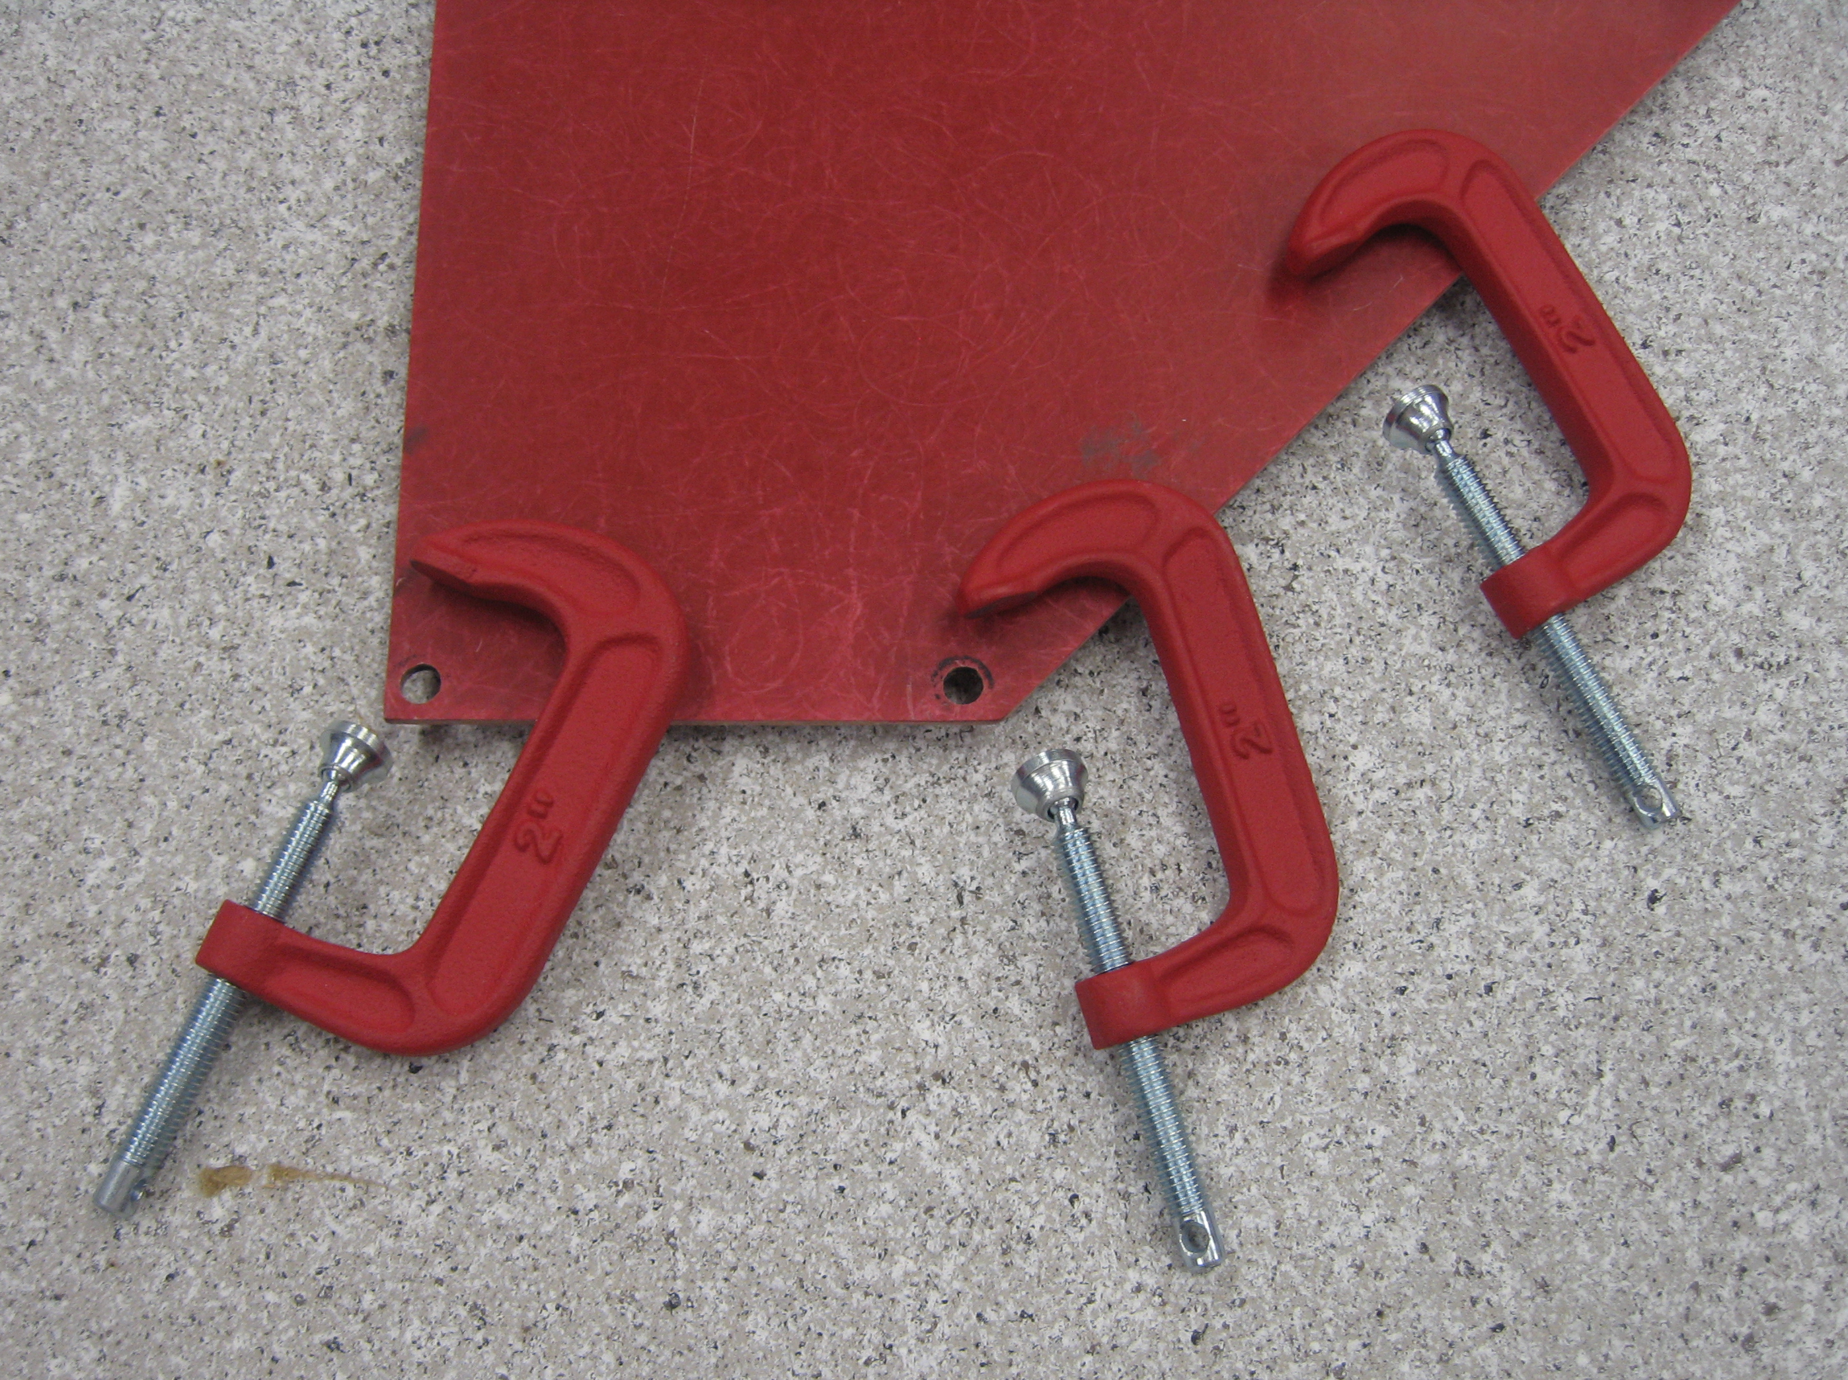
Project Results: Passive
Numerous tests conducted:
  Original gear covers
  Scale model gear cover
  Addition of Vibra Block, sound barrier, foam, etc.
  Scale model cover with MFCs
  Various attachment points for sound barrier panel
  Control vs. without control, shunt circuit, and constant voltage
Final comparisons for each component made
  How effective was each component?
Different Attachment Points for Barrier
C Clamps Used for Testing
16

Slide 17
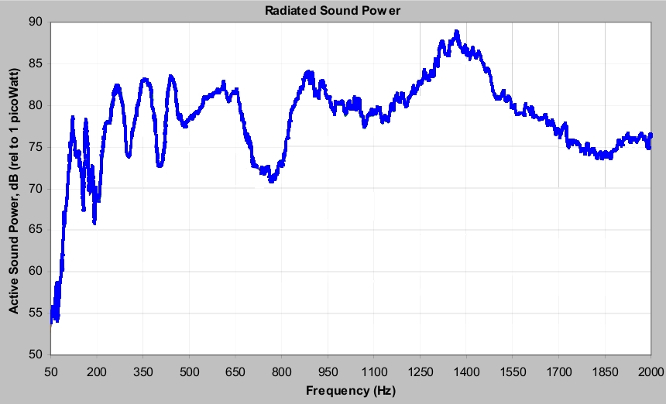
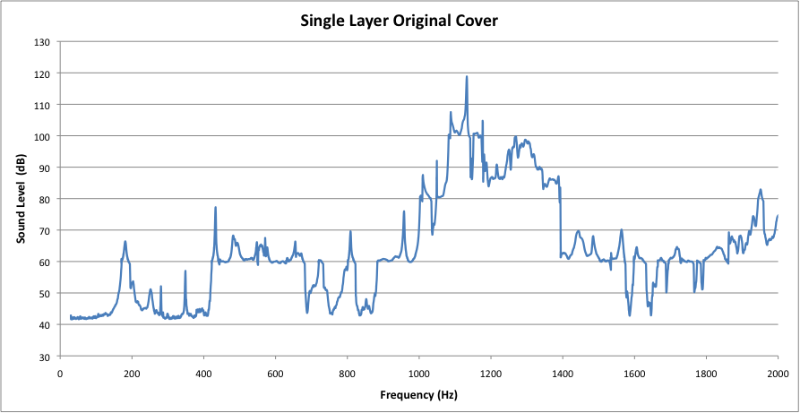
Project Results: Passive
Accurate replication of original gear cover data:
Same Trends Seen in Frequency Ranges
17

Slide 18
Project Results: Passive (No MFCs)
Layering | Increase/Decrease | Sound Level | Frequency Range
VibraBlock Washer | Decrease | 10 dB | 1750-2000 Hz
Dual Layer with VibraBlock | Decrease | 15 dB | 200 Hz
 | Decrease | 10 dB | 1800-2000 Hz
Sound Barrier | Decrease | 15 dB | 500-700 Hz
 | Decrease | 10 dB | 1600-1800 Hz
 | Increase | 10 dB | 1800-2000 Hz
Sound Absorbing Foam | Decrease | 15-20 dB | 500-1000 Hz
Results of scale model with no MFCs:
  Decrease in noise with the addition of each material
  Change in sound barrier attachment method?
  How will MFC actuators affect sound?
18
Notes:
Original dual layer drops dB by about 20 in mid frequency range

Slide 19
Project Results: Sound Data
Layering | Increase/Decrease | Sound Level | Frequency Range
MFCs (no voltage) | Decrease | 20 dB ⬆ | 700-800 Hz
 | Decrease | 10-20 dB | 1800-2000 Hz
 | Decrease | Constant 5 dB | After 700 Hz
Control vs. No Control | Decrease | 5 dB | @ 1150 & 1400
Sound Barrier | Decrease | 10 dB | @ 300, 450, 750
 | Decrease | 10 dB | 1250-1400 Hz
 | Decrease | 5 dB | 1700-2000 Hz
Sound Absorbing Foam | Decrease | 5 dB | Main Drop @ 500
 | Decrease | 5 dB | 1400-2000 Hz
Final assembly vs. unaltered cover:
  Large reductions in 400-800, 1200-1500, & 1800-2000 Hz ranges
Notes:
Original dual layer drops dB by about 20 in mid frequency range

Slide 20
Project Effectiveness
MFCs w/Control
MFCs w/Max Voltage
Percentage estimations determined using Simpsons Rule
Project Budget: over $200 under budget
20

Slide 21
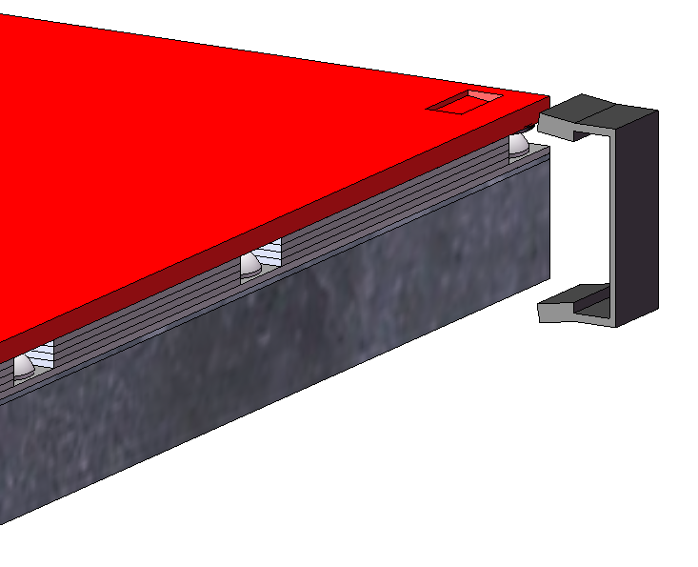
Project Conclusion
Testing Results
  MFC actuators passively increase stiffness (like ribs)
  Cantilever beam and controller prove concept
  MFCs proved to NOT be cost effective at reducing dBs
  Overall passive design with sound barrier proved very effective
Future Prospects
  Use a simpler constraining/attachment system for sound barrier
  Incorporate and test strain gauges for feedback control
  Make MFC actuators more effective:
    Quicker frequency response
    More advanced dynamic modeling
Scale Model With Spring Clamps
21

Slide 22
Questions?
Thanks to:
  Academic Advisor: Dr. William Oates
  Cummins Representatives: Richard Varo and David Moenssen
  Shaker Lab Assistants & Dr. Collins
  Faculty Advisors: Dr. Shih and Dr. Waryoba
  Bobby Avant at the AAPL Machine Shop
  Dr. Clark’s Stride Lab & Christopher Kulinka
22

Slide 23
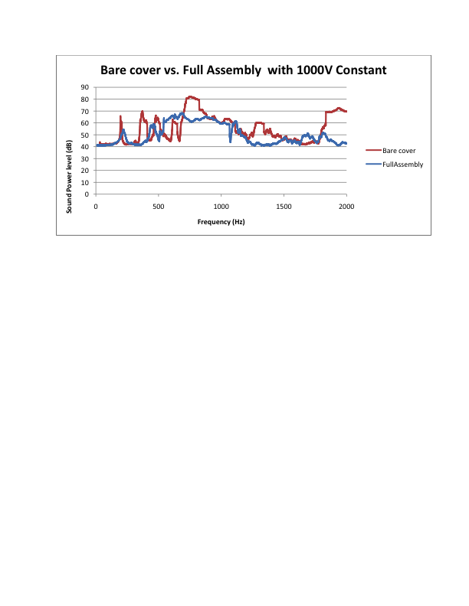
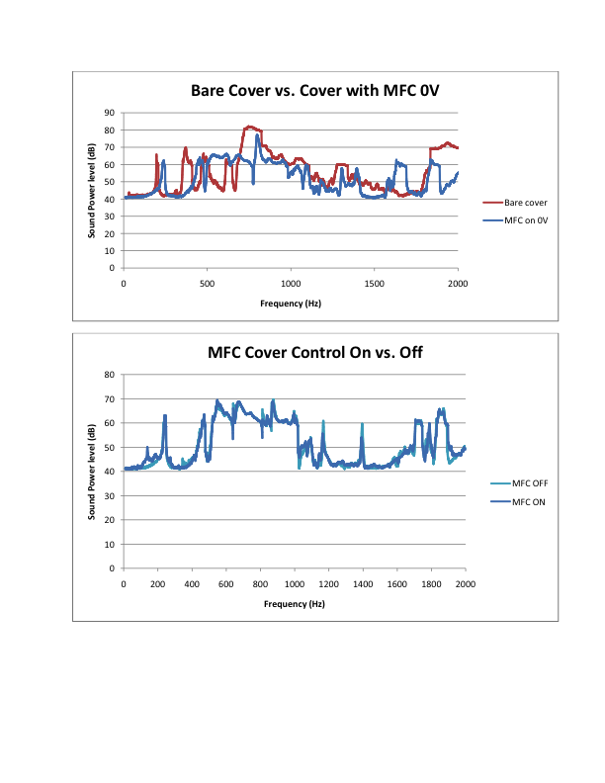
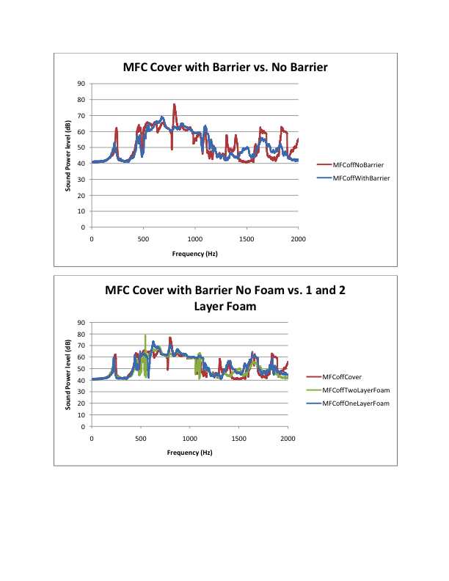
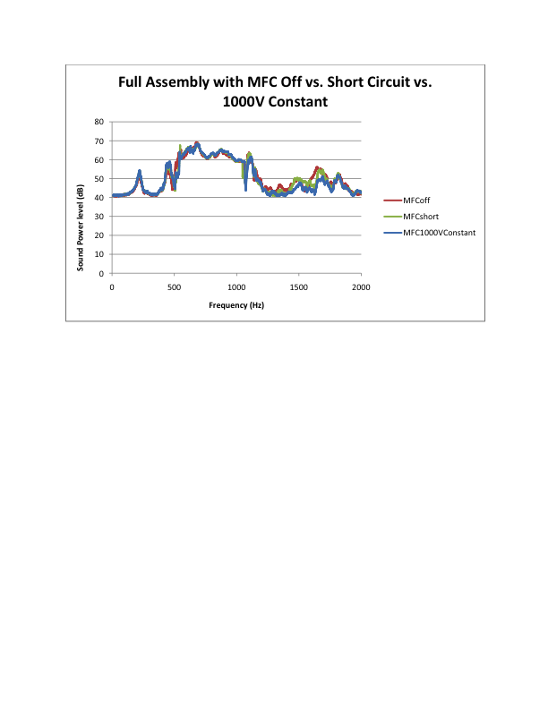
Project Testing: Sound Data
23

