Slide 1
One Box Gunnery Trainer Interim Design Review
Group 10
Anthony Muller
Gerald Tyberghein
Joshua Wood

Slide 2
Overview
The Advanced Gunnery Trainer System
Problem Statement
Product Specifications
Breakdown
Tradeoffs
Concept Design
Tip Analysis
MIL-STD-810
FEM Analysis
Cost Analysis
Future Plans

Slide 3
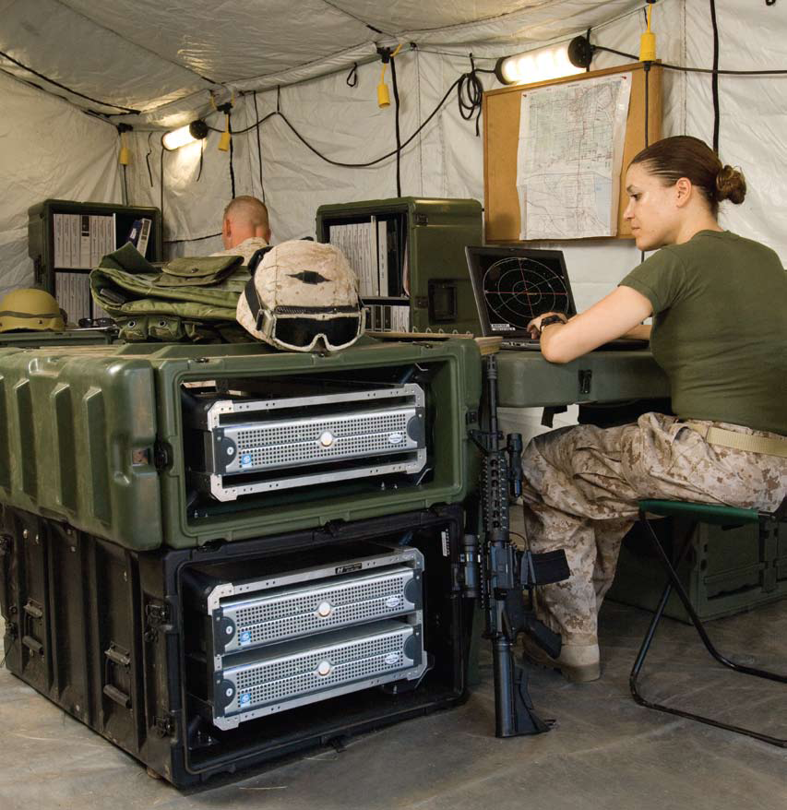
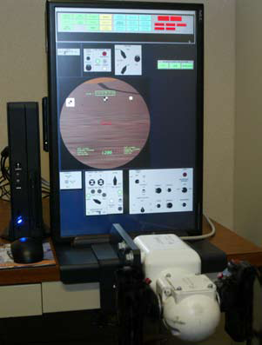
Introduction
Figure 1: Lockheed Martin TAGTS
Source(www.lockheedmartin.com)
Figure 2: Pelican-Hardigg case in military use
Source: Pelican-Hardigg Case (www.pelican.com)

Slide 4
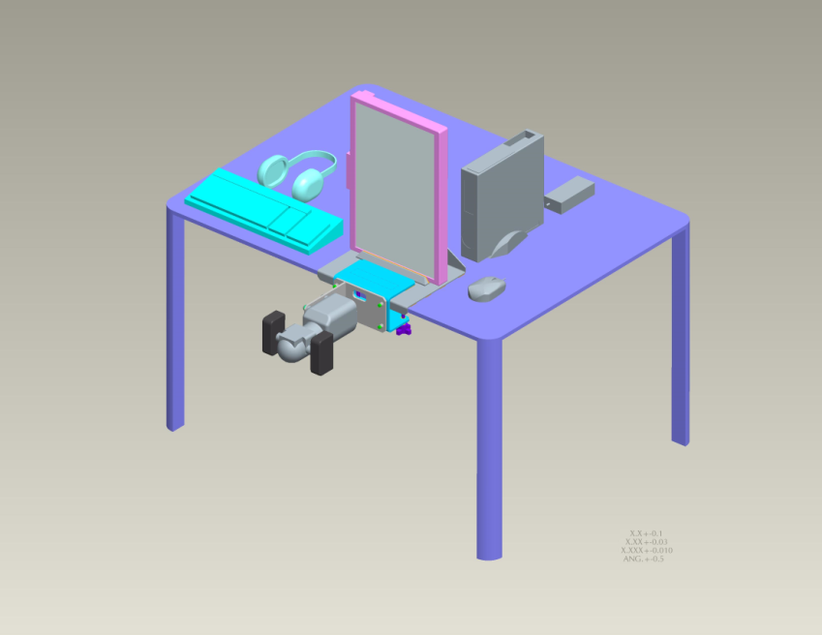
Product Specifications
Weighs less than 120 lbs
Sights and gunner handle mounted in correct tactical position
Equipment must be safe when being transported
Packing does not interfere with components’ cooling
System must be stable
System must be durable
Easy to set up
Figure 3: Current TAGTS setup
Source: Payne, Jeffrey

Slide 5
Breakdown
Table 1: Tabletop vs. Box on Floor Properties
Component | Tabletop | Box on Floor
Weight | 102-110 lbs | 110-130 lbs
Handle Linkage | 2 parts | 6 parts
Monitor Linkage | 1 part | 6 parts
Case Durability | High | Medium
Ease of Access | High | Medium
Air Ventilation | High | Low – Medium
User Convenience | Medium | Medium
Manufacturing | Easy | Difficult
Shock Mounting | High | Medium-High

Slide 6
Tradeoff Decision – Main Points
Weight – about 15-20 lbs lighter than Box on Floor.
Shock Mounts – Pelican provided shock mounts will provide better impact force protection compared to a foam insert/sheet metal combination for a box on floor design.
Manufacturing – Easier on large scale to order a Pelican case with internal Mac Rack frame and shock mounts rather than design and manufacture foam inserts and sheet metal for every case.
User Convenience – Easier to access parts for maintenance and repairs. Also, leg room is not an issue.

Slide 7
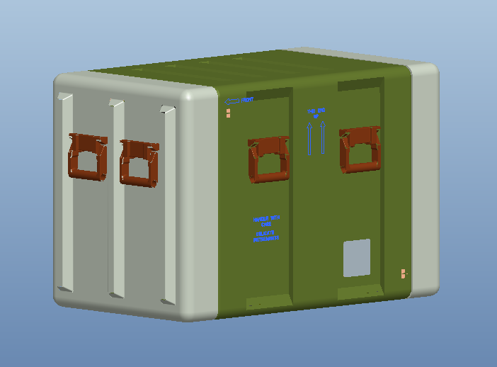
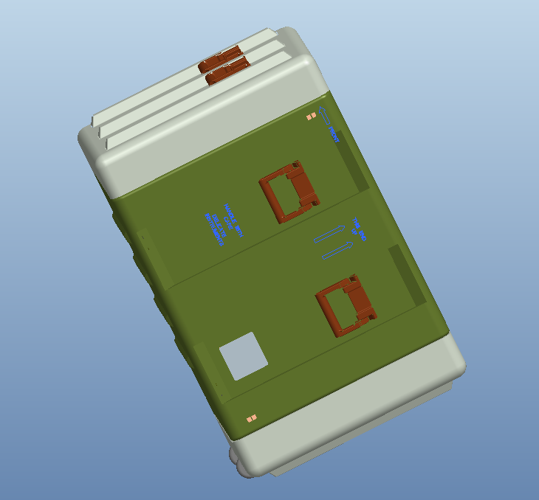
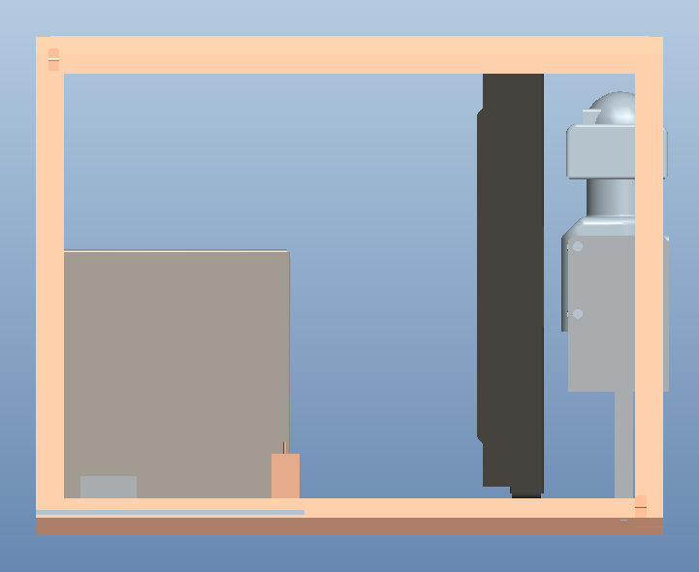
Concept
Figure 4 : Case Packed
Position
Figure 5 :
Case Rolling
Figure 6: Side View Inside Case

Slide 8
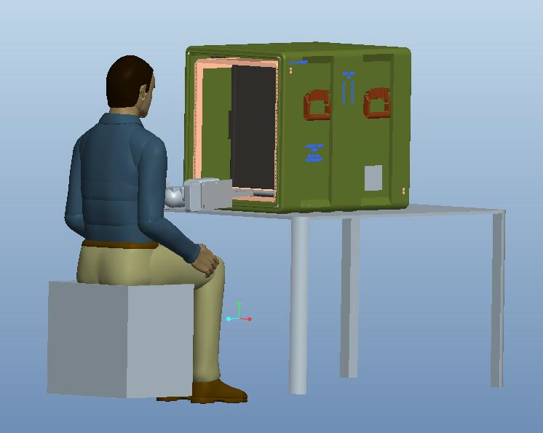
Concept
Figure 7: Person Using TAGTS

Slide 9
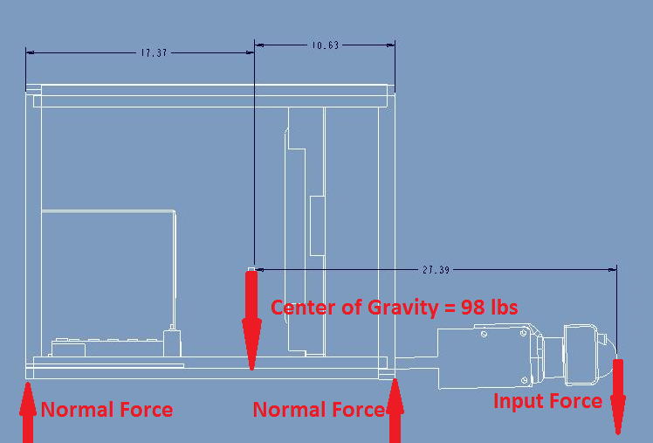
Tip Analysis
Figure 8 : Force Distribution of Deployed System

Slide 10
Tip Analysis
Set left side normal force equal to 0, to assume tipping.
Take moments about right side normal force, and solve for the input force on the handle.
98lbs(10.63in) – F(16.76in) = 0
Maximum applied downward force on handle
F = 62.16 lbs

Slide 11
MIL-STD-810 Test
“…a generally accepted standard of ruggedisation for testing and compliance for mobile computers and equipment.” (Secure Systems and Technologies)
Mechanical Shock
Random Mechanical Vibration
Altitude

Slide 12
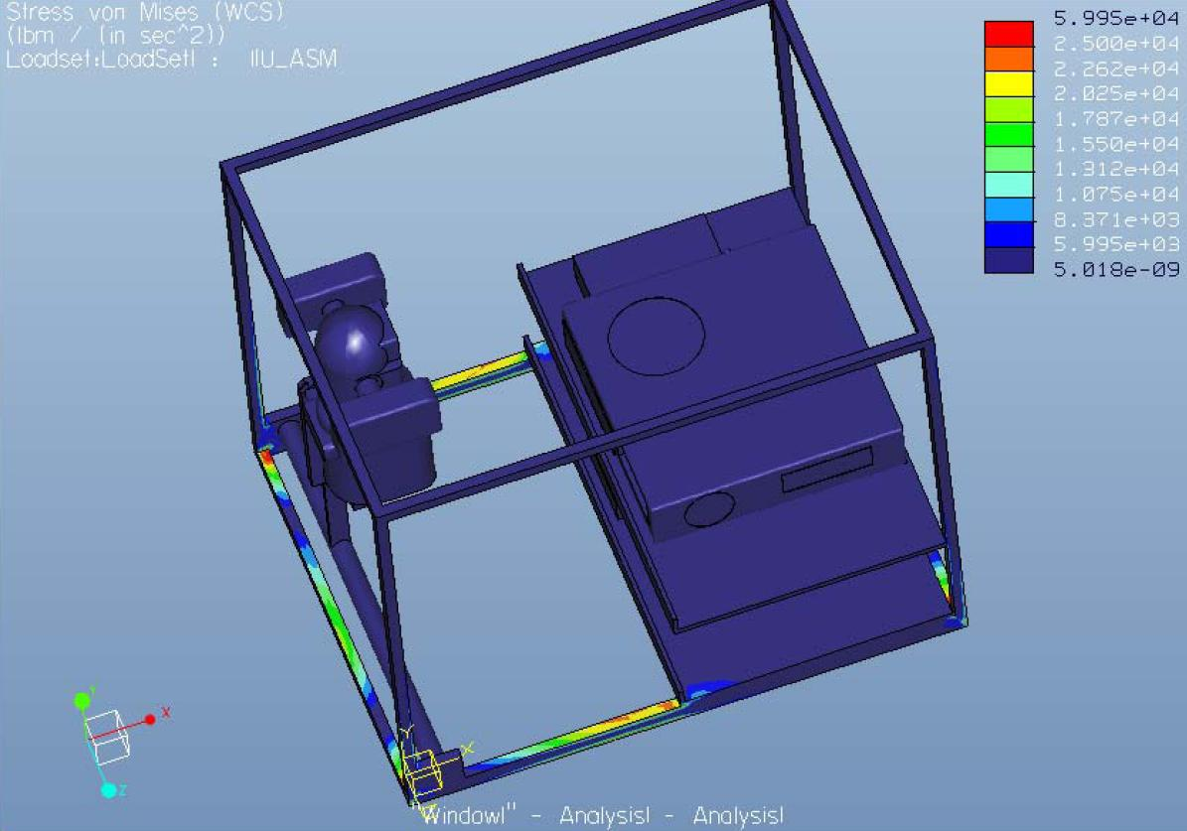
FEM Analysis
Figure 9 : Stress Distribution of von Mises

Slide 13
Cost Analysis
Item |  | End Product Cost | Require for Project | Project Cost
Box |  | 1800 |  | 0
Monitor |  | 700 |  | 0
 | Bracket | 200 | √ | 200
Computer |  | 500 |  | 0
 | Bracket | 65 | √ | 65
Keyboard |  | 70 |  | 0
 | Mount in Lid | 25 | √ | 25
Mouse |  | 20 |  | 0
 | w/ Kybrd | 0 |  | 0
Headset |  | 300 |  | 0
 | w/ Kybrd | 0 |  | 0
Handle |  | Proprietary |  | 0
 | Bracket | 150 | √ | 150
 | USB Interface | Proprietary |  | 0
Power Strip |  | 45 | √ | 45
 | Mount | 5 | √ | 5
Cable Management |  | 50 | √ | 50
Total |  | 3930+ |  | 540+

Slide 14
Future Plans
Currently in “Design Refinement” Phase of Gantt Chart
Attend Interservice/Industry Training, Simulation, and Education Conference (11/29/10-12/02/10)
Order Pelican case from Ms. Daria Boley of Pelican Hardigg
Implement components into case and mount system for testing and analysis

Slide 15
References
Lockheed Martin. The Advanced Gunnery Trainer System (AGTS) Tabletop Trainer. Lockheed Martin. Www.lockheedmartin.com. Web. 31 Oct. 2010.
Pelican. Pelican Hardigg Cases. Pelican, 2010. Www.pelican.com. Web. 03 Nov 2010.
Secure Systems and Technologies. MIL-STD-810 Overview. Secure Systems and Technologies. http://www.sst.ws/images/downloads/MIL-STD-810%20overview%20iss%205.pdf. Web. 31 Oct. 2010.

Slide 16
Acknowledgement
Sponsor – Lockheed Martin
- Jeffrey Payne (Mechanical Engineer)
Sponsor – Pelican Hardigg
- Daria Boley (Pelican Hardigg Salesperson)
Advisors –
- Dr. Rob Hovsapian
- Dr. Patrick Hollis
- Dr. Srinivas Kosaraju
- Ms. Shannon Ingersoll
- Mr. Joseph Trpisovsky

