Slide 1

One Box Gunnery Trainer
Final Presentation
Group 10
Anthony Muller
Gerald Tyberghein
Joshua Wood

Slide 2
Overview
Problem Statement
Product Specifications
Initial Concept Designs
Final Design
Pelican Case
Finalized Parts List
Mounting Simulation Hardware/Software
Drop Testing
Force and Static Analysis
Results
Improvements

Slide 3
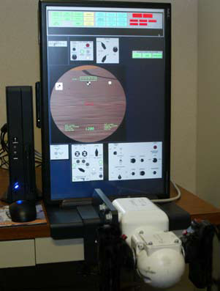
Problem Statement
Advanced Gunnery Trainer System simulates many military vehicle operations. We’re dealing with the M1 Abrams tank simulator.
TAGTS requires assembly and breakdown every time it must be transported.
Inconvenient to the user and takes time, and can get disorganized.
Re-design system to make easier to assemble and transport.
Figure 1: Lockheed Martin TAGTS
Source(www.lockheedmartin.com)

Slide 4
Product Specifications
System must weigh less than 120 lbs.
System must satisfy 15 degree tip rule.
Handle and monitor must be mounted in correct tactical position.
Equipment must be safe while transported.
Packaging does not interfere with cooling.

Slide 5
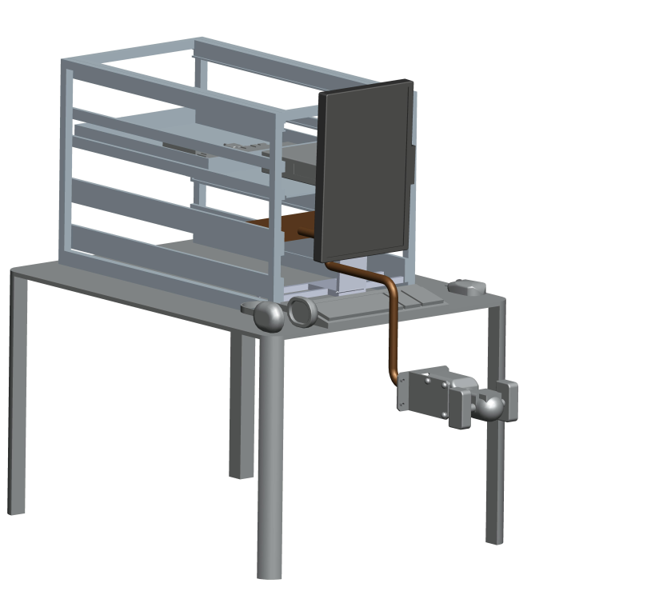
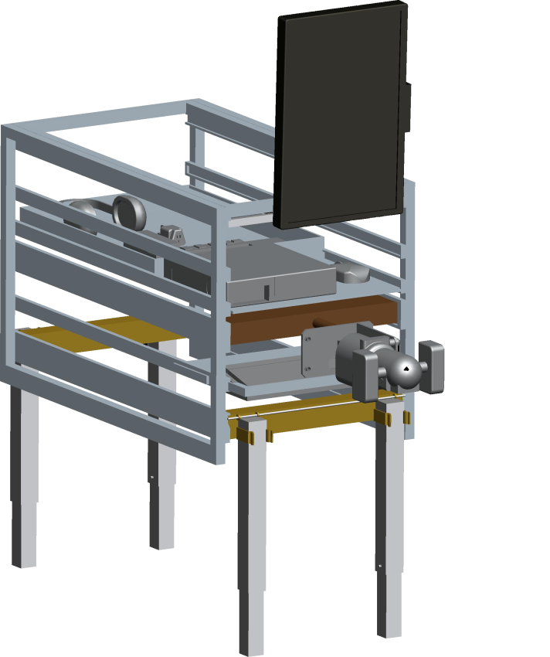
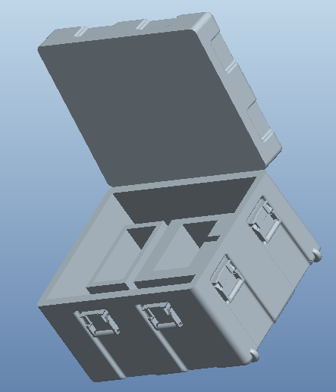
Initial Concepts
Figure 2 : Tabletop Box on Floor Hybrid Concepts

Slide 6
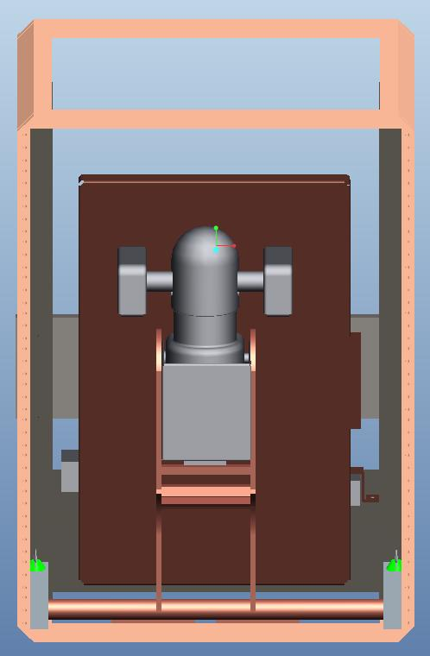
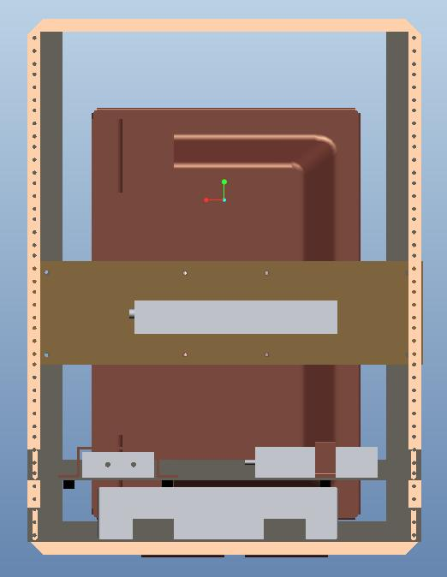
Final Concept
Figure 3: Front Internal View
Figure 4:Rear Internal View

Slide 7
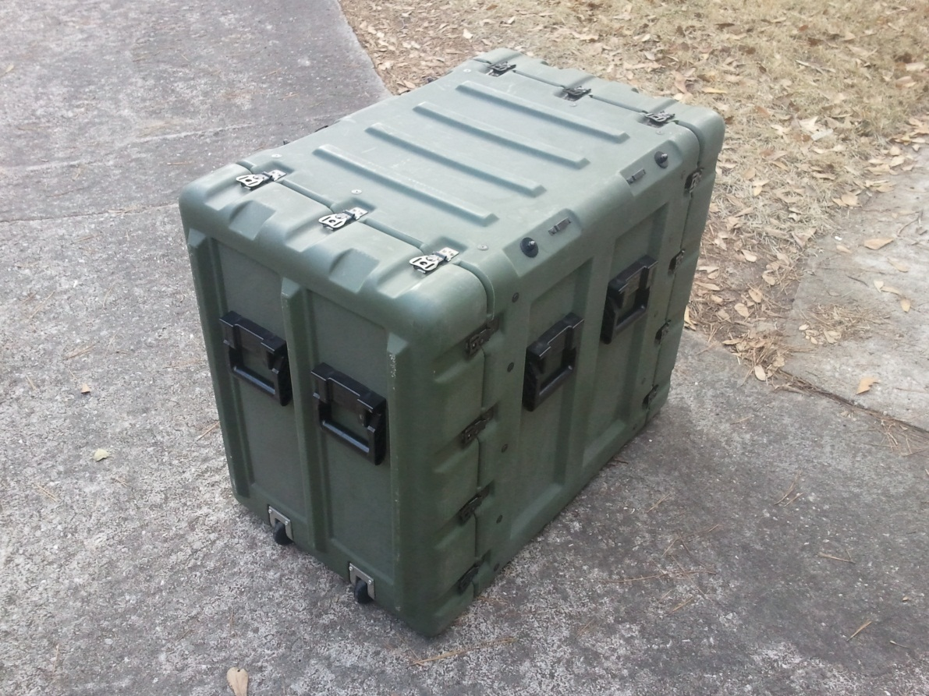
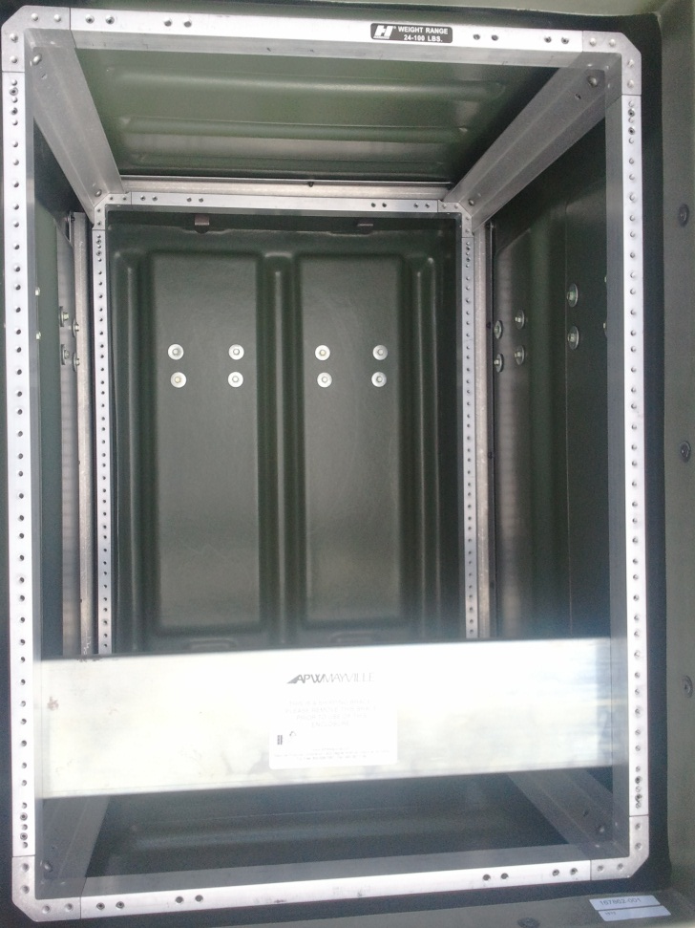
Our Case (14U case, 26” case)
Figure 5: Pelican Case for our project
Figure 6: Internal rear view of case

Slide 8
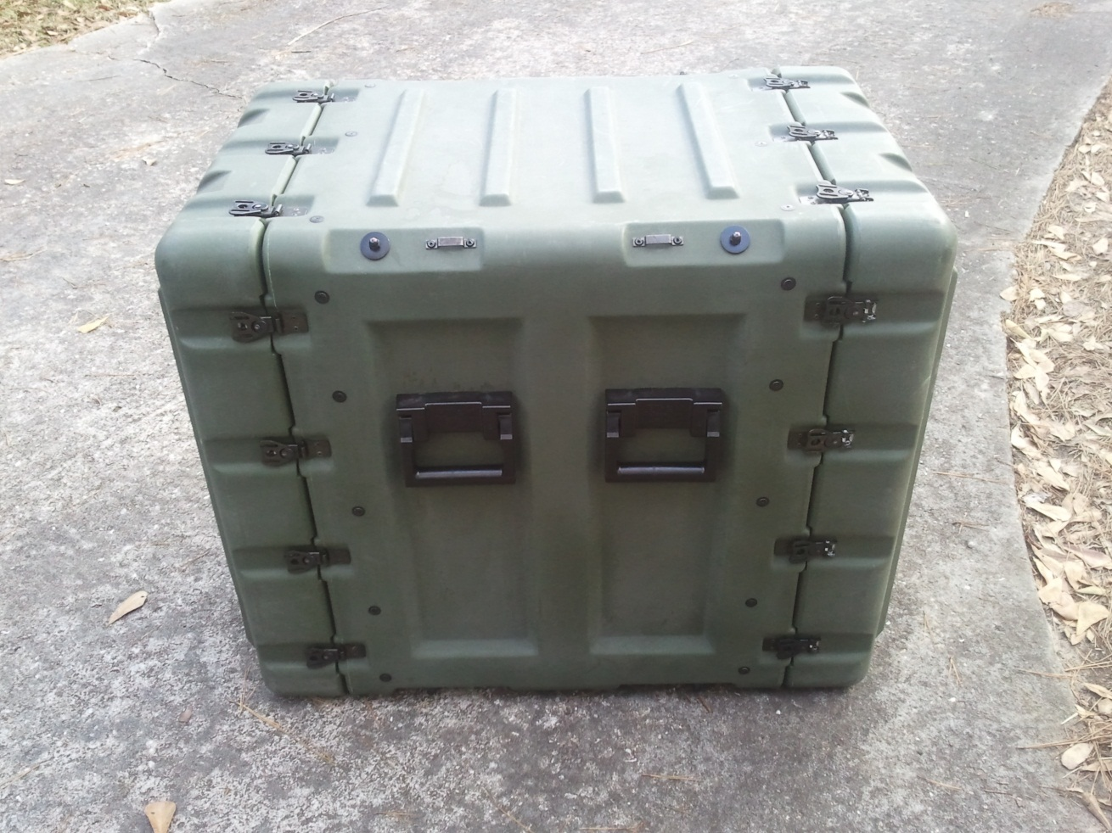
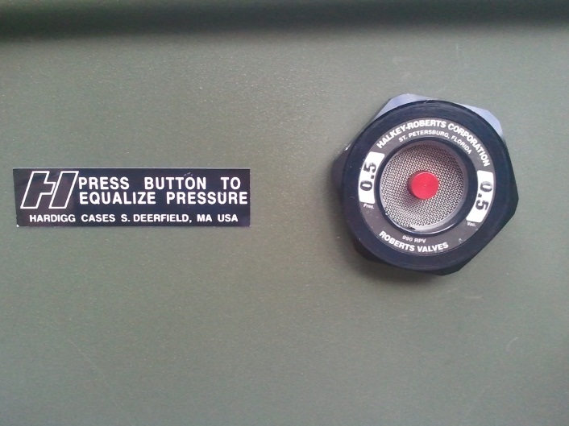
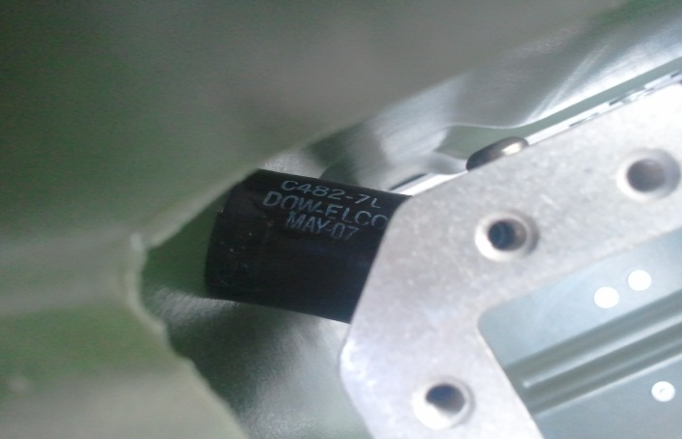
Our Case
Figure 7: Side view
Figure 8: Pressure
Release Valve (Top)
Shock Mount (Bottom)

Slide 9
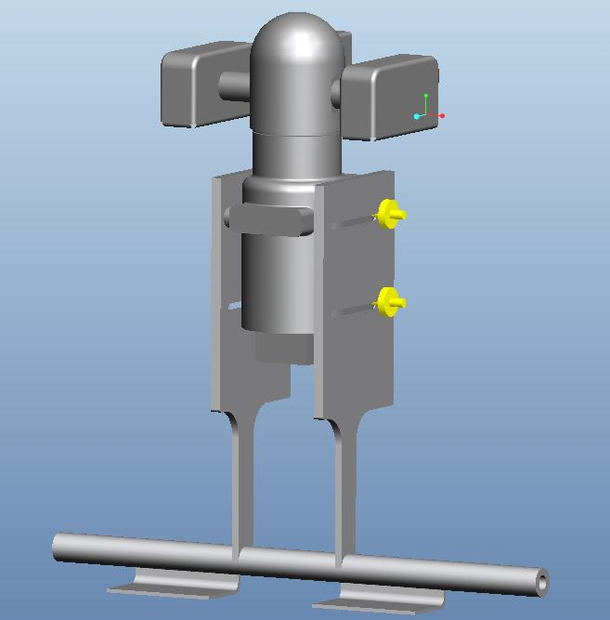
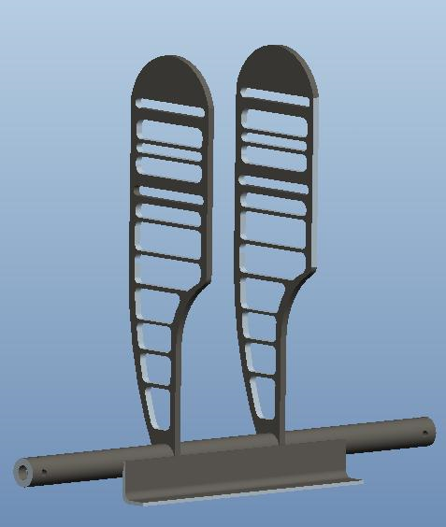
The Handle Pivot
Figure 9: Handle Pivot (Before/After)

Slide 10
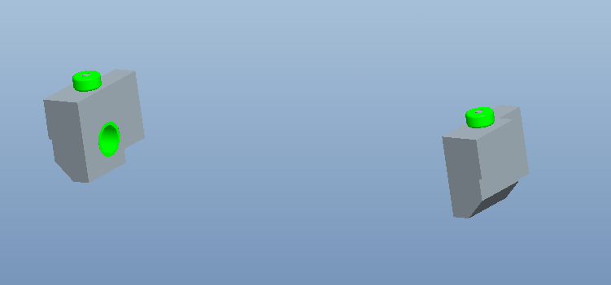
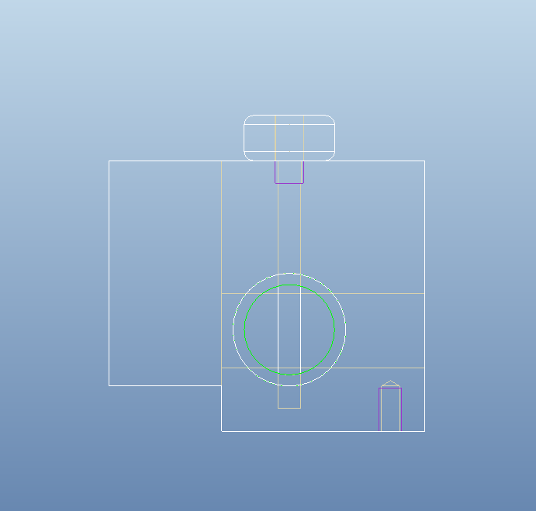
The Bearing Blocks
Figure 10: Bearing blocks
Figure 11:
Side internal view of bearing block

Slide 11
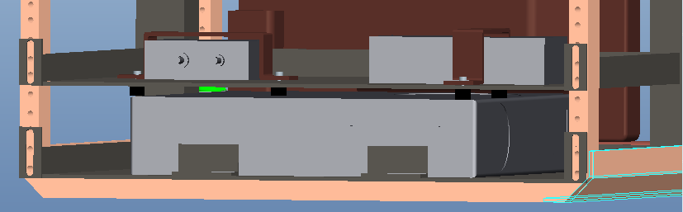
The Computer Shelf
Figure 12: Computer Shelf

Slide 12
Finalized Parts List
Table 1: Parts List (images from www.mcmaster.com)
Description | Quantity | Total Price
Aluminum square tubing | 1 (6ft) | 36.22
Aluminum bar for pivot | 1 (3ft) | 19.28
Bronze Sleeve Bearings | 4 | 9.96
Aluminum bearing blocks | 1 | 74.82
Locking pin | 1 | 3.41
L- brackets for pivot | 1 (4ft) | 10.98
Handle and monitor mount | 2 (3ft) | 64.28
U-bracket for handle | 1 | 12.20
Shelf material | 1 | 58.21
Neoprene tubing | 1 (1ft) | 2.00
Silicone dampening | 1 (2ft) | 10.32
Neoprene for aux. parts | 1 (2ft) | 43.62
Auxiliary brackets | 1 (3ft) | 36.65
Medium Density Fiberboard | 1 (4’x8’) | 32.96
Total |  | $ 414.91

Slide 13
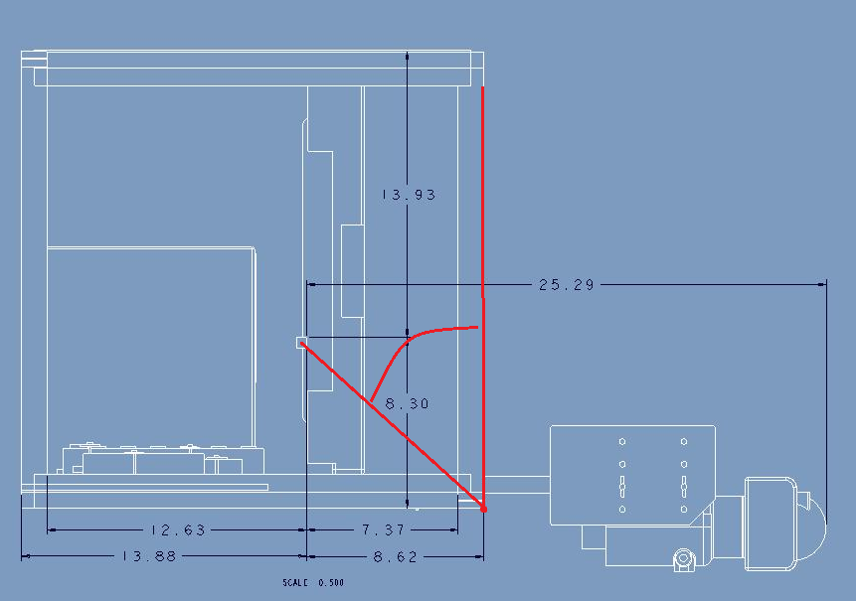
Static Tip Analysis
Figure 13 : Maximum Angle of Deployed System

Slide 14
Static Tip Analysis
Tipping occurs when left normal force is equal to 0 and center of gravity passes the right normal force.
Solving for this angle, theta=atan(8.62/8.3) = 46deg
Product specification: Satisfy 15 degree tip rule

Slide 15
Risks Assessed
Components may be damaged by impact forces or vibration.
  We analyzed impact forces from drop testing to analyze if our design completely satisfies the fragility bounds for the components. Given the results we know that there needs to be some tweaking in our design.
Components and mounts may not assemble as desired in design
  We had to re-drill and cut down a lot of parts after being machined to fit our exact frame.

Slide 16
Risks Assessed
Handle may swing into computer monitor
  L-bracket stop was implemented to prevent this.
Once assembled, system could weigh more than expected
  We have room to cut down material, however our system did not weigh more than desired.
Specific Pelican case model may not be available
  We were able to use another case that was available, modifying our design to suit the new dimensions.

Slide 17
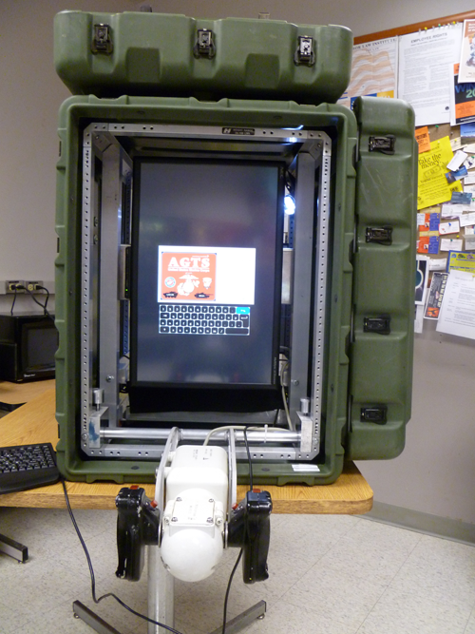
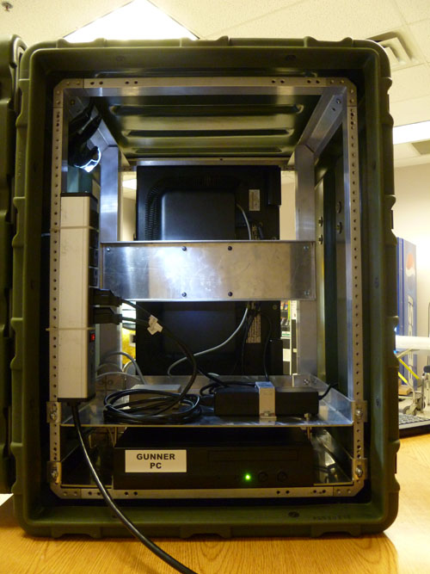
Mounting the Components
Figure 14: Front View
Figure 15: Rear View

Slide 18
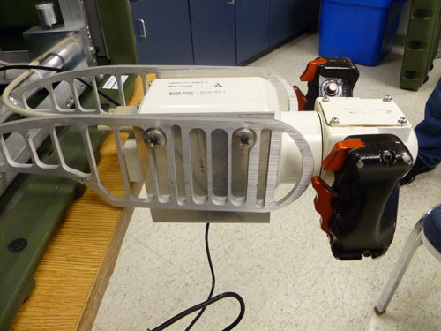
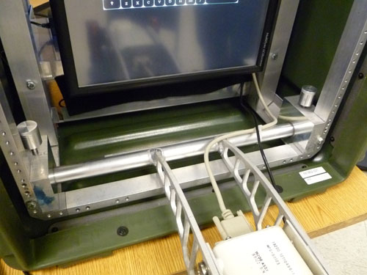
Mounting the Components
Figure 16: Side view of gunner handle
Figure 17: Angled view of pivot bar and pins

Slide 19
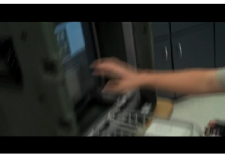
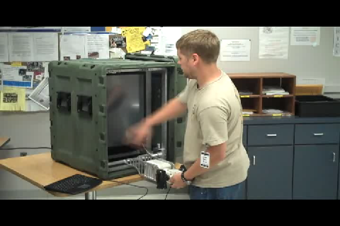
Handle and Touchscreen Demonstration
Touchscreen to input username and password, stays rigid when touched or handled.
Using gunner handle in correct position. Mount holds gunner and allows desired mobility.

Slide 20
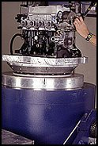
Satisfying Transportation Safety :
MIL-STD-810 Test
“…a generally accepted standard of ruggedisation for testing and compliance for mobile computers and equipment.” (Secure Systems and Technologies)
Mechanical Shock
Random Mechanical
Vibration
Altitude
Figure 18 : Vibration Test
Source: Qualtest (www.qualtest.com)

Slide 21

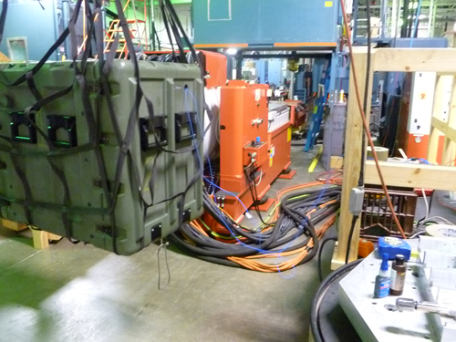
Drop Testing
6 drop tests conducted at Qualtest Inc.
Figure 19: Case hoisted for drop in Qualtest

Slide 22
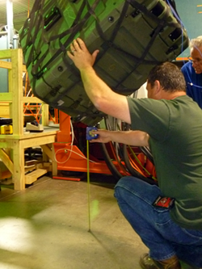
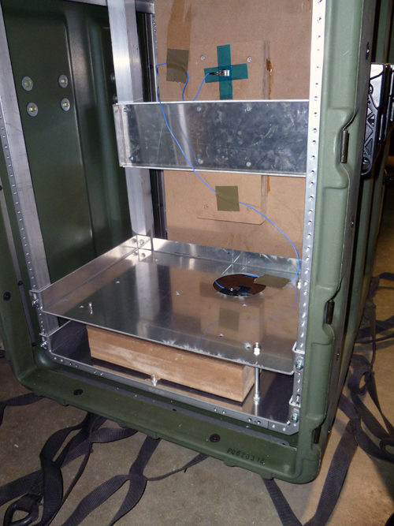
Drop Testing
Figure 20: Drops measured 30” from ground to impact point.
Figure 21: Impact force measured using two tri-axial accelerometers on computer and monitor mockups

Slide 23
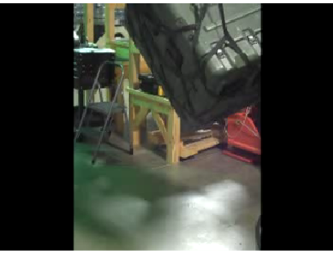
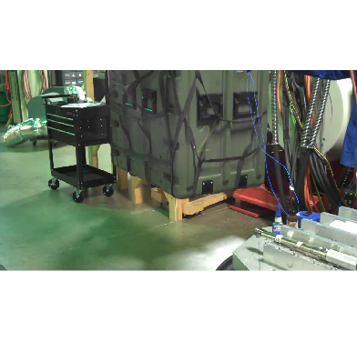
Drop Testing
Drop test #1 on bottom of case Drop test #2 on front corner

Slide 24
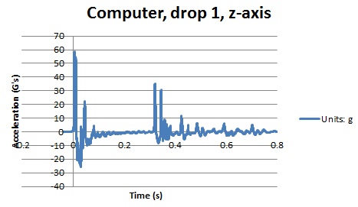
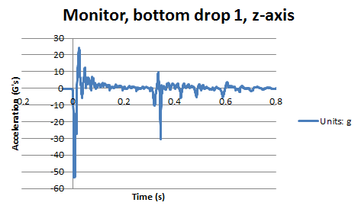
Force Analysis – Drop 1
Graphs of first drop test on bottom of case, acceleration vs. time in the z-axis. In the x and y axis, there was much smaller acceleration. There is a spike in the computer at about 59G, and in the monitor at about -54G.
Figure 22: Drop 1, computer, z-axis
Figure 23: Drop 1, monitor, z-axis

Slide 25
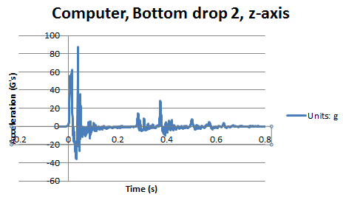
Force Analysis – Drop 1 retake
We redid the first drop in hopes of lower forces, however one of our screws sheared off and caused an even higher peak in the computer’s impact force of about 90G. The monitor did not see this spike.
Figure 24: Drop 1 retake, computer, z-axis

Slide 26
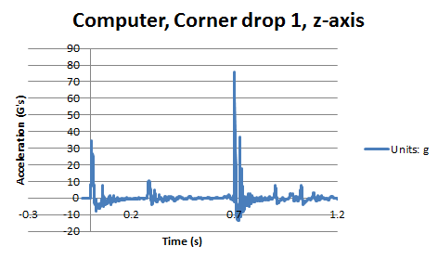
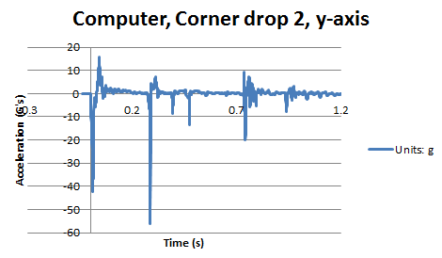
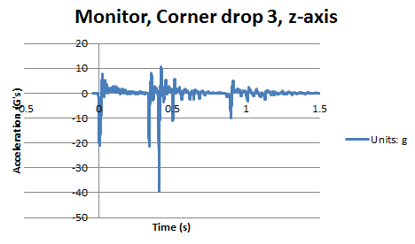
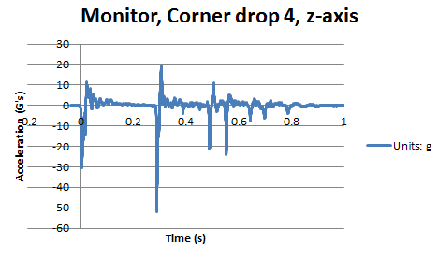
Force Analysis – Corner Drops
Figure 25: All figures were the extreme cases from each drop. Titles depict graph

Slide 27
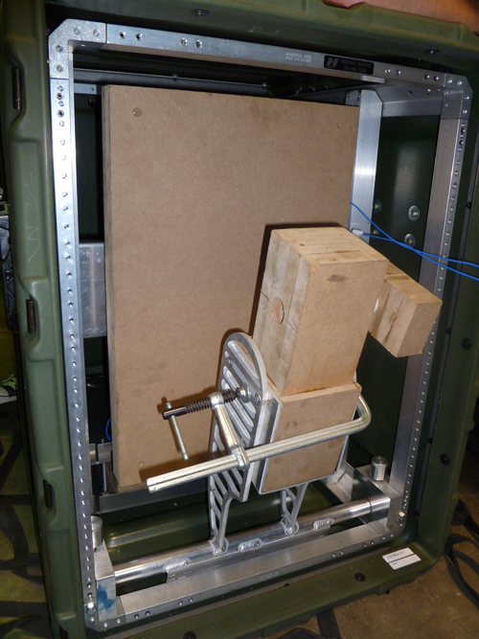
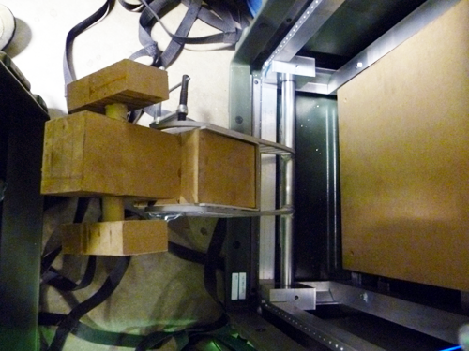
The Aftermath
Figure 26: Handle after 2 front corner drops. Bent outward at 45 degree angle
Figure 27: Handle after all 5 drops. Lost piece of mockup, handle mounts deflected, however back drops “corrected” bending a bit

Slide 28
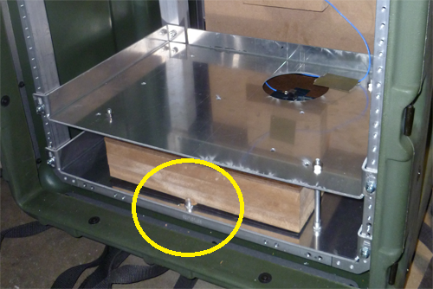
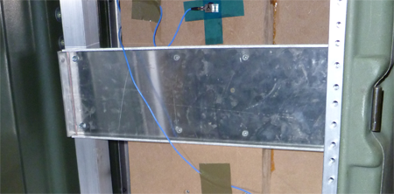
The Aftermath
Figure 28: Rivet-nut started to dig into computer mockup.
Figure 29: Monitor endured all tests without problems.

Slide 29
Results
System weighed exactly 120 lbs.
Some overshoot in impact force, but most peak forces were within the range of 40-60 G.
Computer and Monitor remained completely stationary throughout all drops.
Design allows for thorough airflow and ease of access for any maintenance.
Gunner handle moved during drops due to insufficient durability in handle mount.

Slide 30
Improvements
Cut out less material in gunner handle mount
Add in horizontal support in gunner handle
Order case specific for our design
Rubber grommets over rivet nuts to prevent any grinding
Utilize Group 9’s handle for more simulations

Slide 31

Acknowledgements
Sponsor – Lockheed Martin
- Jeffrey Payne (Mechanical Engineer)
Sponsor – Pelican Hardigg
- Daria Boley (Pelican Hardigg Salesperson)
Advisors –
- Dr. Rob Hovsapian
- Dr. Patrick Hollis
- Dr. Srinivas Kosaraju
- Ms. Shannon Ingersoll
- Mr. Joseph Trpisovsky

Slide 32
References
Lockheed Martin. The Advanced Gunnery Trainer System (AGTS) Tabletop Trainer. Lockheed Martin. Www.lockheedmartin.com. Web. 31 Oct. 2010.
Pelican. Pelican Hardigg Cases. Pelican, 2010. Www.pelican.com. Web. 03 Nov 2010.
Qualtest. Www.qualtest.com/index. Web. 10 Nov 2010
Secure Systems and Technologies. MIL-STD-810 Overview. Secure Systems and Technologies. http://www.sst.ws/images/downloads/MIL-STD-810%20overview%20iss%205.pdf. Web. 31 Oct. 2010.

