Slide 1

One Box Gunnery Trainer
Progress Report
Group 10
Anthony Muller
Gerald Tyberghein
Joshua Wood

Slide 2
Overview
Background Information
Progress
Spring Semester Schedule
Preliminary Parts List
Pelican Case
The Handle Pivot
Bearing Blocks
The Computer Shelf
Risk Assessment

Slide 3
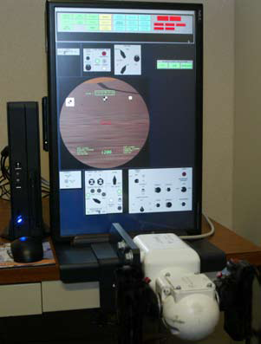
Background Information
We aim to take current Tabletop Advanced Gunnery Trainer System and make it more compact and easy to assemble.
Target weight is 120 lbs.
Everything packed into a Pelican-Hardigg case for durability.
Must undergo several military standard tests for safe transportation and environment exposure.
Figure 1: Lockheed Martin TAGTS
Source(www.lockheedmartin.com)

Slide 4
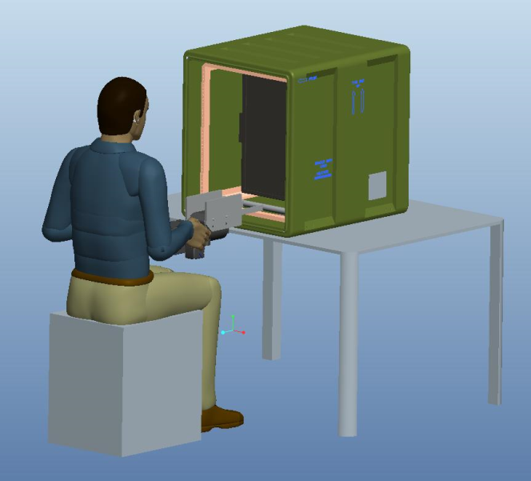
What We Have Done
Designed prototype that satisfies all customer needs.
Completed list of parts to order, and are currently in ordering process.
Selected specific Pelican-Hardigg case model, and are waiting for confirmation.
Conducted FEM and static analysis to prove case will not undergo any deformations, or tip over when used.
Figure 2: Final Design

Slide 5
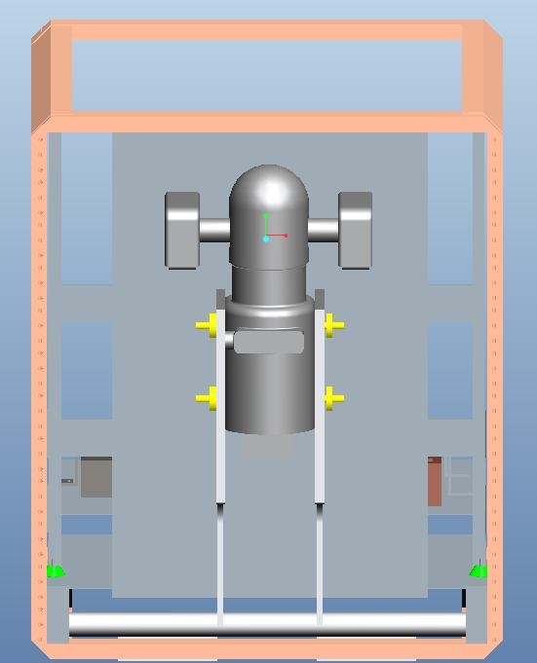
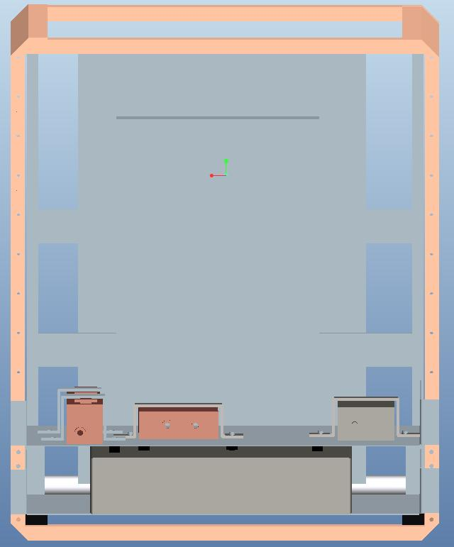
What We Have Done
Figure 3: Front Internal View
Figure 4:Rear Internal View

Slide 6
Spring Semester Schedule
Order Parts ✔
Order Case ✔
Assemble Mounting Equipment
Machine Mock Components
Test at Qualtest Laboratories
Assemble System with Real Components

Slide 7








Preliminary Parts List
Table 1: Parts List (images from www.mcmaster.com)
Name | Picture | Quantity | Description | Cost
Aluminum 6061 36” Round Tube |  | 1 | Handle pivot point | 19.28
Aluminum 6063 Square Tube |  | 1 | Bridge between handle pivot and handle mount | 16.15
Aluminum 6061 Square Tube |  | 1 | Handle mount | 19.52
Aluminum 6061 12”x3.5” Sheet |  | 1 | Bearing block material | 39.01
Sleeve Bearings |  | 4 | Bearings used in handle pivot | 4*(1.92)
Aluminum 1100 24”x36” Sheet |  | 2 | Shelf material | 2*(28.46)
Neoprene Rubber |  | 2 | Shock protection for auxiliary parts | 21.81
Polyurethane |  | 2 | Dampening and support | 22.33

Slide 8

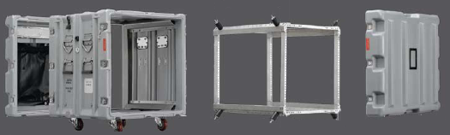
The Pelican-Hardigg Case
Model number MR1923-02/29/02
12U case, 20” case
Figure 5: Dual lid case opened to show rack
Source: (www.pelican.com)
Figure 6: Wheel transport
Source: (www.pelican.com)

Slide 9
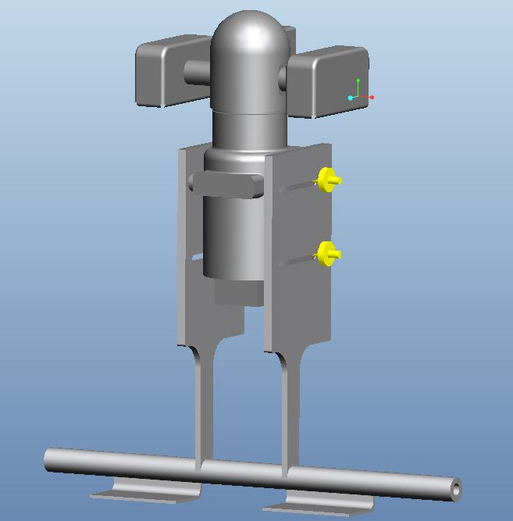
The Handle Pivot
Figure 7: Handle Pivot

Slide 10
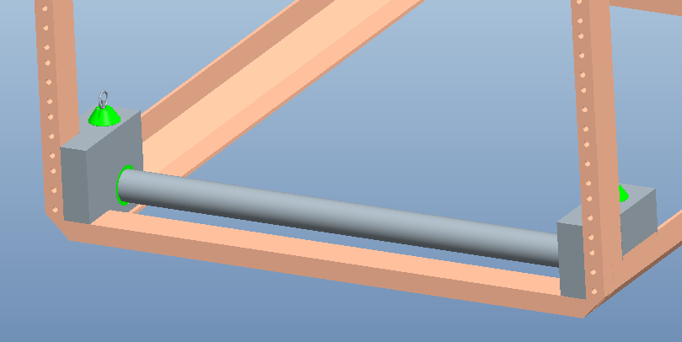
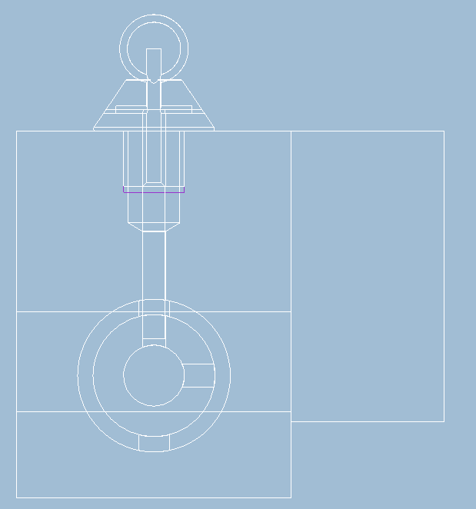
The Bearing Blocks
Figure 8: Pivot Inserted into bearing blocks
Figure 9:
Side internal view of bearing block

Slide 11
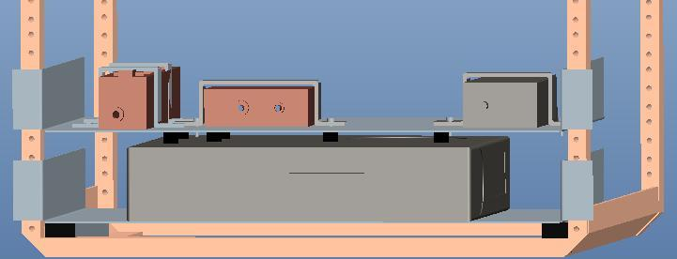
The Computer Shelf
Figure 10: Computer Shelf

Slide 12
Risk Assessment
Components may be damaged by impact forces or vibration.
  We will study the frequencies and forces distributed through mock components and compare them to actual components’ properties
Components and mounts may not assemble as desired in design
  We have extra parts and excess money from our budget if needed. We also left room for error in case dimensions must be altered.

Slide 13
Risk Assessment
Handle may swing into computer monitor
  Stops implemented in design to prevent handle from swinging forwards or backwards. Spring loaded pins prevent handle from rotating.
Once assembled, system could weigh more than expected
  In our design, we accounted for the possibility of extra weight from miscellaneous parts by staying 12 lbs. under our target weight.

Slide 14
References
Lockheed Martin. The Advanced Gunnery Trainer System (AGTS) Tabletop Trainer. Lockheed Martin. Www.lockheedmartin.com. Web. 31 Oct. 2010.
Pelican. Pelican Hardigg Cases. Pelican, 2010. Www.pelican.com. Web. 03 Nov 2010.

Slide 15

Acknowledgements
Sponsor – Lockheed Martin
- Jeffrey Payne (Mechanical Engineer)
Sponsor – Pelican Hardigg
- Daria Boley (Pelican Hardigg Salesperson)
Advisors –
- Dr. Rob Hovsapian
- Dr. Patrick Hollis
- Dr. Srinivas Kosaraju
- Ms. Shannon Ingersoll
- Mr. Joseph Trpisovsky

