Slide 1
One Box Gunnery Trainer Progress Report 2
Group 10
Anthony Muller
Gerald Tyberghein
Joshua Wood

Slide 2
Overview
Product Specifications
Finalized Parts List
Pelican Case
Case Images
Re-designed Handle Pivot
Bearing Blocks
The Computer Shelf
Risk Assessment
Risks Assessed

Slide 3
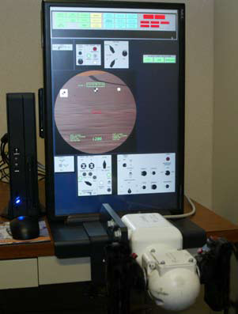
What We Have Done
Designed prototype that satisfies all customer needs.
Ordered and received case and parts.
Currently making drawings in Pro E
Conducted FEM and static analysis to prove case will not undergo any deformations, or tip over when used.
Figure 1: Lockheed Martin TAGTS
Source(www.lockheedmartin.com)

Slide 4
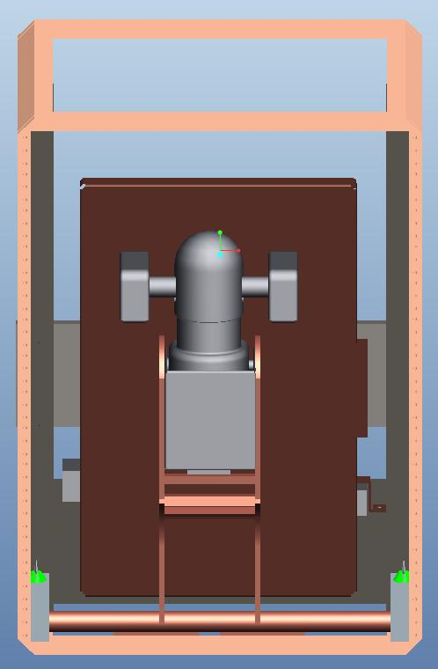
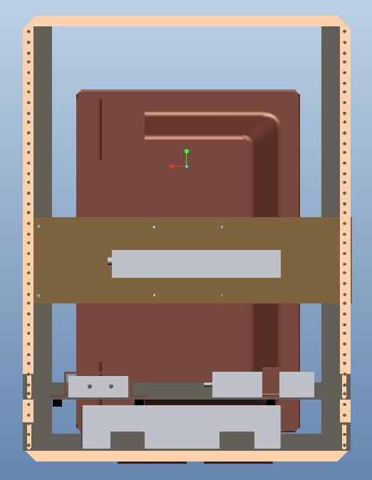
What We Have Done
Figure 3: Front Internal View
Figure 4:Rear Internal View

Slide 5
Spring Semester Schedule
Table 1: Schedule
Task | Time Frame
Order Parts | January 24th-29th
Order Case | January 25th
Complete Part Drawings | February 21st-February 25th
New FEM Analysis | February 25th-February 28th
Machine Equipment | February 28th-March 4th
Assemble Components | March 4th
Test Case at Qual Test Labs | March 17th or March 24th
Final Data Analysis | March 24th-March 31st
Open House Presentation | April 14th

Slide 6
Finalized Parts List
Table 2: Parts List (images from www.mcmaster.com)
Description | Quantity | Total Price
Aluminum square tubing | 1 (6ft) | 36.22
Aluminum bar for pivot | 1 (3ft) | 19.28
Bronze Sleeve Bearings | 4 | 9.96
Aluminum bearing blocks | 1 | 74.82
Locking pin | 1 | 3.41
L- brackets for pivot | 1 (4ft) | 10.98
Handle and monitor mount | 2 (3ft) | 64.28
U-bracket for handle | 1 | 12.20
Shelf material | 1 | 58.21
Neoprene tubing | 1 (1ft) | 2.00
Silicone dampening | 1 (2ft) | 10.32
Neoprene for aux. parts | 1 (2ft) | 43.62
Auxiliary brackets | 1 (3ft) | 36.65
Medium Density Fiberboard | 1 (4’x8’) | 32.96
Total |  | $ 414.91

Slide 7
The Pelican-Hardigg Case
Model number: MR1926-05/25/05
14U case, 20” case – changed since last presentation from a 12U case due to ordering delays.
Figure 5: Dual lid case opened to show rack
Source: (www.pelican.com)
Figure 6: Wheel transport
Source: (www.pelican.com)

Slide 8
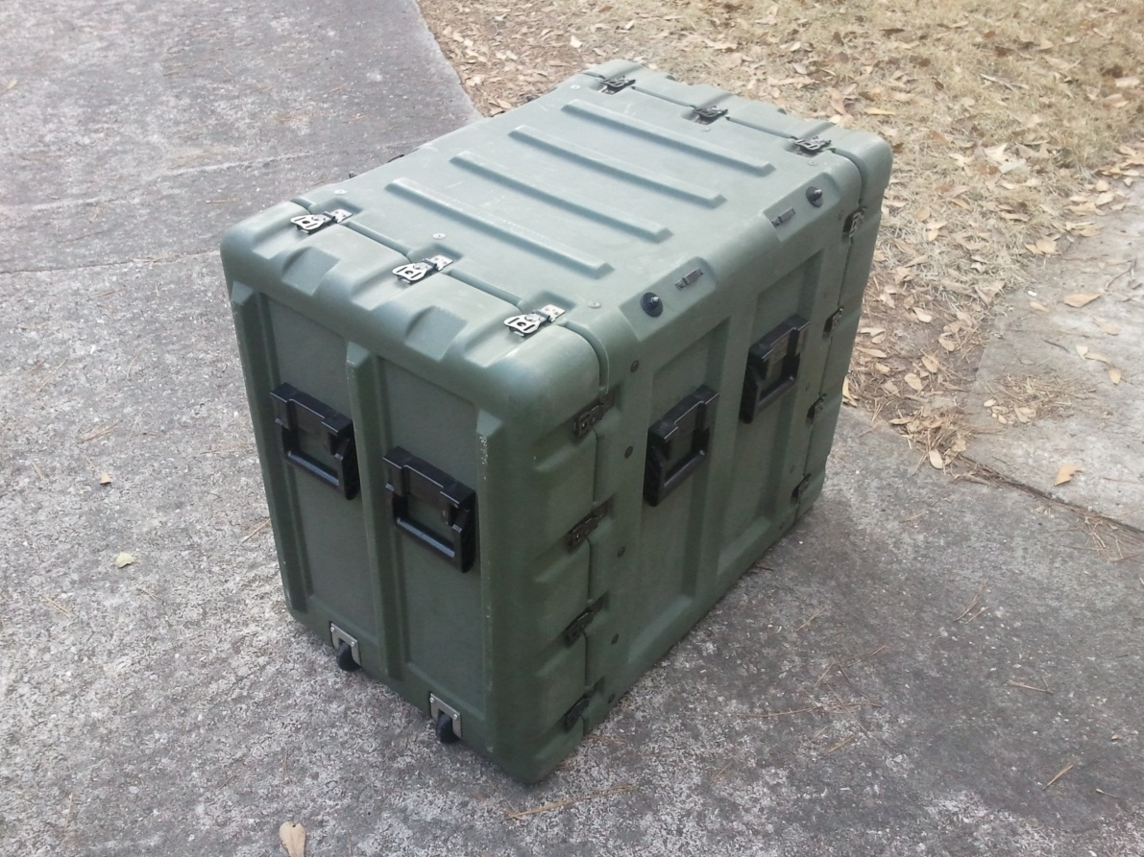
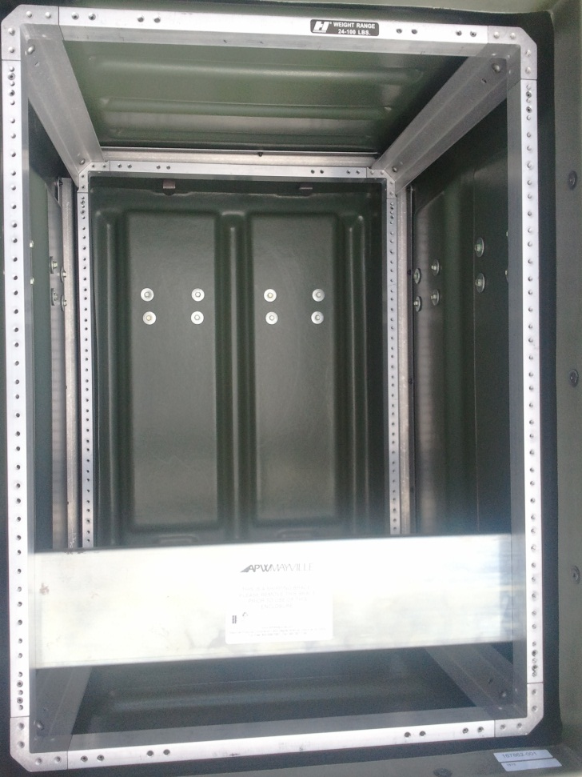
Our Case
Figure 7: Pelican Case for our project
Figure 8: Internal rear view of case

Slide 9
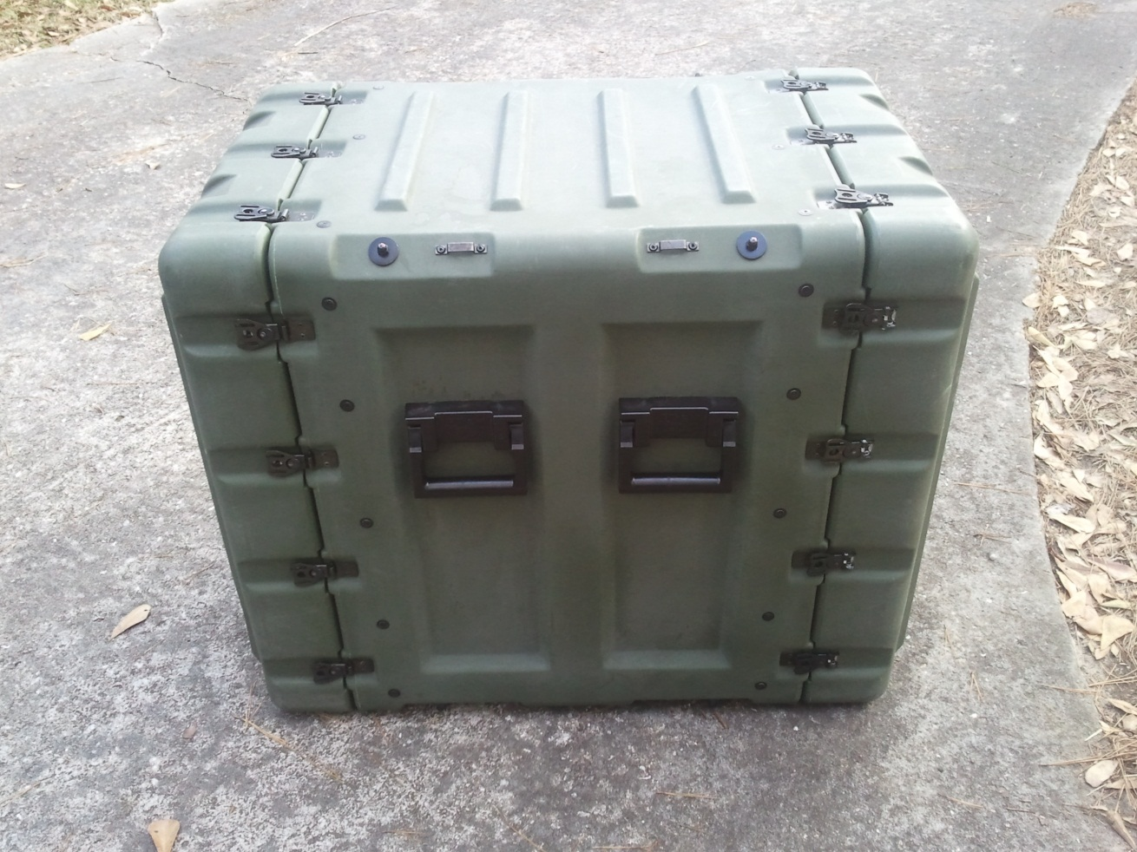
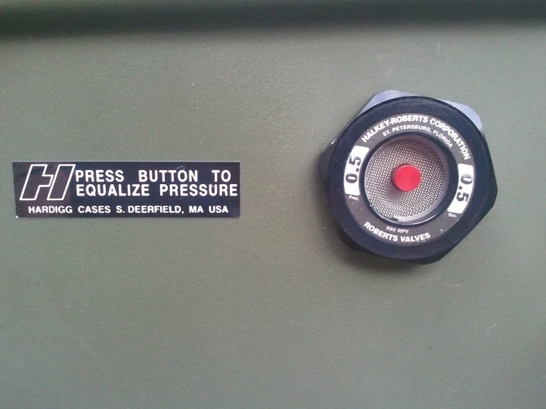
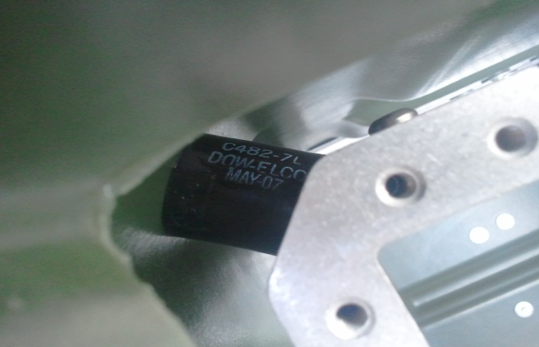
Our Case
Figure 9: Side view
Figure 10: Pressure
Release Valve (Top)
Shock Mount (Bottom)

Slide 10
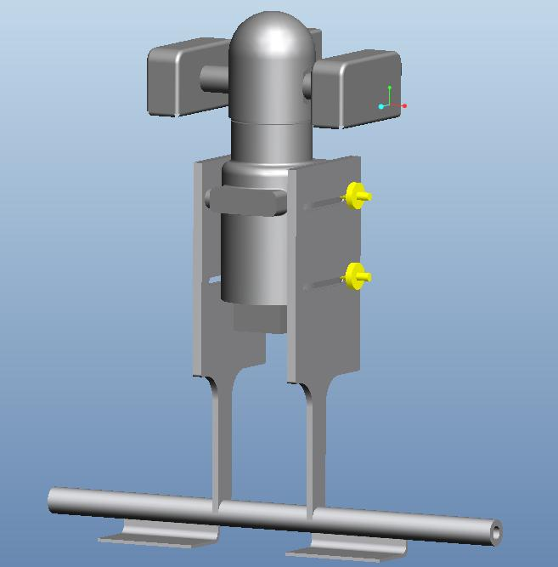
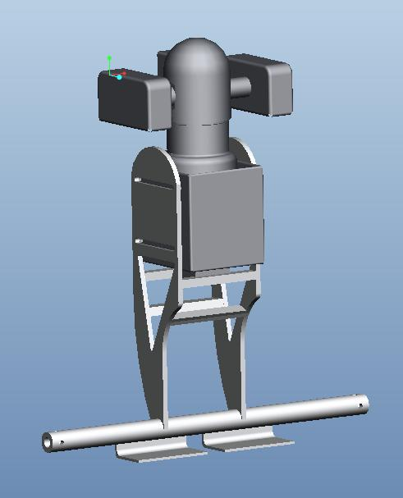
The Handle Pivot
Figure 11: Handle Pivot (Before/After)

Slide 11
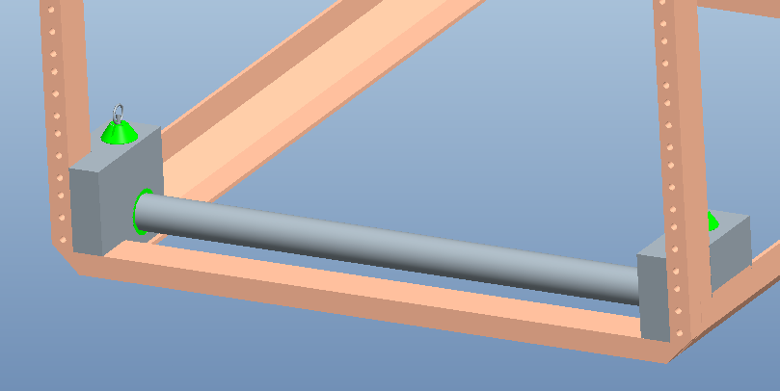
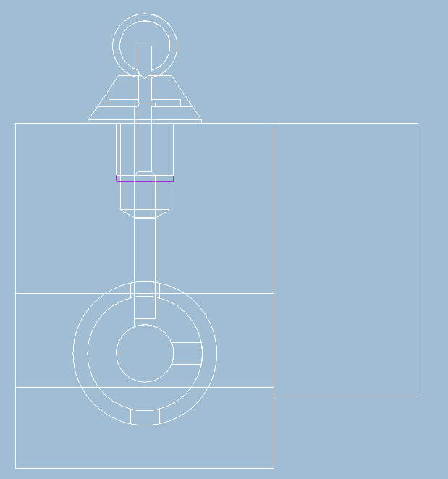
The Bearing Blocks
Figure 12: Pivot Inserted into bearing blocks
Figure 13:
Side internal view of bearing block

Slide 12
The Computer Shelf
Figure 14: Computer Shelf

Slide 13
Risk Assessment
Components may be damaged by impact forces or vibration.
We will study the frequencies and forces distributed through mock components and compare them to actual components’ properties
Components and mounts may not assemble as desired in design
We have extra parts and excess money from our budget if needed. There is extra room in the case if needed to expand or limit dimensions.

Slide 14
Risk Assessment
Handle may swing into computer monitor
Stops implemented in design to prevent handle from swinging forwards or backwards. Spring loaded pins prevent handle from rotating.
Once assembled, system could weigh more than expected
In our design, we accounted for the possibility of extra weight from miscellaneous parts by staying 12 lbs. under our target weight.

Slide 15
Risks Already Assessed
Run into problems with ordering specific case.
Use any other possible means of a case, and redesign system in order to meet requirements.
We may need a hole in the case for Qual Test to wire in.
We needed a hole into the case, and we were able to take out a pressure release valve that was already implemented into the case, and use that as our hole; leaving the case un-damaged and un-modified.

Slide 16
References
Lockheed Martin. The Advanced Gunnery Trainer System (AGTS) Tabletop Trainer. Lockheed Martin. Www.lockheedmartin.com. Web. 31 Oct. 2010.
Pelican. Pelican Hardigg Cases. Pelican, 2010. Www.pelican.com. Web. 03 Nov 2010.

Slide 17
Acknowledgements
Sponsor – Lockheed Martin
- Jeffrey Payne (Mechanical Engineer)
Sponsor – Pelican Hardigg
- Daria Boley (Pelican Hardigg Salesperson)
Advisors –
- Dr. Rob Hovsapian
- Dr. Patrick Hollis
- Dr. Srinivas Kosaraju
- Ms. Shannon Ingersoll
- Mr. Joseph Trpisovsky

