Slide 1

One Box Gunnery Trainer
Group 10
Anthony Muller
Gerald Tyberghein
Joshua Wood

Slide 2
Overview
The Advanced Gunnery Trainer System
Problem Statement
Product Specifications
The Case
Single Lid
Dual Lid
Concepts
Current Setup in Single Lid Case
Tabletop Case
Hybrid Case
Box on Floor
Future Plans

Slide 3
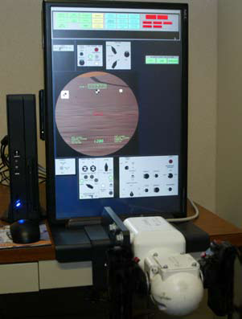

The Advanced Gunnery Trainer System (AGTS)
Figure 1: M1A1 Abrams
Source: The Advanced Gunnery Trainer System (AGTS) Tabletop Trainer (www.lockheedmartin.com)
Figure 2: Lockheed Martin AGTS
Source(www.lockheedmartin.com)

Slide 4
The Advanced Gunnery Trainer System (AGTS)
Compact, cost efficient tabletop system
Used to sustain precision gunnery skills at all levels
Provides training procedures, basic skills, and drills
Can be linked together with other AGTSs

Slide 5
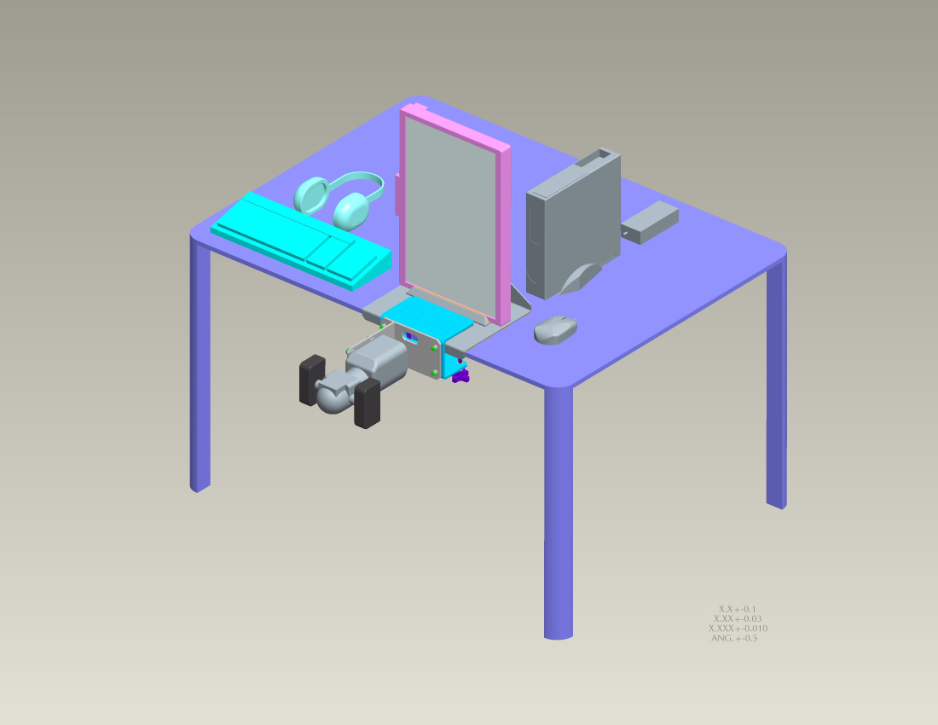
Problem Statement
Current system consists of several components packed into a case, which must be taken out and assembled. The mounting is not tactically correct.
Takes time to assemble
Takes up table room
Table height not always same
Figure 3: Current TAGTS Source(Payne, Jeff)

Slide 6
Main Product Specifications
Weighs less than 100 lbs
Sights and gunner handle mounted in correct tactical position
Equipment must be safe when being transported
Packing does not interfere with components’ cooling
System must be stable
System must be durable
Easy to set up

Slide 7
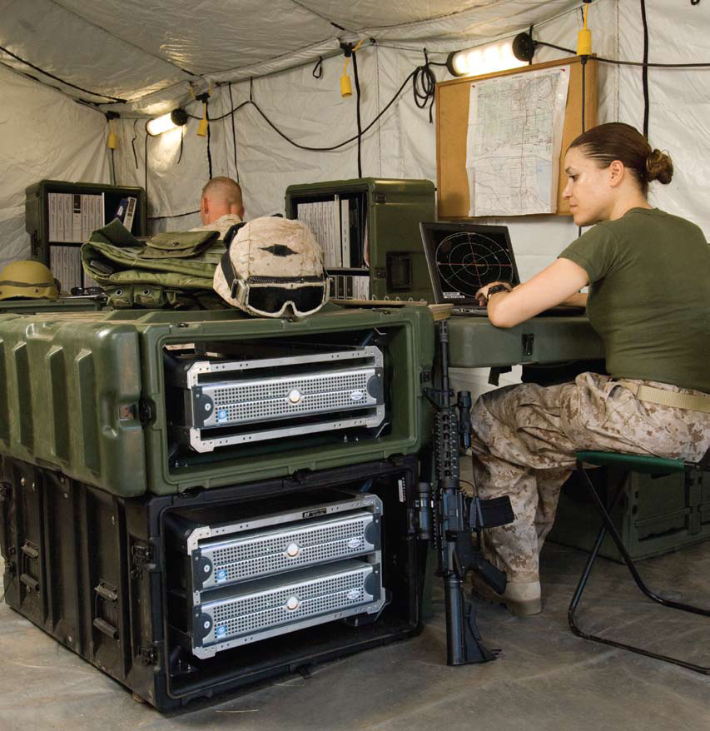
The Case
Designed by Pelican-Hardigg
Thoroughly tested and proven durable. G-rated.
Various models allowing for specific fragility protection
Figure 4: Pelican-Hardigg case in military use
Source: Pelican-Hardigg Case (www.pelican.com)

Slide 8
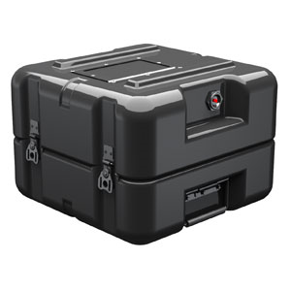
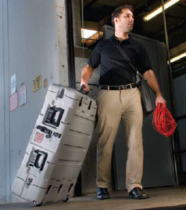
Single Lid Case
Good for ‘box on floor’ design
Lacks internal rack mount
Figure 5: Single Lid Case
Source: (www.pelican.com)
Most models come with wheels for easy transport
Figure 6: Wheel transport
Source: (www.pelican.com)

Slide 9
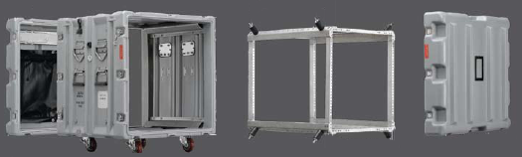
Dual Lid Case
Built in internal rack mount (Mac Rack)
Mounted shock prevents vibration and impact
Increased airflow with two open lids
Figure 7: Dual lid case opened to show rack Source: (www.pelican.com)

Slide 10
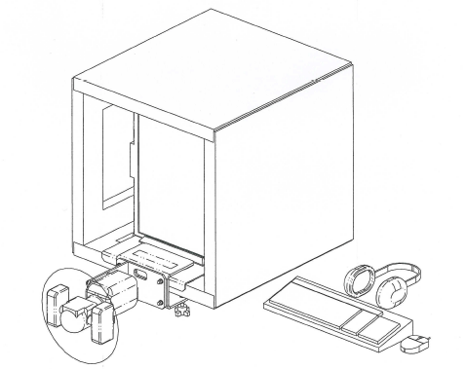
Concept 1: Current Setup in Single Lid Case
Very simple implementation
Allows monitor to be upright
Rigid joints allow rugged use
Small and compact
Figure 8: Concept 1
Source: (Payne, Jeff)

Slide 11
Concept 1: Current Setup in Single Lid Case
Pros
Easy to assemble
Stable and durable
Upright monitor
Gunner handle does not add tipping weight
Cons
Gunner must be manually setup
Some components not mounted in box
No rack mount

Slide 12
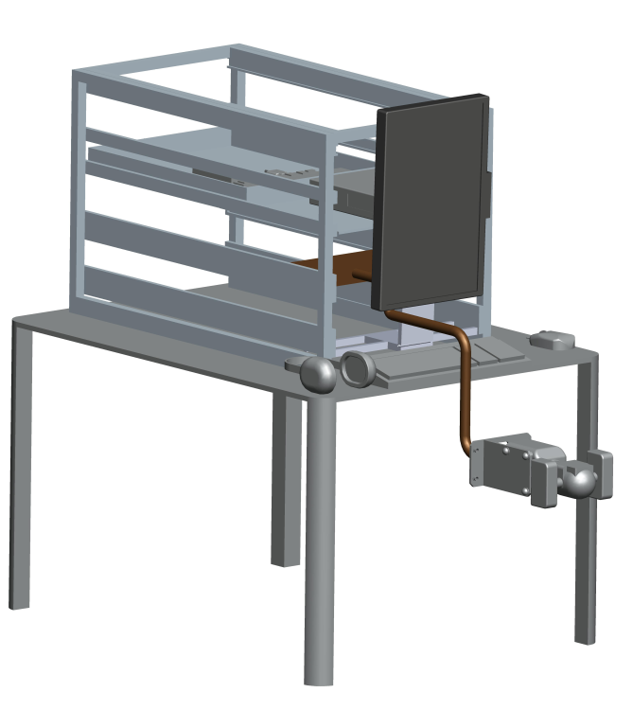
Concept 2: TableTop Case
Easily setup
Largely self contained
Computer securely mounted
Very compact
Figure 9: Concept 2 Deployed

Slide 13
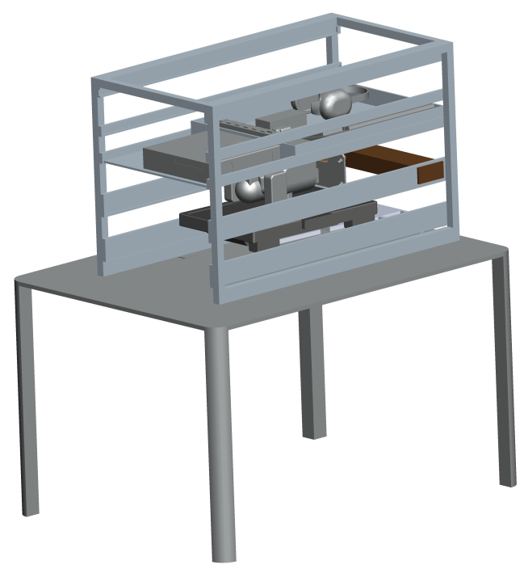
Figure 10: Concept 3 Retracted

Slide 14
Concept 2: TableTop Case
Pros
Faster setup
More portable
Very Stable
Rack mount
Cons
Heavy due to double lid
Table required
Not a great improvement

Slide 15
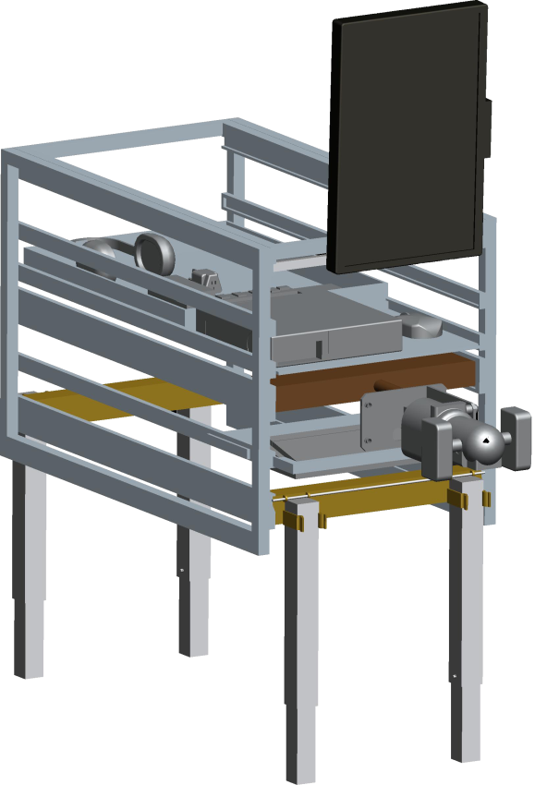
Concept 3: Hybrid Case
Extendable Legs
Handle on slide rail
Quick setup
Handle mounted on
slide rail
Figure 11: Concept 3 Deployed

Slide 16
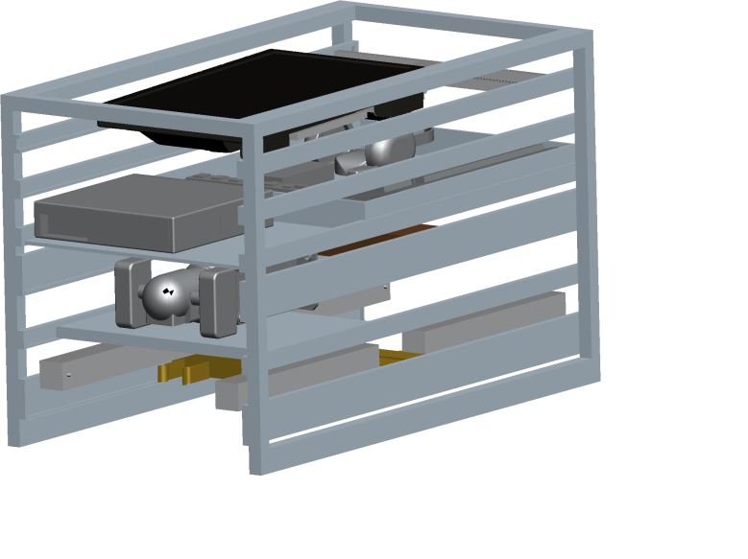
Figure 12: Concept 3 Retracted

Slide 17
Concept 3: Hybrid Case
Pros
Highly compact
Extremely portable
No table required
Cons
Heavy due to double lid
More easily tipped over
Less durable

Slide 18
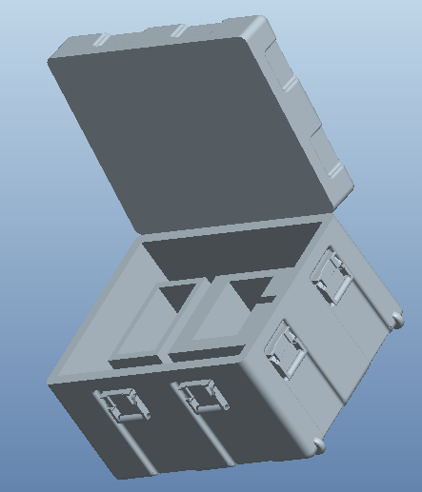
Concept 4: Box on Floor
Single lid case sits on floor
Monitor and gunner handle come out and up to correct tactical height
Allows use in any environment without a table
Figure 13: Single Lid Model

Slide 19
Concept 4: Box on Floor
Pros
No table needed
Sturdy, since it rests on floor
Cons
No shock rated rack mount
Could be awkward with leg room

Slide 20
Selection Matrix
 |  | Concepts
 |  | Current Setup |  | Box on Floor |  | Table Top Case |  | Hybrid Case
Specifications | Importance Weight | Rating | Weighted Scores | Rating | Weighted Scores | Rating | Weighted Scores | Rating | Weighted Scores
Ease of Assembly | 15% | 1 | 0.15 | 4 | 0.6 | 3 | 0.45 | 3 | 0.45
Durability | 20% | 4 | 0.8 | 2 | 0.4 | 4 | 0.4 | 2 | 0.4
User Friendly | 10% | 2 | 0.2 | 4 | 0.4 | 3 | 0.15 | 3 | 0.45
Portability | 30% | 1 | 0.3 | 3 | 0.9 | 4 | 1.2 | 4 | 1.2
Lightweight | 10% | 3 | 0.3 | 2 | 0.2 | 2 | 0.2 | 2 | 0.2
Stability | 15% | 4 | 0.6 | 2 | 0.3 | 4 | 0.6 | 1 | 0.15
 | Score | 15 | 0.39 | 17 | 0.47 | 20 | 0.50 | 15 | 0.48
 | Selection |  | No |  | No |  | Yes |  | No

Slide 21
Future Plans
Trip to Lockheed Martin Orlando (10/17/10)
Attend Interservice/Industry Training, Simulation, and Education Conference (11/29/10-12/02/10)
Implement components into case and mount system for testing and analysis

Slide 22

References
Lockheed Martin. The Advanced Gunnery Trainer System (AGTS) Tabletop Trainer. Lockheed Martin. Www.lockheedmartin.com. Web. 10 Oct. 2010.
Pelican. Pelican Hardigg Cases. Pelican, 2010. Www.pelican.com. Web.

