Slide 1
One Box Gunnery Trainer Final Design
Group 10
Anthony Muller
Gerald Tyberghein
Joshua Wood

Slide 2
Overview
The Advanced Gunnery Trainer System
The Pelican-Hardigg Case
Product Specifications
Concepts
Selection
Final Concept Design
Analysis
Tipping
FEM
Cost
Possible Improvements
Next Semester

Slide 3
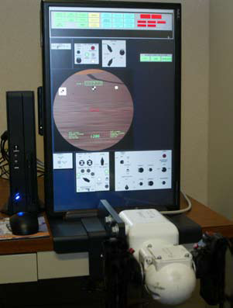
The Advanced Gunnery Trainer System
(AGTS)
Compact, cost efficient tabletop system
Used to sustain precision gunnery skills at all levels
Provides training procedures, basic skills, and drills
Can be linked together with other AGTSs
Figure 1: Lockheed Martin TAGTS
Source(www.lockheedmartin.com)

Slide 4
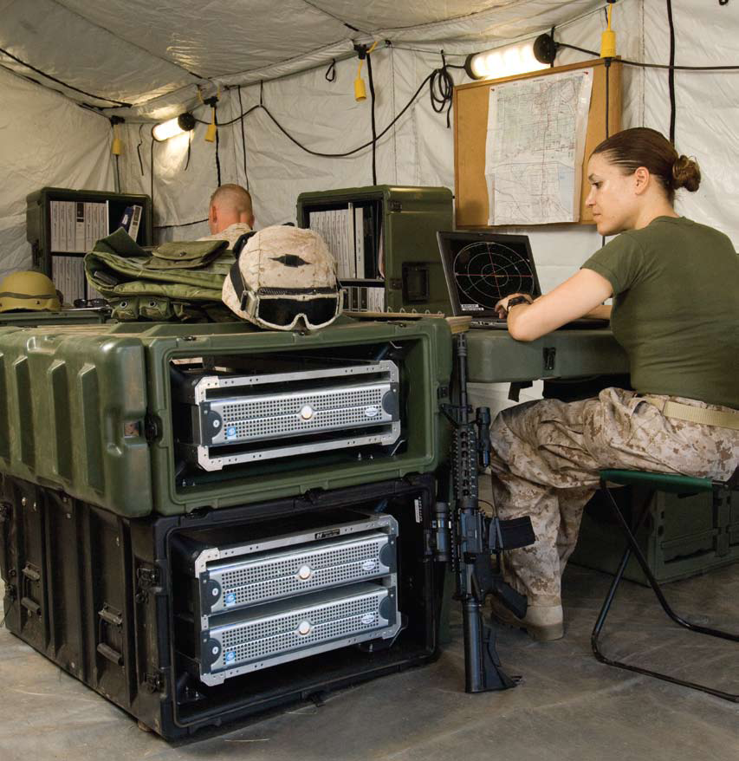
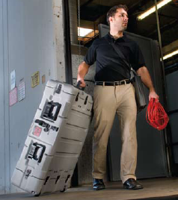
The Pelican-Hardigg Case
Figure 3: Dual lid case opened to show rack
Source: (www.pelican.com)
Figure 2: Pelican-Hardigg case in military use
Source: Pelican-Hardigg Case (www.pelican.com)
Figure 4: Wheel transport
Source: (www.pelican.com)

Slide 5
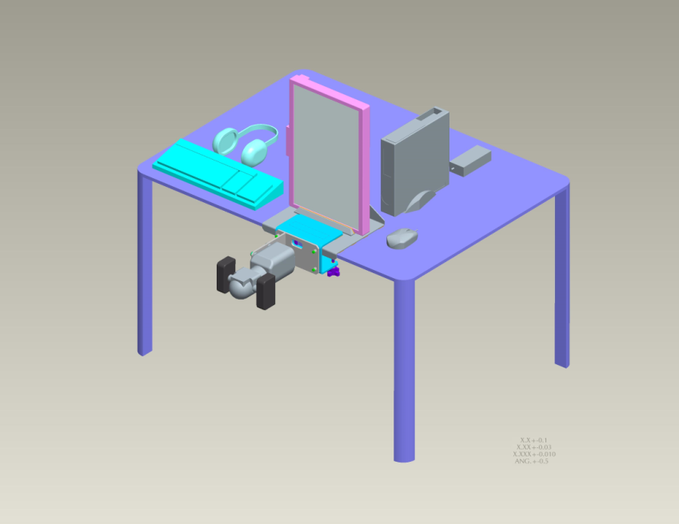
Product Specifications
Weighs less than 120 lbs
Gunner handle and monitor mounted in correct tactical position
Equipment must be safe when being transported
Packing does not interfere with components’ cooling
System must be stable (15 degree tip)
System must be durable
Easy to set up
Figure 5: Current TAGTS setup
Source: Payne, Jeffrey

Slide 6
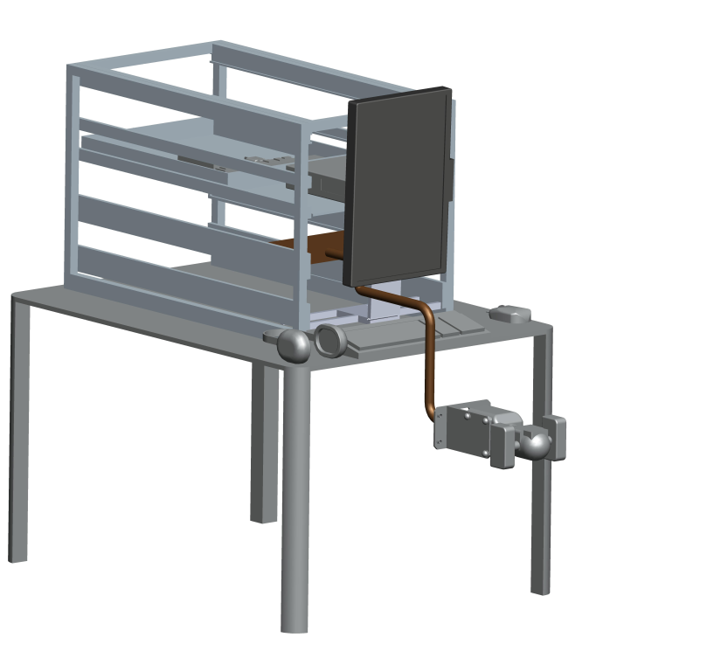
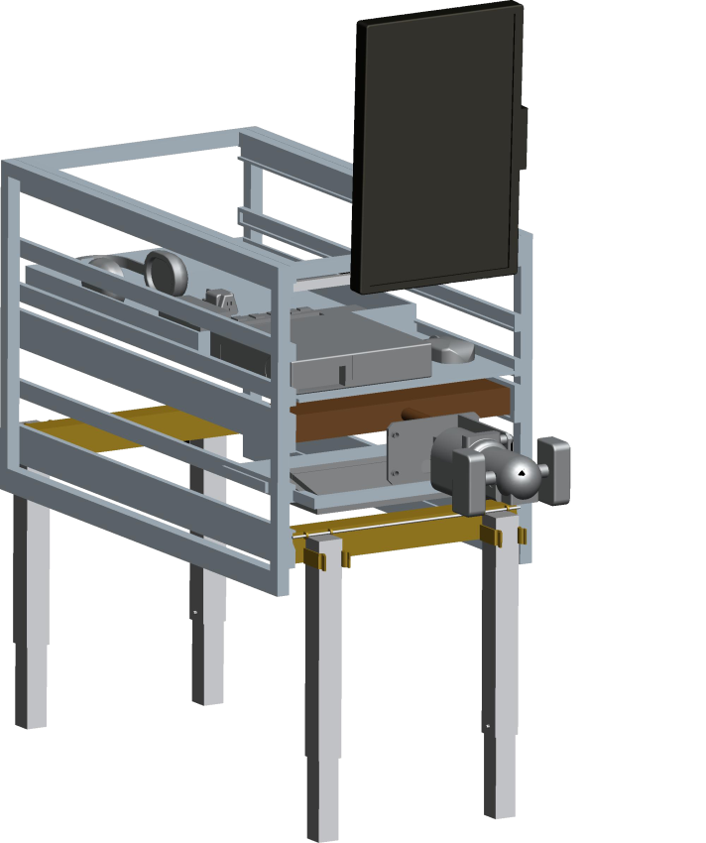
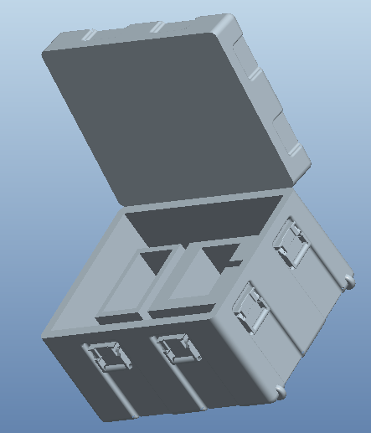
Main Concepts
Figure 6 : Tabletop, Box on Floor, Hybrid Concepts.

Slide 7
Selection Matrix
Table 1: Selection Matrix for 3 Concepts
 |  | Tabletop |  | Box on Floor |  | Hybrid
Specifications | Weight (/100%) | Rating (1-5) | Weighted Scores | Rating | Weight scores | Rating | Weighted scores
Ease of Assembly | 15% | 3 | 0.45 | 4 | 0.6 | 3 | 0.45
Durability | 20% | 4 | 0.8 | 2 | 0.4 | 1 | 0.2
Lightweight | 30% | 4 | 1.2 | 3 | 0.9 | 4 | 1.2
User Friendly | 10% | 3 | 0.3 | 4 | 0.4 | 3 | 0.45
Portability | 10% | 2 | 0.2 | 2 | 0.2 | 2 | 0.2
Stability | 15% | 4 | 0.6 | 2 | 0.3 | 1 | 0.15
 | Score |  | 0.59 |  | 0.47 |  | 0.44
 | Selection |  | Yes

Slide 8
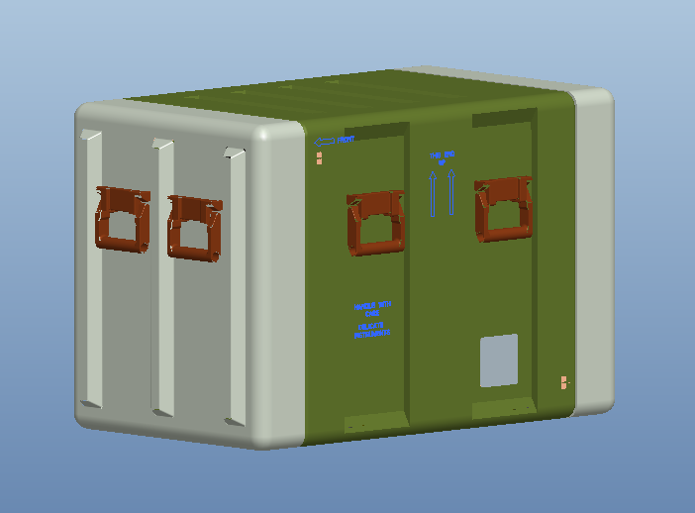
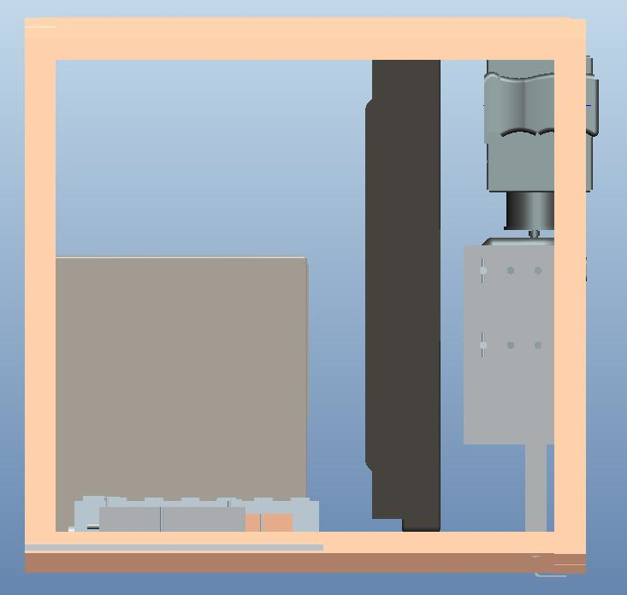
Finalized Concept
Figure 7 : Case Packed
Position
Figure 8 : Side View Inside Case

Slide 9
Satisfying Weight Specification
Case weight : 52 lbs
Components’ total weight : 40 lb
Mounting equipment’s weight : 15 lbs
Miscellaneous hardware weight : 5 lbs
Total weight : 112lbs
Product specification weight : Under 120 lbs

Slide 10
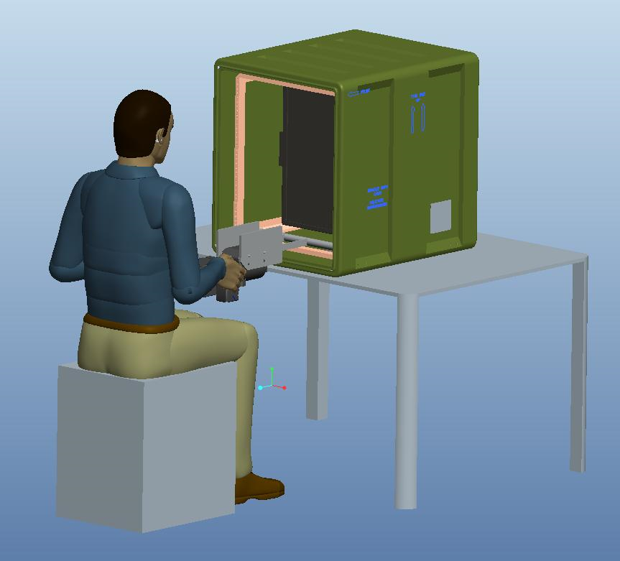
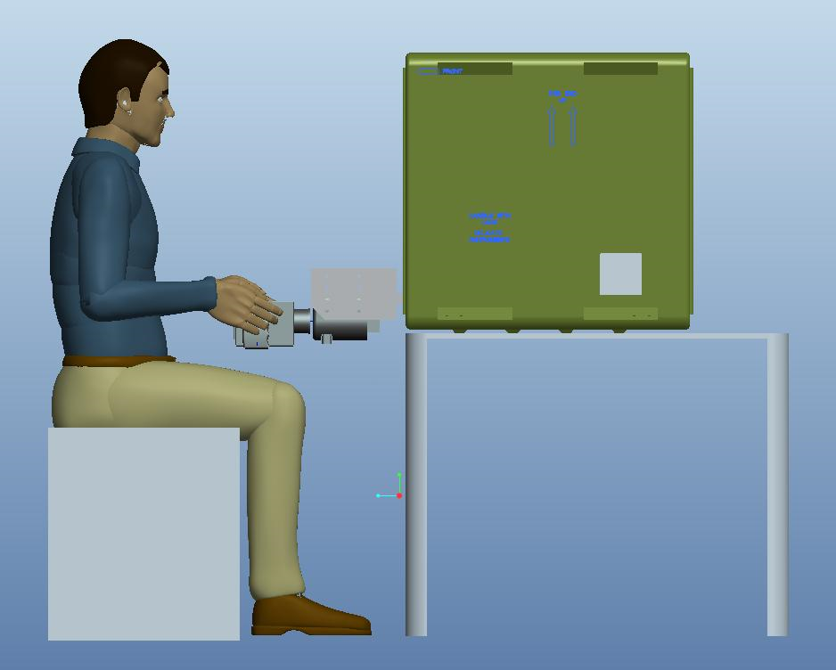
Satisfying Correct Mounting Position and Ease of Assembly Specifications
Figure 9: Person Using TAGTS

Slide 11
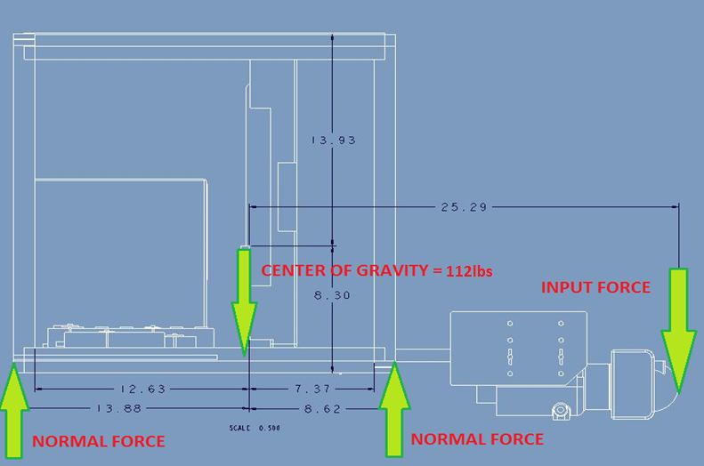
Satisfying Stability Specification: Maximum Input Force Analysis
Figure 10 : Force Distribution of Deployed System

Slide 12
Tip Analysis
Set left side normal force equal to 0, to assume tipping.
Take moments about right side normal force, and solve for the input force on the handle.
112lbs(8.62in) – F(16.67in) = 0
Maximum applied downward force on handle
F = 58 lbs

Slide 13
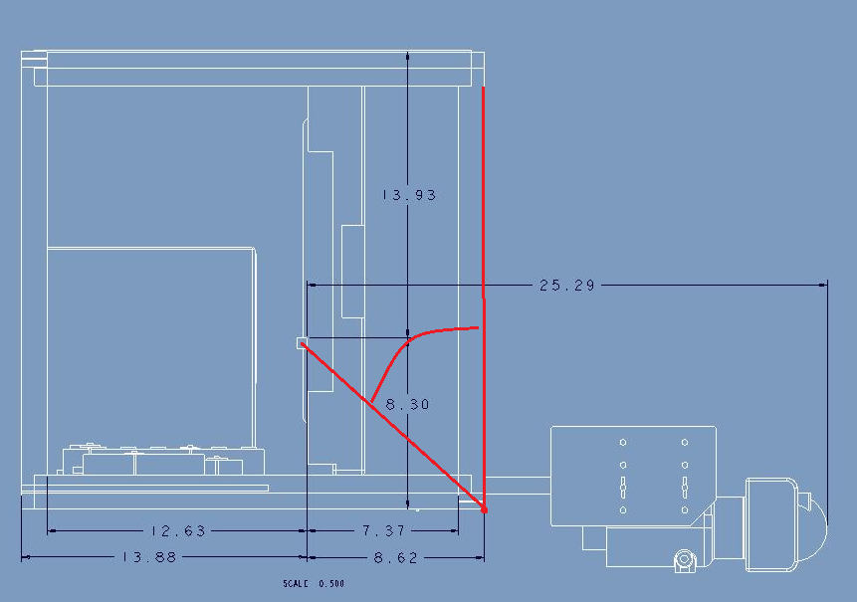
Satisfying Stability Specification: Maximum Tip Angle Analysis
Figure 11 : Maximum Angle of Deployed System

Slide 14
Tip Analysis
Tipping occurs when left normal force is equal to 0 and center of gravity passes the right normal force.
Solving for this angle, theta=atan(8.62/8.3) = 46deg
Product specification: Satisfy 15 degree tip rule

Slide 15
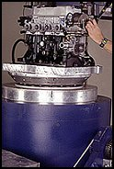
Satisfying Transportation Safety :
MIL-STD-810 Test
“…a generally accepted standard of ruggedisation for testing and compliance for mobile computers and equipment.” (Secure Systems and Technologies)
Mechanical Shock
Random Mechanical
Vibration
Altitude
Figure 12 : Vibration Test
Source: Qualtest (www.qualtest.com)

Slide 16
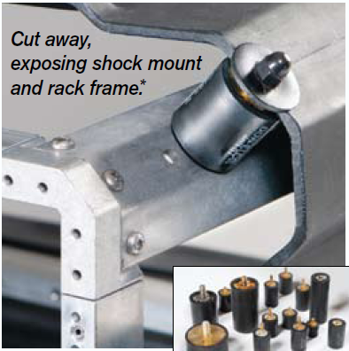
Satisfying Durability Specification: Shock Mounts
For our case model:
Shock mounts rated for
30-50G fragility
Provide shock and vibration dampening for systems weighing 20-200lbs
Provides cooling airflow
Figure 13 : View of Shock Mounts
Source: Pelican-Hardigg Case (www.pelican.com)

Slide 17
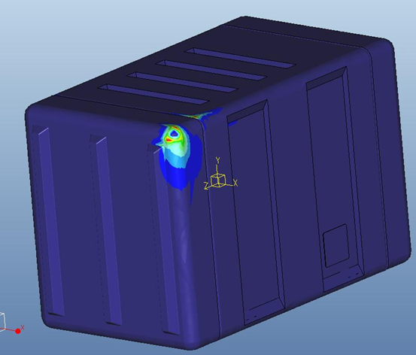
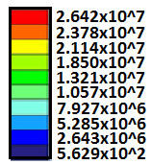
FEM Analysis
Lbm/(in sec^2)
Figure 14 : Stress Distribution of von Mises

Slide 18
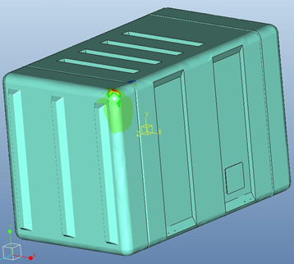
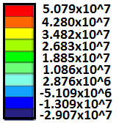
FEM Analysis
Lbm/(in sec^2)
Figure 15 : Stress Distribution of the Maximum Principle Stresses

Slide 19
Cost Analysis
Table 2 : Cost Analysis
Item | End Product Cost | Required for Project | Project Cost
Box | 1800 |  | 0
Monitor Bracket | 700 200 | √ | 0 200
Computer Bracket | 500 65 | √ | 0 65
Keyboard Mount in Lid | 70 25 | √ | 0 25
Mouse | 20 |  | 0
Headset | 300 |  | 0
Handle Bracket USB Interface | Proprietary 150 Proprietary | √ | 0 150 0
Power Strip Mount | 45 5 | √ √ | 45 5
Cable Management | 50 | √ | 50
Total | 3930+ |  | 540+

Slide 20
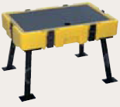
Possible Improvements
Add attachable legs to increase
portability
Utilize touchscreen to eliminate
mouse and keyboard
Incorporate handle design from Senior Design Team 9 to allow for other vehicle simulations
Figure 16 : Pelican Legs
Source:(www.pelican.com)

Slide 21
Next Semester…
Install mounting equipment into Pelican case
Machine mockup components to mount in case to test
Visit General Dynamics Lab Systems
Visit Qual Test Labs to run tests and analyze results
Bring system to Lockheed Martin to implement real components in case and run tests.

Slide 22
References
Lockheed Martin. The Advanced Gunnery Trainer System (AGTS) Tabletop Trainer. Lockheed Martin. Www.lockheedmartin.com. Web. 31 Oct. 2010.
Pelican. Pelican Hardigg Cases. Pelican, 2010. Www.pelican.com. Web. 03 Nov 2010.
Qualtest. Www.qualtest.com/index. Web. 10 Nov 2010
Secure Systems and Technologies. MIL-STD-810 Overview. Secure Systems and Technologies. http://www.sst.ws/images/downloads/MIL-STD-810%20overview%20iss%205.pdf. Web. 31 Oct. 2010.

Slide 23
Acknowledgements
Sponsor – Lockheed Martin
- Jeffrey Payne (Mechanical Engineer)
Sponsor – Pelican Hardigg
- Daria Boley (Pelican Hardigg Salesperson)
Advisors –
- Dr. Rob Hovsapian
- Dr. Patrick Hollis
- Dr. Srinivas Kosaraju
- Ms. Shannon Ingersoll
- Mr. Joseph Trpisovsky

