Slide 1
Spring progress report side under ride guard and aerodynamic fairing
Kenji Petrucci
Cody Jones
Sam Murphy

Slide 2
Introduction
Passenger cabin intrusion, PCI
Severe Injury/fatalities
No requirement to prevent side under ride

Slide 3
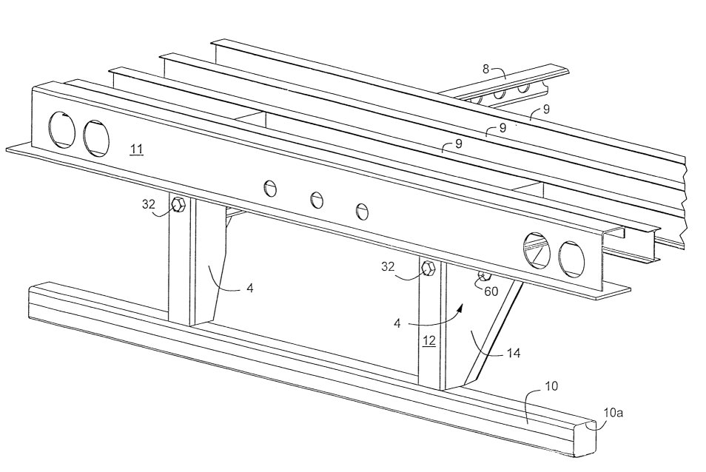
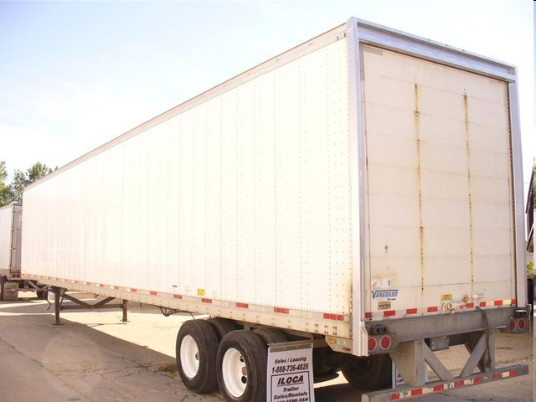
Background
Rear guard
initially required in 1953 but were highly ineffective; safer guards required in 1998 by NHTSA

Slide 4
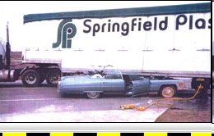
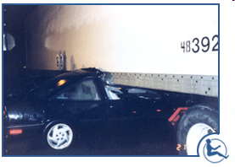
Background
Over 4 million trailers travel on US roads, none with side under ride guards
Approx 226 people die annually due to side under ride
98% of collisions with a trailer result in at least 1 fatality
*all pictures from http://www.crashforensics.com/truckunderride.cfm

Slide 5
Customer needs
Absorb force of a light duty vehicle (6000lbs) traveling at 35mph and prevent under ride
Cost efficient and easily installed by end user; bolt-on “kit” configuration
Provide aerodynamic qualities
Offset cost of purchase/installation
Increase fuel efficiency
Reduction in total hauling capacity

Slide 6
Product Specifications
Impulse time of 200ms
Impulse force vs. static force
Safety factor N = 2
 | English | SI
Mass | 6000lb | 2722kg
Velocity | 35mph | 15.65m/s
Δt | 0.2s | 0.2s
Δv | 35mph | 15.65m/s
Table 1

Slide 7
Product Specifications
Units of N*s
Factor of safety = 2 means double the impulse force
Nearly 500,000N of force for static load

Slide 8
Product Specifications
Modular vs. single unit
Impact always on at least 2 sections
Force per bar approximately 213,000N
47,884lbs

Slide 9
Final Design
Aluminum
1.5in (0.25in wall thickness) square tubing
0.25in thick brackets for welding
Steel
2in (0.25in wall thickness) square tubing
Weld directly to trailer I-beam
6in x 24in x 0.5in aluminum impact bar

Slide 10
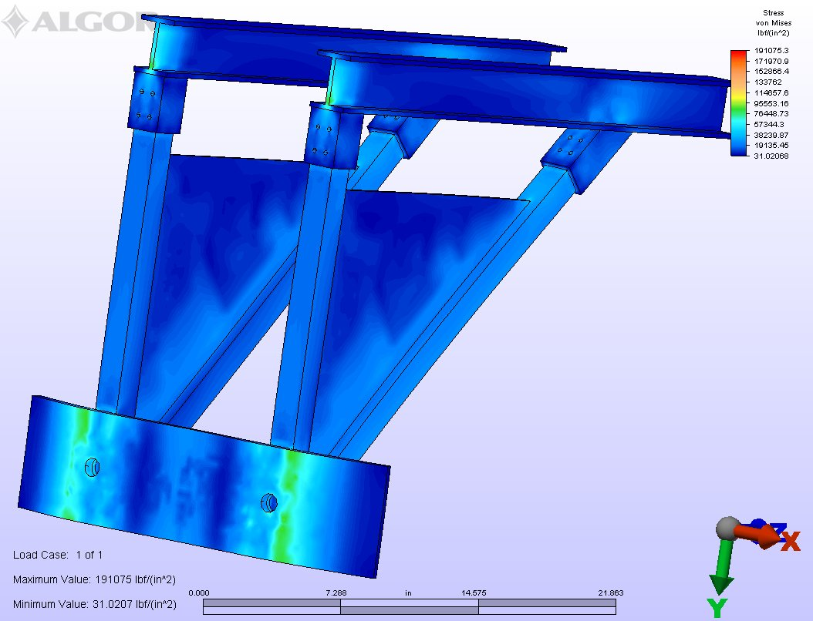
Final Design Aluminum w/brackets

Slide 11
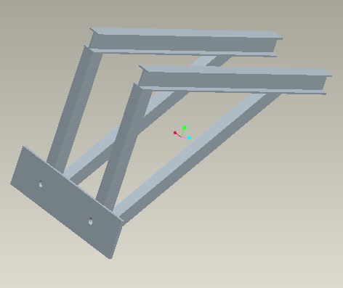
Final Design Steel

Slide 12
Stress/Deflection Analysis 6061-Al
Max stress
100ksi for steel
85ksi for aluminum
Max stress at joint corners
Impact bar failure acceptable

Slide 13
Summary
Aluminum questionable (6061-T6)
UTS = 45ksi
Tensile yield strength = 40ksi
UBS = 88ksi
Bearing yield strength = 56ksi
Max deflection at ends acceptable, even if failure occurs
Safety factor of 2 realistic and achievable

Slide 14
Fabrication/Assembly/Testing

Slide 15
Risks
Time constraints
Parts/Shipping
Fabrication
Welding, machining
Testing
Correct material choice

Slide 16
Acknowledgements
Dr. Hollis
Faculty advisor
Perry Ponder
Sponsor
Andrew Magaletti

Slide 17
References
Çengel, Yunus A., Robert H. Turner, and John M. Cimbala. Fundamentals of Thermal-fluid Sciences. 3rd ed. Boston: McGraw-Hill, 2008. Print.
Wolfson, Richard. Essential University Physics. 1. San Francisco: Pearson Addison Wesley, 2007. Print
www.onlinemetals.com

