Slide 1
Water Spray System
Group 17:
Shane Boland
Justin Collins
Scott McMurry

Slide 2
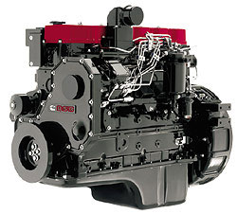
Overview
Introduction
Initial Design Concept
Revised Design Concept
Piping Structure
System Interface
Cost Analysis
Conclusions
Future Work
A 215 hp Cummins diesel engine

Slide 3
Project Background
Cummins tests the effect of water on engines and their electrical components
The test simulates the effect of driving over water puddles by spraying an engine undergoing an endurance test

Slide 4
Product Specifications
Capable of spraying 3 ft x 6 ft area
Stable structure
Automated/Variable Spray Settings
Spray Duration
Spray Intervals
Flow rate of 1 gpm

Slide 5
Product Specifications
Arrows indicate the planes of the engine that must be sprayed (A=C=D=3 ft; B=6 ft)

Slide 6
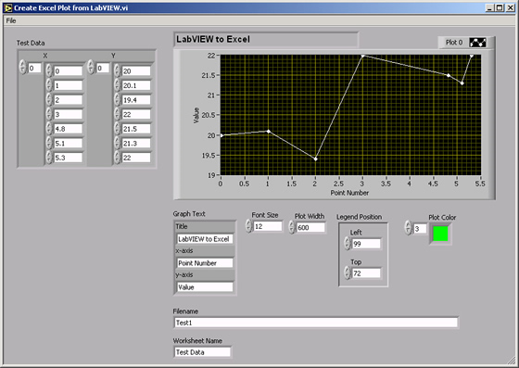
System Interface
Graphical User Interface
Lab View
Universal program
Ease of Use
Example of Lab View front screen

Slide 7
Project Background
Cummins tests the effect of water on engines and their electrical components
The test simulates the effect of driving over water puddles by spraying an engine undergoing an endurance test

Slide 8
Product Specifications
Capable of spraying 3 ft x 6 ft area
Stable structure
Automated/Variable Spray Settings
Spray Duration
Spray Intervals
Flow rate of 1 gpm per nozzle

Slide 9
Product Specifications

Slide 10
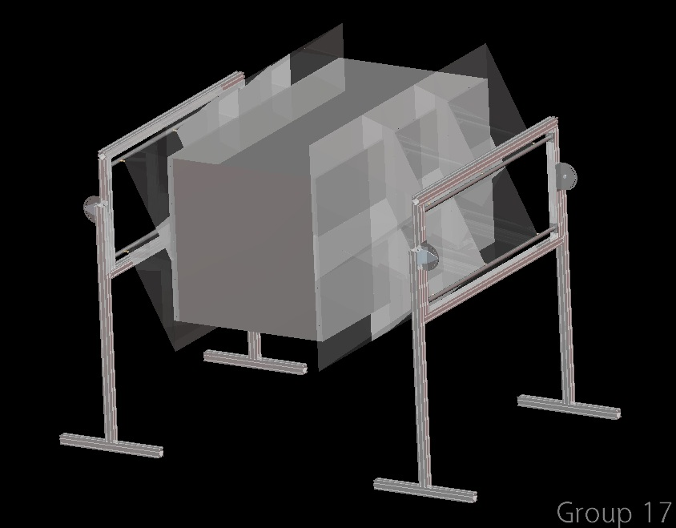
Design Concept
General

Slide 11
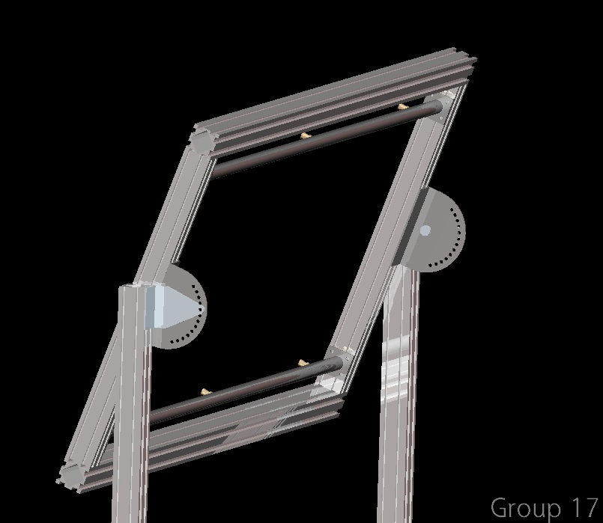
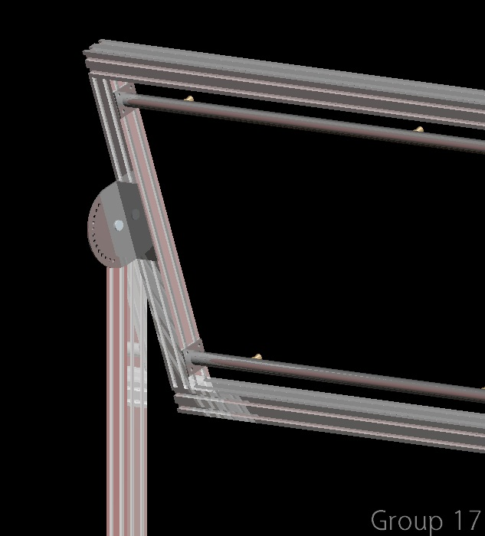
Revised Design Concept
Position Adjustment
Anterior view of hinge mechanism
Interior view of hinge mechanism
Hinge Mechanism allows for the spray structure to rotate. This is useful for different shaped engines such as V-configurations

Slide 12
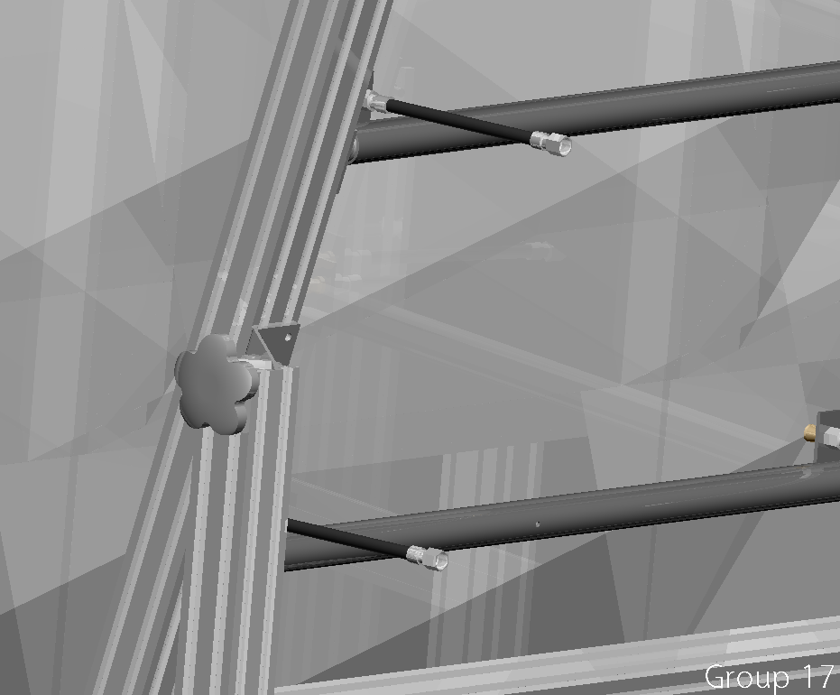
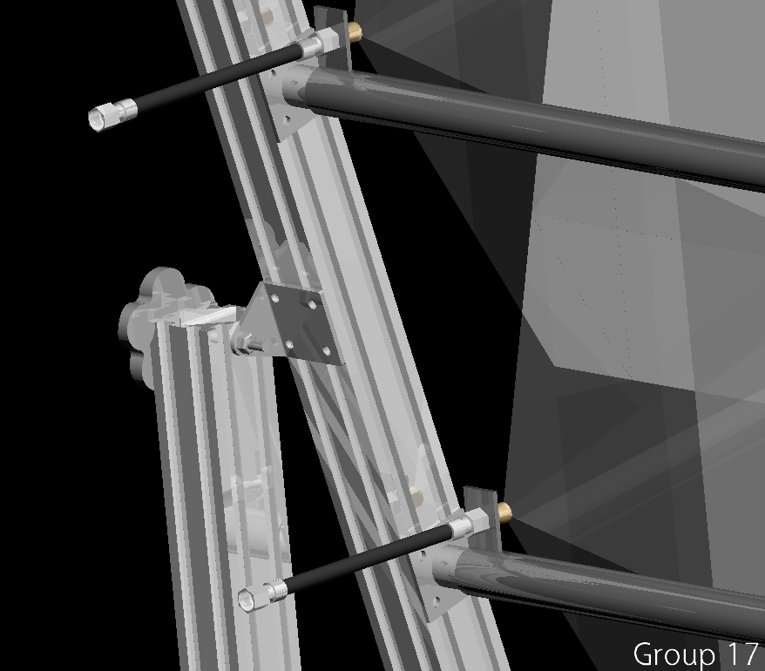
Design Concept
Position Adjustment

Slide 13
Bill of Materials
Part | Unit Price | Quantity | Part Total | Part Number
1/2" x 18" Brass Threaded Pipe | 15.41 | 1 | 15.41 | 4512K18
1/2" x 24" Brass Threaded Pipe | 20.60 | 4 | 82.40 | 4512K55
1/2" x 36" Brass Threaded Pipe | 30.92 | 4 | 123.68 | 4512K31
1/2" x 48" Brass Threaded Pipe | 41.14 | 2 | 82.28 | 4512K32
Extended-Life Centrifugal Pump | 399.17 | 1 | 399.17 | 9929K55
5' Hose with Male-Female Fittings | 26.66 | 12 | 319.92 | 5043T7
5' Hose with Male-Male Fittings | 29.32 | 2 | 58.64 | 5043T6
Brass Plug Valve | 18.68 | 12 | 224.16 | 5045K3
Brass Tee-Junction | 6.05 | 3 | 18.15 | 4429K253
Brass Elbow Junction | 5.16 | 4 | 20.64 | 4429K163
Brass Square Spray Pattern Nozzle | 9.47 | 12 | 113.64 | 33925K54
Brass Pipe Cap | 3.43 | 4 | 13.72 | 4429K143
48" Framing Extrusion | 18.24 | 10 | 182.40 | 15EX1515UL-48
L-Bracket | 4.00 | 16 | 64.00 | 15CB4804
 |  | Total | 1718.21

Slide 14
Conclusion
Redesign meets sponsor’s approval
No automated motion
Entire engine sprayed simultaneously

Slide 15
Future Work
Use Pro Piping program to analyze system
Finalize entire structure
Purchase materials
Assemble and test

Slide 16
A Special Thanks to…
Mr. Alex Dugé
Cummins- Experimental Mechanics
Mr. Andrew Zac-Williams
Cummins- Structural Analyst
Dr. Farrukh Alvi
Faculty Advisor
Dr. Rob Hovsapian
Dr. Srinivas Kosaraju
FAMU-FSU College of Engineering
Mechanical Engineering Department

Slide 17
Questions?

Slide 18
References
Alvi, Dr. Farrukh S. Lab1: “Pipe Flow: Major and Minor Losses”. FAMU/FSU College of Engineering. EML4304: Experiments in Thermal Fluid Sciences, 2010
Janna, William S. Design of Fluid Thermal Systems. Stamford, CT: Cengage Learning, 2011. Print.
McMaster-Carr. <http://www.mcmaster.com/#>
Faztek T-Slotted Aluminum Solutions. <http://www.faztek.net>

