Slide 1


Autonomous Underwater Vehicle (RoboSub)
Milestone #1: Specifications and Requirements

Slide 2
Overview of Design Team
Goals
  Education
    Design and construction process
  Competition
  Teamwork
    Communication
Interdisciplinary Team
  Computer and Electrical Engineering
  Mechanical Engineering

Slide 3
Team members
Victoria Jefferson – Project Manager (PM)
Andy Jeanthenor Software Technical Lead
Kevin Miles Electrical Lead
Reece Spencer– Mechanical Technical Lead
Tad Byrne– Mechanical Design Lead
Yanira Torres – Equipment/Debug Technical Lead

Slide 4
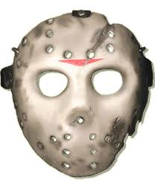
Objective/Theme
Design, construct, and program a functional Autonomous Underwater Vehicle capable of all operational parameters in 10 months to win the AUVSI RoboSub Competition.
The theme of last year’s competition was “Underwater the 13th”.
Expected Results
  Create a vehicle which not only meets the design requirements, but does so in a way which is more precise and efficient than our competitors.

Slide 5
Overview of the AUV Project
The project is to design an autonomous "RoboSub" to be entered in the Autonomous Underwater Vehicle Competition sponsored by the Office of Naval Research (ONR) and the AUVSI organization.

Slide 6
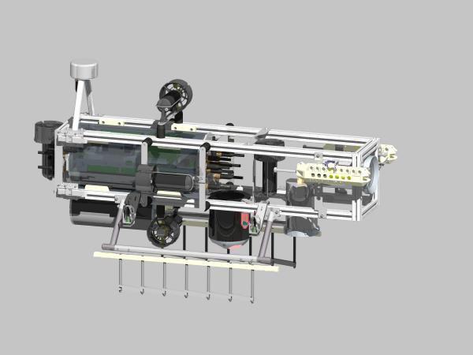
Existing Work/Prior Solutions
University of Maryland: Tortuga III Cornell University: Tachyon
:http://www.auvsifoundation.org/AUVSI/FOUNDATION/UploadedImages/UniversityOfMaryland_JournalPaper.pdf
:http://www.auvsifoundation.org/AUVSI/FOUNDATION/UploadedImages/CUAUV2010JournalPaper.pdf

Slide 7
Statement of the Problem
Required Capabilities
  Vehicle must operate autonomously, no communication is permitted
  General water maneuverability; controllable by ARM microprocessor
  Abort mission override control to float vessel to surface in case of mechanical failure
  Kill switch and prop shrouds

Slide 8
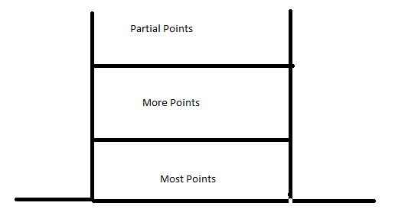
Obstacle Course (1 of 3)
Buoy 1 (Green)
Buoy 2 (Red)
Buoy 3 (Yellow)
Next Slide
Given “PATH” created by 6” wide, 4’ long ORANGE PVC sheets
Object 2: “Hedge”
Goal: Vehicle must pass between given risers. The lower it passes, the more points the team receives
Object 1: “Life Vest”
Goal: Hit whichever two buoys are specified

Slide 9
Obstacle Course (2 of 3)
Next Slide
Object 3: Weapons
Goal: The vehicle must drop off two markers into two different specified bins. Each bin is “see through” and the top is open, each with a different weapon, which is how we will know which bin to drop the marker in. Each box is 24” x 12” x 6”
Object 4: Window Pane
Goal: Vehicle must “shoot” missile through correct window pane, specified by color. Each section is 24” x 24”

Slide 10

Obstacle Course (3 of 3)
9 ft diameter orange PVC octagon (at surface).
Object 5: Counselor Rescue
Goal: Locate counselor from pinger on ground floor. Hoist counselor out of box, to the surface, within octagon at surface
PVC Box (2 x 2 ft) holds “counselor”. Object must be hoisted out of box and rise to surface within octagon
Acoustic “pinger” to give location in pool. 0.5 Hz, 0.9s duration. 2s between each pulse
Bottom of pool

Slide 11
Statement of the Problem
Desired Capabilities
  Ability to read latitude and longitude and “lock on” to a specific direction (compass)
  Accelerometer (for stability control)
  Remote control capabilities for trial and test run error debugging.
  Data recording for testing and debugging purposes (hard drive)
  Inflatable bladder to float vehicle to surface

Slide 12
Operational Description
Inputs/Outputs
  Color
    Marker path
    Buoys
    Fire a torpedo
  Shape
    Deploy markers into a bin
    Maneuver
  Sound
    Acoustic Pinger
Functions
  Capable of grasping a PVC structure
  Surface within a designated area with PVC load
  Release mechanism to drop PVC structure
  Sub should become buoyant in the event of a systems failure to ensure that the sub does not sink and become damaged

Slide 13
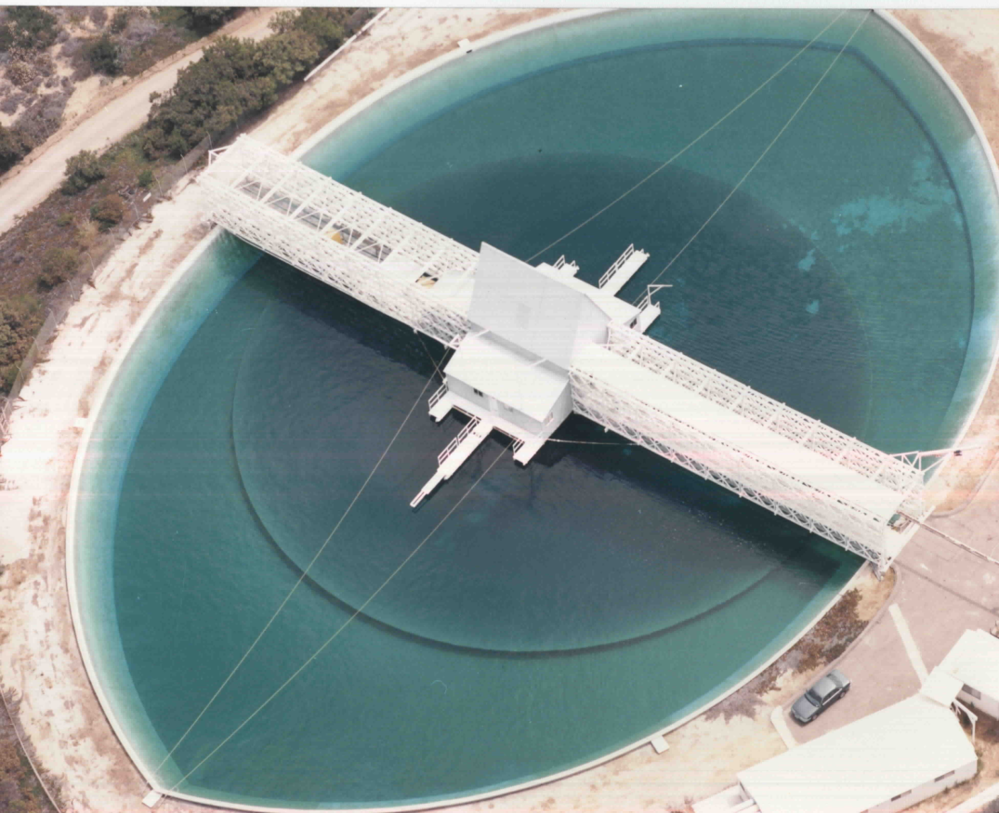
Environments
Operating Environment
Camp TRANSDEC,
San Diego CA
Salt water environment
Maximum depth of 16 ft
Maneuver through points
of interest

Slide 14
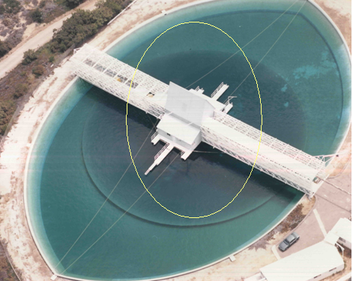
Environments
User Environment
Bridge overlooking salt
water operating
environment
User will not interact
with product once
product operation has
begun

Slide 15
Requirements
Functional
Motors, Thrusters
  Makes the RoboSub mobile
Electrical/Power System
  Connects software to hardware
  Powers onboard components
Hardware Interfaces
  ARM Processors and/or Controllers
  Open circuit voltage of any battery must not exceed 60 VDC
  Kill Switch
Software Interfaces
  Required to write to and read from shared memory (from all components)
  Control algorithms

Slide 16
Requirements
Non-Functional
Performance
  Operate autonomously
  Battery powered
Safety
  Electrical components should be protected from water damage and properly covered to prevent electrical discharge.
  Vehicle must be slung on a harness or sling.
Security
  Documents should be kept in a secure location
  Design should be kept in a secure location

Slide 17
Design Constraints
Size | 6 ft x 3 ft x 3 ft
Weight | Max: 110 lbs
Markers/Torpedo | ½ in x ½ in x 6 in Safe Speed
Processors/Controllers | ARM
Time | 10 Months
Budget | Currently: $9,500

Slide 18


Preliminary Test Plan
Capabilities Test Plan
  Thrusters
  Sensors
  Buoyancy
  Automation
Requirements Test Plan
  Firing Control
  Grasp/Release Control
Constraints Test Plan
  Salinity of Water
  Weight of RoboSub

Slide 19
System Features
Watertight Casing
Battery
Processor/Controllers
Propulsion System
Torpedo Launcher
Grasping and dropping mechanism
Buoyancy Control
  Emergency system

Slide 20
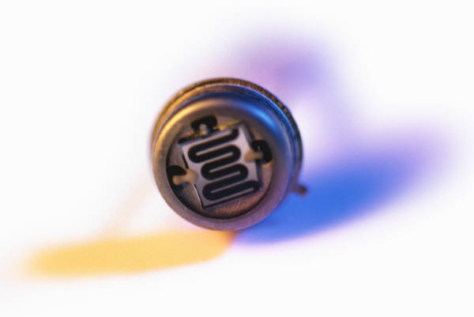
System Features: Sensors
Light and Shape Detection
  Visible wavelength: 380-750 nm
Sound receiver
    Frequency: 0.5 Hz, 1 second separation, 187 dB
Inertial guidance
  Detect changes in orientation or position
Sonar or Ultrasonic

Slide 21
Methodology
Mechanical Design
  Fall
    Performance specifications
    Generate potential designs and solutions to meet specifications
    Finalize vehicle design
    Analysis
    Purchase materials and necessary equipment
    Construction
  Spring
    Finish Construction
    Testing

Slide 22
Methodology
Computer/Electrical Design
  Fall
    Define the problem
    Conduct research
    Narrow down options/pick equipment
    Start Programming/Electrical system
  Spring
    Finish up programming
    Test interfaces (software meets hardware)
    Analyze possible alternatives/solutions
    Present product

Slide 23
References
http://www.auvsifoundation.org/AUVSI/FOUNDATION/UploadedImages/AUV_Mission_Final_2010.pdf
http://www.auvsifoundation.org/auvsi/foundation/Competitions/AUVCompetition/Default.aspx?C=00000000-0000-0000-0000-000000000000

Slide 24
Questions?

