Slide 1
Autonomous Underwater Vehicle:
Final Presentation
Group 18
Victoria Jefferson Reece Spencer
Andy Jeanthenor Yanira Torres
Kevin Miles Tadamitsu Byrne

Slide 2
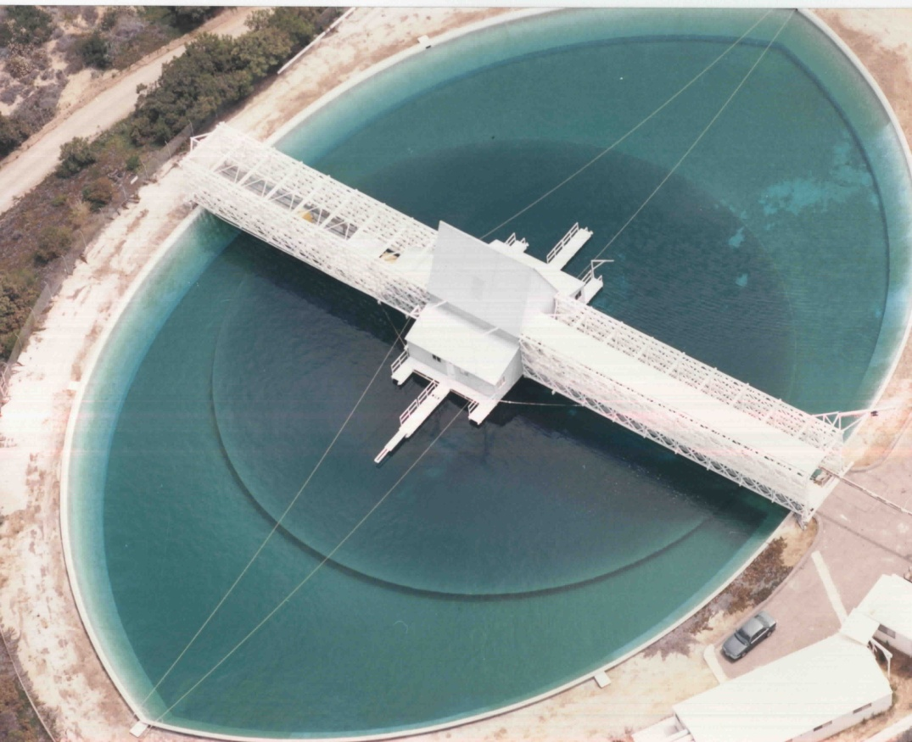
Project Overview
Autonomous Underwater Vehicle Competition
Competing in TRANSDEC Anechoic Pool, CA in July 2011
Competition Overview
AUV will complete tasks underwater
15 minute time limit per run
6 underwater tasks
Graded on completion of tasks as well as team design

Slide 3
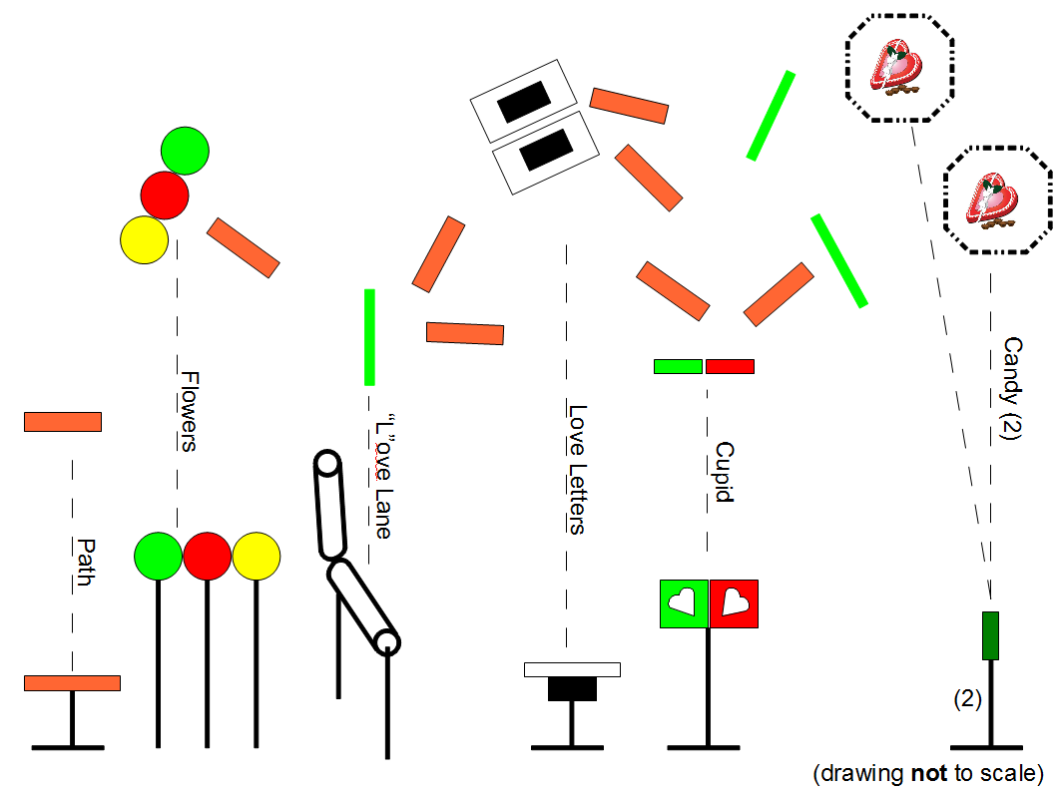
Preliminary Rules
Theme: RoboLove
Tasks
Validation gate
Orange Path
Buoys
Love Lane
Marker Dropper or Torpedo
Acoustic Pinger and rescue
Surface in octagon
Weight and size constraints
Must weigh under 110 pounds (Our AUV: appox. 50 lbs.)
6ft long, 3ft wide, 3ft high (Our AUV: 2.5 x 2.0 x 0.75 ft)

Slide 4
Tad Bryne

Slide 5
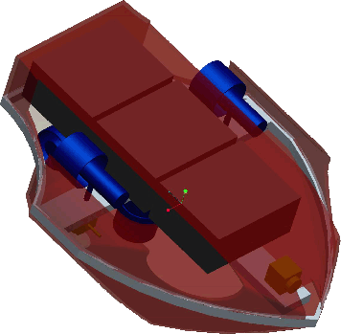
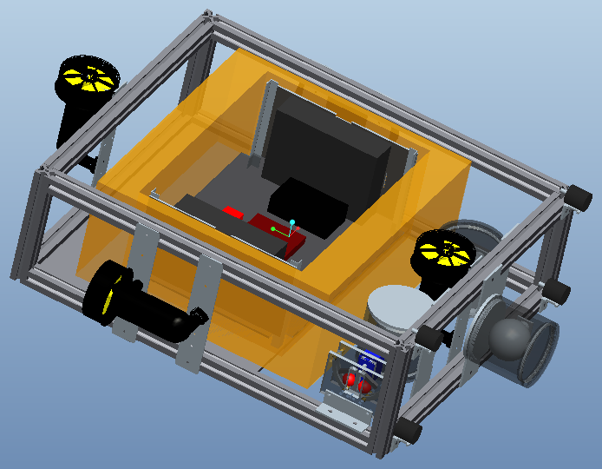
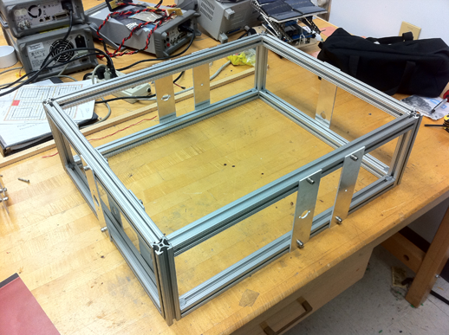
Frame Overview
80/20 Extruded Aluminum
Can easily adjust and move every component
Corrosion resistant
Design from previous year was pretty, but very difficult to adjust and manufacture
Shape is negligible at low speeds

Slide 6
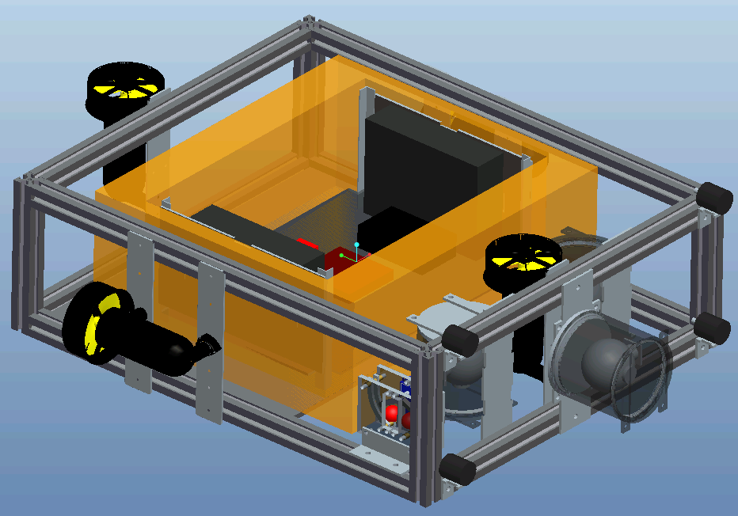
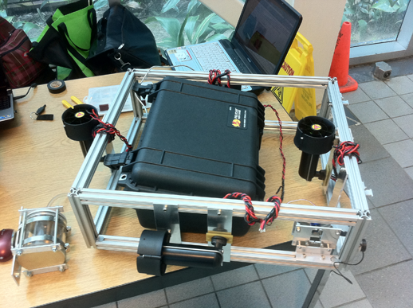
Hull Overview
Hull consists of a watertight Pelican Box (1450 Model)
Purchasing Pelican Box is more simple than designing watertight housing and is also inexpensive
Hull will house all onboard electronics
Box size was chosen based on size of batteries and onboard electronic components

Slide 7
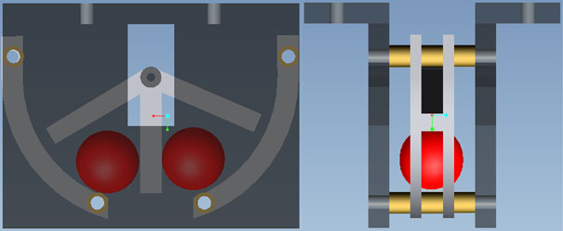
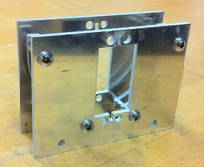
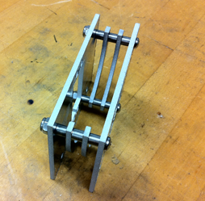
Marker Dropper
Marker must be dropped in a box on the pool floor
Utilize Traxxas 2056 waterproof servomotor that will rotate arm to release markers
This method was chosen because due to simplicity and low cost – used scrap aluminum from machine shop
First design used electromagnets and was more complex
The device successfully dropped both balls on command

Slide 8
Reece Spencer

Slide 9
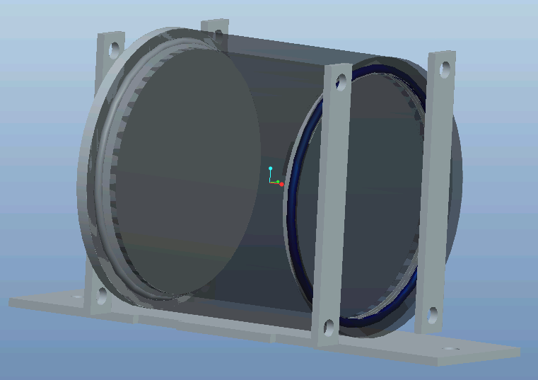
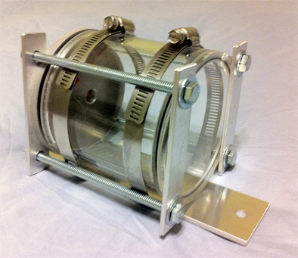
Camera Housing Design
Original design involved large diameter PVC pipe and metal latches
PVC was too thin and metal latches were too large
Final design uses acrylic and aluminum shell with acrylic viewing lens
Homemade clamps compress O-rings and keep housing water-tight

Slide 10
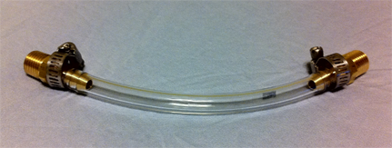
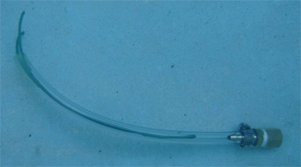
Waterproofing Methods
The first method proposed was to use SubConn or Fischer pre-made connectors – very expensive, but easy
Alternative method 1: Connect pelican box and camera housing using vinyl tubing
Method 2: A combination of vinyl tubing and epoxy
Final solution:
Camera Housing: Method 1
Hydrophones/servo: Method 2
Thrusters: SubConn connectors

Slide 11
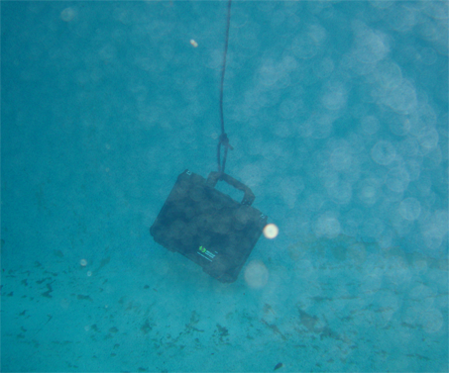
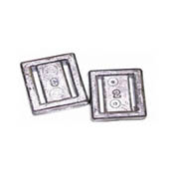
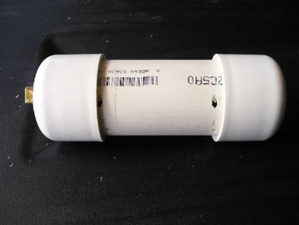
In-water Testing
The buoyant force of the Pelican Box was +35 lbs
The camera housing was approximately neutral without camera
No leaks penetrated either container after 15 minutes at a depth of 10 ft
Lead weights and sealed PVC pipes will be attached to the frame to make the AUV neutrally buoyant

Slide 12
Kevin Miles

Slide 13
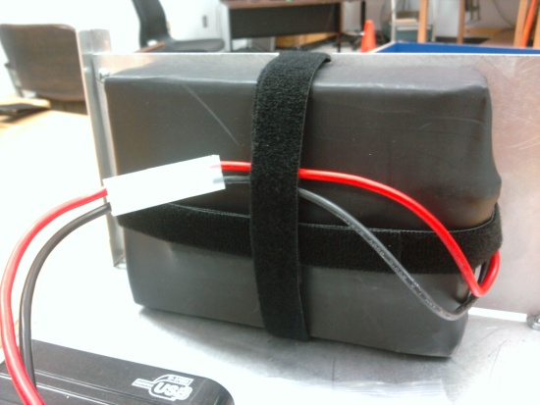
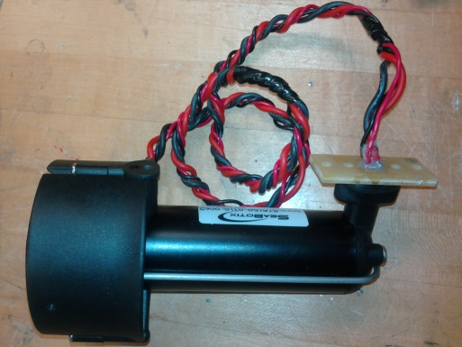
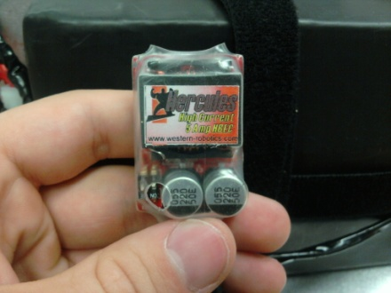
Major Power Components
Batteries
Two 14.8 V DC batteries combine for 29.6V DC output
Built-in PCM maintains a voltage between 20.8 V and 33.6 V
Motors
Max Power: 150W(each motor)
Built in Motor Controller
Switching Voltage Regulator (S.V.R.) for USB Power
15V-40V input
Output 5.17V, 6A

Slide 15
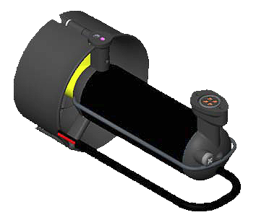
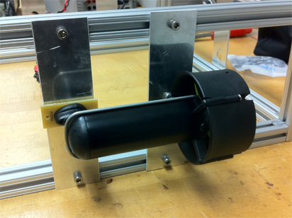
Thruster Overview
SeaBotix SBT150 thrusters were chosen for functional ability and water resistance as well it’s built-in motor controller, voltage regulator, and low power consumption
Four thrusters will be placed on the AUV in a configuration that will allow for forward/reverse motion, left/right turning and depth control
Other thrusters were more expensive, larger, and had higher power consumption

Slide 16
Electrical Tests
Product | Test Procedure | Expected Results | Achieved Results | Pass/Fail
SVR | Output Voltage | Output: 5.3V | 5.176V | Pass
Battery (2) | Output Voltage | Output: 29.6V | 33V | Pass
Switch | On/Off | Handles 150W | Handles 150W | Pass
Thruster Plate | Waterproof | No continuity underwater | No continuity underwater | Pass
SubConn Connectors | Waterproof | N/A, Waiting Arrival | N/A | N/A

Slide 17
Victoria Jefferson & Andy Jeanthenor:

Slide 18
Prioritization of Sensors
Cameras
Function: Eyes underwater
Need: Critical (used in all tasks)
IMU
Function: Sense of Direction Underwater
Need: Moderate
Hydrophones
Function: Ears Underwater
Need: Low (used in only one task)

Slide 19
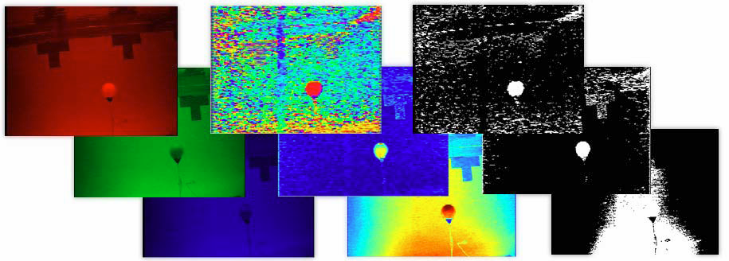
Software for Sensors
Cameras
Originally OpenCV
Last minute change: Matlab Image Processing
Due to Linking errors
IMU
RS-232 interface
Linux C Source Code

Slide 20
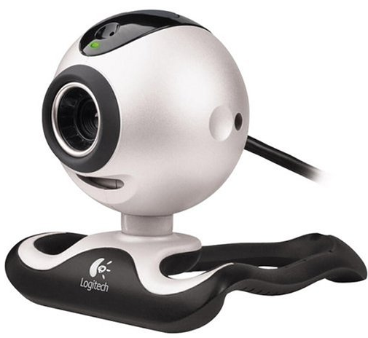
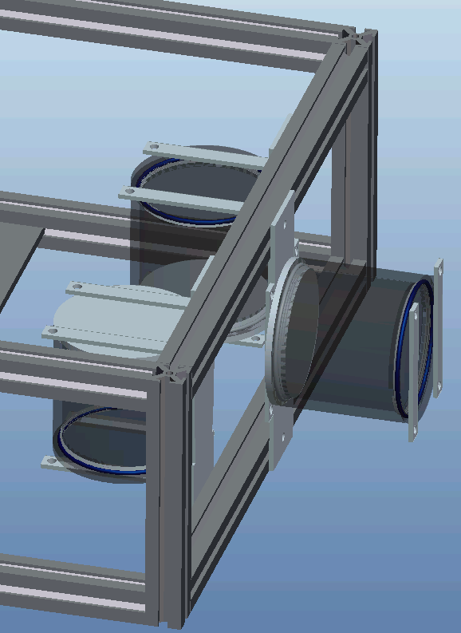
Cameras
Original choice was Unibrain Fire-I, but the software was not compatible with our system
Three Logitech Quickcam Pro 4000 webcams will be used
Needed for light/color and shape recognition
CCD camera chosen for ability to operate in low light conditions
The cameras chosen for cost efficiency as well as compatibility with our software

Slide 21
Camera Tests
Type of Test | Description of Test | Pass/Fail
Unit | Ensure proper configuration in OpenCV software | Fail
Unit | Test for acceptable quality images | Pass
Integration | Compatible with microprocessor | Incomplete
Integration | In Camera housing/produces same quality images | Incomplete

Slide 22
Inertial Measurement Unit
Navigation/Stability Control
PhidgetSpatial 3/3/3-9 Axis IMU
Accelerometer: measure static and dynamic acceleration (5g)
Compass: measures magnetic field (±4 Gauss)
Gyroscope: Measures angular rotation (400°/sec)
Chosen for low cost and because it contained a compass instead of magnetometer unlike other IMUs

Slide 23
IMU Tests
Type of Test | Description of Test | Pass/Fail
Unit | Ensure operational capabilities on Windows | Pass
Unit | Functionality on Linux | Pass
Integration | Compatible with microprocessor | Incomplete

Slide 24
Control System: BeagleBoard
The BeagleBoard(CPU):
Single Board Computer
Operating System:
Angstrom-BeagleBoard demo
Programming:
CodeSourcery GNU Toolchain (Cross Compiler)
Outputs:
I²C
USB/Serial
Program will run real-time

Slide 25
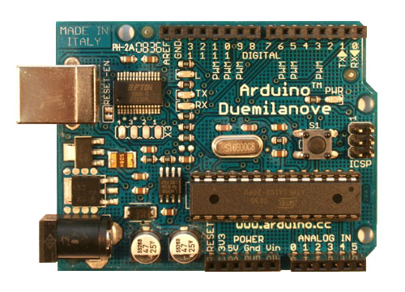
Control System: Arduino
Arduino Duemilanove
Microcontroller Board
Programming:
Arduino IDE
C Programming Language
Built-in Libraries
Outputs:
PWM
ADC
UART TTL (5V) serial communication/USB

Slide 26
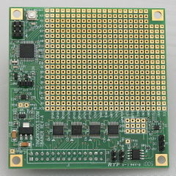
Component Software: Motors
Programming:
Communicate with Motor Controllers via I²C
BeagleBoard I²C operate at 1.8V, 5V needed to communicate with motor controllers
TrainerBoard will be used as expansion board
Motors tested with I²C ports on Arduino

Slide 27
Software Structure
Start
Path Found?
Detect Current Task
Path Lost?
Follow Path To Objective
Y
N
N
N
Y
Search For Path
Objective Found?
Y
Complete Objective
N
Have All Task Been Completed
Y
Store Data and Increment Task Counter
Finish

Slide 28
Software Tests
Component | Type of Test | Description of Test | Pass/Fail
Adruino Board | Unit | Checked for factory hardware verification by reading the manual and make sure everything works as it should in the manual | Incomplete
Beagleboard | Unit | The microcontroller and the sensors are fully powered by the proposed battery configuration. | Incomplete

Slide 29
Software Tests
Component | Type of Test | Description of Test | Pass/Fail
BeagleBoard with I²C expansion | Integration | BeagleBoard sends the appropriate instructions to the motors | Incomplete
Beagleboard with Sensors | Integration | Test whether the microcontroller and the sensors perform the functions needed for AUV operation properly | Incomplete

Slide 30
Yanira Torres

Slide 31
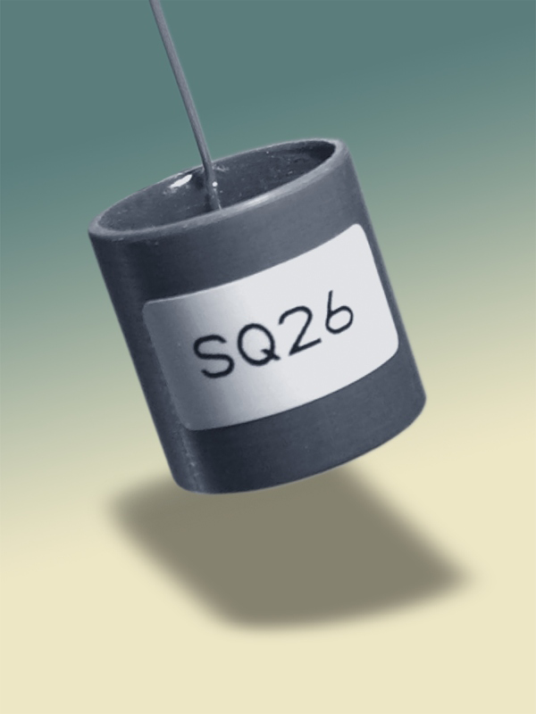
Hydrophones
SensorTec SQ26-01 hydrophone
Full audio-band signal detection and underwater mobile recording
Operates at desired sound level
Performs in desired frequency range (22-40 kHz)

Slide 32
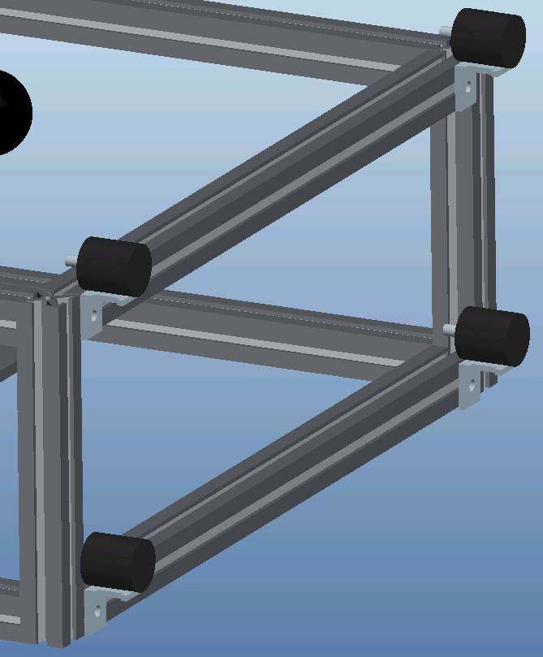
Hydrophone Configuration
4 hydrophones will be utilized to determine the location of the acoustic pinger
2 hydrophones will be placed horizontally to determine direction
The other two will be vertical in order to determine the depth

Slide 33
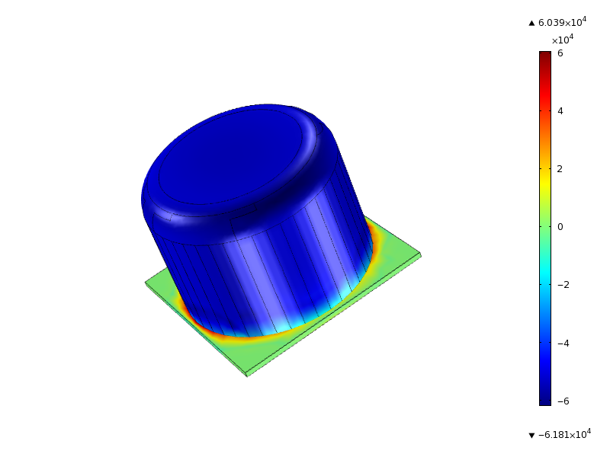
Camera Housing Analysis
Stress Tensor (Pa)
Acrylic cylinder
Acrylic viewing lens
Aluminum end cap

Slide 34
Schedule

Slide 35
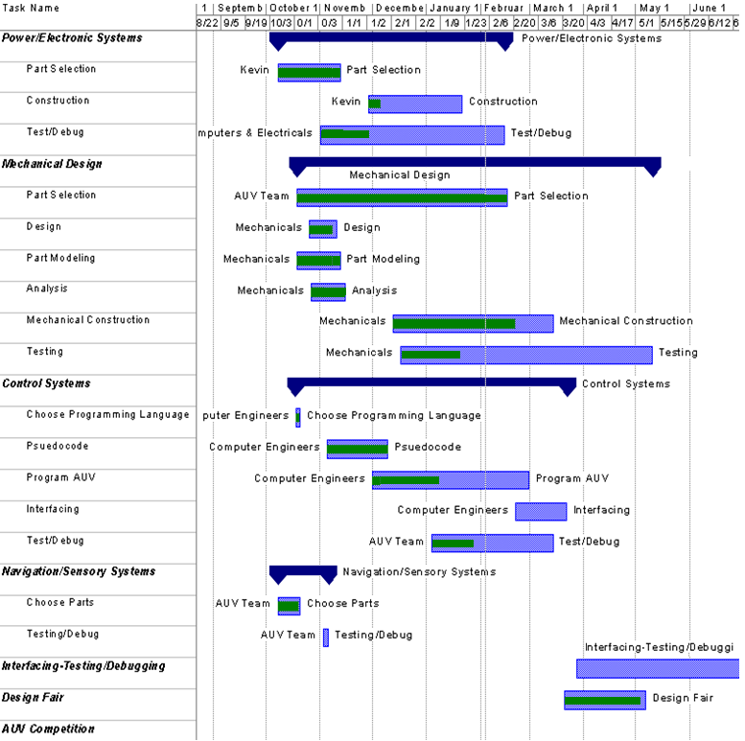

Slide 36
Budget

Slide 37
Item | Quantity | Price
Main Battery | 2 | $920.25
Voltage Regulator | 1 | $80.00
Motors/Thrusters | 4 | $2884.29
Hydrophones | 3 | $609.99
Microcontroller | 1 | $31.44
BeagleBoard | 1 | Free
CCD Camera | 3 | $413.96
Pelican Case | 1 | $87.40
Miscellaneous (ME & ECE) Wires/Electronic Kits/Cables & Connectors | N/A | $789.38
8020 Frame | N/A | $220.68
Aluminum Plate 14 in x 12 in x ¼ in | 1 | $70.00
Inertial Measurement Unit | 1 | $162.23
Total Expenses | N/A | $6,269.62

Slide 38
Item | Price
Transportation (5 people driving, 2 flying) | $3,000.00
Hotel Accommodations (2 hotel rooms for 5-6 nights) | $1,500.00
Miscellaneous Expenses (such as replacement of damaged equipment) | $1,500.00
Total Expenses | $6,000.00

Slide 39
Special Thanks
Northrop Grumman
Harris Corporation
ARM
FAMU/FSU College of Engineering
Dr. Harvey

Slide 40
References
"Official Rules and Mission AUVSI & ONR's 13th Annual International Autonomous Underwater Vehicle Competition." AUVSI Foundation. Web. Sept.-Oct. 2010. <http://www.auvsifoundation.org/AUVSI/FOUNDATION/UploadedImages/AUV_Mission_Final_2010.pdf>.
Barngrover, Chris. "Design of the 2010 Stingray Autonomous Underwater Vehicle." AUVSI Foundation. Office of Naval Research, 13 July 2010. Web. 09 Nov. 2010. <http://www.auvsifoundation.org/AUVSI/FOUNDATION/UploadedImages/SanDiegoiBotics.2010JournalPaper.pdf

