Slide 1

The ARTEMIS Project
Lunar Regolith Excavator Student Competition
ME Team #8 / ECE Team #1
James Dickson | Jeremy Nagorka
Anthony Gantt | Jennifer Schrage
Christopher Loftis | Nick Stroupe
Lindsey Alan Williams
Notes:
h

Slide 2
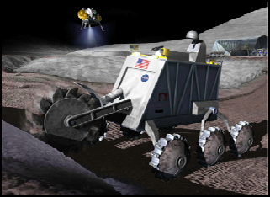
The Lunabotics Mining Competition
Lunabotics Mining Competition
  Designed to engage and retain students in STEM disciplines
  Provide a competitive environment in which may result innovative ideas and solutions that could be applied to actual lunar excavation
Max Weight | 80 kg
Max Power Supply | 40 V
Max Current | 15 A
Min Excavation Material | 150 kg
Max width/length | 1.3 m
Max height | 2.4 m
Max setup time | 10 minutes
Operation time | 30 minutes
Figure 1. Artist’s rendering of lunar excavation, taken from Lunabotics Mining Competition announcement
Table 1. Competition Specifications

Slide 3
Needs Analysis Flow Diagram
Requirements
Telerobotic or Autonomous
Minimum excavation is 10.0 kg
Interfaces – Internal & External
Track
Conveyor Belt
Elements
Hardware mass limit is 80 kg
Locomotion
Power System
Sensors
Excavation
Max voltage 40 V
Max Current
15 A
System
Microcontroller
Cowcatcher
Power System
Motors
Linear Actuator
Communication
Collector Bin
V - Plow
Sensors
LEGEND
Physical
FAMU/FSU COE
NASA
Dr. Jonathan Clark
Requirement / Regulation / Other
Contributors / Other Aspects
Figure 2. Needs analysis flow diagram for ARTEMIS Project

Slide 4
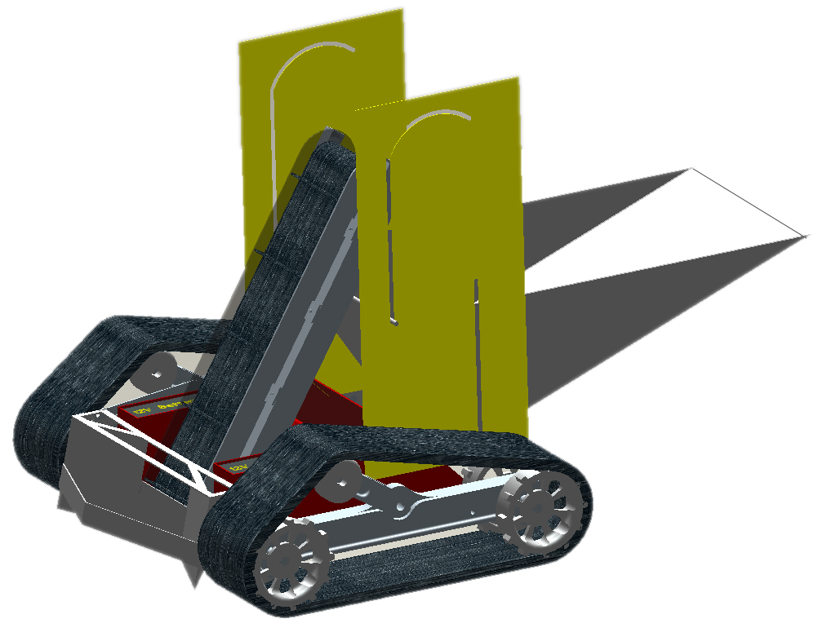
Robotic Platform Design
Figure 3. Robot design schematic

Slide 5
Circuit Block Diagram
Power Supply
Motors
Microcontroller
Movement of Robot
Conveyor Belt
2 Brushless Motors
2 Linear Actuator
Brushed Motor
Sensors
Tracks
Plow Lift
Collection Bin Lift
Inertial Navigation Sensor
IR Beacons
Current Sensor
Weight Sensor
Sharp IR Range Sensor
Bump Sensor
Figure 4. Circuit block diagram

Slide 6
System Breakdown
ARTEMIS Robot
Excavation
Excavation Tools
Material Transport
Locomotion
Power Transmission
Power
Microcontroller and Communications
Navigation
Obstacle Avoidance
Traction
Power Regulation
Power storage
Signal receivers/ Transmitter
Signal Processing
Stability
Program
Sensors
Obstacle Avoidance
Figure 5. System breakdown structure
Notes:
1) System 2) Subsystems 3) Components followed by 4) subcomponents and 5) parts

Slide 7
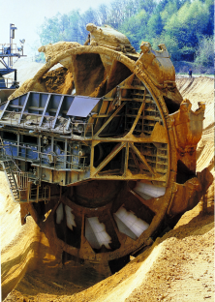
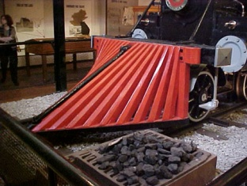
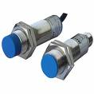
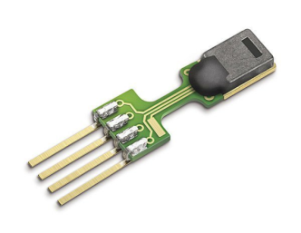
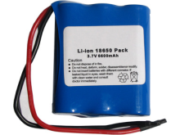
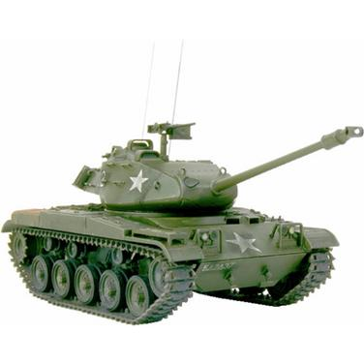
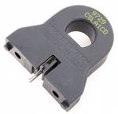
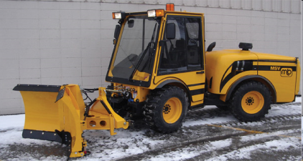
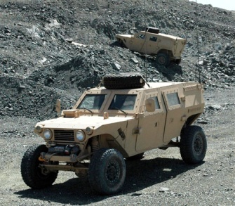
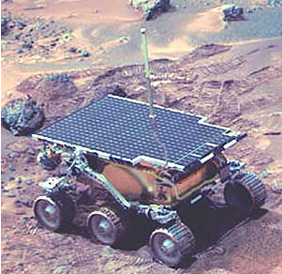
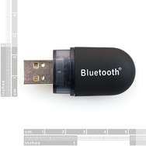
Concept Generation
An initial design, overall design idea was proposed, then brainstorming for each subsystem
Assigned specific qualities desired for final platform, then evaluated
Excavation
Power
Sensors
Locomotion
Communications
  Zigbee
  Bluetooth
  WiFi
Figure 6. Top 3 concepts for each subsystem

Slide 8
Concept Selection
 |  | Concepts
 |  | Tracks |  | 4 Wheels |  | 6 Wheels |  | C-Legs |  | iSprawl Legs |  | Worm
Specifications | Importance Weight | Rating | Weighted Score | Rating | Weighted Score | Rating | Weighted Score | Rating | Weighted Score | Rating | Weighted Score | Rating | Weighted Score
Traction | 20.00% | 5 | 1 | 2 | 0.4 | 3 | 0.6 | 0 | 0 | 1 | 0.2 | 4 | 0.8
Stability | 10.00% | 5 | 0.5 | 3 | 0.3 | 4 | 0.4 | 1 | 0.1 | 2 | 0.2 | 0 | 0
Maneuverability | 15.00% | 4 | 0.6 | 3 | 0.45 | 2 | 0.3 | 1 | 0.15 | 5 | 0.75 | 0 | 0
Speed | 15.00% | 2 | 0.3 | 4 | 0.6 | 3 | 0.45 | 1 | 0.15 | 5 | 0.75 | 0 | 0
Power | 10.00% | 5 | 0.5 | 3 | 0.3 | 4 | 0.4 | 2 | 0.2 | 1 | 0.1 | 0 | 0
Cost | 10.00% | 3 | 0.3 | 5 | 0.5 | 4 | 0.4 | 2 | 0.2 | 1 | 0.1 | 0 | 0
Simplicity | 10.00% | 2 | 0.2 | 5 | 0.5 | 4 | 0.4 | 3 | 0.3 | 1 | 0.1 | 0 | 0
Low Maitenance | 5.00% | 2 | 0.1 | 4 | 0.2 | 3 | 0.15 | 5 | 0.25 | 1 | 0.05 | 0 | 0
Dust Resistance | 5.00% | 2 | 0.1 | 4 | 0.2 | 3 | 0.15 | 5 | 0.25 | 1 | 0.05 | 0 | 0
 | Score |  | 3.6 |  | 3.45 |  | 3.25 |  | 1.6 |  | 2.3 |  | 0.8
 | Selection | 1st |  | 2nd |  | 3rd |  | - |  | - |  | -
Table 2. Example Concept Selection Matrix for the Locomotion Subsystem
Note: House of Quality primarily used for weighting, comparison, and selection

Slide 9
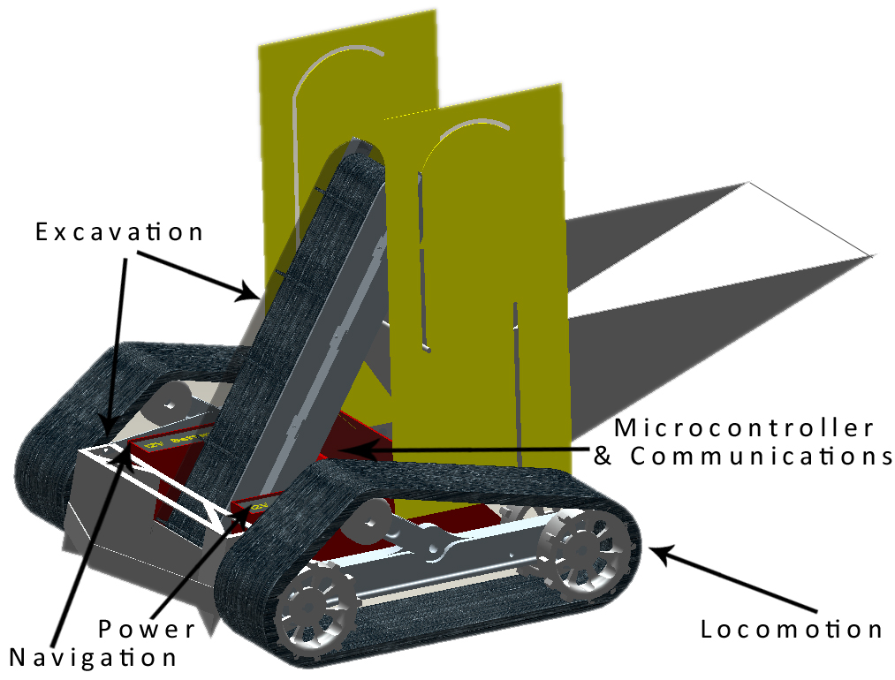
System Overview
Figure 7. Overall platform design with subsystems

Slide 10
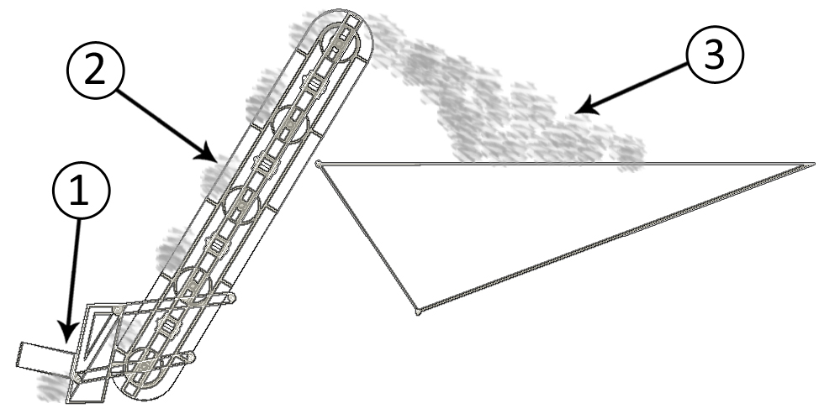
Excavation Subsystem Design
Excavation Subsystem Components:
  Plow – piles regolith onto conveyor belt
  Conveyor Belt – transports regolith for deposit in bucket
  Bucket – holds regolith until delivery to holding bin
Figure 8. Excavation subsystem components and flow of regolith

Slide 11
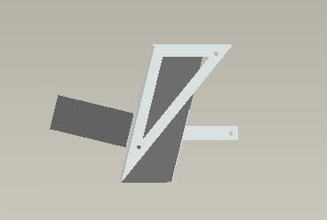

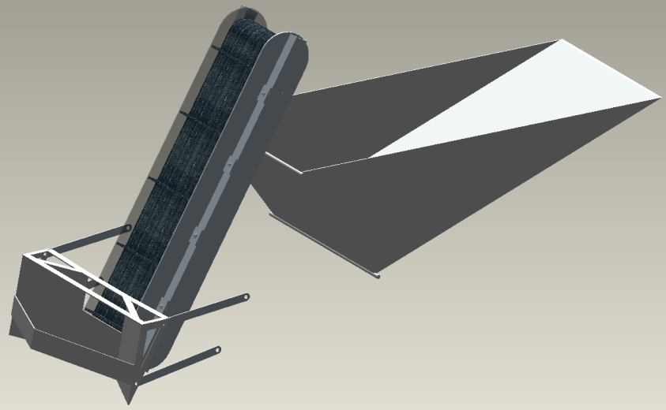
Excavation Subsystem Design
Integrated regolith channeling and rock deflection
Coupled to conveyor for maximum efficiency
Linearly actuated engagement
Constrained angle using parallel 4-bar
Figure 9. Side view of plow (top) and integration of plow (bottom)
Figure 10. Top view of plow design

Slide 12
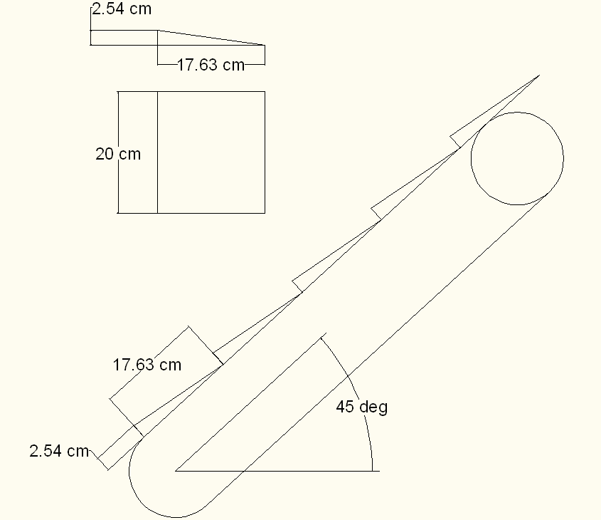
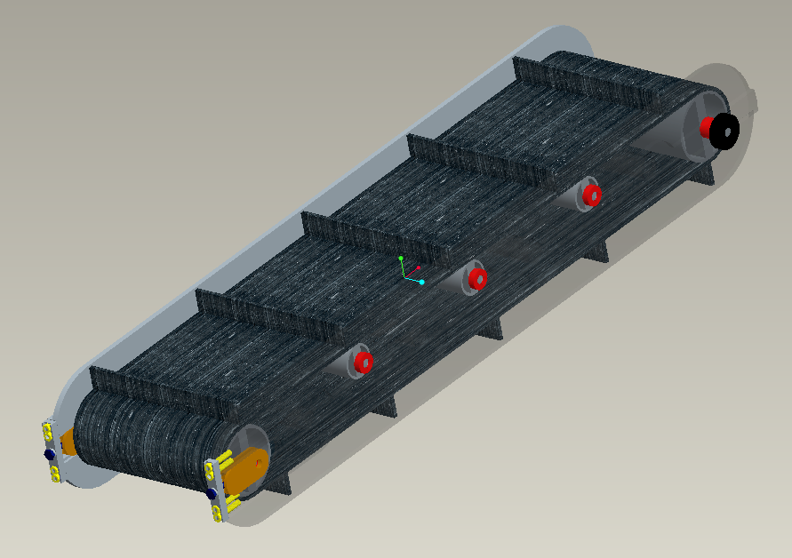
Paddle belt Conveyor
Design Analysis
  Assumptions and Constants
    Inclination angle of 45 degrees
    Uniform load distribution
    Belt velocity of 1 m/s
    Maximum regolith density of 1.91 g/cm³
    Each scoop excavates a volume of 448 cm³
    Belt coefficient of friction of 0.3
    Bearing coefficient of friction of 0.0015
  Results
    Angular velocity of 26.2 rad/s
    Angular acceleration of 13.1 rad /s²
    Max load of 4.28 kg
    Required motor torque of 1.59 N*m
    Total mass of 8.4 kg
    Total mass of conveyor and load of 12.68 kg
Figure 11. Design drawing of conveyor belt and isometric view of final design
Notes:
12

Slide 13
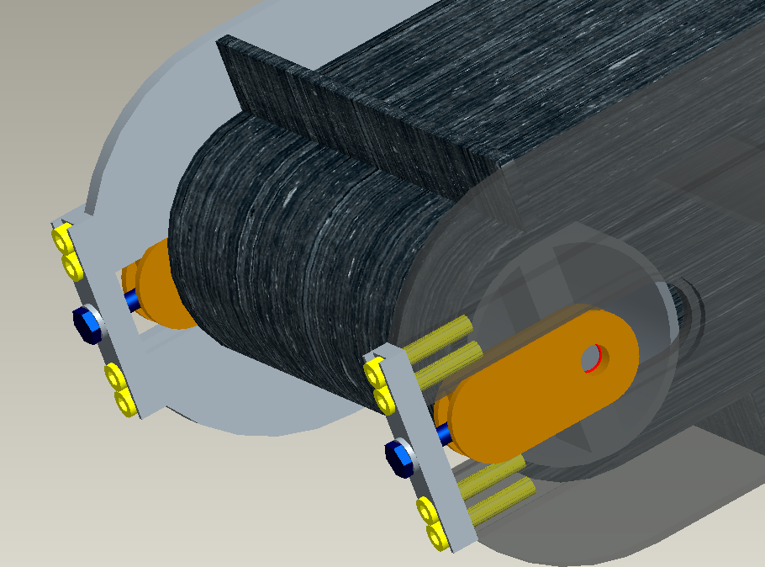
Paddle belt Conveyor
Tensioning Mechanism
  One mechanism per side
    One DOF prismatic joint
    Integrated bearing housing
    Single bolt adjustment
      Clockwise rotation
        Increase belt tension
      Counter-clockwise rotation
        Decrease belt tension
Figure 12. Tensioning mechanism on conveyor belt
Notes:
13

Slide 14
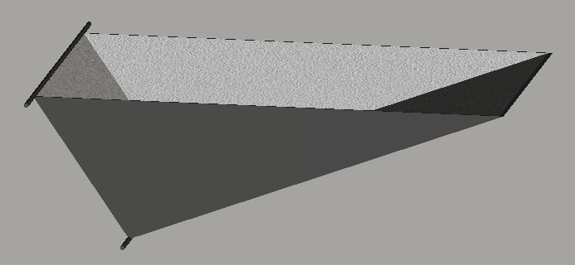
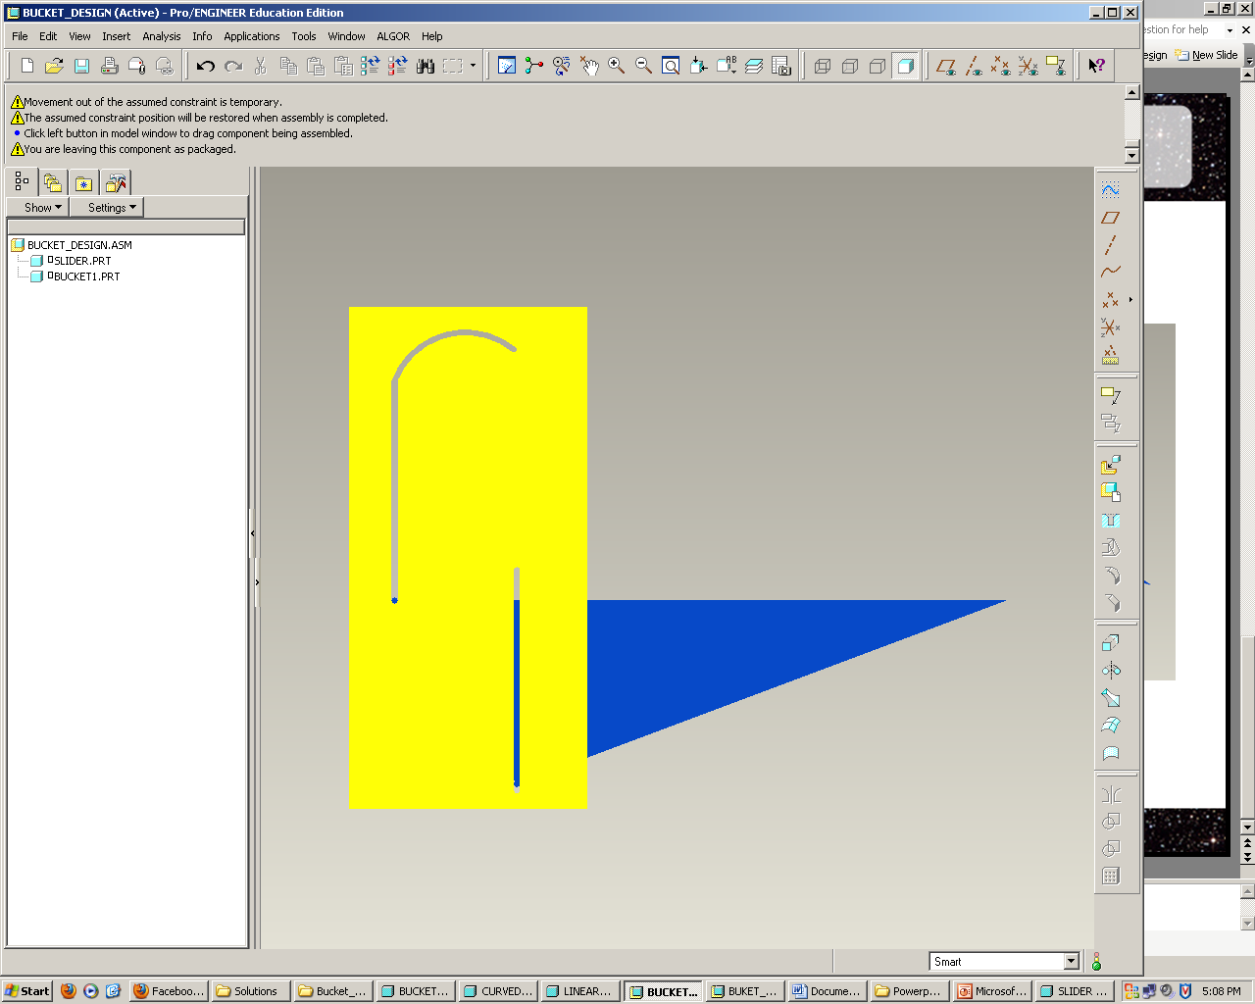
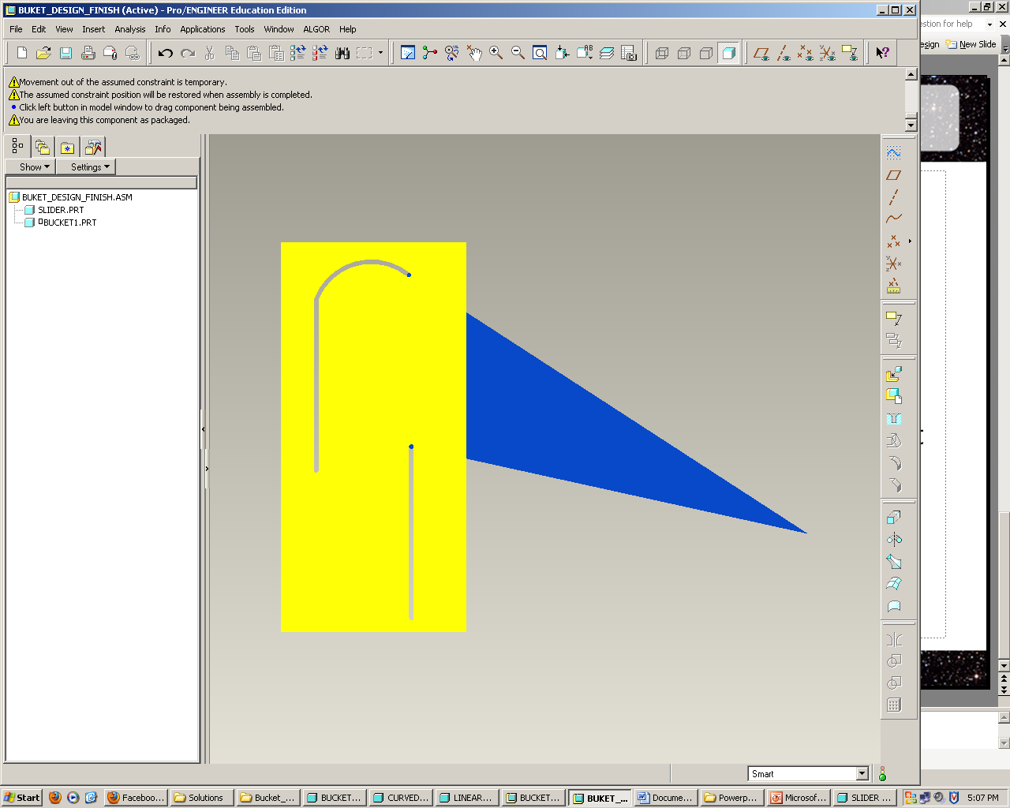
Excavation Subsystem Design
Density of Regolith – 1.5 g/cm³
Desired capacity – 100 kg
Required Volume – 0.066 m³
Our Bucket
  Capacity 0.075 m³
  Height 0.3 m
  Length 1.0 m
  Width 0.5 m
  Material Al 6061
  Weight 9 kgs
Figure 13. Isometric view of bucket design
Figure 14. Example of bucket dumping from side view

Slide 15
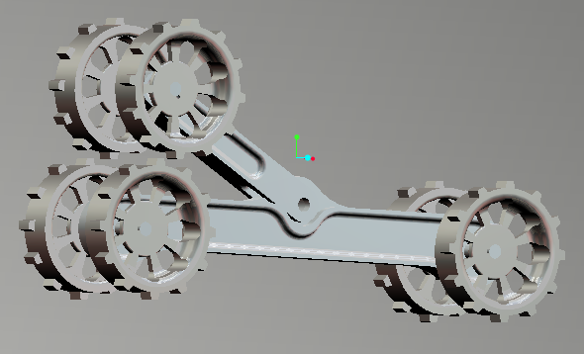
Locomotion Subsystem Design
Center Frame with torsion arm for tension
  k=150 (Nm/deg)
Motor housed in main body with drive shaft to rear sprockets
Total mass of each track ~12 kg with tread
Figure 15. Isometric view of track frame

Slide 16
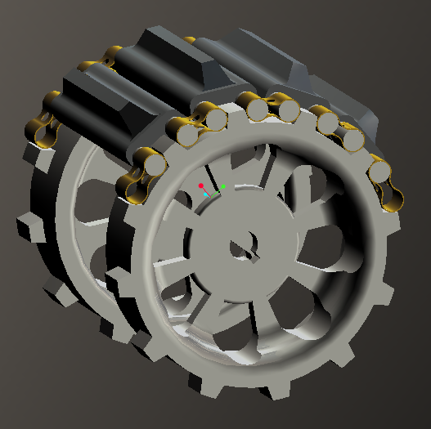
Locomotion Subsystem Design
Chain Assembly
  Variation of a bike chain
  15 cm tread surface at center
  Individually adjustable connector links
  Pin Joint allows large circular deformations
Figure 16. Isometric view of driving sprocket with example of treads

Slide 17
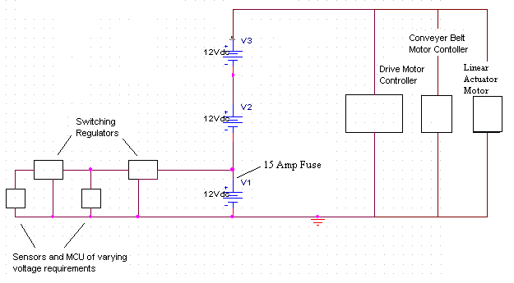
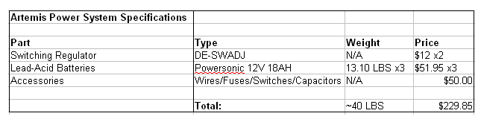
Power Subsystem Design
Figure 17. Power subsystem schematic
Table 3. ARTEMIS Power System Specifications

Slide 18
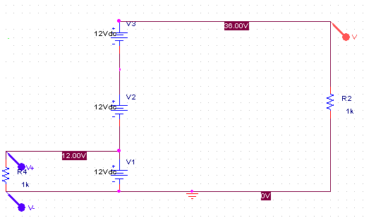
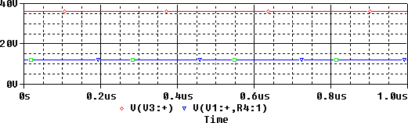
Power Subsystem Simulation
Figure 18. Schematic of power system simulation (top) and results (bottom)

Slide 19
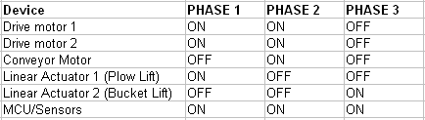
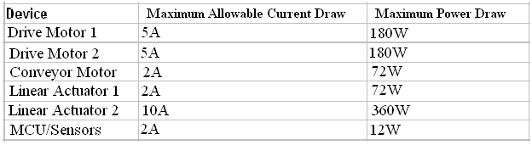
Power Subsystem Overview
PHASE 1: Plow Engage
PHASE 2: Regolith Collection
PHASE 3: Regolith Deposit into Collector
Table 4. Device operation according to sequence
Table 5. Maximum device specifications in accordance to phase and 15A draw limit

Slide 20
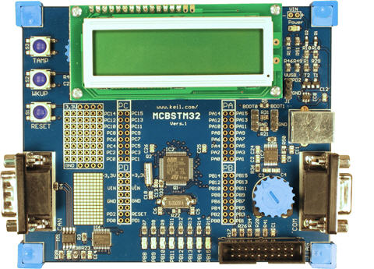
Microcontroller
8 bit AVR vs 32 bit ARM vs Single-board Computer
  AVR- slower, tons of support, very easy to program, 5V I/O
  ARM- faster, more complicated, 3.3V I/O
  Single-board- expensive, complete overkill
Chose MCBSTM32, an ARM Cortex M3 board from Keil
  32 bit 72MHz
  2 SPI, 2 I2C, 3 UART, 16 ADC
  48 General I/O
  Free, Donated by ARM
Figure 19. Example of ARM Microcontroller

Slide 21
Telerobotic Interface
Remote operation of robot
  At minimum: Start and stop
Network provided which adds two second delay
Playing Field
WAN
2s delay
1Mbps Bandwidth
Control Room
Robot
Relay
Computer
Control
Computer
Figure 20. Diagram of communications during competition
Link Robot to WAN Wirelessly
  WiFi- 58Mbps, Complicated, High Power, Most Expensive
  Xbee- 0.25Mbps, Simple, Medium Power, Cheapest
  Bluetooth- 1Mbps, Medium Complexity, Low Power,Medium Cost

Slide 22
Interfacing Diagram
Bluetooth Modem
BlueSMiRF
3.3V
Receiving Laptop
Relay to WAN
Telerobotic Interface
Figure 21. All Inputs/Outputs
to microcontroller
Serial
115200bps
2
3x Brushed Motor Drivers
H-Bridge
Conveyor & Actuators
2 Outputs Each
Forward,Reverse,Brake,Free
Digital
Output
20
Microcontroller
2x Brushless Motor Drivers
Drive Motors
7 Outputs Each
6 Commutation,1 PWM Speed
Inertial Navigation Unit
3 Axis Accelerometer
2 Axis Gyroscope
3.3V
Digital
Input
8
Analog
Input
10
Rangefinder
Sonar or IR
3.3V
2x Brushless Motor Feedback
3xHall Effect Sensors
5.0V
Analog
Amplifier
2x Bump Sensors
5.0V
Weight Sensor
Digital Scale Load Cell
5.0V
2x IR Beacon Detector
Phototransistor circuit
3.3V
Current Sensor
15A sensor
3.3V

Slide 23
Navigation Subsystem Design
From start, proceed on random or preset course
Once out of starting square, start digging
When bin is full, move to center of area and face collector
Move towards collector using beacons for alignment
When at wall of collector, dump regolith
Reset inertial navigation and repeat
Robot
B
B
Collector
Figure 22. Diagram of Competition setup

Slide 24
Navigation Sensors
Power Supply
Sensors
Microcontroller
Inertial Navigation Sensor
IR Beacons
Current Sensor
Weight Sensor
Sharp IR Range Sensor
Bump Sensor
Figure 21. Navigation Sensor flow chart
Inertial Navigation Sensors
Accelerometer and gyroscope provide position and direction sensing independent of the robots environment
  Accelerometers measure acceleration in X Y and Z axises
  Gyroscopes measure pitch, yaw, and roll
Accelerometer pseudocode running once per second:
Use yaw for steering, pitch and roll not needed

Slide 25
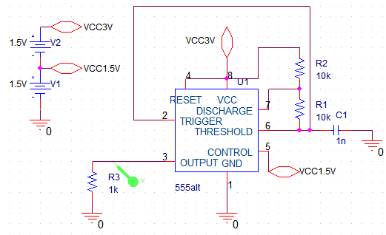
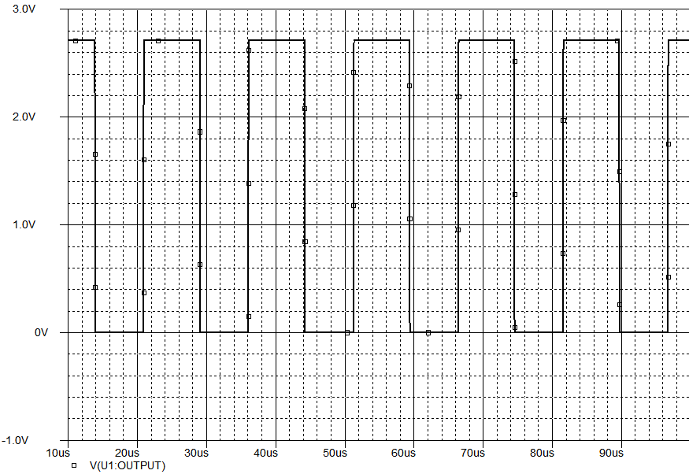
IR Beacons
Self-contained beacons running IR LEDs off normal batteries
Used to allow robot to find and align with collector using infrared detectors
Need to modulate LEDs
Use a 555 timer to generate a square wave
        Figure 22. Frequency and duty cycle are changed by changing R and C

Slide 26
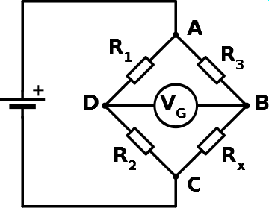
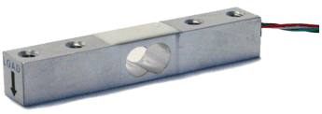
Weight Sensor
The robot needs to know when its bin is full and to return to dump
  Taking apart a cheap digital scale gives a force sensor so the robot can know the weight of the regolith it has
  The scale works as a wheatstone bridge, one resistor varies with the weight(deformation) and changes the voltage Vg
        This is a small voltage and needs to be amplified so the controller can read it
Figure 23. Circuit diagram for weight sensor (left) and weight sensor (right)

Slide 27
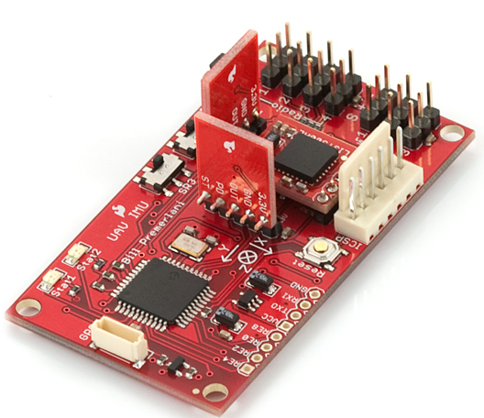
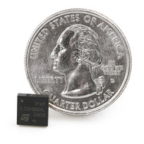
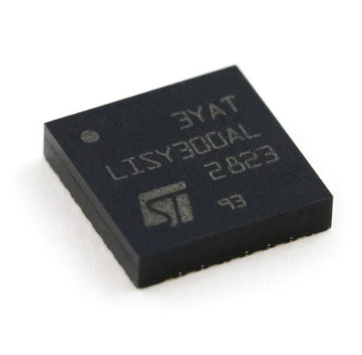
Sensors
Navigational Sensors
  IR Sharp Sensor
  IR Beacon Sensor
  Inertial Measurement Unit (IMU)
Current Sensor
Pressure Sensor
  Bumper Sensor
  Weight Sensor
Figure 24. Three axis inertial navigation sensor
Figure 25. Single gyroscope

Slide 28
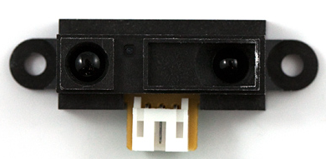
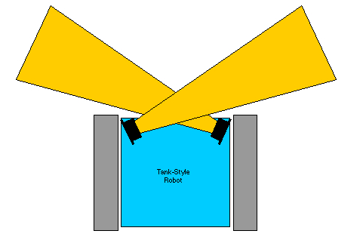
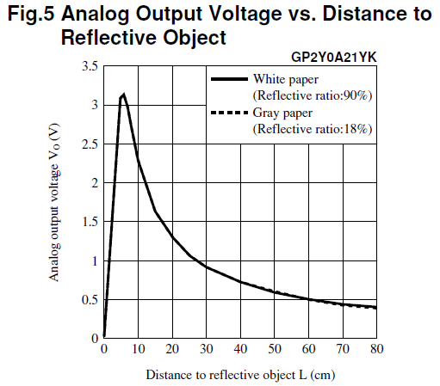
IR Sharp Sensor
Figure 27. IR Sharp Sensor
Figure 26. Configuration of IR Sharp sensors on platform
Figure 28. Analog output voltage vs. distance to reflective object

Slide 29
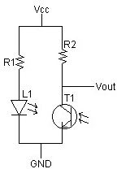

IR Beacon Sensor
IR Emitter Circuit
Tank-style Robot

Slide 30
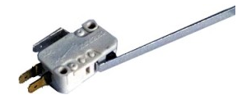
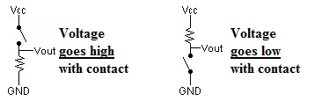
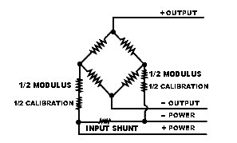
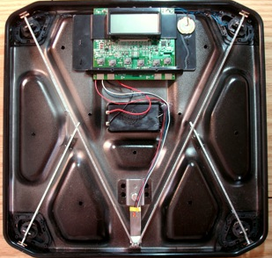
Bumper and Weight Sensor
Tactile Bump Sensor Circuits
Figure 30. Bump Sensor
Figure 29. Weight Sensor Circuit
Figure 31. Weight sensor in situ

Slide 31
Cost Analysis of System
 | Part Description | QTY | Price | Total
Excavation |  |  |  | $93.97
 | Aluminum Plate, 1/8"x12"x24" | 4 | $22.84 | $91.36
 | Aluminum Rod, 3/16"x72" | 1 | $2.61 | $2.61
 |  |  | Total
Locomotion |  |  |  | $687.61
 | Aluminum Block, 8"x8"12" | 1 | $435.40 | $435.40
 | Aluminum Rectangular Tube, 2"x4"x72" | 3 | $54.43 | $163.29
 | Aluminum Rod, 1"x60" | 1 | $20.92 | $20.92
 | Aluminum Rod, 1/2"x72" | 4 | $6.22 | $24.88
 | Brass Flat plate, 3/32"x3/4"x72" | 2 | $21.56 | $43.12
Power |  |  |  | $229.85
 | Switching Regulator | 2 | $12.00 | $24.00
 | Lead Acid Batteries | 3 | $51.95 | $155.85
 | Accessories (Wires, Fuses, etc) | 1 | $50.00 | $50.00
Microcontroller and Communications |  |  |  | $0.00
 | ARM Microcontroller* | 1 | $0.00 | $0.00
 | Bluetooth Adapters | 1 |  | $0.00
Navigation |  |  |  | $242.80
 | IR Sharp Sensor | 1 | $9.95 | $9.95
 | IR Beacon Detector | 1 | $14.95 | $14.95
 | IR LEDs (850 nm 100pcs) | 100 | $0.07 | $7.00
 | IR LEDs (940 nm 100 pcs) | 100 | $0.06 | $6.00
 | IMU | 1 | $149.95 | $149.95
 | Gyroscope | 1 | $11.95 | $11.95
 | Bumper Sensor | 2 | $1.50 | $3.00
 | Weight Sensor | 1 | $40.00 | $40.00
Total Cost of System |  |  |  | $1,254.23

Slide 32
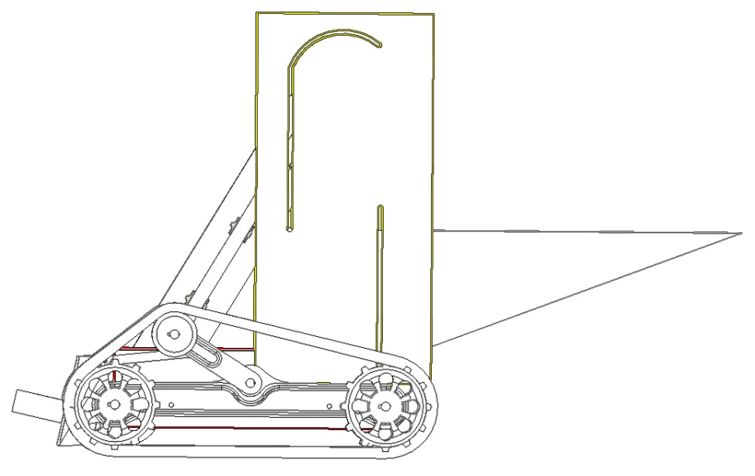

Conclusions
Plow excavation unit with conveyor belt for regolith transport
Tracks on either side used for locomotion
Lead-acid batteries for power integrated in regulator circuits for components
ARM Microcontroller for control
Various sensors for navigation and obstacle avoidance
Figure 32. Final ARTEMIS Design

Slide 33
Questions and Comments
The ARTEMIS Project

