Slide 1
The ARTEMIS Project
Lunar Regolith Excavator Student Competition
ME Team #8 / ECE Team #1
James Dickson | Jeremy Nagorka
Anthony Gantt | Jennifer Schrage
Christopher Loftis | Nick Stroupe
Lindsey Alan Williams
Notes:
h

Slide 2
The Lunabotics Mining Competition
Lunabotics Mining Competition
Designed to engage and retain students in STEM disciplines
Provide a competitive environment in which may result innovative ideas and solutions that could be applied to actual lunar excavation
Max Weight | 80 kg
Max Power Supply | 40 V
Max Current | 15 A
Min Excavation Material | 150 kg
Max width/length | 1.3 m
Max height | 2.4 m
Max setup time | 10 minutes
Operation time | 30 minutes
Figure 1. Artist’s rendering of lunar excavation, taken from Lunabotics Mining Competition announcement
Table 1. Competition Specifications

Slide 3
Needs Analysis Flow Diagram
Requirements
Telerobotic or Autonomous
Minimum excavation is 150.0 kg
Interfaces – Internal & External
Track
Conveyor Belt
Elements
Hardware mass limit is 80 kg
Locomotion
Power System
Sensors
Excavation
Max voltage 40 V
Max Current
15 A
System
Microcontroller
Cowcatcher
Power System
Motors
Linear Actuator
Communication
Collector Bin
V - Plow
Sensors
LEGEND
Physical
FAMU/FSU COE
NASA
Dr. Jonathan Clark
Requirement / Regulation / Other
Contributors / Other Aspects
Figure 2. Needs analysis flow diagram for ARTEMIS Project

Slide 4
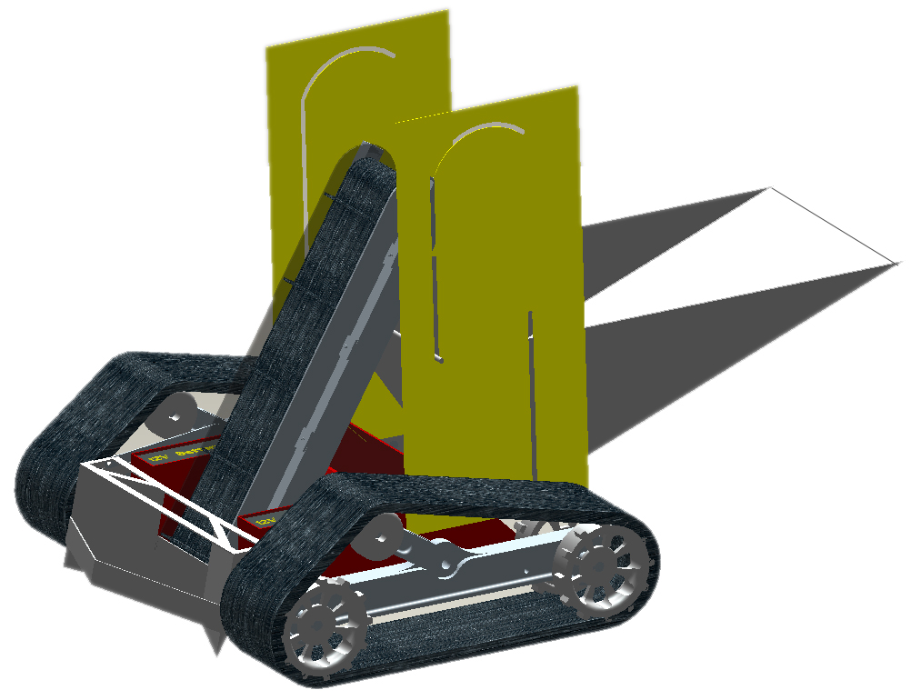
Robotic Platform Design
Figure 3. Robot design schematic

Slide 5
Circuit Block Diagram
Power Supply
Motors
Microcontroller
Movement of Robot
Conveyor Belt
2 Brushless Motors
2 Linear Actuator
Brushed Motor
Sensors
Tracks
Plow Lift
Collection Bin Lift
Inertial Navigation Sensor
IR Beacons
Current Sensor
Weight Sensor
Sharp IR Range Sensor
Bump Sensor
Figure 4. Circuit block diagram

Slide 6
System Breakdown
ARTEMIS Robot
Excavation
Excavation Tools
Material Transport
Locomotion
Power Transmission
Power
Microcontroller and Communications
Navigation
Obstacle Avoidance
Traction
Power Regulation
Power storage
Signal receivers/ Transmitter
Signal Processing
Stability
Program
Sensors
Obstacle Avoidance
Figure 5. System breakdown structure
Notes:
1) System 2) Subsystems 3) Components followed by 4) subcomponents and 5) parts

Slide 7
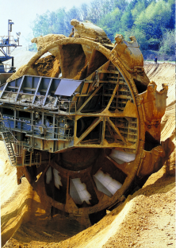
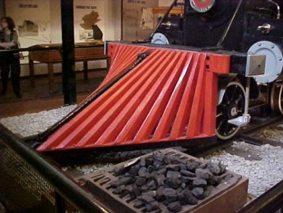
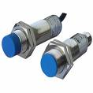
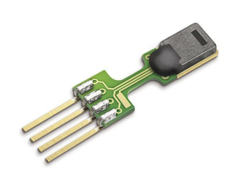
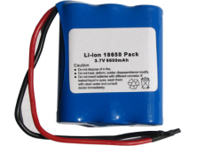
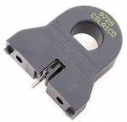
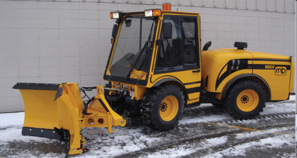
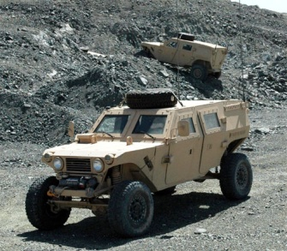
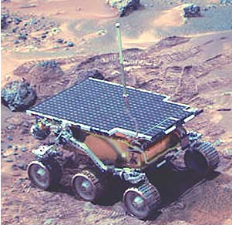
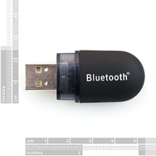
Concept Generation
An initial design, overall design idea was proposed, then brainstorming for each subsystem
Assigned specific qualities desired for final platform, then evaluated
Excavation
Power
Sensors
Locomotion
Communications
Zigbee
Bluetooth
WiFi
Figure 6. Top 3 concepts for each subsystem

Slide 8
Concept Selection
 |  | Concepts
 |  | Tracks |  | 4 Wheels |  | 6 Wheels |  | C-Legs |  | iSprawl Legs |  | Worm
Specifications | Importance Weight | Rating | Weighted Score | Rating | Weighted Score | Rating | Weighted Score | Rating | Weighted Score | Rating | Weighted Score | Rating | Weighted Score
Traction | 20.00% | 5 | 1 | 2 | 0.4 | 3 | 0.6 | 0 | 0 | 1 | 0.2 | 4 | 0.8
Stability | 10.00% | 5 | 0.5 | 3 | 0.3 | 4 | 0.4 | 1 | 0.1 | 2 | 0.2 | 0 | 0
Maneuverability | 15.00% | 4 | 0.6 | 3 | 0.45 | 2 | 0.3 | 1 | 0.15 | 5 | 0.75 | 0 | 0
Speed | 15.00% | 2 | 0.3 | 4 | 0.6 | 3 | 0.45 | 1 | 0.15 | 5 | 0.75 | 0 | 0
Power | 10.00% | 5 | 0.5 | 3 | 0.3 | 4 | 0.4 | 2 | 0.2 | 1 | 0.1 | 0 | 0
Cost | 10.00% | 3 | 0.3 | 5 | 0.5 | 4 | 0.4 | 2 | 0.2 | 1 | 0.1 | 0 | 0
Simplicity | 10.00% | 2 | 0.2 | 5 | 0.5 | 4 | 0.4 | 3 | 0.3 | 1 | 0.1 | 0 | 0
Low Maitenance | 5.00% | 2 | 0.1 | 4 | 0.2 | 3 | 0.15 | 5 | 0.25 | 1 | 0.05 | 0 | 0
Dust Resistance | 5.00% | 2 | 0.1 | 4 | 0.2 | 3 | 0.15 | 5 | 0.25 | 1 | 0.05 | 0 | 0
 | Score |  | 3.6 |  | 3.45 |  | 3.25 |  | 1.6 |  | 2.3 |  | 0.8
 | Selection | 1st |  | 2nd |  | 3rd |  | - |  | - |  | -
Table 2. Example Concept Selection Matrix for the Locomotion Subsystem
Note: House of Quality primarily used for weighting, comparison, and selection

Slide 9
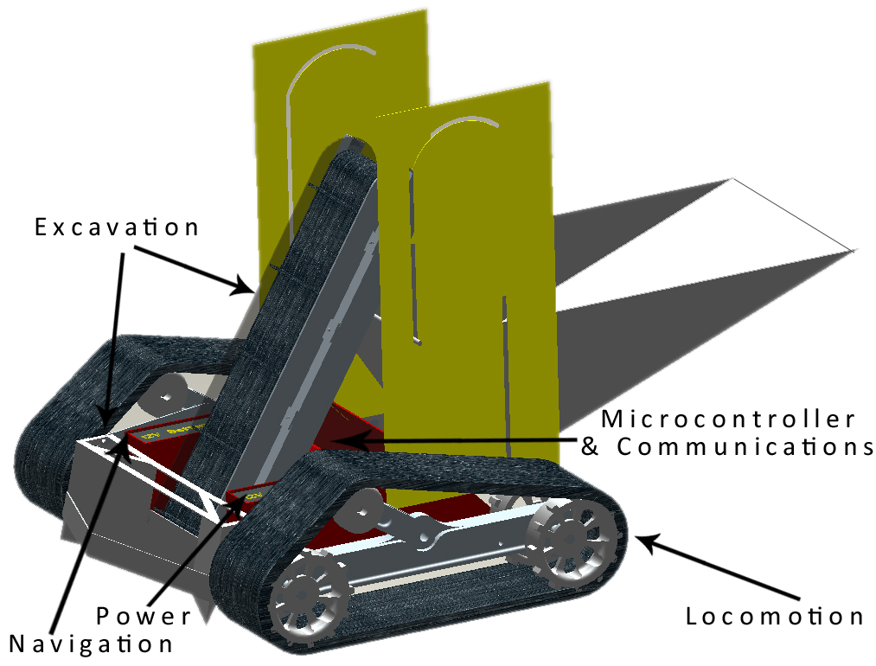
System Overview
Figure 7. Overall platform design with subsystems

Slide 10
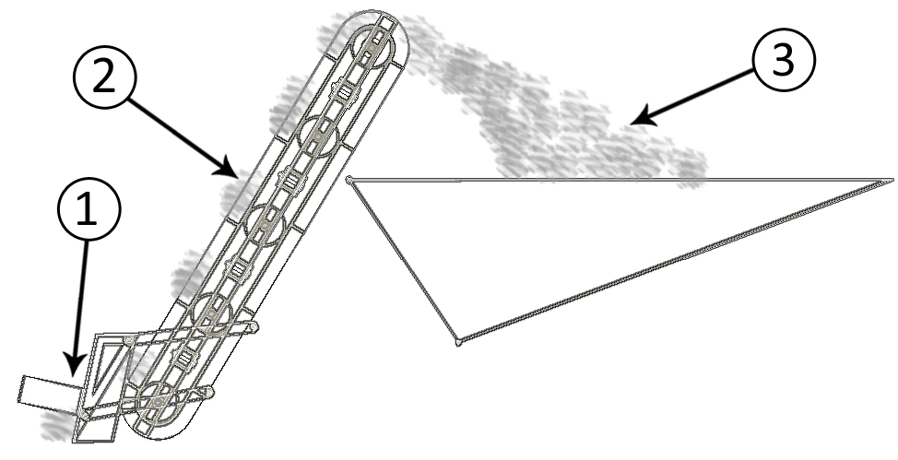
Excavation Subsystem Design
Excavation Subsystem Components:
Plow – piles regolith onto conveyor belt
Conveyor Belt – transports regolith for deposit in bucket
Bucket – holds regolith until delivery to holding bin
Figure 8. Excavation subsystem components and flow of regolith

Slide 11
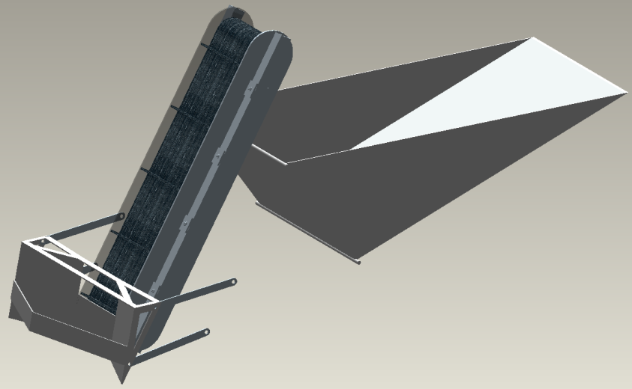
Excavation Subsystem Design
Integrated regolith channeling and rock deflection
Coupled to conveyor for maximum efficiency
Linearly actuated engagement
Constrained angle using parallel 4-bar
Figure 9. Side view of plow (top) and integration of plow (bottom)
Figure 10. Top view of plow design

Slide 12
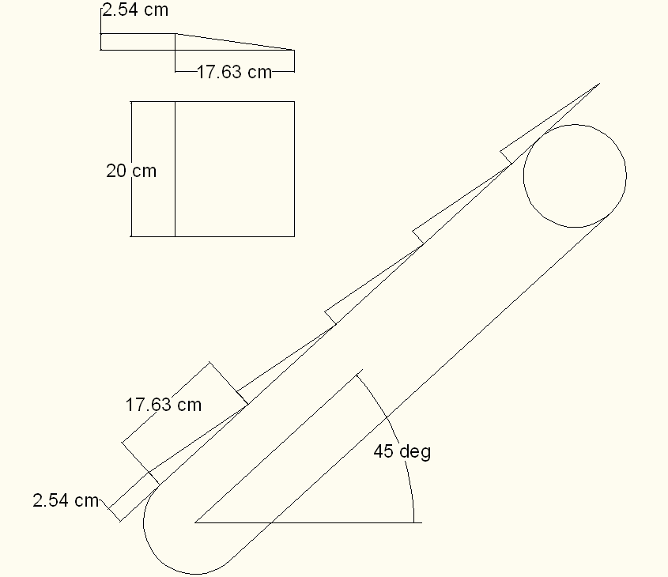
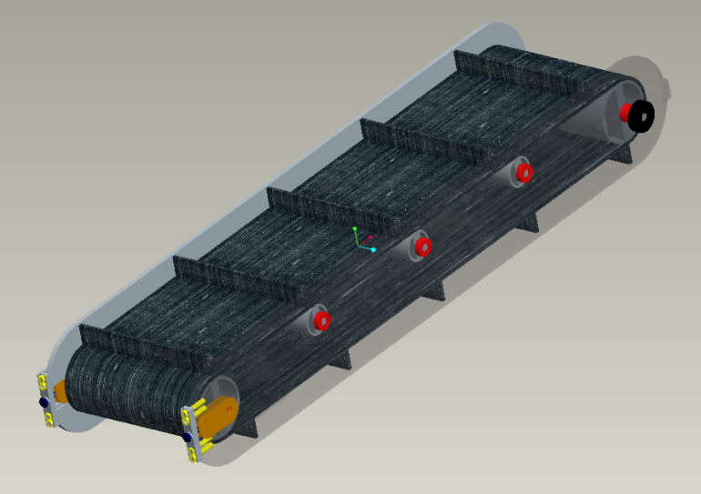
Paddle belt Conveyor
Design Analysis
Assumptions and Constants
Inclination angle of 45 degrees
Uniform load distribution
Belt velocity of 1 m/s
Maximum regolith density of 1.91 g/cm³
Each scoop excavates a volume of 448 cm³
Belt coefficient of friction of 0.3
Bearing coefficient of friction of 0.0015
Results
Angular velocity of 26.2 rad/s
Angular acceleration of 13.1 rad /s²
Max load of 4.28 kg
Required motor torque of 1.59 N*m
Total mass of 8.4 kg
Total mass of conveyor and load of 12.68 kg
Figure 11. Design drawing of conveyor belt and isometric view of final design
Notes:
12

Slide 13
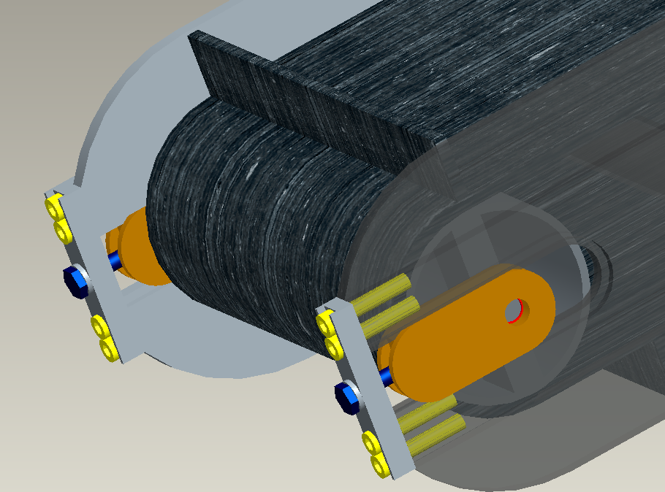
Paddle belt Conveyor
Tensioning Mechanism
One mechanism per side
One DOF prismatic joint
Integrated bearing housing
Single bolt adjustment
Clockwise rotation
Increase belt tension
Counter-clockwise rotation
Decrease belt tension
Figure 12. Tensioning mechanism on conveyor belt
Notes:
13

Slide 14
Excavation Subsystem Design
Density of Regolith – 1.5 g/cm³
Desired capacity – 100 kg
Required Volume – 0.066 m³
Our Bucket
Capacity 0.075 m³
Height 0.3 m
Length 1.0 m
Width 0.5 m
Material Al 6061
Weight 9 kgs
Figure 13. Isometric view of bucket design
Figure 14. Example of bucket dumping from side view

Slide 15
Locomotion Subsystem Design
Center Frame with torsion arm for tension
k=150 (Nm/deg)
Motor housed in main body with drive shaft to rear sprockets
Total mass of each track ~12 kg with tread
Figure 15. Isometric view of track frame

Slide 16
Locomotion Subsystem Design
Chain Assembly
Variation of a bike chain
15 cm tread surface at center
Individually adjustable connector links
Pin Joint allows large circular deformations
Figure 16. Isometric view of driving sprocket with example of treads

Slide 17
Power Subsystem Design
Figure 17. Power subsystem schematic
Table 3. ARTEMIS Power System Specifications

Slide 18
Power Subsystem Simulation
Figure 18. Schematic of power system simulation (top) and results (bottom)

Slide 19
Power Subsystem Overview
PHASE 1: Plow Engage
PHASE 2: Regolith Collection
PHASE 3: Regolith Deposit into Collector
Table 4. Device operation according to sequence
Table 5. Maximum device specifications in accordance to phase and 15A draw limit

Slide 20
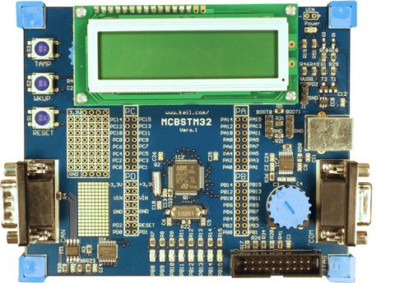
Microcontroller
8 bit AVR vs 32 bit ARM vs Single-board Computer
AVR- slower, tons of support, very easy to program, 5V I/O
ARM- faster, more complicated, 3.3V I/O
Single-board- expensive, complete overkill
Chose MCBSTM32, an ARM Cortex M3 board from Keil
32 bit 72MHz
2 SPI, 2 I2C, 3 UART, 16 ADC
48 General I/O
Free, Donated by ARM
Figure 19. Example of ARM Microcontroller

Slide 21
Telerobotic Interface
Remote operation of robot
At minimum: Start and stop
Network provided which adds two second delay
Playing Field
WAN
2s delay
1Mbps Bandwidth
Control Room
Robot
Relay
Computer
Control
Computer
Figure 20. Diagram of communications during competition
Link Robot to WAN Wirelessly
WiFi- 58Mbps, Complicated, High Power, Most Expensive
Xbee- 0.25Mbps, Simple, Medium Power, Cheapest
Bluetooth- 1Mbps, Medium Complexity, Low Power,Medium Cost

Slide 22
Interfacing Diagram
Bluetooth Modem
BlueSMiRF
3.3V
Receiving Laptop
Relay to WAN
Telerobotic Interface
Figure 21. All Inputs/Outputs
to microcontroller
Serial
115200bps
2
3x Brushed Motor Drivers
H-Bridge
Conveyor & Actuators
2 Outputs Each
Forward,Reverse,Brake,Free
Digital
Output
20
Microcontroller
2x Brushless Motor Drivers
Drive Motors
7 Outputs Each
6 Commutation,1 PWM Speed
Inertial Navigation Unit
3 Axis Accelerometer
2 Axis Gyroscope
3.3V
Digital
Input
8
Analog
Input
10
Rangefinder
Sonar or IR
3.3V
2x Brushless Motor Feedback
3xHall Effect Sensors
5.0V
Analog
Amplifier
2x Bump Sensors
5.0V
Weight Sensor
Digital Scale Load Cell
5.0V
2x IR Beacon Detector
Phototransistor circuit
3.3V
Current Sensor
15A sensor
3.3V

Slide 23
Navigation Subsystem Design
From start, proceed on random or preset course
Once out of starting square, start digging
When bin is full, move to center of area and face collector
Move towards collector using beacons for alignment
When at wall of collector, dump regolith
Reset inertial navigation and repeat
Robot
B
B
Collector
Figure 22. Diagram of Competition setup

Slide 24
Navigation Sensors Diagram
Power Supply
Sensors
Microcontroller
Inertial Navigation Sensor
IR Beacons
Sharp IR Range Sensor
Current Sensor
Bump Sensor
Weight Sensor
Figure 23. Navigation Sensor flow chart

Slide 25
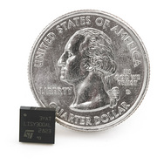
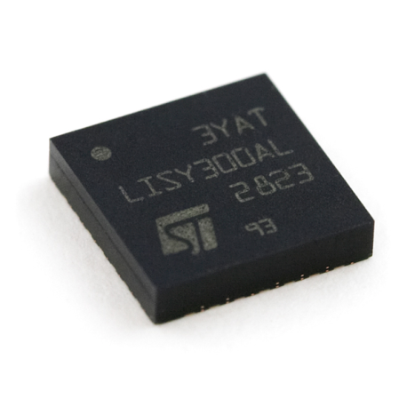
Sensors
Velocity v_{t}
Navigational Sensors
Inertial Measurement Unit (IMU)
IR Beacon Sensor
IR Sharp Sensor
Current Sensor
Pressure Sensor
Bumper Sensor
Weight Sensor
MCU
ω_{ib}
Gyro’s
Altitude R_{c}
F^{b}
Depth z
Accelerometer
Figure 24. Three axis inertial navigation sensor
Figure 25. Single gyroscope

Slide 26
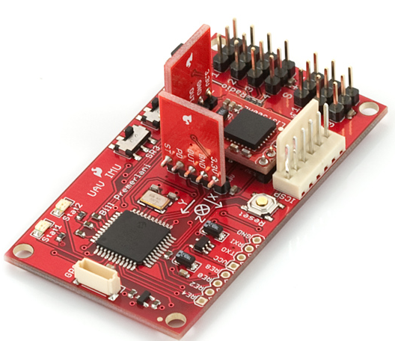
Inertial Measurement Unit
Inertial Navigation Sensors
Accelerometer and gyroscope provide position and direction sensing independent of the robots environment
Accelerometers measure acceleration in X, Y, and Z axis
Gyroscopes measure pitch, yaw, and roll
Figure 26. Three axis inertial navigation sensor

Slide 27
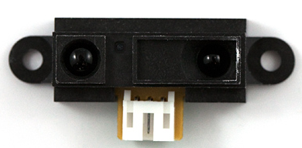
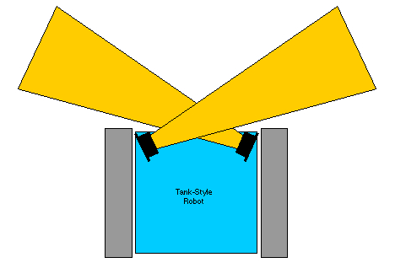
IR Sharp Sensor
Figure 28. IR Sharp Sensor
Figure 27. Configuration of IR Sharp sensors on platform
Figure 29. Analog output voltage vs. distance to reflective object

Slide 28
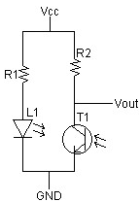
IR Beacon and Sensor
IR Emitter Circuit
Tank-style Robot

Slide 29
Current Sensor
Used for sensing the amount of current being used
Measure current to prevent blow out of 15 A fuse
Must be in series with the circuit
Figure 30. Current Sensor

Slide 30
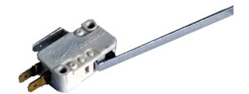
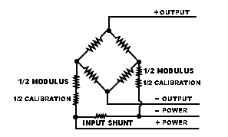
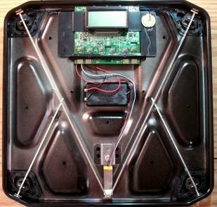
Bumper and Weight Sensor
Tactile Bump Sensor Circuits
Figure 31a. Bump Sensor
Figure 31. Bump Sensor Circuit
Figure 32. Weight Sensor Circuit
Figure 32a. Weight sensor in situ

Slide 31
Cost Analysis of System
The Artemis Project Budget Breakdown
 | Part Description | QTY | Price | Total
Excavation |  |  |  | $1,409.97
 | Aluminum Plate, 1/8"x12"x24" | 4 | $22.84 | $91.36
 | Aluminum Rod, 3/16"x72" | 1 | $2.61 | $2.61
 | Linear Actuator, Plow | 1 | $512.00 | $512.00
 | Linear Actuator, Bucket | 1 | $804.00 | $804.00
Locomotion |  |  |  | $1,384.85
 | Aluminum Block, 8"x8"12" | 1 | $435.40 | $435.40
 | Aluminum Rectangular Tube, 2"x4"x72" | 3 | $54.43 | $163.29
 | Aluminum Rod, 1"x60" | 1 | $20.92 | $20.92
 | Aluminum Rod, 1/2"x72" | 4 | $6.22 | $24.88
 | Bearings, 1" | 8 | $12.23 | $97.84
 | Rubber Sheet, 1-1/2"x24"x6' | 2 | $71.10 | $142.20
 | Maxon Brushless DC Motor, EC 16 15 W | 2 | $196.70 | $393.40
 | Roller, 40mmx50mm | 2 | $31.90 | $63.80
 | Brass Flat plate, 3/32"x3/4"x72" | 2 | $21.56 | $43.12
Power |  |  |  | $229.85
 | Switching Regulator | 2 | $12.00 | $24.00
 | Lead Acid Batteries | 3 | $51.95 | $155.85
 | Accessories (Wires, Fuses, etc) | 1 | $50.00 | $50.00
Microcontroller and Communications |  |  |  | $110.00
 | ARM Microcontroller* | 1 | $0.00 | $0.00
 | Accessories (Wires, Breadboard, etc.) | 1 | $75.00 | $75.00
 | Bluetooth Adapters | 1 | $35.00 | $35.00
Navigation |  |  |  | $242.80
 | IR Sharp Sensor | 1 | $9.95 | $9.95
 | IR Beacon Detector | 1 | $14.95 | $14.95
 | IR LEDs (850 nm 100pcs) | 100 | $0.07 | $7.00
 | IR LEDs (940 nm 100 pcs) | 100 | $0.06 | $6.00
 | IMU | 1 | $149.95 | $149.95
 | Gyroscope | 1 | $11.95 | $11.95
 | Bumper Sensor | 2 | $1.50 | $3.00
 | Weight Sensor | 1 | $40.00 | $40.00
Total Cost of System |  |  |  | $3,677.47
 | Miscellaneous Costs (Shipping, etc) | 1 |  | $300

Slide 32
Conclusions
Plow excavation unit with conveyor belt for regolith transport
Tracks on either side used for locomotion
Lead-acid batteries for power integrated in regulator circuits for components
ARM Microcontroller for control
Various sensors for navigation and obstacle avoidance
Figure 33. Final ARTEMIS Design

Slide 33
Questions and Comments
The ARTEMIS Project

