Slide 1
The ARTEMIS Project
Lunar Regolith Excavator Student Competition
ME Team #8 / ECE Team #1
James Dickson | Jeremy Nagorka
Anthony Gantt | Jennifer Schrage
Christopher Loftis | Nick Stroupe
Alan Williams

Slide 2
Outline
The Lunabotics Competition
System Overview
Test Bed construction
Excavation Subsystem Design
Locomotion Subsystem Design
Power Subsystem Design
Microcontroller and Communications Design
Budget
Schedule

Slide 3
The Lunabotics Mining Competition
Lunabotics Mining Competition
Designed to engage and retain students in STEM disciplines
Provide a competitive environment in which may result innovative ideas and solutions that could be applied to actual lunar excavation
Max Weight | 80 kg
Min Excavation Material | 10 kg
Max width | 1.5 m
Max length | 0.75 m
Max height | 2 m
Max setup time | 10 minutes
Operation time | 15 minutes
Max take down time | 5 minutes
Figure 1. Artist’s rendering of lunar excavation, taken from Lunabotics Mining Competition announcement
Table 1. Competition Specifications

Slide 4
Needs Analysis Flow Diagram
Requirements
Telerobotic
Minimum excavation is 10.0 kg
Interfaces – Internal & External
Track
Conveyor Belt
Elements
Hardware mass limit is 80 kg
Locomotion
Power System
Sensors
Excavation
No
Power Restraint
System
Microcontroller
Cowcatcher
Power System
Motors
Linear Actuator
Communication
Collector Bin
User Interface
Control
LEGEND
Physical
FAMU/FSU COE
NASA
Dr. Jonathan Clark
Requirement / Regulation / Other
Contributors / Other Aspects
Figure 2. Needs analysis flow diagram for ARTEMIS Project

Slide 5
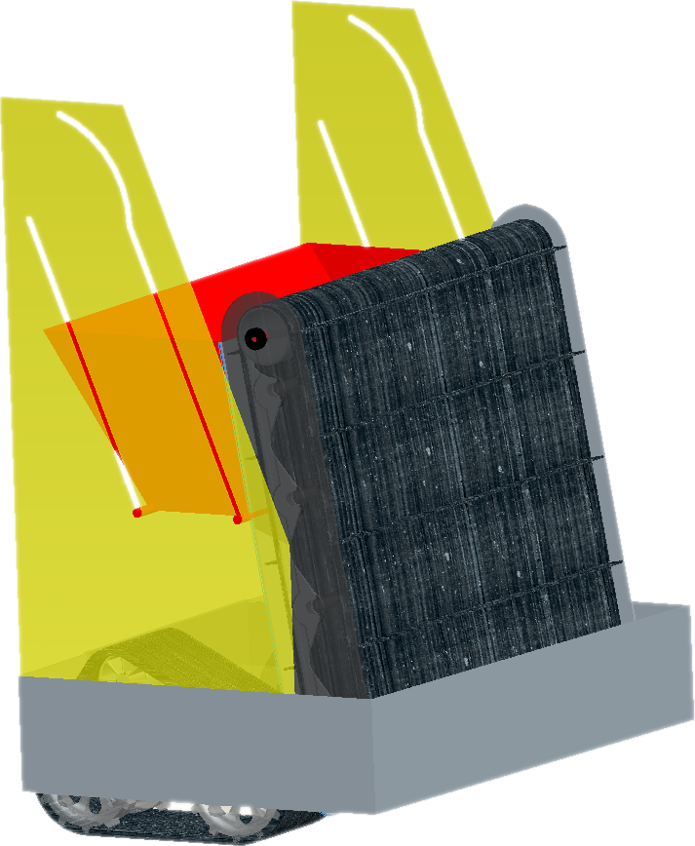
Robotic Platform Design
Figure 3. Robot design schematic

Slide 6
Circuit Block Diagram
Power Supply
Motors
Microcontroller
Movement of Robot
Conveyor Belt
Communications
2 Brushed Motors
1 Linear Actuator
Operator Input
Brushed Motor
Sensors
Tracks
Collection Bin Lift
3-Axis Accelerometer
Current Sensor
Weight Sensor
Camera
Bump Sensor
Figure 4. Circuit block diagram

Slide 7
System Breakdown
ARTEMIS Robot
Excavation
Excavation Tools
Material Transport
Locomotion
Power Transmission
Power
Microcontroller and Communications
Control
Obstacle Avoidance
Traction
Power Regulation
Power storage
Signal receivers/ Transmitter
Signal Processing
Stability
Program
User Interface
Information Relay
Directional Inputs
Figure 5. System breakdown structure
Notes:
1) System 2) Subsystems 3) Components followed by 4) subcomponents and 5) parts

Slide 8
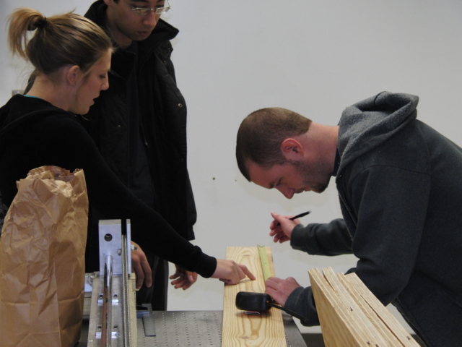
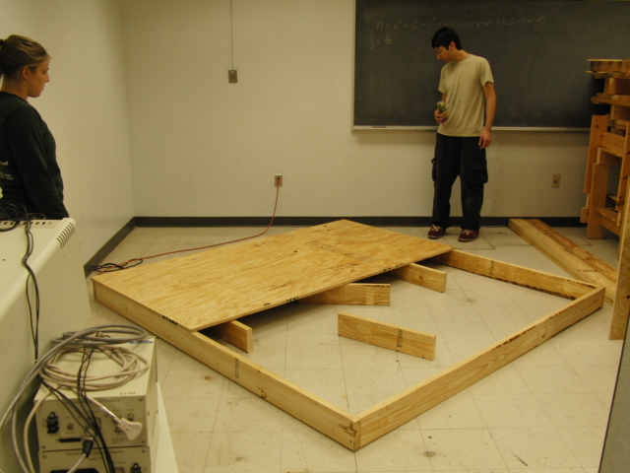
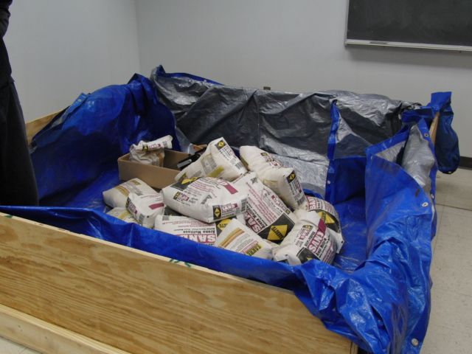
Building the Testing Bed
Figure 6. Construction of test bed

Slide 9
Completed Test Bed
Figure 7. Completed Test Bed

Slide 10
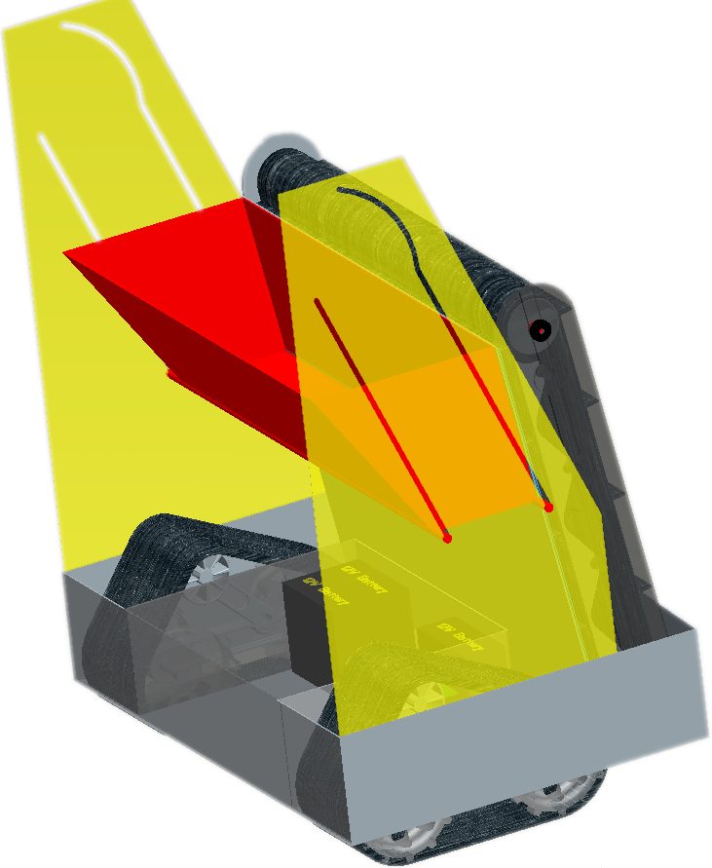
System Overview
Excavation
Power
Communications
Locomotion
Figure 8. Overall platform design with subsystems

Slide 11
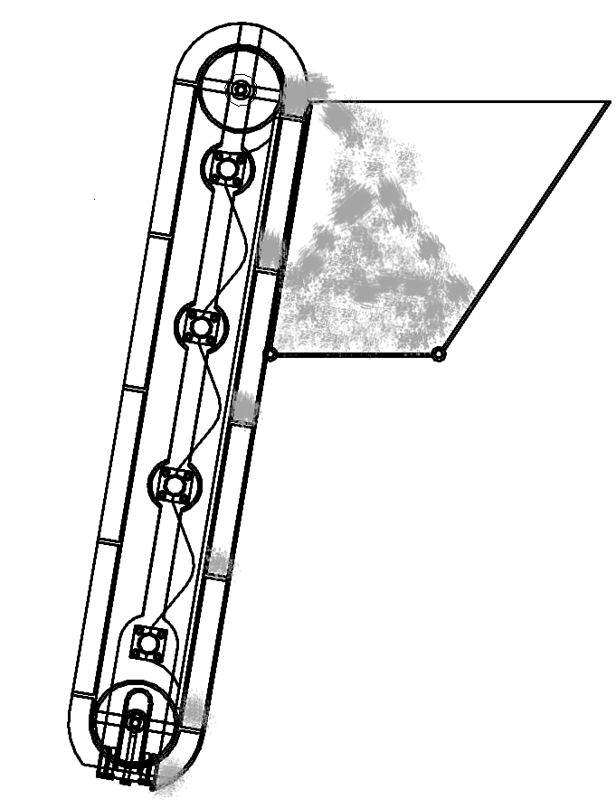
Excavation Subsystem Design
Excavation Subsystem Components:
Cleated belt – cleats excavate regolith into trough
Conveyor – transports regolith up trough to be deposited into bucket
Bucket – holds regolith until delivery to holding bin
3
2
1
Figure 9. Excavation subsystem components and flow of regolith

Slide 12
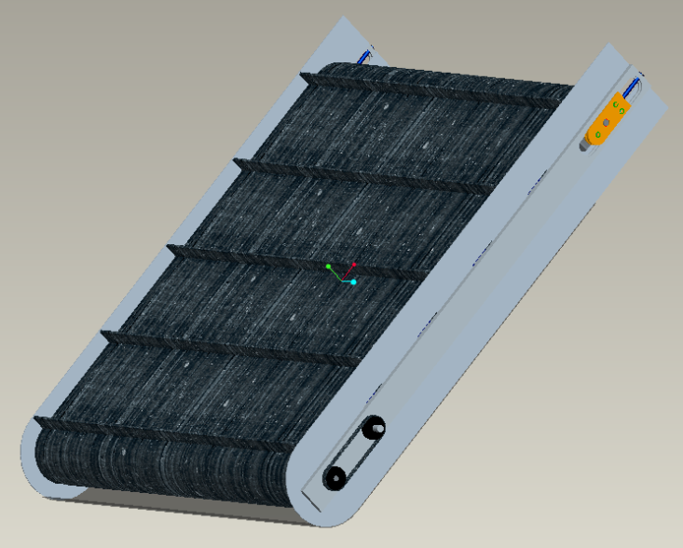
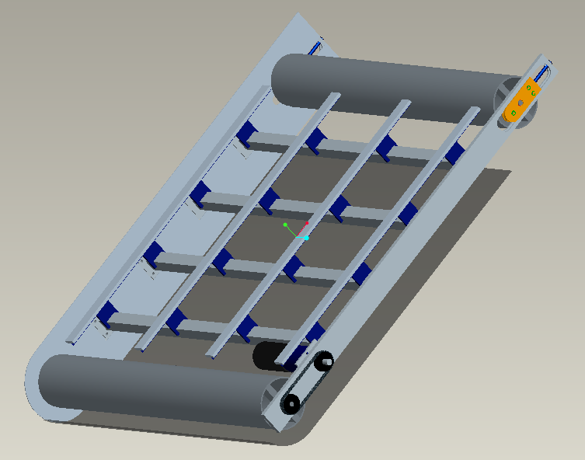
EXCAVATION
CLEATED CONVEYOR REVISION
Overall width reduced
from 94 to 81 cm
Weight savings through use of thinner material
Easier machining
Estimated excavation rate of
0.5 kg/s
Figure 10. Conveyor Isometric View
Figure 11. Conveyor Isometric view with Belt and right shield removed
12
Notes:
12

Slide 13
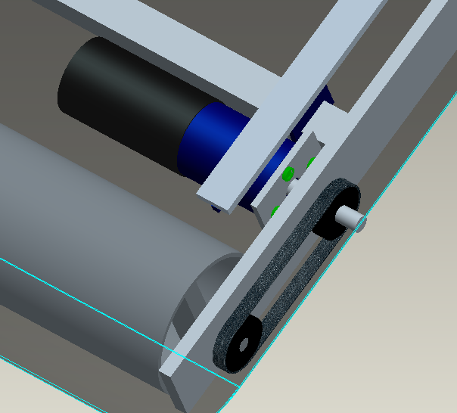
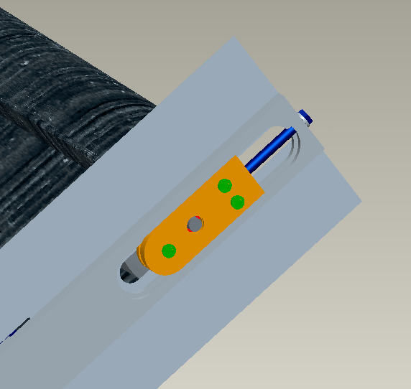
EXCAVATION
CLEATED CONVEYOR REVISION
Motor assembly mounted on the inside of the frame
Belt drive coupling between motor shaft and driven roller
Two piece belt tensioning mechanism
Two bolt tension adjustment
Figure 12. Detail View of Motor
Mounting and Belt Drive
Figure 13. Conveyor Belt Tensioning
Mechanism
13
Notes:
13

Slide 14
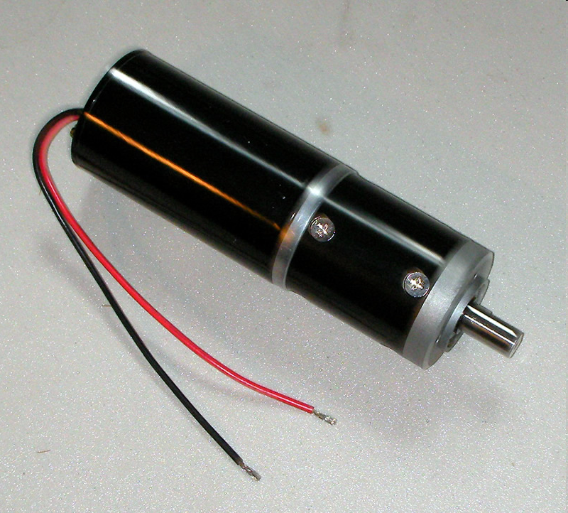
EXCAVATION
CONVEYOR MOTOR
24 Volt DC motor with 12:1 gear
reduction drive
Motor Ratings:
285 RPM
Current rating of 2850 mA
Torque rating of 1.1 Nm
Stall torque of 29 Nm
Weight
1.58 kg
Figure 14. High Torque 24V Electric Motor with 12:1 Gear Reduction
14
Notes:
14

Slide 15
EXCAVATION
WHATS NEXT?
Source cleated conveyor belt
Fabricate frame and rollers
Purchase sealed bearings
Purchase gears and belt drive
Test
15
Notes:
15

Slide 16
Bucket Design
Density of Regolith - 1.5 g/cm³
Desired Capacity - 100 kg
Required Volume - 0.066 m³
Time to Reach Desired Capacity - 200 s
Our Bucket
Volume - 0.0675 m³
Material AL 6061
4.23 kg
Figure 16. Isometric view of bucket design
Figure 17. Example of bucket dumping from side view

Slide 17
Locomotion Subsystem
Track Specifications:
10 kg weight / track
70.5 x 16 x 20.4 cm
24 V / 30 A motor
4:1 Primary gear reduction with a 1.5:1 gear reduction at chain
Initial design ~13 kg at a cost of $1654.00 per track. Sponsorship by E.M.T. Robotics placed final tracks at cost of $638.00 and weight of 10 kg.
Figure 18. Track design

Slide 18
Locomotion Subsystem
Figure 19. Tracks run at 9 V and 6.0 A for example test runs

Slide 19
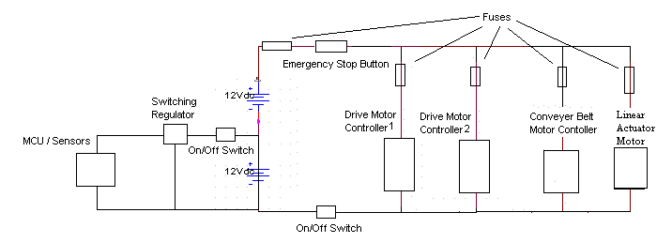
System Power Circuit
Figure 20. System Power circuit including fuses, motors, and power supplies

Slide 20
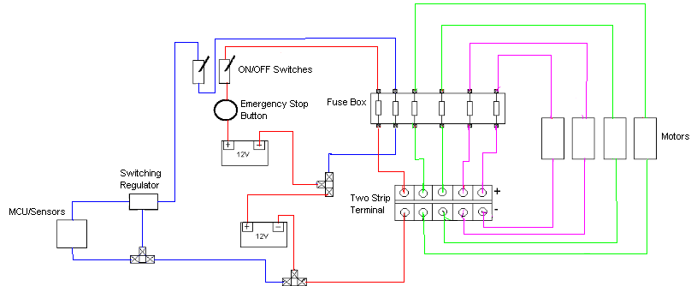
Wiring Diagram
Figure 21. Wiring diagram for ARTEMIS
Red – 10AWG
Green – 16 AWG
Purple – 18 AWG
Blue – 28 AWG
Notes:
20

Slide 21
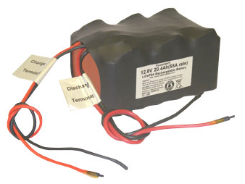
Battery Type
LiFeP04
“Lithium Iron Phosphate”
- 12V
- 55A Maximum Discharge Rate
- 19.8 Ah
- Weight: 2.45 Kg each
- Cost: $289.00 each
Figure 22. Example of a LiFeP04 battery

Slide 22
Next Steps
- Test batteries upon arrival.
- Test and verify current draw of motors.
- Purchase remaining electrical components (wires, switches, fuses, terminals) from local electronics store.
- Assemble and continue testing.

Slide 23
Telerobotic Interface
Network provided has no extra delay
Control robot directly with remote commands, non-autonomous
Playing Field
Control Room
WAN
no delay
5Mbps Bandwidth
Robot
Wi-Fi
module
Control
Computer
Figure 23. Diagram of communications during competition
Link Robot to WAN Wirelessly
WiFi access point to WAN provided
Using Wifly serial to WiFi module on robot
So far the whole link is setup in lab
All but Wifly setup and working

Slide 24
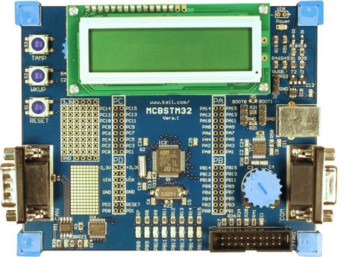
Microcontroller Side
Programming tasks required for microcontroller
Read in data from sensors
Send gathered data through comm link
Receive commands through comm link
Drive motors from commands
Interpret sensor inputs into
useful data
Limited autonomy
Figure 24. ARM Microcontroller

Slide 25
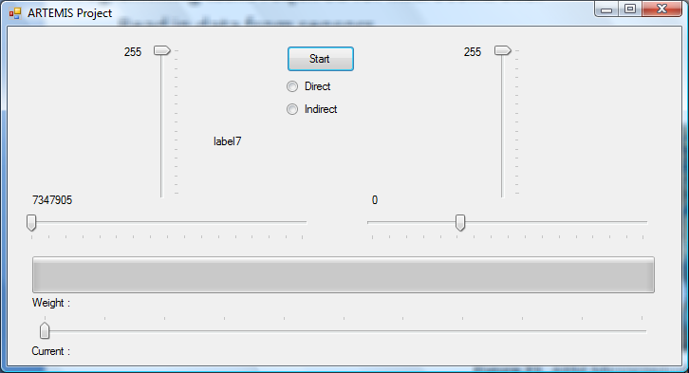
Control Computer Side
Programming tasks required for control computer
Read in and interpret input from a joystick – PS2 controller
Send commands over comm link
Receive and display data from comm link
User interface so far

Slide 26
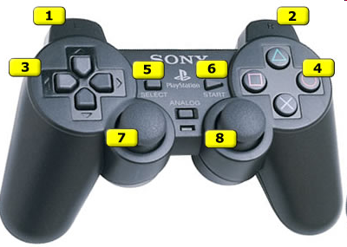
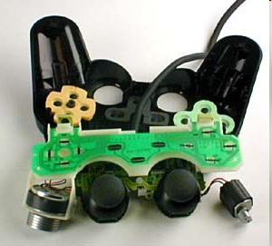
Controller
The standard PS2 controller has 15 buttons; all of them, except for start and select, which are analog. They include:
Four buttons arranged as a directional
pad on the top left
Analog, Start and Select buttons in the top middle
Four action buttons on the top right
Two action buttons on the front left
Two action buttons on the front right
One analog joystick on the top left
One analog joystick on the top right
Figure 25. Example of controller inputs
Figure 26. Internal circuitry of controller

Slide 27
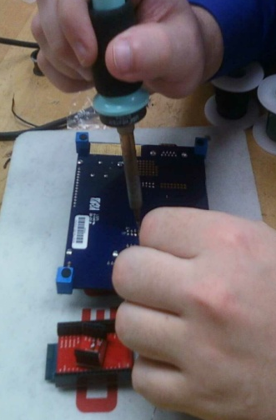
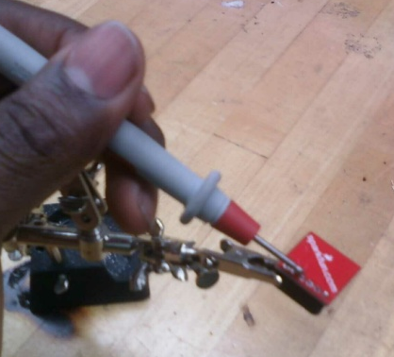
Sensors
Gyroscope
Accelerometer
Current Sensor
IR Sensor
Figure 27. Testing of sensors and microcontroller

Slide 28
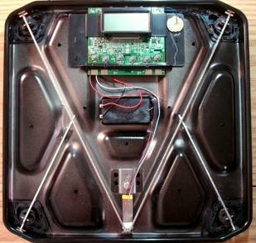
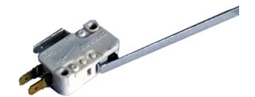
Sensors
Weight Sensor
Figure 28. Weight sensor and circuit
Bump Sensor
Figure 29. Bumper sensor

Slide 29
Cost Analysis of System

Slide 30
Lifecycle
Concept Development
Needs Analysis
Concept Exploration
Concept Definition
Engineering Development
Advanced Development
Engineering Design
Integration & Evaluation
Post Development
Production
Operation & Support

Slide 31
Projected Schedule
Assemble chassis and tracks together (completed by 3/1)
Assemble electrical components in chassis (completed by 3/5)
Assemble conveyor excavator and bucket (completed by 3/13)
Finish acquiring building materials, circuitry, motors, and batteries (3/5)
Re-design as needed

Slide 32
Conclusions
Figure 31. Final ARTEMIS Design

Slide 33
Acknowledgements

Slide 34
Questions and Comments
The ARTEMIS Project

Slide 35
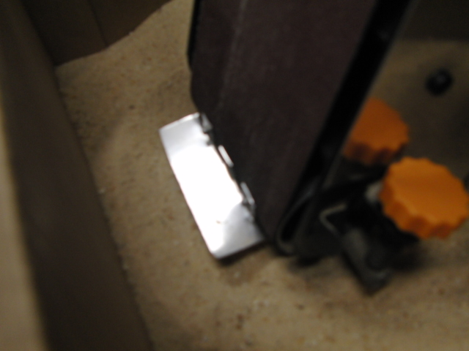
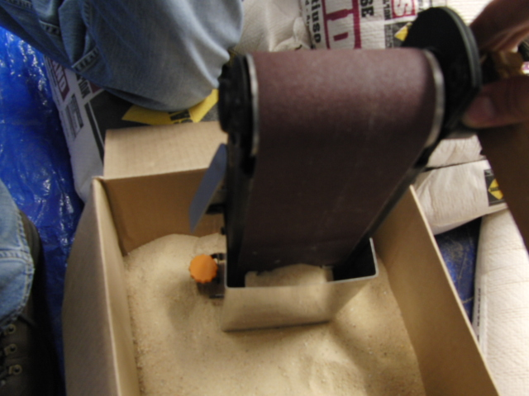
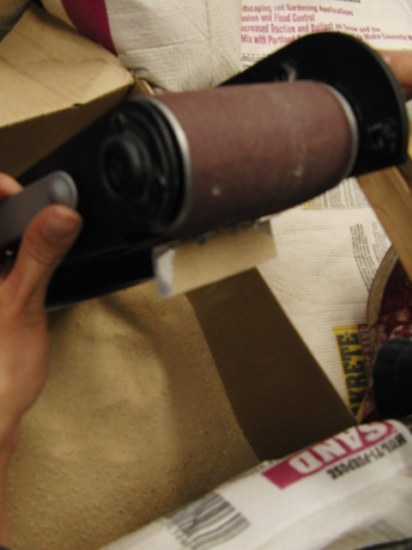
Prototyping Belt Design
Figure 32. Testing of the belt prototype design

