Slide 1

The ARTEMIS Project
Lunar Regolith Excavator Student Competition
ME Team #8 / ECE Team #1
James Dickson | Jeremy Nagorka
Anthony Gantt | Jennifer Schrage
Christopher Loftis | Nick Stroupe
Alan Williams
Notes:
h

Slide 2
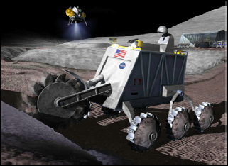
The Lunabotics Mining Competition
Lunabotics Mining Competition
  Designed to engage and retain students in STEM disciplines
  Provide a competitive environment in which may result innovative ideas and solutions that could be applied to actual lunar excavation
Max Weight | 80 kg
Min Excavation Material | 10 kg
Max width | 1.5 m
Max length | 0.75 m
Max height | 2 m
Max setup time | 10 minutes
Operation time | 15 minutes
Max take down time | 5 minutes
Figure 1. Artist’s rendering of lunar excavation, taken from Lunabotics Mining Competition announcement
Table 1. Competition Specifications

Slide 3
Needs Analysis Flow Diagram
Requirements
Telerobotic
Minimum excavation is 10.0 kg
Interfaces – Internal & External
Track
Conveyor Belt
Elements
Hardware mass limit is 80 kg
Locomotion
Power System
Sensors
Excavation
No
Power Restraint
System
Microcontroller
Cowcatcher
Power System
Motors
Linear Actuator
Communication
Collector Bin
User Interface
Control
LEGEND
Physical
FAMU/FSU COE
NASA
Dr. Jonathan Clark
Requirement / Regulation / Other
Contributors / Other Aspects
Figure 2. Needs analysis flow diagram for ARTEMIS Project

Slide 4
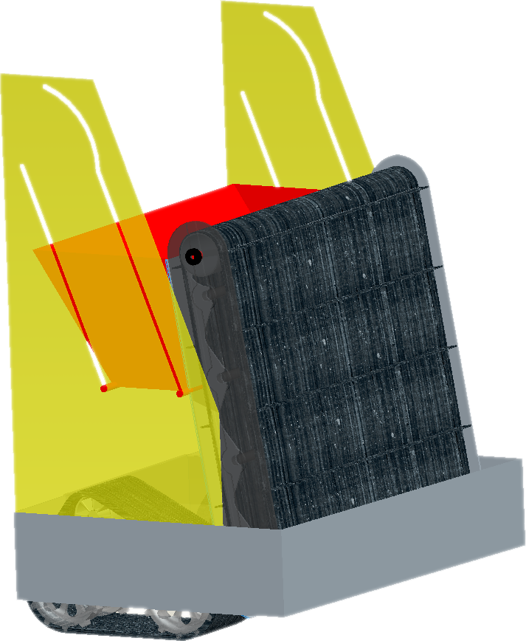
Robotic Platform Design
Figure 3. Robot design schematic

Slide 5
Circuit Block Diagram
Power Supply
Motors
Microcontroller
Movement of Robot
Conveyor Belt
Communications
2 Brushless Motors
1 Linear Actuator
Operator Input
Brushed Motor
Sensors
Tracks
Collection Bin Lift
3-Axis Accelerometer
Current Sensor
Weight Sensor
Camera
Bump Sensor
Figure 4. Circuit block diagram

Slide 6
System Breakdown
ARTEMIS Robot
Excavation
Excavation Tools
Material Transport
Locomotion
Power Transmission
Power
Microcontroller and Communications
Control
Obstacle Avoidance
Traction
Power Regulation
Power storage
Signal receivers/ Transmitter
Signal Processing
Stability
Program
User Interface
Information Relay
Directional Inputs
Figure 5. System breakdown structure
Notes:
1) System 2) Subsystems 3) Components followed by 4) subcomponents and 5) parts

Slide 7
Current Progress and Future Work
Build evaluation test bed (Sand Box)
Build prototypes of excavation and locomotion systems
Redesign prototyped systems as needed
Manufacture final design
Evaluate final design
Redesign necessary systems

Slide 8
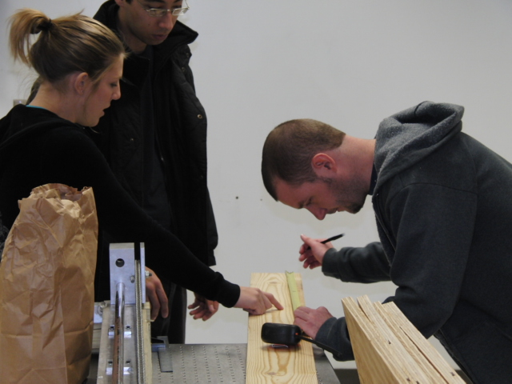
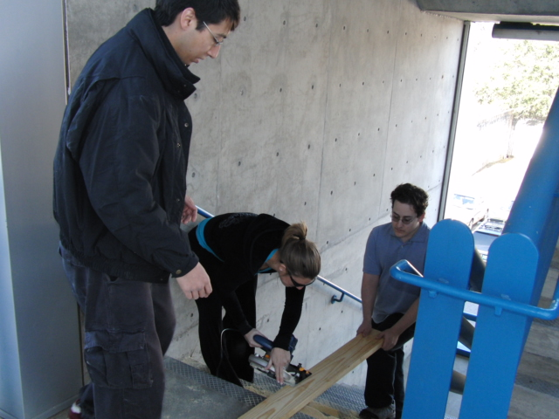
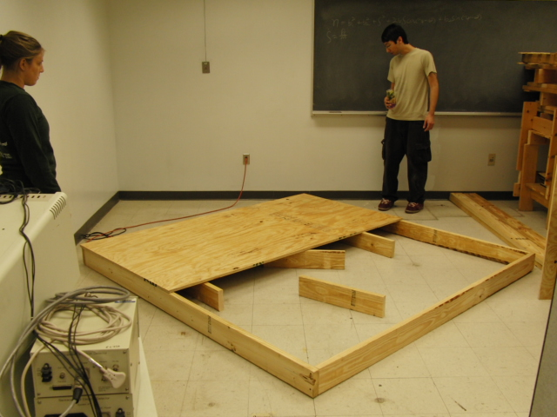
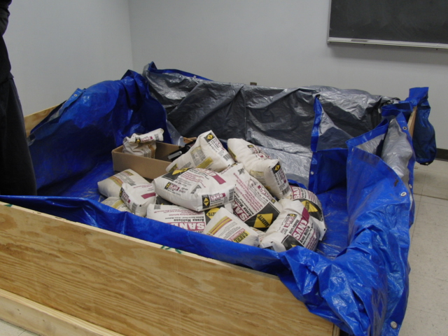
Building the Testing Bed

Slide 9
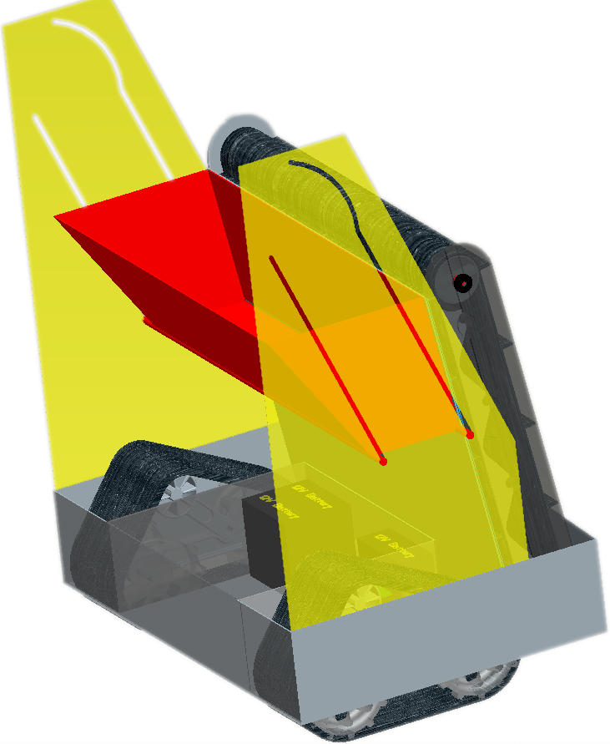
System Overview
Excavation
Power
Communications
Locomotion
Figure 7. Overall platform design with subsystems

Slide 10
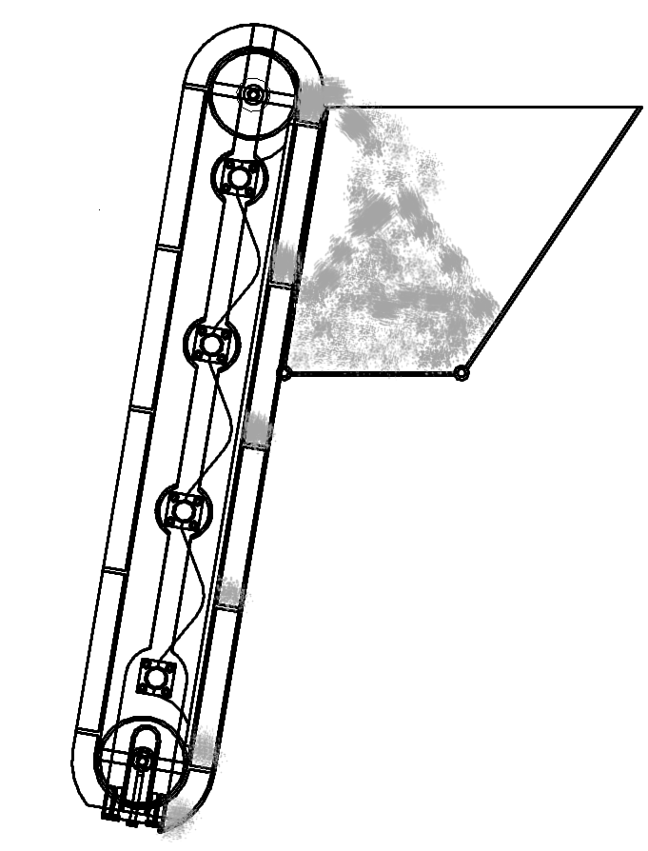
Excavation Subsystem Design
Excavation Subsystem Components:
  Cleated belt – cleats excavate regolith into trough
  Conveyor – transports regolith up trough to be deposited into bucket
  Bucket – holds regolith until delivery to holding bin
3
2
1
Figure 8. Excavation subsystem components and flow of regolith

Slide 11
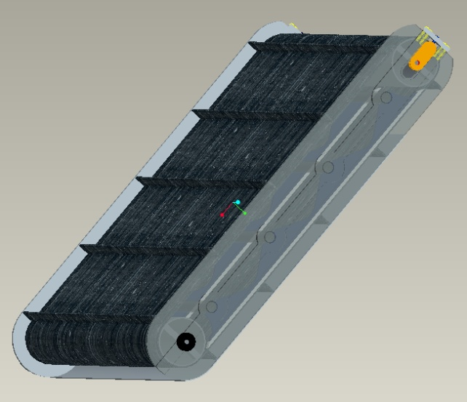
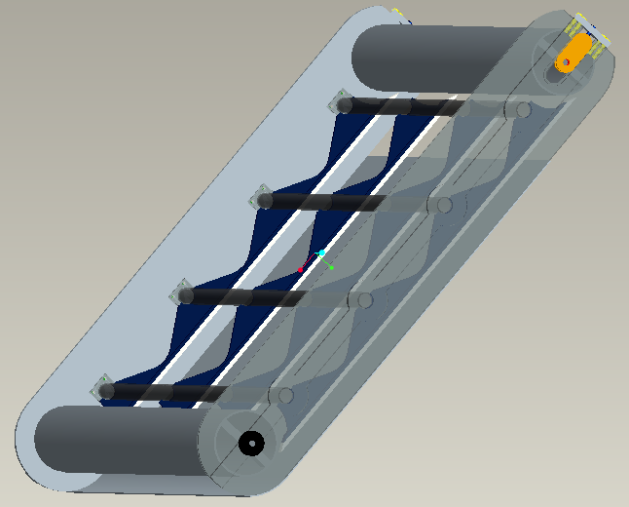
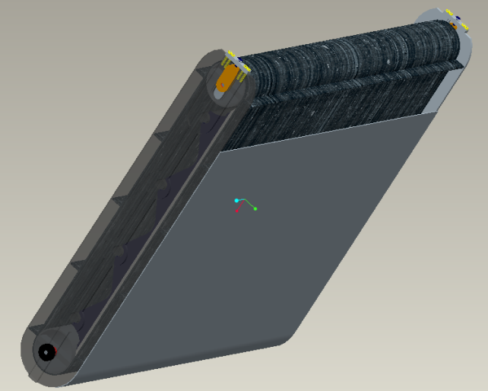
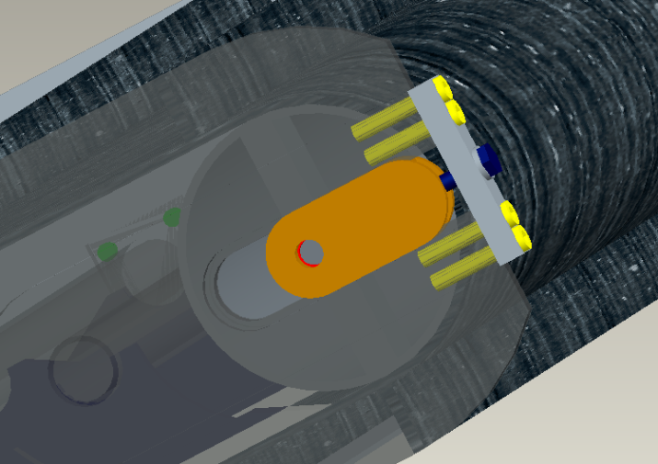
Excavation
  CLEATED CONVEYOR DESIGN
  Lightweight Aluminum Frame
  2 Aluminum Rollers
  90 cm Belt Width
  2.54 cm Cleat Height
  2 Single Bolt Belt Tensioning Mechanisms
  4 Delrin Sliders
  Aluminum Trough
  Spur Gear
Figure 9. Conveyor Isometric View
Figure 10. Conveyor Isometric
View Without Belt
Figure 11. Conveyor Bottom
Isometric View
Figure 12. Conveyor Belt Tensioning
Mechanism
11
Notes:
11

Slide 12
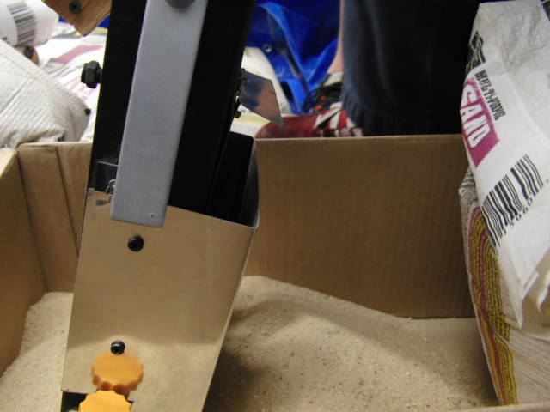
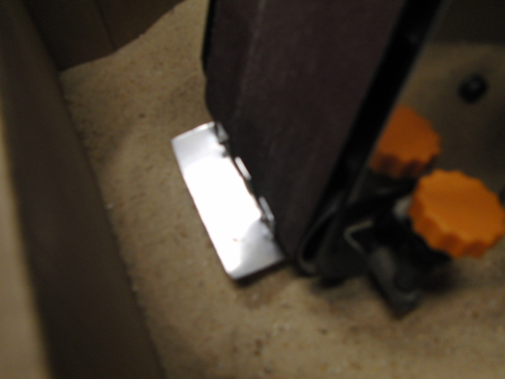
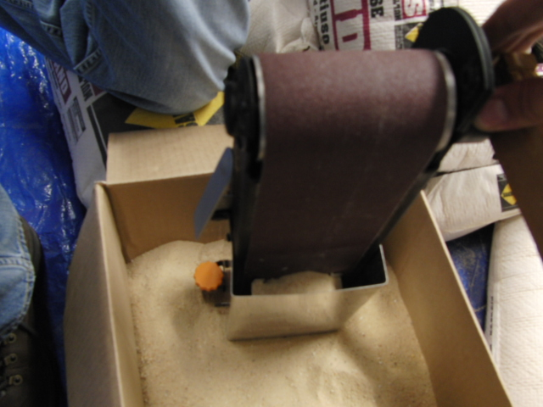
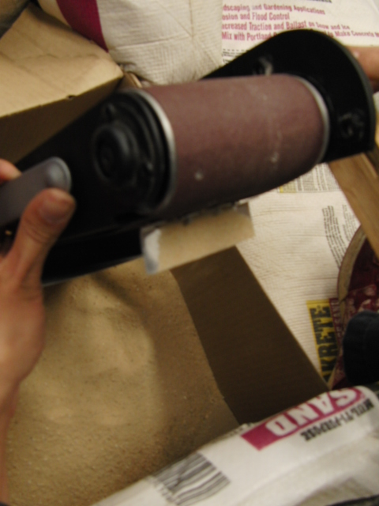
Prototyping Belt Design

Slide 13
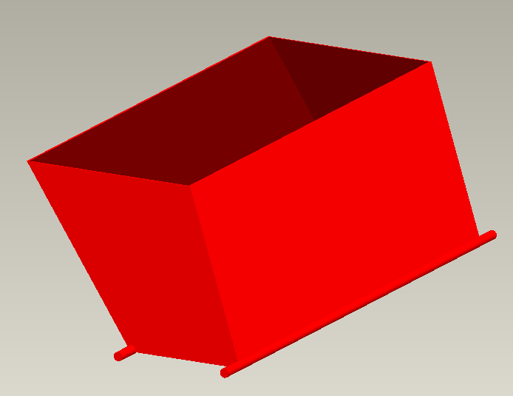
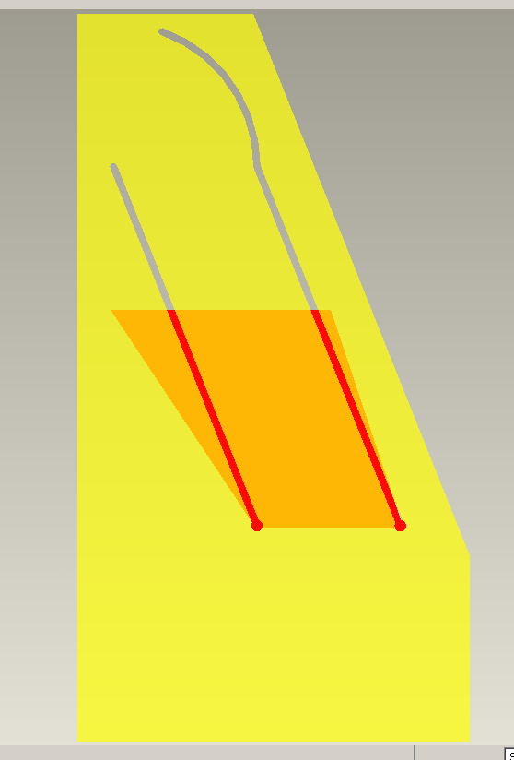
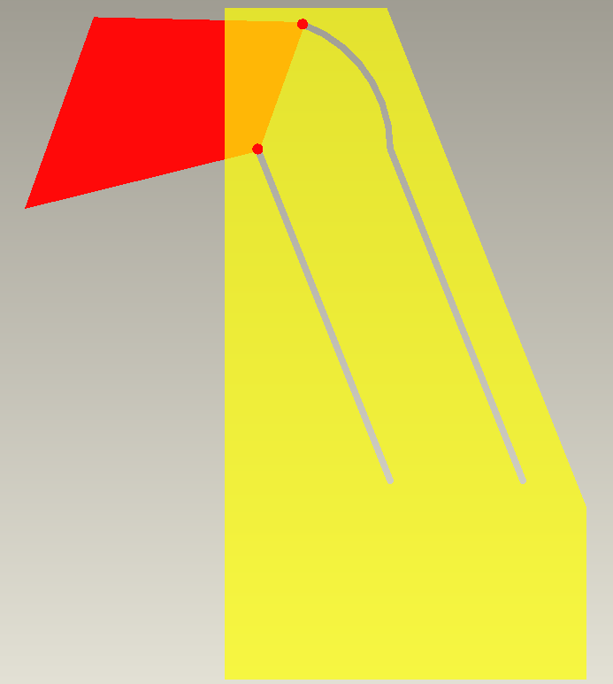
Bucket Design
Density of Regolith – 1.5 g/cm³
Desired capacity – 100 kg
Required Volume – 0.066 m³
Our Bucket
  Volume 0.0675 m³
  Height 0.3 m
  Length 0.4 m
  Width 0.9 m
  Material Al 6061
  Weight 8 kgs
Figure 13. Isometric view of bucket design
Figure 14. Example of bucket dumping from side view
13

Slide 14
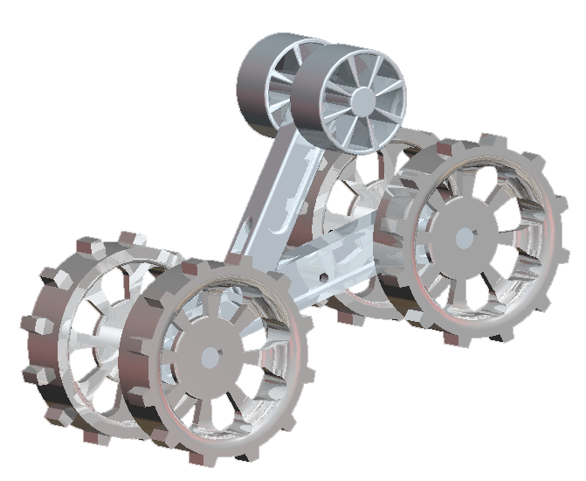
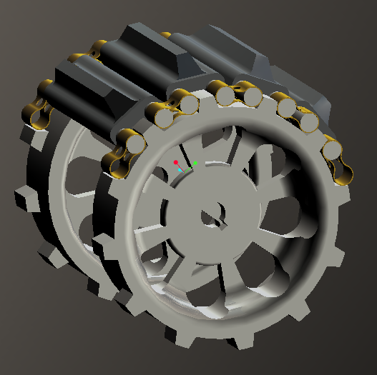
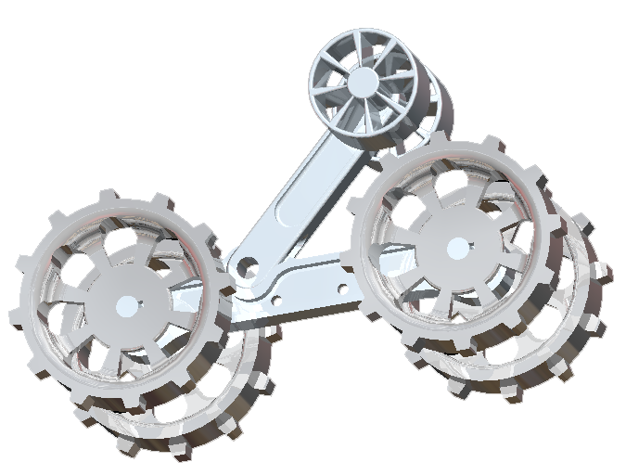
Locomotion Subsystem Design
Figure 16. Isometric view of driving sprocket with example of treads
Figure 15. Isometric view of track frame
Notes:
Torsion Spring tensioner, K=150 Nm/deg
Rear sprockets driven by independent 24 V motors housed in main body
Total mass of each track ~10 kg with tread
Reduction of mass through using lattice work frame

Slide 15
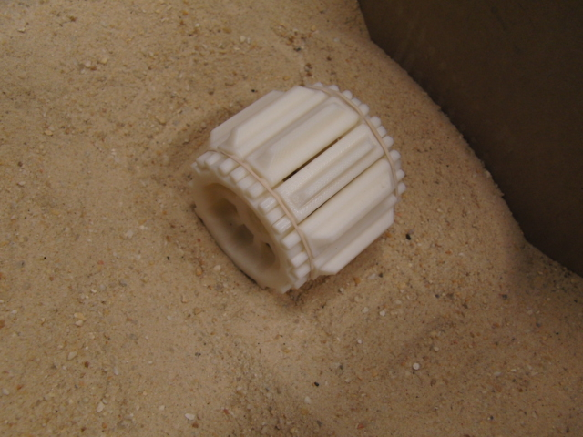
Prototyping Locomotion
Perceived Problems
  Manufacture of tread structures complicated and time consuming
Solutions
  Re-design tread system using hollow pin chains for tread assembly

Slide 16
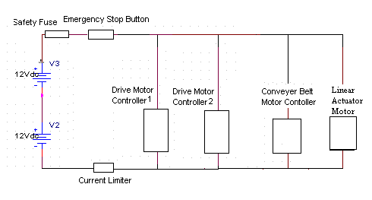
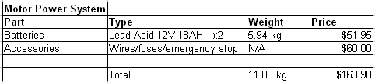
Motor Power Circuit
Current limited to: 50A
Battery selection: 18AH
For 15 minutes - 72A
Wire Gauge: 6 AWG

Slide 17
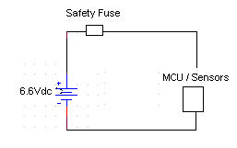
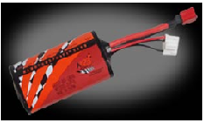
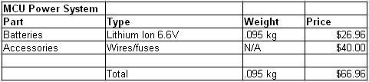
MCU Power Circuit

Slide 18
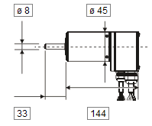
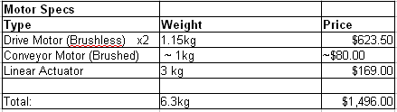
Motor Specifications
Drive Motors
Drive Motors
Maxon Nominal Values
(136207) 24 V
Brushless 7.47 A
310 mNm 4520 RPM
Conveyor Motor
Not selected Nominal Values
24 V
~ 5 A
Linear Actuator
Firgelli Auto Nominal Values
24 V
3 A
150 kg Lift Force
Notes:
18

Slide 19
Weight / Cost Analysis
Total Cost of Power Systems and Motors: $1,726.86
(without including shipping costs)
Total Weight of Power System and Motors: 18.275 kg
Options to reduce Costs: Change to Brushed Drive motors
Disadv – low efficiency, possible dust interference problems
Options to reduce Weight: Change to Lithium Polymer Batteries
Disadv – higher costs

Slide 20
Telerobotic Interface
  Network provided has no extra delay
    Control robot directly with remote commands, non-autonomous
Playing Field
Control Room
WAN
no delay
5Mbps Bandwidth
Robot
Wi-Fi
module
Control
Computer
Figure 20. Diagram of communications during competition
  Link Robot to WAN Wirelessly
    WiFi access point to WAN provided
    Using serial to WiFi module on robot
  Virtual serial port redirection software on control computer
    Works like wired serial connection from both ends
    Transmit data as ASCII characters

Slide 21
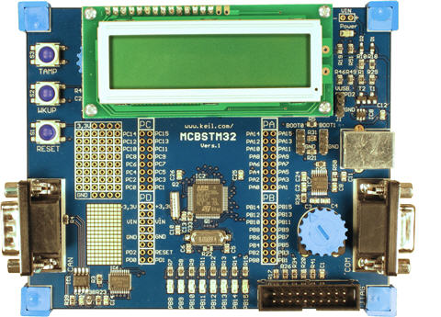
Microcontroller Side
Programming tasks required for microcontroller
Read in data from sensors
Send gathered data through comm link
Receive commands through comm link
Drive motors from commands
Control loop to maintain motor
synchronization
Figure 21. ARM Microcontroller

Slide 22
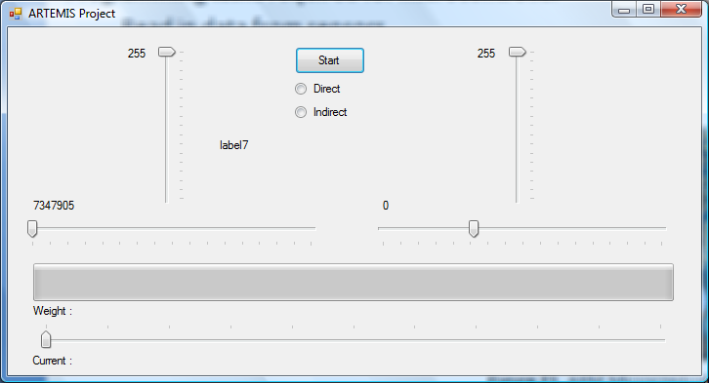
Control Computer Side
Programming tasks required for control computer
  Read in and interpret input from a joystick – PS2 controller
  Send commands over comm link
  Receive and display data from comm link
User interface so far

Slide 23
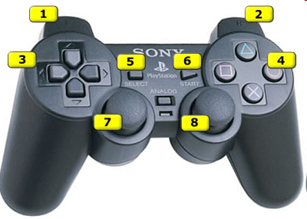
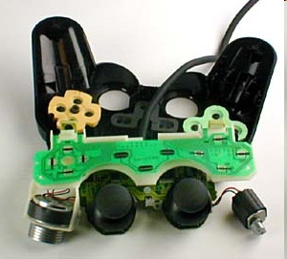
Controller
The standard PS2 controller has 15 buttons; all of them, except for start and select, which are analog. They include:
Four buttons arranged as a directional
pad on the top left
Analog, Start and Select buttons in the
top middle
Four action buttons on the top right
Two action buttons on the front left
Two action buttons on the front right
One analog joystick on the top left
One analog joystick on the top right
Figure 22. Example of controller inputs
Figure 23. Internal circuitry of controller

Slide 24
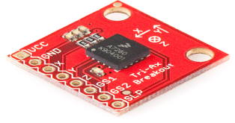
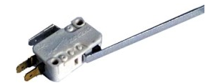
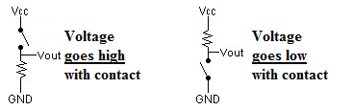
Sensors
Accelerometer
  Accelerometers provide position and direction sensing independent of the robots environment
  Accelerometers measure acceleration in X, Y, and Z axis
Tactile Bump Sensor Circuits
  Once sensors run into an object a signal is sent to the microprocessor.
Figure 24. Three axis accelerometer
Figure 25. Bump Sensor
Figure 26. Bump Sensor Circuit

Slide 25
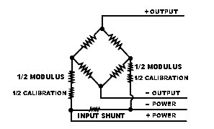
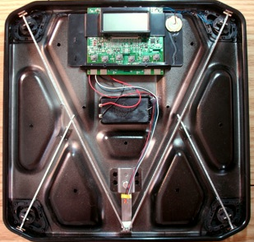
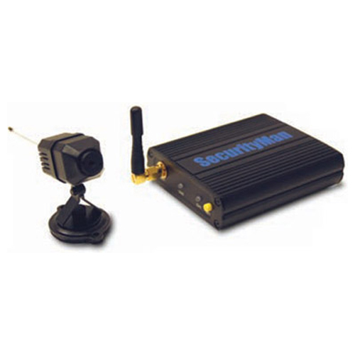
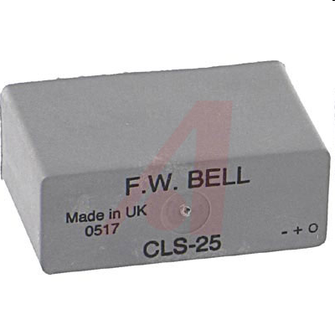
Sensors
Figure 27. Weight Sensor Circuit uses a wheatstone bridge to measure electrical resistance
Figure 28. Weight sensor in situ
Figure 29. Web camera for sensing environment
Figure 30. Current sensor

Slide 26
Cost Analysis of System
The Artemis Project Budget Breakdown
 | Part Description | QTY | Price | Total
Excavation |  |  |  | $1,237.78
 | Radial Ball bearings | 1 | $8.95 | $8.95
 | Tensioner Belt | 1 | $5.45 | $5.45
 | Washer | 2 | $0.35 | $0.70
 | Frame Mounting hardware | 3 | $5.78 | $17.34
 | Tensioner Mounting Bolts | 1 | $5.78 | $5.78
 | Sheet AL6061 | 2 | $46.28 | $92.56
 | AL 1.5" Tube | 1 | $34.76 | $34.76
 | AL 3" Tube | 1 | $28.94 | $28.94
 | AL 1" Tube | 1 | $17.83 | $17.83
 | 0.5" Square Al Sheet | 1 | $26.28 | $26.28
 | Paddle belt | 1 | $63.24 | $63.24
 | Radial gear | 1 | $17.58 | $17.58
 | Teflon sheet | 1 | $47.56 | $47.56
 | Aluminum Sheet | 1 | $61.81 | $61.81
 | Linear Actuator | 1 | $809.00 | $809.00
Locomotion |  |  |  | $3,702.47
 | Aluminum Block, 8"x8"12" | 1 | $435.40 | $435.40
 | Aluminum Rectangular Tube, 2"x4"x72" | 3 | $54.43 | $163.29
 | Aluminum Rod, 1"x60" | 1 | $20.92 | $20.92
 | Aluminum Rod, 1/2"x72" | 4 | $6.22 | $24.88
 | Bearings, 1" | 8 | $12.23 | $97.84
 | Rubber Sheet, 1-1/2"x24"x6' | 2 | $71.10 | $142.20
 | Roller, 40mmx50mm | 2 | $31.90 | $63.80
 | Brass Flat plate, 3/32"x3/4"x72" | 2 | $21.56 | $43.12
 | Maxon Motor Controller | 2 | $497.09 | $994.18
 | Maxon DC Motor | 2 | $661.72 | $1,323.44
Power |  |  |  | $229.85
 | Switching Regulator | 2 | $12.00 | $24.00
 | Lead Acid Batteries | 3 | $51.95 | $155.85
 | Accessories (Wires, Fuses, etc) | 1 | $50.00 | $50.00
Microcontroller and Communications |  |  |  | $110.00
 | ARM Microcontroller* | 1 | $0.00 | $0.00
 | Accessories (Wires, Breadboard, etc.) | 1 | $75.00 | $75.00
 | Bluetooth Adapters | 1 | $35.00 | $35.00
Control |  |  |  | $43.00
 | 3-Axis Accelerometer | 1 | $50 | $50.00
 | Bumper Sensor | 2 | $1.50 | $3.00
 | Weight Sensor | 1 | $40.00 | $40.00
Total Cost of System |  |  |  | $6,123.10
 | Miscellaneous Costs (Shipping, etc) | 1 |  | $300
 | Regolith Simulant for evaluation | 1 |  | $500
Current cost of system: $6,123.10

Slide 27
Lifecycle
Concept Development
Needs Analysis
Concept Exploration
Concept Definition
Engineering Development
Advanced Development
Engineering Design
Integration & Evaluation
Post Development
Production
Operation & Support

Slide 28
Spring Semester Schedule
Finish Prototyping
Finish acquiring building materials, circuitry, motors, and batteries
Begin assembly and testing of platform
Evaluate platform
Re-design as needed

Slide 29
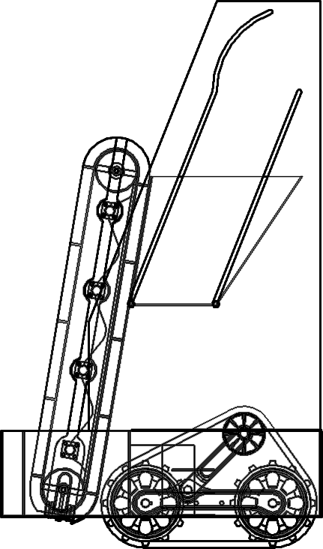
Conclusions
Figure 31. Final ARTEMIS Design

Slide 30
Questions and Comments
The ARTEMIS Project

