Slide 1
NASA Lunabotics Mining Competition Interim Design Presentation
Team 19: Aleks Fedoriw
Duncan Haldane
Arthur Pack
Michael Pearse
Carlos Ruiz

Slide 2
Chassis
Material:
Aluminum 6063
¾” Square Tubing
¼” Plate
Primary Focus:
Attachment for Motor/Gearbox Assembly
Attachment for Excavation/Dumping Systems

Slide 3
Chassis
Additional Constraints:
1m x .370m Max Dimensions
Minimize Weight
Mass Calculations (ProEngineer):
Volume = 3.33e+06 mm³
Surface Area = 1.33e+06 mm²
Density = 2.685e-06 kg/mm³
Total Mass = 8.95 kg

Slide 4
Walking
Walking using hip actuated leg
Torque at touchdown: 70 Nm @ 1.5 Hz
Motor: 18V (36V) Maxon RE65 with 50:1 gear reduction
35 A draw for each motor
Need 105 A capability

Slide 5
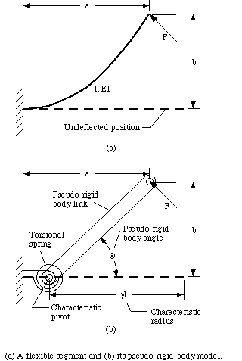
Leg Design
Semi-circular legs 0.297 m in Diameter, 9cm wide
Need Radial Stiffness of 15,905 N/m
Pseudo Rigid Body Model
w = 0.09m; t = 0.00518m

Slide 6
FEA Simulation
For a 1 kN load
Vertical tip Deflection: 65.93mm
K = 1000/0.06593 = 15,167 N/m
Vertical Deflection

Slide 7
Excavator System
Bucket Chain system
Uses lower plate to hold material while scoops push it along
Swivels on a four-bar linkage
Powered by a single motor

Slide 8
Bucket System
Uses two power screws to lift bucket
Cable connected to frame forces bucket to dump contents
Lid is hinged to allow contents to dump farther away from the bucket
Very lightweight

Slide 9
Final Design

Slide 10
System Power Circuit

Slide 11
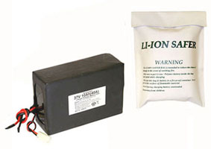
Battery Type
Lithium Ion Polymer
Packing | 10 pcs High Power Polymer Li-Ion Cell: 3.7V 10 Ah
Voltage | 37V
Capacity | 10 Ah
Max. Discharging Rate | 70A
Weight | 5 Lb.
Cost | $699 .95

Slide 12
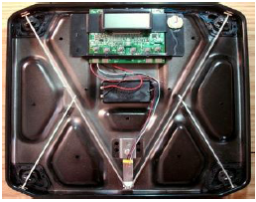
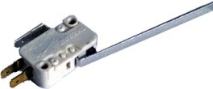
Sensors
Webcam
Weight Sensors
Bump Sensor

Slide 13
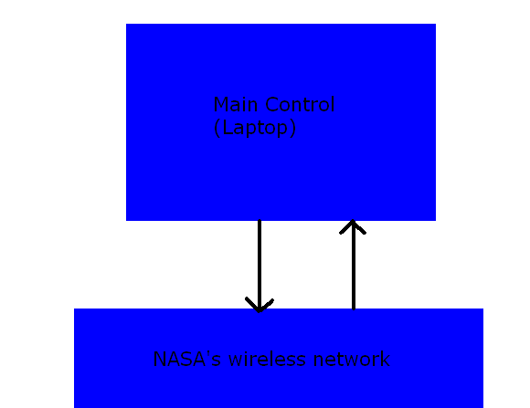
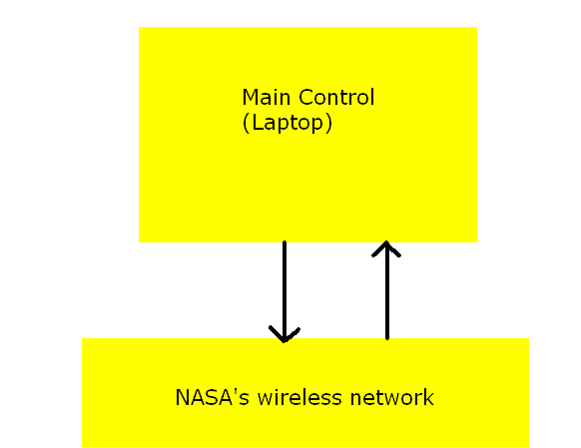
Main Control

Slide 14
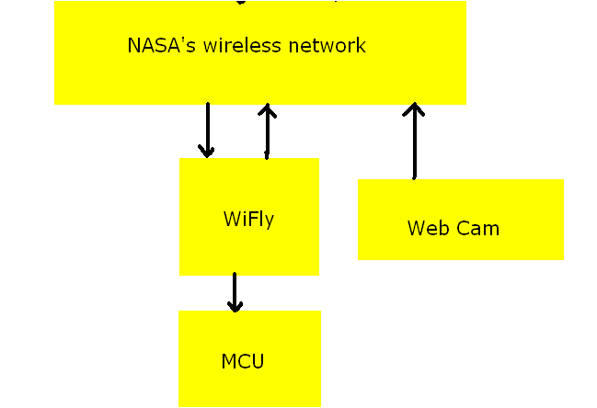
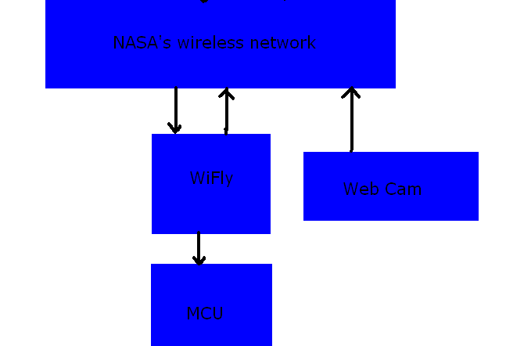
Wireless Aspects

Slide 15
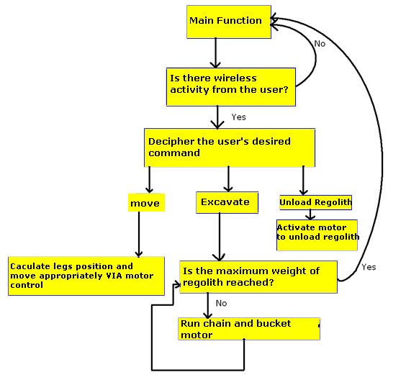
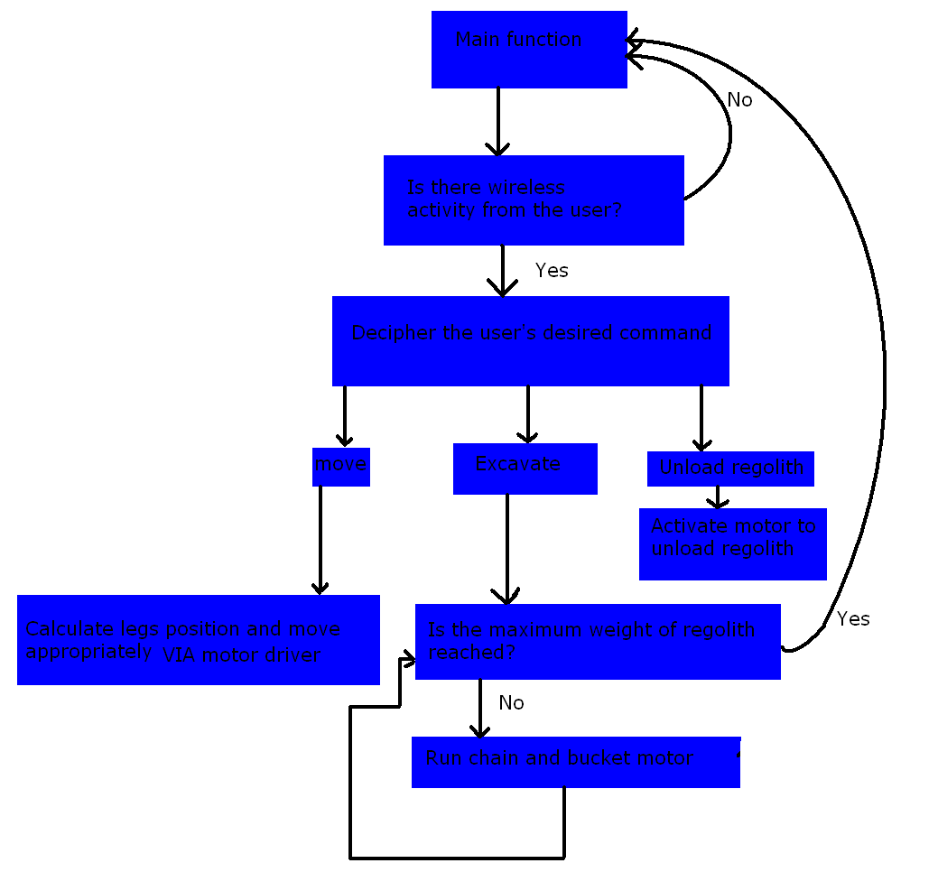
MCU

Slide 16
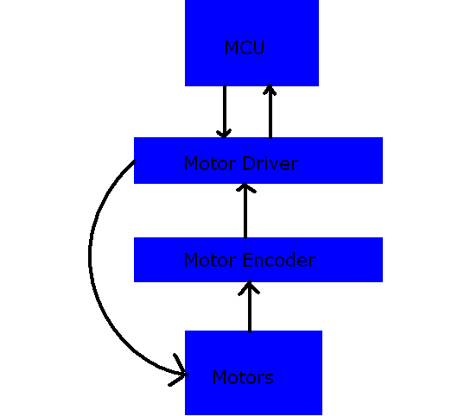
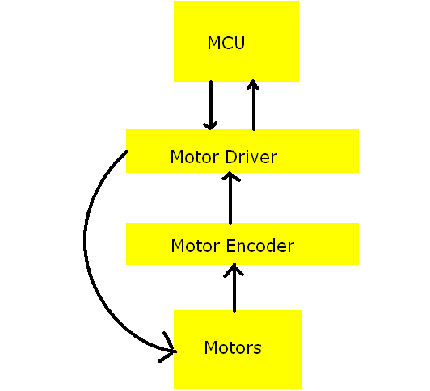
Controls

Slide 17
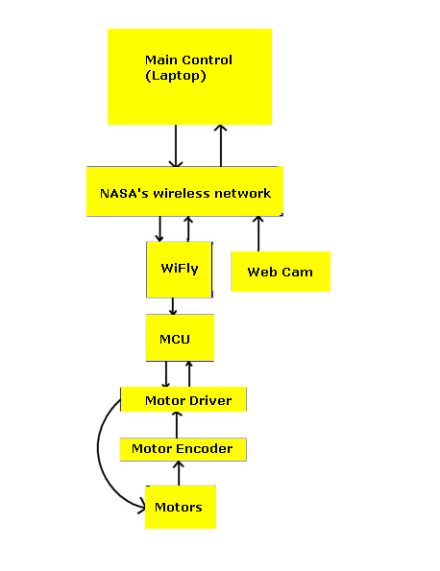
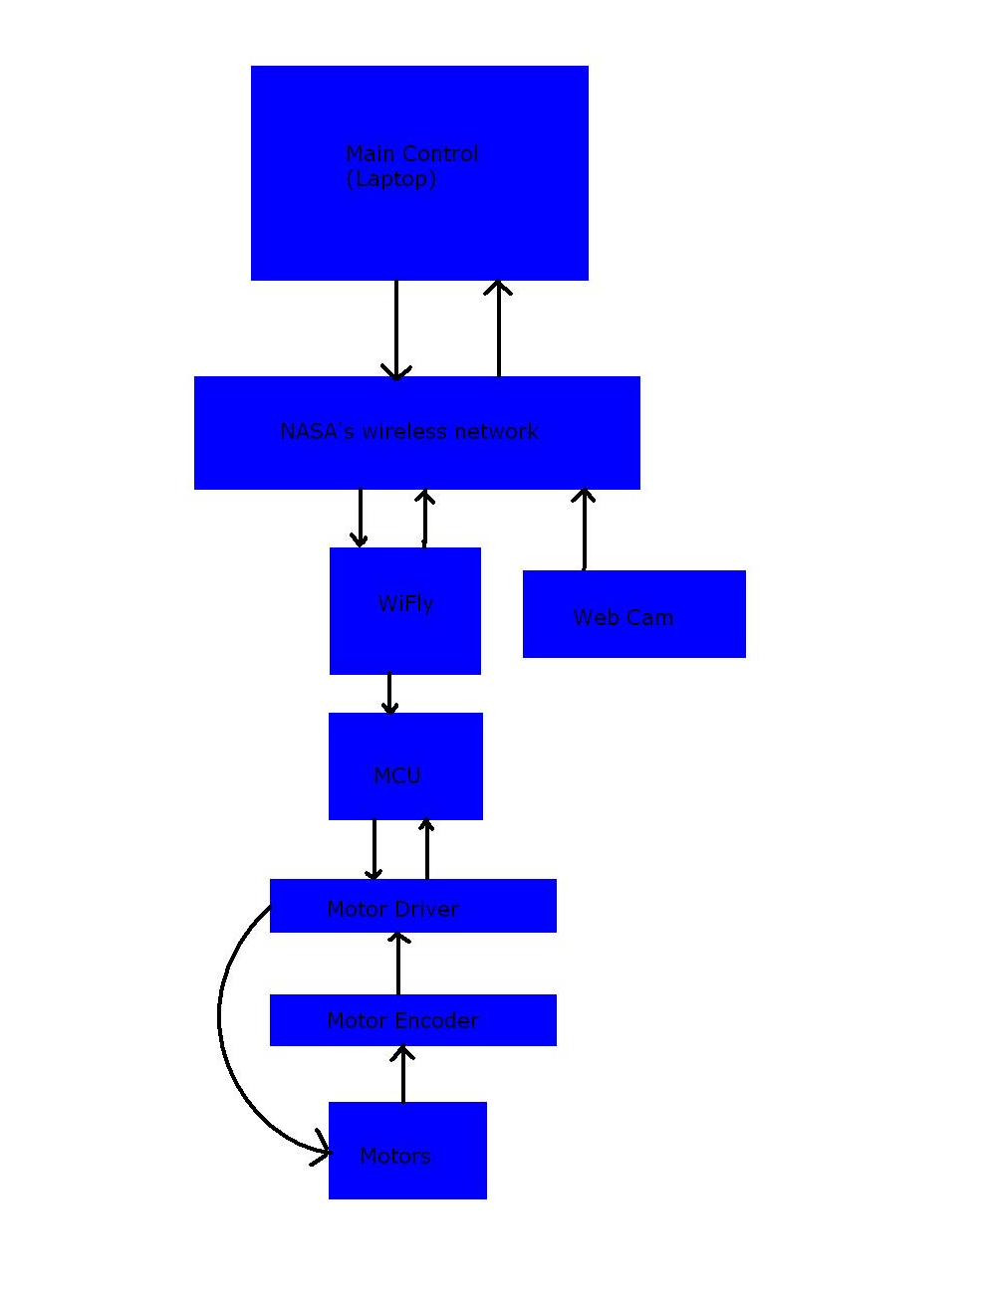
Overall design

Slide 18
Questions?
?

