Slide 1

The ARTEMIS Project
Lunar Regolith Excavator Student Competition
ME Team #8 / ECE Team #1
James Dickson | Jeremy Nagorka
Anthony Gantt | Jennifer Schrage
Christopher Loftis | Nick Stroupe
Alan Williams
Notes:
h

Slide 2
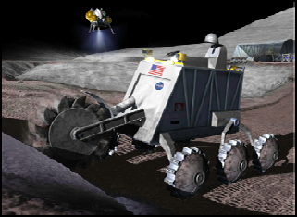
The Lunabotics Mining Competition
Lunabotics Mining Competition
  Designed to engage and retain students in STEM disciplines
  Provide a competitive environment in which may result innovative ideas and solutions that could be applied to actual lunar excavation
Max Weight | 80 kg
Min Excavation Material | 10 kg
Max width | 1.5 m
Max length | 0.75 m
Max height | 2 m
Max setup time | 10 minutes
Operation time | 15 minutes
Max take down time | 5 minutes
Figure 1. Artist’s rendering of lunar excavation, taken from Lunabotics Mining Competition announcement
Table 1. Competition Specifications

Slide 3
Needs Analysis Flow Diagram
Requirements
Telerobotic
Minimum excavation is 10.0 kg
Interfaces – Internal & External
Track
Conveyor Belt
Elements
Hardware mass limit is 80 kg
Locomotion
Power System
Sensors
Excavation
Power Restraint Unspecified
System
Microcontroller
Cowcatcher
Power System
Motors
Linear Actuator
Communication
Collector Bin
User Interface
Control
LEGEND
Physical
FAMU/FSU COE
NASA
Dr. Jonathan Clark
Requirement / Regulation / Other
Contributors / Other Aspects
Figure 2. Needs analysis flow diagram for ARTEMIS Project

Slide 4
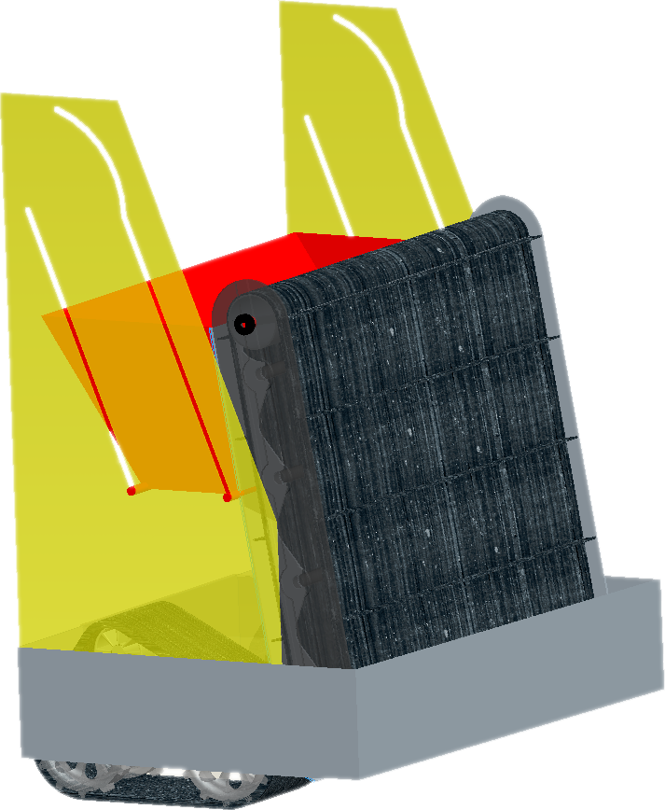
Robotic Platform Design
Figure 3. Robot design schematic

Slide 5
Circuit Block Diagram
Power Supply
Motors
Microcontroller
Movement of Robot
Conveyor Belt
Communications
2 Brushless Motors
1 Linear Actuator
Operator Input
Brushed Motor
Sensors
Tracks
Collection Bin Lift
3-Axis Accelerometer
Current Sensor
Weight Sensor
Camera
Bump Sensor
Figure 4. Circuit block diagram

Slide 6
System Breakdown
ARTEMIS Robot
Excavation
Excavation Tools
Material Transport
Locomotion
Power Transmission
Power
Microcontroller and Communications
Control
Obstacle Avoidance
Traction
Power Regulation
Power storage
Signal receivers/ Transmitter
Signal Processing
Stability
Program
User Interface
Information Relay
Directional Inputs
Figure 5. System breakdown structure
Notes:
1) System 2) Subsystems 3) Components followed by 4) subcomponents and 5) parts

Slide 7
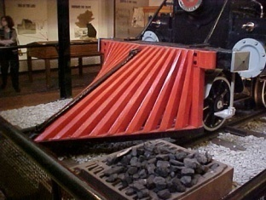
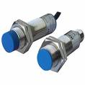
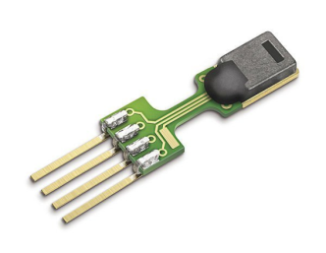
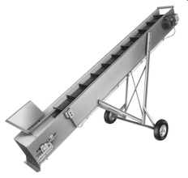
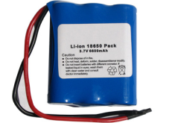
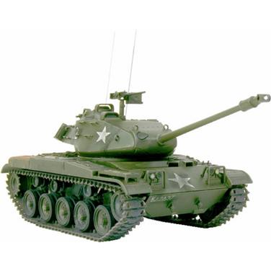
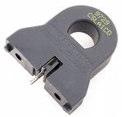
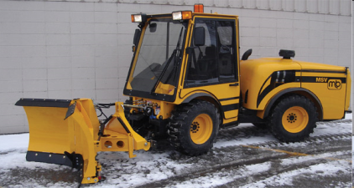
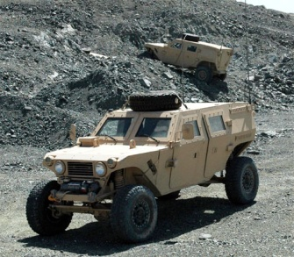
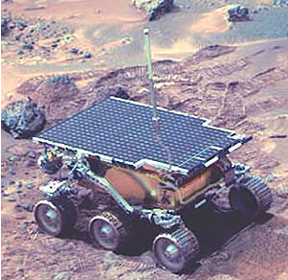
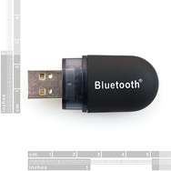
Concept Generation
An initial design, overall design idea was proposed, then brainstorming for each subsystem
Assigned specific qualities desired for final platform, then evaluated
Excavation
Power
Sensors
Locomotion
Communications
Figure 6. Top 3 concepts for each subsystem

Slide 8
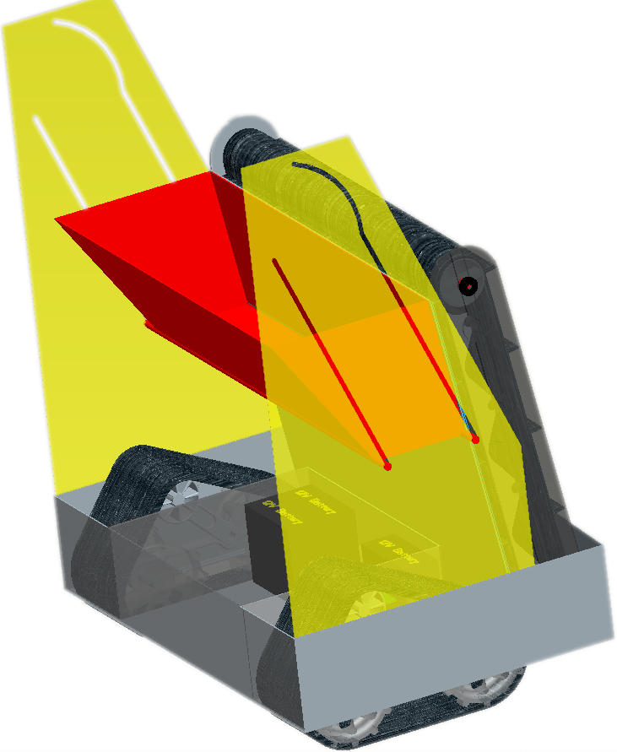
System Overview
Excavation
Power
Communications
Locomotion
Figure 7. Overall platform design with subsystems

Slide 9
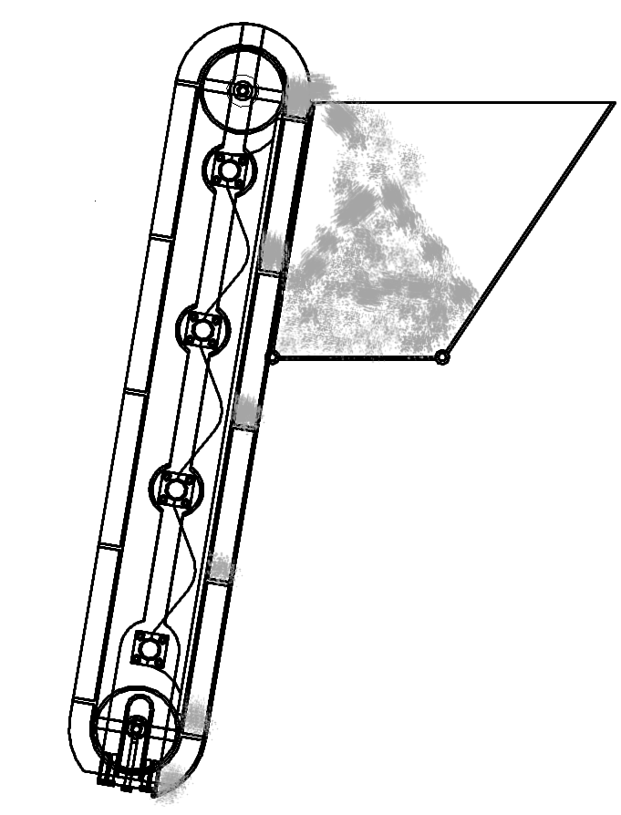
Excavation Subsystem Design
Excavation Subsystem Components:
  Cleated Belt – cleats excavate regolith and deposit into trough
  Conveyor – transports regolith up trough to be deposited into bucket
  Bucket – holds regolith until delivery to holding bin
3
2
1
Figure 8. Excavation subsystem components and flow of regolith

Slide 10
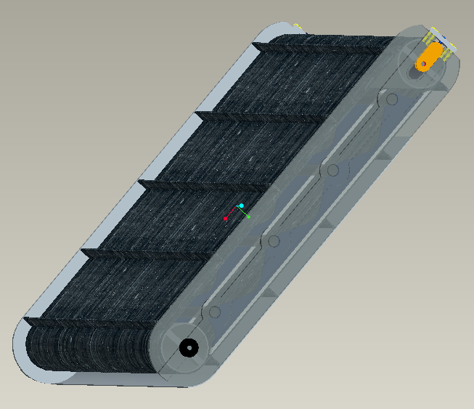
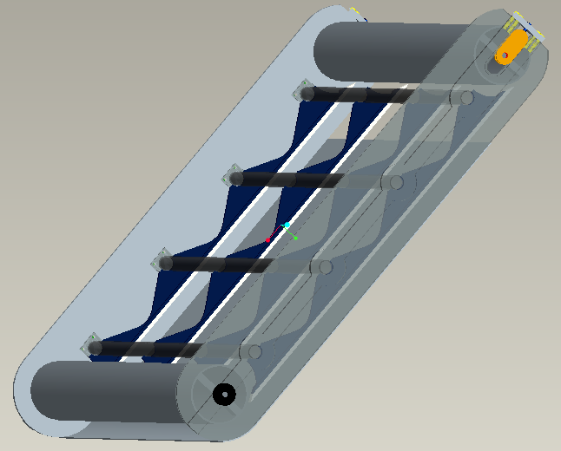
CLEATED CONVEYOR
Final Design
  Key Design Elements
    Two piece Al frame
    Aluminum rollers
      One driven, one idle
      10.16 cm in dia
    Paddle belt
      PVC 120 material
      90 cm belt width
      Ten total cleats
      21.6 cm cleat spacing
      2.54 cm cleat height
    Belt tension mechanism
      One per side
    Low friction sliders
      4 total
      Delrin material
    Belly pan
      Aluminum
    Hardware
      Sixteen Al Allen head screws
      Five sealed, radial ball bearings
      Eight Al tension plate bolts
      Two SS adjuster bolts
    Spur Gear
      Al 6065
Figure 9. Isometric
Design View
Figure 10. Isometric
Design View w/o Belt
Notes:
10

Slide 11
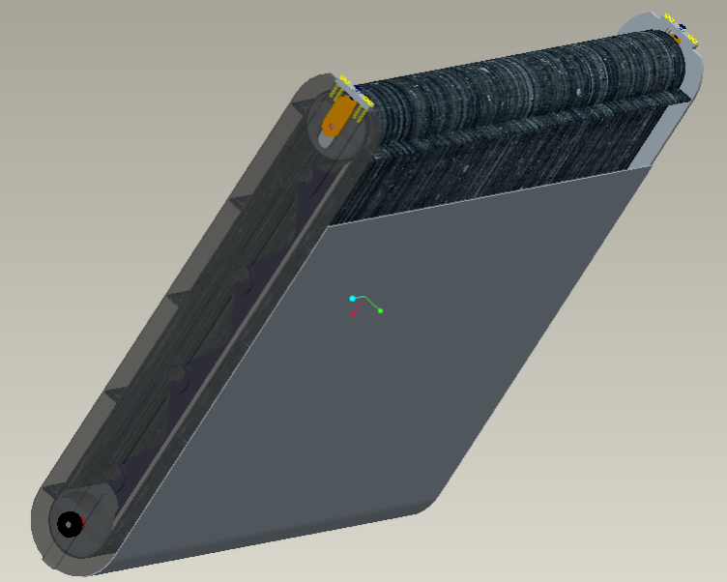
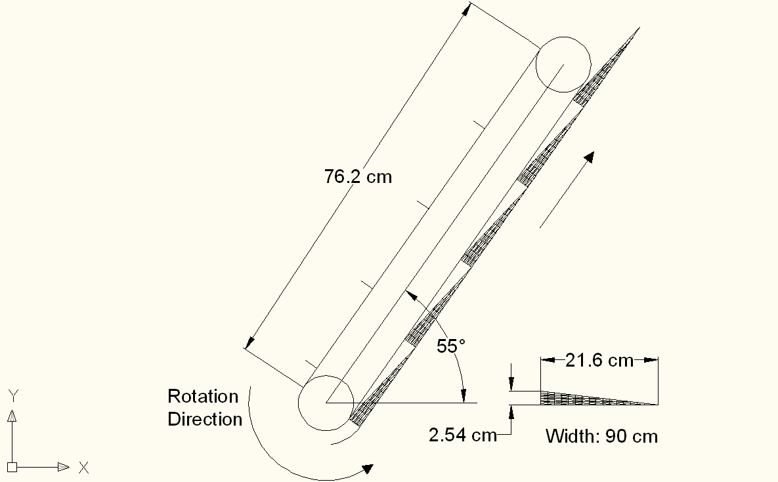
CLEATED CONVEYOR
Design Analysis
  Assumptions and Constants
    Inclination angle of 55 degrees
    Uniform load distribution
    Belt velocity of 1 m/s
    Maximum regolith density of 1.91 g/cm³
    Each scoop excavates a volume of 2471.17 cm³
    Belt coefficient of friction of 0.3
    Bearing coefficient of friction of 0.0015
  Results
    Angular velocity of 9.84 rad/s
    Angular acceleration of 6.56 rad/s²
    Max load of 23.6 kg
    Required input torque of
    10.3 N*m
Figure 11. Conveyor Design Drawing
11
Notes:
11

Slide 12
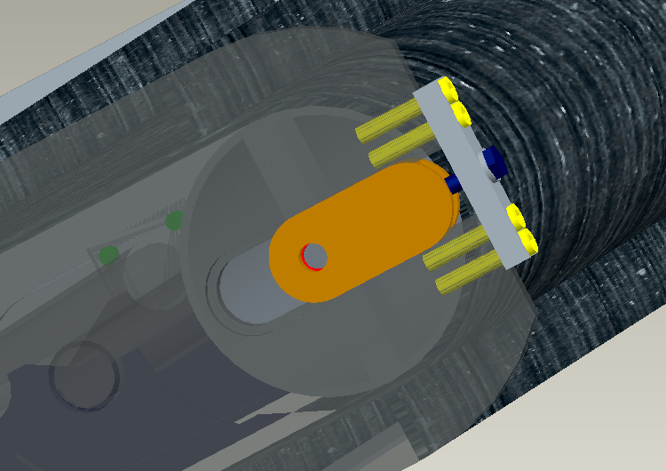
CLEATED CONVEYOR
Tensioning Mechanism
  One mechanism per side
    One DOF prismatic joint
    Integrated bearing housing
    Single bolt adjustment
      Clockwise rotation
        Increase belt tension
      Counter-clockwise rotation
        Decrease belt tension
Figure 12. Belt Tensioning Mechanism
12
Notes:
12

Slide 13
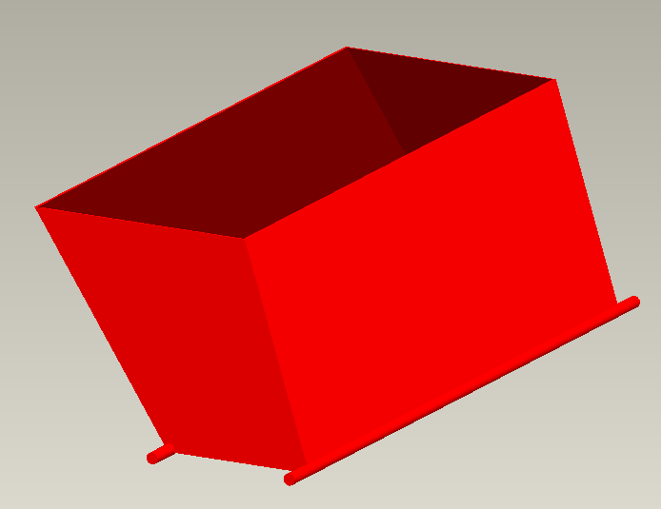
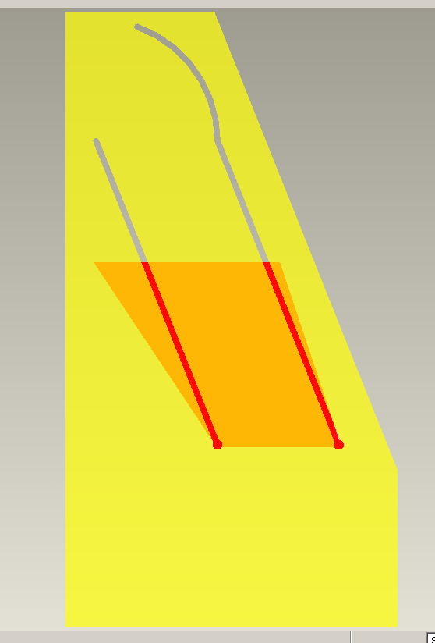
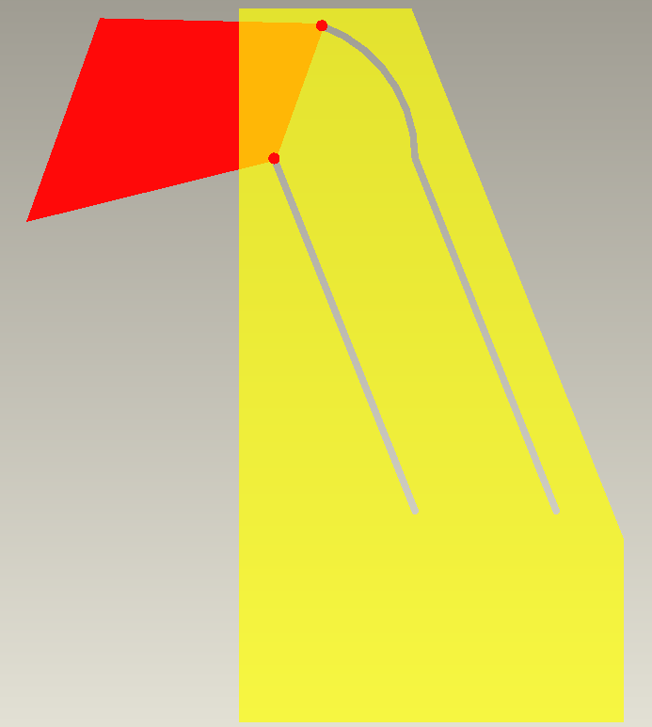
Bucket Design
Density of Regolith – 1.5 g/cm³
Desired capacity – 100 kg
Required Volume – 0.066 m³
Our Bucket
  Volume 0.0675 m³
  Height 0.3 m
  Length 0.4 m
  Width 0.9 m
  Material Al 6061
  Weight 8 kgs
Figure 13. Isometric view of bucket design
Figure 14. Example of bucket dumping from side view
13

Slide 14
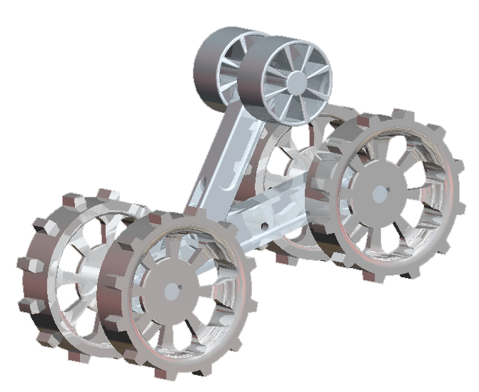
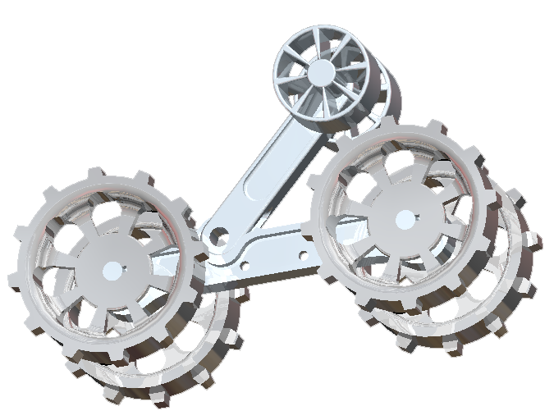
Locomotion Subsystem Design
Torsion Spring tensioner, K=150 Nm/deg
Rear sprockets driven by independent 24 V motors housed in main body
Total mass of each track ~10 kg with tread
Reduction of mass through using lattice work frame
Figure 15. Isometric view of track frame

Slide 15
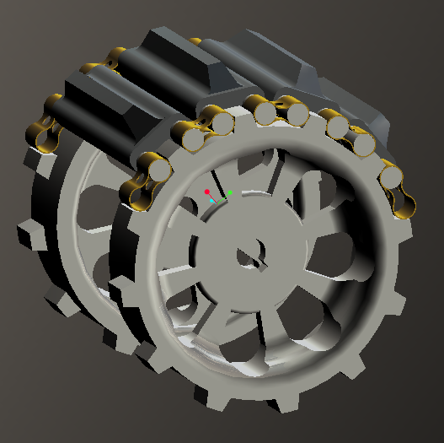
Locomotion Subsystem Design
Chain Assembly
  15 cm tread surface at center made of heavy duty, reinforced rubber
  Individually adjustable connector links using nut and bolt to tighten
  Pin Joint allows large circular deformations
  Tread links drawn tight by tensioning arm on frame
Figure 16. Isometric view of driving sprocket with example of treads

Slide 16
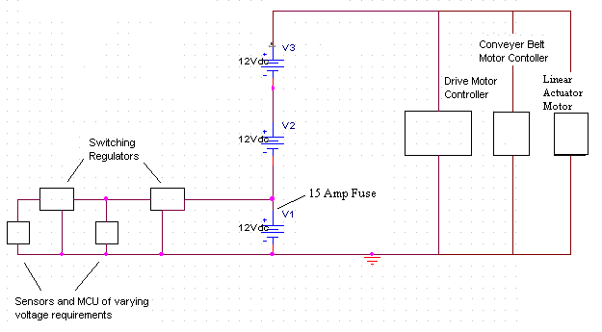
Power Subsystem Design
Figure 17. Power subsystem schematic
Artemis Power System Specifications
Part | Type | Weight
Switching Regulator (2) | DE-SWADJ | N/A
Lead-Acid Batteries (3) | Powersonic 12V 18AH | 5.94 kg
Accessories | Wires/Fuses/Switches/Capacitors | N/A
 | Total: | 17.82 kg
Table 3. ARTEMIS Power System Specifications

Slide 17
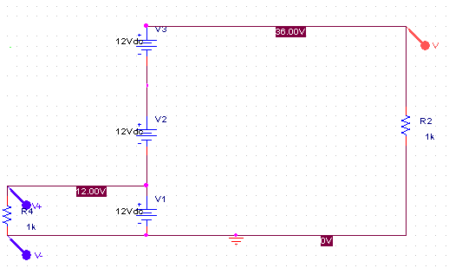
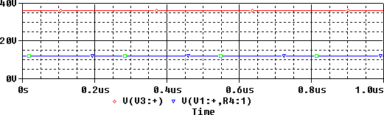
Power Subsystem Simulation
Figure 18. Schematic of power system simulation (top) and results (bottom)

Slide 18
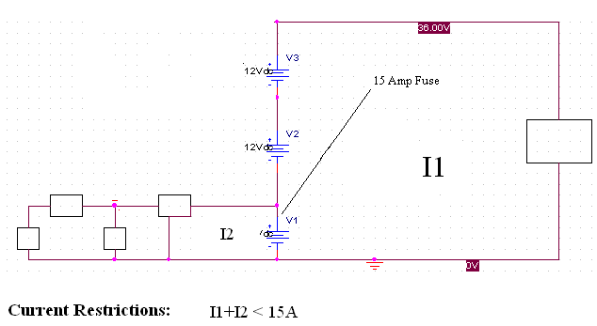
Maximum Current Analysis
The combined current of I1 and I2 must never exceed 15A.
Figure 19. Diagram of circuit with fuse

Slide 19
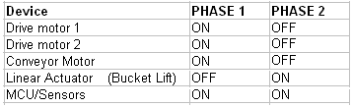
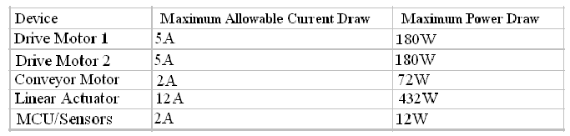
Power Subsystem Overview
PHASE 1: Regolith Collection
PHASE 2: Regolith Deposit into Collector
Maximum Device Specifications in accordance to phase and 15A draw limit:

Slide 20
Telerobotic Interface
  Network provided now has no delay
    Control robot directly – not autonomous
  Network provided now has no delay
    Control robot directly – not autonomous
Playing Field
Control Room
WAN
no delay
5Mbps Bandwidth
Robot
Control
Computer
Figure 20. Diagram of communications during competition
  Link Robot to WAN Wirelessly
    WiFi access point to WAN provided
    Using serial to WiFi module on robot
  Virtual serial port redirection software on control computer
    Works like wired serial connection from both ends
    Transmit data as ASCII characters

Slide 21
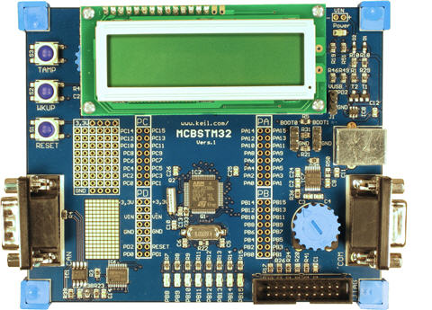
Microcontroller Side
Programming tasks required for microcontroller
Read in data from sensors
Send gathered data through comm link
Receive commands through comm link
Drive motors for that command
Control loop to keep motors at
correct speed
Figure 21. ARM Microcontroller

Slide 22
Control Computer Side
Programming tasks required for control computer
  Read in and interpret input from a joystick – PS2 controller
  Send commands over comm link
  Receive and display data from comm link
Two options for control of drive motors
Direct
Each joystick directly controls a drive motor
Indirect
Drive motors to go in direction of joystick

Slide 23
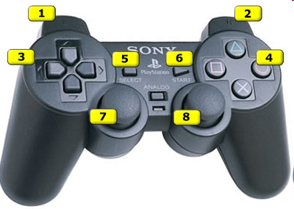
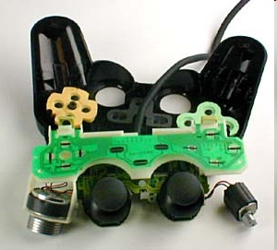
Controller
The standard PS2 controller has 15 buttons; all of them, except for start and select, which are analog. They include:
Four buttons arranged as a directional
pad on the top left
Analog, Start and Select buttons in the
top middle
Four action buttons on the top right
Two action buttons on the front left
Two action buttons on the front right
One analog joystick on the top left
One analog joystick on the top right
Figure 22. Example of controller inputs
Figure 23. Internal circuitry of controller

Slide 24
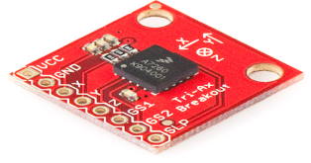
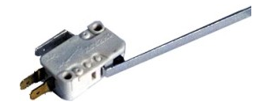
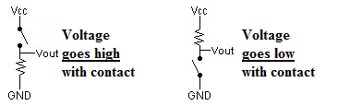
Sensors
Accelerometer
  Accelerometers provide position and direction sensing independent of the robots environment
  Accelerometers measure acceleration in X, Y, and Z axis
Tactile Bump Sensor Circuits
  Once sensors run into an object a signal is sent to the microprocessor.
Figure 24. Three axis accelerometer
Figure 25. Bump Sensor
Figure 26. Bump Sensor Circuit

Slide 25
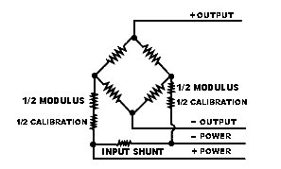
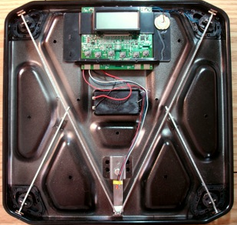
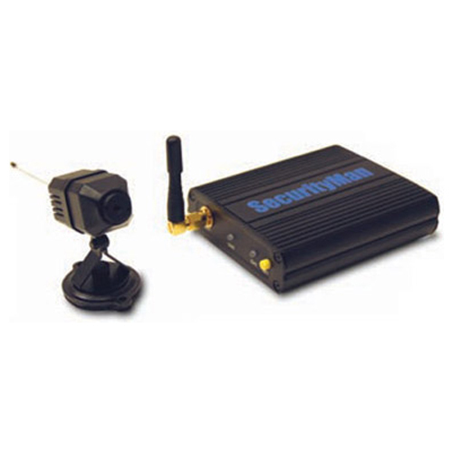
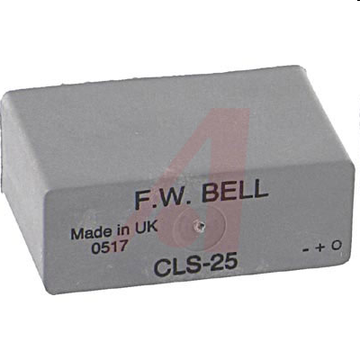
Sensors
Figure 27. Weight Sensor Circuit uses a wheatstone bridge to measure electrical resistance
Figure 28. Weight sensor in situ
Figure 29. Web camera for sensing environment
Figure 30. Current sensor

Slide 26
Cost Analysis of System
The Artemis Project Budget Breakdown
 | Part Description | QTY | Price | Total
Excavation |  |  |  | $1,237.78
 | Radial Ball bearings | 1 | $8.95 | $8.95
 | Tensioner Belt | 1 | $5.45 | $5.45
 | Washer | 2 | $0.35 | $0.70
 | Frame Mounting hardware | 3 | $5.78 | $17.34
 | Tensioner Mounting Bolts | 1 | $5.78 | $5.78
 | Sheet AL6061 | 2 | $46.28 | $92.56
 | AL 1.5" Tube | 1 | $34.76 | $34.76
 | AL 3" Tube | 1 | $28.94 | $28.94
 | AL 1" Tube | 1 | $17.83 | $17.83
 | 0.5" Square Al Sheet | 1 | $26.28 | $26.28
 | Paddle belt | 1 | $63.24 | $63.24
 | Radial gear | 1 | $17.58 | $17.58
 | Teflon sheet | 1 | $47.56 | $47.56
 | Aluminum Sheet | 1 | $61.81 | $61.81
 | Linear Actuator | 1 | $809.00 | $809.00
Locomotion |  |  |  | $3,702.47
 | Aluminum Block, 8"x8"12" | 1 | $435.40 | $435.40
 | Aluminum Rectangular Tube, 2"x4"x72" | 3 | $54.43 | $163.29
 | Aluminum Rod, 1"x60" | 1 | $20.92 | $20.92
 | Aluminum Rod, 1/2"x72" | 4 | $6.22 | $24.88
 | Bearings, 1" | 8 | $12.23 | $97.84
 | Rubber Sheet, 1-1/2"x24"x6' | 2 | $71.10 | $142.20
 | Roller, 40mmx50mm | 2 | $31.90 | $63.80
 | Brass Flat plate, 3/32"x3/4"x72" | 2 | $21.56 | $43.12
 | Maxon Motor Controller | 2 | $497.09 | $994.18
 | Maxon DC Motor | 2 | $661.72 | $1,323.44
Power |  |  |  | $229.85
 | Switching Regulator | 2 | $12.00 | $24.00
 | Lead Acid Batteries | 3 | $51.95 | $155.85
 | Accessories (Wires, Fuses, etc) | 1 | $50.00 | $50.00
Microcontroller and Communications |  |  |  | $110.00
 | ARM Microcontroller* | 1 | $0.00 | $0.00
 | Accessories (Wires, Breadboard, etc.) | 1 | $75.00 | $75.00
 | Bluetooth Adapters | 1 | $35.00 | $35.00
Control |  |  |  | $43.00
 | 3-Axis Accelerometer | 1 | $50 | $50.00
 | Bumper Sensor | 2 | $1.50 | $3.00
 | Weight Sensor | 1 | $40.00 | $40.00
Total Cost of System |  |  |  | $6,123.10
 | Miscellaneous Costs (Shipping, etc) | 1 |  | $300
 | Regolith Simulant for evaulation | 1 |  | $500
Current cost of system: $6,123.10

Slide 27
Lifecycle
Concept Development
Needs Analysis
Concept Exploration
Concept Definition
Engineering Development
Advanced Development
Engineering Design
Integration & Evaluation
Post Development
Production
Operation & Support

Slide 28
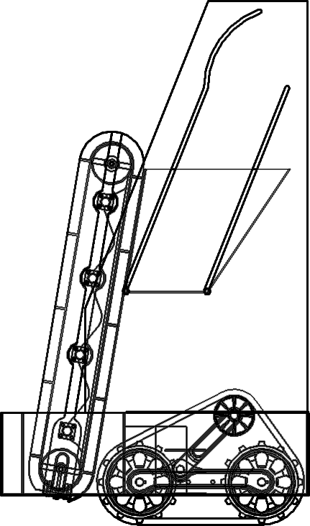
Conclusions
Cleated Conveyor belt used for excavation
Tracks on either side used for locomotion
Lead-acid batteries for power
ARM Microcontroller for processing
Tele-robotic interface using sensors
Figure 31. Final ARTEMIS Design

Slide 29
Questions and Comments
The ARTEMIS Project

