Slide 1
Integration of experimental propulsion systems in micro air vehicles
Final Fall 2010 Presentation
November 30, 2010
Team # 3
Erica Cosmutto
Hunter Metzger
Joel Ware
Kristina De Armas
Michael Isaza
Santiago Baus

Slide 2
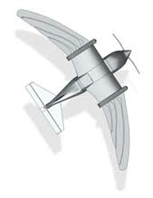
OverView
Project Scope
Product Specifications
Project Goal
Fixed vs. Varying Values
Boundary Layer Ingestion
Calculations
Fuselage Designs
Design of Experiments
Cost of Materials
Weight and Cost Analysis
Future Work Plan

Slide 3
Project scope
Integrate an electric ducted fan into the fuselage of a Micro Air Vehicle (MAV)
Focus on:
Fuselage design
Duct design
Integrating electronics and fan into the fuselage
Goal:
Design 3 fuselages
Inlet close to fan
Inlet close to fan with rod
Inlet away from fan
Each will demonstrate the effectiveness of the propulsion system and duct design

Slide 4
Project Goal
The team’s goal is to produce 3 fuselage designs and be able to judge these designs based on the following:
Weight
Flight time (Efficiency)
Maximum speed
Stability (Center of Gravity)

Slide 5
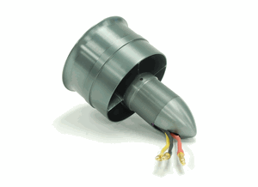
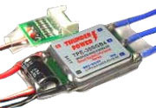
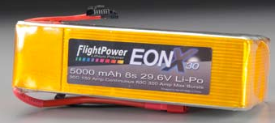
Final Component Selection
76mm ID, 80mm OD
22.2V
391g
55A
$129.50
TP8000-6S4PL
22.2V
8000mAh
16C
$509.99
Smart Guide ESC
Up to 44.4V
100A
$120.00

Slide 6
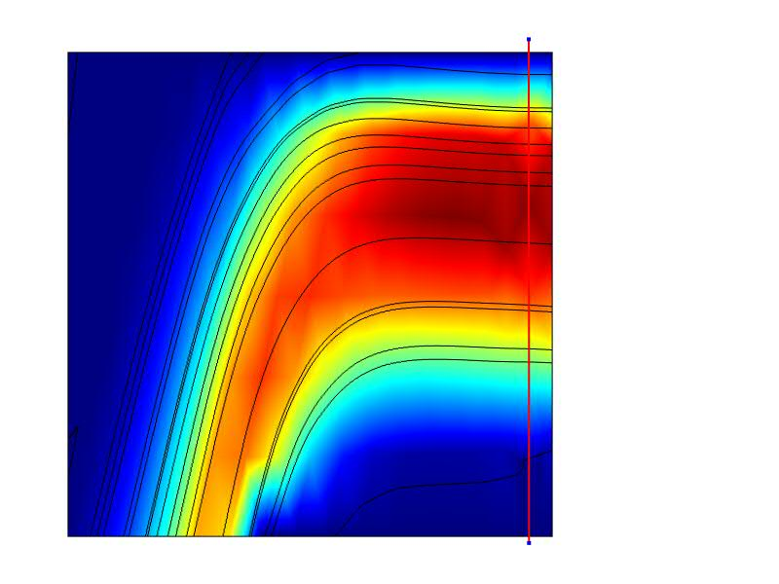
Boundary Layer Ingestion
P=0.5T(2V₁+∆V)
or
V₁= Incoming velocity(m/s)
P=Power (W)
Power required to accelerate slow moving air is less than the power needed to create the same acceleration in a faster incoming velocity
T=Torque (N)
= Mass flow rate (kg/s)
∆V=Change in velocity(m/s)
Incoming flow decreases, decreasing power required to obtain a certain thrust
Use boundary layer as slow velocity
∆V produces thrust
COMSOL Representation of Flow

Slide 7
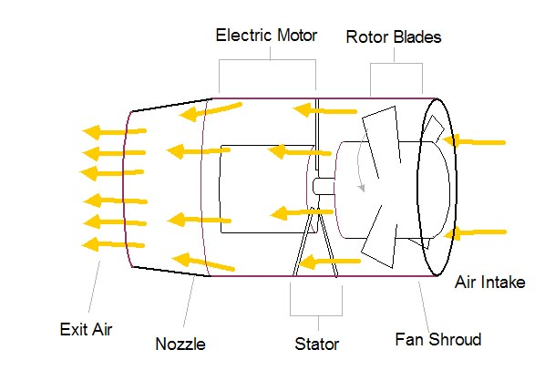
Calculations
Force Acting on the Fan Blades
Pressure Drop Across Fan
Mass Flow Through Duct
Velocity After the Fan

Slide 8
Calculations Continued
Assume velocity outside of MAV is 30 m/s

Slide 9
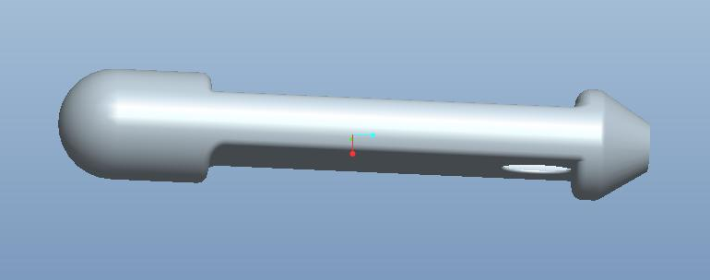
Design 1: Hole Close to Fan
COMSOL Representation of Flow
Velocity Profile
Less losses due to duct
High velocity entering
and exiting fan
High thrust
Air flow not fully developed
Not very efficient

Slide 10
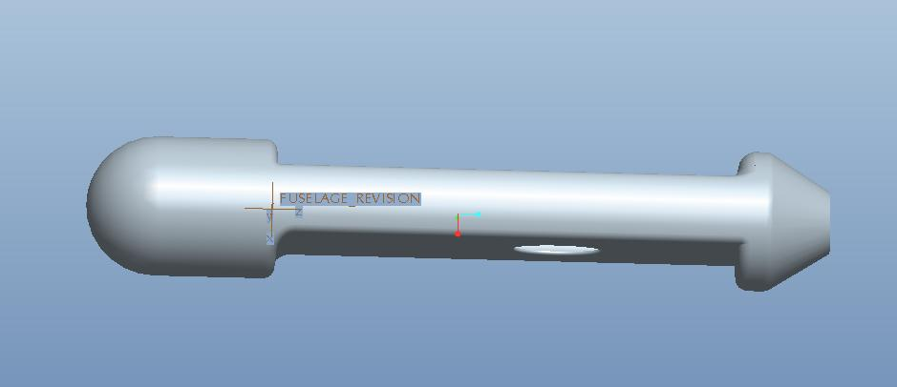
Design 2: Hole Farther away from Fan
COMSOL Representation of Flow
Velocity Profile
Air flow more fully developed
Lowest velocity
‘Feeds’ the fan more boundary layer
Increases efficiency

Slide 11
Design 3: rob attached to hub
Velocity Profile
COMSOL Representation of Flow
Rod attached to maximize flow that reaches blades
High velocity

Slide 12
Fixed vs. Varying Values
Fixed Values
Measurement | Value
Length | 32”
Diameter | 6”
Inlet Area | 5.412 in²
Exit Area | 4.23 in²
Varying Values
Fuselage | Distance From Inlet to Fan
Design 1 | 10.2282”
Design 2 | 4.52098”
Design 3 | 10.2282”

Slide 13
Design of Experiment
2^{k} Factorial design
2 levels and 2 factors with 1 sample
Response: Velocity exiting the fan
Factors:
Distance of inlet from Fan
Use of rod at hub
Coded level table

Slide 14
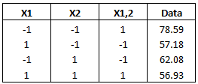
Results
Contrast, Beta and Test Statistic
Predictive model

Slide 15
More results
Interaction Plot

Slide 16
How to interpret the results?
Distance from EDF to Inlet
Rod usage
Interaction between these factors

Slide 17
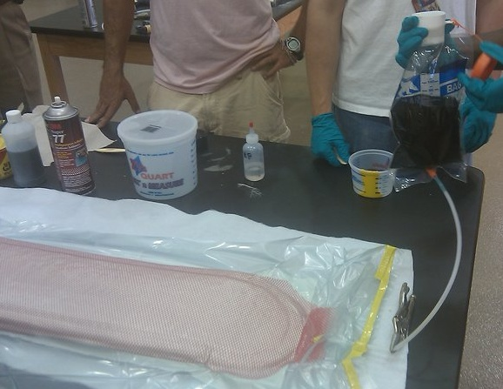
Vacuum Bagging Process
Carbon fiber-reinforced polymer
Low cost & desired results
Mold construction provided by sponsor

Slide 18
Cost of Materials
Material | Amount | Cost ($)
Carbon Fiber | 6 yards | 301.50
Epoxy Resin | 1 quart | 22.25
Spray Adhesive | 1 can | 12.95
Peel Ply | 2 yards | 22.00
Breather Cloth | 2 yards | 16.00
Flow Media | 2 yards | 75.80
Nylon Bagging Film | 2 yards | 17.00
Vacuum Tubing | 3 ft | 4.35
Yellow Sealant Tape | 2 rolls | 27.80
 | TOTAL | 499.65

Slide 19
Weight and Cost Analysis
Component | Cost ($)
EDF | 129.95
Battery | 509.99
Battery Charger | 109.98
Woodworks LipoSack (Storage) | 34.99
ESC | 120.00
Transmitter/ Receiver | 179.97
Industrial Strength Velcro | 7.00
Fuselage Materials | $499.65
TOTAL | 1591.53
Component | Weight (lbs.)
EDF | 0.862
Battery | 2.05
ESC | 0.242
Transmitter/ Receiver | 0.033
Fuselage | 1.977
TOTAL | 5.164

Slide 20
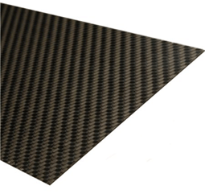
Future Work Plan
Manufacture Fuselages
Create Decision Matrix
Weight
Measure using a scale
Efficiency
How long will it run at full capacity in wind tunnel
Velocity
Compare pressures using pitot-static tube

Slide 21
acknowledgements
1st Lieutenant Brewer
Dr. Hovsapian
Dr. Kosaraju
Dr. Okoli
Dr. Englander
Dr. Ordonez
Dr. Shih
Dr. Horne
Dr. Chuy
Dr. Ahmed

Slide 22
questions

Slide 23
Resources
"76mm Aluminum Alloy Electric Ducted Fan." Nitro RC Planes, Inc. 2010. Web. 05 Oct. 2010. <http://www.nitroplanes.com/lealalel76du.html>.
Çengel, Yunus A., and Robert H. Turner. Fundamentals of Thermal-fluid Sciences. 3rd ed. Boston: McGraw-Hill, 2001. Print.
Draganfly Innovations Inc. RCToys.com Sells RC Airplanes RC Blimps RC Helicopters & Parts. 2008. Web. 07 Oct. 2010. <http://www.rctoys.com/pr/category/rc-information/rc-hobby-parts-component-info/>.
"Electric Ducted Fan Jet." RC Hobby Universe Guide to RC Airplanes, Helicopters, Boats, Cars and Trucks! 2006. Web. 07 Oct. 2010. <http://www.rc-hobby-universe.com/electric-ducted-fan-jet.html>.
“Integrating GPS with MAVs.”<http://www.mil.ufl.edu/~number9/mav/>.
Marc De Piolenc, F. "Ducted Fan Design, Volume 1 (Revised)." Google Books. Web. 29 Nov. 2010. <http://books.google.com/books?id=YcAjcSSP4HMC&printsec=frontcover&dq=Ducted Fan Design Volume 1&source=bl&ots=WtfDi_ZHQZ&sig=4G6VIAKC63HnIZLlQMLFf56LTZ0&hl=en&ei=nYnoTID_GMP6lwewtLGcCw&sa=X&oi=book_result&ct=result&resnum=9&ved=0CEYQ6AEwCA#v=onepage&q=efficiency&f=false>.
“RC Hobby Universe.” <http://www.rc-hobby universe.com/electric-ducted-fan-jet.html>.

Slide 26
Calculations:

