Slide 1


Integration of experimental propulsion systems in micro air vehicles
Design for Six Sigma Approach- DMAVD
Define Phase
October 12, 2010
Team # 3
Erica Cosmutto
Hunter Metzger
Joel Ware
Kristina De Armas
Michael Isaza
Santiago Baus

Slide 2



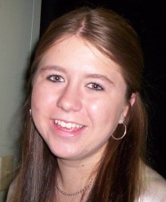
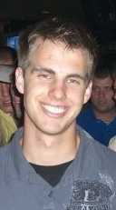

Interdisciplinary senior design
Meet our Team!
Erica Cosmutto
Hunter Metzger
Joel Ware
Kristina De Armas
Michael Isaza
Santiago Baus
Joel Ware
Mechanical Engineering Student
ME Treasurer
Director of Design
Santiago Baus
Industrial Engineering Student
IE Team Leader
Director of Quality
Kristina De Armas
Industrial Engineering Student
IE Data Organizer
Director of Six Sigma Methods
Erica Cosmutto
Mechanical Engineering Student
ME Team Leader
Director of Analysis
Hunter Metzger
Mechanical Engineering Student
ME Data Organizer
Director of Component Selection
Michael Isaza
Industrial Engineering Student
IE Treasurer
Director of Manufacturing

Slide 3
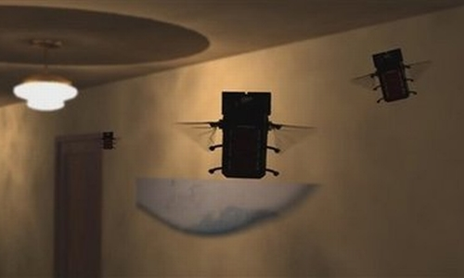
PRESENTATION OVERVIEW
Introduction to Micro Air Vehicles (MAVs)
What is DMADV?
Project Charter
Communication Strategy
Compelling Need
Process Documentation
Customer Requirements
Mechanical Elements
Future Plans
References
Questions
U.S. Air Force, Bud Sized Spy

Slide 4
Micro Air Vehicles (MAVs)
Class of unmanned aerial vehicles (UAVs)
Intelligent robots of the sky
  Multi-purpose
    Military
    Research
    Government
    Commercial
Max wing span of 15cm (~6 inches)
Insect-sized aircraft expected in the future
  Extremely discrete operations
Notes:
military potential, primarily for reconnaissance, targeting, surveillance and communication relays.
In civilian applications, it is expected to be useful for biochemical and hazardous material sensing, sensor implantation, and search and rescue missions. Commercial applications include traffic monitoring, power line inspections, real estate aerial photography, and wildlife surveys

Slide 5
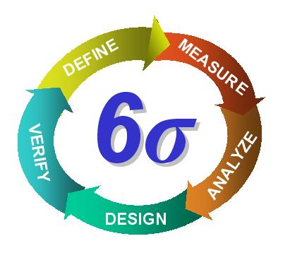
What is DMADV?
Directly related to Design for Six Sigma (DFSS)
One of the two methodologies of Six Sigma
Extremely effective way to create a new product or a new process design
Goals
  Design to be predictable
  Defect free
Notes:
Six sigma-> improves efficiency and removes defects
Increased emphasis on strong leadership and a commitment to making clear decision that begins with verifiable details, no guesswork

Slide 6
Project Charter
Business Case Eglin Air Force has worked with FAMU-FSU engineering students before to improve MAV designs. The team will design 4 basic designs of a MAV. The fuselage design will remain the same, while the placement of the electric ducted fan will move around the design in order to reach the effective design. If we fail to come up with the most effective form of integration of a experimental propulsion system in a MAV, the Air Force loses time in getting these designs out in the field working at its best potential. | Opportunity Statement MAVs were first designed in 1993 and are currently still undergoing improvements to effectively integrate new means of propulsion that would improve efficiency and flight capabilities. Once the most effective design can be identified, MAVs will undergo mass production and be ready for field use. MAVs could revolutionize the way military approaches a situation.
Goal Statement Design and develop the most efficient and flight ready MAV by integrating an experimental propulsion system. Response (Y) = Effective integration of experimental propulsion system in Micro Air Vehicles Input variables: x₁ = Basic MAV requirements x₂ = Eglin Air Force requirements x₃ = ME Department requirements x₄ = IE Department requirements | Project Scope In Scope: Incorporate new means of propulsion that improve the efficiency and flight capabilities of MAVs Out of Scope: Design and development of wings, Takeoff and landing, and Servo selection
Project Plan Start: September 7, 2010 Define: October 19, 2010 Deadline (6 weeks) Measure: November 30, 2010 (6 weeks) Analyze, Design, Verify: Spring 2011 | Team Selection Sponsor: LT. John S. Brewer ME Faculty Advisor:Dr. Englander IE Faculty Advisor:Dr. Okoli ME Team Members: Erica Cosmutto, Joel Ware, Hunter Metzger IE Team Members: Kristina De Armas, Santiago Baus, Michael Isaza Resources: ME and IE Department Faculty, HPMI Jerry Horne

Slide 7
Business Case
Eglin Air Force Base
Integrate components into a Micro Air Vehicle
Design 4 basic MAV models
  One distinct fuselage design
  Variable placements of electric ducted fan
Failure to experiment on new propulsion systems
  Results in:
    Set back in technology advancement
    Loss of potential field reconnaissance
Notes:
Eglin Air Force wants to improve the current Micro Air Vehicle Designs they are currently incorporating
Main focus of improvement is to implement an Electric Ducted Fan and/or a Micro-Turbine Engine and test its effectiveness

Slide 8
Opportunity statement
MAVs were first designed in 1993
Experiment integrating new propulsion systems in MAVs
  Electric ducted fan
  Carbon fiber fuselage
Proper implementation of an effective propulsion system
  MAVs undergo mass production
  Revolutionize the way the military approaches certain situations
Notes:
Undergoing improvements to effectively integrate new means of propulsion that would improve efficiency and flight capabilities
Proper implementation of an effective propulsion system would revolutionize the way the military approaches certain situations

Slide 9
Goal statement
Design and develop the most efficient and flight ready MAV by integrating an experimental propulsion system
Input Variables
  Basic MAV requirements
  Eglin Air Force requirements
  ME Department Requirements
  IE Department Requirements

Slide 10
Project scope
Integrate an electric ducted fan into the fuselage of a Micro Air Vehicle (MAV)
Our Focus
  Fuselage design
  Duct design
  Integrating electronics and fan into the fuselage
Goals
  Design four types of fuselage (choose one to manufacture)
  Each will demonstrate the effectiveness of the propulsion system and duct design
Out of Scope
  Design and development of wings
  Take off and landing
  Servo selection

Slide 11
Project plan
Start Date: September 7, 2010
Define Phase: October 19, 2010- 6 weeks
Measure Phase: November 30, 2010- 6 weeks
Analyze, Design, Verify: Spring 2011

Slide 12
Project organization chart
Lt. John Brewer
Customer
Dr. Okoli
IE Advisor
Dr. Englander
ME Advisor
Hunter Metzger
ME Organizer
Joel Ware
ME Treasurer
Erica Cosmutto
ME Team Leader
Michael Isaza
IE Treasurer
Kristina De Armas
IE Organizer
Santiago Baus
Team Leader

Slide 13
Communication strategy
Effective communication strategy
Defines the message to be delivered and the method of delivery

Slide 14
Compelling need
“Unless you convince me I am worse off, I won’t change”
MAVs will soon play an important role in future warfare
  Increase the war fighters situational awareness
  Facilitate rapid and precise engagement
  Decrease amount of fatalities
Use threat opportunity matrix as tool
Notes:
Urban battlefields call for tools which increase the war fighters situational awareness and capacity to engage rapidly and precisely

Slide 15
Threat Opportunity Matrix
Threats
Opportunity
Failure to improve military operations | Reduce large amount of casualties Increase effectiveness of military missions
An increased risk of national security Failure to implement new technologies | New technologies may be implemented due to a better design
Short Term
Long Term

Slide 16
Process documentation
Sipoc diagram
Start Boundary: Proposal
End Boundary: Integration of Components
Suppliers
Inputs
Process
Outputs
Customers
Pre-designed wings
Fuselage designs
Battery
Speed & flight control
Electric ducted fan
Constraints
Duct Designs
CAD, Pro-E, Catia sketches
3D Printing
Fuselage & Duct Manufacture
Integration
of
Components
Eglin Air Force Base
HPMI
Tower Hobbies
Flight ready MAV
Eglin Air Force Base
Notes:
Process Documentation

Slide 17
Customer requirements
Important to customer
  Establishes a target
Numerous requirements
  Brainstorm cause and effects
  How should we measure?
Tools used to organize and measure
  Fishbone Diagram
  House of Quality
Results obtained from tools
  Max relative weight: 10.3
  Focus on width and weight

Slide 18
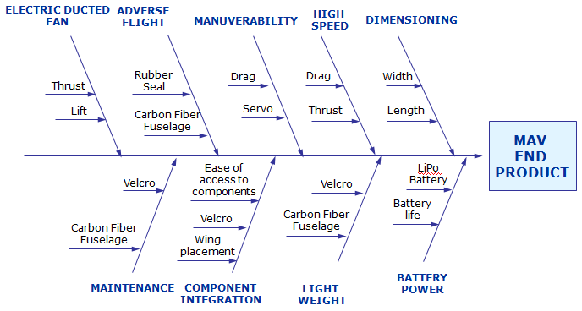
Fishbone diagram

Slide 19
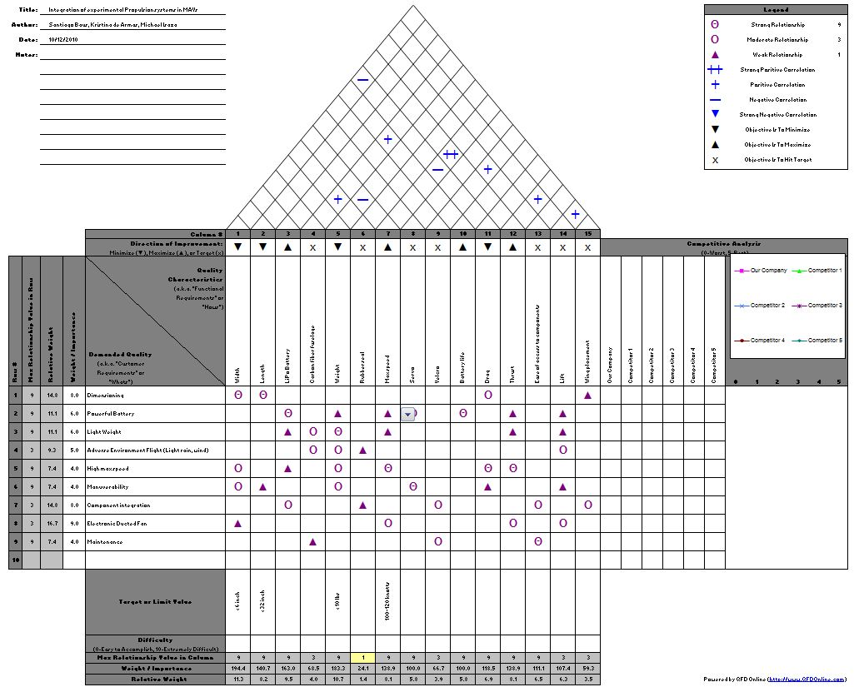
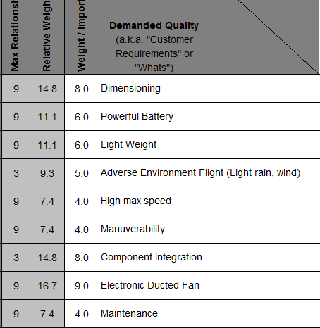
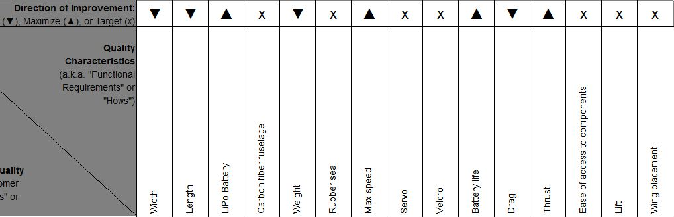
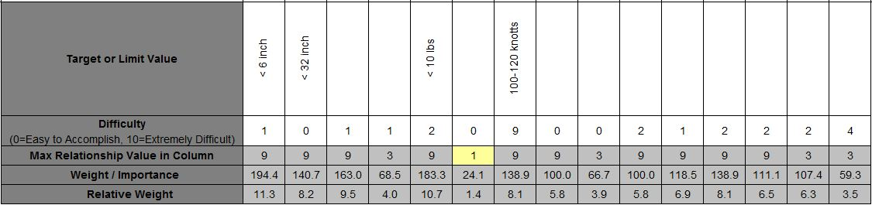
House of quality

Slide 20
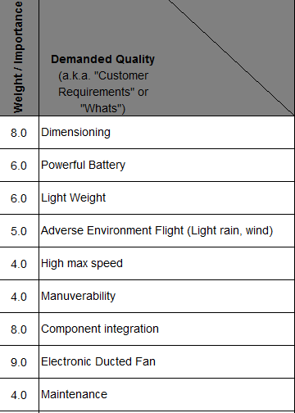
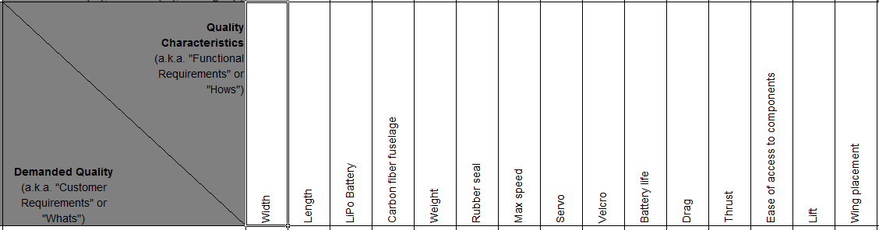
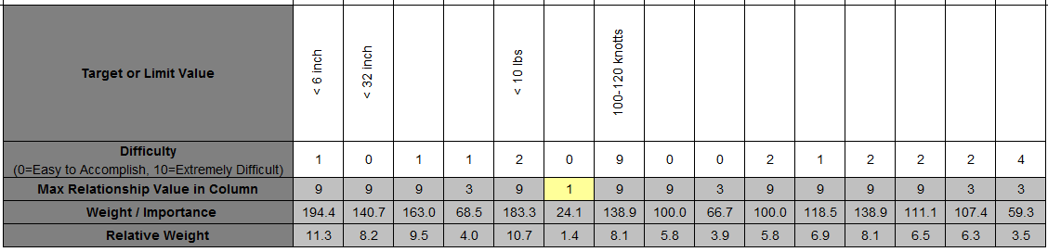
House of quality
A closer look

Slide 21
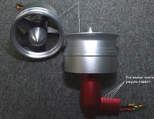
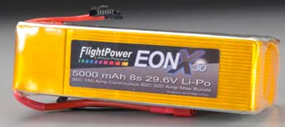
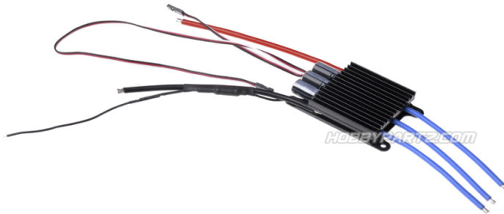
Component selection
Electronic
Speed Control
Electric Ducted Fan
Battery
www.towerhobbies.com
www.hobbypartz.com
www.airshowrc.com
4kg of Thrust
90mm Inner Diameter
29.6V
65A
8S Li-Po Battery (29.6V)
30C Current
5000 mAh
6-12 Cell Li-Po (22.2V – 44.4V)
150A

Slide 22
Weight and cost analysis
Component | Weight
EDF | 563 g
Battery | 1080 g
ESC | 125 g
TOTAL: | 1768 g = 3.90 lbs
Component | Cost
EDF | $199.99
Battery | $319.99
Battery Balance Charger | $109.98
Woodworks LipoSack (Storage) | $34.99
ESC | $88.00
Program Card for ESC | $8.50
Transmitter/Receiver | $179.97
Industrial Strength Velcro | $7.00
TOTAL | $948.42
Constrained to a total of 10 lbs
Average density of carbon fiber: 0.065 lbs/in³
By V=m/ρ → carbon fiber cannot exceed 93.84 in³

Slide 23

Fuselage and Ideal duct design
Fuselage Design
  Material (Carbon Fiber Composite)
  Geometry of Fuselage
Ideal Duct Design
  High Pressure after fan
  Hole in front of fan (more air being pulled in by fan)
  Efficient
  Small diameter

Slide 24
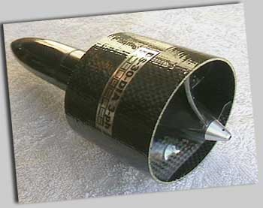
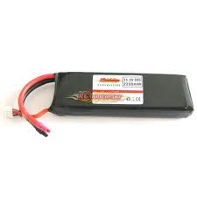
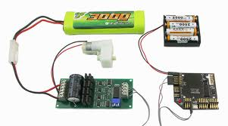
Integration of Components
One set of components
Hatch to remove electrical components
Velcro

Slide 25
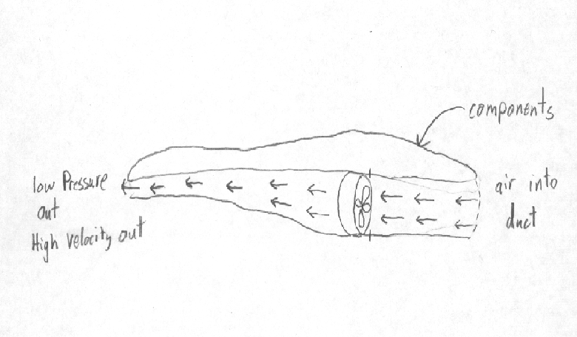
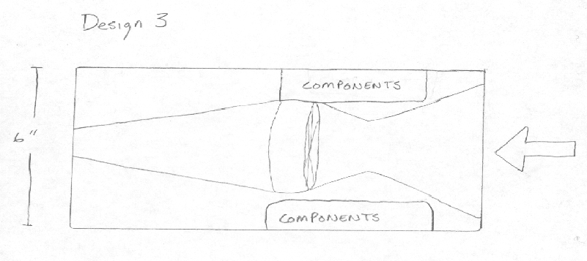
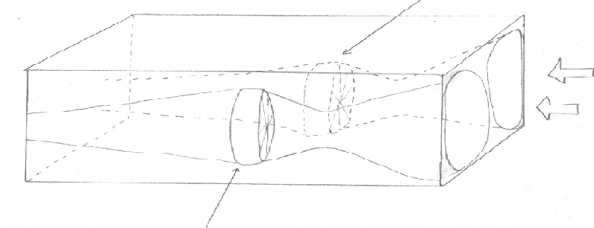
Design Concepts
Design 3
Choose one fuselage design
Vary duct design
Design 1
Design 2
Design 4

Slide 26
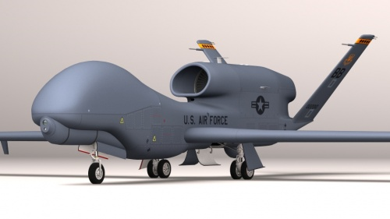
Future plans
Finalize EDF and purchase components
Detailed Design (Comsol, Catia)
Analysis (mass flow, thrust, weight, dimensions)
Create molds
Assemble
Test
Explore manufacturing process
DAMES
Optimizing facility layout

Slide 27
Resources
"76mm Aluminum Alloy Electric Ducted Fan." Nitro RC Planes, Inc. 2010. Web. 05 Oct. 2010. <http://www.nitroplanes.com/lealalel76du.html>.
Çengel, Yunus A., and Robert H. Turner. Fundamentals of Thermal-fluid Sciences. 3rd ed. Boston: McGraw-Hill, 2001. Print.
Draganfly Innovations Inc. RCToys.com Sells RC Airplanes RC Blimps RC Helicopters & Parts. 2008. Web. 07 Oct. 2010. <http://www.rctoys.com/pr/category/rc-information/rc-hobby-parts-component-info/>.
"Electric Ducted Fan Jet." RC Hobby Universe Guide to RC Airplanes, Helicopters, Boats, Cars and Trucks! 2006. Web. 07 Oct. 2010. <http://www.rc-hobby-universe.com/electric-ducted-fan-jet.html>.
“Integrating GPS with MAVs.”<http://www.mil.ufl.edu/~number9/mav/>.
“RC Hobby Universe.” <http://www.rc-hobby universe.com/electric-ducted-fan-jet.html>.

Slide 28

questions

