Slide 1
Integration of experimental propulsion systems in micro air vehicles
Deliverable: Interim Design
November 9, 2010
Team # 3
Erica Cosmutto
Hunter Metzger
Joel Ware
Kristina De Armas
Michael Isaza
Santiago Baus

Slide 2
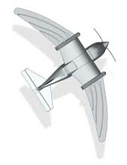
OverView
Introduction
EDF vs Propeller
Final Component Selection
IE Update
Calculated Values
Designs
Center of Gravity
Cost and Weight Analysis
Conclusion
Future Work

Slide 3
Introduction
Integrate an electric ducted fan into the fuselage of a Micro Air Vehicle (MAV)
Focus on:
Fuselage design
Air Flow Inlet/Duct design
Integrating electronics and fan into the fuselage
Constraints:
10 lb max
6 in diameter
32 in length

Slide 4
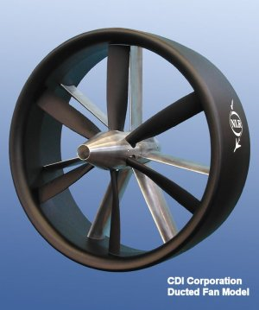
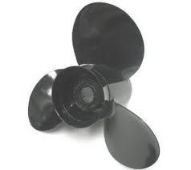
EDF VS Propeller fan
Duct reduces losses in thrust caused by tip vortices
The Ducted fan operated at higher velocity
EDF has a smaller diameter
EDFs are quieter and safer

Slide 5
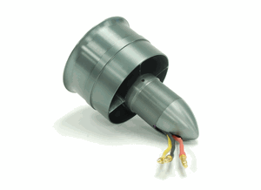
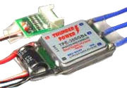
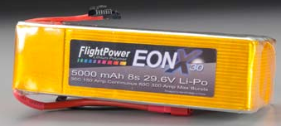
Final Component Selection
76mm ID, 80mm OD
22.2V
391g
55A
$129.50
TP8000-6S4PL
22.2V
8000mAh
16C
$509.99
Smart Guide ESC
Up to 44.4V
100A
$120.00

Slide 6
IE Update
Lean Six Sigma Methodology
DMAIC process
Define Phase Complete
Measure Phase due November 30th
Define performance standards
Establish data collection plan
Validate the measurement system
Collect necessary data from existing system

Slide 7
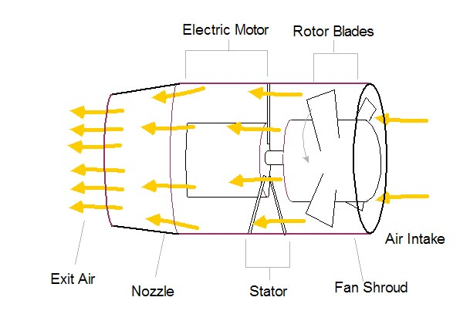
Values Calculated
Maximum Thrust of 2.2 kg =21.6 N
Ideal Inlet Area= 5.643 in² (FSA, Fan Sweep Area)
Ideal Exit Area=4.3 in² (75% of FSA)
Maximum Velocity Exiting Fan=52.478 m/s

Slide 8
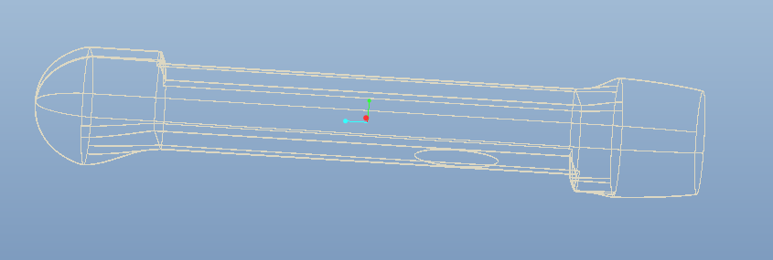
Design 1
Design specified by sponsor
Intake from the bottom of the MAV

Slide 9
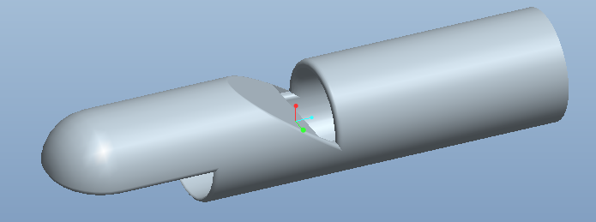
Design 2
Intake on top and bottom
Laminar flow off top surface

Slide 10
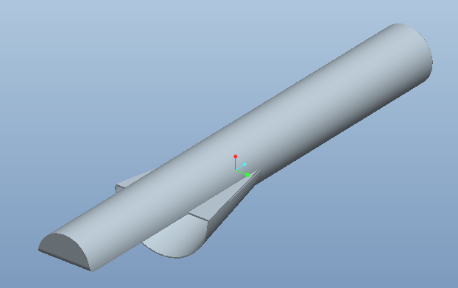
Design 3
Maximize flow intake
Simple design

Slide 11
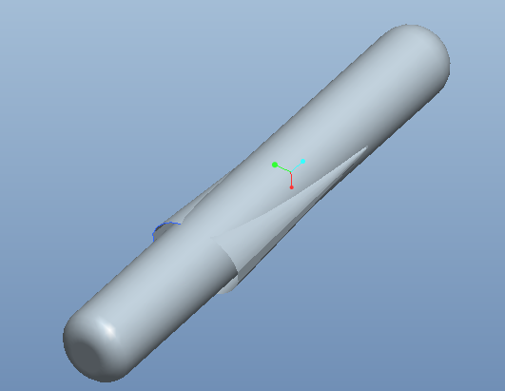
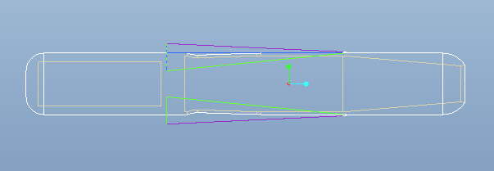
Design 4
Uses two side ducts
Smooth intake of air

Slide 12
Center of Gravity
1.92 in
Desired
CG
Current
CG
ESC
110g
Fan
391g
Battery
932g
Fuselage
3084g

Slide 13
Cost and Weight Analysis
Component | Cost | Weight
EDF | $129.95 | .862 lbs
Battery | $509.99 | 2.05 lbs
Battery Charger | $109.98
Woodworks LipoSack (Storage) | $34.99
ESC | $120.00 | .242 lbs
Transmitter/ Receiver | $179.97 | .033 lbs
Industrial Strength Velcro | $7.00
TOTAL | $1091.88 | 3.187 lbs

Slide 14
Conclusion
Four fuselage designs
Initial Calculations and Analysis
Calculated Ideal Inlet and Outlet Areas
Center of Gravity Analysis
Final Component Selection
The team has started work at HPMI

Slide 15
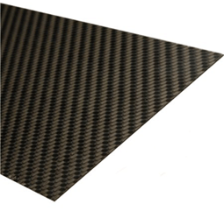
Future Work
Continue work at HPMI
Produce the first mold
Receive Components
Testing in Comsol and wind tunnels
Measurement of Existing Model

Slide 16
References
Hobbypartz.com
Thunderpowerrc.com
Hobbytown.com
“The Calculation and Design of Ducted Fans”.Wattflyer.com
www2.nlr.nl/public/facilities/AVET-Info/Content/UK/PropBlades.html
www.sterndrive.info/400_800_cobra_propellers.html

Slide 17
Calculations:

