Slide 1
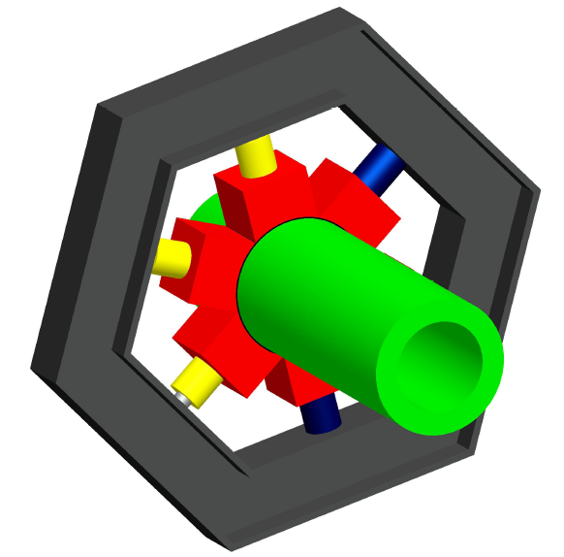
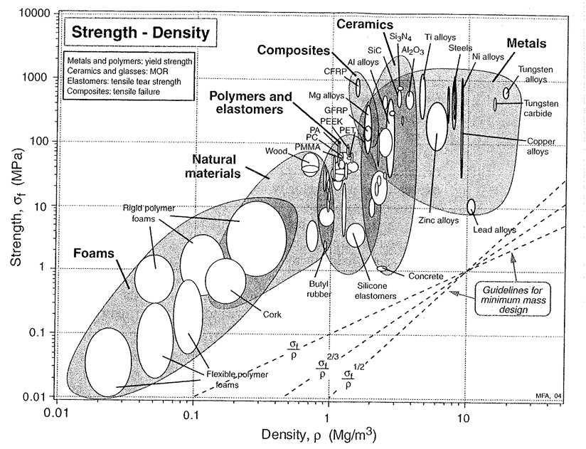
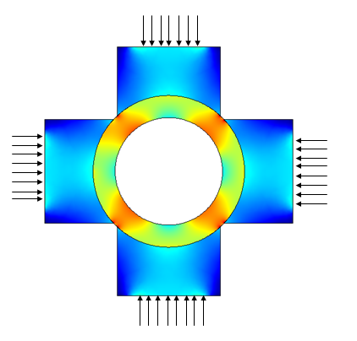
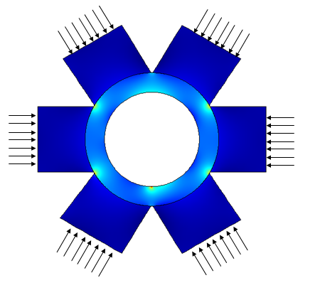
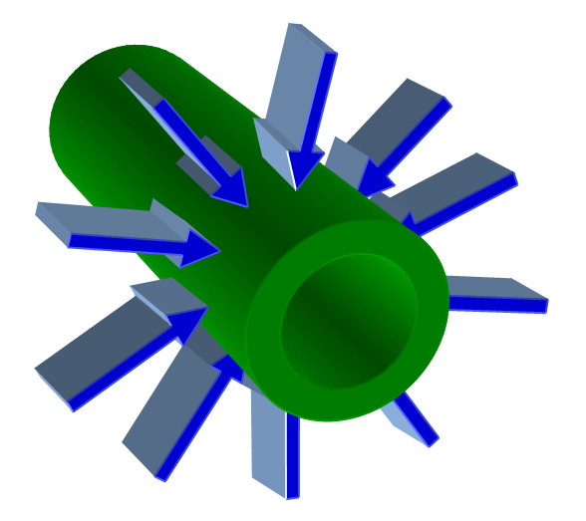
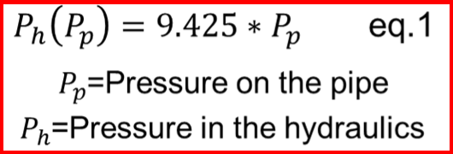
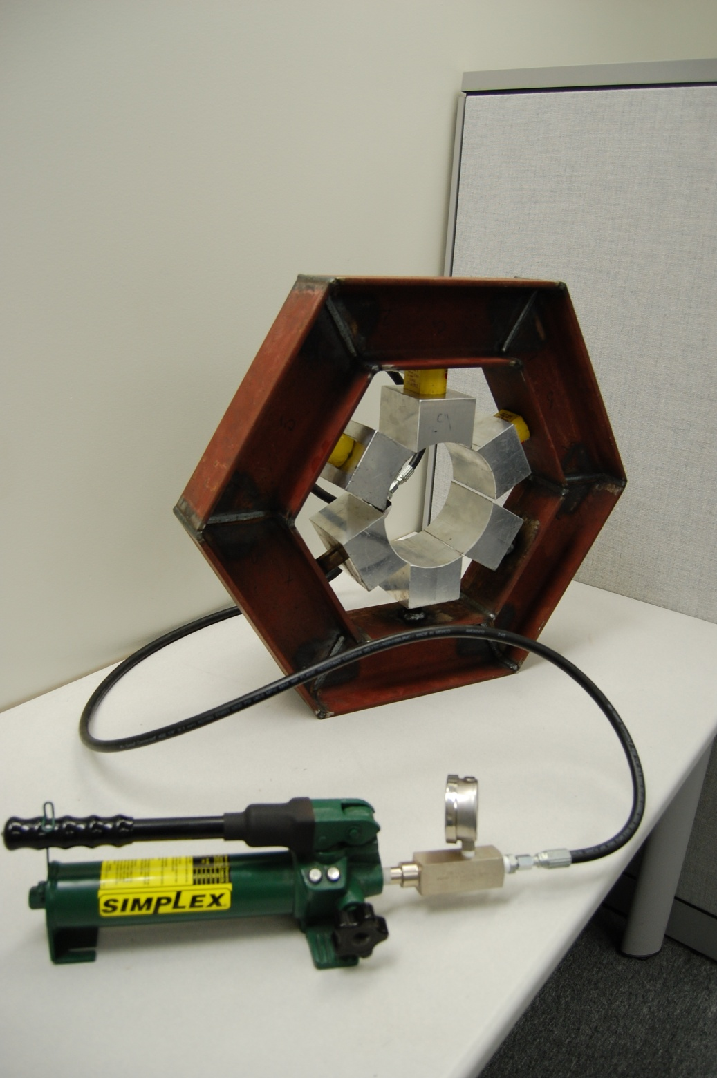
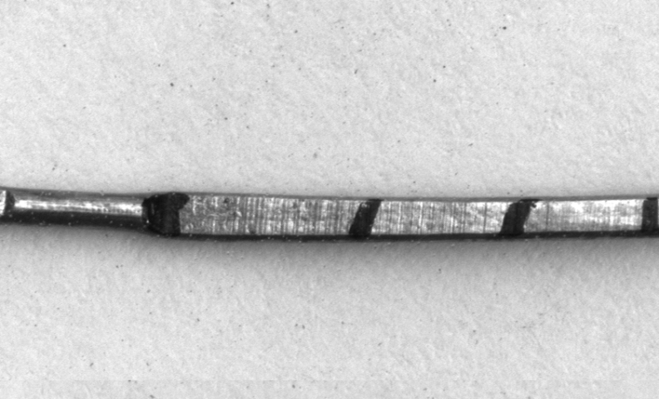
The CRUSHED Experiment
The Group
Design Process
Material Selection
New System
These are some of the initial ideas for the design process
Material selection in design techniques were used to
Due to restrictions the dimensions had to be recalculated around our hydraulic specifications
New I-Beam Dimensions
Phillip Munday
pmm06d@fsu.edu
Columns
Plates
Material TBD
Pipe
Hydraulic press
52MPa
Outer Ring
Justin Roose
jr08k@fsu.edu
Sections
Pipe
Safety & Hazards
Aluminum sections and Steel I-beam outer ring were used
Carlos Sanabria
cs06c@fsu.edu
The safety hazard are mostly due to the large pressures and forces used in the system.
Safety glasses and knowledge of the system is strongly advised
Finite Element
Analysis
Initial Problem
F
t
Pressure Distribution (MPa)
Pressure Distribution (MPa)
L
w
Final Design and Testing
10,000 psi of pressure around a 6” diameter pipe
Problems and
Restrictions
Pressure Distribution (MPa)
Available force application devices restrict our force and final surface pressure
Restrictions
No sensors
Must be cantilevered
Calibration needed
Type |  | Single Acting
Material of Construction |  | Steel
Capacity (Tons) |  | 5
Stroke (In.) |  | 0.62
Effective Area (sq. in.) |  | 0.99
Oil Capacity (Cu.-In.) |  | 0.62
Retracted Height (In.) |  | 1.63
Extended Height (In.) |  | 2.25
Outside Dia. (In.) |  | 1.62 x 2.31
Plunger Dia. (In.) |  | 1.12
Bearings |  | Bronze
FEA was done to look for an optimum number of sections, geometry and pressure distribution estimation

