Slide 1
The CRUSHED Experiment
By: Carlos Sanabria
Justin Roose
Phillip Munday

Slide 2
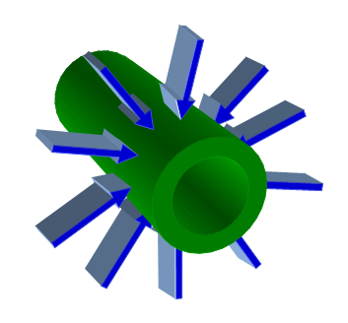
The Experiment
We are to apply 10,000 psi of a quasi-hydrostatic pressure on a 6” diameter pipe
Figure 1 – Sketch
Pipe under hydrostatic pressure

Slide 3
Concept Generation
Figure 2 – Concepts
Four plates with an incompressible media
Fluid Pressure
High strength fabric
Hose Clamp
Segments
a)
Plates
Pipe
b)

Slide 4
Concept Generation
c)
Figure 2 – Concepts
Four plates with an incompressible media
Fluid Pressure
High strength fabric
Hose Clamp
Segments
d)

Slide 5
Concept Generation
Figure 2 – Concepts
Four plates with an incompressible media
Fluid Pressure
High strength fabric
Hose Clamp
Segments
e)

Slide 6
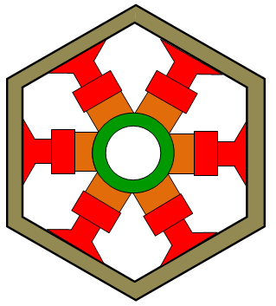
The Design Process
Hydrostatic Press
Outer Ring
Pipe
Spacing (incompressible media)
Figure 3 – Transverse cross section of the pipe being compressed by six sections

Slide 7
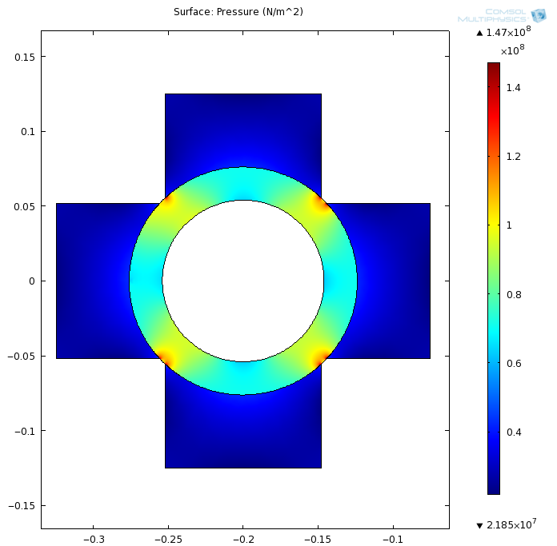
FEA
Thinking about these sections and how close to real hydrostatic pressure these forces will be, we have to find out how many pieces (sections) we need.
An FEA was done to determine the pressure distribution, failure points and strains.
Figure 4 – FEA sample
Using 4 sections and a distributed known load

Slide 8
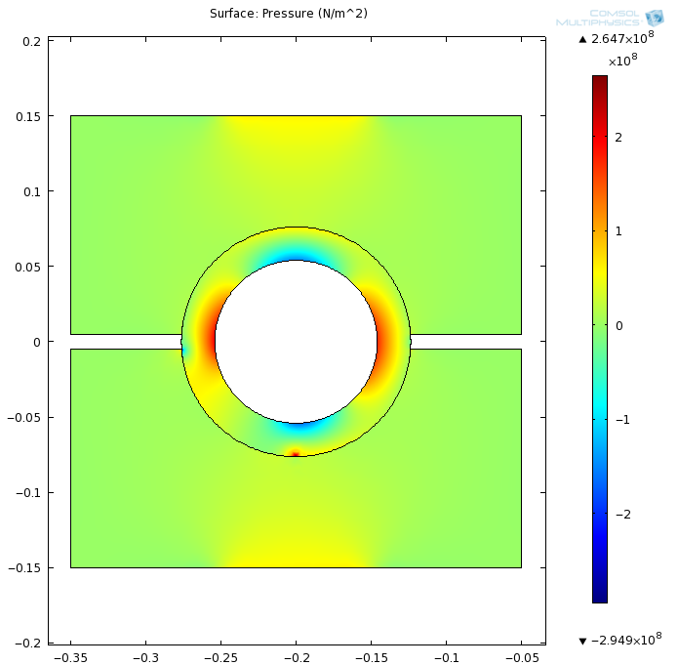
Two sections
Pressure Distribution (MPa)
Figure 5 – Two sections
Not an option!

Slide 9
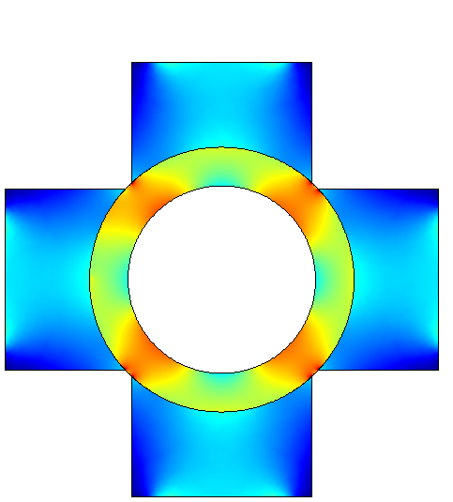
Four sections
Pressure Distribution (MPa)
Figure 6 – Four sections
Still not uniform

Slide 10
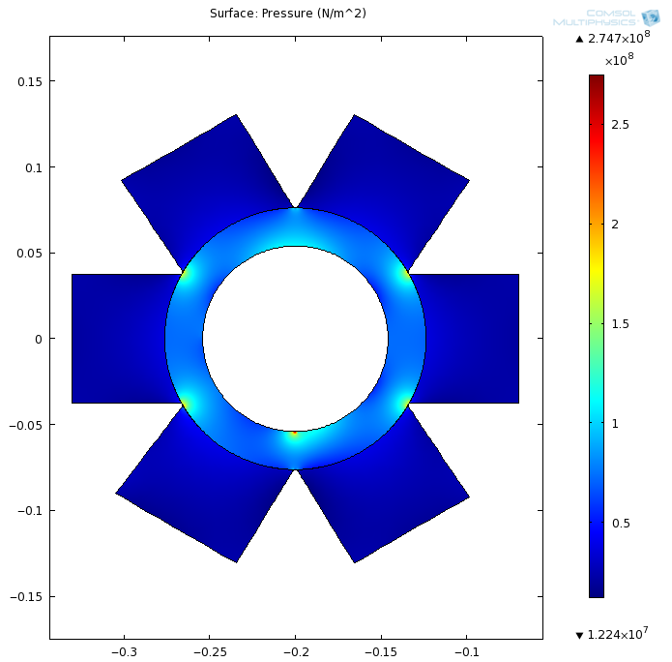
Six sections
Pressure Distribution (MPa)
Figure 7 – Six sections
Better pressure distribution

Slide 11
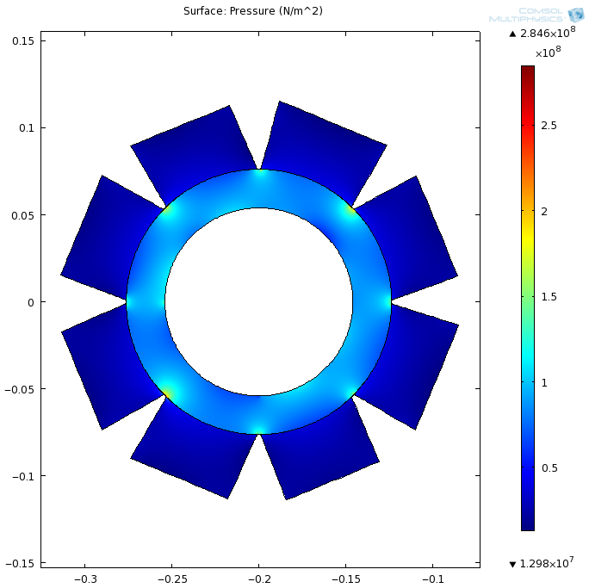
Eight sections
Pressure Distribution (MPa)
Figure 8 – Eight sections
Much Better pressure distribution… overkill?

Slide 12
Force application
Screws vs. Hydraulic actuators
vs.
Figure 9 – Force Application
Side view of the two force application options

Slide 13
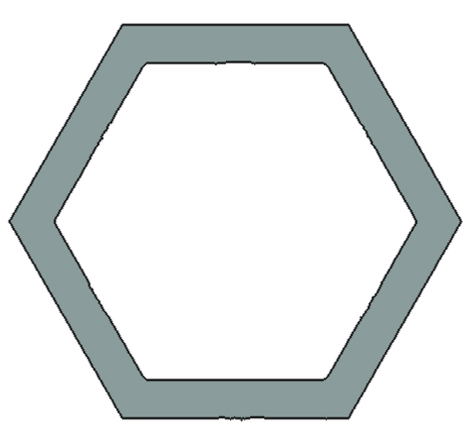
Material Selection
F
w
F
h
Aluminum
Steel
d
Figure 12 – A single section
Figure 13 – The hexagonal outer ring

Slide 14
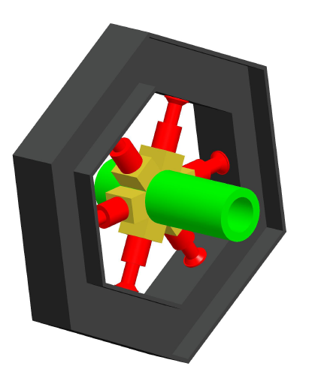
Final Design (for 10,000 psi)
Design for a surface pressure up to 10,000 psi
Figure 14 – Final Design for the fall semester

Slide 15
The problem:
The strongest actuators that can accommodate our budget are not nearly as strong as our calculations assumed
Our sponsor advised that we should design around the actuator’s force

Slide 16
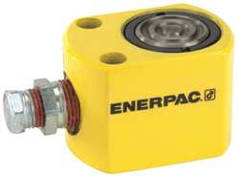
Available actuators considering our budget
Type |  | Single Acting
Material of Construction |  | Steel
Capacity (Tons) |  | 5
Stroke (In.) |  | 0.62
Effective Area (sq. in.) |  | 0.99
Oil Capacity (Cu.-In.) |  | 0.62
Retracted Height (In.) |  | 1.63
Plunger Dia. (In.) |  | 1.12
Figure 15 – Model Number RW50

Slide 17
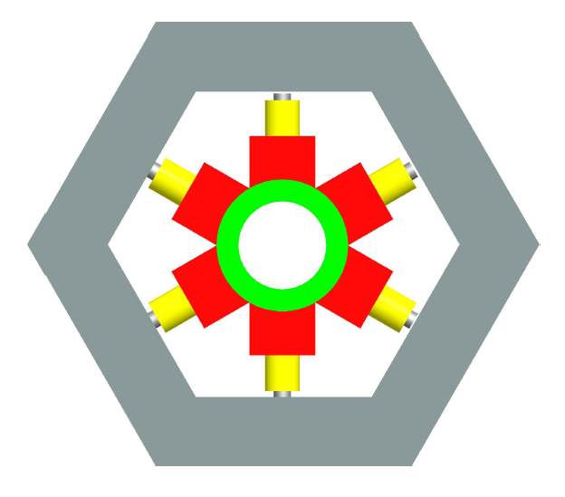
New Ring Dimensions and forces
Five tons of force from each actuator
14.05 in
Figure 16 – New ring Dimensions

Slide 18
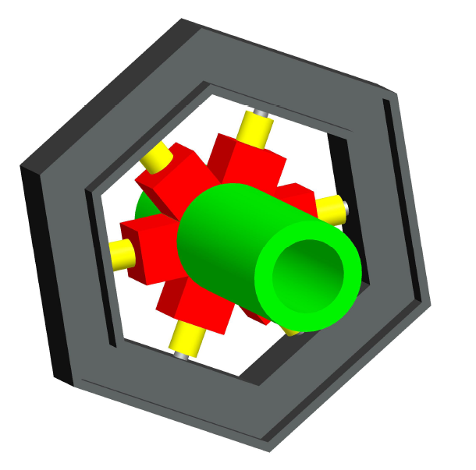
Optimizing
New I-Beam Dimensions
Replacing Actuators
Natural Rubber Insertion
Figure 17 – New System Layout and next steps

Slide 19
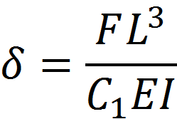
I - beams
12.73 in
w
δ
s
h
8.11 in
t
Figure 18 – Ring Piece Dimensions and Deflection
h | 4 in
w | 2.796 in
s | 0.326 in
t | 0.293 in

Slide 20
I - beams
NOT SIGNIFICANT!

Slide 21
I – beams w4-13
4.06 in
4.16 in
0.28 in
0.345 in
Figure 19 – I - beam dimensions

Slide 22
Replacing Actuators by Stationary Columns
L = Length of the Column
Columns are characterized by it’s Slenderness Ratio
K = Radius of Gyration
$$Sr=\sqrt{\frac{L}{k}}$$
$$k=\sqrt{\frac{Second Moment of Inertia}{Area of Cross Section}}$$

Slide 23
Replacing Actuators by Stationary Columns
If the Slenderness Ratio < 10
The column is now bound by the Mechanical Properties
To ensure this:
L = 1.94 inch
same length as hydraulic cylinders
Diameter > 0.776 inch
Diameter is set to be 1 inch
Made out of structural steel ASTM - A36
Same as I-beams

Slide 24
Replacing Actuators by Stationary Columns
Structural Steel ASTM – A36
Elastic Modulus = 29,000 ksi
Yield Stress = 36 ksi
Stress$=\frac{Applied Force}{Area}$
Stress = 12 ksi
Str$ain=\frac{Stress}{Elastic Modulus}$
Strain = 0.0004

Slide 25
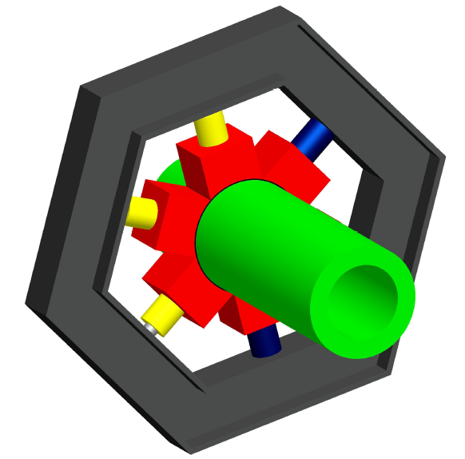
Final System
New I-Beam Dimensions
Columns
Natural Rubber Insertion
Figure 20 – Final System

Slide 26
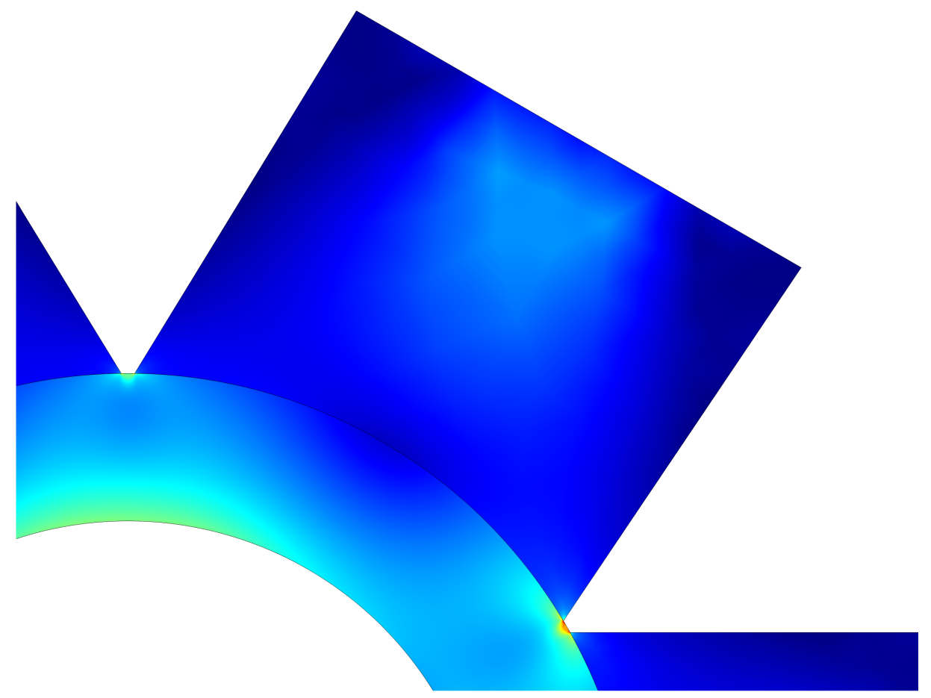
New FEA
Stress (ksi)
F = 10,000lbs
5
4
3
2
1
Figure 21 – FEA with a smaller
force area

Slide 27
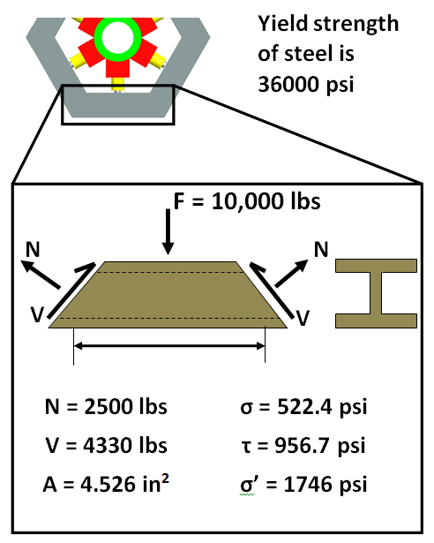
Welding points
Figure 22 – Welding area forces
and stresses

Slide 28
Safety
High pressure and high forces are always dangerous to work with
Need to have intimate knowledge of the system to operate
Keep others in close proximity aware of the testing
Eye protection is advised

Slide 29
Procedure for Use
Insert pipe into the center
Be sure all hydraulic hoses are clear
Make sure everyone all safety precautions are in place
Calculate desired pressure (using equation 1)
Increase hydraulic pressure to the calculated pressure
Perform dynamic testing
Release the pressure in the hydraulics
Remove pipe
$P_{h}\left(P_{p}\right)=9.425∗P_{p}$ eq.1
$P_{p}$=Pressure on the pipe
$P_{h}$=Pressure in the hydraulics

Slide 30
Pipe Pressure vs. Hydraulic Pressure
$$P_{p}\left(P_{h}\right)=\frac{P_{h}}{9.425}$$

Slide 31
Testing
Attached a strain gauge on the inside of the pipe
Get a relationship between hydraulic pressure and pressure on the pipe
Put copper wire between the pipe
Check to see how quasi-hydrostatic the pressure is

Slide 32
Cost
Table 1
Part | Cost | Quantity | Total
Hydraulic Pump | $262.50 | 1 | $262.50
Hydraulic Cylinders | $219.00 | 3 | $657.00
Hose and Connectors | $24.66 | 4 | $98.64
Hydraulic Manifold | $103.07 | 1 | $103.07
I-beam Sections | $25.00 | 6 | $150.00
Steel Columns | $9.78 | 3 | $29.33
Aluminum Blocks | $33.52 | 6 | $201.12
Rubber | $11.95 | 1 | $11.95
Pressure Gauge | 63.67 | 1 | $63.67
Pressure Adapter | $52.85 | 1 | $52.85
Total Costs |  |  | $1,630.13

Slide 33
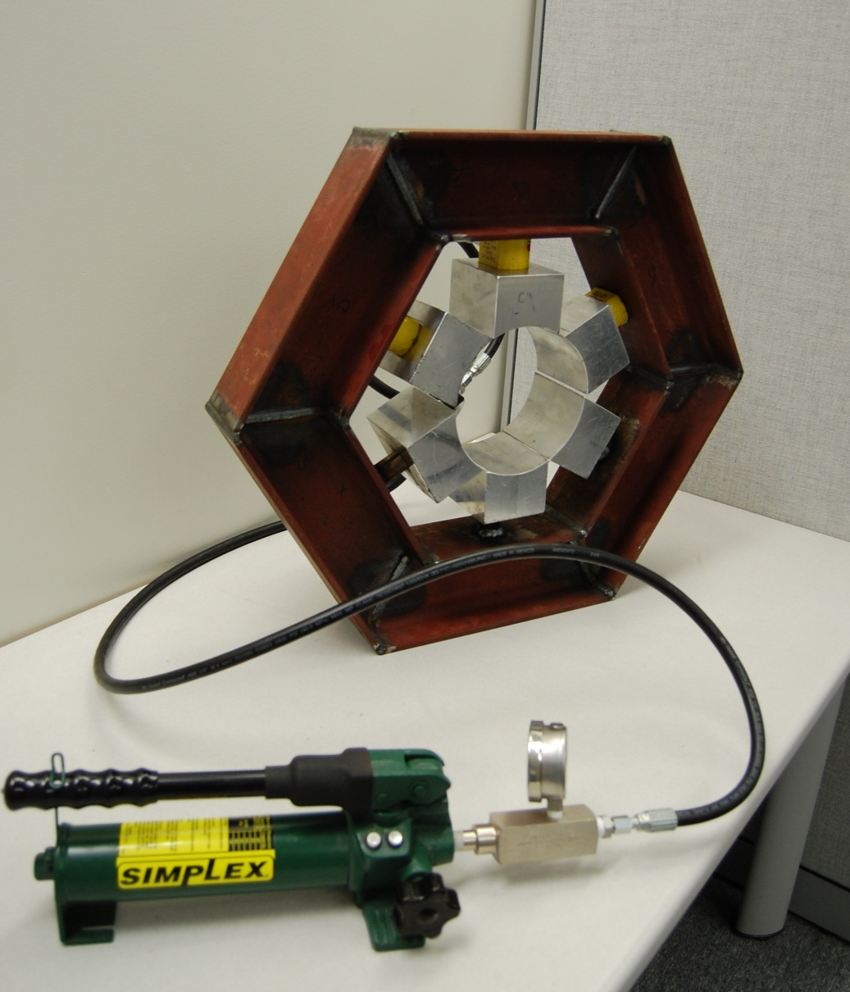
Conclusion
Max Pipe Pressure = 1061 psi

Slide 34
Acknowledgments
Dr. Eric Hellstrom
Dr. William Oates
Dr. Janet Wolfson
Dr. Zohrob Hovsapian
Dr. Srinivas Kosaraju
S & H Hydraulics
Jeremy Phillips
John Deep

Slide 35
Questions?

