Slide 1
The CRUSHED Experiment
By: Carlos Sanabria
Justin Roose
Phillip Munday

Slide 2
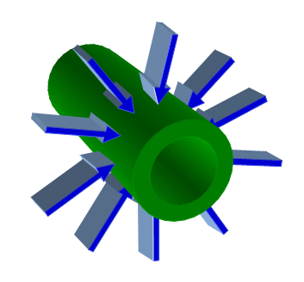
The Experiment
We are to apply a semi-hydrostatic pressure on a 6” diameter pipe.
Figure 1 – Sketch
Pipe under hydrostatic pressure

Slide 3
Our Previous Idea
Pipe
Plates
Material TBD
Figure 2 – Previous Concept Selection
An incompressible solid being put under pressure by four steel plates
Notes:
It uses a material as the incompressible media that will be put under pressure by four steel plates that will be tightened down through bolts at the 45° angled ends as shown in Figure

Slide 4
The Problem: Crinkling
Stress Concentrations
Figure 3 – Zoomed in section after pressure is applied
These stress concentrations compromise the pressure distribution and the material itself
Notes:
the inner diameter of this incompressible media will have to be slightly larger than the outer diameter of the pipe so that we can slide the pipe in without problems. Therefore there has to be some deformation for the material to come in full contact with the pipe, and this will introduce some crinkling in the material’s diameter as shown in Figure

Slide 5
Our New Idea
Figure 4 – New Idea
Sections of material that are to be tightened down at the same time using an external plate as support shown
Notes:
So we revisited our previous ideas and came up with the following solution: Sections of this material that are to be tightened down at the same time using an external plate as support shown in Figure

Slide 6
Or Even Better
Figure 5 – Using Hydrostatic Presses
Eight sections using hydraulic presses that will expand instead of screws
Notes:
Another idea could be using hydraulic presses that will expand instead of screws, as shown in Figure. This would lower the stress concentrations on the surrounding plate since there are no threads. Plus, it will be very easy to measure the pressure being applied.

Slide 7
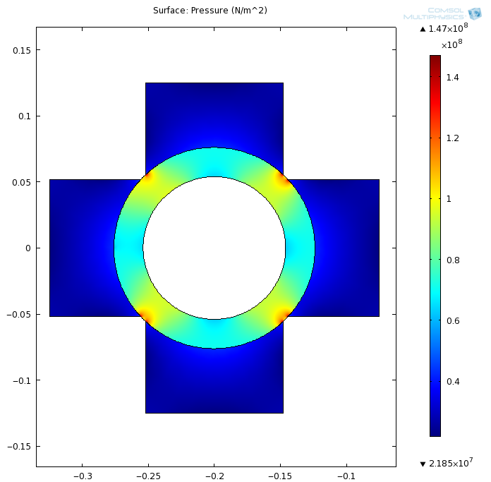
FEA
Thinking about these sections and how close to real hydrostatic pressure these forces will be, we have to find out how many pieces (sections) we need.
An FEA was done to determine the pressure distribution, failure points and strains.
Figure 6 – FEA sample
Using 4 sections and a distributed known load
Notes:
Thinking about these sections and how close to real hydrostatic pressure these forces will be, we have to find out how many pieces do we need

Slide 8
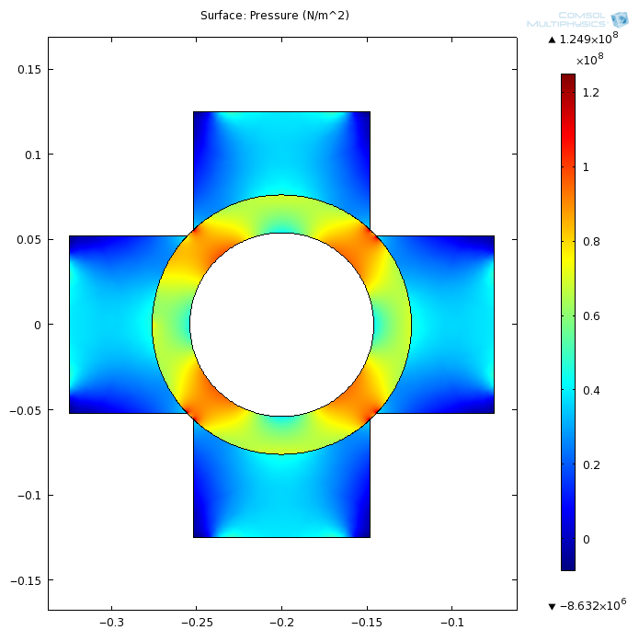
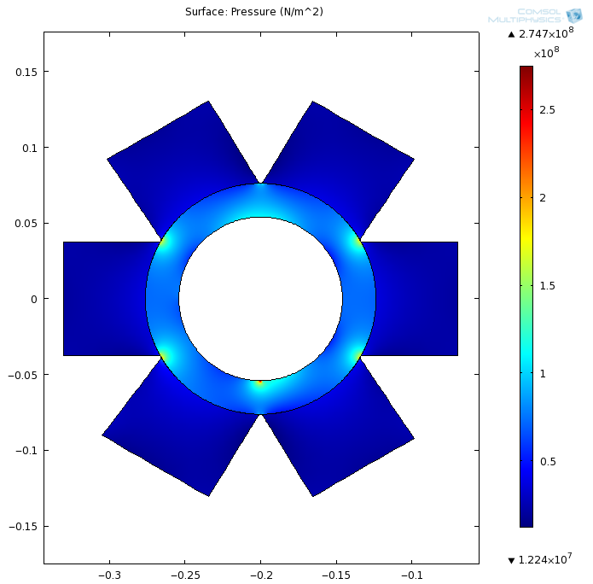
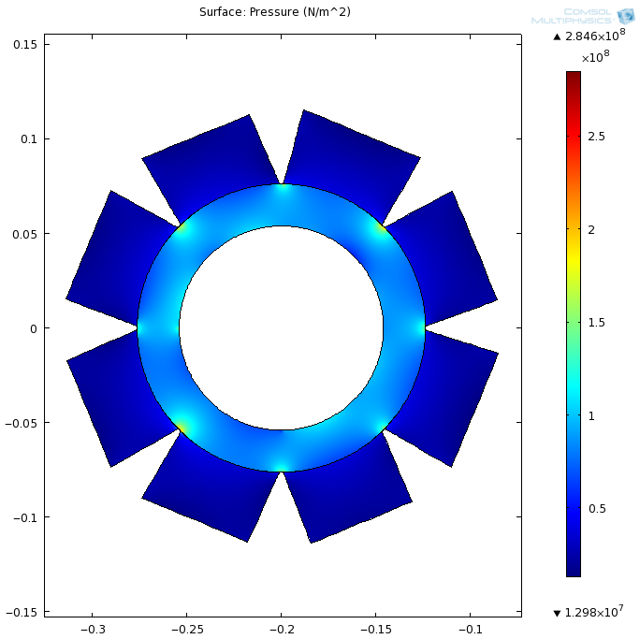
Exploring the number of sections in detail
2
4
6
8
Notes:
Exploring the number of sections in detail…

Slide 9
Two sections
70MPa
Figure 7 – Two sections
Not an option!
Notes:
as you can see the pressure distribution is not uniform at all. This is definitely not an option

Slide 10
Four sections
73MPa
Figure 8 – Four sections
Still not uniform
Notes:
A total pressure of 73MPa had to be applied at each section end to reach the 70MPa on the pipe’s surface. As you can see the pressure distribution is still very uneven.

Slide 11
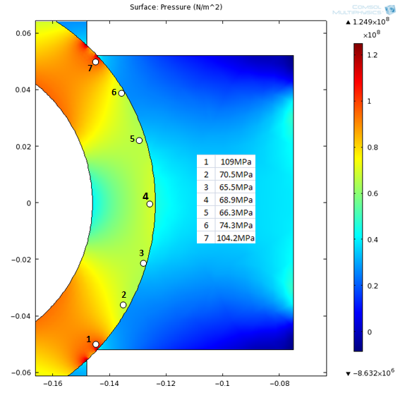
Four sections close up
Figure 9 – Four sections close up
Pressure varies from 66MPa to 70MPa
Notes:
Figure shows a closer view of one of the sections and its pressure distribution. The pressure around the pipe’s surface varies from 66MPa to 70MPa. With peak values around the edges of ≈ 109MPa. But you can see how even though it doesn’t vary that much over the surface, inside the pipe is not uniform at all.

Slide 12
Six sections
52MPa
Figure 10 – Six sections
Better pressure distribution
Notes:
A total pressure of 52MPa had to be applied at each section end to reach the 70MPa on the pipe’s surface, slightly lower than the pressure needed with four sections and just by looking at it you can see how the pressure is distributed much more evenly.

Slide 13
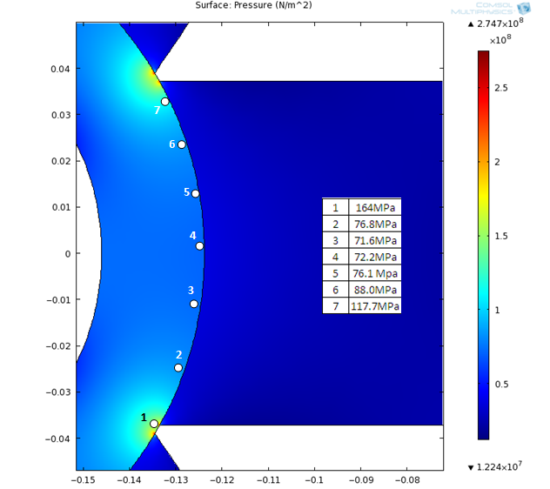
Six sections close up
Figure 11 – Six sections close up
Pressure varies from 71MPa to 88MPa but is much more uniform
Notes:
Figure shows how the pressure is distributed along the pipes surface with six sections. The pressure varies from 71MPa to 88MPa. But looking at the whole things you can see that everything else gets a lot more uniform than 4 sections.

Slide 14
Eight sections
50MPa
Figure 12 – Eight sections
Much Better pressure distribution… overkill?
Notes:
A total pressure of 50MPa had to be applied at each section end to reach the 70MPa on the pipe’s surface, slightly lower than the pressure needed with six sections.

Slide 15
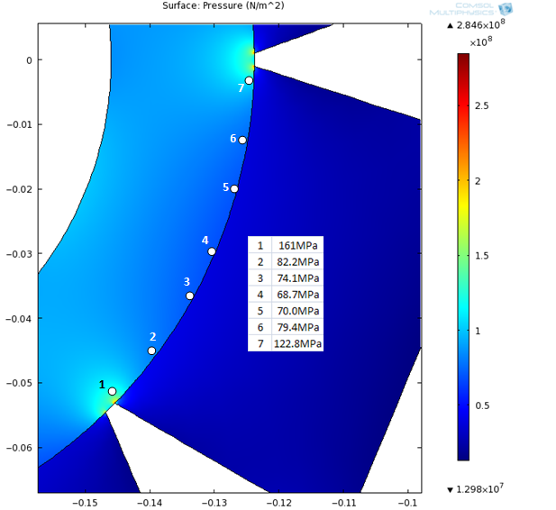
Eight sections close up
Figure 13 – Eight sections close up
High pressure areas around the corners are smaller
Notes:
Figure 13 shows how the pressure is distributed along the pipes surface with eight sections. The pressure varies from 68MPa to 82MPa. Comparing these results with the ones from the six sections we can see how the high pressure areas around the corners are smaller.

Slide 16
How many?
It seems as if six sections is our best option for three reasons:
Pressure is much more uniform than four sections
Even though eight sections is more uniform, six sections is still uniform enough.
Eight sections requires a lot more parts (pressure application devices TBD)
6
Notes:
With this study we found out that four sections is still too few sections to make a uniform pressure distribution, six sections gets closer to the desired uniformity, and eight sections is even more uniform.
It seems as if six sections is our best option for three reasons:
Pressure is much more uniform than four sections
Even though eight sections is more uniform, six sections is still uniform enough.
Eight sections requires a lot more parts (pressure application devices TBD)

Slide 17
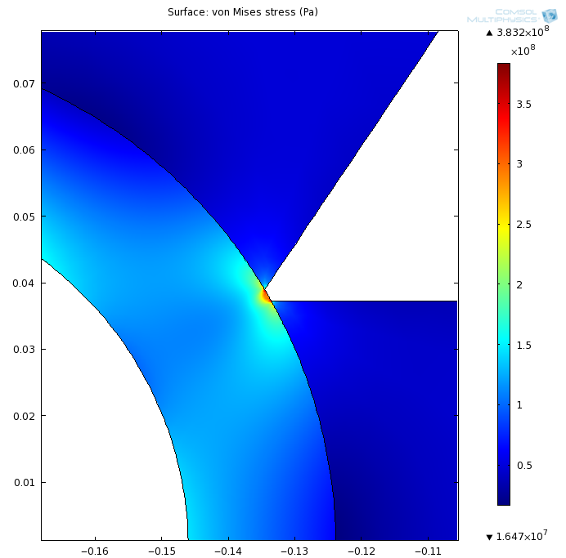
Failure?... Nope!
Figure 14 – Six section Stress
Pipe won’t fail!
Notes:
Figure shows the von mesis stress plotted. Notice how even at the edges the stress never exceed the 383 MPa on the pipe’s surface. The yielding stress of steel is more than 400 MPa. So we are on a good range. The pipe will not fail due to stress concentrations. On the other hand, the sections are under a stress around the 50 and 70MPa on the edges and the ultimate compressive strength of concrete is around 30MPa so the sections might fail unless another material is chosen aluminum for example has yield strength of 400MPa. The material is still to be determined.

Slide 18
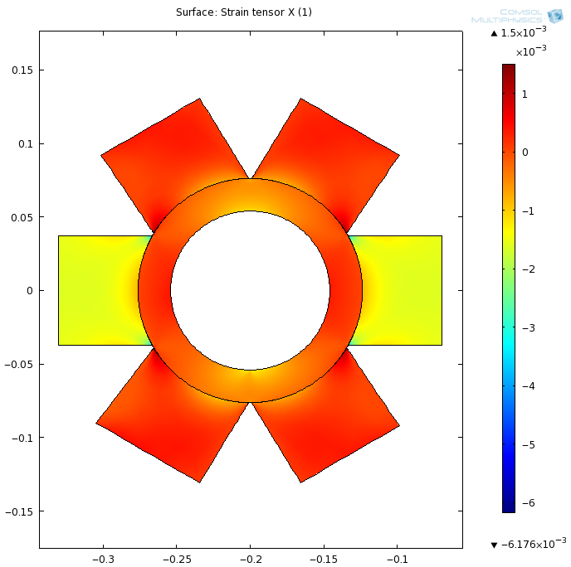
Deflection?... Nope!
Figure 15 – Six section Strain
Pipe and sections won’t deflect!
Notes:
The Figure displays the strain in the X. Notice how this deflection is less than % 0.1 therefore we are in the safe zone, we can bring these sections as close to each other as the machining (shaping) tolerance lets us. (similar results for strain in Y)

Slide 19
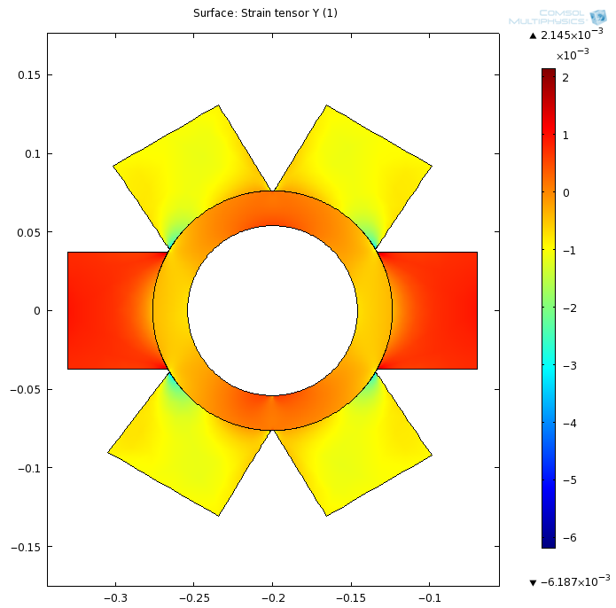
Deflection?... Nope!
Figure 16 – Six section Strain
Pipe and sections won’t deflect!
Notes:
Y

Slide 20
Material Selection
Function:
Light Strong Inexpensive Column
Constraints:
Geometry is specified
Material must have strength > 52MPa
Objective
Minimize mass and cost
F = 585kN
0.075 m
0.05 m
0.15 m
Figure 17 – A single section
Notes:
The problem we are looking at is a simple column being in compression. We are given the dimensions of these columns and the force they need to withstand. The figure is a sketch of the problem with the pertinent data. This force is to be applied uniformly over the surface and the column is expected not to yield. Yielding would cause deflection, and this will force the sections to touch each other and interfere with the calculations.

Slide 21
Material Selection
Starting with the following equations
Eliminating the area between these two equations we get
Then our material index is
F = 585kN
A = 0.01125 m²
0.05 m
Figure 18 – Simplified Sketch
Notes:
There are several assumptions that can be made here to simplify the problem. Since we are dealing with a column under compression, the shape does not influence the performance of the column therefore we do not have to look into shape factors. Another useful assumption is that both areas at the bottom and at the top are very similar to each other (in size) and since the column is so short it will not buckle. If the constraints are followed, the column will not yield and the section ends will not overlap.
The figure simplifies the problem into a more convenient geometry following the assumptions stated above.
Now we need to set up an equation that describing the quantity to be minimized (mass). Starting with the following equations
Eliminating between these two equations we get
Then our material index is

Slide 22
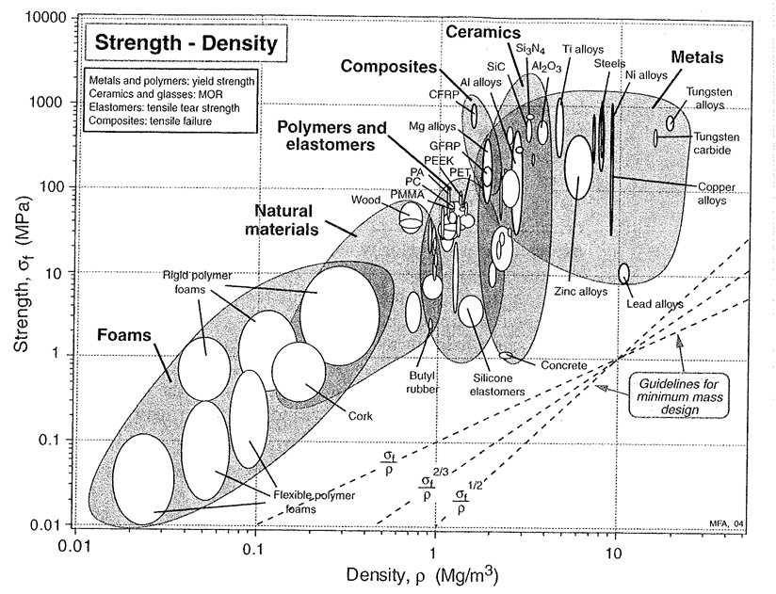
Material Selection
Figure 19 – Strength plotted against density
Notes:
We know that our material has to have a yielding strength higher than 52 MPa therefore looking at the graph in Figure 6 our material of choice has to be above this blue line. And, by maximizing the material index, we minimize the mass (maximize the objective). To do this we push this red line as high as we can to get the best material
According to the graph the materials that would be the strongest and lightests columns are CFRP, GFRP, Magnesium alloys, titanium alloys, aluminum alloys and some technical ceramics. Lets look at these options to see which one maximizes our second objective, inexpensive.

Slide 23
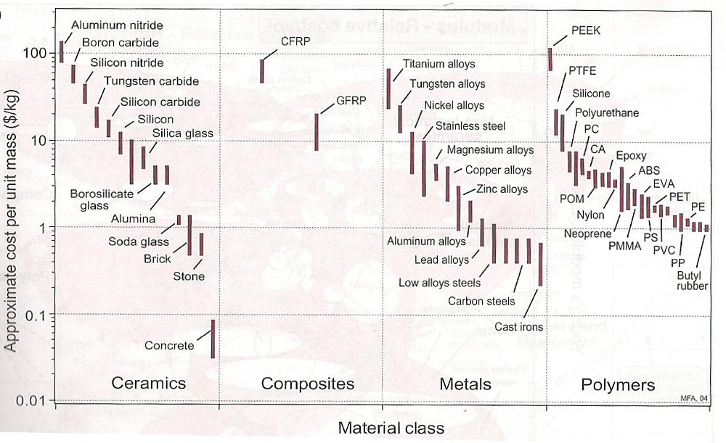
Material Selection
Figure 20 – Approximate cost/kg of material
Notes:
Figure 7 has a graph of the approximate cost per unit mass. The graph shows that aluminum alloys are the best option.

Slide 24
Analysis On the Fasteners
Bolts are typically stronger
Nuts are weaker
5/16 x 18 thread pattern
Failure is due to direct shear in threads
Thread Pullout
low strength bolt designation
medium strength bolt designation
high strength bolt designation
Notes:
A fastener is a bolt

Slide 25
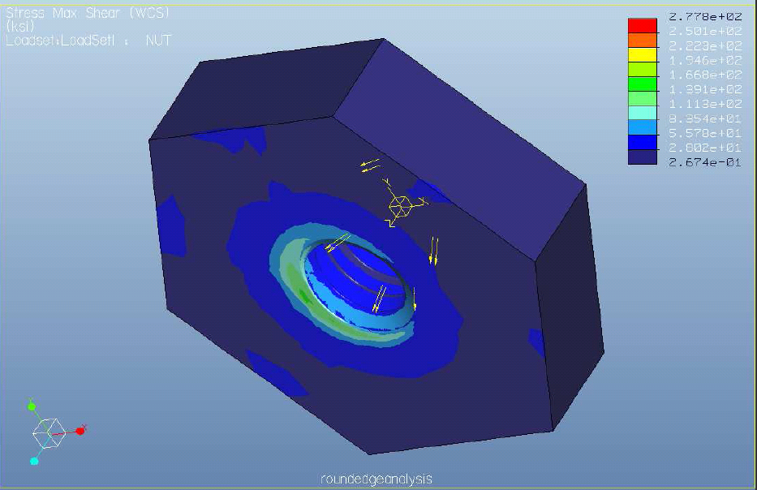
FEA On the Nut - 6280 lbf on threads Shear Stress = 139 ksi
Figure 21 – Forces are distributed to the last two threads evenly
Notes:
Figure 7 has a graph of the approximate cost per unit mass. The graph shows that aluminum alloys are the best option.

Slide 26
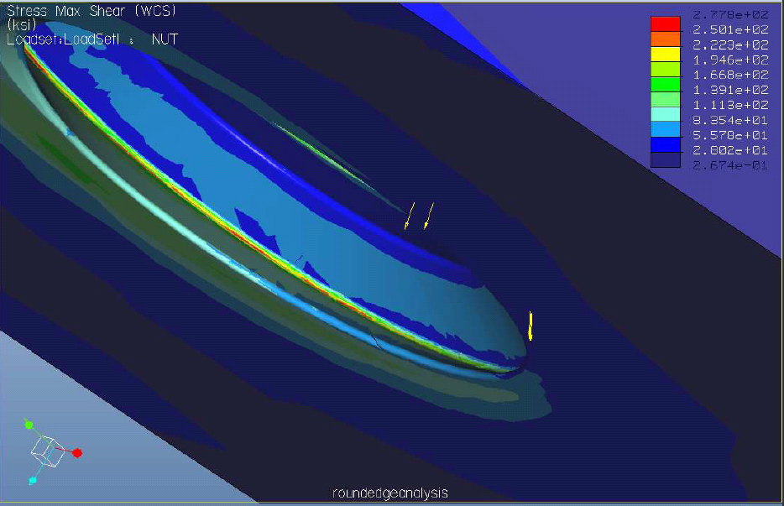
FEA On the Nut - 6280 lbf on threads Shear Stress = 258 ksi
Figure 22 – Forces are distributed to the last two threads evenly
Notes:
Figure 22 zoomed in to see behind the threads

Slide 27
Does the Nut Fail…………..NO!
Shear Stress values are compared to Proof Load
Proof Load is the 90% of yielding stress
If load was only on the first thread
FAIL
Load is shared through multiple threads
PASS
Localized yielding would further mesh threads
Further distributing the load

Slide 28
How about the pressure application? Ring Failure? We are working on it!
vs.

