Slide 1
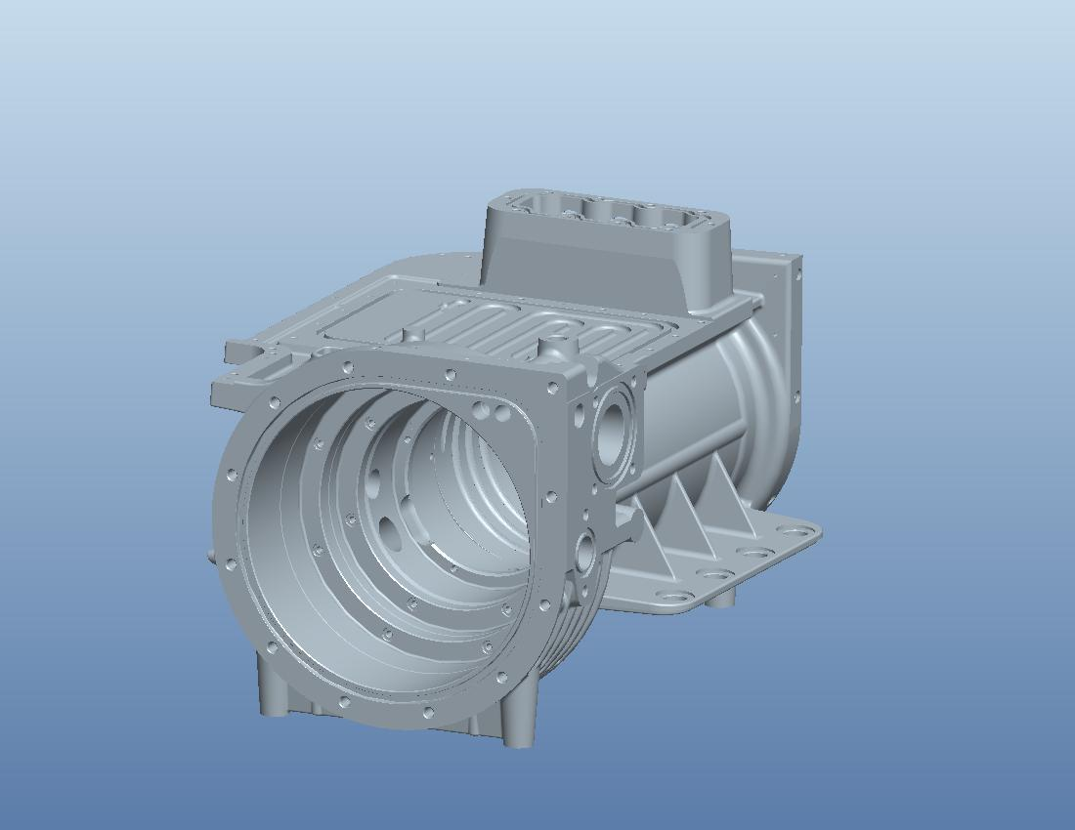
Team 8
ME Senior Design Danfoss Turbocor: Stator Insertion
Gregory Boler Jr.
Matt Desautel
Ivan Dudyak
Kevin Lohman
Figure 1: Compressor Housing

Slide 2
Overview
Danfoss Turbocor Background/Introduction
Product Specification
Design Approach
Initial Expansion Calculations
Experiment 1: Verifying Linear Expansion
Concept Generation/Selection
Heat Transfer Calculations
Experiment 2: Proof of Concept Testing
Design Details
Cost Analysis
Final Prototype Pictures
Acknowledgments

Slide 3
Cutting Edge Compressors
Outstanding Efficiency
Totally oil-free operation
Extended life with minimal scheduled maintenance
Onboard digital controls and electronics
Exceptionally quiet operation
Compact
Environmentally responsive
Figure 2: Turbocor Compressor
Notes:
Danfoss Turbocor technology advancements enable new advantages for the HVACR industry Outstanding energy efficiency: The Turbocor family of chillers' competitive full load and outstanding part load efficiency enables HVACR OEM's to exceed ASHRAE 90.1 and California Title 24 energy efficiency requirements.
Totally oil-free operation: No oil management hardware, controls or downtime costs. Improved heat transfer efficiency.
Extended equipment life with minimal scheduled maintenance: Solid-state electronics, no lubrication and no metal-to-metal contact of rotating components.
Onboard digital controls and power electronics: Enables effective monitoring, control and self-diagnosis/correction of system operation. Eliminates some traditional OEM control and power panel costs.
Exceptionally quiet operation: 70dBA (conversation level) sound with virtually no vibration.
Compact: 50% less footprint and 1/4 to 1/5 the weight of traditional compressors. The actual operating weight is only 265 pounds while conventional screw compressors can weigh over 1000 pounds.
Environmentally responsive: Optimized for CFC-free HFC-134a, plus high-energy efficiency means reduced greenhouse gas emissions.
ETL Listed

Slide 4
Introduction
Background
Heating of an aluminum housing to allow thermal expansion of the material
Once expanded a stator is inserted into the housing
The housing cools in ambient conditions locking the stator in place through an interference fit

Slide 5
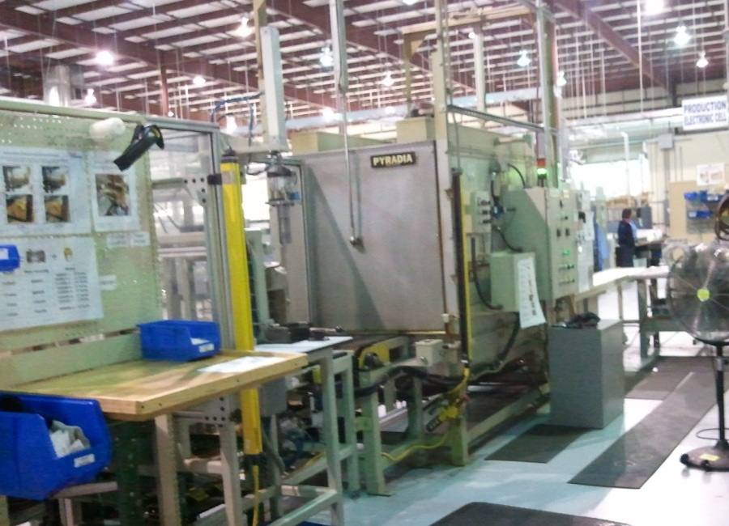
Product Specification
Current method
Large oven requiring extensive floor space
Lengthy heating time ~ 45 minutes
High final temperature ~ 300°F
Four units per cycle
Long cooling time before the technicians can continue assembly is approximatly 60 minutes
Figure 3: Current Oven

Slide 6
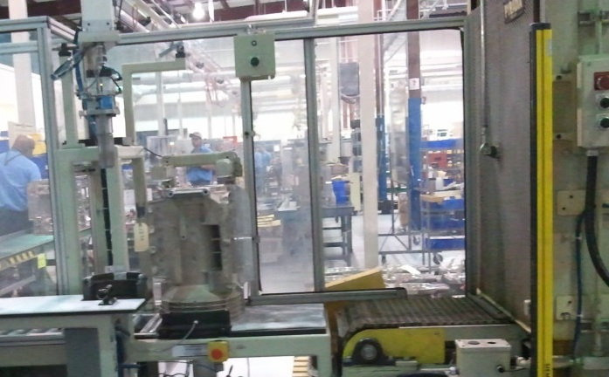
Product Specification
Current method
Stator inserted at a secondary station after heating cycle
Precise position required for pneumatic actuator
Additional floor space required for the secondary station
Figure 4: Stator Insertion Station

Slide 7
Product Specification
Engineering Requirements
Reduced heating time, < 10 min.
Lower final temperature
Smaller size
Thermal expansion must allow for 60 microns clearance at maximum material conditions
Method for aligning stator and housing for thermocouple insertion

Slide 8
Design Approach
Problem Specification
Preliminary thermal expansion calculations to determine the housing temperature to reach the desired clearance
Construction of heating unit proof of concept
Experimental measurements of housing expansion in a thermal chamber
Final design and prototype of heating unit
Calculation of heat input needed to achieve the desired temperature using hot air
Experimental testing and design adjustment
Design concept and component selection based on analysis
Final Product Evaluation

Slide 9
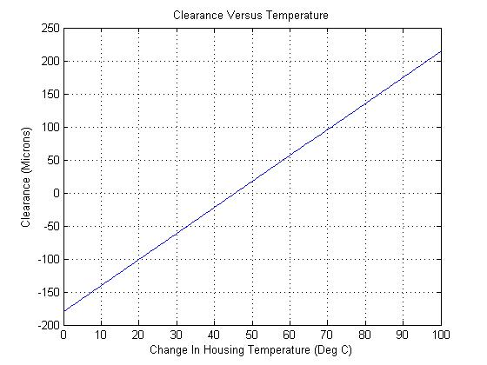
Initial Expansion Calculations
Sliding fit at maximum material condition
60 microns clearance
Linear Expansion Equation
60.5 μm
61 °C
0 μm
45.5 °C
Figure 5: Linear Expansion Relationship

Slide 10
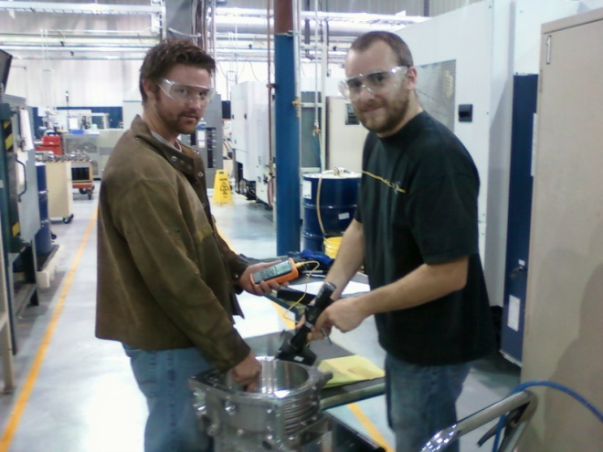
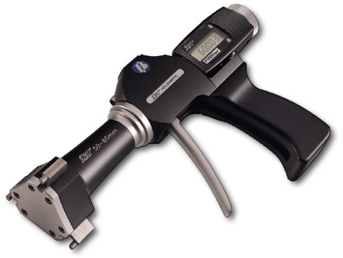
Experiment 1: Verifying Linear Expansion
Steps:
Heat housing
Take diameter measurements at various temperatures
Plot experimental data versus theoretical data
Data analysis
Figure 6: Experiment 1
Figure 7: Bore Gauge
(http://www.fvfowler.com)

Slide 11
Where to measure?
Linear expansion equation
Dimensionless linear expansion
Figure 8: Compressor Housing Cross-Section

Slide 12
Figure 9: Experiment 1 Data Analysis

Slide 13
Concept Decision Matrix
Concept Selection
 |  | Convective Oven |  | Oil bath |  | Internal Resistive |  | Induction Heating
Selection Criteria | Weight | Rating | Weight Score | Rating | Weight Score | Rating | Weight Score | Rating | Weight Score
Performance | 30% | 4 | 1.2 | 5 | 1.5 | 3 | 0.9 | 3 | 0.9
Complexity | 20% | 4 | 0.8 | 3 | 0.6 | 2 | 0.4 | 2 | 0.4
Size | 20% | 3 | 0.6 | 2 | 0.4 | 4 | 0.8 | 3 | 0.6
Durability | 15% | 3 | 0.45 | 4 | 0.6 | 1 | 0.15 | 2 | 0.3
Cost | 10% | 2 | 0.2 | 2 | 0.2 | 3 | 0.3 | 3 | 0.3
User Friendly | 5% | 3 | 0.15 | 1 | 0.05 | 3 | 0.15 | 3 | 0.15
Total |  | 3.4 |  | 3.35 |  | 2.7 |  | 2.65
Ranking |  | 1 |  | 2 |  | 3 |  | 4

Slide 14
Concept Decision Matrix
Concept Selection
 |  | Convective Oven |  | Oil bath |  | Internal Resistive |  | Induction Heating
Selection Criteria | Weight | Rating | Weight Score | Rating | Weight Score | Rating | Weight Score | Rating | Weight Score
Performance | 30% | 4 | 1.2 | 5 | 1.5 | 3 | 0.9 | 3 | 0.9
Complexity | 20% | 4 | 0.8 | 3 | 0.6 | 2 | 0.4 | 2 | 0.4
Size | 20% | 3 | 0.6 | 2 | 0.4 | 4 | 0.8 | 3 | 0.6
Durability | 15% | 3 | 0.45 | 4 | 0.6 | 1 | 0.15 | 2 | 0.3
Cost | 10% | 2 | 0.2 | 2 | 0.2 | 3 | 0.3 | 3 | 0.3
User Friendly | 5% | 3 | 0.15 | 1 | 0.05 | 3 | 0.15 | 3 | 0.15
Total |  | 3.4 |  | 3.35 |  | 2.7 |  | 2.65
Ranking |  | 1 |  | 2 |  | 3 |  | 4

Slide 15
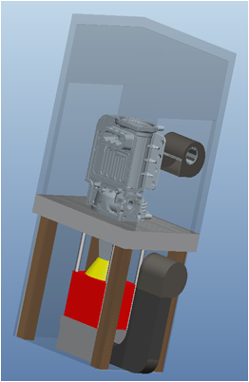
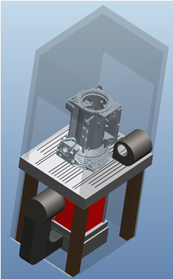
Convection Heating Design
Key Components
Insulated hood
Heater
Insulated heater enclosure
External blower
Housing alignment table
Figure 10: Provisional Design

Slide 16
Q
loss
Heat Transfer Analysis
1
W
Heat input to system 2 from heater
Q21
Heat transferred from system 2 to system 1
Q loss
Heat lost from system 2 to outside environment
Q21
2
W
Figure 11: Heat Transfer System

Slide 17
System 1
First Law System 1
1
Q21
System 2
Q
loss
First Law System 2
Q21
2
W
Figure 12: Heat Transfer Systems

Slide 18
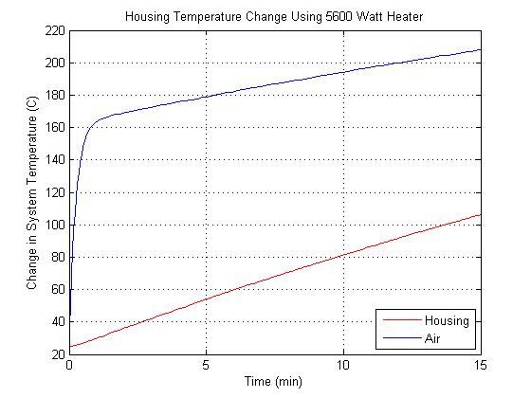
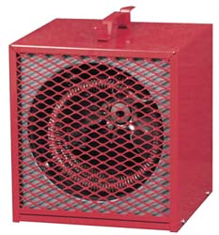
Coupled System of Ordinary Differential Equations
Initial Conditions
MATLAB
MSC 5600 watt electric portable heater
85 °C (60 °C Change)
11 min
Figure 13: Electric Heater
(http://www.mscdirect.com)
Figure 12: System Temperature vs. Time

Slide 19
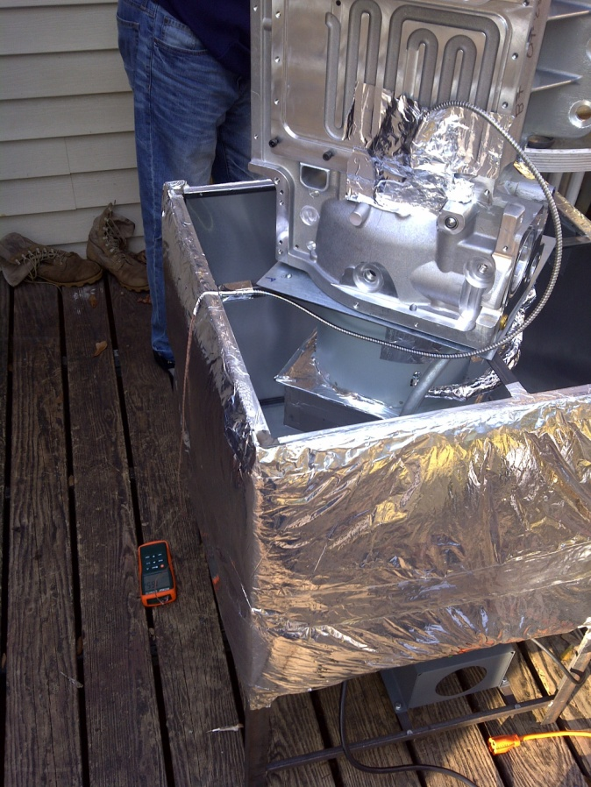
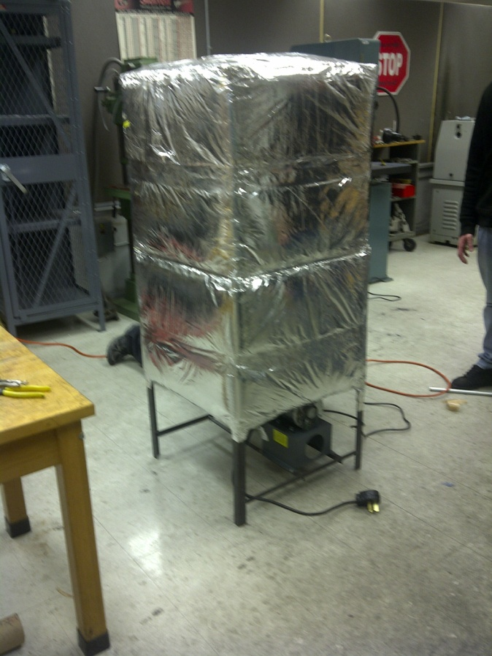
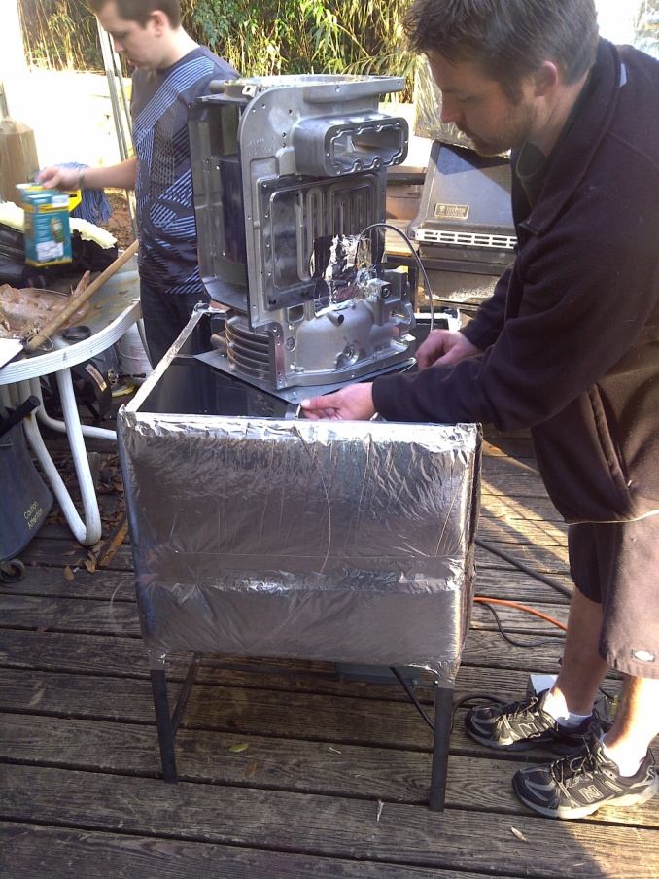
Experiment 2: Proof of Concept Testing
Thermocouple
Housing
Insulation
Heater
Blower
Figure 14: Experiment 2 Setup

Slide 20
Experiment 2: Proof of Concept Data
Figure 15: Experiment 2 Data
Notes:
Scatter plot of experimental data vs. our model

Slide 21
Experiment 2: Proof of Concept Data
Figure 16: Experiment 2 Average Data
Notes:
Average of all of our data with 2 standard deviations error

Slide 22
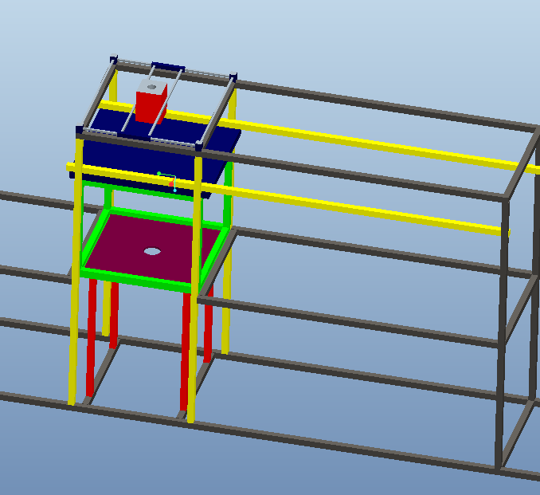
Final Design Structure
Main structure assembled utilizing 80/20
Hood lowers and closes using sliding Teflon bearings
Lid slides open and closed utilizing Teflon bearings
Pneumatic actuator utilizing expanding mandrel to place stator
Pneumatic Actuator
Lid
Hood
Main Structure
Figure 17: Main Structure

Slide 23
Final Design Stator Alignment
Key Features:
Pins to locate stator alignment ring
Pin to align stator to stator alignment ring
Pins to locate housing
Spring loaded mechanism to move housing into position
Slots to allow air circulation

Slide 24
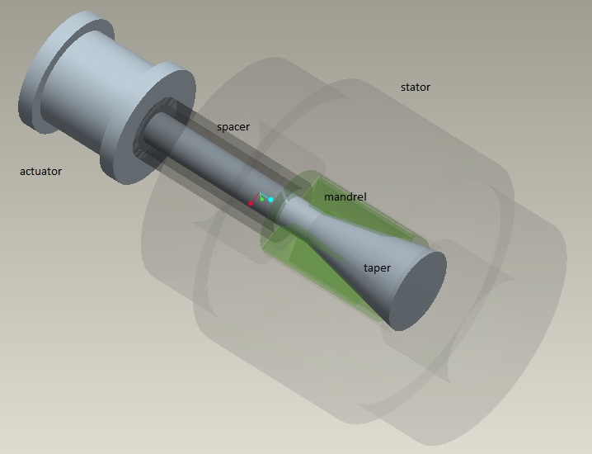
Final Design: Stator Inserter
Figure 18: Expanding Mandrel

Slide 25
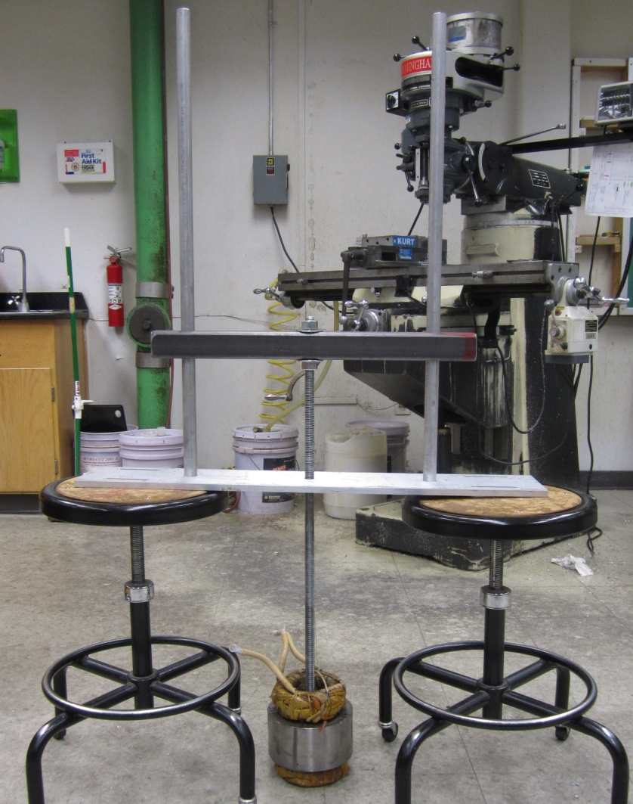
Temporary Stator Inserter
No Rotation of Stator
Allows stator insertion by hand
Temporary system due to time constraints
Figure 19: Temporary Stator insertion

Slide 26
Cost Analysis
Table 1: Convection Heater Cost Analysis
Part | Description | Supplier | Unit Price ($) | QTY | Total Price ($)
Electric Heater | 5600W 100 CFM | MSC | 138.09 | 1 | 138.09
Blower | 515 CFM | MSC | 249.95 | 1 | 249.95
Steel Plate | Plate for base | MSC | 320.00 | 1 | 320.0
Table Lever Parts | Spring, Sleeve Bearing, Slider Pin, Drill Rod | MSC | N/A | 12 | 37.16
Ultra Flex Hose | 5' Length 4" ID | MSC | 74.24 | 1 | 74.24
80/20 Extrusion | 25 Series Mono Slot Bar 6m | AES | 63.40 | N/A | 760.80
80/20 Hardware | Misc. Hardware | AES | N/A | N/A | 1878.85
Aluminum Sheet Metal | Alloy 6061 | MSC | 43.57 | 1 | 43.57
 |  |  |  | Total | 3502.66
Notes:
Our group went over budget, but it was expected because we had to make sure that our design was not only sufficient for senior design, but also for Turbocor. They were willing to spend more money for a project that will definitely be implemented in their near future of heating and cooling of stators getting inserted in the housing.

Slide 27
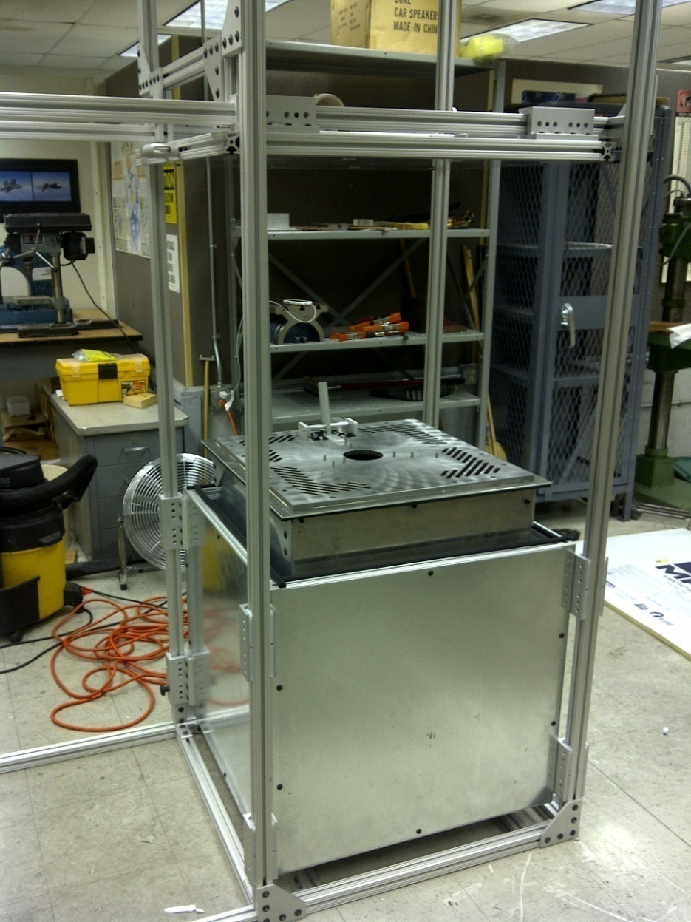
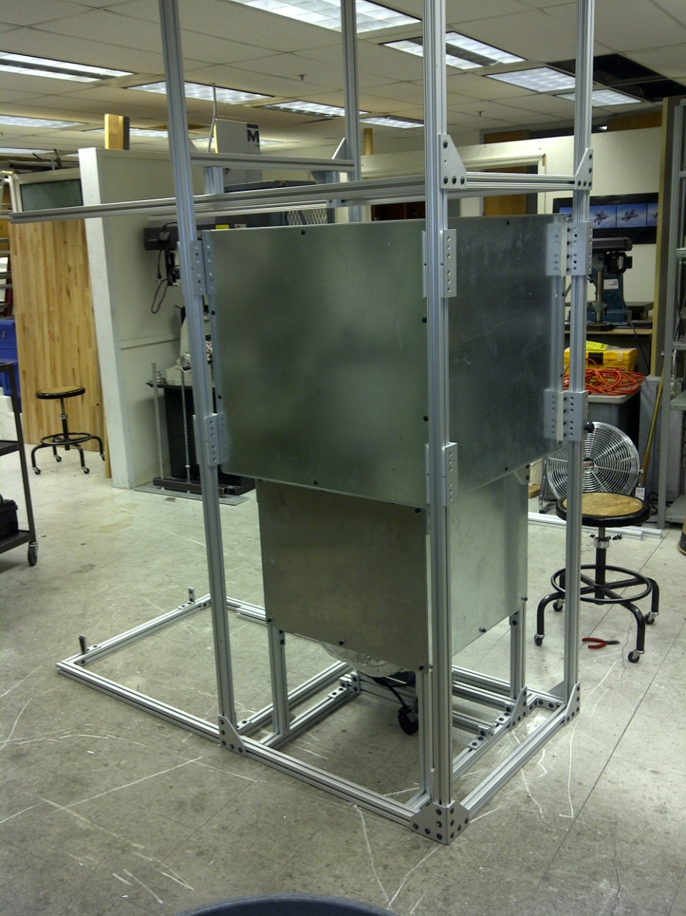
Final Prototype Pictures
Figure 20: Final Prototype

Slide 28
Acknowledgements
Turbocor
Rob Parsons
Dr. Lin Sun
Kevin Gehrke
Famu/FSU College of Engineering
Dr. Juan C. Ordóñez
Dr. Kareem Ahmed
Dr. Rob Hovsapian
Dr. Srinivas Kosaraju

Slide 29
Questions?

Slide 30
References
"Aluminum A356 T6 Properties." N.p., n.d. Web. 15 Nov 2010. <http://www.matweb.com/>.
"Linear Expansion." N.p., n.d. Web. 15 Nov 2010. <http://hyperphysics.phy-astr.gsu.edu>.
Engineering Tool Box. N.p., n.d. Web. 15 Nov 2010. <http://www.engineeringtoolbox.com/>.
Cengel, Turner, Cimbala. Thermal Fluid Sciences. New York:
McGraw Hill, 2008

Slide 31
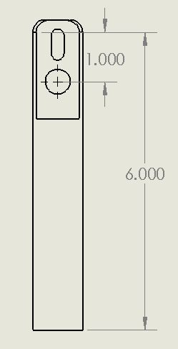
Spring Mechanism Calculations
Experimental testing:
showed 30-32lbs of force needed to move the housing along the plate
Selected Springs
Selected springs offer 30% more force to ensure housing locates
Spring Force
Spring Specs:
20 lbs at full compressed length
Required input force to move lever
Static analysis shows any applied force grater the 6.6lbs will actuate lever
Operator Force
Fig. 14: Spring Mechanism

Slide 32
Internal Convection Coefficient
Air density calculation – Air treated as ideal gas
Reduced temperature greater than 2
Operating pressure substantially lower than critical pressure
Reynolds Number
Determine flow condition inside of housing
Turbulent flow – Housing geometry simplified to a cylinder
Dittus-Boelter equation for calculating Nusselt number.
Iteration
Need average air temperature in system
Guess and iterate until convergence

Slide 33
External Convection Coefficient
Graschof Number – Ratio of buoyancy forces to viscous forces
Rayleigh Number – Needed for Nusselt number correlation
Nusselt Number – Flat vertical plate correlation used
Iteration
Properties based on film temperature
Guess surface temp
Run simulation
Substitute new value until convergence

