Slide 1
Gunnery Control Handle
Group 9: Senior Design
Deanna McKenzie Michael D. Brown William Thornton

Slide 2
Presentation Outline
Background
Project Introduction
Center Body
Handle Attachment
Haptics
Sensors
Cost Analysis
Conclusion
Future Plans

Slide 3
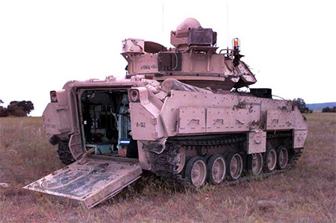
Background
Armored Vehicles
Very expensive pieces of equipment
Pilots cannot always be trained in the field
Need for simulators to help train drivers
There are MANY types of vehicles; hence MANY different simulators

Slide 4
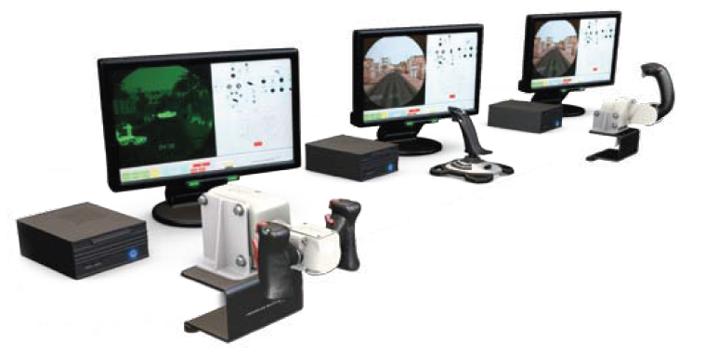
Project Scope
Design a generic simulator handle
Reduce Weight
Make handle interchangeable

Slide 5
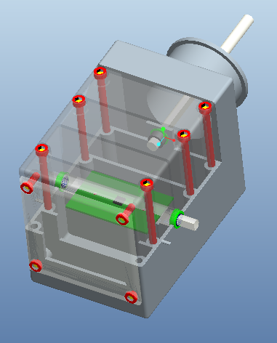
Center Body
Design
Aspects
Two shafts = roll and pitch
Accelerometer for roll and pitch sensing
Top and back detachable
Ribbed for support

Slide 6
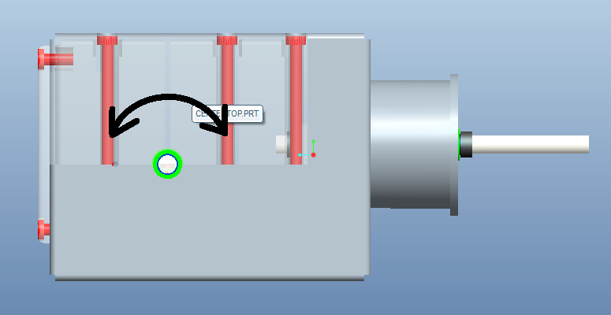
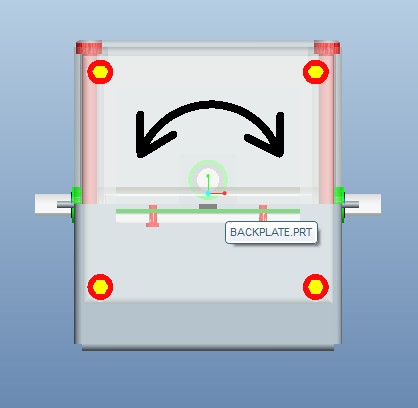
Center Body
Handle bar and ball bearings allow for pitch rotation
Center bar and ball bearings allow for yaw rotation
Pitch
Roll

Slide 7
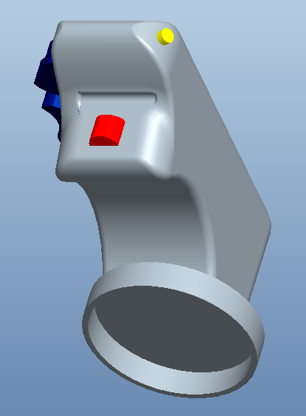
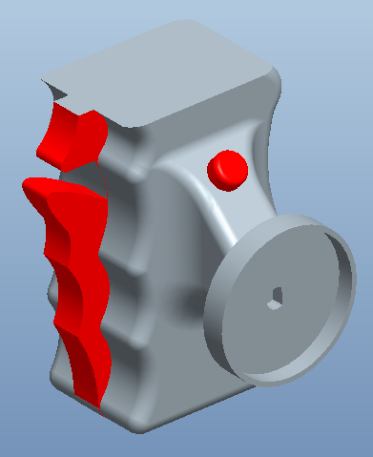
Handles
Detachable handles from a Generic center body
Handles can be removed from the center body
Handles customized to a different vehicle
M2-Bradley
M1-Abrams

Slide 8
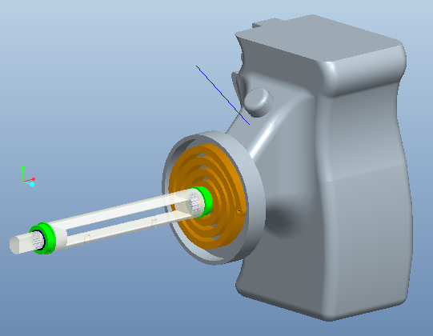
Handles
Properties of each handle:
Customized buttons and triggers
Will connect/disconnect with a keyed shaft
Torsion spring
Keyed shaft
M1-Abrams
handle

Slide 9
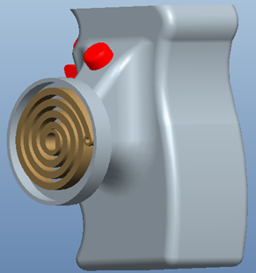
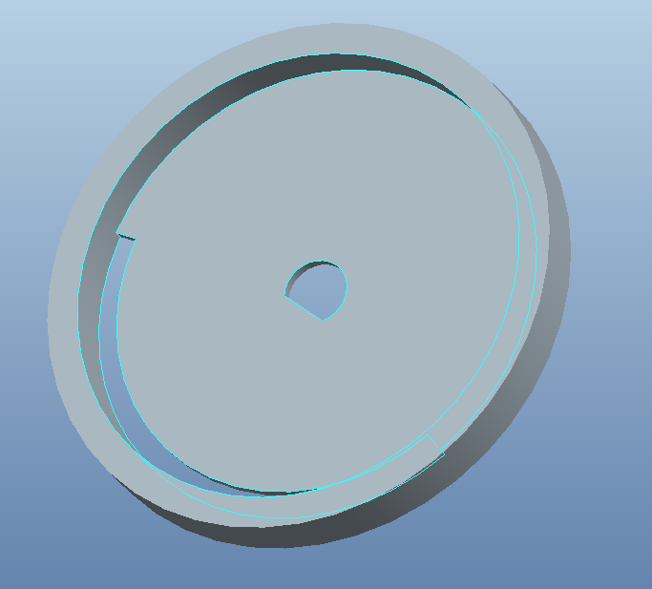
Design Selection for Haptic Response
Opposing Clock Spring
2 springs per handle
Customized to each handle configuration
Slide onto keyed shaft
Attach to peg on center body
Held in place by handle
Cap to allow 150˚ full angle

Slide 10
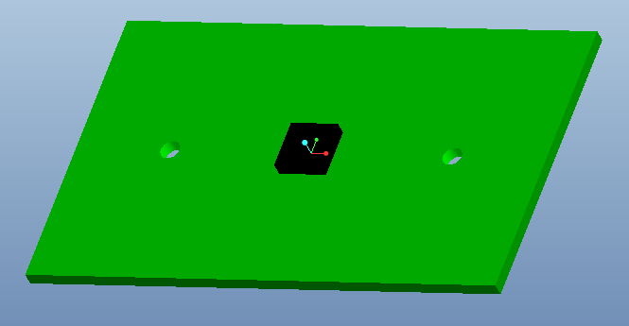
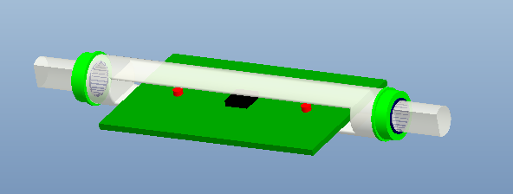
Concept for Handle Sensing Methods
Accelerometer
2 dimensional sensing
X-plane measures yaw
Y-plane measures pitch
Attached to handle shaft through center
Circuitry Unknown

Slide 11
Cost Analysis
Part | Quantity | Supplier | Pr ice ($) | Total Cost ($) | Item Number
Shaft | 1 | McMaster-Carr | 11.35 | 11.35 | 88955K261
Bearings | 4 | McMaster-Carr | 8.72 | 34.88 | 57155K338
Shaft | 1 | McMaster-Carr | 16.66 | 16.66 | 87095K621
Torsion Springs | 6 | McMaster-Carr | 7.88 | 47.28 | 9293K31
Accelerometer | 1 | Dimension Engineering | 22.95 | 22.95 | DE-ACCM2G2
Total $133.12
Unknowns include: Wiring for circuitry, Plastics, Hardware

Slide 12
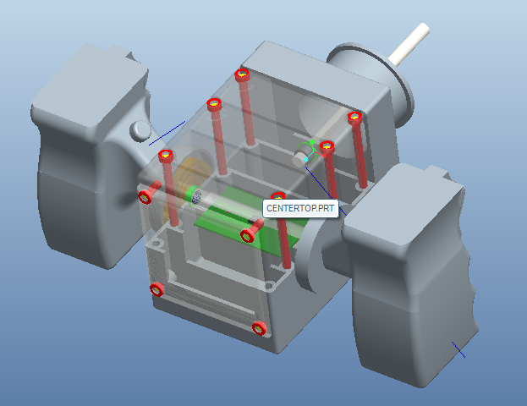
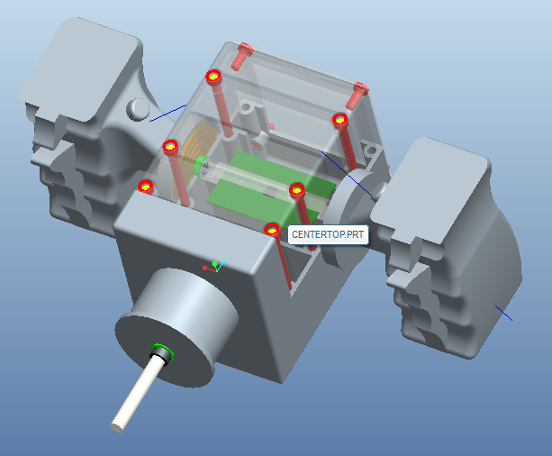
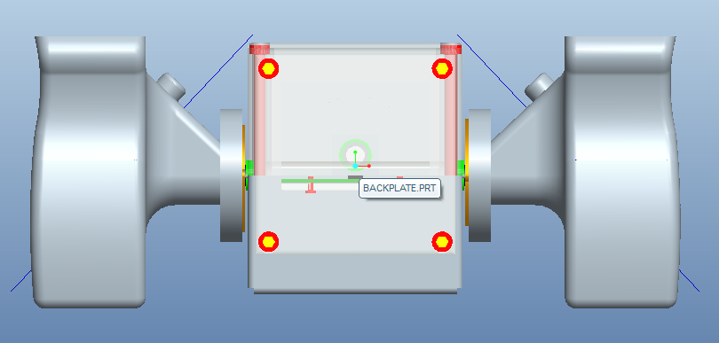
Final Design

Slide 13
Future Plans
Meet with Sponsor with prototype
Finalize Design
Plastic material testing
Order Materials

Slide 14
Questions
???

