Slide 1
Gunnery Control Handle
Group 9: Senior Design
Deanna McKenzie Michael D. Brown William Thornton

Slide 2
Presentation Outline
Project Scope
Pro E Assembly
Rapid Prototyping
Equipment
Center Body
Microcontroller
Specs
Schematic
Cost Analysis
Future Plans
Rapid Prototype Handles
Complete Assembly
Optimize Assembly/Design
Schedule
Risk Assessment

Slide 3
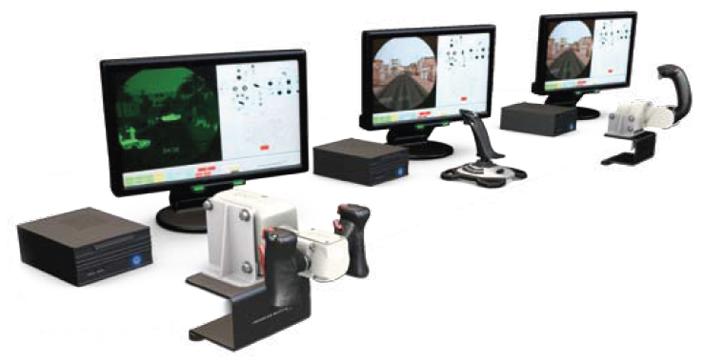
Project Scope
Design a generic simulator handle
Reduce Weight
Make handle interchangeable

Slide 4
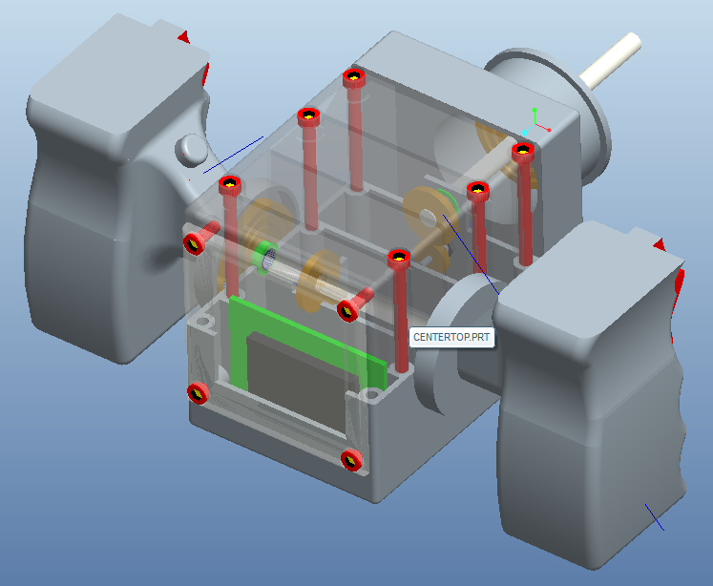
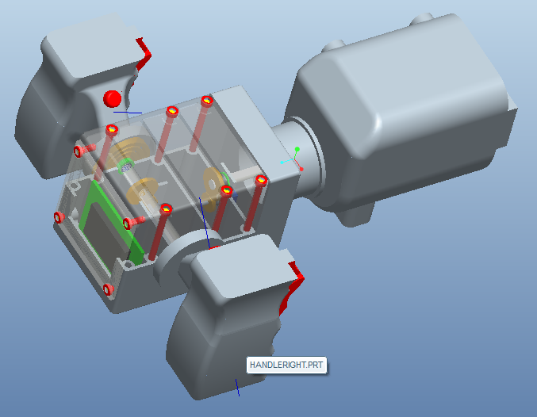
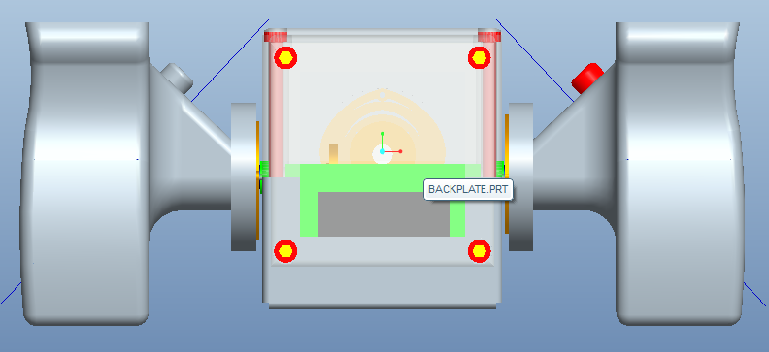
Pro/E Assembly

Slide 5
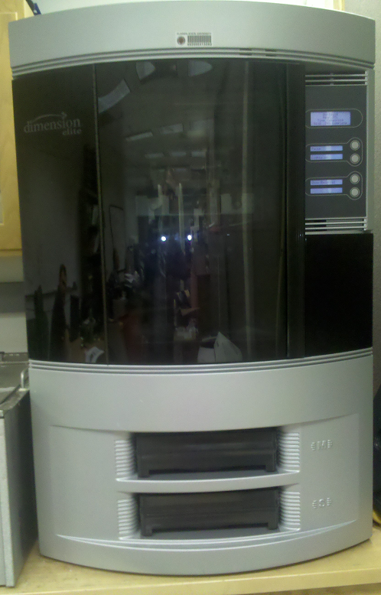
Rapid Prototyping Equipment
Can print models up to 10” x 10” x 12”
Prints with ABSplus thermoplastic
Production grade
Printed from bottom up
Soluble supports during printing
Allows for more complex modeling

Slide 6
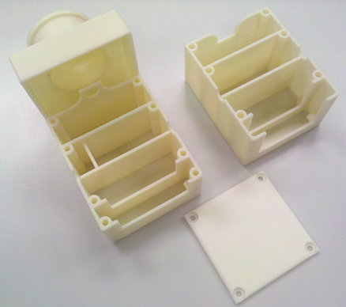
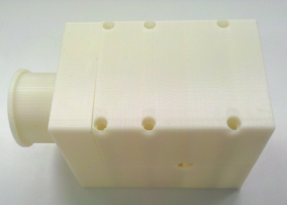
Center Body: Rapid Prototype
Material is layered ABS plastic
Weaker than injection molded ABS
Only to be used as prototype

Slide 7
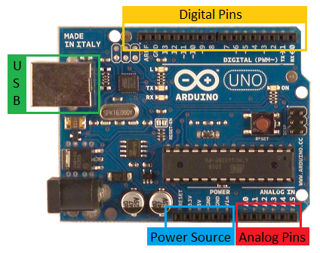
Microcontroller
Arduino Uno Microcontroller
Open source
Thirteen digital pins plus ground pin
6 analog to digital converters
6 power source options
USB connectivity/power
Can be powered by adapter, USB or battery

Slide 8
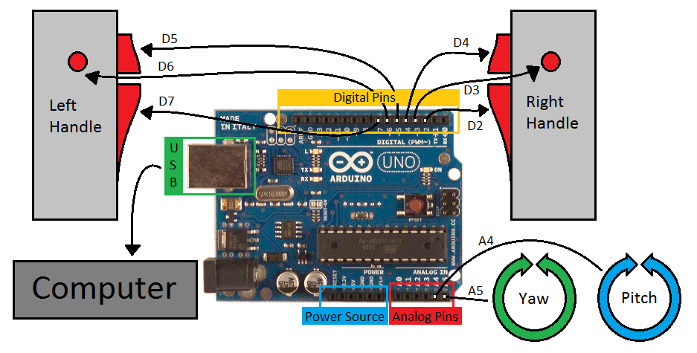
Microcontroller: Schematic

Slide 9
Microcontroller Programming
Programming done in C
Have written preliminary programs to show:
Digital pins are working
When a button is pressed, an LED light will turn on.
Analog pins are working
When variable resistor passes voltage threshold, an LED light will turn on.
Currently working on using microcontroller in Visual Basic for a more user friendly GUI

Slide 10
Cost Analysis
Ordered
Future Orders
Part | Quantity | Unit Price ($) | Total Cost ($)
Shaft | 1 | 20.25 | 20.25
Bearings | 4 | 8.72 | 34.88
Microcontroller | 1 | 29.95 | 29.95
Potentiometers | 2 | 6.35 | 12.70
Pinion Gear | 2 | 13.05 | 26.10
Gear | 2 | 13.56 | 27.12
6-cond. Wire | 15 ft | 0.31/ft | 4.65
4-cond. wire | 15 ft | 0.37/ft | 5.55
Total $161.20
Part | Quantity | Unit Pr ice ($) | Total Cost ($)
Torsion Springs | 4 | 7.88 | 47.28
Buttons 1 | 4 | 10.92 | 43.68
Buttons 2 | 2 | 10.92 | 21.84
Hardware | - | - | -
Triggers | - | - | -
Total $112.80
We have currently received no pricing information for rapid prototyping material or services

Slide 11
Rapid Prototype Handles
Using the same method and machining for the center body
Model for handles to evaluate design
Trigger holes are the right size
Placement of electronic wiring
Fits in the hand comparably to M1-Abrams and M2-Bradley Handles

Slide 12
Assemble Rapid Prototype
Make sure parts fit together according to design
Evaluate size and feel of the handles and center body
Redesign handles if needed

Slide 13
Optimize Design
Optimize parts and fabricate with injection molded engineering plastic
Find correct torsion spring loading for each handle design
Finalize code for microcontroller

Slide 14
Schedule
General Dynamics Trip: Feb. 23
Four Aker: Feb. 23
All parts ordered by: Feb. 25
Microcontroller:
Digital Button Programming Feb. 28
Analog (potentiometer) Programming March 4
Handles Printed: March 4
Assembly (w/out microcontroller) March 18
Debugging/Comp. Integration March 18
Full Assembly March 25
Operations Manual/Final Reports April 4

Slide 15
Risk Assessment
Risks
Possible Solutions
Wiring space in shaft
Internal/External springs
Shaft mount strength
Parts don’t arrive on schedule
2-types of wire
May require redesign
Thicken mount
Use time to plan and reschedule
We are a fair amount below budget as well, so we do have options if something goes wrong.

Slide 16
Questions
???

