Slide 1




Air Flow Unlimited
Group 13
Joseph Cognato
Jonathan Glynn
Matthew Hartman
Ramon Villarreal

Slide 2
Intro
Airfoil structure analysis
Airfoil force calculations and material selection
Shape evaluation for the carts
Spring selection and material choices for the carts
User interface preliminary design

Slide 3
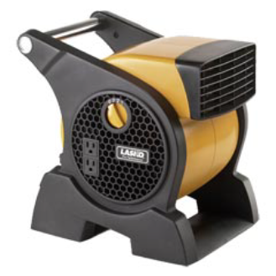
Air blower
Air flow rate is 310 cubic feet per minute.
Gives 40 miles per hour air flow at the exit.
2 Blowers in total run off of a 120 AC outlet.
Further evaluation will be used to get the best approximation of the air speed at specific points in the display.

Slide 4
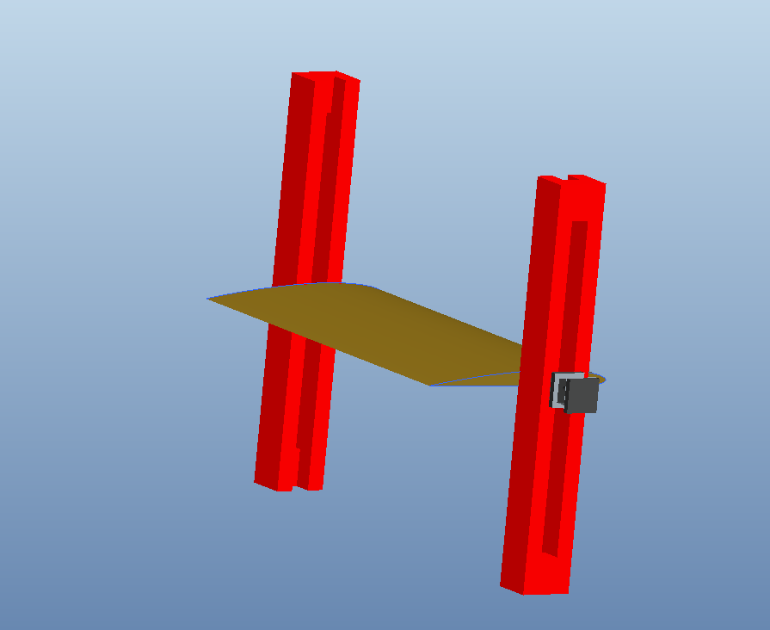
Airfoil Display

Slide 5
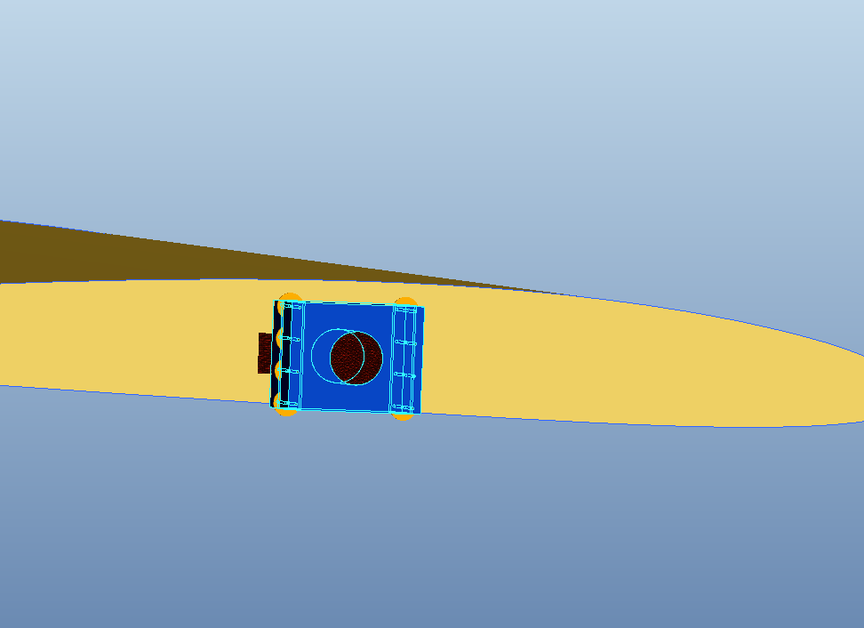
Airfoil Display

Slide 6
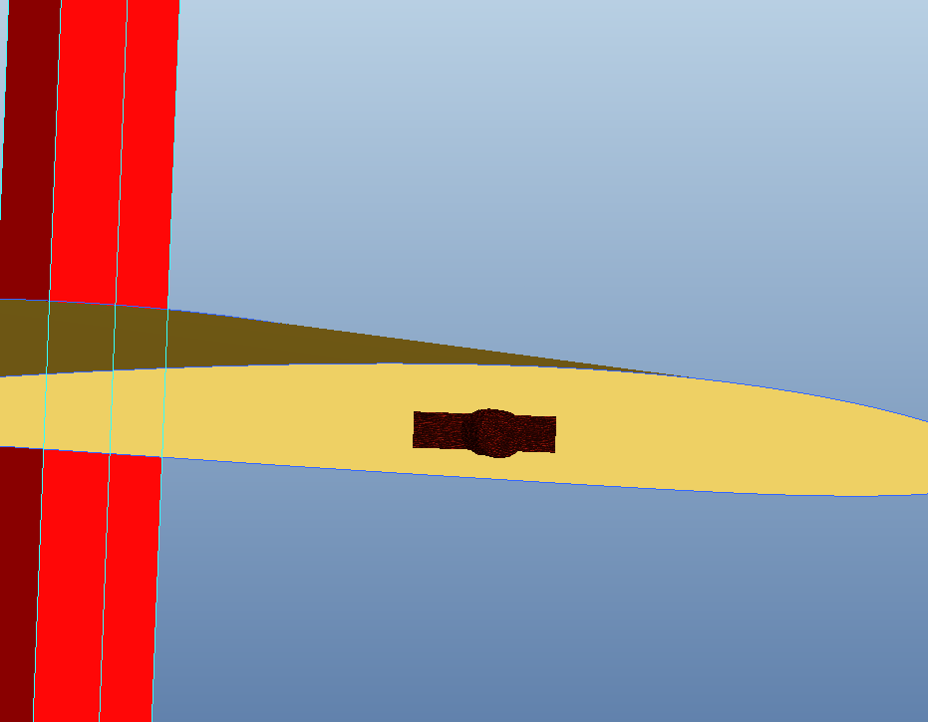
Airfoil Display

Slide 7
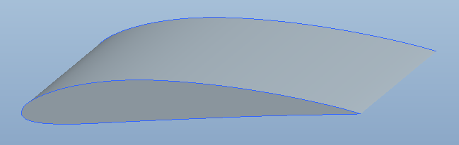
Airfoil Design 1
NACA 4412

Slide 8
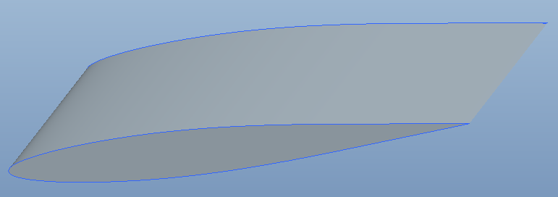
Airfoil Design 2
NACA 63-010A

Slide 9
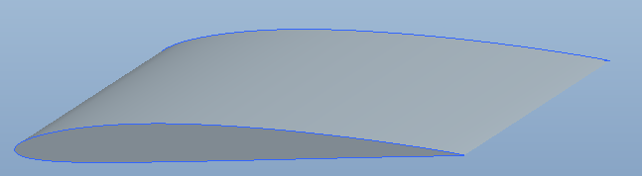
Airfoil Design 3
NACA 2408

Slide 10
Lift

Slide 11
Drag

Slide 12
Comparison
NACA 2408
NACA 4412
Max. lift ~0.7
Max. Drag ~0.27
Smaller surface area
Simpler shape
Max. lift ~0.78
Max. Drag ~0.3
Larger surface area
Slightly heavier

Slide 13
Airfoil Material
Combination of materials
Hollow Center
Carbon Fiber (CFRP)
Balsa
Bamboo

Slide 14
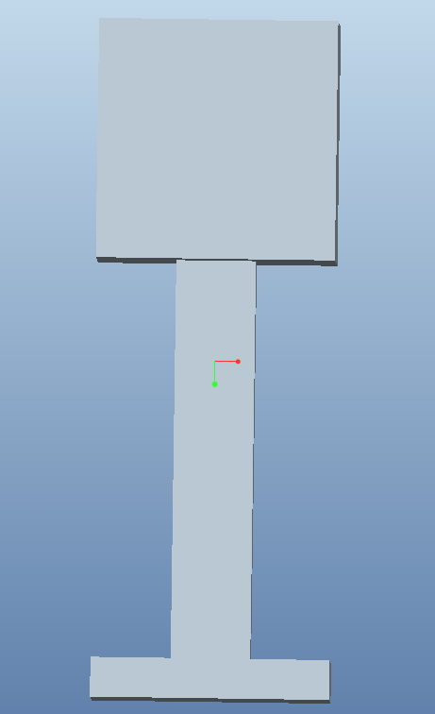
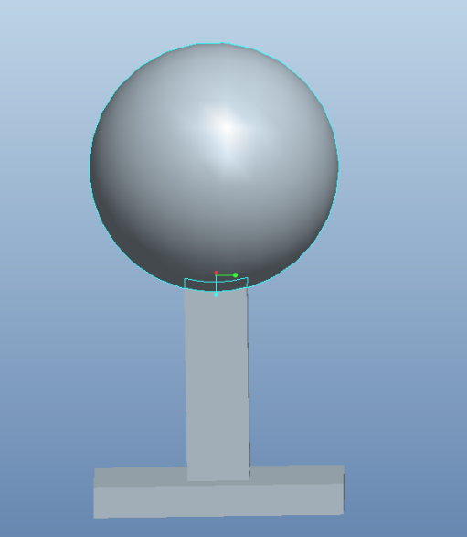
Carts Attachments
Two attachments spherical, and square
Drag force for a sphere with radius 2in. 0.7349 N
Drag force for a square with sides 4in in length 2.09 N
The cart only weights 226 grams so the attachments will be able to produce movement

Slide 15
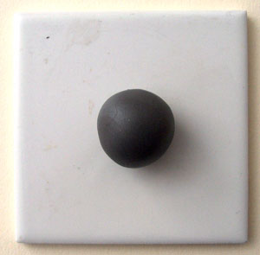
Attachment materials
light materials desired to optimize force produced
polymer clay can be used to sculpt hollow designs
Light weight and inexpensive

Slide 16
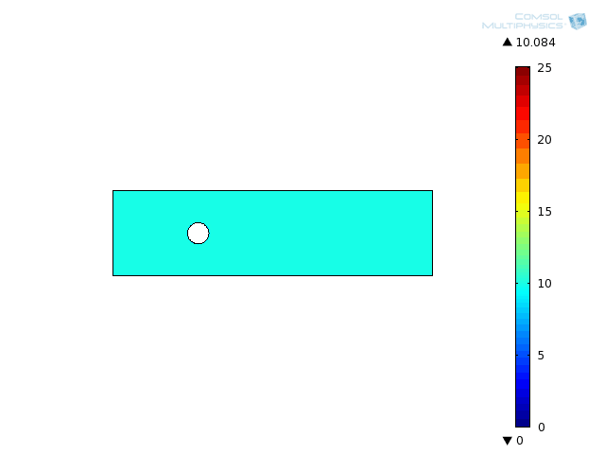
COMSOL MultiPhysics
Based on attachments
Velocity profile
Visualization of vortices
Distribution of wake
Display of drag

Slide 17
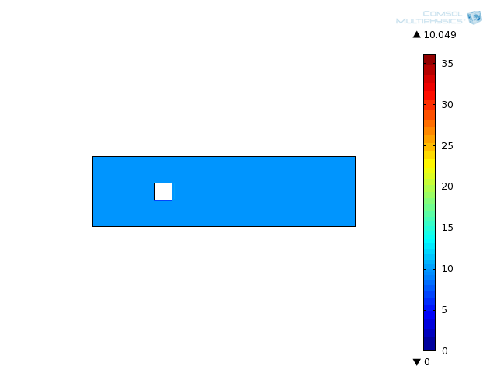
COMSOL MultiPhysics contd.

Slide 18
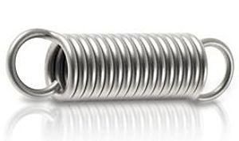
Spring
For the max force of 2.09N this spring will provide adequate movement
usable for both circle and square carts

Slide 19
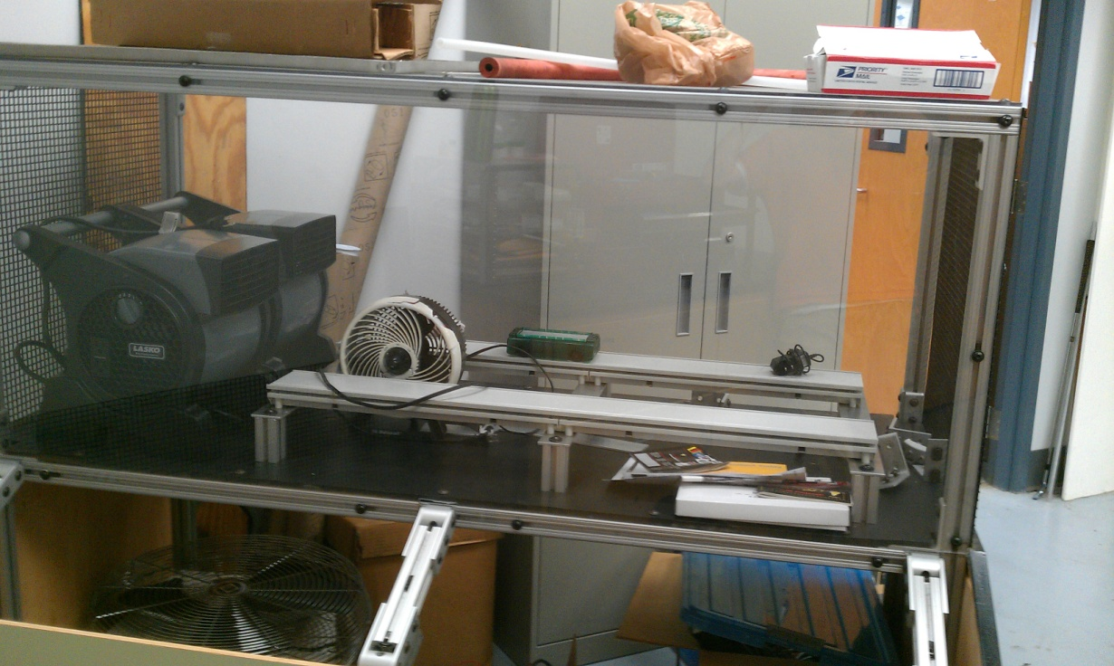
Display Potentials
For both mechanical displays there will be an independent control and monitor.
Robust designs for both are a must.
Potentiometers instead of buttons or switches are safer, and limit the input.
Monitors instead of touch screens for a cheaper and safer alternative.

Slide 20
Future
Motor selection after final choices of materials and formatting for carts and airfoils
Configuration between control inputs and mechanisms
Selection of hardware for display and user controls
Measure the actual air speed and mass flow with a pitot-static probe
Use COMSOL to evaluate the airfoil at different attack angles

Slide 21
Questions

Slide 22
References
http://www.ae.illinois.edu/m-selig/ads/coord_database.html#N
http://www.grc.nasa.gov/WWW/k-12/airplane/foil3.html
http://www.leespring.com/browse_catalog.asp?rbunitOfMeasure=Metric&springType=E&partnum=&UnitOfMeasure=metric&specsCriteria=&subType=&isMIL=&pageNumber=2

