Slide 1


SUAS Project
Student Unmanned Aerial System
FAMU/FSU College of Engineering
Mechanical Engineering Department (1)
Electrical and Computer Engineering Department (2)
Antwon Blackmon¹
Walker Carr¹
Alek Hoffman²
Ryan Jantzen¹
Eric Prast²
Brian Roney²
Sponsored by FCAAP
April 12 2012

Slide 2
Presentation Overview
Introduction
Concepts Generation and Selection
Final Design
Engineering Economics
Project Results
Conclusion

Slide 3
Introduction
Primary Objectives:
Systems Engineering approach for the design and manufacture of an Unmanned Aerial System (UAS)
UAS able to complete specified mission.
UAS design compliant with the 2012 AUVSI Student UAS Competition requirements.
Project Budget of $ 3000

Slide 4
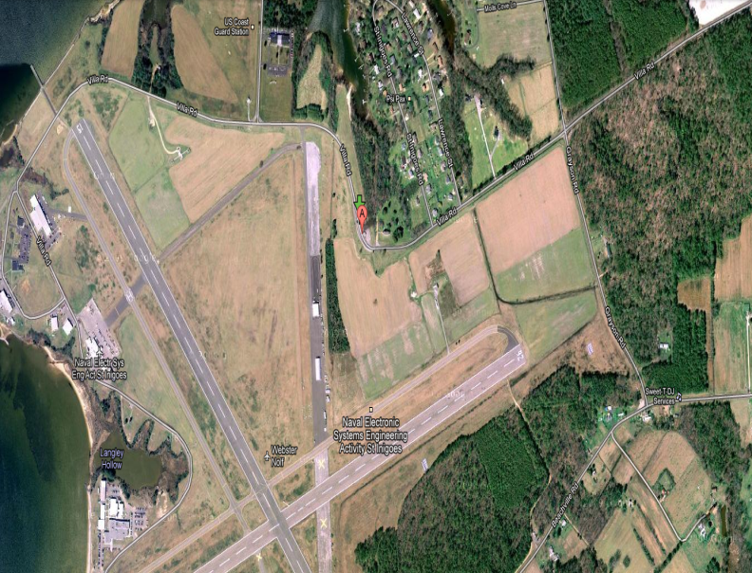


Mission Profile
Warm-up & Take-off
Climb
Waypoint Navigation
Autonomous Area Search
Waypoint Navigation
Descent
Landing
(Constant Target Recognition)
5
6
3
4
1
7
2

Slide 5
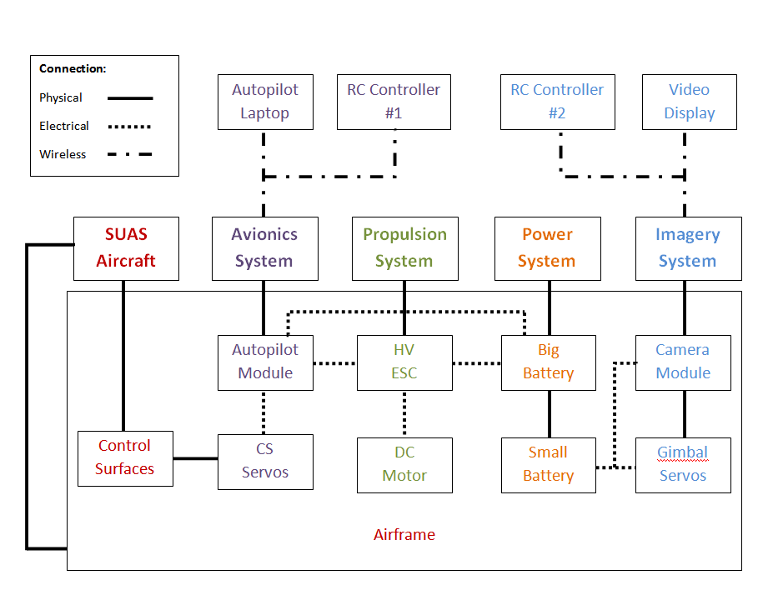
SUAS Simple Functional Diagram

Slide 6
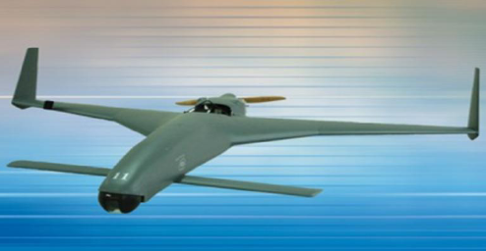
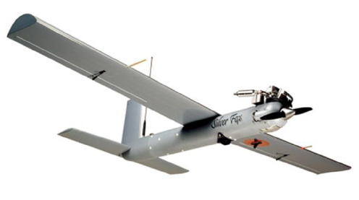
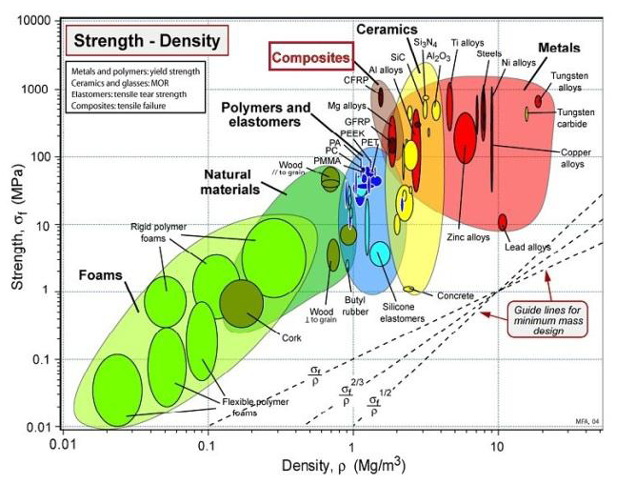
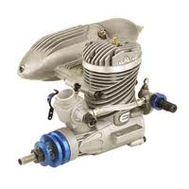
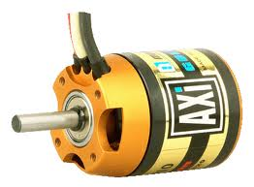
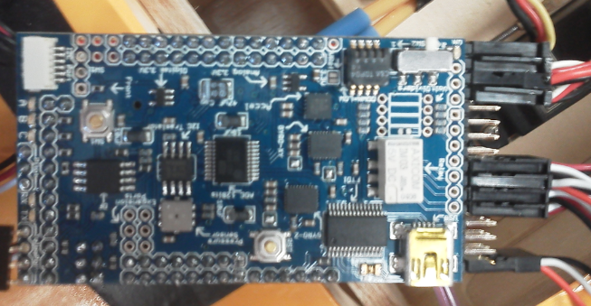
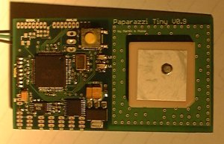
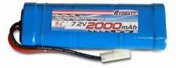
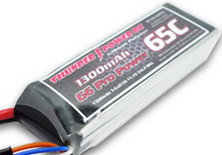
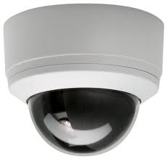
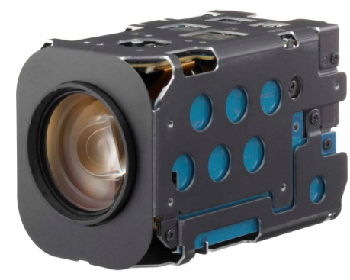
Concepts Generation
Aircraft Configurations
Materials
Propulsion Systems
Autopilot Systems
Power Supply Systems
Camera Systems

Slide 7
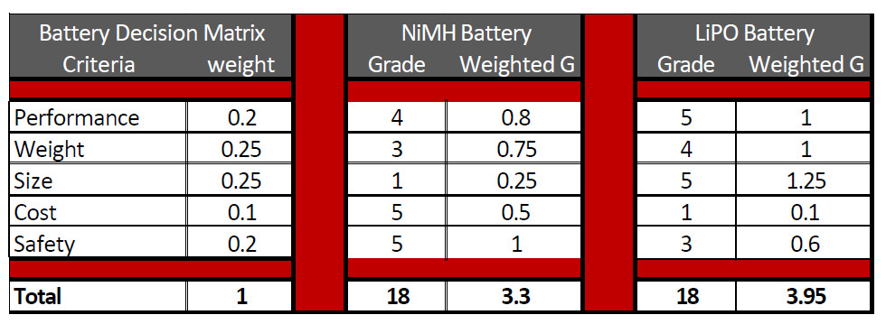
Concepts Selection
Decision Matrix

Slide 8
Concepts Selected
Aircraft Configuration: Conventional
Airfoils
Materials:
Fiberglass
Foam
Carbon Fiber
Balsa Wood
Propulsion System:
Brushless DC Electric
HV ESC with Data Log
Autopilot System:
ArduPilot Mega
Xbee Telemetry
Power Supply System:
LiPo Batteries
BEC
Camera System:
Sony Block Camera
Arduino Board
Lawmate Video

Slide 9
Final Design
SUAS Aircraft
Propulsion System
Avionics System
Imagery System
Power Supply System

Slide 10
Final Design
SUAS Aircraft
Propulsion System
Avionics System
Imagery System
Power Supply System

Slide 11
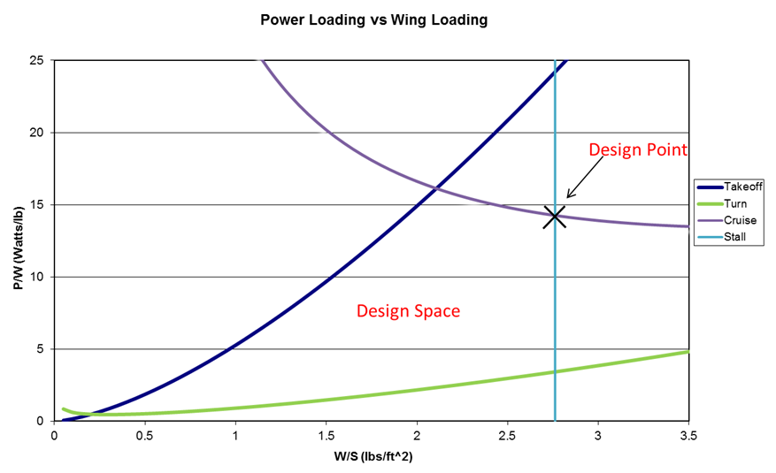
Aircraft Preliminary Sizing
Utilized equations of motion for multiple phases of flight
Assumed Values:
Cruise Speed: 55 mph
Stall Speed: 25 mph
Takeoff Distance: 500 ft.
Design Point:
P/W = ~14 Watts/lb
W/S = ~2.7 lb/ft²
P/W – Power Loading
W/S – Wing Loading

Slide 12
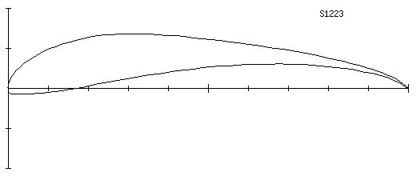
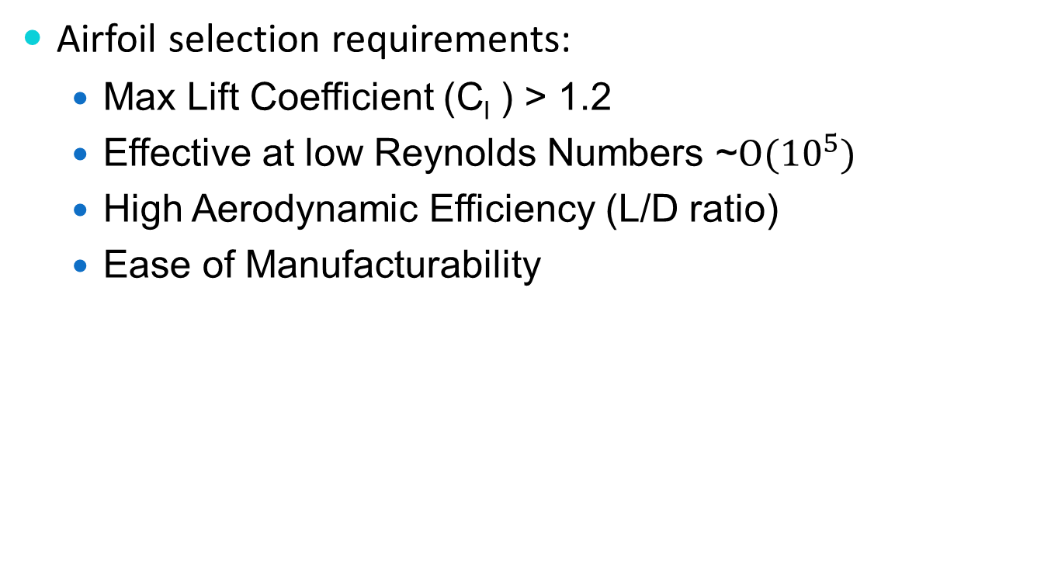
Airfoil Selection
Airfoil selection requirements:
  Max Lift Coefficient (C_{l} ) > 1.2
  Effective at low Reynolds Numbers ~$Ο({10}^{5})$
  High Aerodynamic Efficiency (L/D ratio)
  Ease of Manufacturability
L – Lift
D - Drag

Slide 13
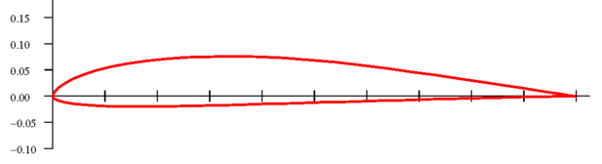
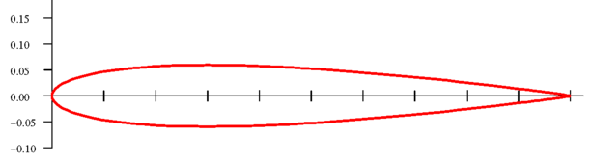
Airfoil Selection
Wing: SD 7037
Horizontal/Vertical Tail: NACA0012

Slide 14
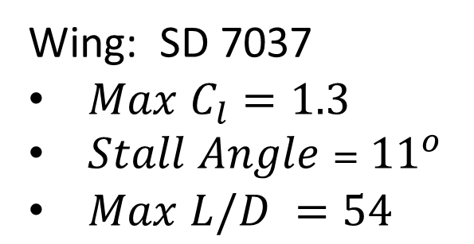
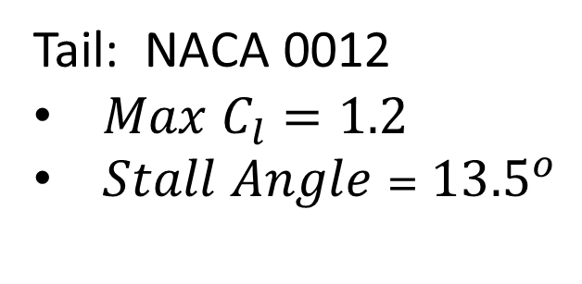
Airfoil Analysis
Wing: SD 7037
$Max C_{l}=1.3$
$Stall Angle$ = ${11}^{o}$
$Max L/D =54$
Tail: NACA 0012
$Max C_{l}=1.2$
$Stall Angle$ = ${13.5}^{o}$

Slide 15
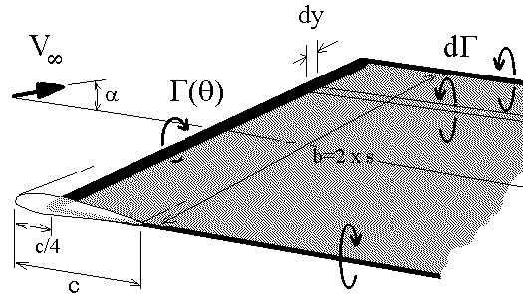

Aerodynamic Analysis
Sectional Lift Coefficient
  Prandtl’s Lifting Line Theory
$$Γ −Circulation$$
$$b −wing span$$
$$c −chord length$$
$$α −Angle of Attack$$

Slide 16
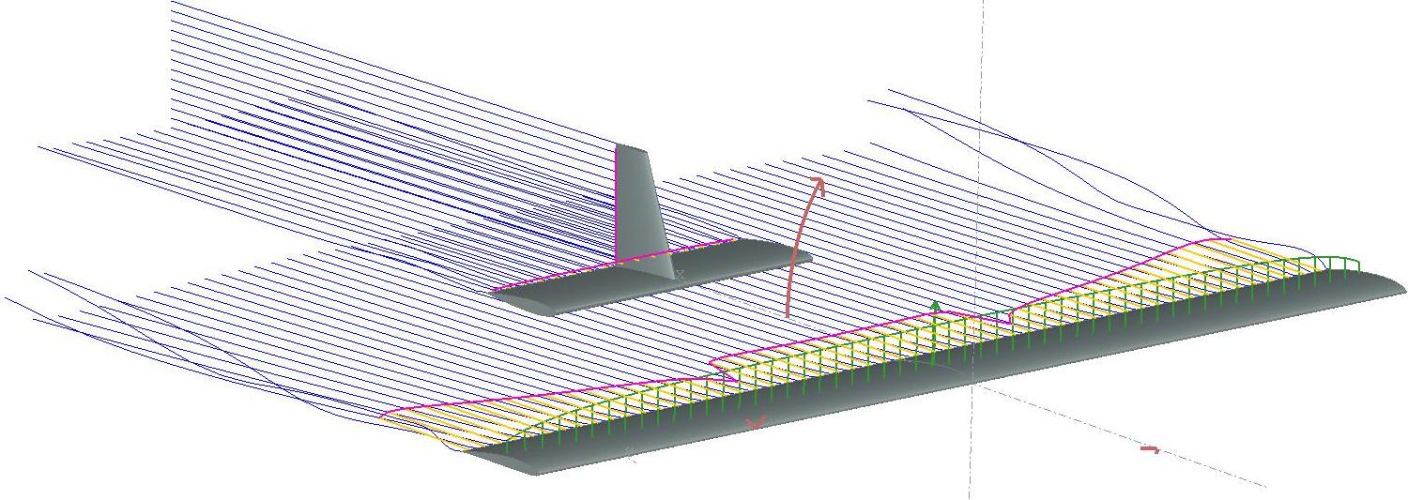
Aerodynamic Analysis
Moment
Viscous Drag
Lift Force
Induced Drag

Slide 17
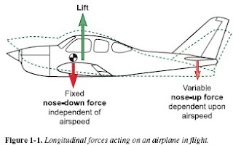
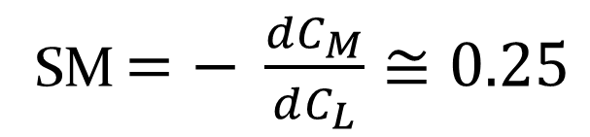
Stability Analysis
Longitudinal Stability (stability in pitch)
Static Margin:
SM $=− \frac{dC_{M}}{dC_{L}}≅0.25$
$$C_{M} −Moment Coefficient C_{L} −Lift Coefficient$$

Slide 18
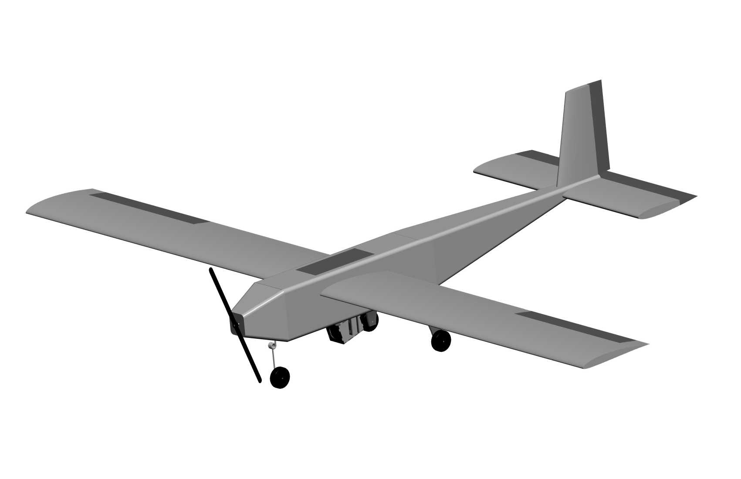
Overall Aircraft Layout

Slide 19
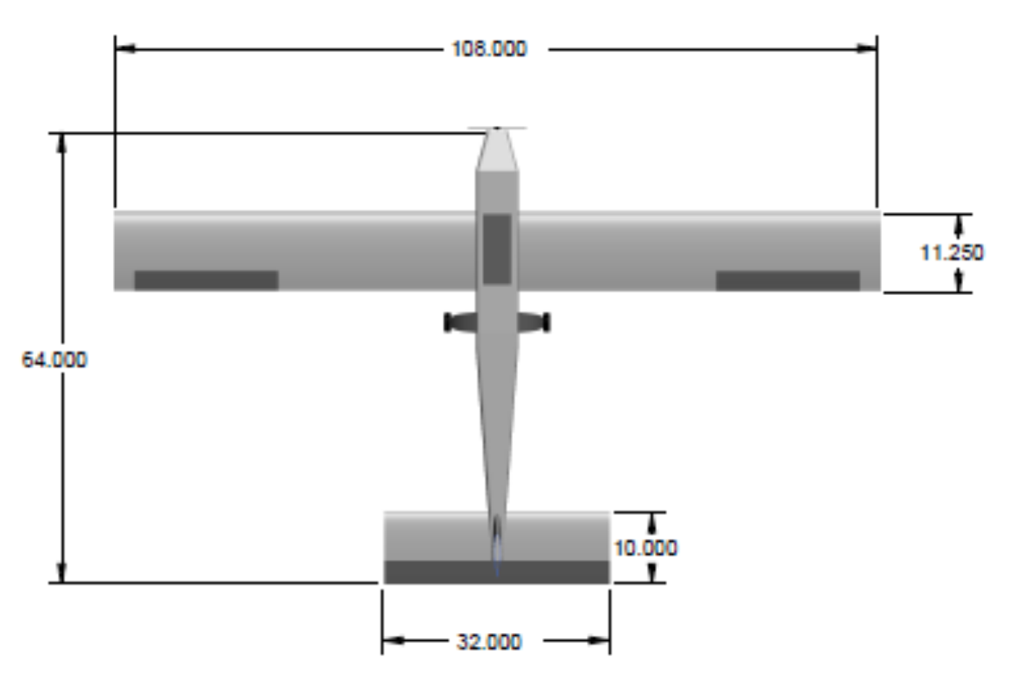
Overall Aircraft Layout

Slide 20
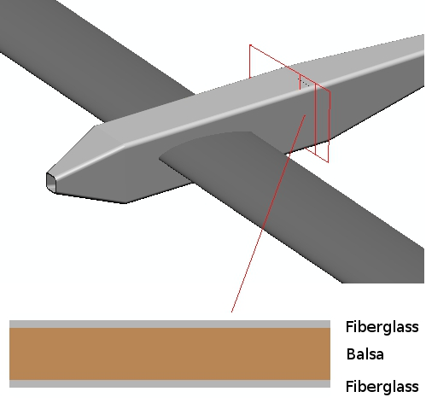
Fuselage Structure

Slide 21

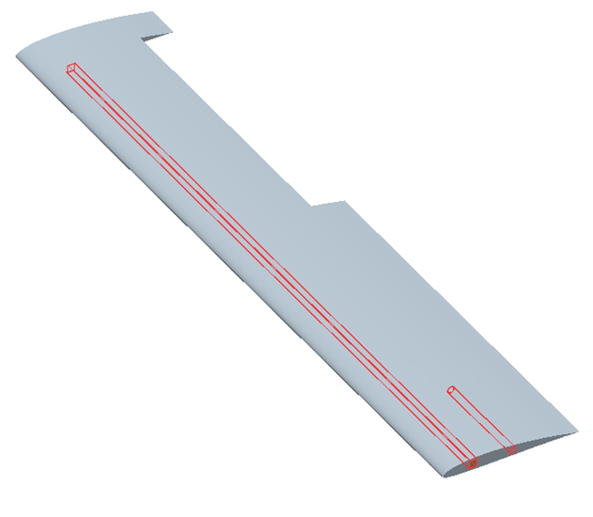
Wing and Spar Structure
11.25 in
Spar
Connection Tube
Wing:
  Foam core
  Two layer carbon fiber outer skin
Spar Location: 25% chord
Connection Location: 55% chord
Connection Length: 6 in
51 in

Slide 22

Spar Structure
48 in
Balsa wood core
Two layer carbon fiber top and bottom caps
3k weave carbon fiber sleave
0.5 in

Slide 23
Final Design
SUAS Aircraft
Propulsion System
Avionics System
Imagery System
Power Supply System

Slide 24
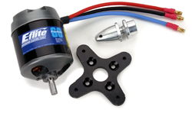
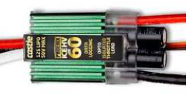
Propulsion System
Eflite Power 60 Brushless DC Motor
CC High Voltage Electronic Speed Controller

Slide 25
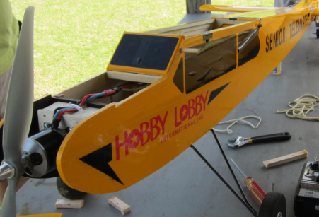
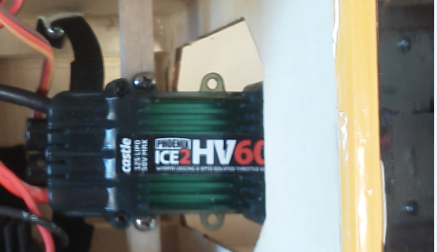
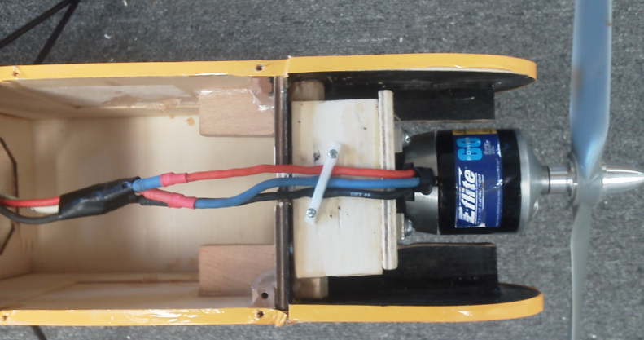
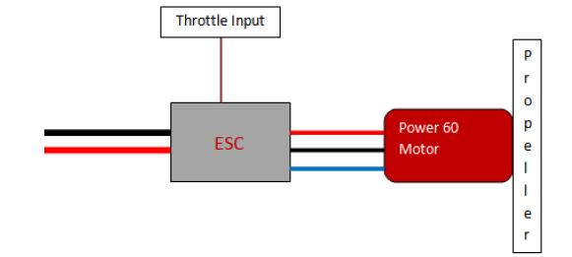
Electronic Speed Controller
Motor and Propeller

Slide 26
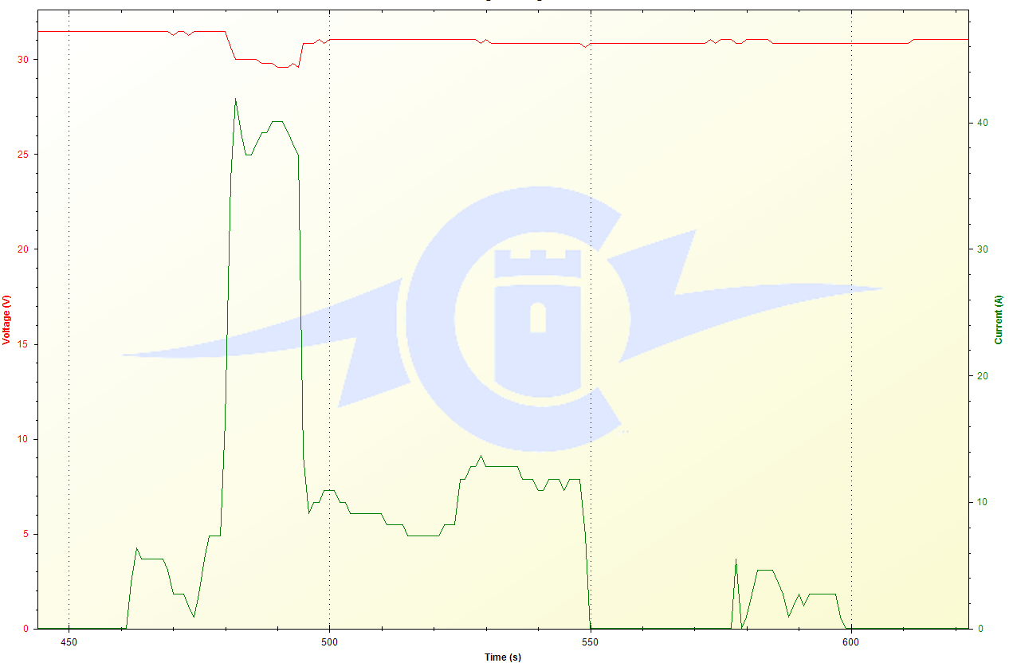
Propulsion System Data from Test Flight #2
Takeoff (41.9A, 29V )
Voltage (V)
Current (A)
Cruise (13.2A, 31V)
Taxi (6A, 31.5 V)
Landing and Taxi (5.5A, 31V)
Time (s)

Slide 27
Final Design
SUAS Aircraft
Propulsion System
Avionics System
Imagery System
Power Supply System

Slide 28
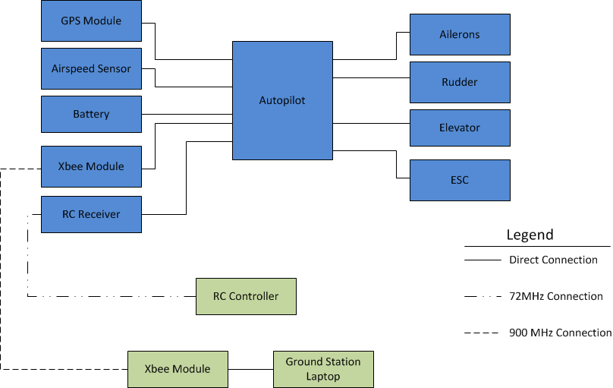
Avionics System Overview
*
*ESC – Electronic Speed Controller

Slide 29
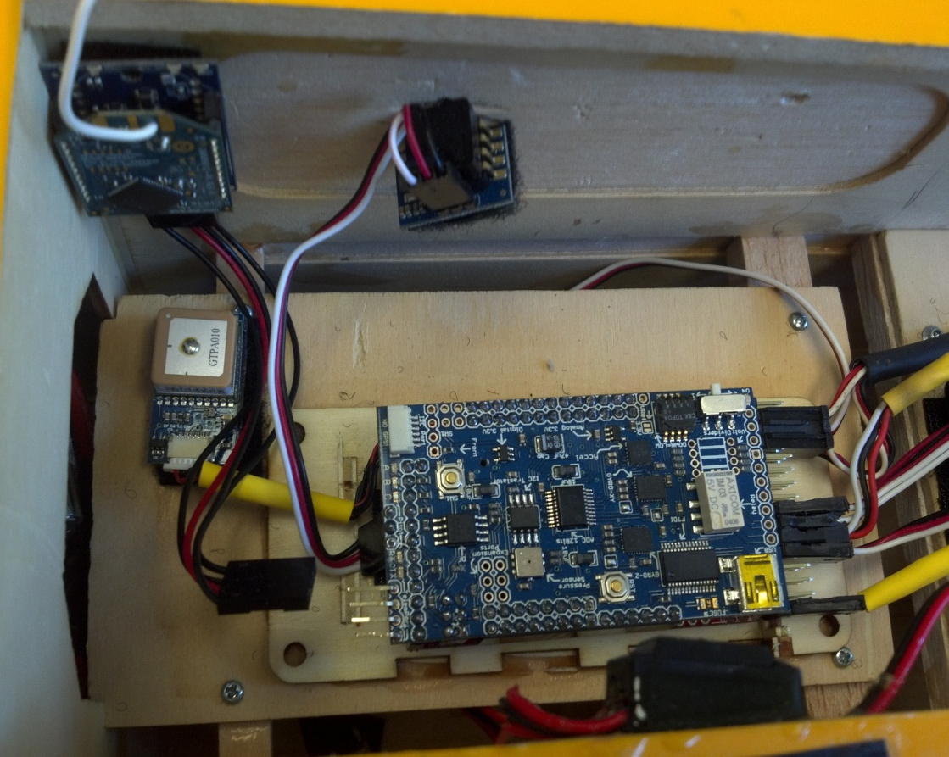
Autopilot System Design
Ardupilot Mega & ground station software
Xbee 900MHz Telemetry
MediaTek MT3329 GPS
MPXV7002DP Airspeed Sensor
Personal laptop
Futaba FPS148 Servos
Xbee Tx
Air Speed Sensor
GPS
Autopilot Board

Slide 30
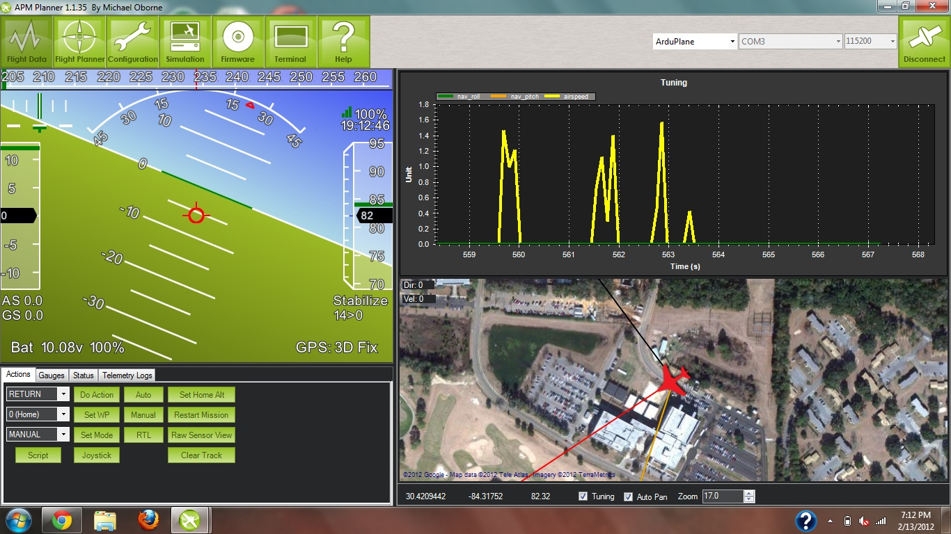
Autopilot Ground Station

Slide 31
Autopilot to Control Surface Interface
The autopilot uses PWM* signals to interface with the control surfaces of the plane.
*PWM – Pulse Width Modulation

Slide 32
Final Design
SUAS Aircraft
Propulsion System
Avionics System
Imagery System
Power Supply System

Slide 33

Imagery System Constraints
Maximum Altitude = 750 ft.
Target Characteristics
  -Shape
  -Color
  -Orientation
Off-Path Targets

Slide 34
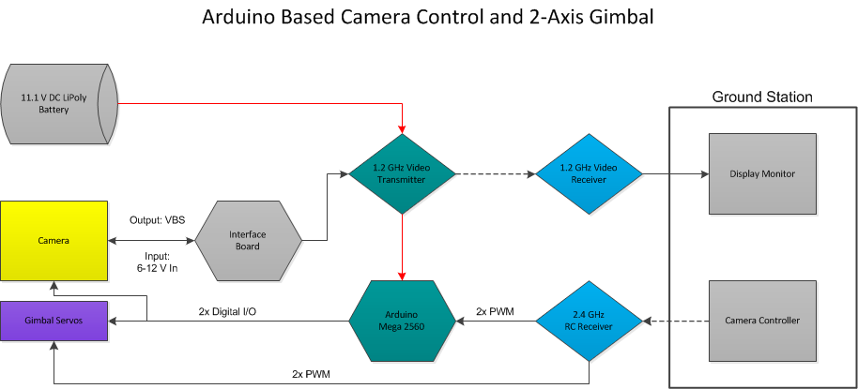
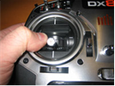
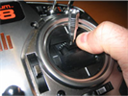
Imagery System Overview
Gimbal Control
Camera
Zoom

Slide 35
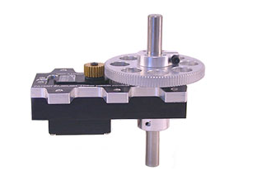
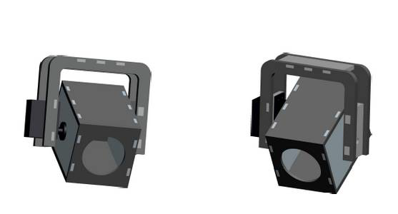
Camera Gimbal
Top Mounted Pan Gearbox System
-Continuous 360° Rotation
Camera Housing & Direct Drive Tilt System
-Easily Assembled
-ABS Plastic

Slide 36
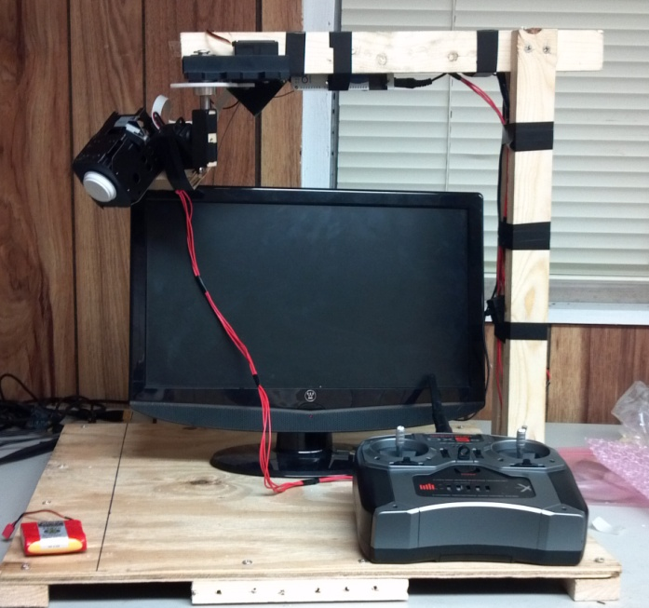
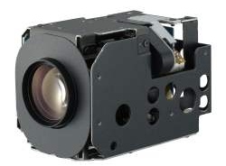
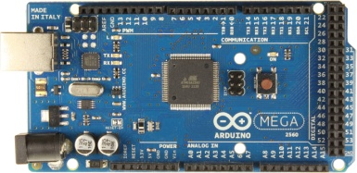
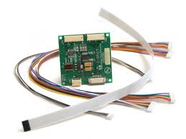
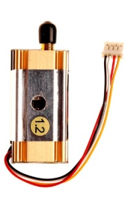

Video System Integration and Testing
Arduino Mega 2560
Sony Block Camera
Pan / Tilt Servo System
1.2 GHz Wireless TX and RX
RC Camera Controller
Test Description | Pass / Fail
±90˚ Panoramic Rotation | Pass
-90˚ Tilt Rotation | Pass
Arduino and RC Communication | Pass
Block Camera to Arduino Communication | Pass
Wireless Camera and Servo Control | Pass
Long Distance Wireless Video | Pass
EMI Signal Interference | Pass*
Integration with 2-axis Gimbal | N/A

Slide 37



Video and Telemetry Testing
Wireless Range Test – Success!
Long distance video recognition – Success!

Slide 38
Final Design
SUAS Aircraft
Propulsion System
Avionics System
Imagery System
Power Supply System

Slide 39



Power Supply System
Big Battery Pack:
2 8-cell 29.6 V Lipo Batteries (7.7 Ah Capacity)
Small Battery Pack:
1 3-cell 11.1 V (1.3 Ah Capacity)
CC Pro Battery Eliminator Circuit (29.6V→5V)

Slide 40

Top Level Electronics Diagram

Slide 41
Engineering Economics
$3000 Initial Budget
Some additional funds added

Slide 42


Results
Telemaster Test Aircraft
Electronics systems integrated
Test Aircraft flown successfully
Video feed operational
Aircraft Components Constructed
Aircraft Components Constructed

Slide 43

Conclusion
Demonstrated proficiency in:
  Systems Engineering
  Electronic System Design
  Computer Programming
  Aerodynamic Design
  Manufacturing

Slide 44

Conclusion
Successfully Completed FAMU/FSU COE:
  ME Capstone Course
  ECE Capstone Course
Had Fun!

Slide 45
Acknowledgements
FCAAP Representative & ME Advisor
  Dr. Rajan Kumar
ECE Advisor
  Dr. Mike Frank
President of Seminole RC Club
  Mr. Jim Ogorek

Slide 46


Slide 47

End of Presentation

