Slide 1
Ic Probe to Test Super Conducting Samples
Final Design
Team 16
Amy Eckerle
Andrew Whittington
Philip Witherspoon
Fall 2011
FAMU-FSU College of Engineering

Slide 2
The Project
Modify existing cryostat probe to conserve the amount of liquid helium used during a critical current measurement test.
Stainless Steel Jacket
Current Leads
Cryostat
Voltage tap wire
Helium level
Voltage tap
Sample
Magnet
The Problem

Slide 3
Objectives
Test 6-8 straight/spiral samples
Capability to deliver 1000 Amps to samples
Durable
Conserve Helium
Main focus
The Problem

Slide 4
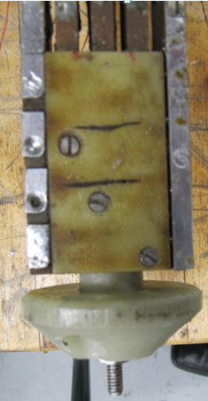
Existing Probe Layout
Stainless Steel Jacket
Current Leads
Voltage tap wire
Cryostat
Helium level
Voltage tap
Magnet
Sample

Slide 5
Concepts
Ways to Reduce Helium Consumption
Heat Exchanger
HTS Leads and support
Number of Leads
Fins
Gas Insulation
Jacket Design

Slide 6
Concepts
Ways to Reduce Helium Consumption
Heat Exchanger Cap
Heat Exchanger
HTS Leads and support
Number of Leads
Fins
Gas Insulation
Jacket Design
Covers current leads
Cools leads using excess gaseous helium

Slide 7
Concepts
Ways to Reduce Helium Consumption
Heat Exchanger
HTS Leads and support
Number of Leads
Fins
Gas Insulation
Jacket Design
G10 Support
Poor Conductor of heat
Low thermal conductivity with high electrical conductivity
Great reduction in copper surface area
Prevents copper leads from entering liquid helium bath
HTS Lead

Slide 8
Concepts
Ways to Reduce Helium Consumption
Current Leads
Heat Exchanger
HTS Leads and support
Number of Leads
Fins
Gas Insulation
Jacket Design
Leads are major heat leak
Maintain 6-8 samples with least amount of leads possible
Optimization

Slide 9
Concepts
Ways to Reduce Helium Consumption
Current Leads
Heat Exchanger
HTS Leads and support
Number of Leads
Fins
Gas Insulation
Jacket Design
Increase surface area
Increase heat transfer
Circular fins
Only in gaseous helium range

Slide 10
Concepts
Ways to Reduce Helium Consumption
Current Leads
Heat Exchanger
HTS Leads and support
Number of Leads
Fins
Gas Insulation
Jacket Design
Wells
Using the helium burn off gas to insulate the material
Layer of gas between the leads and fluid
Wells

Slide 11
Concepts
Ways to Reduce Helium Consumption
Current Leads
Heat Exchanger
HTS Leads and support
Number of Leads
Fins
Gas Insulation
Jacket Design
Stainless steel portion
G10 portion
interrupts thermal conduction of the stainless steel tube

Slide 12
Concept Selection
Concept Selection Table
Concepts | Accepted | Helium Savings per test (L) | Final
Heat Exchanger | No | --- | No
HTS Lead and Support | Yes | ≤ 26% | Modified
Number of Leads | Yes | ≤ 22% | Yes
Fins | Yes | 9% | Yes
Gas Insulation | No | --- | No
Jacket Design | Yes | .2% | Modified

Slide 13
System Analysis
Temperature Profile
To find the 35 Kelvin point on the copper leads
Used Standard heat conduction equation
Integrated to find temperature profile

Slide 15
Temperature with Convection
Assumed exponential temperature profile of gas
Used temperature profile for conduction
Properties relative to Temperature
Dynamic Viscosity
Density
Thermal Conductivity

Slide 16
Temperature with Convection
Mass flow-rate of helium gas, forced convection will be used
Nusselt equation to find the variable Convection Coeff.
Reynolds Number
Prandtl Number
Nusselt Number

Slide 17
Temperature with Convection
Standard convection equation
Subtracted this heat from conducted heat
Integrated again to get a new temperature profile

Slide 19
Concept Analysis - HTS lead
Temperature Profile marked 0.1281 meters from liquid to be 35 Kelvin
Heat transferred analysis is similar to that of the copper leads, however with different temperature differences and material properties.

Slide 20
Concept Analysis – Jacket
Heat transfer for solid stainless steel jacket
Stainless steel portion
Current Leads
G10 portion

Slide 21
Concept Analysis – Jacket Design
Heat transfer for G10 replacement at critical point
Top – stainless steel
Bottom – G10
Five spacers, do not protrude
Middle spacer connection for stainless steel and g10 portion
Jacket portions | Length
Stainless steel | 0.711 m
G10 | 1.029 m
Material | Average Thermal conductivity, k
Stainless Steel | 16 W/m*K
G10 | 0.35 W/m*K
Notes:
Assume 300K outside of cryostat, 270K at point of joint

Slide 22
Concept Analysis - Jacket
The cross sectional area is needed to determine the resistance
From these equations the heat transfer of the stainless steel and g10 portions of the combined jacket may be determined from
The combined heat transfer rate is

Slide 23
Concept Analysis - Jacket
Casing | Heat transfer, q
Stainless steel only | 0.188W
G10 and stainless steel | 0.082W
Results
Much lower heat transfer
G10 interrupts the transfer of heat from the environment through the stainless steel

Slide 24
Concept Analysis - Fin
Current Leads
 | Heat transfer
Finned Copper Lead | 9.628W
Unfinned circular copper lead | 6.337W
Increase | 3.291W

Slide 25
Concept Analysis – Optimization of Leads
Number of Samples | 1 | 2 | 3 | 4 | 5 | 6 | 7 | 8
# Leads | 2 | 3 | 4 | 5 | 7 | 8 | 9 | 10
He losses During Magnet ramping (L) | 7.50 | 11.25 | 15.00 | 18.75 | 26.25 | 30.00 | 33.75 | 37.50
He losses During Testing (L) | 1.56 | 4.69 | 9.38 | 15.63 | 27.34 | 37.50 | 49.22 | 62.50
He Losses During Magnet cool down (L) | 50.00 | 50.00 | 50.00 | 50.00 | 50.00 | 50.00 | 50.00 | 50.00
He Losses for single test (L) | 59.06 | 65.94 | 74.38 | 84.38 | 103.59 | 117.50 | 132.97 | 150.00
Number of test | 6 | 3 | 2 | 2 | 2 | 1 | 1 | 1
He Losses over total test (L) | 354.38 | 197.81 | 148.75 | 168.75 | 207.19 | 117.50 | 132.97 | 150.00
150 liters used in 3 hour test with a 10 lead probe with 8 samples mounted
One lead uses 5 liters/hour
One hour to cool down magnet estimated 50 liters used
Magnet ramping takes 45 minutes
75 minutes used for testing, 9.375 minutes per sample
Multiple test needed for low sample count
 | Number of Leads
Lowest | 6 | 117.50
He Burn off (L) | 7 | 132.97
 | 8 | 150.00
 | 3 | 148.75
 | 4 | 168.75
 | 2 | 197.81
 | 5 | 207.19
Highest | 1 | 354.38

Slide 26
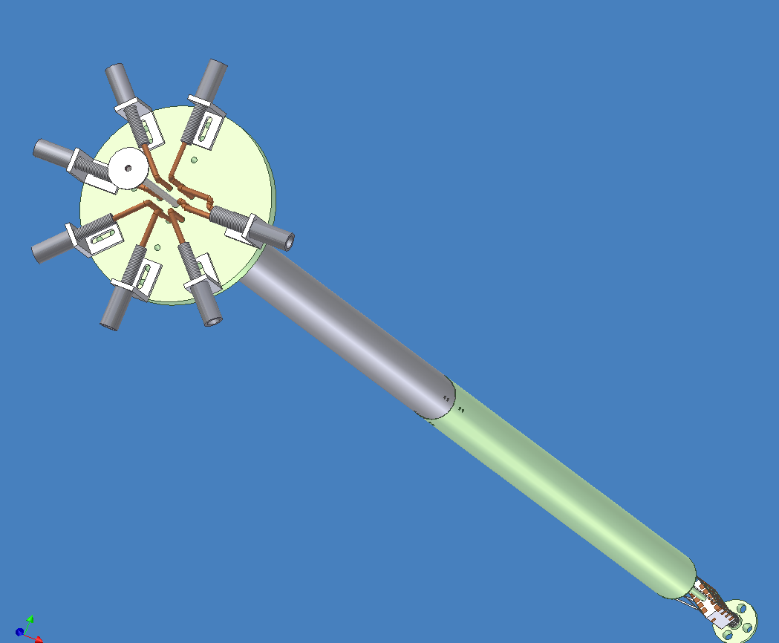
Final Probe Design – Full Length

Slide 27
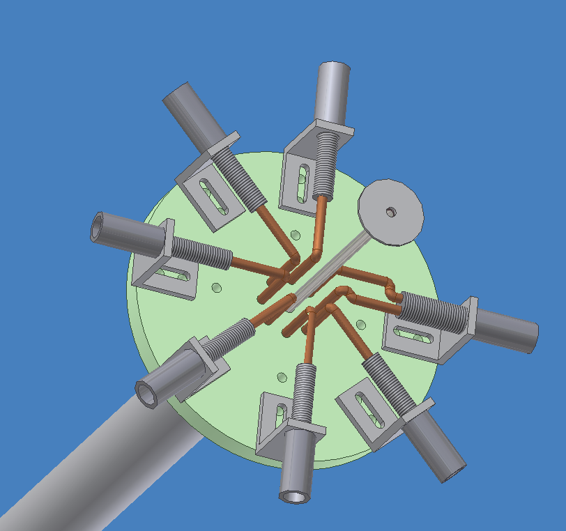
Final Probe Design – Top View

Slide 28
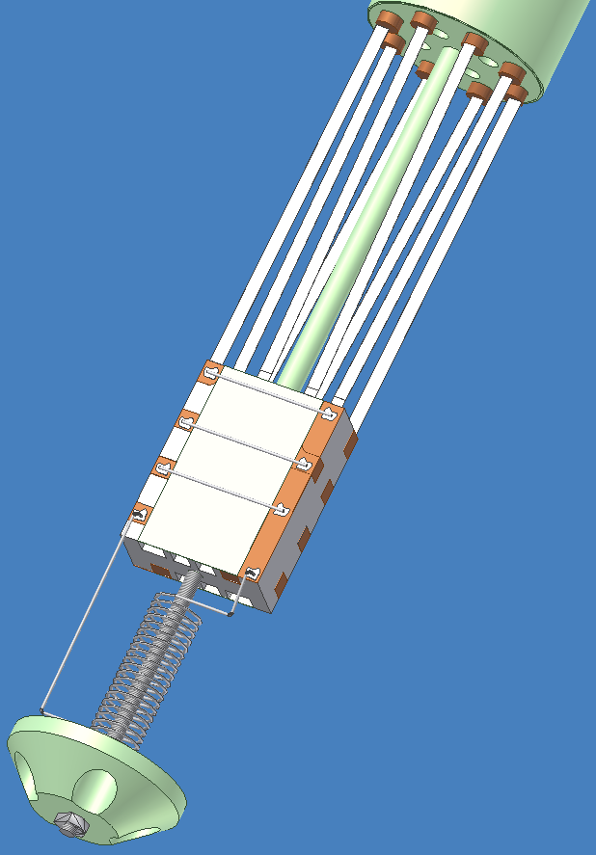
Final Probe Design – Sample Holder

Slide 29
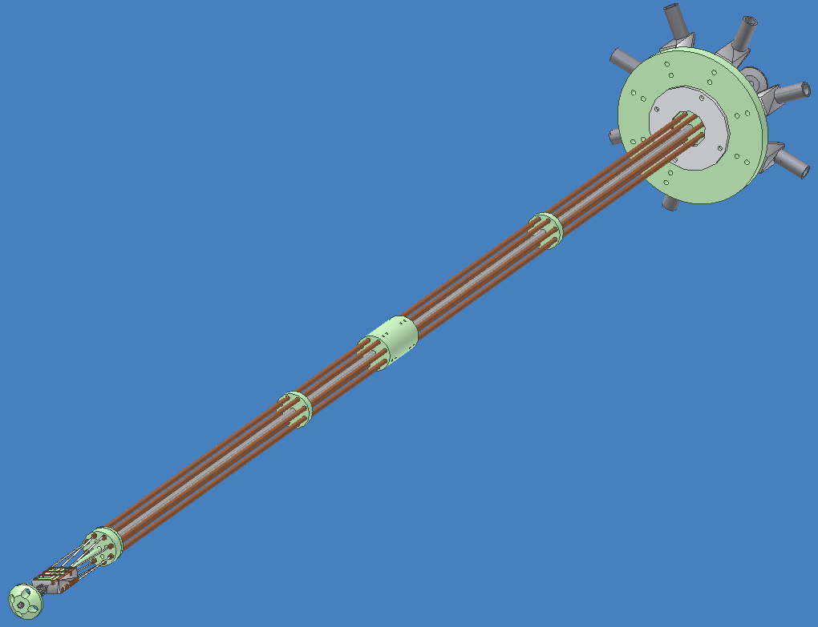
Final Probe Design – Inner View

Slide 30
Bill of Materials -
PART NO. | PART NAME | NOTE | MATERIAL/ PART | QTY | UNIT COST | TOTAL
1 | VOLTAGE PIN CONNECTION | PROVIDES CNNECTION FOR VOLTAGE READING | 19 PIN CONNECTOR | 1 | 0.00 | 0.00
2 | LOWER MSP | MAIN BODY | 2 3/8" OD x .0625 WALL S.S. TUBING | 1 | 273.00 | 273.00
3 | SAMPLE HOLDER |  | G-10 | 0 | 0.00 | 0.00
4 | STABILIZER | PROTECTS PART NO.10 | G-10 | 1 | 0.00 | 0.00
5 | CURRENT LEADS | INCLUDES 2 EXTRA PIECES | COPPER ROD (5/16 Diameter 6ft Length) | 8 | 33.88 | 271.04
6 | CURRENT LEAD SPACER-1 | KEEPS CURRENT LEADS IN PLACE | G-10 ROD (2 1/2" Diameter 1ft Length | 1 | 61.13 | 61.13
7 | PROBE TOP FLANGE | PROVIDES MOUNTING SUPPORT FOR S.S SHAFT | G-10 PLATE (12" x 12" x 3/4") | 1 | 44.15 | 44.15
8 | PIN CONNECTOR BLANK-1 | FOR PART NO.10 | NW 40 | 1 | 15.30 | 15.30
9 | PIN CONNECTOR BLANK-2 | FOR PART NO.10 | NW 40 | 1 | 10.80 | 10.80
10 | PIN CONNECTOR CLAMP | FOR PART NO.1 | NW 40 | 1 | 7.65 | 7.65
11 | O- RING | FOR PARTS NOS. 8 & 9 | NW 40 | 1 | 3.60 | 3.60
12 | COLLAR-3 | KEEPS PART NO.3 IN PLACE IN DEWAR | ALUMINUM (4" x 4" x 3/4" Thickness) | 1 | 61.77 | 61.77
13 | PRESSURE VALVE | FOR PART NO.2 (HELIUM EXHAUST) | 1 PSI | 1 | 97.00 | 97.00
14 | SET SCREWS | FOR PART NO.7 | #10-24 x 5/16" (Packet of 2) | 1 | 0.46 | 0.46
15 | BRASS MACH SCREWS | FOR PART NO. 3 | #4-40 x 3/8" (Packet of 6) | 2 | 0.78 | 1.56
16 | SS SCREWS | FOR PART NO. 3 | #4-40 x 1/4" Check | 4 | 0.00 | 0.00
17 | VOLTAGE WIRE TUBING |  | STAINLESS STEEL TUBING (1/4" Diameter) | 0 | 0.00 | 0.00
18 | VOLTAGE WIRES |  | 80 FT | 0 | 0.00 | 0.00
19 | SUPERCONDUCTOR | FOR PART NO. 5 | 2 m | 6 | 65.00 | 780.00
20 | DIODE | FOR PART NO. 3 | GIVES TEMP OF SAMPLES IN DEWAR | 0 | 0.00 | 0.00
21 | MISC (Beer Fund) |  |  |  |  | 200.00
 | TOTAL COST |  |  |  |  | 1827.46

Slide 31
Future Goals
For the spring semester
January – Order materials
February – Machine and assemble
March – Testing
April – Finished product

Slide 32
Acknowledgments
Dr. Hovsapian, Adjunct Faculty, Florida State University, Mechanical Engineering, Ph.D.
Dr. Kosaraju, Adjunct Faculty and Postdoctoral Researcher
Dr. Hellstrom, Ph.D. Materials Science, Stanford University,
Dr. Trociewitz, Associate Scholar/Scientist, ASC
Applied Superconductivity Center
NHMFL

Slide 33
References
Çengel, Yunus A., Robert H. Turner, and John M. Cimbala. Fundamentals of Thermal-fluid Sciences. Boston: McGraw-Hill, 2008. Print.
Ekin, Jack W. . Experimental Techniques for Low-temperature Measurements. New York: Oxford UP, 2006. Print.
Thomas, Lindon C. Fundamentals of Heat Transfer. Englewood Cliff, NJ: Prentice-Hall, 1980. Print.

Slide 34
Questions?

Slide 36
Sponsors
NHMFL
Applied Superconductivity Center

Slide 37
Concept 2- HTS Leads
Replacing Copper with HTS leads
High temperature superconducting leads
Conducts current orders of magnitude greater than copper
Poor conductor of heat
Reduces surface area of copper
Removes copper from entering liquid helium bath

Slide 38
Concept 2 & 3 – Structural Support
HTS Leads
Need structural support
G10 encasement

Slide 39
Existing Probe
Copper current leads for existing probe
Top flange made of G-10
Stainless steel casing
G-10 sample holder
Concept 2 - HTS leads

Slide 40
Existing Probe
The current leads for existing probe
Concept 2 - HTS leads

Slide 41
Concept 2 – HTS Lead
Remove section of copper lead
Replace with HTS material
Solder joint
Concept 2 - HTS leads

Slide 42
Concept 3 – Structural Support
Remove section of copper lead
G-10 Structural support
HTS material
Concept 2 & 3 - HTS leads

Slide 43
Concept 4 – Reduce Leads
Reduce the amount of leads
Leads are major heat leak
Temperature gradient
Maintain 6-8 samples with least amount of leads possible
Optimization
Notes:
Ambient air to 4.2 K

Slide 44
Circular Fins
Easy to machine
Fit in given space
Need circular leads
Number of fins
Too many may not be helpful
3.9mm
Cross section of
a proposed circular
copper lead

Slide 45
Concept 6 – Gas Insulation
Using the helium burn off gas to insulate the material.
Layer of gas between the leads and fluid
Non-boiling, Nucleate boiling, film boiling
Changing the orientation of leads
Vertical Vs. inclined
Trapping of gas, wells

Slide 46
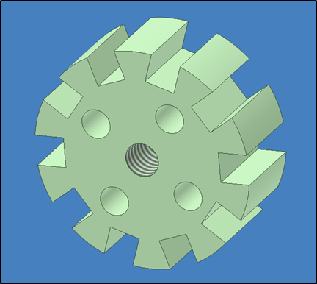
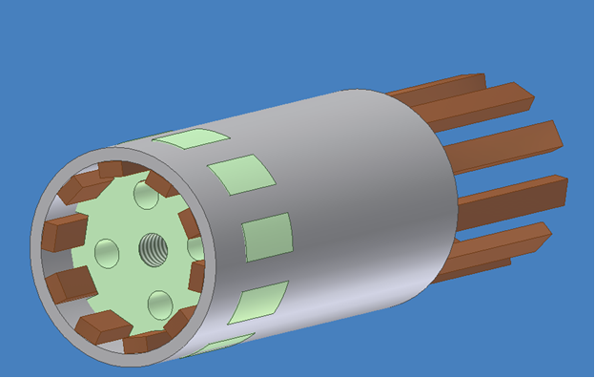
Concept 7–Spoke Thermal Cap
G-10, a fibrous material, is used as a current lead spacer
Modification to this part can interrupt thermal conduction of the stainless steel tube.

Slide 47
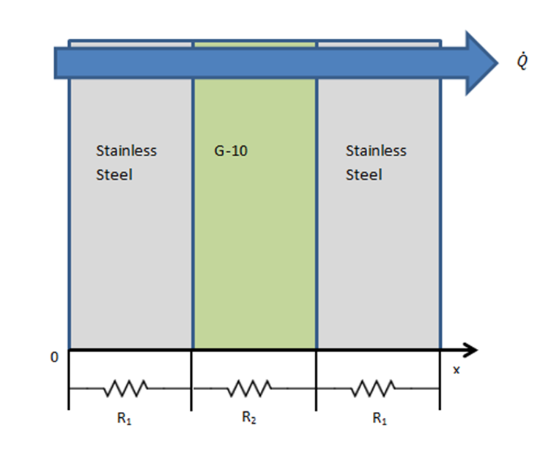
Concept 7 - Casing/Spoke Design
Concept 7 – Spoke Design
Hard to implement
New Design
interrupts thermal conduction of the stainless steel tube
Easy to implement
New Casing Design

Slide 48
Concept Analysis – Fins
For calculations,
Assumed
Adiabatic tip
Annular fins of a rectangular profile
Fin temperature varies only in one direction
Analysis of smooth lead vs. finned lead

Slide 49
Concept Analysis - Fins
Analysis of smooth lead
Maximum radius 3.937mm
Simplification - calculations performed for a specific point on the lead
Heat transfer rate of the smooth lead is given by:
Where, h is taken as the average convection rate determined in previous calculations, A is the surface area of smooth lead, Tb is the temperature of the casing, and T∞ is the temperature of the gas
Notes:
Ts=250K Tinf=105K Tinf is temp of gas Ts-Tb temperature of the casing

Slide 50
Concept Analysis - Fins
Analysis of the finned lead
Maximum radius of fin is 3.937mm
Increase the surface area of the lead
Design*
Thickness – 0.5 mm
Spacing – 2.0 mm
Using annular fin efficiency tables, η = 0.81
From,
Heat transfer rate of the finned lead,
* More detailed calculations available in appendix

Slide 51
Concept Analysis - Fins
Analysis of the finned lead
Using annular fin efficiency tables, η = 0.81
From,
Heat transfer rate of the finned lead,
Area increase,

