Slide 1
Critical Current Probe
Team 16
Mid-Point Review
Amy Eckerle
Andrew Whittington
Philip Witherspoon
NHMFL
Applied Superconductivity Center

Slide 2
The Project
Modify existing cryostat probe to conserve the amount of liquid helium, $5/liter of liquid He, used during a critical current measurement test.
Stainless Steel Jacket
Current Leads
Cryostat
Voltage tap wire
Helium level
Voltage tap
Sample
Magnet
Notes:
Mention what a critical current measurement is

Slide 3
Constraints
Constraints
Test 6-8 samples
Budget of $4000
Constant casing diameter
Minimum length to reach center of cryostat

Slide 4
Solutions
HTS Leads and support
Poor Conductor of heat
Low thermal conductivity with high electrical conductivity
Great reduction in copper surface area
Prevents copper leads from entering liquid helium bath
G10 Support
HTS Lead

Slide 5
Solutions
Number of Leads
Current Leads
Leads are major heat leak
Maintain 8 samples with 6 leads

Slide 6
Solutions
Jacket Design
Current Leads
interrupts thermal conduction of the stainless steel tube
Stainless steel portion
G10 portion

Slide 7
Problems
Re-design was needed for HTS leads protection
Previous design of sample holder was impractical
New design was made
Ordering Problems

Slide 8
HTS Section
High Temperature Superconducting
Eight tapes will be stacked
Reduce surface area
Most important section
Fragile
Copper Lead
HTS Lead

Slide 9
HTS Protection
No HTS Protection
Free hanging, fragile wires
Susceptible to twisting and pulling
Low durability
Protection Requirements
Protect HTS leads
Allow for thermal contraction

Slide 10
HTS Protection
Spacers
Keeps rods from swinging or touching
Have holes drilled for voltage taps, copper leads, and support rods
Will connect to G-10 casing via holes screws

Slide 11
HTS Protection
G-10 Support Rods
Prevents rods from twisting
Screwed into top spacer
Clamp placed on bottom spacer will allow for upward motion

Slide 12
HTS Protection
G-10 Casing
Adds durability
Prevents bending

Slide 13
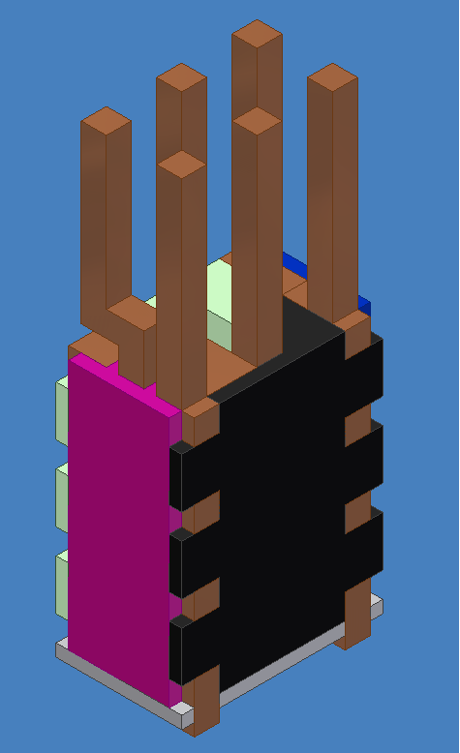
Sample Holder Redesign
Reduction in leads required new design
New design features
Avoidance of bending copper
Using 6 current leads for 8 samples
Mounting for spiral sample
Need to order copper for sample holder

Slide 14
Parts en Route
8 ft current leads (qty. 6)
Current connects (qty. 6)
Copper for sample holder
G-10 Rods (qty. 4)
Stycast

Slide 15
Machining
Parts Needing Machining
Sample holder
Copper leads
Current connects
Parts Undergoing Machining
G-10 top flange
Spacers
Jacket welding
Guide
Connector
Notes:
Be more specific on parts being machined

Slide 16
Machining
Parts Needing Machining
Sample holder
Copper leads
Current connects
Parts Undergoing Machining
G-10 top flange
Spacers
Jacket welding
Guide
Connector
Notes:
Be more specific on parts being machined

Slide 17
Machining
Parts Needing Machining
Sample holder
Copper leads
Current connects
Parts Undergoing Machining
G-10 top flange
Spacers
Jacket welding
Guide
Connector
Notes:
Be more specific on parts being machined

Slide 18
Machining
Parts Needing Machining
Sample holder
Copper leads
Current connects
Parts Undergoing Machining
G-10 top flange
Spacers
Jacket welding
Guide
Connector

Slide 19
Machining
Parts Needing Machining
Sample holder
Copper leads
Current connects
Parts Undergoing Machining
G-10 top flange
Spacers
Jacket welding
Guide
Connector

Slide 20
Machining
Parts Needing Machining
Sample holder
Copper leads
Current connects
Parts Undergoing Machining
G-10 top flange
Spacers
Jacket welding
Guide
Connector

Slide 21
Machining
Parts Needing Machining
Sample holder
Copper leads
Current connects
Parts Undergoing Machining
G-10 top flange
Spacers
Jacket welding
Guide
Connector

Slide 22
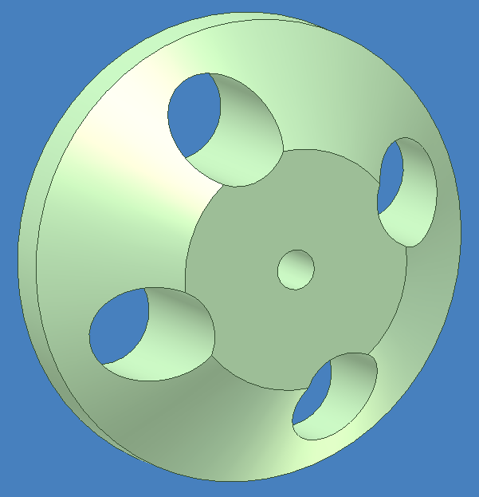
Machining
Parts Needing Machining
Sample holder
Copper leads
Current connects
Parts Undergoing Machining
G-10 top flange
Spacers
Jacket welding
Guide
Connector

Slide 23
Machining
Parts Needing Machining
Sample holder
Copper leads
Current connects
Parts Undergoing Machining
G-10 top flange
Spacers
Jacket welding
Guide
Connector

Slide 24
Testing
Testing can only occur when the final design has been completely finished
Place probe in existing cryostat for regular testing
Compare helium losses with the existing design
Comparing weight

Slide 26
Questions?

