Slide 1
Critical Current Probe
Team 16
Final
April 2012
Amy Eckerle
Andrew Whittington
Philip Witherspoon
NHMFL
Applied Superconductivity Center

Slide 2
Overview
Background
Introduction
The Project
Objectives
Constraints
Concepts
Final Design
Project Plan
Manufacturing and Assembly
Economics
Results
Environmental Issues

Slide 3
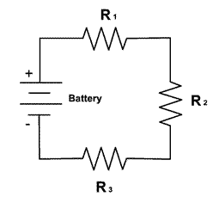
Super Conductivity
Superconductivity is a phenomenon that allows an indefinite amount of current to flow with negligible resistance.

Slide 4
Critical Current
Critical Current Probes measures how much current a sample can take before it becomes non-superconducting
Temperature
Magnetic Field
Orientation

Slide 5
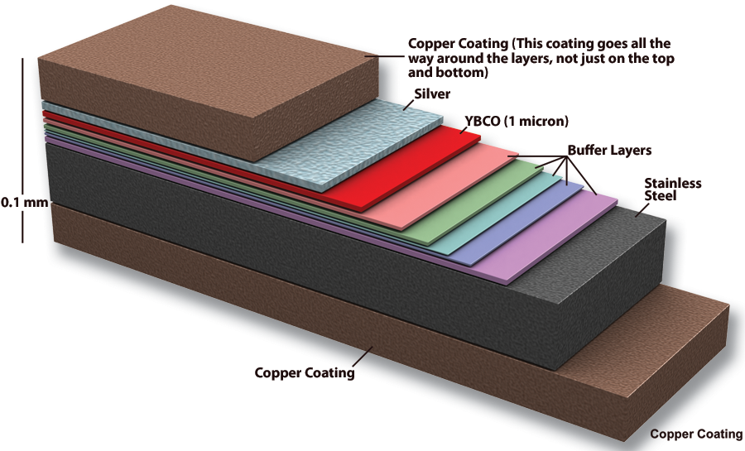
Samples
Sample are made of YBCO
HTS (High Temperature Superconducting)
Samples are mounted at the base of two current leads running the length of the probe
Submerged in cryogenic liquid
Notes:
Mention how this is different from LTS
Mention how the bottom of the probe is at lower temperature to allow for superconductivity which will be explained in detail later

Slide 6
The Project
Design a critical current probe to conserve the amount of liquid helium used during a critical current measurement test
$5/liter of liquid He
Stainless Steel Jacket
Current Leads
Cryostat
Voltage tap wire
Helium level
Voltage tap
Sample
Magnet
Notes:
Mention what a critical current measurement is

Slide 7
Objectives
Conserve Helium
Test 6-8 short samples
Test one spiral sample
Deliver 1000 Amps to the samples
Durability

Slide 8
Constraints
Constraints
Budget of $4000
Constant casing diameter
Minimum length to reach center of cryostat
Current Leads
Stainless Steel Jacket
Cryostat

Slide 9
Concepts
Ways to Reduce Helium Consumption
Heat Exchanger
HTS Leads and support
Number of Leads
Fins
Gas Insulation
Jacket Design

Slide 10
Concept Selection
Concept Selection Table
Concepts | Accepted | Helium Savings per test (L) | Final
Heat Exchanger | No | --- | No
HTS Lead and Support | Yes | ≤ 26% | Modified
Number of Leads | Yes | ≤ 22% | Yes
Fins | No | 9% | Yes
Gas Insulation | No | --- | No
Jacket Design | Yes | .2% | Modified

Slide 11
Solutions
HTS Leads and support
Low thermal conductivity with high electrical conductivity
Great reduction in copper surface area
Prevents copper leads from entering liquid helium bath
G10 Support
HTS Lead

Slide 12
Solutions
Number of Leads
Current Leads
Leads are major heat leak
Maintain 8 samples with 6 leads

Slide 13
Solutions
Jacket Design
Current Leads
interrupts thermal conduction of the stainless steel tube
Stainless steel portion
G10 portion

Slide 14
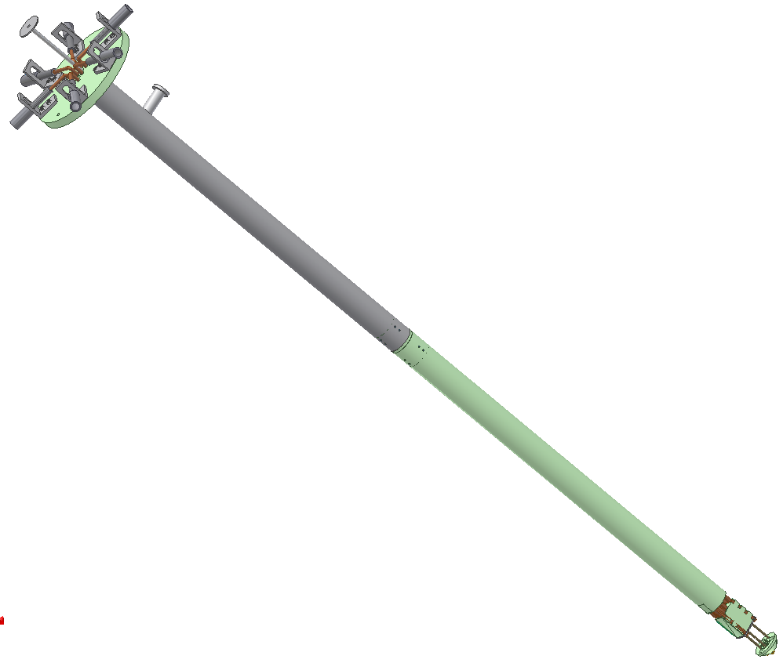
Final Design

Slide 15
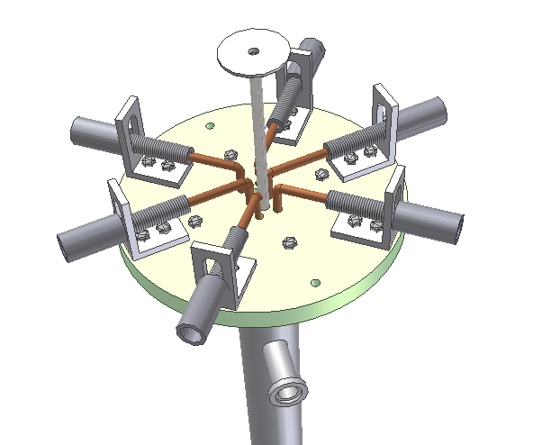
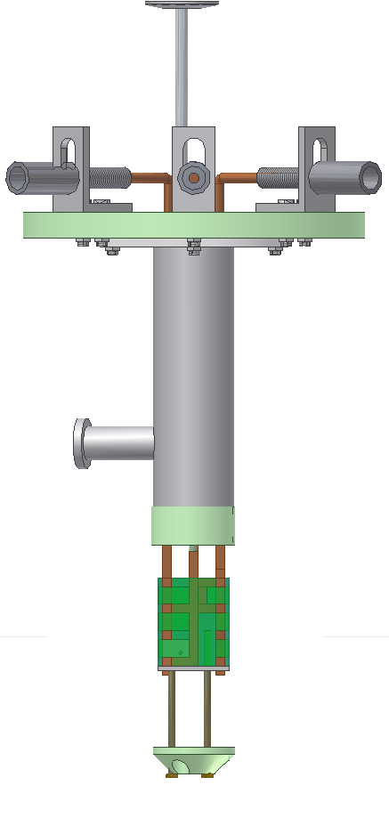
Final Design – Current Connects

Slide 16
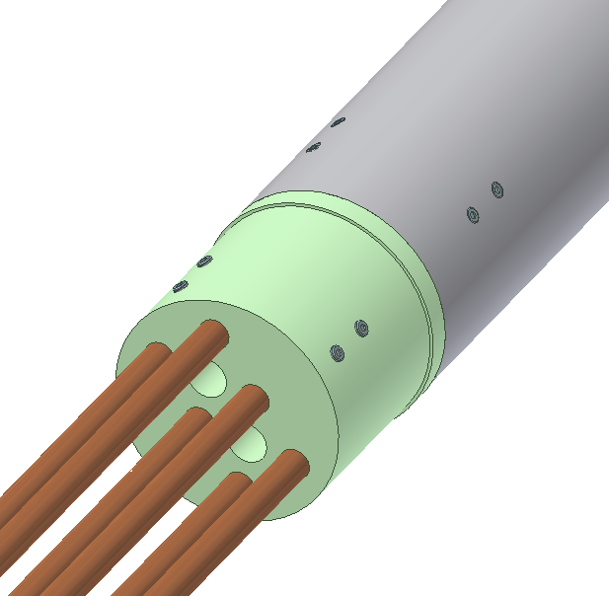
Final Design – Current Connector

Slide 17
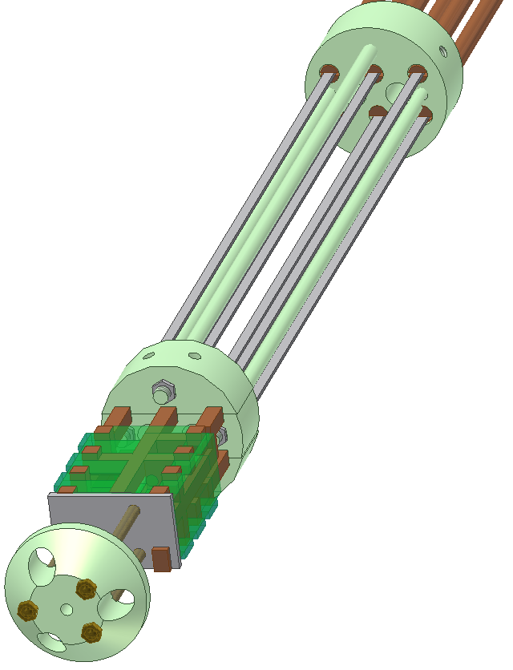
Final Design - HTS

Slide 18
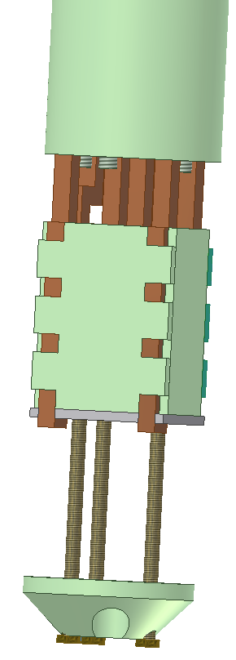
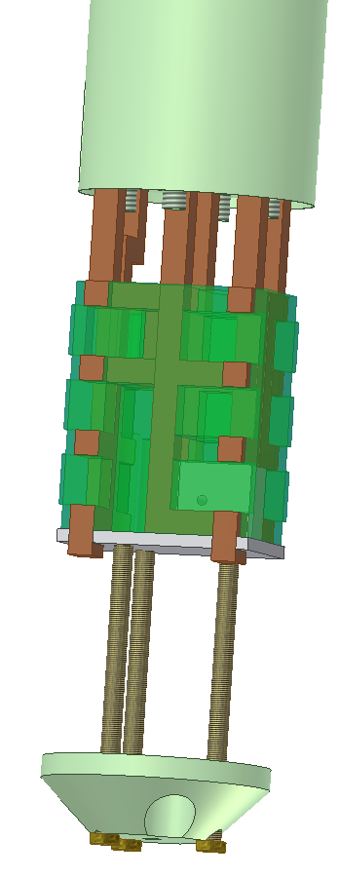
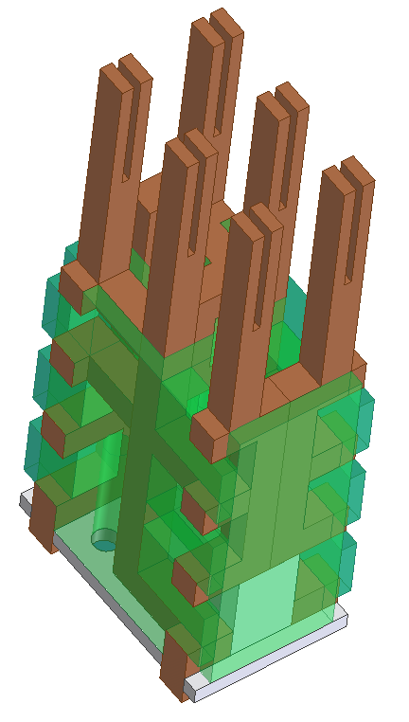
Final Design - Sample Holder/Guide

Slide 19
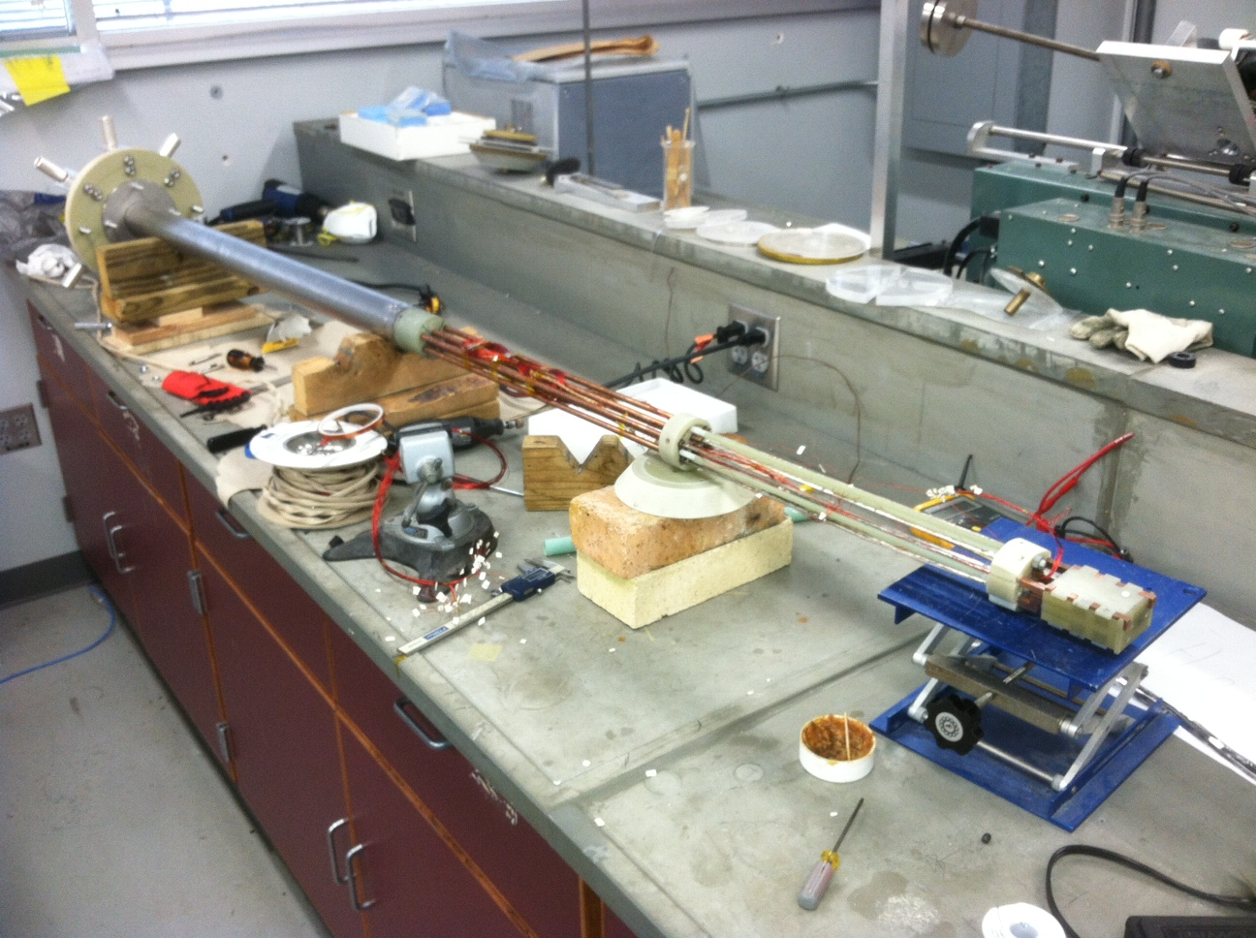
Final Design

Slide 20
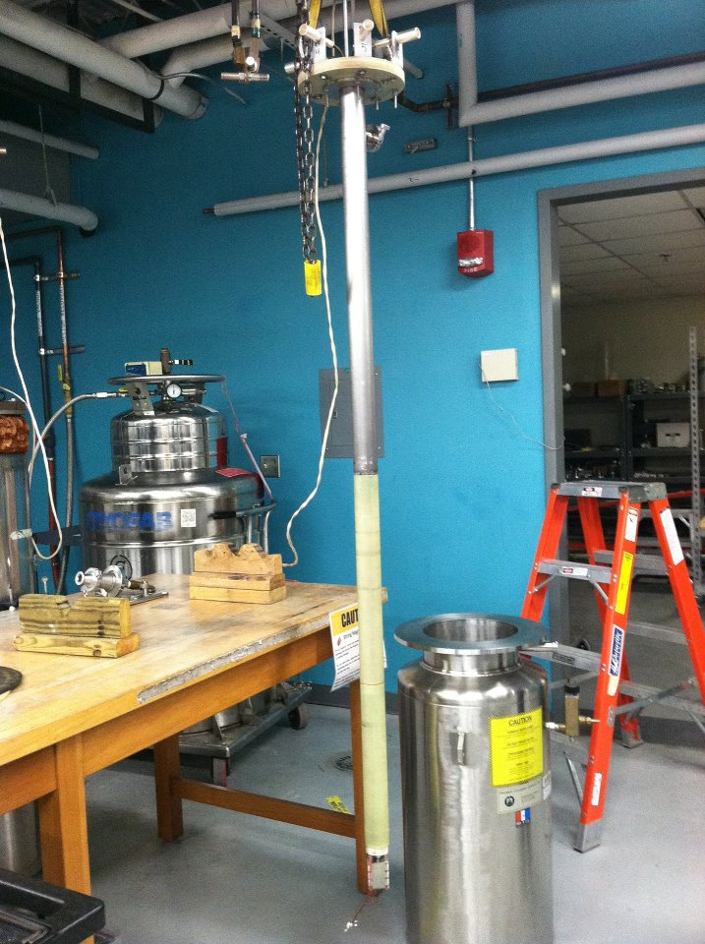
Final Design

Slide 21
Project Plan

Slide 22
Manufacturing and Assembly
Machining
ASC shop
NHMFL shop
Exotic Machining, Inc
Assembly
Top flange
Stainless steel tube
Spacer
Copper leads
Current connects
G10 connector
Sample holder
Soldering of HTS leads
HTS support system
Voltage taps

Slide 23
Manufacturing and Assembly
Assembly
Top flange
Stainless steel tube
Spacer
Copper leads
Current connects
G10 connector
Sample holder
Soldering of HTS leads
HTS support system
Voltage taps

Slide 24
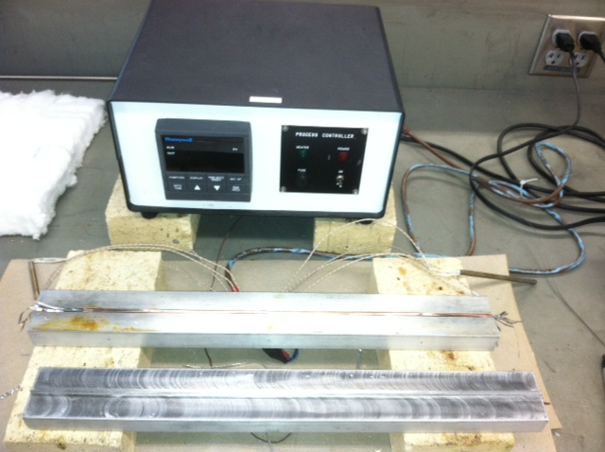
Soldering of HTS Leads
Special device was created to solder 8 HTS tapes together
Soldering to copper leads using various heating methods

Slide 25
Economics
Budget of $4000
material | quantity | cost
110 Alloy Copper rods | 6 | $291.00
G-10 Tube | 1 | $611.04
G10 Plate | 1 | $88.24
Stainless steel plate | 1 | $81.49
G10 rod | 1 | $125.77
G-10 plate | 1 | $67.40
90deg angles steel | 1 | $44.06
Sockets threaded, current connects | 6 | $180.00
copper plate | 1 | $60.95
copper bar | 1 | $62.52
G-10 Plate | 1 | $60.18
aluminum bar | 1 | $49.34
cartridge heater | 7 | $247.24
cartridge heater | 2 | $40.52
wing nut | 1 | $11.21
compression springs | 2 | $26.72
Exotic Machining | 1 | $400.00
 | Total | $2,447.68

Slide 26
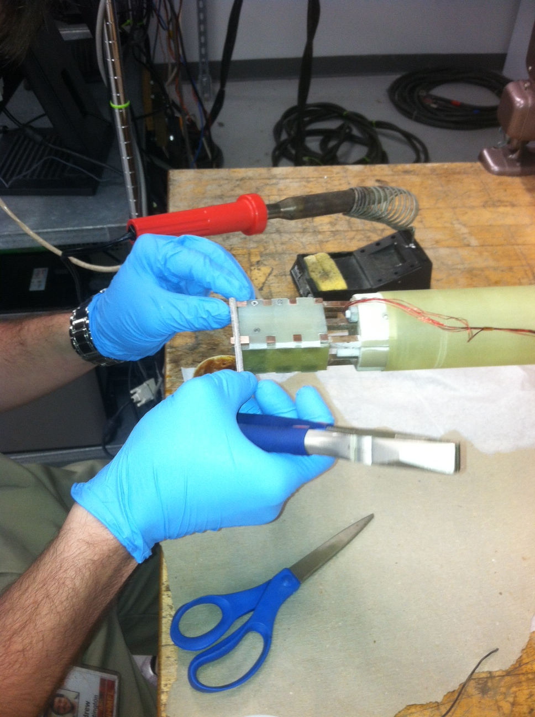
Preparing
Applied voltage taps along the probe
Soldered a strip of HTS to complete circuit
Covered base with G-10 to protect HTS

Slide 27
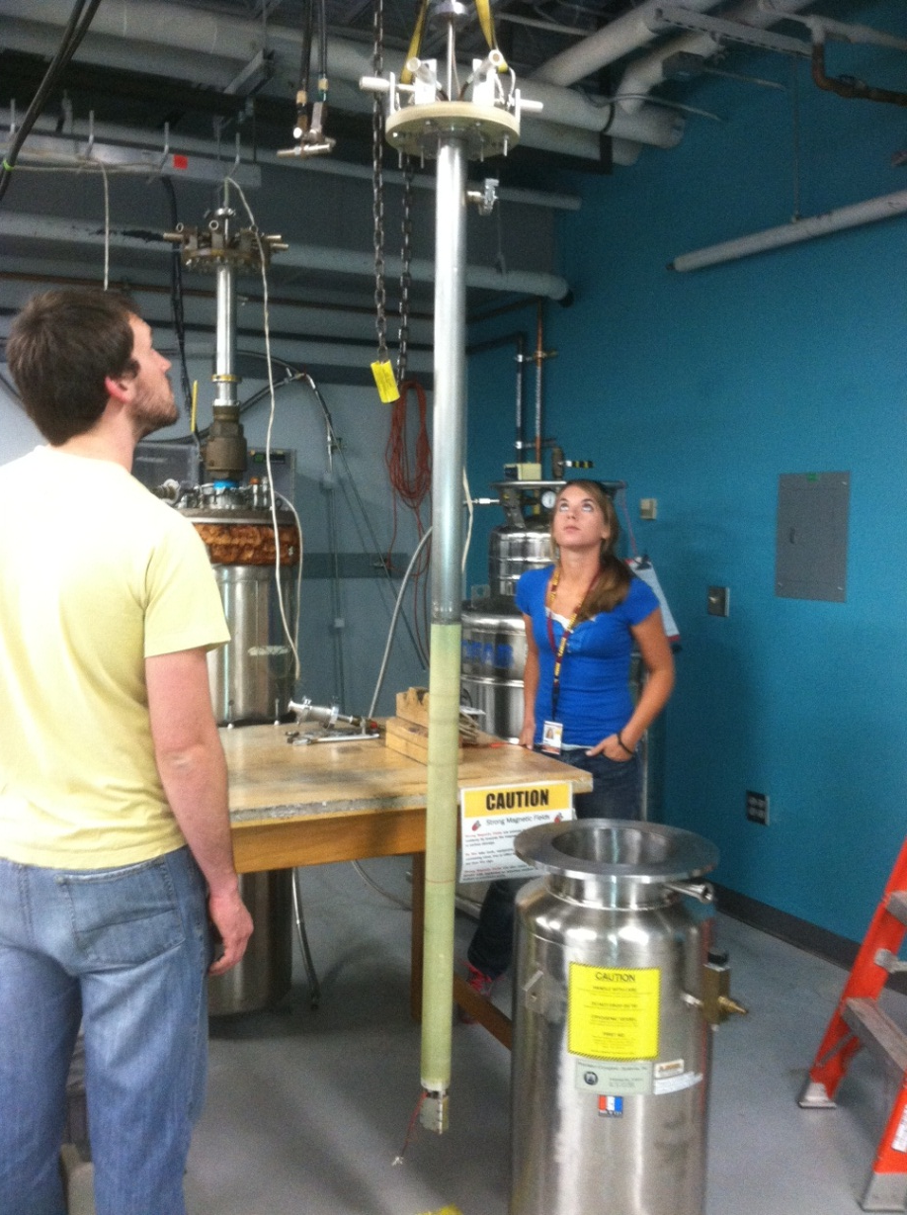
Testing
Took place the NHML
Lifted by crane into cryogenic bath
Preliminary testing
To make sure HTS Lead was superconducting
Final testing in Liquid helium to measure burn off
Notes:
Mention preliminary testing was don in liquid nitrogen
Current Leads 4 and 5

Slide 28
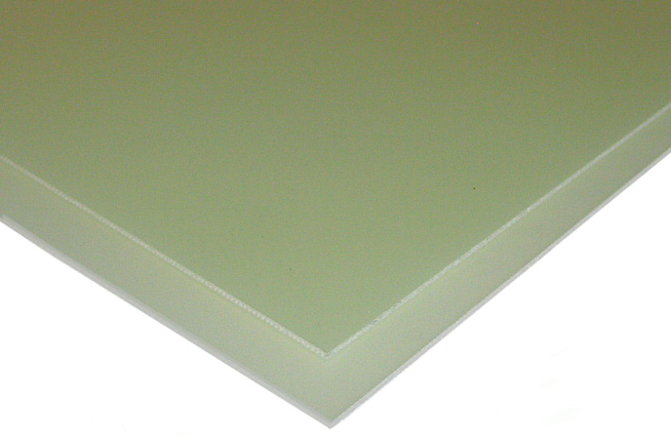
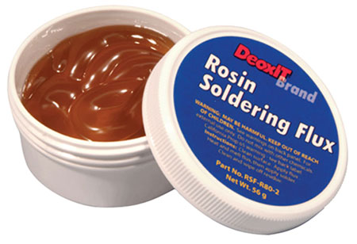
Environmental/Safety Hazards
G-10
Flux
Cutting Fluid
Machining Hazards
Heating Hazards
Handling Liquid Helium
Electric Current
Weight
G-10
Flux

Slide 29
Results
Preliminary test results (in liquid nitrogen)
Took place after 12pm 4/5/12
Future testing (in liquid helium)
Will take place at NHMFL 4/6/12

Slide 30
Conclusions
Testing in liquid nitrogen will completed on two leads
Full testing will be completed on 4/5/12 if the preliminary is successful

Slide 31
Acknowledgments
Dr. Hovsapian, Adjunct Faculty, Florida State University, Mechanical Engineering, Ph.D.
Dr. Kosaraju, Adjunct Faculty and Postdoctoral Researcher
Dr. Hellstrom, Ph.D. Materials Science, Stanford University,
Dr. Trociewitz, Associate Scholar/Scientist, ASC
Applied Superconductivity Center
NHMFL
Bill Sheppard, NHMFL Machine Shop
Robert Stanton, NHMFL
Bill Starch, ASC Machine Shop
Dimitri Argonaut, ASC Machine shop

Slide 32
References
Çengel, Yunus A., Robert H. Turner, and John M. Cimbala. Fundamentals of Thermal-fluid Sciences. Boston: McGraw-Hill, 2008. Print.
Ekin, Jack W. . Experimental Techniques for Low-temperature Measurements. New York: Oxford UP, 2006. Print.
Thomas, Lindon C. Fundamentals of Heat Transfer. Englewood Cliff, NJ: Prentice-Hall, 1980. Print.

Slide 33
Drawings

