Slide 1
Critical Current Probe
Team 16
Interim Design
Amy Eckerle
Andrew Whittington
Philip Witherspoon

Slide 2

Sponsors
NHMFL
Applied Superconductivity Center

Slide 3
The Project
Modify existing cryostat probe to conserve the amount of liquid helium used during a critical current measurement test.

Slide 4
Objectives
Conserve Helium
Test 6-8 straight samples
1 Spiral sample
Capability to deliver 1000 Amps to samples
Durable

Slide 5
Concepts
Concept 1 – Heat Exchanger
Concept 2 – HTS Leads
Concept 4 – Reduce Leads
Concept 5 – Fins
Concept 6 – Gas Insulation
Concept 7 & 3 – Casing/Spoke Design

Slide 6
Analysis on Original Probe
Give a base line to compare modifications
Need to find the heat transfer from room temperature to cryogenic level
Key attributes of probe needed:
  Surface and cross sectional area
  Temperature of starting and finish location
  Length and number of leads (optimization)
  Temperature dependant thermal conductivity
    λ(T)

Slide 7


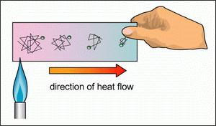
Conduction
Will cause the highest form of heat transfer
  Very large temperature gradient

Slide 8
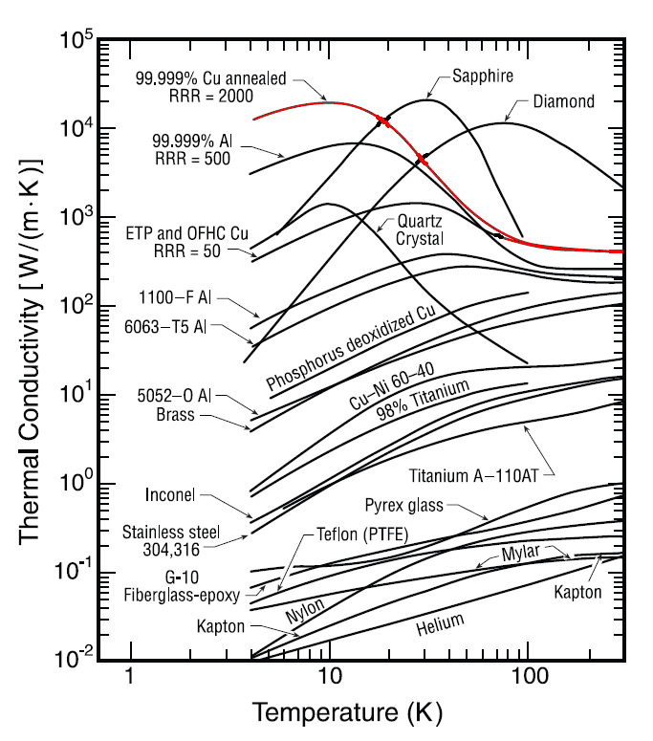

Slide 9
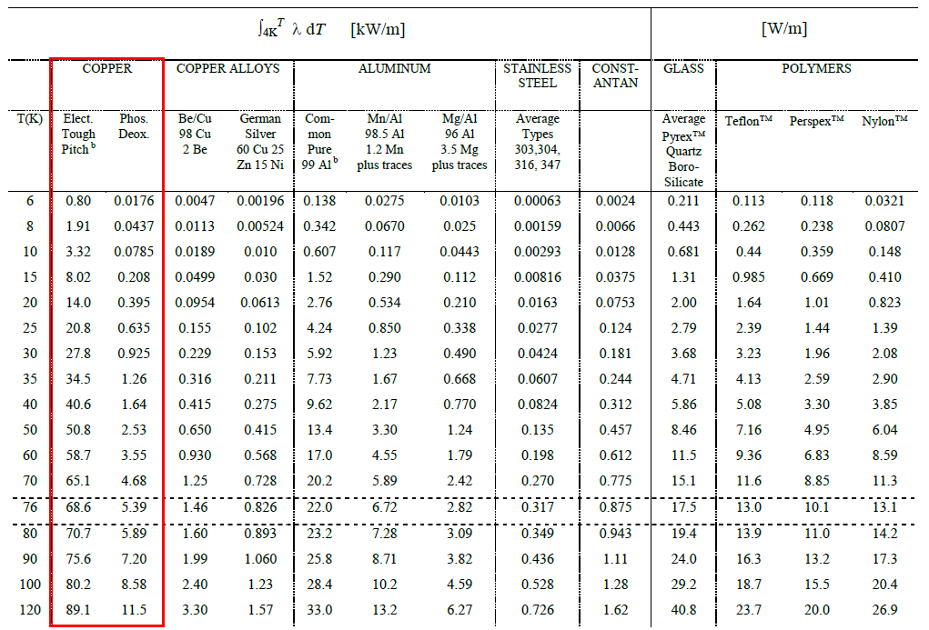
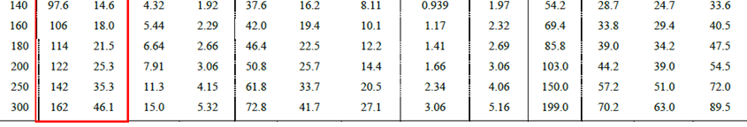

Slide 10

Convection
Helium gas traveling up through the probe will act as a heat exchanger.
Use LMTD method
Higher temp
Lower temp
Flow of gas (assume constant temperature)
Convection Coefficient

Slide 11


Convection Coefficient
Natural convection
Raleigh number (vertical plate)
Heat transfer coefficient (all ranges)

Slide 12
Radiation
Normally over looked, however at low temperatures will have noticeable affects.
Standard radiation equation
Reflectivity of material
Temperature difference holds biggest weight

Slide 13
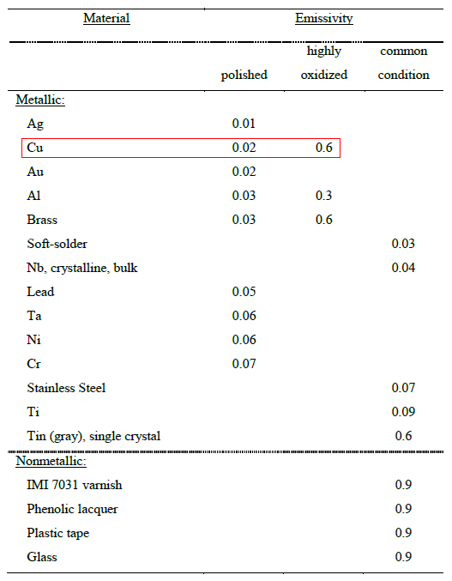

Slide 14
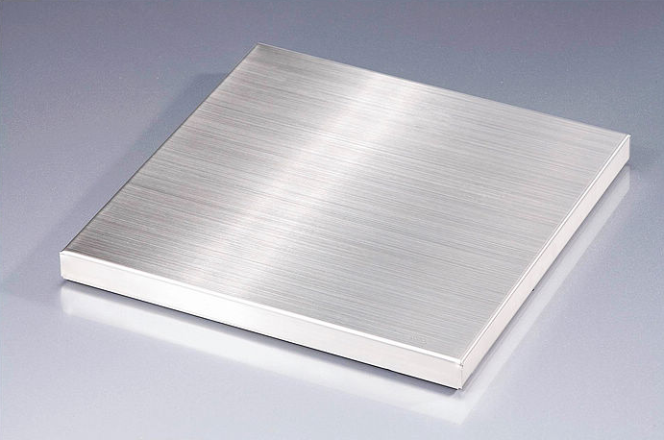
Radiation shields
Use Stainless steel
  Low emissivity
  Low thermal conductivity
Put cylindrical plate around samples
Place circular plate near top of cryostat

Slide 15
Radiation shields (cont.)
Steel metal casing blocks most of radiation
Only radiation leak would be at the neck
Implementing a shield up top, cause more damage than good
Impractical

Slide 16
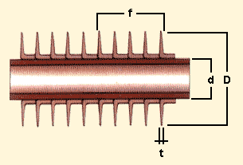
Copper Lead Fins
Increase convection
Fins will be used to cool the portion of the probe that is in the gaseous helium

Slide 17
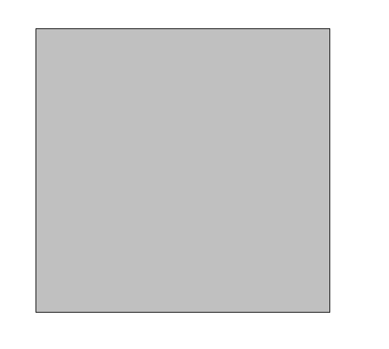
Dimensions
The existing current leads have a rectangular cross section
The area will be increased with the use of fins
Not much extra room
  Must optimize fins for the amount of area allotted
6.75mm
6.5mm
Existing
Current lead
Cross section (mm)

Slide 18
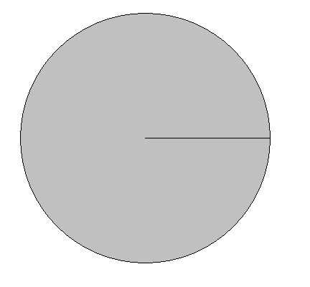




Circular Fins
2.9mm
Easy to machine
Fit in given space
Need circular leads
Number of fins
  Too many may not be helpful
Cross section of
a proposed circular
copper lead

Slide 19
Fin Types
Tip conditions:
  Convection heat transfer
  Adiabatic
  Constant temperature
  Infinite Fin length
Can assume adiabatic – Not accurate
Convection from fin tip
  Use corrected length

Slide 20



Convection from Fin tip
The corrected length, Lc, is used in place of the length, L, in the adiabatic equations
Each fin will need to be analyzed separately due to the changing temperature, T∞, through the system
For circular fin
Relation for the temperature
distribution:
Heat transfer rate:

Slide 21
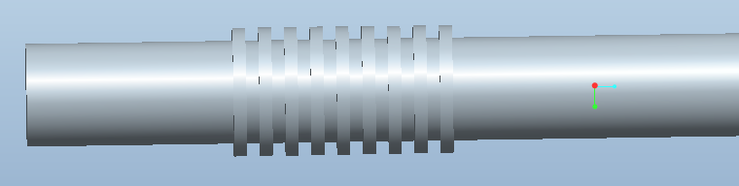
Placement of Fins
To conserve helium: Need to cool the portion of the probe that enters the liquid helium
Used in the lower portion of the probe within the cryostat region above the liquid helium
Increase the heat transfer from the gaseous helium to the probe
Possible design using circular fins

Slide 22
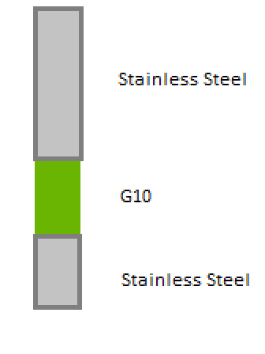
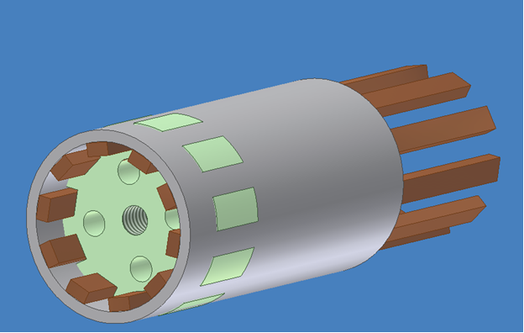
Casing/Spoke Design
Concept 7 – Spoke Design
  Hard to implement
Simpler design
New Design
  interrupts thermal conduction of the stainless steel tube
  Easy to implement
Previous Design
New Design

Slide 23

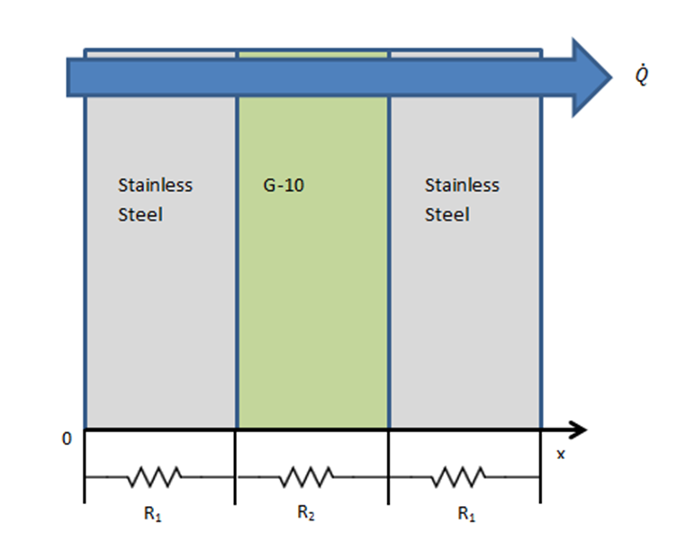
Equations
k, thermal conductivity
  Specific for material
A, is the area
T, is the temperature
with respect to placement

Slide 24
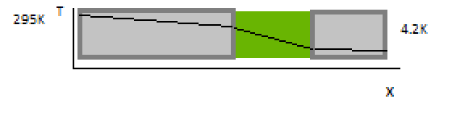
Needed Information
Lower thermal conductivity allows thermal insulation
Thermal conductivity changes with temperature at cryogenic levels
Material | Thermal conductivity, k
Stainless Steel (room temperature) | 16 W/mK
G10 (room temperature) | 0.5 W/mK
G10 (cryogenic temperatures) | 0.02-0.05 W/mK
Theoretical temperature profile
With G10
Length

Slide 25
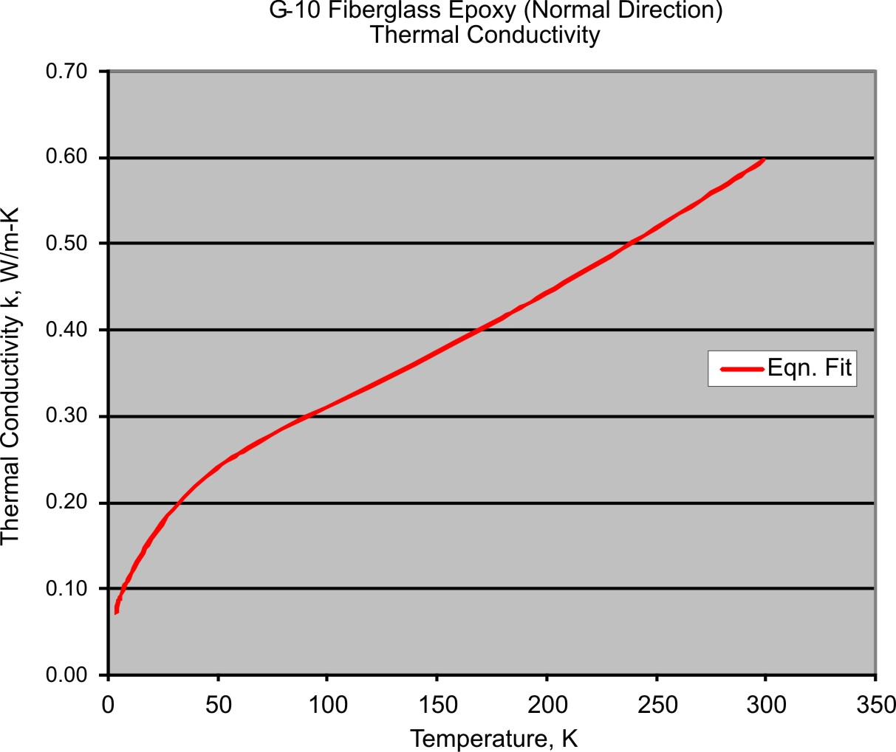
G-10 Thermal Conductivity as a Function of Temperature

Slide 26
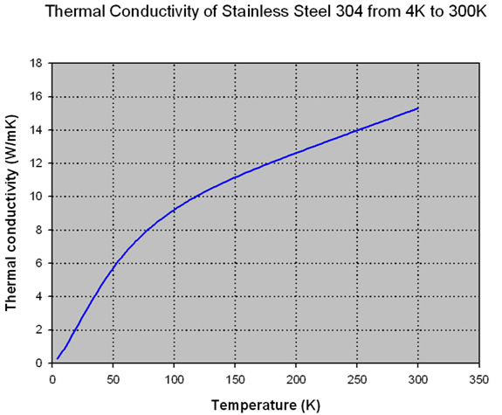
Stainless Steel
Thermal Conductivity as a Function of Temperature

Slide 27



Calculation Steps
First find the rate of heat transfer
Then, using this find temperature at different values of x
Can make this a function of length to plot
Can plot without G10 portion vs. with G10 to measure effectiveness

Slide 28
HTS leads
High temperature superconducting leads
Conducts current orders of magnitude greater than copper
Poor conductor of heat
  Reduces surface area of copper
  Removes copper from entering liquid helium bath

Slide 29
Existing Probe
Copper current leads for existing probe
Top flange made of G-10
Stainless steel casing
G-10 sample holder

Slide 30
Existing Probe
The current leads for existing probe

Slide 31
Remove section of copper lead
Replace with HTS material
Solder joint

Slide 32
Remove section of copper lead
G-10 Structural support
HTS material

Slide 33
HTS Design
Amount of current that is passed through HTS lead depends on:
  Temperature
  Applied field

Slide 34
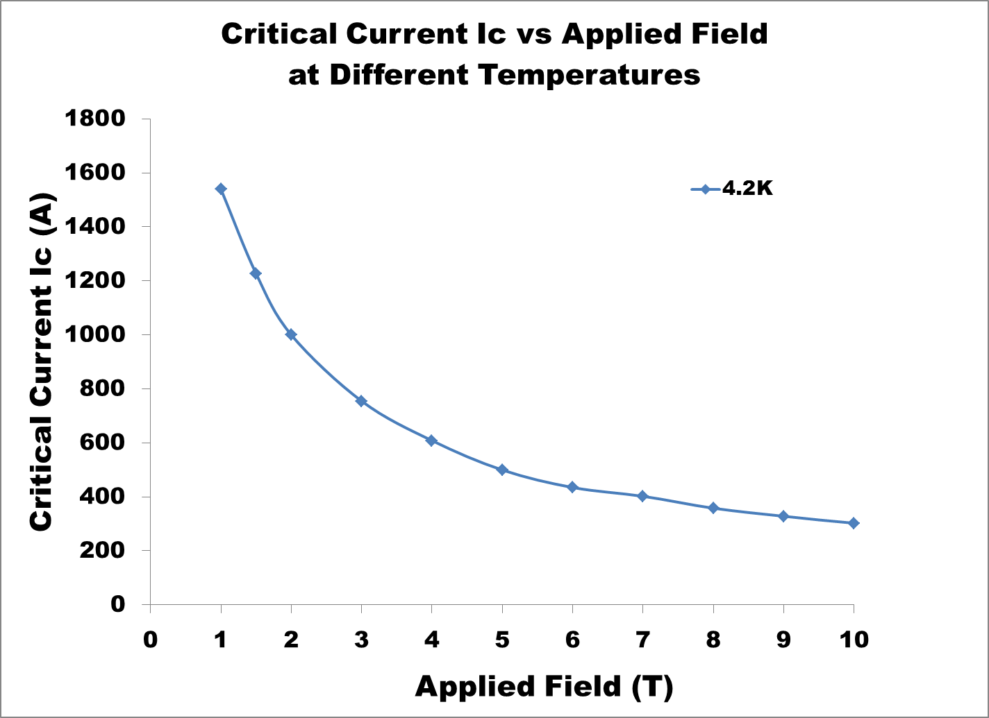
Current Changes due to Applied Field and Temperature

Slide 35
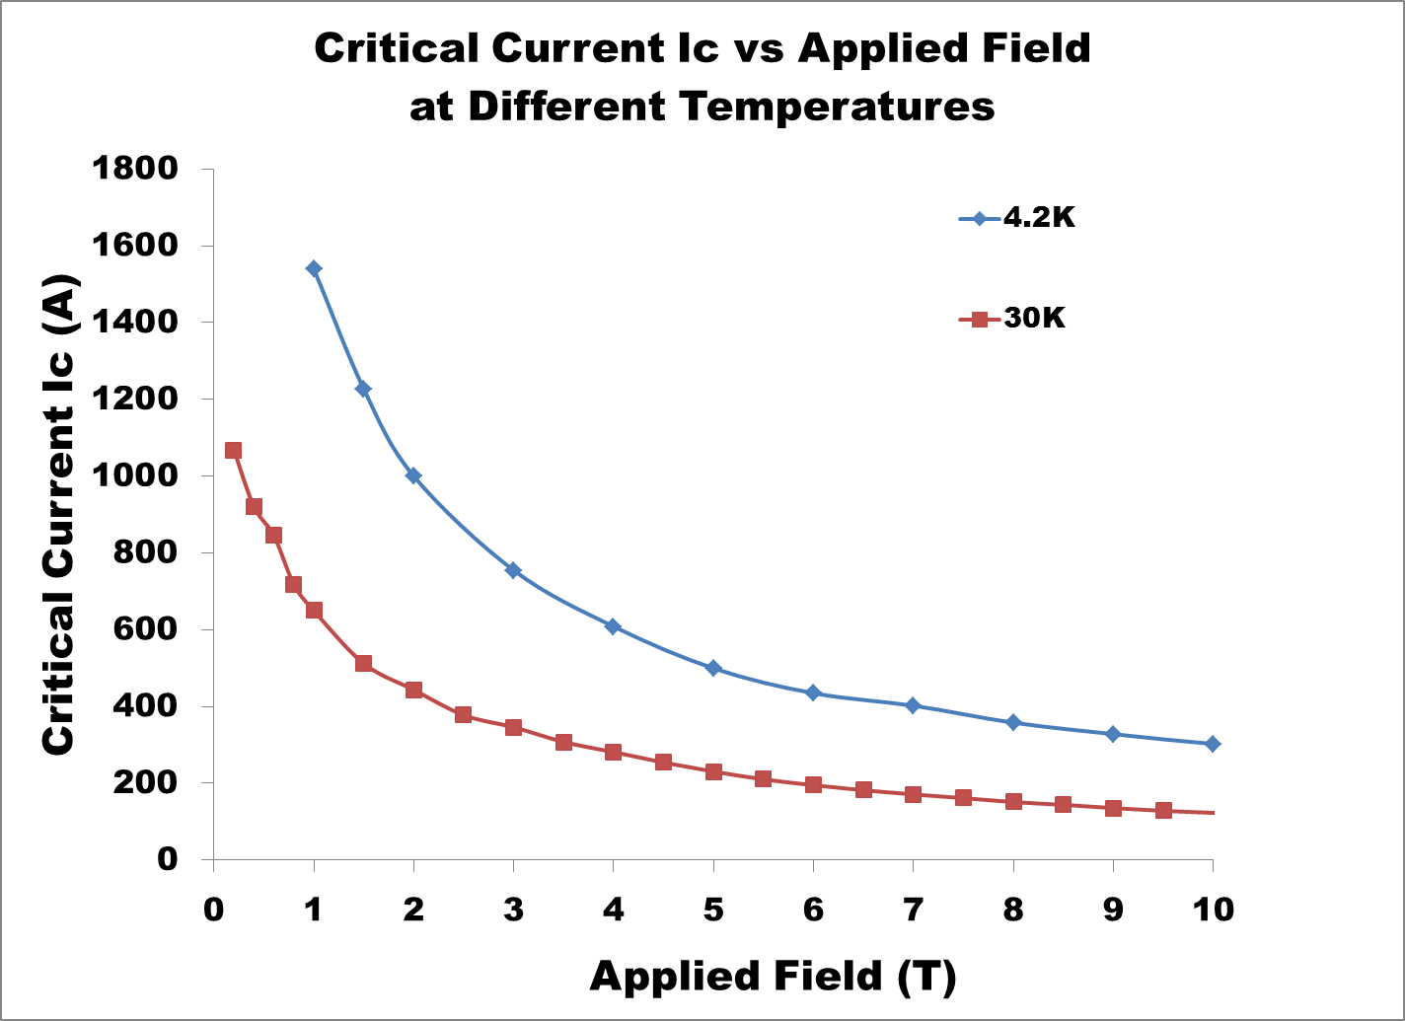
Current Changes due to Applied Field and Temperature

Slide 36
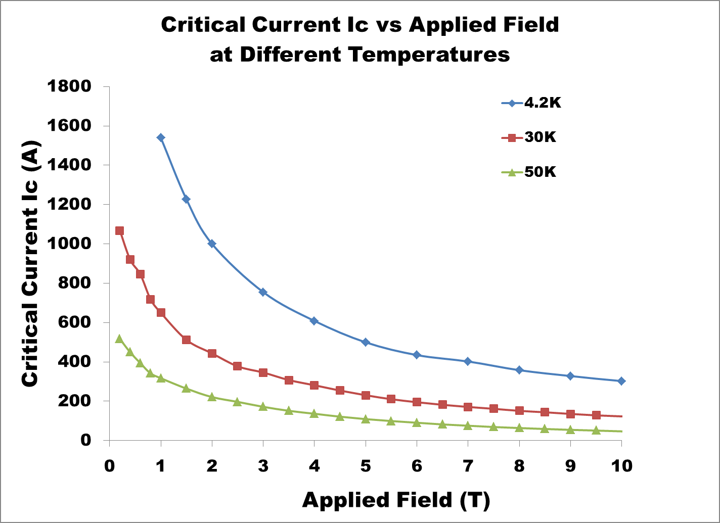
Current Changes due to Applied Field and Temperature

Slide 37
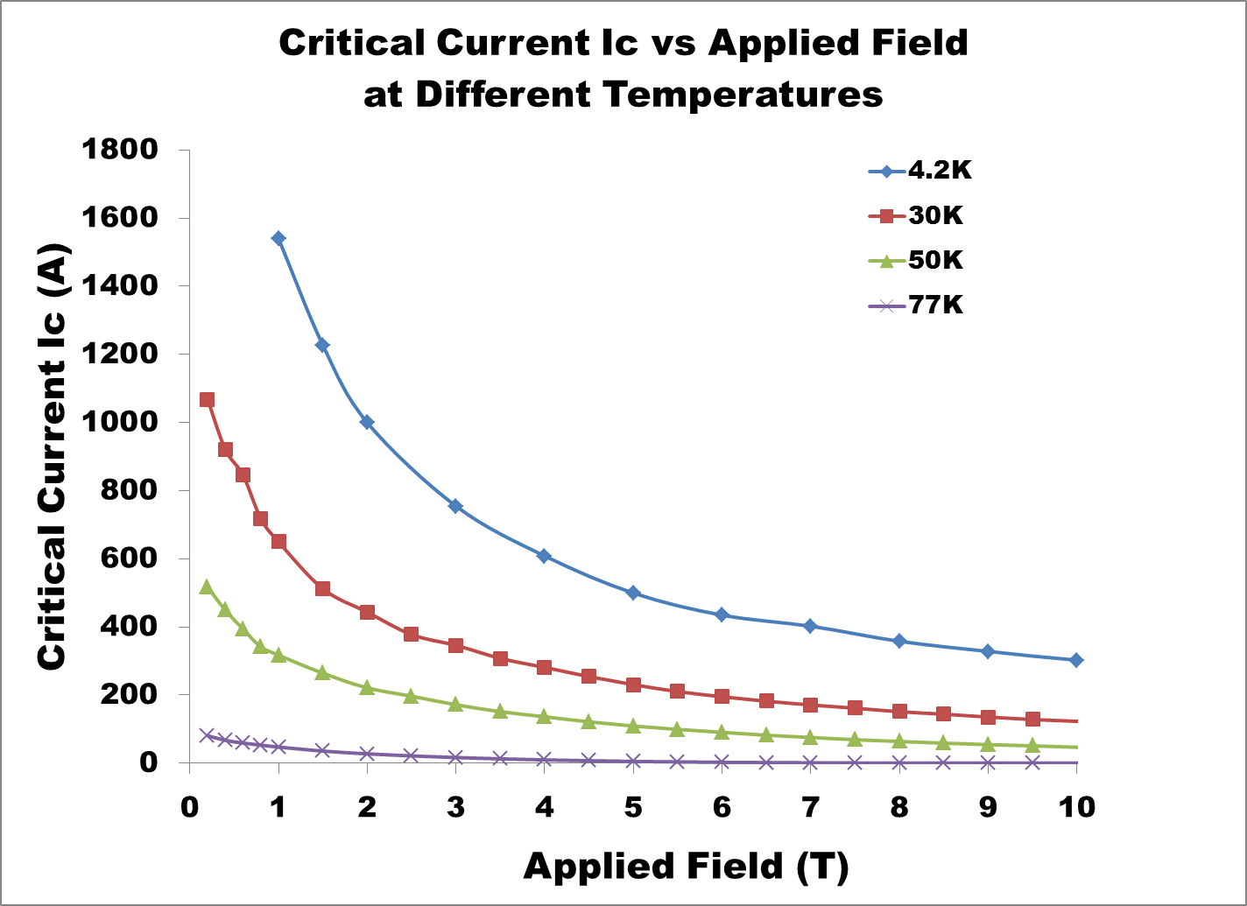
Current Changes due to Applied Field and Temperature

Slide 38
Needed Information for HTS Leads
Temperature profile of cryostat
  Placement for HTS leads
Field profile from magnet
  Layers of HTS required for 1000 Amps of current
Heat transferred from HTS lead

Slide 39
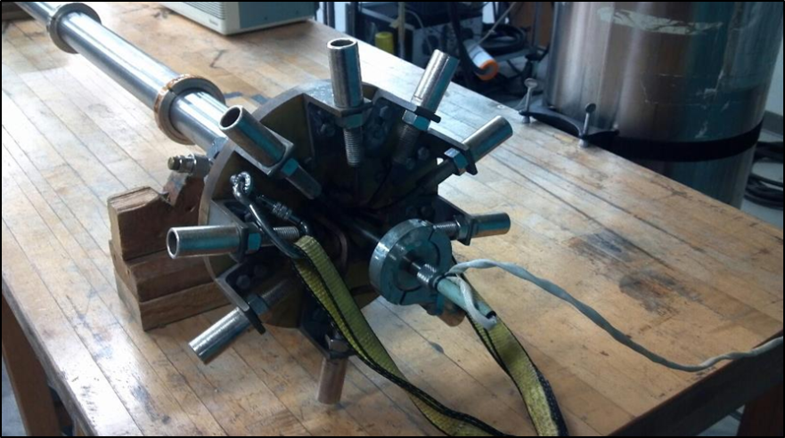
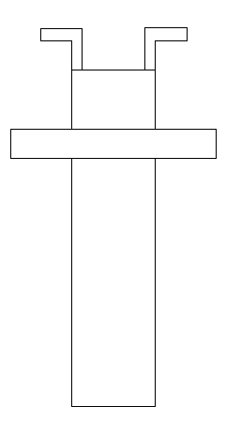
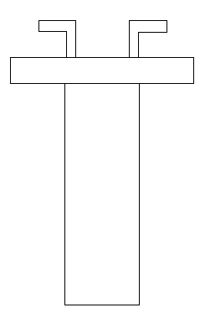
Heat Exchanger cap
Reduce the temperature gradient in copper leads
Complexity of cap poses problem
Substitute with extension of leads

Slide 40
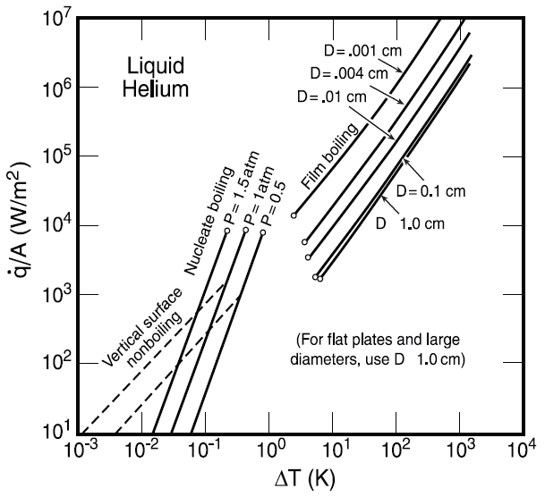
Gas insulation
Would be hard to manage due to maintaining temperature difference.
HTS (High Temperature superconducting) leads already decided

Slide 41


Optimization of Leads
Reducing the number of leads
Less heat transferred but more tests that would need to be done.
C is the number of tests
x is the number of leads
a is the heat transfer rate of one lead
h is any helium losses independent of leads
Q is total heat transferred.

Slide 42
Accepted Concepts
Concept 2 – HTS Leads
  Great reduction in copper surface area
  Prevents copper leads from entering liquid helium bath
Concept 4 – Reduce Leads (Optimization)
  Optimization is a necessary part of probe design

Slide 43
Rejected Concepts
Concept 6 – Gas Insulation
  With accepted HTS becomes impractical

Slide 44
Further Calculation
Concept 1 – Heat Exchanger
  Heat exchanger effectiveness
  Equivalent length to replace heat exchanger
Concept 5 – Fins
  Type of fin
  Frequency / fin efficiency
Concept 7 & 3 – Casing/Spoke Design
  Compare heat transfer of as is casing with G-10 insert

Slide 45
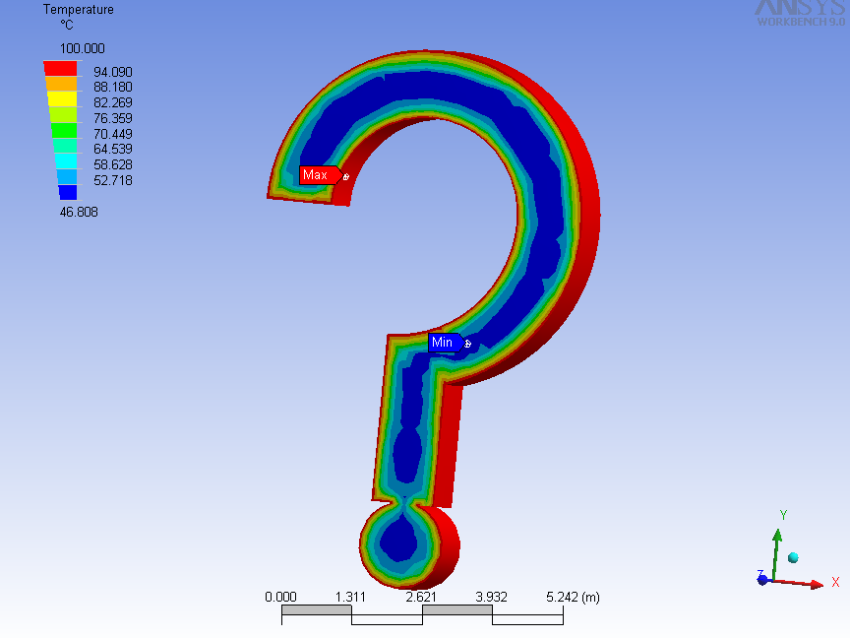
Questions

