Slide 1
Rotational Compressor Valve
Group 18:
Alejandro Castro
Sam Leuthold
Andrew Borger
GE Sponsor: Todd Hopwood
Faculty Advisor: Dr. Van Sciver

Slide 2
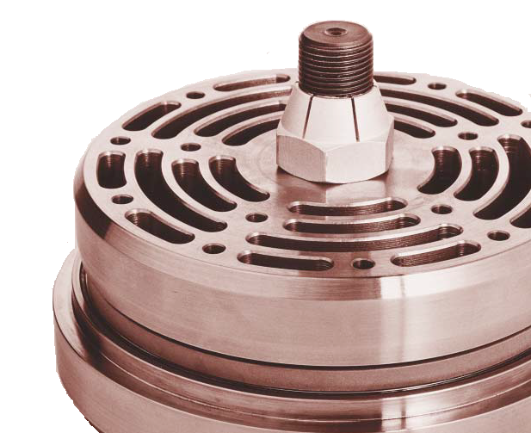
Overview
Application
Current Valves
Problem Statement
Project Scope
Concept Selection
Interim Designs
Final Design Selection
Final Design
Current Progress
Future Scope
Summary

Slide 3
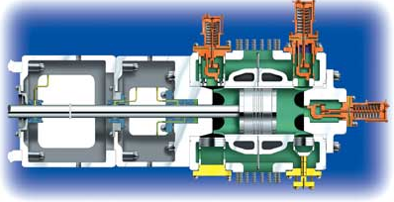
Application

Slide 4
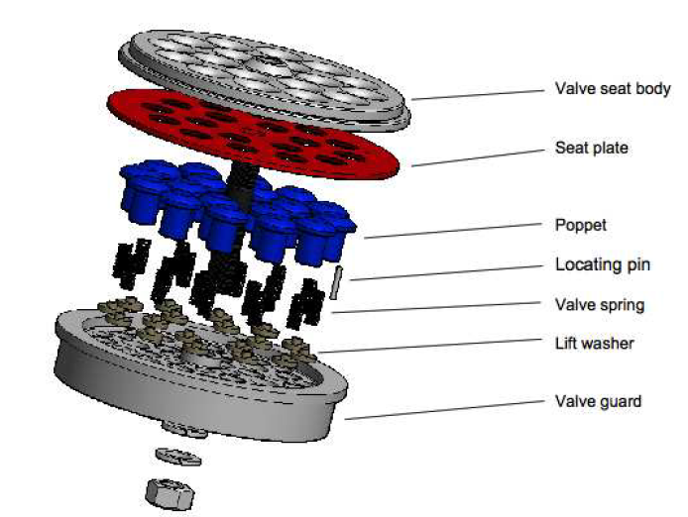
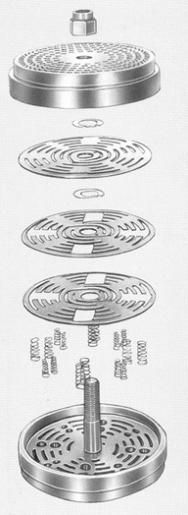
Current Valves
Plate Valves
Poppet Valves
Valve Seat
Valve Shutter
Valve Springs
Valve Stop

Slide 5
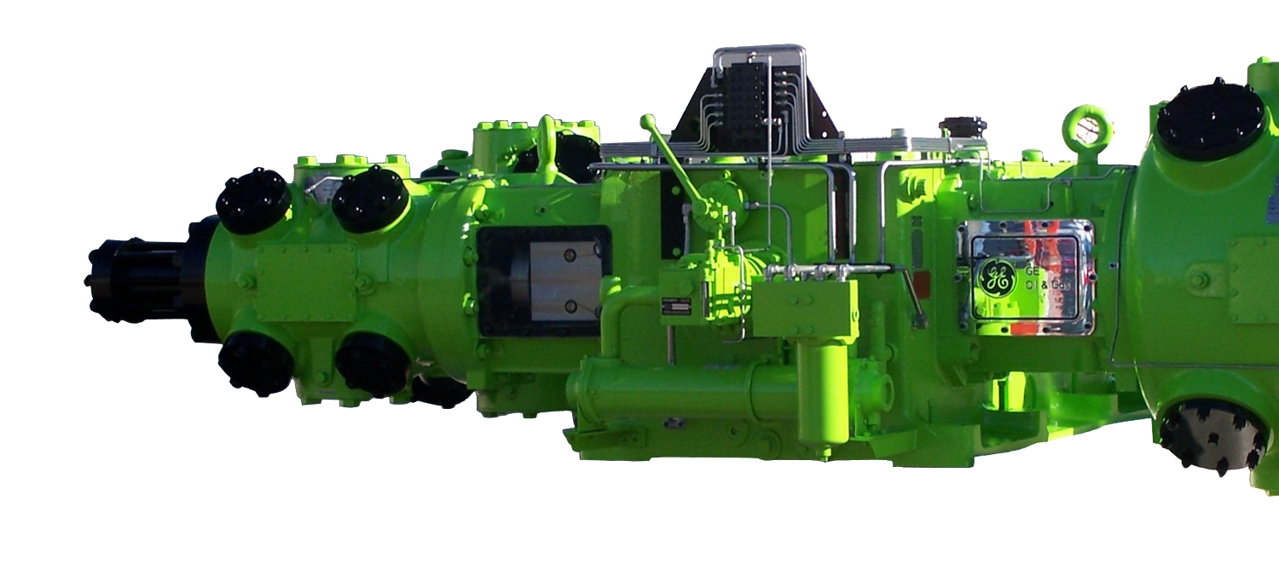
Problem Statement
Reciprocating compressors move large volumes of natural gas
Current compressor valves are reliable but inefficient
Inefficiencies caused from indirect flow path
Project Goal: Obtain direct flow with a rotational type valve

Slide 6
Project Scope
Must operate in a rotational manner and obtain laminar flow
Operate at pressures between 30 psi and 600 psi
Materials must be able to withstand temperatures approaching 350F
Modifiable to fit all current gas compressors used by G.E.
Is to be easily replaced
The valve is to outperform the volumetric flow rate of the current plate and poppet valve
2000$ budget

Slide 7
Concept Selection

Slide 8
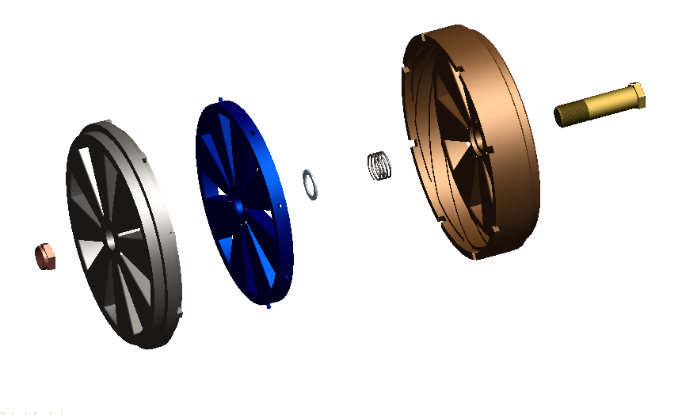
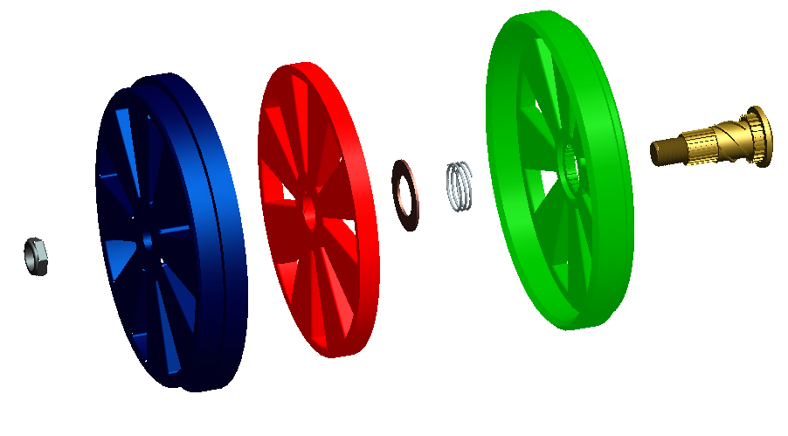
Housing Pitch Rotation
Interim Designs
Inner Thread Rotation
Same basic concept as Design 1
Threaded outside housing plate
Simple retaining bolt
Fixed outer casing
Rotating/translating center plate
Splined and threaded center bolt
Return spring
Gas Flow
Gas Flow

Slide 9
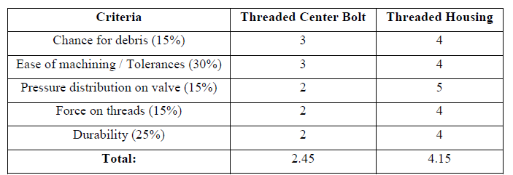
Final Design Selection

Slide 10
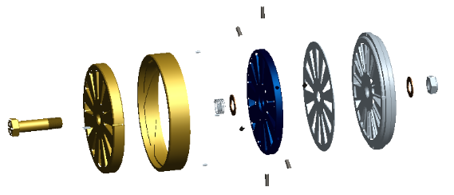
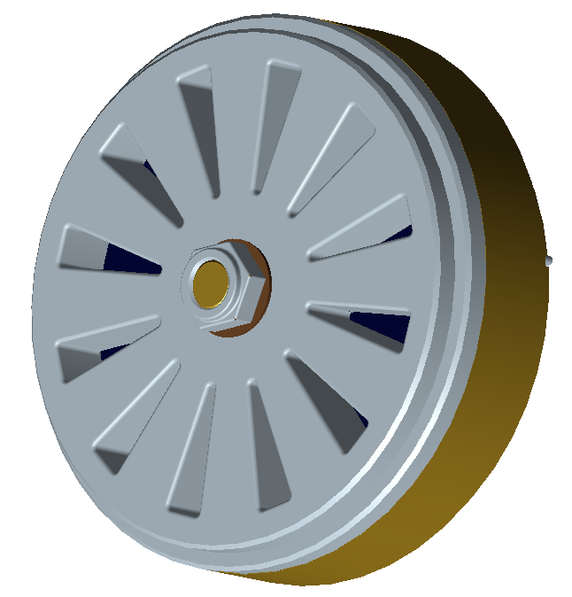
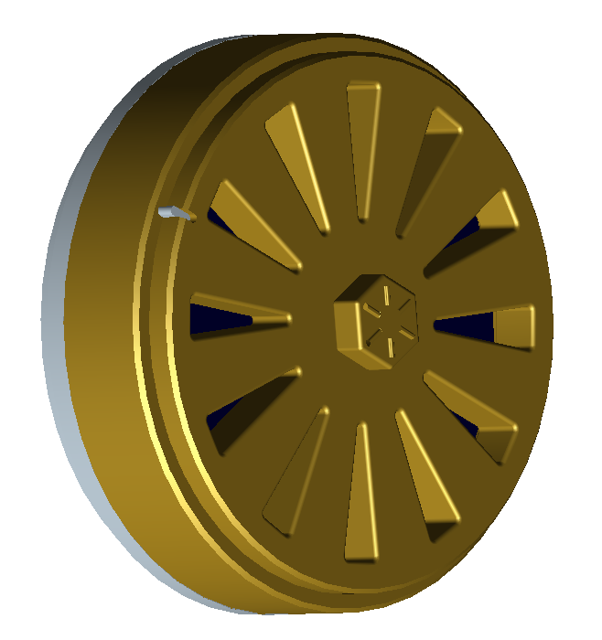
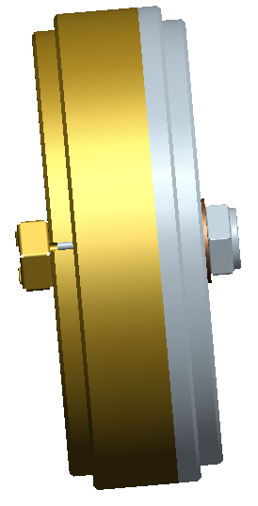
Final Design
Testing Parameters: Volumetric flow, temperature, and pressure
4 piece design
Material selection
Gas Flow

Slide 11
Current Progress
Parts have been ordered and ready for pickup: 12”x 12” x 2” , 12” x 12” x 1” , 12” x 12” x ½” Steel plates
Machinist contacted for machining advice
Final Design changes have been made for ease of machining
Test rig currently being designed

Slide 12
Future Scope
Machining is to begin next week
Test rig is to be constructed within machining time
Rigorous testing will follow for the remainder of the semester
During testing valve performance will be optimized

Slide 13
Summary
3-D prototype already implemented
Design slightly changed for machining purposes
Parts have been ordered
Machining is to be started next week
Test rig currently being designed
Total Budget: $2000
Total spent: $197.76
Project is running within accepted schedule

Slide 14
Questions

