Slide 1
Rotational Compressor Valve
Group 18:
Alejandro Castro
Sam Leuthold
Andrew Borger
GE Sponsor: Todd Hopwood
Faculty Advisor: Dr. Van Sciver

Slide 2
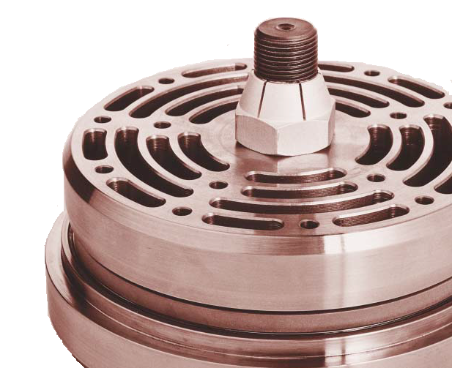
Overview
Application
Problem Statement
Project Scope
Final Design(Initial)
Problems Encountered
Final Design
Current Progress
Testing
Potential Issues
Modified Future Scope
Summary

Slide 3
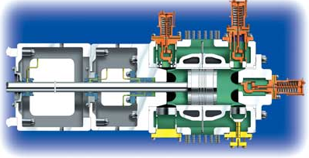
Application

Slide 4
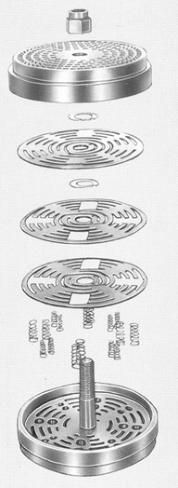
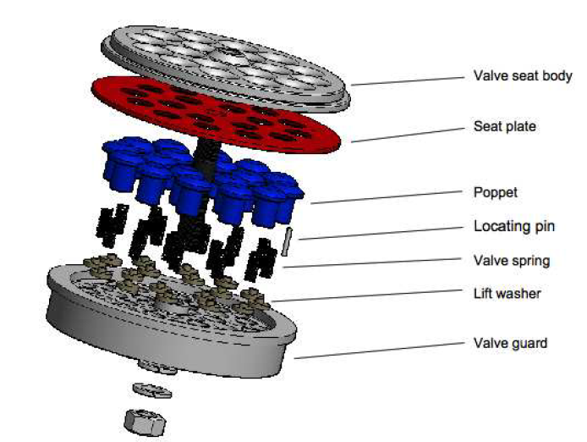
Current Valves
Plate Valves
Poppet Valves
Valve Seat
Valve Shutter
Valve Springs
Valve Stop

Slide 5
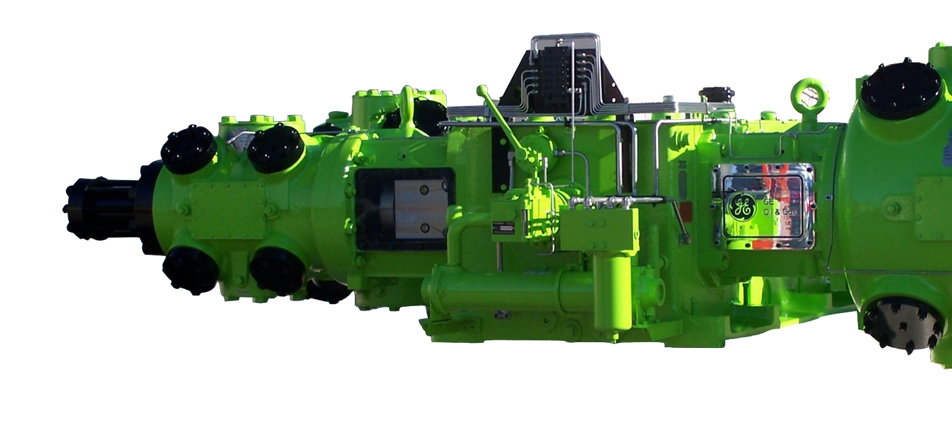
Problem Statement
Reciprocating compressors move large volumes of natural gas
Current compressor valves are reliable but inefficient
Inefficiencies caused from indirect flow path
Project Goal: Obtain direct flow with a rotational type valve

Slide 6
Project Scope
Must operate in a rotational manner and obtain direct flow
Operate at pressures between 30 psi and 600 psi
Materials must be able to withstand temperatures approaching 350F
Modifiable to fit all current gas compressors used by G.E.
Is to be easily replaced
$2000 budget

Slide 7
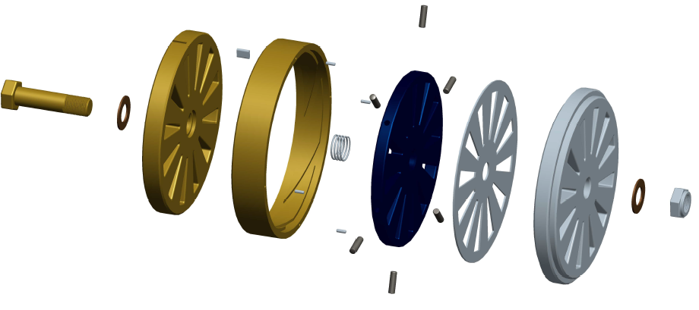
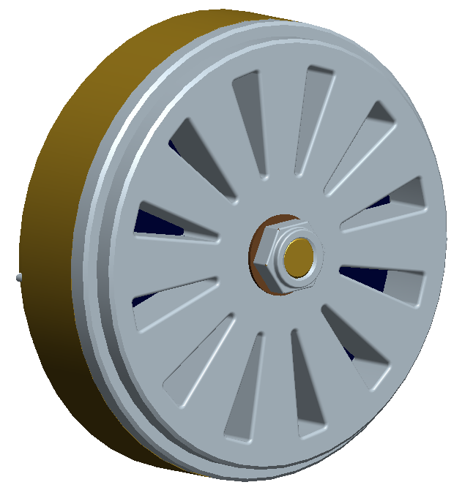
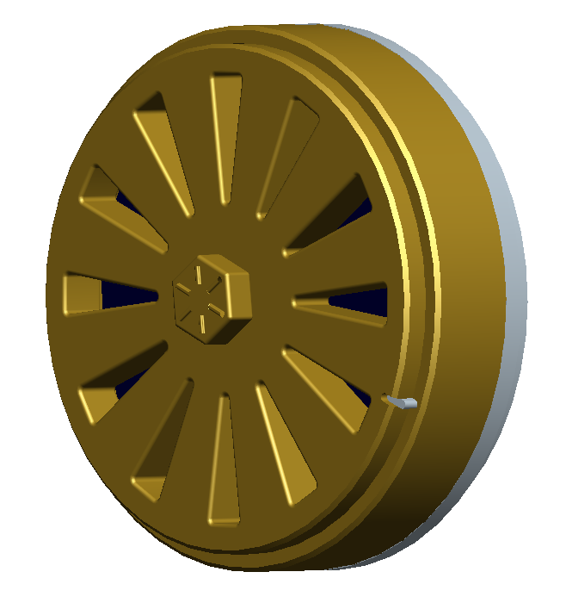
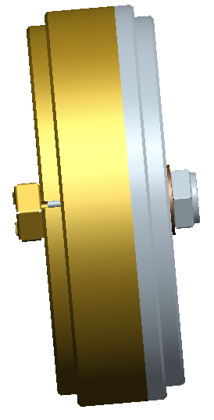
Final Design(initial)
Gas Flow

Slide 8
Problems Encountered
Machining of the threads on the outer housing would have been overly complicated
A separate threaded insert needed to be designed
Thickness of back plate needed to be minimized to be easily milled
Prototype materials have been changed from production materials due to cost

Slide 9
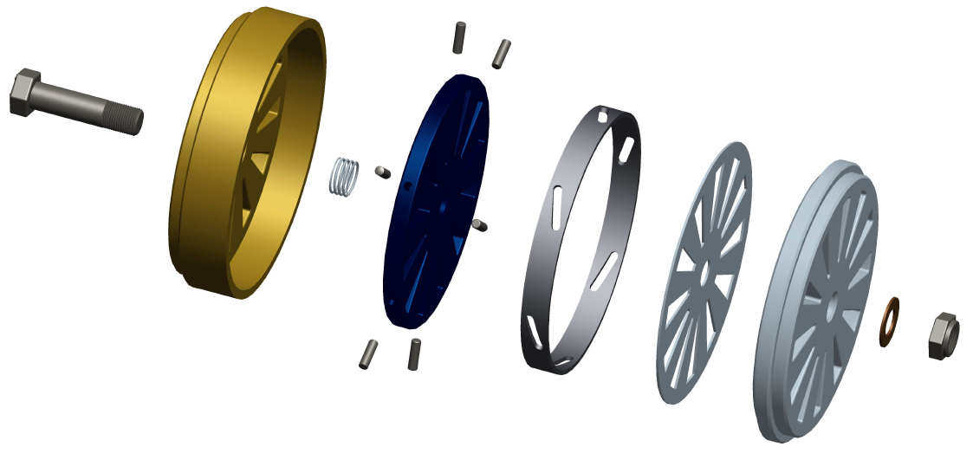
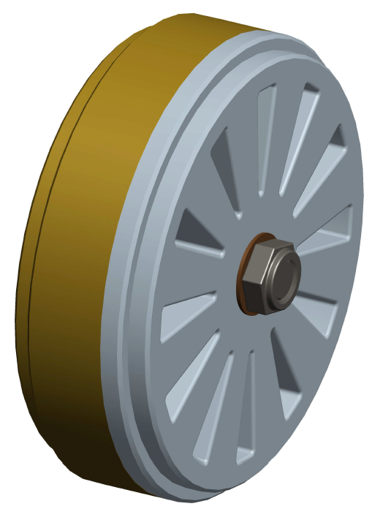
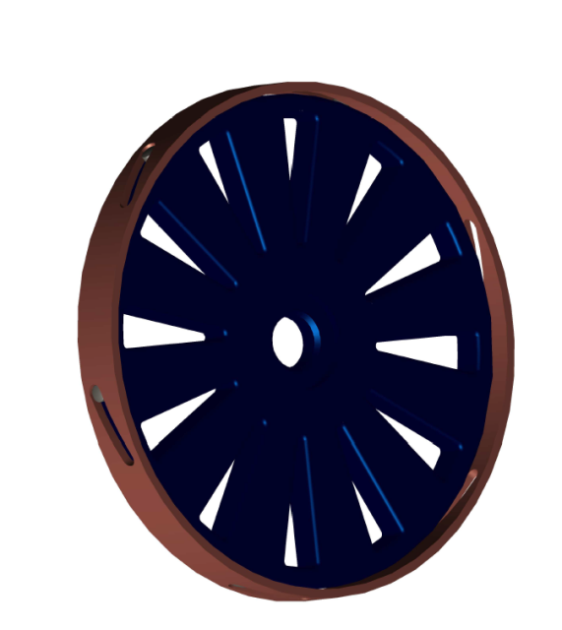
Final Design(Modified)
Gas Flow

Slide 10
Current Progress(update)
Final design changes have been made for ease of machining
Valve machining in progress
Materials for test rig in process of being ordered: $438.43
Materials for flow visualization have been ordered: $243.67

Slide 11
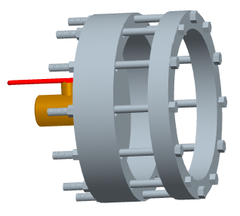
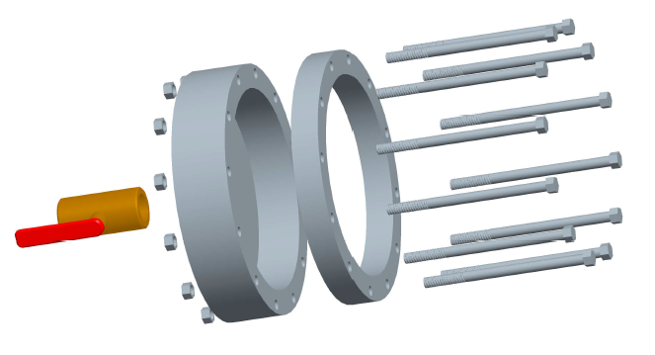
Test Rig
≈ 50 psi
≈ 50 psi

Slide 12
Test Rig
≈ 50 psi

Slide 13
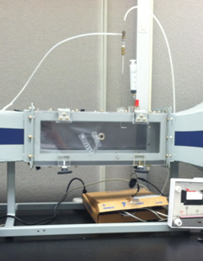
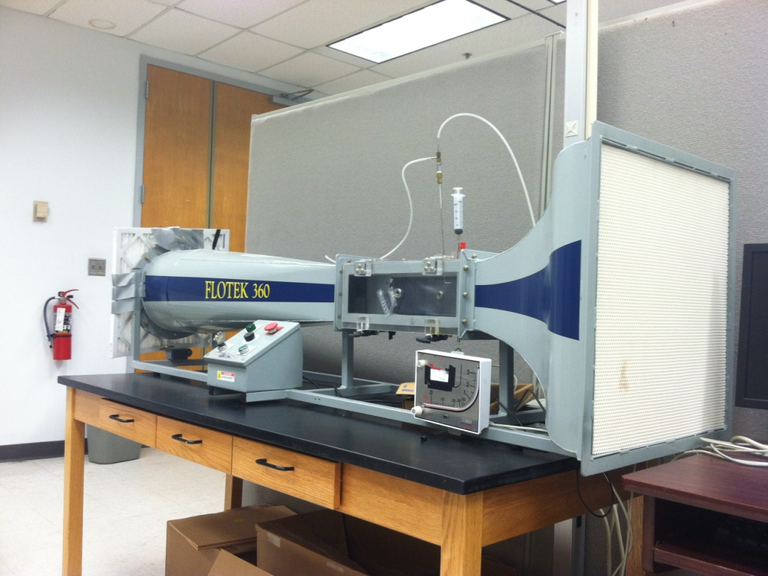
Wind-Tunnel Smoke Wire Test
A simplified acrylic model will allow flow visualization through entire valve

Slide 14
Potential Issues
Valve does not completely open
Test conditions are not the same as operating conditions
Thread and/or pin binding
Machining tolerances

Slide 15
Future Scope
Machining in progress
Parts for test rig being ordered
Testing will follow for the remainder of the semester
During testing valve performance will be optimized
Collaboration with team 19 not likely

Slide 16
Summary
3-D prototype already implemented
Design slightly changed for machining purposes
Machining in progress
Parts for test rig currently being ordered
Total Budget: $2000
Total spent: $879.86
Project is running slightly behind accepted schedule due to machining difficulties

Slide 17
Questions

Slide 18
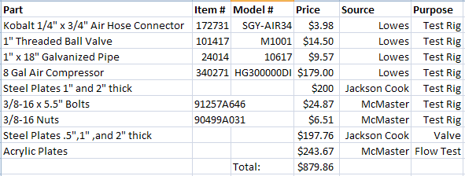
Bill of Materials

Slide 19
Original Test Rig Design

Slide 20
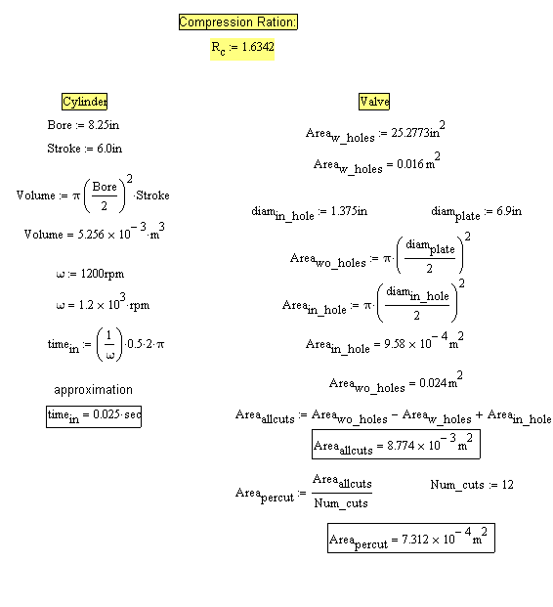
Calculations

