Slide 1
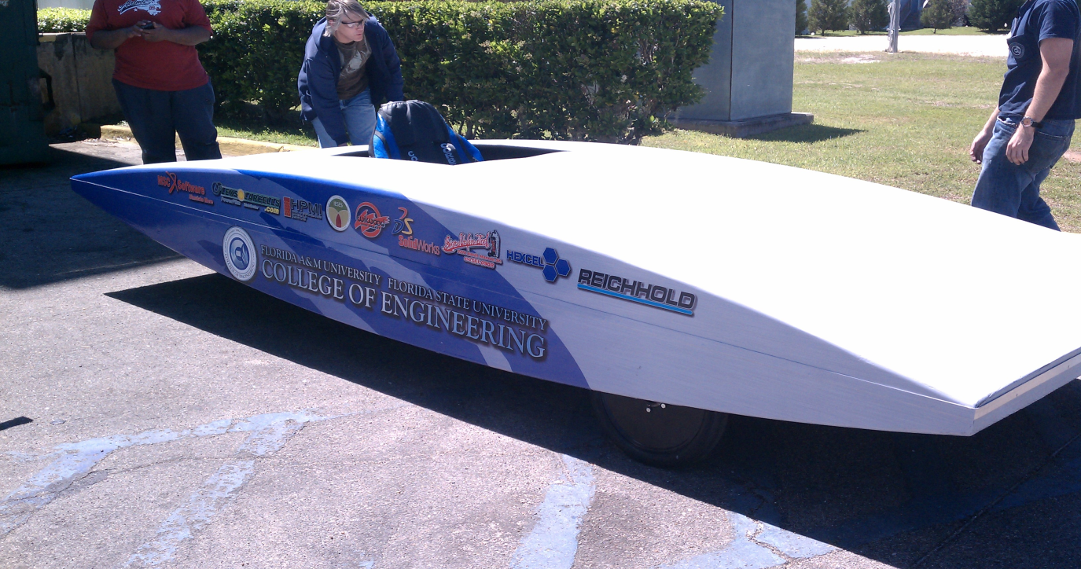
Team #2 Solar Car Project Senior Design 2011 – 2012
Electrical Team:
Shawn Ryster
Patrick Breslend
Greg Proctor
Jordan Eldridge
Mechanical Team:
Valerie Pezzullo
Bradford Burke
Tyler Holes

Slide 2
Overview of the Current State of the Project
Current Budget: $1600
Estimated cost of the project $3,652
Protection circuits being fabricated by Dante

Slide 3
Motor
Presented by: Greg Proctor

Slide 4
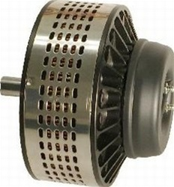
Lemco DC Brushed Motor (LEM200-127)
Rated Voltage 48V
Rated Current 215A
High Torque at low speeds
8.55 kW rated power
Will need a new motor controller.
Cost: $1900

Slide 5
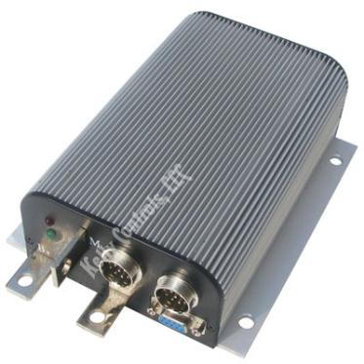
Kelly Motor Controller - KDZ48201
Input voltage range 18V – 60V
Output voltage 24V-48V
Maximum sustained amperage of 80A
Supports regenerative braking.
Cost: $200

Slide 6
Motor & Motor Controller Budget and Schedule Risks
Budget Risk
Schedule Risk
Cost of the motor exceeds current budget
Outside sponsorship
Funds from University
Envision Credit Union
Ordering the motor takes time
Without funds ordering the motor will be pushed into spring.
Mitigated by ordering and installing motor controller

Slide 7
Maximum Power Point Tracker
Presented by: Shawn Ryster

Slide 8
Overall Approach
Purchase Pre-existing MPPT
Build our own converter/MPPT
Pros:
Easy Implementation
Cons:
Much more expensive
Pros:
More Experience with design of converter/MPPT
Minimum Cost
Already Have Microcontroller
Cons:
More design of converter/MPPT

Slide 9
Boost Converter Topology
Components
Inductor (L)
High Frequency Switch: MOSFET
Diode
Capacitor (C)
L
C
Voltage output increases as duty cycle of switch increases.
Ideal case

Slide 10
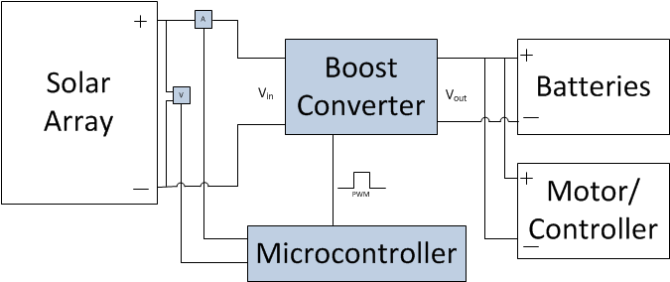
MPPT top level

Slide 11
MPPT algorithm
Perturb and Observe
Incremental Conductance

Slide 12
Current and Voltage Transducers
Current Transducer
Tamura S22P015S05
-15A to 15 A
5 V supply
$15.88
Voltage Transducer
LEM USA Inc. - LV 20-P
0 -600 V
15 V supply
$36.60

Slide 13
Inductor and Capacitor Values
Inductor (1 mH)
Wurth Electronics
744824101
10 A max (DC)
$5.62
Capacitor (1.5 mF)
Panasonic
EET-UQ2C152JA
0 -1600 V
3.75 A ripple current
$4.29

Slide 14
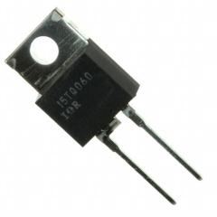
MOSFET and Diode
MOSFET
IXYS
IXTH11P50
11 A max (DC)
500 V drain to source max
$8.58
Schottky Diode
Vishay
8TQ080PBF
8 Amp Max
80 V reverse breakdown voltage
$1.00

Slide 15
Risk | Chance | Impact | Cost
Backordered Parts | Low | Med | Low
Programming/Testing Issues | Med | High | None
Part Failure | Low | High | High
Actual Cost
Components | $71.97
Mounting/PCB | $50.00
Wiring | $20.00
Total | $141.97

Slide 16
Solar Array
Presented by:
Patrick Breslend & Jordan Eldridge

Slide 17
PV Array
Design and Implementation

Slide 18
PT15-300 Solar Module
Parameters
Voltage (oc): 19.0V
Current (sc): 240mA
Rated Operation
Voltage Rating: 15.4V
Current Rating: 200mA
Module Size
Total Size: 270 x 325 mm
Aperture Size: 240 x 300 mm

Slide 19
Module Connection Design
Protection Circuit Design
Protection Circuit Design Implementation

Slide 20
Module and Drill Placement Plan
62 total modules
82 drill holes

Slide 21
PV Array Placement and Drilling

Slide 22
PV Array Implementation
Solar mounting tape to boarder the array
High-Temperature spray adhesive to secure
the PV array onto the car

Slide 23
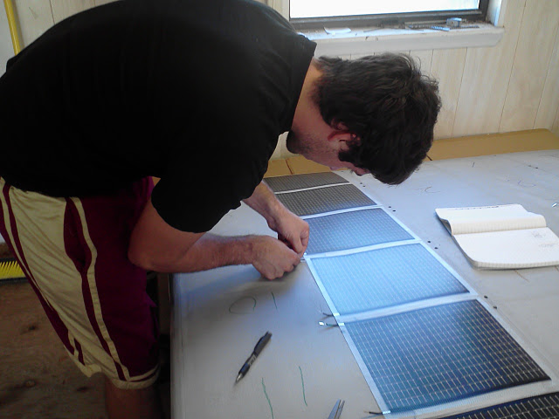
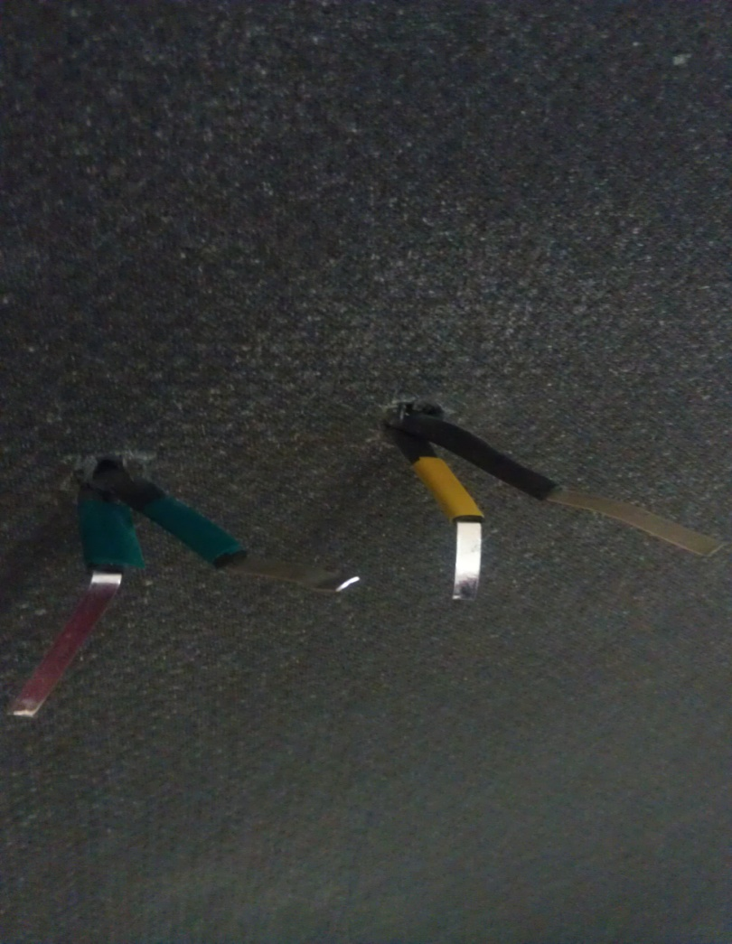
Implementation of wiring system
Color coded tabs to match previous wiring design from the underside of the lid
Color coding and Inserting tabs
into predrilled holes

Slide 24
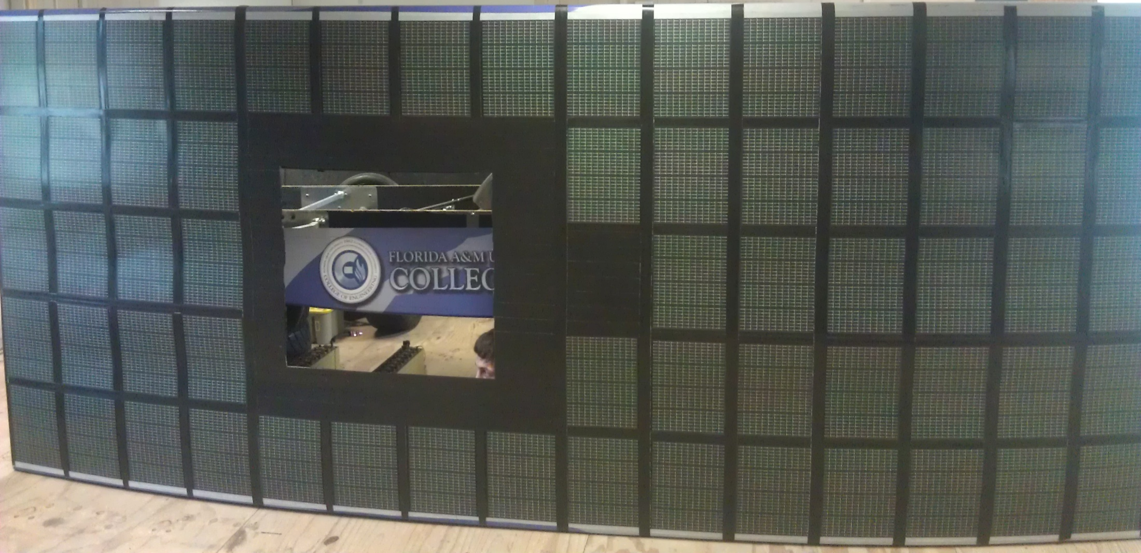
End Result of PV Implementation

Slide 25
PV Array
Simulation

Slide 26
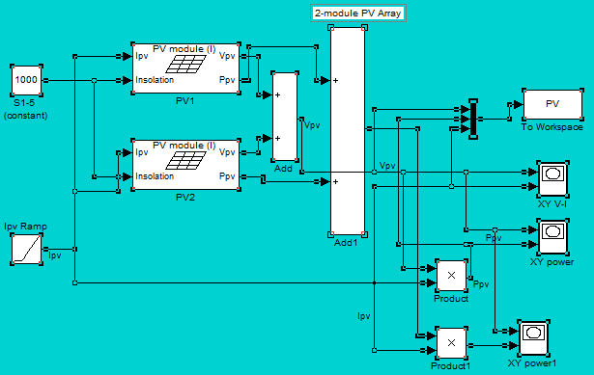
2 Module Series Modeling
Simulink Diagram

Slide 27
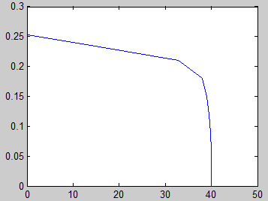
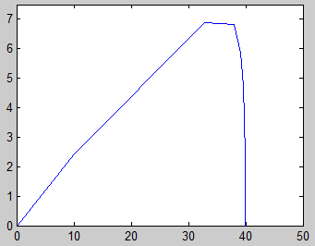
2 module Series Modeling
Simulink Results
IV Curve
P-V Curve

Slide 28
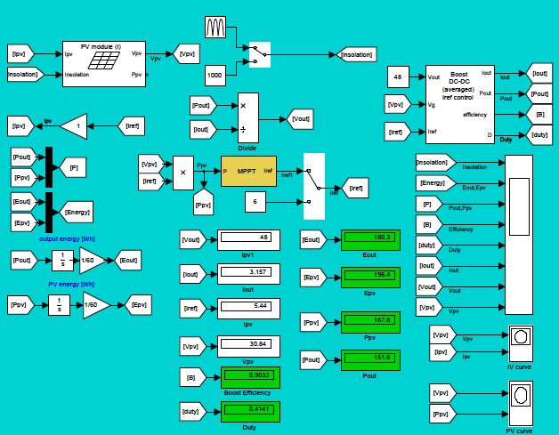
Modeling of Entire PV System
Simulink Diagram

Slide 29
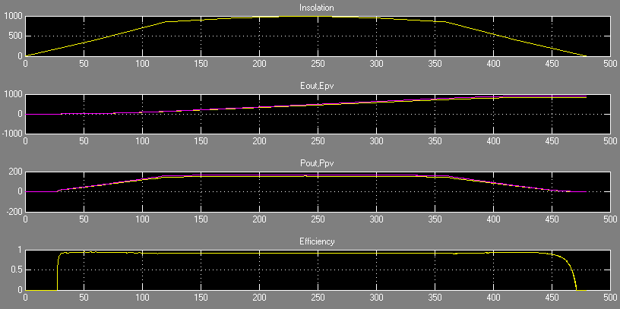
Modeling of Entire PV System
Simulink Results

Slide 30
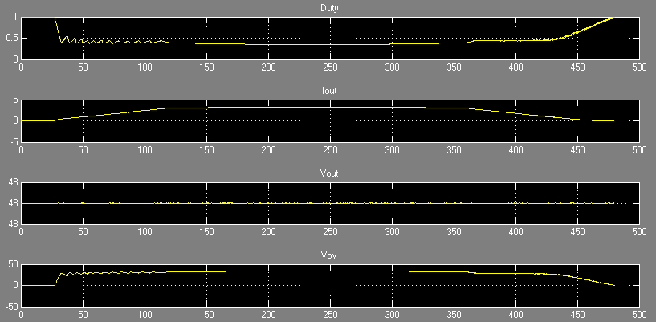
Modeling of Entire PV System
Simulink Results

Slide 31
PV Array
Risks

Slide 32
Technical Risk: Solar Array
Description:
Improper mounting of solar array could allow them to be exposed to the elements. This includes wind, precipitation and sun damage.
Current feedback into a module
Probability: low
The chances of the vehicle being exposed to bad weather at this stage in the project are low. This is due to the vehicle being stored and only removed for testing in acceptable conditions. The vehicle in the next stage will be given a final protective layer to further protect it from potential damage.
Consequences: Moderate
In the current stage the solar modules will be held by mounting tape so that testing can be done with ease of removal for damaged modules. There would be a loss of power from the damaged modules but this is just a small technical issues that can be easily fixed.
Solution:
The solar car will only be run in optimal conditions(means sunny and no chance of rain) and kept indoors and a reasonable temperature when not in use
There is a protection circuit as described previously to keep the modules safe from current feedback.

Slide 33
Schedule Risks: Solar Array
Risks:
Printed circuit-board production could be delayed or have a design flaws.
The delivery of the diodes in the protection circuit could be delayed
Damaging existing cells
No risk in implantation of modules themselves
Probability: Low
Consequences: Moderate
If the PCB’s aren't completed on time or have flaws, or the diodes aren't delivered on schedule the full completion of the PV array will be delayed but will not impede the progress on the rest of the vehicles design.
If a cell is damaged it will have to be removed from the system and with no extra cells to replace a damaged one the array current will diminish but have a very small effect on the overall design
Solution:
In order to ensure that all the PCB’s are completed on time and good quality we are ordering a single unit and inspecting that unit then ordering the remainder units before break so we can inspect and reorder any defective units.
To make sure the diodes arrive on time the ordering process will have to be completed before the end of the week .
Damaging existing cells can be avoided by taking extra care around the PV array especially in the handling of the top of the vehicle.

Slide 34
Budget Risks: Solar Array
Description:
The existing solar array on the vehicle could get damaged and need replacement and with our budget constraints it would be difficult to continue the project
Probability: Very Low
With the solar array on the vehicle and proper care is being taken when working around the vehicle the chance for damage is minimal. And with he vehicle in a non working state at the moment the weather is not a factor in damaging the vehicle
Consequences: Moderate
If the solar panels get damaged they will not be able to be replaced with the current budget but the impact on the car for not having them attached would only cause the current to drop by 250mA for every damaged series set.
Strategy
The only strategy to have to make sure that the panels don’t get damaged and ensure they stay in a working condition.
TOTAL COST OF SOLAR ARRAY/ PROTECTION CIRCUIT: $175.00

Slide 35
Battery System
Design and Implementation

Slide 36
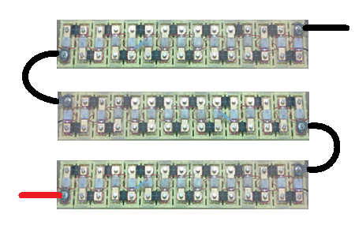
Current VS Previous Designs
Previous
Current
30 LiFePO4 in series
Producing 96V @ 15 A
15 LiFePO4 batteries in series
2 series sets in parallel
Producing 48 V @ 30 A
TOTAL BATTERY COST: $0.00

Slide 37
Battery Management System
Re-using the existing system
Allows for an easy install
Proven to work in previous system
Eliminate the risk of completely draining any one battery
Uses red/green led to show if batteries are in a working condition
Wont allow the series connected system to operate if a single unit is bad

Slide 38
Latch/Hinge System
Presented by: Valerie Pezzullo

Slide 39
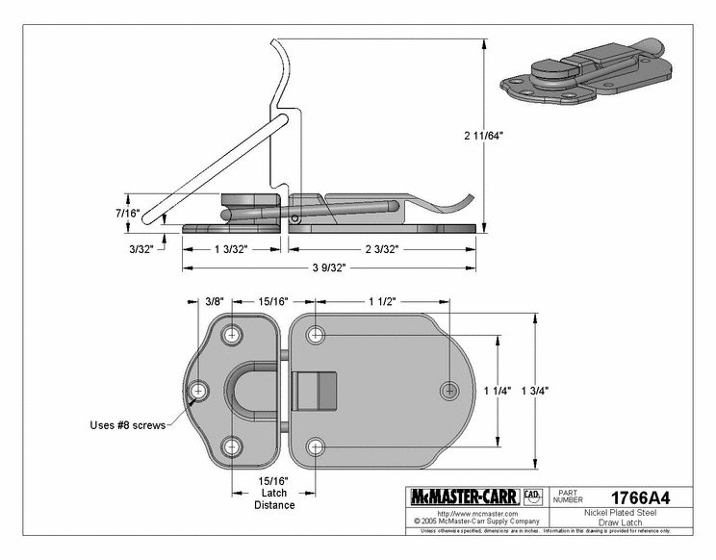
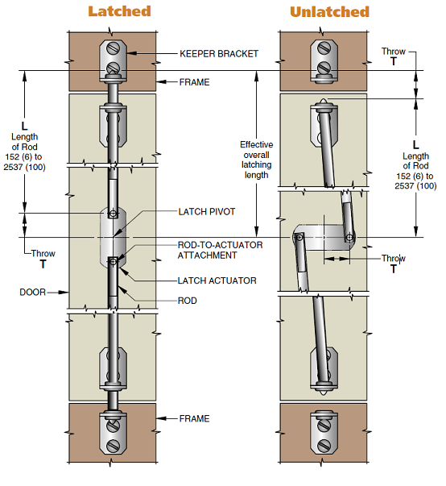
Latches Considered
Draw Latch
Fixed-Rod Multi-Point Latch
Double Point Remote Release Cable Latch

Slide 40
Decision Matrices - Latch
Remote Release Cable Latch
Criteria | Weight | Score | Weighted
Low Cost (ranks high) | 20% | 3 | 0.6
Durability | 10% | 7 | 0.7
Ease of Installation | 20% | 7 | 1.4
Ease of Operation | 30% | 10 | 3
Applicability | 20% | 10 | 2
TOTAL | 100% |  | 7.7

Slide 41
Decision Matrices - Latch
Draw Latch
Criteria | Weight | Score | Weighted
Low Cost (ranks high) | 20% | 10 | 2
Durability | 10% | 7 | 0.7
Ease of Installation | 20% | 7 | 1.4
Ease of Operation | 30% | 7 | 2.1
Applicability | 20% | 2 | 0.4
TOTAL | 100% |  | 6.6

Slide 42
Decision Matrices - Latch
Fixed-Rod Multi-Point Latch System
Criteria | Weight | Score | Weighted
Low Cost (ranks high) | 20% | 5 | 1
Durability | 10% | 7 | 0.7
Ease of Installation | 20% | 5 | 1
Ease of Operation | 30% | 7 | 2.1
Applicability | 20% | 9 | 1.8
TOTAL | 100% |  | 6.6

Slide 43
Final Latch Decision
Latch | Score
Remote Release Cable Latch | 7.7
Draw Latch | 6.6
Fixed-Rod Multi-Point Latch | 6.6

Slide 44
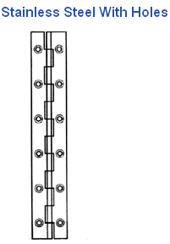
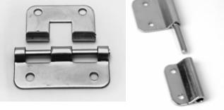
Hinges Considered
Take-off/Lift Apart Hinge
Piano/Continuous Hinge
Or Custom Continuous Hinge

Slide 45
Decision Matrices – Hinge
Take-Apart/Lift-off Hinge
Criteria | Weight | Score | Weighted
Low Cost (ranks high) | 20% | 10 | 2
Durability | 10% | 8 | 0.8
Ease of Installation | 20% | 9 | 1.8
Ease of Operation | 30% | 7 | 2.1
Applicability | 20% | 3 | 0.6
TOTAL | 100% |  | 7.3

Slide 46
Decision Matrices – Hinge
Piano/Continuous Hinge
Criteria | Weight | Score | Weighted
Low Cost (ranks high) | 20% | 3 | 0.6
Durability | 10% | 9 | 0.9
Ease of Installation | 20% | 8 | 1.6
Ease of Operation | 30% | 9 | 2.7
Applicability | 20% | 9 | 1.8
TOTAL | 100% |  | 7.6

Slide 47
Decision Matrices – Hinge
Custom Continuous Hinge
Criteria | Weight | Score | Weighted
Low Cost (ranks high) | 20% | 2 | 0.4
Durability | 10% | 9 | 0.9
Ease of Installation | 20% | 8 | 1.6
Ease of Operation | 30% | 9 | 2.7
Applicability | 20% | 9 | 1.8
TOTAL | 100% |  | 7.4

Slide 48
Final Hinge Decision
Latch | Score
Take-Apart / Lift-Off Hinge | 7.3
Piano / Continuous Hinge | 7.6
Custom Continuous Hinge | 7.4

Slide 49
Final Latch and Hinge Decisions
Double Point Remote Release Cable Latch
Piano/Continuous Hinge
Or Custom Continuous Hinge
Cost: $88.84 + shipping
Cost: $69.97 + shipping

Slide 50
Risks – Latch and Hinge
Budget
Low risk:
Relatively inexpensive compared to other components of car
Technical
Low risk:
Frame and latch stability
Materials used in product are rated for extremely high shear stresses
Schedule
Low risk:
Delayed delivery or loss of product has low probability of occurring

Slide 51
Parking Brake
Presented by: Valerie Pezzullo

Slide 52
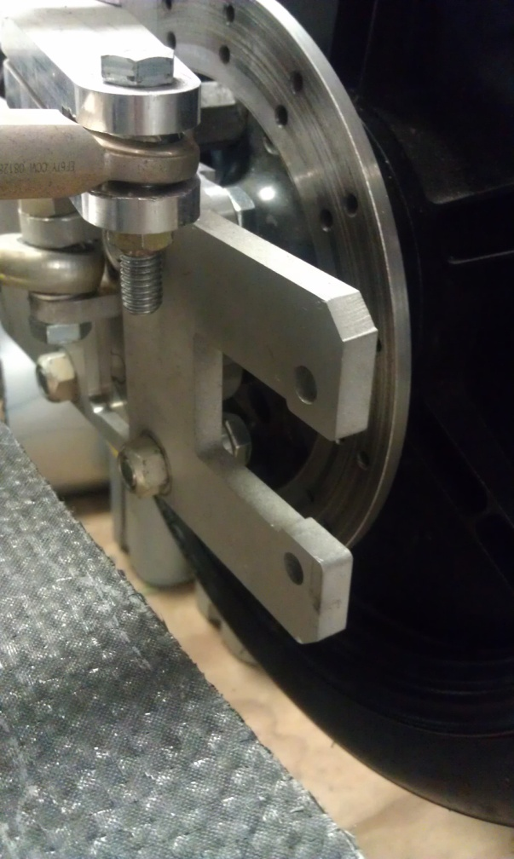
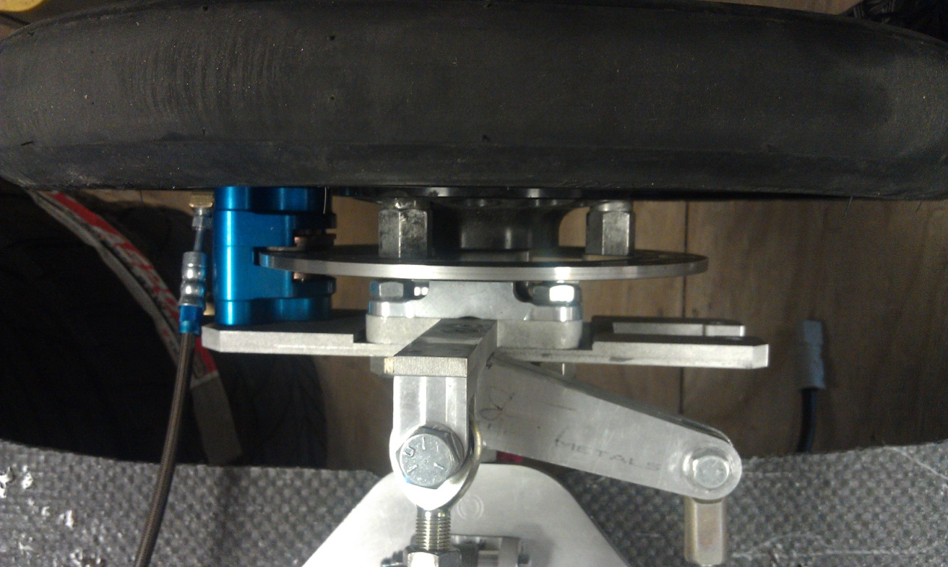
Parking Brake Placement

Slide 53
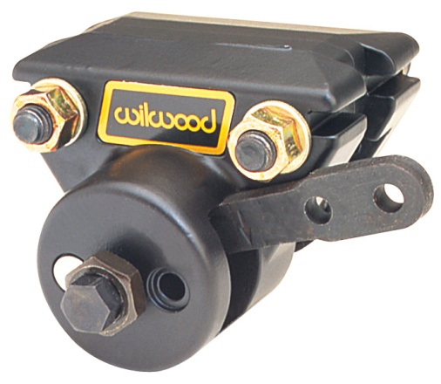
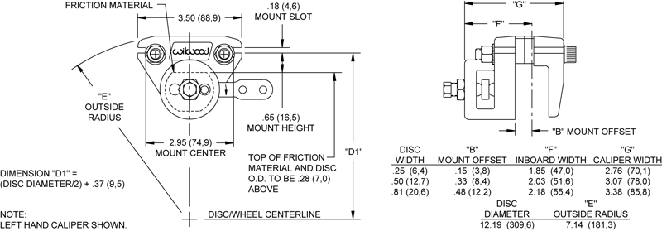
Parking Brake Caliper
Wilwood single piston floating Mechanical Spot Caliper
Cost: $76.79 + cost of brake cable (~ $30) + cost of actuating handle (~30) + cost of nuts & bolts + shipping

Slide 54
Risks – Parking Brake
Budget
High risk:
High probability that the budget will not allow room for parking brake components
Lower priority task
Technical
Low risk:
Installation and operation
Schedule
Low risk:
Delayed delivery or loss of product has low probability of occurring

Slide 55
Air Ventilation
Presented by: Tyler Holes

Slide 56
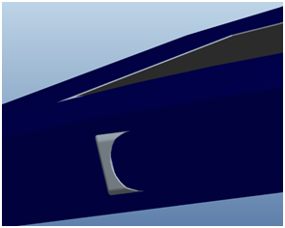
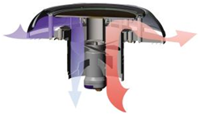
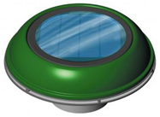
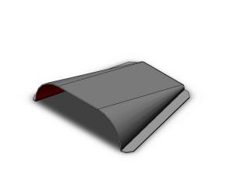
Vents Considered
Side-panel scoop
Solar Vent
Driver centered hood scoop

Slide 57
Decision Matrices – Solar Vent
Solar Vent
Criteria | Weight | Score | Weighted
Low Cost (ranks high) | 20% | 3 | 0.6
Durability | 10% | 8 | 0.8
Ease of Installation | 10% | 9 | 0.9
Ease of Operation | 30% | 10 | 3
Applicability | 30% | 7 | 2.1
TOTAL | 100% |  | 7.4

Slide 58
Decision Matrices – Side Scoops
Side Scoop
Criteria | Weight | Score | Weighted
Low Cost (ranks high) | 20% | 10 | 2
Durability | 10% | 9 | 0.9
Ease of Installation | 10% | 7 | 0.7
Ease of Operation | 30% | 10 | 3
Applicability | 30% | 5 | 1.5
TOTAL | 100% |  | 8.1

Slide 59
Decision Matrices – Hood Scoop
Hood Scoop
Criteria | Weight | Score | Weighted
Low Cost (ranks high) | 20% | 10 | 2
Durability | 10% | 9 | 0.9
Ease of Installation | 10% | 8 | 0.8
Ease of Operation | 30% | 10 | 3
Applicability | 30% | 8 | 2.4
TOTAL | 100% |  | 9.1

Slide 60
Final Ventilation Decision
Air Ventilation | Score
Solar Vent | 7.4
Side Scoop | 8.1
Hood Scoop | 9.1
Solar vent too expensive
Difficult side scoop installation and airflow routing
Hood scoop allows for simple solution to budget, installation and location

Slide 61
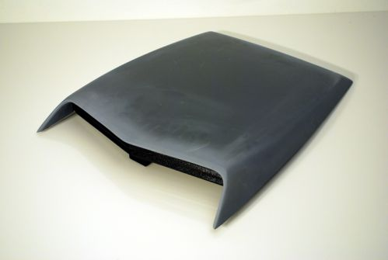
Hood Scoop Design
19.25in.
Lightweight fiberglass material
Mesh screen to filter incoming air
Easy routing of air ducts due to centered location
27in.
20.75in.
Scoop stands at about 3.5 in. tall
Closable vent during cold temperatures

Slide 62
Hood Scoop Placement
Fit in space left between solar array
Allows direct airflow to driver and components
Bolted to frame
Centered in front of the bubble

Slide 63
Risks – Hood Scoop
Budget
Low risk:
Design and fabrication done by team
Relatively low cost of fiberglass
Technical
Low risk:
Possible dirt and bugs coming through vent
Schedule
Low risk:
Delay in fabrication or material does not affect other components progress

Slide 64
Rear Arm and Suspension
Presented by
Tyler Holes & Bradford Burke

Slide 65
Old Rear Arm/Suspension
U-brackets rotated about bolt causing positive camber
Suspension arm designed for the old on-wheel motor
Not set up for convenient removal or installation

Slide 66
New Rear Arm/ Suspension
New design is similar to rear arm of a motorcycle
Is designed for new motor and for just a wheel attachment
Allows for adjustment of rear wheel to keep tension in chain or belt

Slide 67
Risks – Rear Suspension
Budget
Medium Risk:
Design and fabrication done by team
Relatively low cost of Aluminum
Technical
High risk:
Problems occurring during operation would cause significant damage
Schedule
Medium risk:
Problems would delay attending events and trial runs but not other progress on the car

Slide 68
Driver Encasement
Presented by Bradford Burke

Slide 69
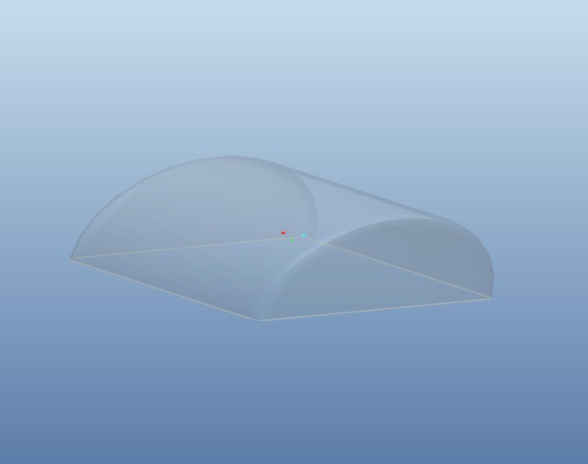
Projected Designs
Design 2
Design 1
Design 3
Design 4

Slide 70
Materials and Mounting
30 in. by 26 in. space for bubble to fit
Polycarbonate plastic
Clear
Grey Tinted
48x48 1/8“ - $183.26
Aluminum channel around the hole on the top
Base of bubble will fit into channel and be bolted in place

Slide 71
Comsol Simulations 2D
Air flow over a circle
Air flow over the 2 Dimensional design
of Bubble 3

Slide 72
Comsol Simulations 3D
Velocity Magnitude and Streamlines
of air flow over a sphere

Slide 73
Comsol Simulations 3D Cont.
Velocity Magnitude and Streamlines
of air flow over chosen design of bubble

Slide 74
Risk Assesment
Budget
High risk:
The materials and forming of the bubble are fairly expensive, only have one chance to make it right
High priority task
Technical
Low risk:
Any errors in design or manufacturing of bubble can affect its functionality in completing the car
Schedule
Low risk:
Mishandling of bubble or incorrect

Slide 75
Schedule

