Slide 1
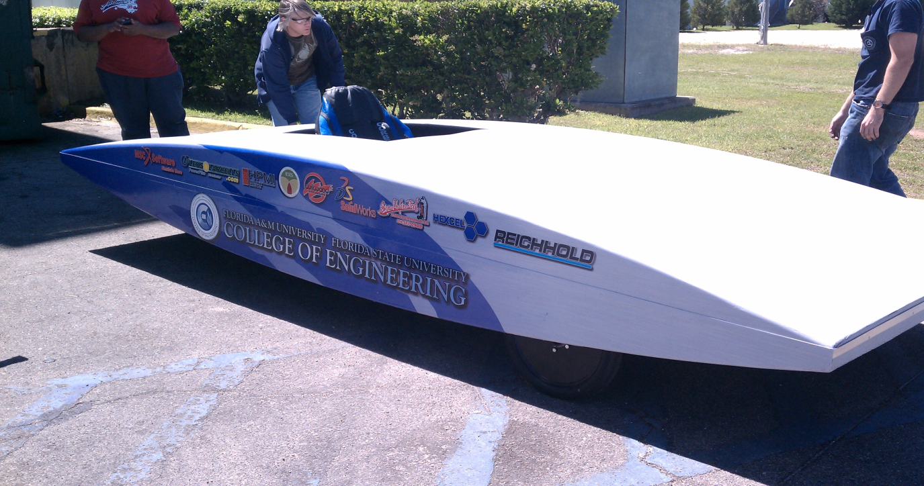


Team #2
Solar Car Project
Senior Design 2011 - 2012

Slide 2
Meet The Team
Electrical Engineers (EE)
  Shawn Ryster – EE-Team Leader
  Patrick Breslend – C0-Treasurer
  Greg Proctor - C0-Treasurer
  Jordan Eldridge –EE Tech Lead
Mechanical Engineers (ME)
Valerie Pezzullo – Secretary
Bradford Burke– ME-Team Lead
Tyler Holes - Media Specialist

Slide 3
Top Priorities
Integrate solar panels into existing system
Revisit regenerative braking system
Construct driver enclosure
Latch the top to the bottom

Slide 4
Fundraising
Website and Brochure
Events
Advertising space on car

Slide 5
Additional Desires
Mechanical and Electrical

Slide 6
Electrical
Redesign the battery box and optimize existing electrical system
Additional information recorded and displayed to driver

Slide 7
Electrical continued
Menu based input system for the MCU
Safety and Indicator lights

Slide 8
Mechanical
Hinged, Assisted lift top
Multi-positional top for more direct sun exposure

Slide 9
Mechanical continued
Design roll cage to meet safety requirements for solar races.
Extend length of rack & pinion
Optimize existing suspension
Add wheel wells

Slide 10
Functional and
Non-Functional Requirements
Electrical

Slide 11
Electrical
Purchasing more solar cells
Design solar array integration
Implement Max power point tracker(MPPT)

Slide 12
Electrical continued
Design charging system to interface the solar arrays with the batteries
Allow charging of batteries while in motion

Slide 13
Functional and
Non-Functional Requirements
Mechanical

Slide 14
Mechanical
Functional Requirements
Implement parking brake
Integrate regenerative braking with mechanical brake
Extend height of steering column and stabilizing rod
Redesign rear wheel attachment

Slide 15
Mechanical
Non-Functional Requirements
Design driver enclosure (bubble)
Latching system for the lid
Driver cockpit equipped with an air ventilation system

Slide 16
Constraints
Mechanical

Slide 17
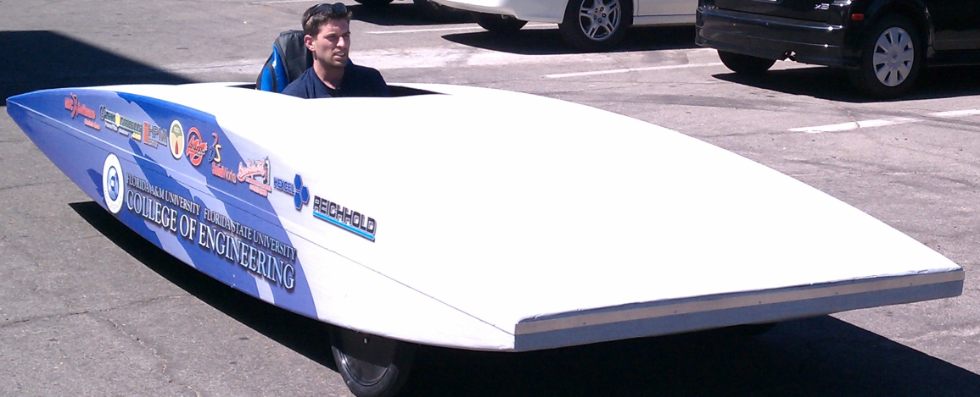
Mechanical
Dimensions for car
  Length 5.0 m
  Width 1.8 m
  Height 1.6 m
Weight Requirement
  No total minimum
  No maximum weight
Body Constraints
  Only limited to current design
  Limited number of holes in body

Slide 18
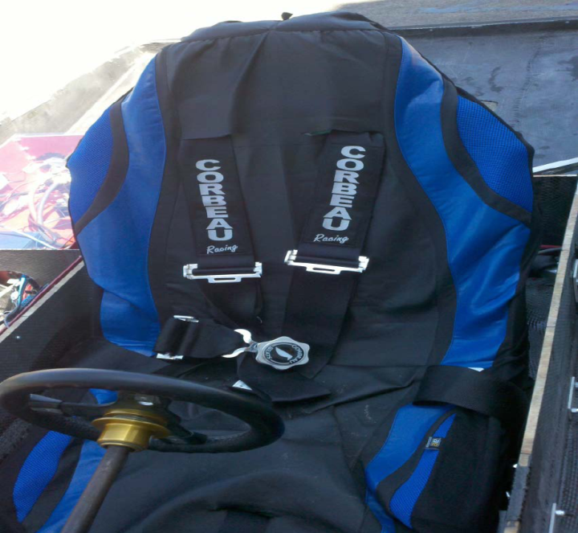
Mechanical continued
Visibility
  100 degrees from center
  Windshield shatter resistant
  Rear viewing system
  Water removal system
Cockpit
  5 point seat belt
  Maintain aerodynamic properties for bubble
  Size of bubble
  Roll cage
    Encompass entire driver

Slide 19
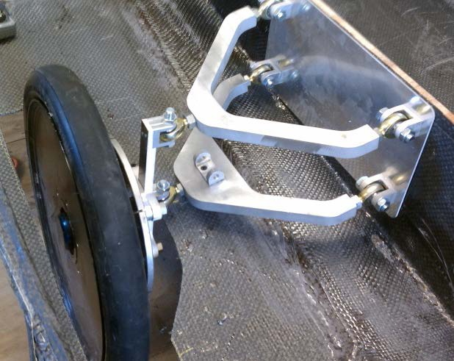
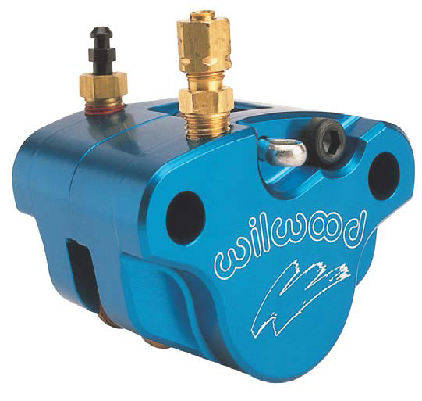
Mechanical continued
Braking
  Balanced
  Dual system
  Parking brake
  Performance test
  Disc Brakes
Wheels
  3 wheels
  Size
  Friction

Slide 20
Constraints
Electrical

Slide 21
Main Electrical Constraints
Budget
Integrating into an existing electrical system
Sources of energy

Slide 22
Electrical continued
Budget
  The solar account is limited to the existing balance left of $580.00 and the sponsors found this year.
  -Motor Controller $3000
  -Motor $6950
  - Solar Array(partial) $4930
  -Batteries System $4250

Slide 23
Electrical continued
Integrating into an existing electrical system
  Not feasible to change existing system components
  MPPT design
  Wiring design
    Size, voltage, and current specific to devices parameters

Slide 24
Electrical continued
Source of Energy
  Solar Panels
    size, temperature, power output
  Regen
    Optimize existing system
  Batteries
    Existing batteries are within nominal motor voltage.

Slide 25
Test Plans
Mechanical

Slide 26
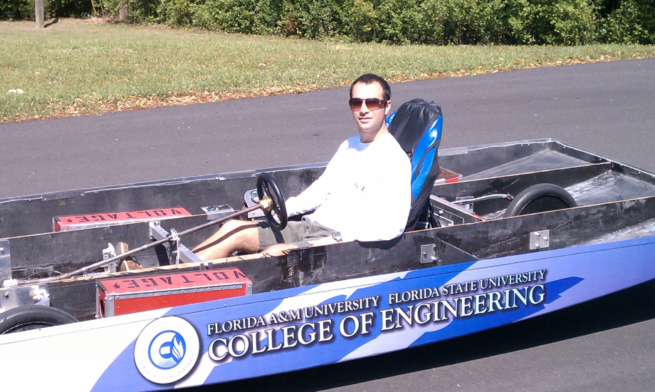
Mechanical
Latch safety
  Feedback from last year’s team shows us the danger of the top of the body not being secure.
  We will be doing test runs at high speed on a straight-away to determine the stability of the body.

Slide 27
Mechanical continued
Braking Tests
  Multiple tests will be conducted under normal and emergency circumstances
  60ft
  120ft
Regenerative Braking
  Disc, regenerative, and combo braking trials
  -while monitoring recaptured energy

Slide 28
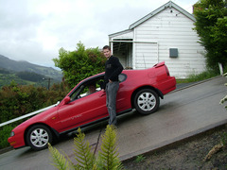
Mechanical continued
Parking Brake
  Parking on an inclined hill.
  Large angles simulated with inclining only the front of the solar car.

Slide 29
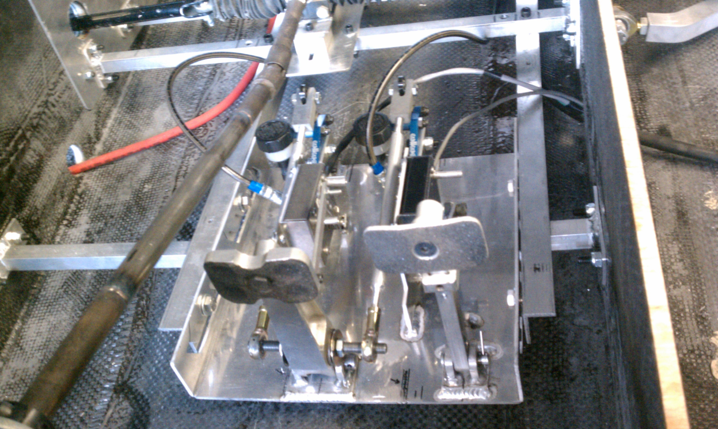
Mechanical continued
Integrated 2-step Braking
  Slowly braking on a level surface to determine when regenerative breaking is engaged.

Slide 30
Test Plans
Electrical

Slide 31
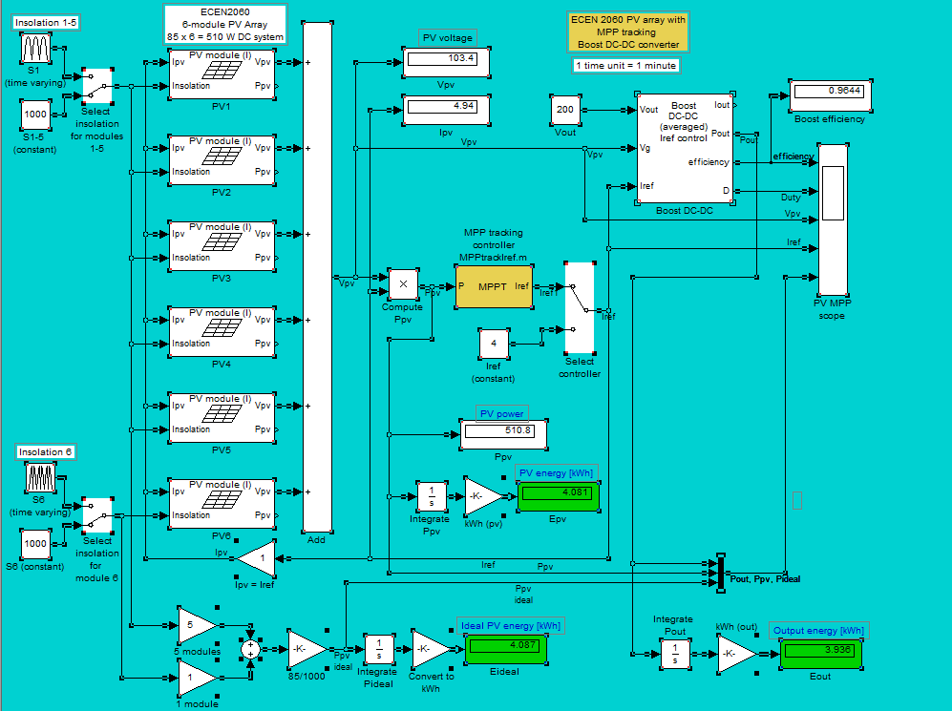
Electrical
Solar Arrays for output voltage potential
  Simulink model

Slide 32
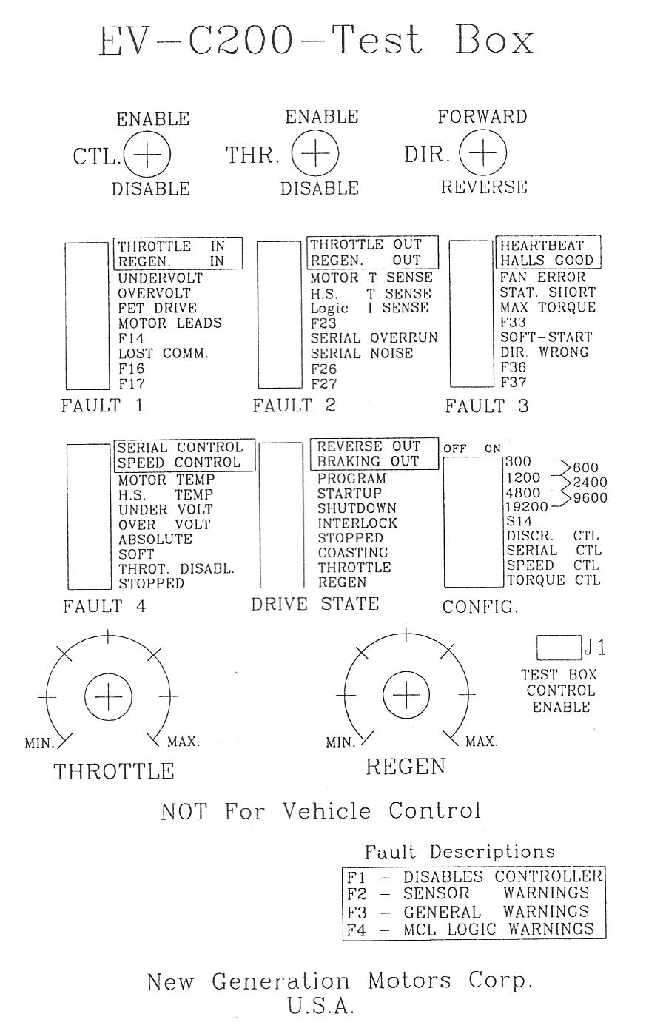
Electrical continued
Test box

Slide 33
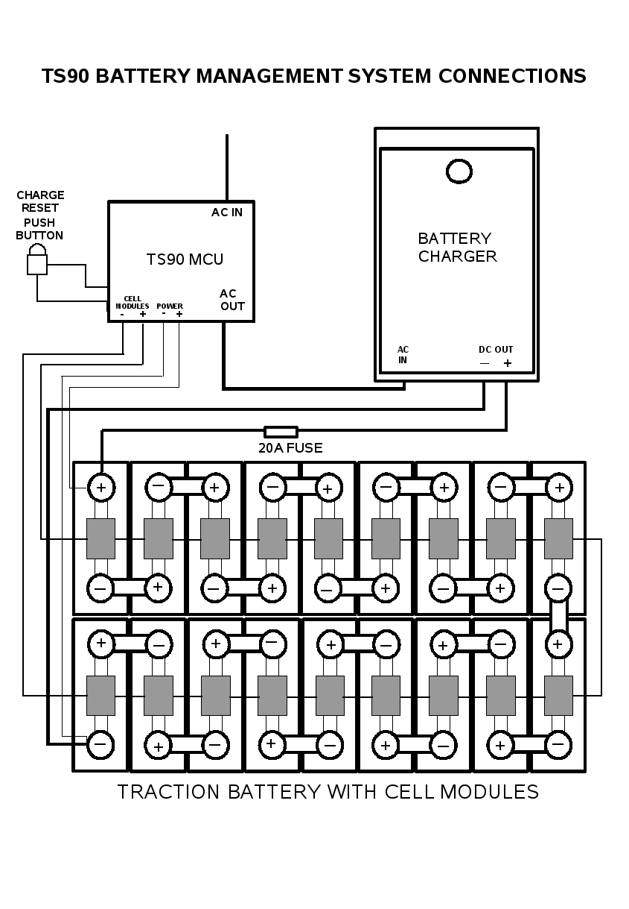
Electrical continued
Battery Charger
  Test through implementation
  Test Box

Slide 34
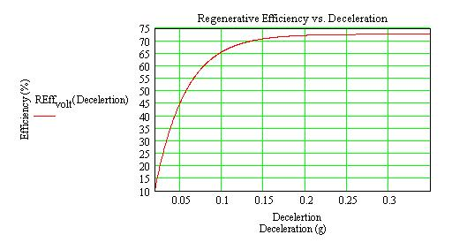
Electrical continued
Regenerative Braking System
  Test Box

Slide 35
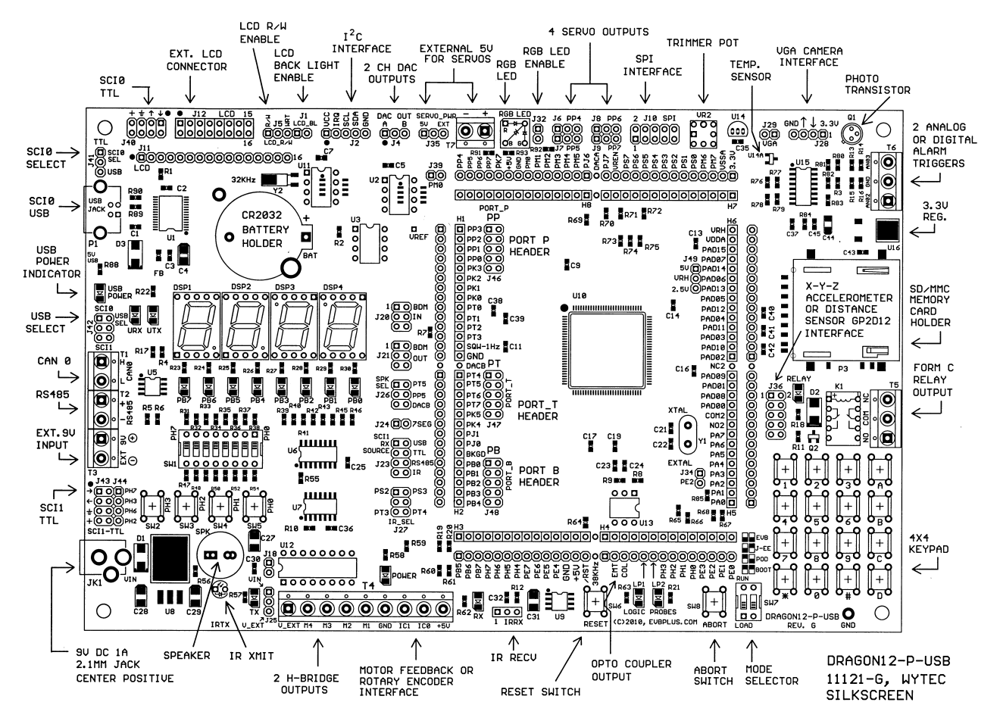
Electrical continued
Testing component temp ranges
  Physical testing of parts to find optimal efficiency
  Using Microcontroller to record temp. values

Slide 36

Questions

