Slide 1
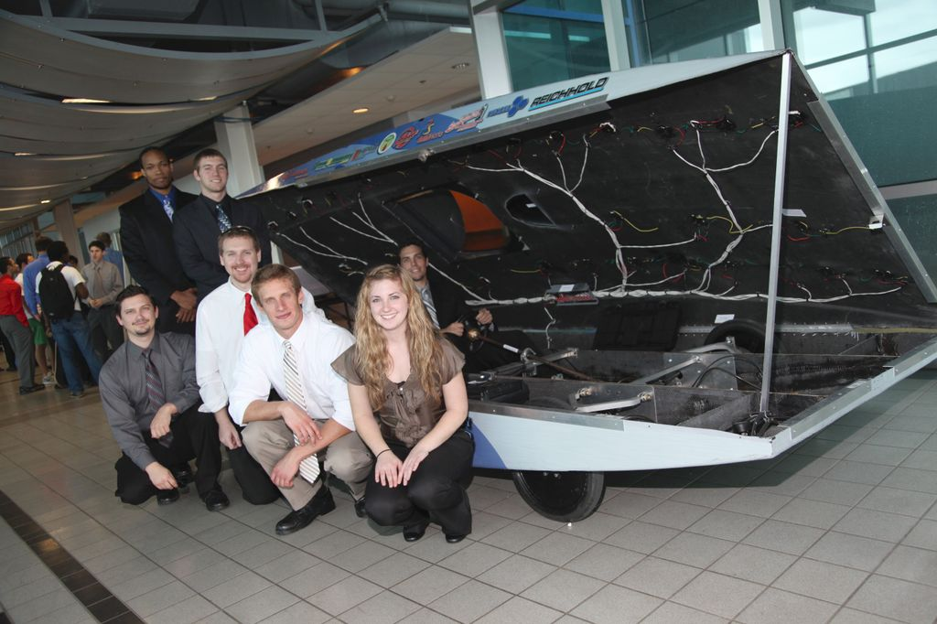
Solar Car Project Senior Design 2011 – 2012
Patrick Breslend-EE
Bradford Burke-ME
Jordan Eldridge-EE
Tyler Holes-ME
Valerie Pezzullo-ME
Greg Proctor-EE
Shawn Ryster-EE

Slide 2
Overview of presentation
Objectives
Overview of Power Flow
Major Components
Motor / Motor Controller
Rear Suspension
Battery / Solar array
MPPT / Boost Converter
Latch / Hinge
Bubble / Air Ventilation
Budget
Conclusion
Status of Objectives
Videos

Slide 3
Key Components
Vehicle capable of solar charging
Max Power Point
Solar Array/protection circuit
Implement regenerative braking
Latch and hinge system
Driver enclosure / Air Circulation
Rear arm suspension & Motor mount

Slide 4
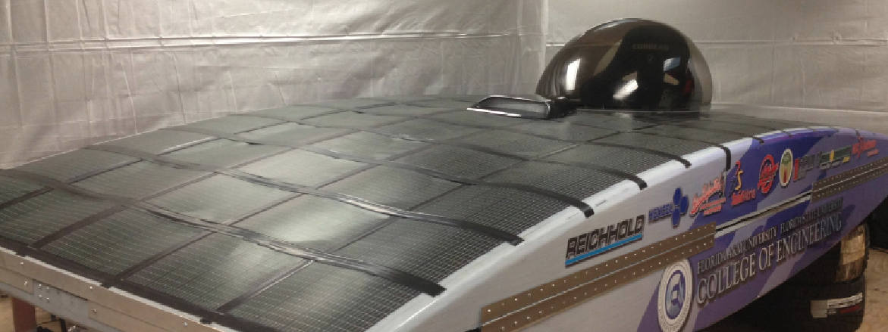
Overview of Power Flow
Top of Vehicle

Slide 5
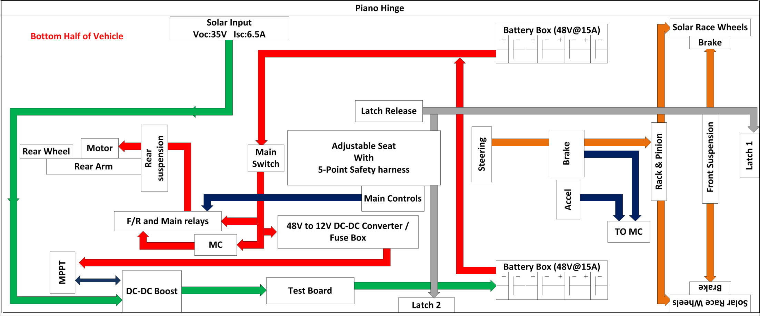
Overview of Power Flow
Bottom of Vehicle

Slide 6
Motor / Motor Controller

Slide 7
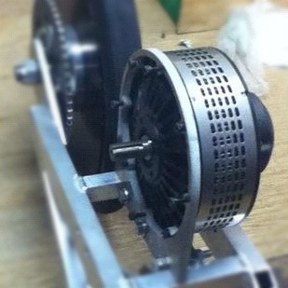
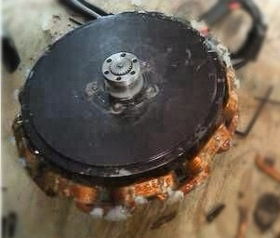
Motor Replacement
48 Volt Rated Motor
88% Peak Efficiency
215 Rated Current
Relatively Inexpensive
Lemco DC Brushed Motor
(LEM200-127)
SCM150 Brushless PM Motor

Slide 8
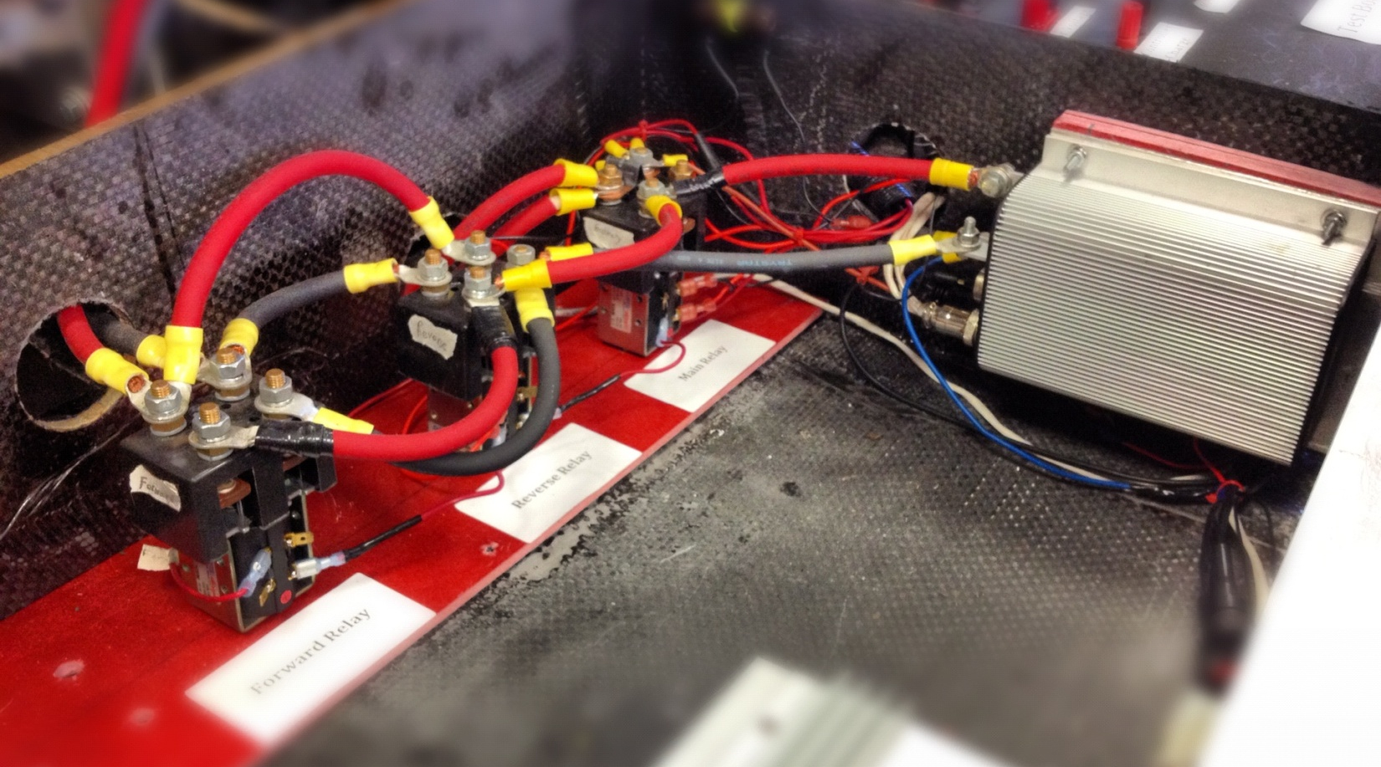
Motor Controller (MC)
Power Relay
Reverse Relay
Kelly Motor Controller
(KDZ48201)
Forward Relay
Pre-Charge Circuit
Power relay delivers power to MC
Motor Controller chosen for:
Compatibility
Regenerative braking

Slide 9
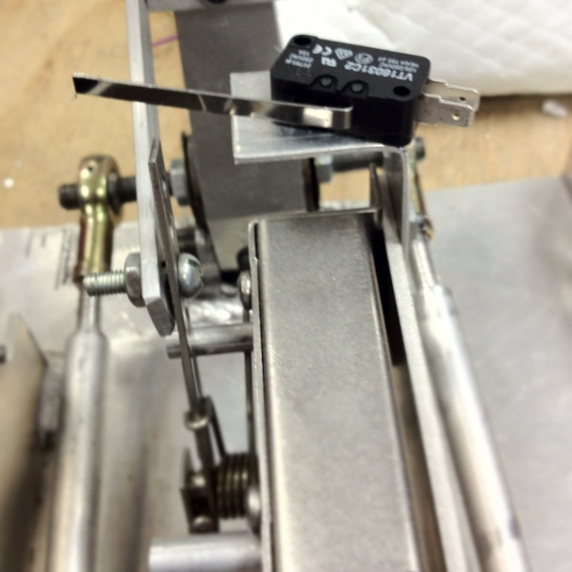
Motor Controller Cont.
Enable Switches
Brakes enable switch tells MC :
Regenerative braking is activated
read potentiometer
Uses mechanical energy of the rotor to drive electrical energy into stator
Accelerator enable switch tells MC to read the potentiometer of the pedal

Slide 10
Rear Arm / Rear Suspension

Slide 11
Old Rear Arm/Suspension
Brackets on back plate rotated at attachment points and became deformed
Back plate was slightly deformed from stress
Shaft was placed on opposite side to secure motor
Motor bolted to arm and wheel bolted to motor

Slide 12
Preliminary Design
Brackets made thicker
Back plate thickness doubled
Brackets bolted at ends to prevent rotation
Wheel able to rotate freely on shaft
Adjustable shaft for chain tension (similar to motorcycle rear arm)
Increased shock angle for more support and less stress on back plate

Slide 13
Drawbacks to Preliminary Design
Solid design making it heavier
Difficult to weld
Chain would be hard to keep in line with motor
Motor placement would be difficult in car

Slide 14
Final Rear Arm/Suspension
Place for motor to attach to arm
Lighter design using Aluminum tubing
Keeps chain length fairly constant while in motion and in line with motor
Brackets welded to back plate

Slide 15
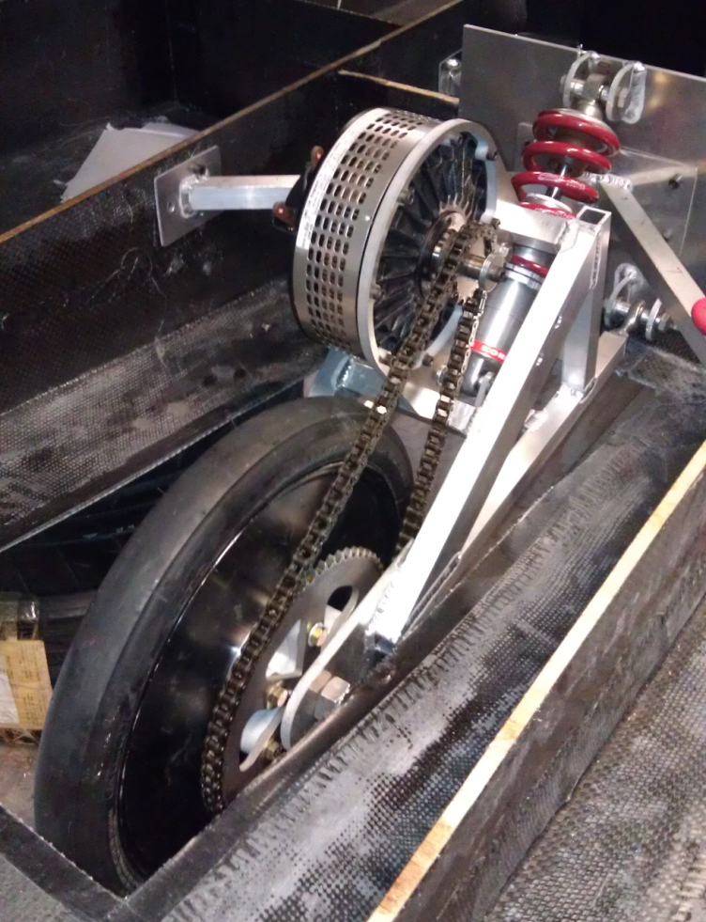
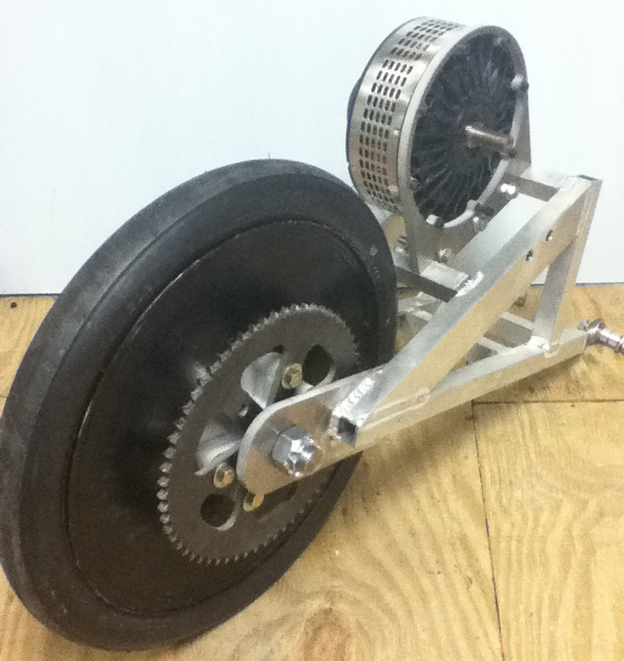
Final Rear Arm/Suspension

Slide 16
Recommendations for Future Work
Additional support for back plate
Stresses applied in Comsol are 4 times than what is actually being applied
Put motor support on arm

Slide 17
Battery / Solar Array

Slide 18
Battery System - LiFePO4
Previous Design
Current Design
96V System
15 Amps
30 Batteries in series
48V System
30 Amps
15 Batteries in Series
2 Series sets in Parallel

Slide 19
Solar Array
PT15-300 Solar Module
Parameters
Voltage (oc): 19.0V
Current (sc): 240mA
Rated Operation
Voltage Rating: 15.4V
Current Rating: 200mA
Module Size
Total Size: 27 x 32.5 cm
Aperture Size: 24 x 30 cm

Slide 20
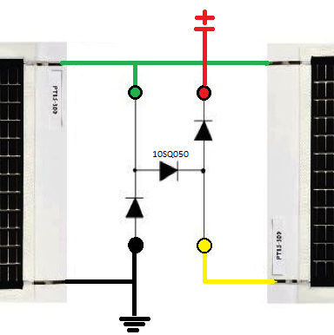
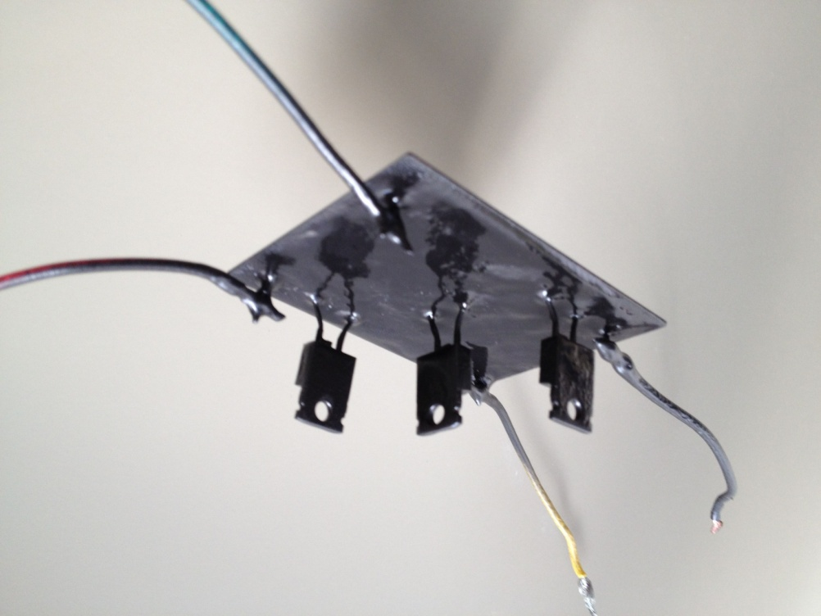
Solar Array
2 Modules in a Series Panel
31 Panels in a Parallel Array
Array Parameters
Voltage (OC): 40.0V
Current (SC): 6.5A

Slide 21
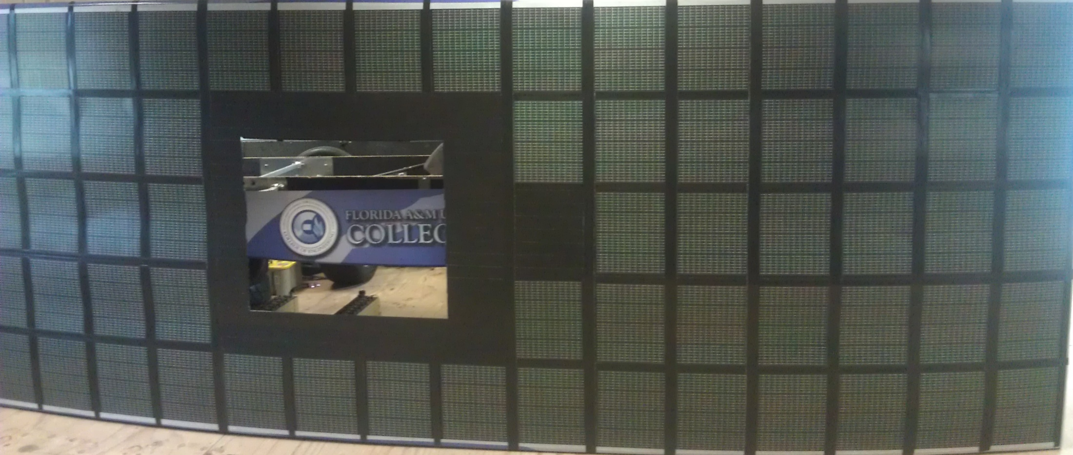
Completed Solar Array
-- Completed solar array covers a total area of 4.5 m ^2

Slide 22
MPPT / Boost Converter

Slide 23
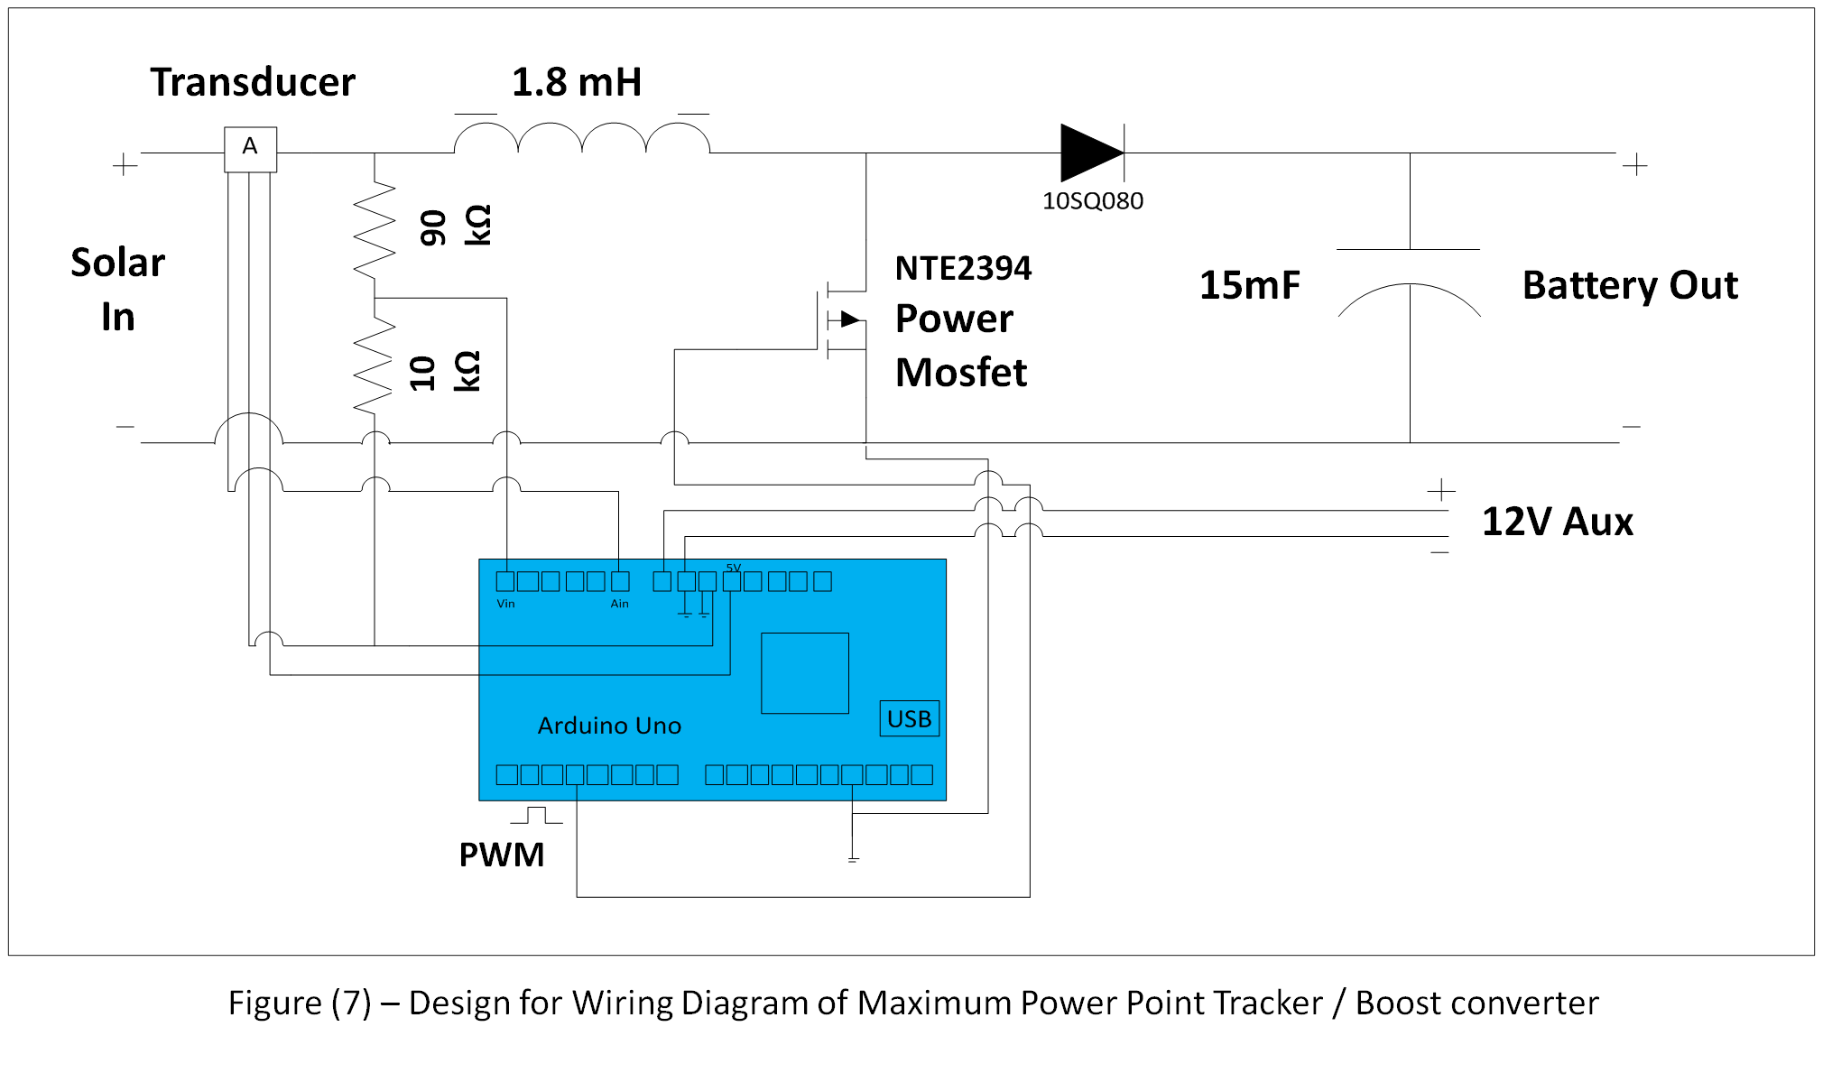
Max Power Point Tracker (MPPT) and Boost Converter

Slide 24
Max Power Point Tracker (MPPT) and Boost Converter
Transducer
Arduino Micro Controller
Inductor
MOSFET
Capacitor
MPPT/ dc-dc Boost Converter Implementation

Slide 25
Varying Irradiation

Slide 26
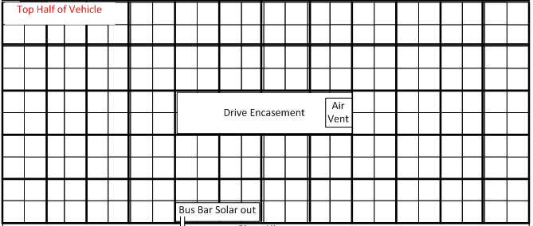
Driver Enclosure / Air Ventilation
Driver Encasement
Air Vent

Slide 27
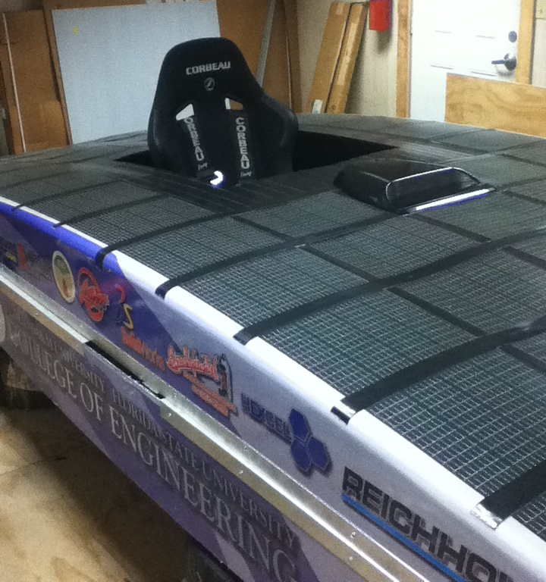
Driver Enclosure
Increase aerodynamic profile
Protection from debris and insects
Keep driver shaded from sun

Slide 28
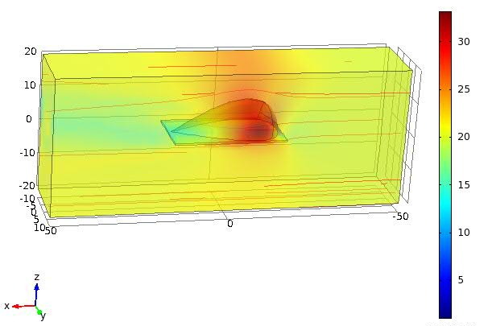
Driver Enclosure, cont.
COMSOL simulation of airflow over one of the proposed bubble designs
Wind velocity = 20 m/s

Slide 29
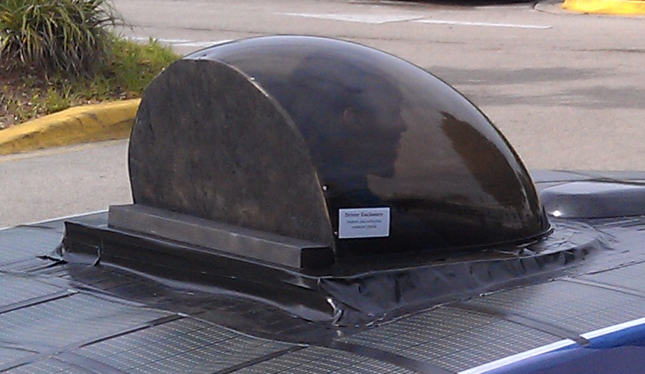
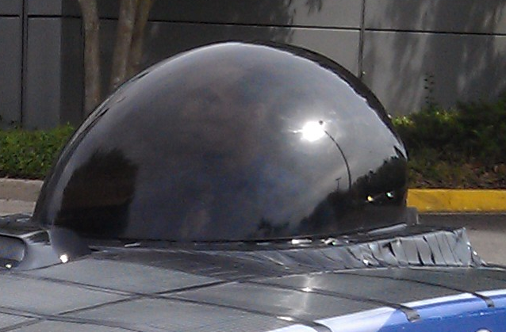
Driver Enclosure, cont.
Final design
Old bubble modified to reduce costs
PICTURE OF BUBBLE WITH ONLY THE $200 BASE
Modified for seat and driver clearance
Mounted for modularity and future modifications

Slide 30
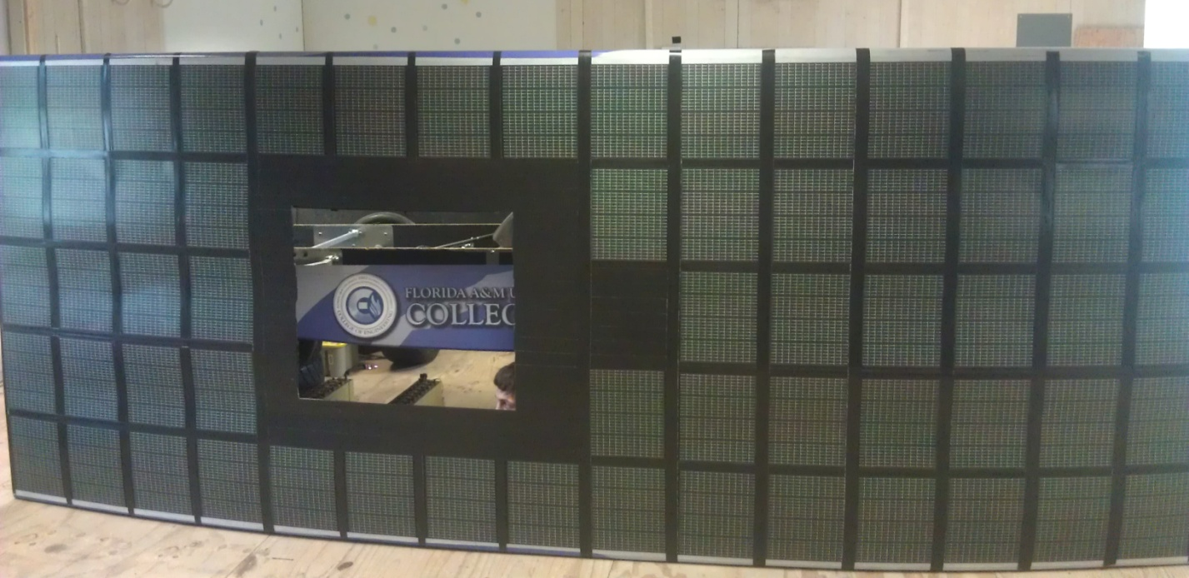
Air Ventilation
Uses no electrical energy from the system
Adds negligible weight
Easy to implement

Slide 31
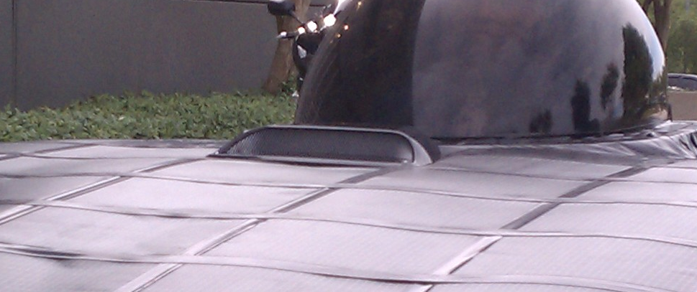
Air Ventilation, cont.
Hood scoop adds minimal drag
Front centered hood scoop adds 0.169 kg/s mass air flow to cabin

Slide 32
Latch / Hinge

Slide 33
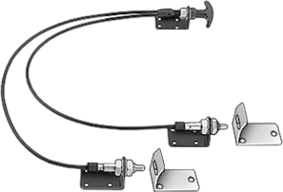
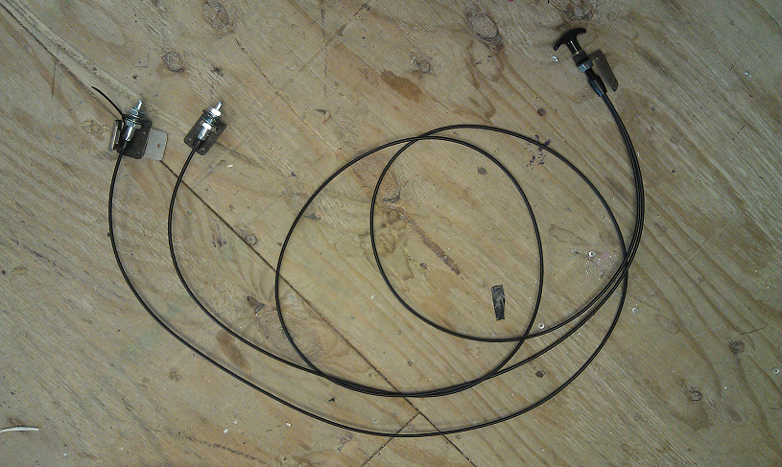
Double-Point Remote-Release Cable Latch
Flexible cable
Two latch points
Spring-loaded
Actuate T-handle
Easy to install
Notes:
The latch we chose was the Double point remote release cable latch. This latch has a flexible cable that is able to fit around the components in the car and allows the driver to access the two latch points from the driver’s seat, regardless of where the latch points are placed on the car. The latch is actuated by the t-handle and the latch points are spring-loaded to allow for both pulling and releasing motions. This latch is easy to install and operate.

Slide 34
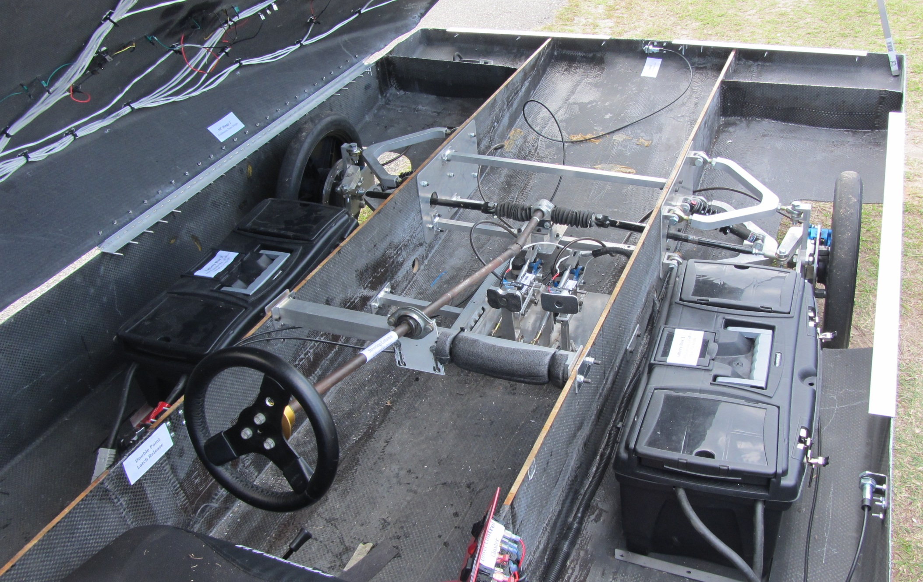
Latch Placement
Latch Point
T-handle
Notes:
As shown in this photo of the inside of the car, the t-handle is placed within reach of the driver. One latch point is placed at the front of the car so that when the car is in operation, the lid will not rise up due to the airflow over the vehicle. The second latch is placed on the side of the vehicle to help with the stability of the lid during operation.

Slide 35
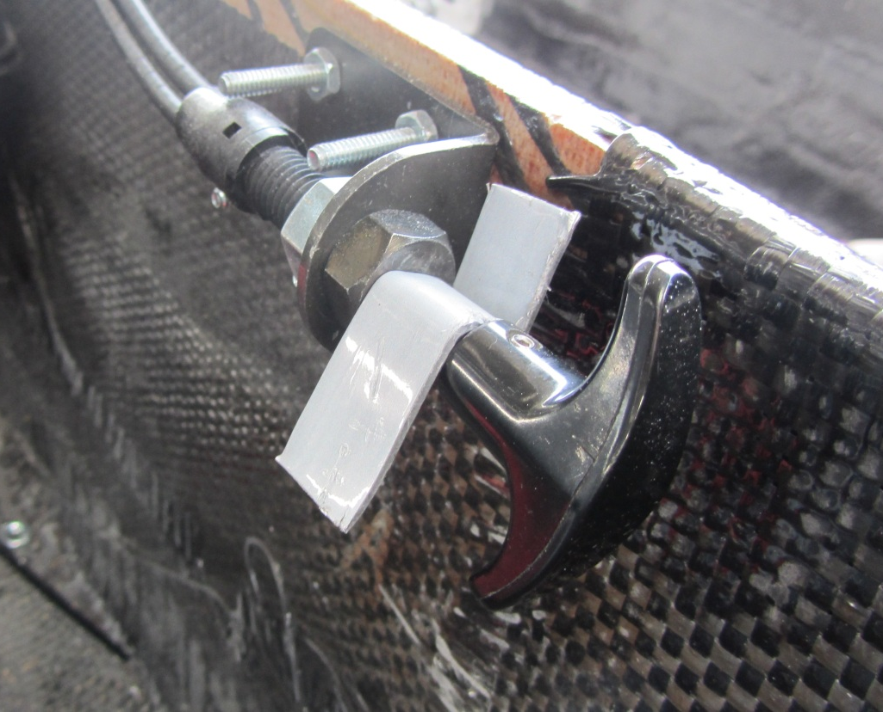
T-Handle Actuator
“Latched” position
T-handle with insert to keep in “unlatched” position
Notes:
Here is a close-up view of the t-handle. The photo on the left shows the “latched” position, in which the latch points are extended. The photo on the right shows the “unlatched” position with an insert to keep the latch points contracted so that when there is no driver in the car, the lid can be closed and the car will not be latched.

Slide 36
Latch Point
1
2
3
Notes:
Here is a close-up of one of the latch points. The first photo shows the latch in the extended position. The second photo shows the latch point and the strike plate as the lid is being lowered. The latch point inserts into the strike plate and locks it in place, as shown in the third photo.

Slide 37
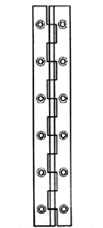
Piano/Continuous Hinge
Customizable lengths
Purchased two 4-foot lengths
Withstand large loads
Easy to install
Notes:
The hinge we chose was the piano hinge, also known as a continuous hinge. This type of hinge comes in customizable lengths, so we were able to purchase two 4-foot lengths to evenly distribute along the 13’ length of the car. This hinge is ideal because it distributes the load across the length of the hinge, so it is able to withstand larger loads than a smaller hinge, like those on a door. It is also easy to install and operate.

Slide 38
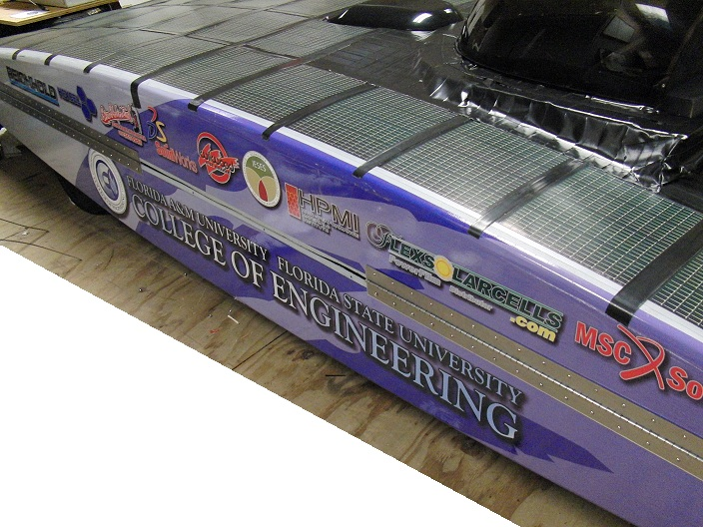
Hinge Placement
Two 4-foot hinges on left side of car
Bolted L-brackets between hinge and body for extra stability
Notes:
The hinges were placed on the left side of the car so that the driver can enter and exit the car on the right side, where one of the latches are located. The two hinges are evenly spaced down the length of the car. We bolted aluminum L-brackets between the hinge and the body, one on the top half and one the lower half of each hinge, for added stability. These L-brackets are also located in several spots along the rim of the car on both the top and bottom halves so that the top would be aligned with the bottom.

Slide 39
Hinge and L-bracket Placement
Notes:
The green circle shows the L-brackets bolted between the hinge and the body, and the red circles show the L-brackets in other locations on the rim of the car.

Slide 40
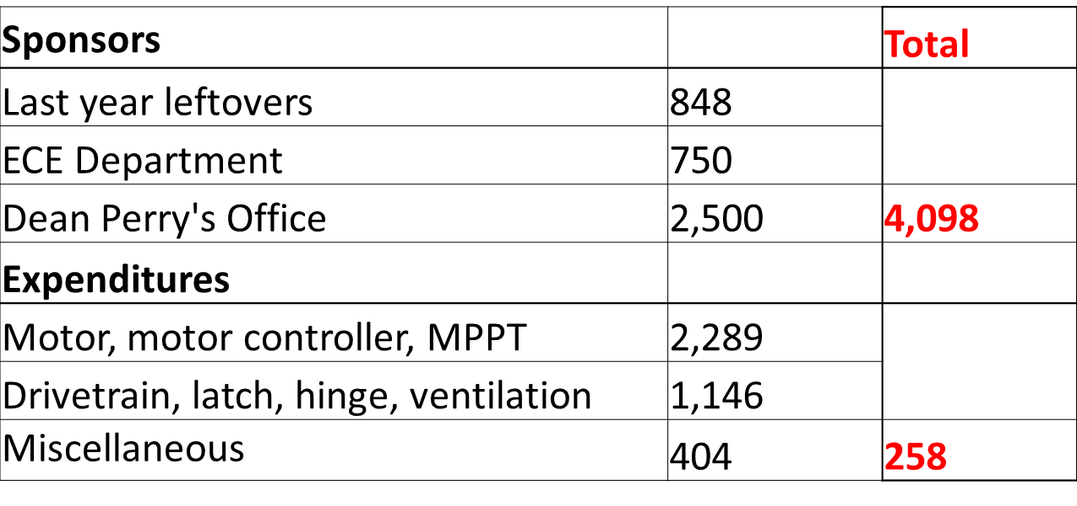
Budget
Notes:
At the beginning of the year, we started out with a little over $4000, with some money left over from last year and new money from the ECE department and Dean Perry’s office. After purchasing all of the components needed for this phase of the project, including the motor, motor controller, MPPT, drivetrain, latch, hinge, air ventilation, and other small miscellaneous items, we are left with a balance of $258.

Slide 41
Status of Objectives
Objectives | Progress
Vehicle capable of solar charging | Completed
Solar array | Completed
Max power point tracker | Completed
Implement regenerative braking | Completed
Latch and hinge system | Completed
Driver enclosure | Completed
Air circulation | Completed
Conversion from 96V to 48V/12V | Completed
Rear arm suspension & Motor mount | Completed
Three-year solar car project | Completed
Notes:
The status of our project is that we have a vehicle capable of solar charging, with the use of a solar array and a max power point tracker, as well as a successful implementation of regenerative braking with our new motor. The latch and hinge systems as well as the driver enclosure and the air circulation are all installed and in working order. We have successfully converted the 96V electrical system to a 48V and 12V system. We have completed the redesign of the rear suspension and motor mounting, and with that we have successfully completed all of our objectives for a functioning three-year solar car project.

Slide 42
Test Runs

Slide 43
Questions?

