Slide 1
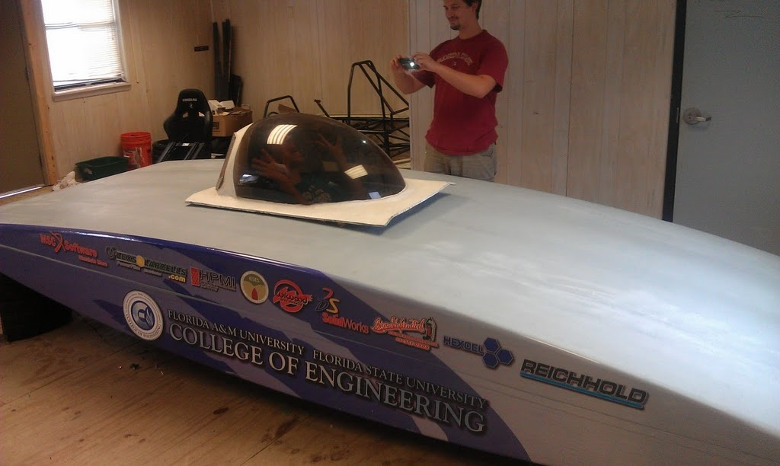
Team #2 Solar Car Project Senior Design 2011 - 2012

Slide 2
TABLE OF CONTENTS
Introductions
Qualifications and Responsibilities of Design Team
Proposed Design
Motor Choice
Statement of Work
Budget and Schedule
Questions

Slide 3
Introduction
Presented by: Patrick Breslend

Slide 4
Meet The Team
Electrical Engineers (EE)
Shawn Ryster – EE-Team Leader
Patrick Breslend – C0-Treasurer
Greg Proctor - C0-Treasurer
Jordan Eldridge –EE Tech Lead
Mechanical Engineers (ME)
Valerie Pezzullo – Secretary
Bradford Burke– ME-Team Lead
Tyler Holes - Media Specialist

Slide 5
Acknowledgements
The senior design team would like to acknowledge the following individuals and organizations for their contributions to the advancement of this project:
Dr. Michael Frank for administrative and technical guidance
Dr. Chris Edrington for electrical engineering technical guidance
Dr. Patrick Hollis for mechanical engineering technical guidance
FAMU-FSU College of Engineering for financial contributions to the project
The Advisory Board

Slide 6
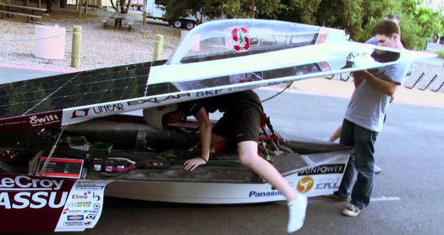
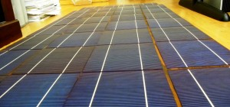
Statement of Problem
Motor Replacement
PV Array
MPPT
Hinge/Latch
Driver Encasement
Parking Brake
Regenerative Braking
Rear Arm & Rear Suspension
Air Circulation

Slide 7
Intended Use(s) / Intended User(s)
SES: Sustainable Engineered Solutions
Solar car will live on with future projects within SES
Provide a continuous learning hands on experience for years to come
Increase interest in the community through participation in local events
Generate donations from the community and relevant businesses
Use of car will almost solely be project team members
Future solar car competitions
American Solar Car Challenge
Sustainable Engineered Solutions (SES)

Slide 8
Intended Use(s) / Intended User(s)
Ultimate goal to compete in the North American Solar Challenge
Solar car set up in phases, meant to enter competition in the years to come

Slide 9
Qualities and Responsibilities
Presented by: Patrick Breslend

Slide 10
Qualities of Project Team
Team Member | Skills and Knowledge
Jordan Eldridge | Photovoltaics, Programming, Control Systems, Electronics, and Testing
Patrick Breslend | Electrical Simulations, Photovoltaics, and Power
Valerie Pezzullo | Dynamic Systems, Control Systems, Vehicle Design, Fluid Dynamics
Greg Proctor | Photovoltaics, Power, Electronics, and Electrical Simulations
Shawn Ryster | Computer Programming, Electrical Simulations and Power Systems
Bradford Burke | Mechanical System, Materials, Vehicle Design and Model Construction
Tyler Holes | Mechanical System, Vehicle Design, Thermo/Fluid Dynamics

Slide 11
Responsibilities of Project Team
Task | Assignment | Skills and Knowledge Needed
3.1: Project Management | Team Lead | Basic managerial skills, organization skills, and communications abilities
3.2:Motor | EE | Power systems, Simulink simulations, control systems, mechanical devices theory, and circuit theory
3.3: PV Array | EE | Photovoltaics, Simulink simulations and circuit theory
3.4:Maximum Power Point Tracker | EE | Controls, circuit theory, and Simulink simulations
3.5: Latch/Hinge | ME | Basic linkages & materials selection
3.6: Driver Encasement (Bubble) | ME | CFD and FEM modeling, fluid dynamics equations, materials selection & design
3.7: Parking Brake | ME | Vehicle design, brake installation, brake testing knowledge
3.8: Rear Suspension and Arm | ME | Vehicle design, suspension analysis
3.9: Regenerative Braking | ME | Basic mechanical & vehicle design
3.10: Air circulation | ME | Thermodynamics

Slide 12
Proposed Design
Presented by: Tyler Holes

Slide 13
Top Level Design
Motor Controller

Slide 14
Motor and Suspension Design
Complications with existing motor → New motor
Lack of funds for new model
Find a less expensive motor that is similar
Redesign rear suspension and arm to fit new motor parameters
Suspension Bracket
Rear Suspension Arm
Carbon Fiber Bottom
Motor
Rear Suspension
Wheel

Slide 15
Latch and Hinge Design
Latch:
Attached to right side of car
Hinge:
Attached to left side of car so driver can exit vehicle away from traffic
Higher operational safety
Aerodynamics improved
Able to prop open for
maximum solar radiation
Driver
Carbon Fiber Bottom
Carbon Fiber Top
Latch
Hinge

Slide 16
Driver Encasement (Bubble) Design
Simulations performed on proposed design shapes
Spherical
Air foil
Final design somewhere in the middle
Material selection
Similar to polycarbonate beads used in motorcycle visors
Shatter resistant
High level of clarity
Bubble
Mount
Carbon Fiber Top

Slide 17
Air Circulation System Design
Circulation ducts using lightweight tubing
Safe operating temperature range: 40˚F – 95˚F
Disposable batteries
Fan
Air Ducts
Fan Mounting Bracket
Carbon Fiber Bottom

Slide 18
Parking Brake Design
Independent of regenerative and disc brakes
Implementation on rear wheel
Parking and emergency situations
Rated for 15° incline
Carbon Fiber Bottom
Parking Brake
Rear Suspension
Motor
Wheel

Slide 19
Regenerative Braking Design
Two-step system in conjunction with disc brakes
Used for light braking
Recapture as much energy as possible
Disc brakes for additional braking
First 50% regenerative braking last 50% disk and regenerative braking
Disc Brakes
Regenerative Brakes
Accelerator
Steering
Driver

Slide 20
Solar Array Design
Presented by: Shawn Ryster
Operate PV array at lower voltage than input voltage of the battery.
Boost the voltage up and lower the current
Space constraints
70 modules
35 parallel panels consisting of two modules in series
Total nominal power of the array = approx. 215 Watts
Power of array in charge mode is greater than the quiescent power of the system

Slide 21
Solar Array Diagram
1
2
34
35
15.4 V
PT15-300
15.4 V
PT15-300
…
PT15-300
15.4 V
PT15-300
15.4 V
MPPT
Batteries
15.4 V
PT15-300
15.4 V
PT15-300
15.4 V
PT15-300
15.4 V
PT15-300

Slide 22
Proposed Motor Solution
Presented by: Shawn Ryster

Slide 23
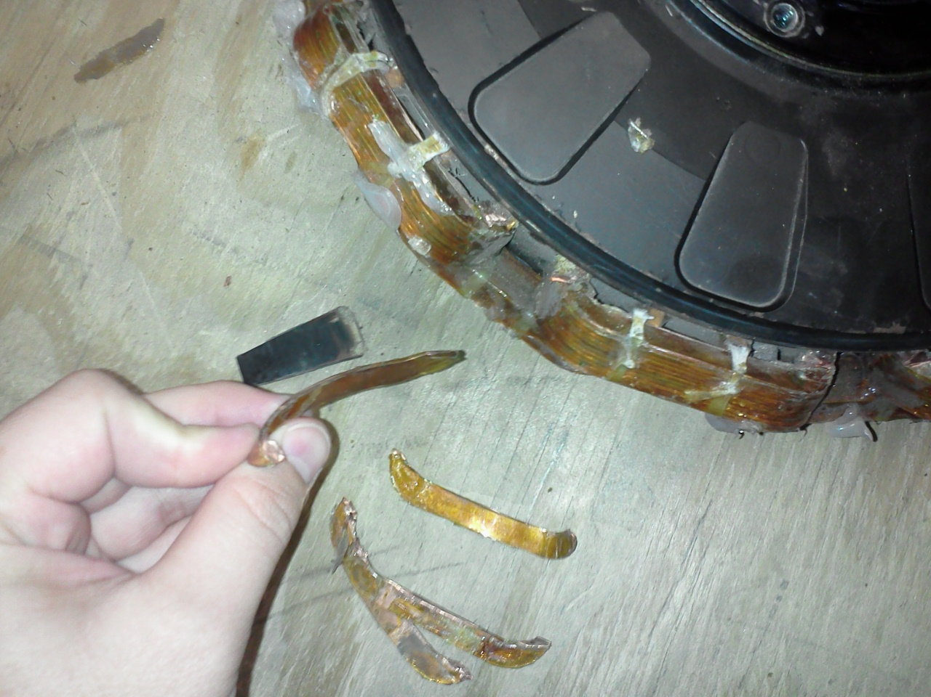
Current Motor
NuGen Motors (SCM-150)
Rated Voltage 100V
7.5kW peak power
Our motor is badly damaged.
$16,000 to replace

Slide 24
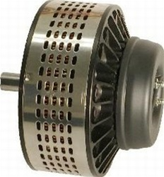
Lemco DC Brushed Motor (LEM200-127)
Rated Voltage 48V
Rated Current 215A
High Torque at low speeds
8.55 kW rated power
$1900
Will need a new motor controller.

Slide 25
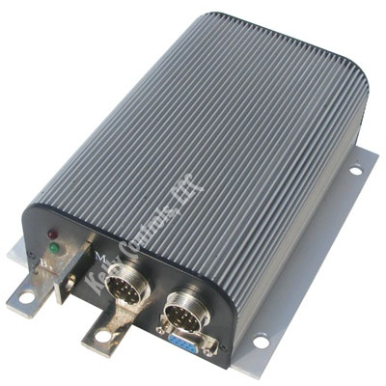
Kelly Motor Controller - KDZ48201
Input voltage range 18V – 60V
Output voltage 24V-48V
Maximum sustained amperage of 80A
Supports regenerative braking.
$199

Slide 26
Statement of Work
Presented by: Shawn Ryster

Slide 27
Task 1: Project Management
1.1 - Managerial Duties
1.2 - Engineering Responsibilities
1.3 - Website
1.4 – Finance and Fundraising

Slide 28
1.1 – Managerial Duties
Approach-
Schedule tasks to be completed weekly
Assign Engineers to scheduled tasks
Conduct weekly meeting to record completion of tasks and assign new tasks
Outcome-
All engineers will be provided with achievable goals
Group work ethic assessed weekly
Project will move according to proposed schedule

Slide 29
1.2 – Engineer Duties
Approach –
Research assigned tasks
Design and simulate for desired results
Implementation of design
Ensure design parameters are within range
Outcome –
Research conducted thoroughly
Find errors in simulation not in implementation
Tests ensure that tasks meet specification

Slide 30
1.3 - Website
Approach –
Provide current progress on project
Sponsor recognition
Keystone for future SES
Provide a medium for advertisement
Outcome –
Available information on current and past designs
Increased sponsorship and members for the club
Increase interest in FAMU/FSU EE/ME departments

Slide 31
1.4 - Finance and Fundraising
Approach –
Treasurer will keep budget current.
Discuss budget for upcoming tasks with managers.
Handle sponsors/donors and coordinate events.
In charge of purchase orders and expenditures.
Outcome –
Each task will be properly funded.
Well organized finances insure completion of project.
Sponsorship will continue into the club.
Record of current budget will stimulate response.

Slide 32
Task 2: Motor Replacement
Presented by: Greg Proctor
Approach -
Research and compare electric motors
Consider budget & electrical constraints
New motor controller and new rear suspension design
Motor and controller testing
Implement motor and rear suspension redesign
Entire system tested
Outcome -
Final, verified motor/controller and rear suspension subsystem
Ready to be integrated congruently with other subsystems

Slide 33
Task 3: PV Array
Objectives –
Design panel configuration of array to fit 6 m².
Designed array voltage < battery voltage.
Mount solar array to vehicle.
Incorporate protective layer over cells.
Approach –
Research irradiation, configuration, mounting, and protection.
Simulate researched designs.
Implement design that fits parameters.
Test that each step is working to specification.

Slide 34
Task 4: Maximum Power Point Tracker
Objective-
Achieve maximum power output
Approach-
Build a MPPT to regulate voltage and current to achieve max power
Notes:
The maximum power point tracker is at its most useful in adverse conditions. Say during a race when you have non-optimal conditions like clouds, rain, etc the MPPT will have to manipulate the current flow and voltage levels to produce the most power. However, during optimal conditions MPPT will not be utilized because power to the system will be abundant.

Slide 35
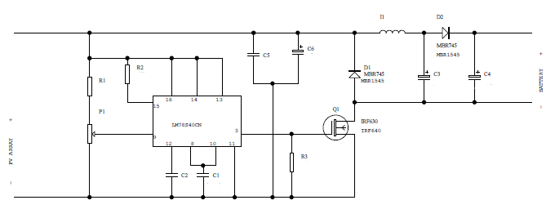
MPPT (cont.)
Outcome-
Design MPPT based on the new motors parameters
Notes:
Boost converter pwm

Slide 36
Task 5: Hinge/Latch system
Approach –
Apply without affecting integrity of body
Research parameters and materials
Installation and testing
Outcomes –
Locked and unlocked from inside or outside
Top will stay latched to bottom
Allow top to be lifted from one side for easy entering/exiting
Lid can be propped up at set angles for optimal solar irradiation and maximum charge
Presented by: Valerie Pezzulo

Slide 37
Task 6: Driver Encasement(Bubble)
Approach –
Research materials and companies to shape the bubble
Design desired bubble shape
Simulate airflow over bubble to calculate drag
CAD and CFD/FEM programs: Pro-Engineer and Comsol
Mount the bubble to the lid
Outcomes –
Driver and electrical components will be shielded from outside environment.

Slide 38
Task 7: Parking Brake
Approach –
Research types of parking brakes and installation techniques
Order parts based on parameters and research
Test the brake while car is parked on inclined surface
Test the effectiveness of brake during emergency stops
Outcomes –
Parked on an inclined surface without the possibility of rolling
Reduce the stopping distance required during emergency stops

Slide 39
Task 8: Regenerative Braking
Presented by: Bradford Burke
Approach –
Make the brake system into a two step braking process
Check the specifications of regenerative brake in the motor
Measure the travelling distance of the brake pedal and modify it to allow more time for regenerative brake
Testing to ensure mechanical brakes engage when we want them to.
Testing to measure energy generated from regenerative brake
Outcomes –
More efficient braking system which generates more energy
Less use of mechanical brakes and parts

Slide 40
Task 9: Rear Arm
Approach –
Light, stiff connection for rear tire
Must allow tire to rotate freely
Outcomes –
Rear tire will be perpendicular to the ground
Arm will not be able to move or rotate at any connection point to the car or suspension

Slide 41
Task 9 (cont.): Rear Suspension
Approach –
Must provide enough stiffness to keep car balanced
Allow the tire to move due to changes in terrain without affecting the driver
Outcomes –
The car will maintain its balance while the car is in motion

Slide 42
Task 10: Air Circulation
Approach –
Use the least amount of electrical energy to move air
Channel air from outside of car inside
Outcomes –
Make the car more comfortable to operate for the driver
Maintain a safe temperature range to operate electrical components efficiently

Slide 43
Budget and Schedule
Presented by: Jordan Eldridge

Slide 44
Budget
Total Estimated Cost Parts, Labor, and Overhead
$206,155.60
Total Parts/Equipment
$15,495.00
Total Personnel With Overhead
$190,660.60

Slide 45
Budget cont.
Personnel
Name | Effort (hr/week) | Base Pay (per hour) | Total (per week) | Total (per semester) | Entire Project Cost
Patrick Breslend | 12 | $30.00 | $360.00 | $5,760.00 | $11,520.00
Bradford Burke | 12 | $30.00 | $360.00 | $5,760.00 | $11,520.00
Jordan Eldridge | 12 | $30.00 | $360.00 | $5,760.00 | $11,520.00
Tyler Holes | 12 | $30.00 | $360.00 | $5,760.00 | $11,520.00
Valerie Pezzullo | 12 | $30.00 | $360.00 | $5,760.00 | $11,520.00
Greg Proctor | 12 | $30.00 | $360.00 | $5,760.00 | $11,520.00
Shawn Ryster | 12 | $30.00 | $360.00 | $5,760.00 | $11,520.00
Team Total | 84 | $210.00 | $2,520.00 | $40,320.00 | $80,640.00
Overhead (45%)
Personnel + Expenses | $86,635.00

Slide 46
Budget cont.
Expenses
Mechanical Expenses | Amount |  | Electrical Expenses | Amount
Bearings | $500.00 |  | Ribbon Wire | $100.00
Chain/Belt | $200.00 |  | Solar cell Solder | $90.00
Labor to machine parts | $2,000.00 |  | Solder Irons x2 | $120.00
Nuts, Bolts, Screws, Washers | $300.00 |  | Solder Iron Tips x 4 | $40.00
Hinges/latches | $600.00 |  | Mounting Tape | $100.00
Rods | $300.00 |  | Wire | $125.00
Extra/Spare Parts | $600.00 |  | Connectors | $20.00
 |  |  | PV cell protection | $800.00
Sub Total | $4,500.00 |  | Sub Total | $1,495.00
Equipment
ITEM | Amount
Materials | $2,500.00
Electric Motor | $2,000.00
Bubble fabrication and delivery | $2,000.00
Rear suspension/Motor Mount | $1,500.00
MPPT | $1,500.00
Motor Controller | $1,500.00
Total Equipment | $9,500.00
Total Expenses | $5,995.00

Slide 47
Schedule - Electrical
Major Milestone | Estimated Task Completion
PV Array Research | 11/1/2011
PV Array Mounting | 1/4/12
PV System Test | 3/26/12
Full PV Integration with Protection | 4/12/12
MPPT Research/Design | 12/7/11
MPPT Purchase/Assembly | 1/30/11
MPPT Implementation/Testing | 2/23/12
Motor Research | COMPLETED
Motor Purchase | 11/15/11
Motor Installation | 1/5/12
Motor Integration/Testing | 4/12/12

Slide 48
Schedule - Mechanical
Major Milestone | Estimated Task Completion
Latch/Hinge Research | 11/10/11
Latch/Hinge Fabrication and Install | 12/1/11
Driver Encasement(Bubble) Research | 11/20/11
Bubble Fabrication/Installation | 1/15/12
Parking Brake Research | 12/18/12
Parking Brake Installation/Testing | 1/12/12
Air Circulation Research | 1/15/11
Air Circulation Implementation | 2/25/12
Rear Suspension Research | 11/15/11
Rear Suspension Installation | 12/30/11
Regenerative Braking Tuning | 4/15/12

Slide 49
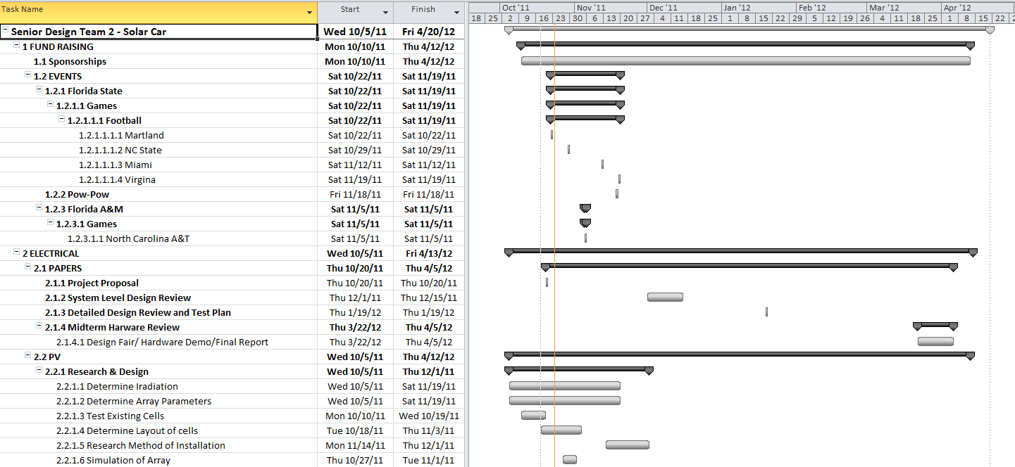
Gantt Chart

Slide 50
Gantt Chart (cont.)

Slide 51
Gantt Chart (cont.)

Slide 52
Gantt Chart (cont.)

Slide 53
QUESTIONS

